Slide 1
H-SAF precipitation products quality assessment and meteorological applications
Ján Kaňák, Ľuboslav Okon
SHMÚ (Slovakia)
Marco Petracca, Silvia Puca
DPC (Italy)
Jan.Kanak@shmu.sk Luboslav.Okon@shmu.sk
Marco.Petracca@protezionecivile.it Silvia.Puca@protezionecivile.it
Ján Kaňák

Slide 2
Outline
Overview – work with data
Formats and data files content
Precipitation products
Satellite data versus „ground truth“
Case studies – the way to applications?
Case study: Slovakia 24th of July 2017
How to properly merge precipitation data?
How to do data up-scaling
How to do data over-lapping
How to match data in time and space
Conclusions
Notes:
Abstract
For proper usage of satellite products in meteorological applications it is necessary to take the set of skills which can be divided into technical, logistic and routine work with data, and final application of meteorological knowledge base by means of interpretation tools. Our lesson will provide step by step introduction to validation work with the H-SAF precipitation products, introducing BUFR, GRIB and NETCFD decoding, reading and upscaling with the aim to put these various satellite products into common grid suitable for comparison against essential precipitation measurements considered as ground truth. Passing through the validation process and being aware of the accuracy of satellite products, we will show the applicability of these data using selected show cases over Central Europe. Case studies were prepared to demonstrate possibilities but also shortcomings of satellite data, which users need to take into account in practical usage. Because the proper preparation of satellite products is not important only for validation process itself, but also for practical applications, using show cases we will explain how to merge together various sources of precipitation information, e.g. irregular rain gauge point data, regular radar grid data, satellite scanned grids derived from microwave and infrared imagers. We will discuss the special treatment of continuous and discreet parameters like precipitation intensity or accumulated rain versus precipitation phase, quality index and surface type’s parameters to be up-scaled into common grid. Once up scaled data can be merged with the aim to obtain the most probable final values of instantaneous and accumulated precipitation fields. Final message of this training lesson addressed to meteorologists and hydrologists will be targeted to understanding that precipitation must be considered as stochastic parameter describing complex 3D processes in the atmosphere.

Slide 3
Quality Assessment activities - Overview, work with data
When one to want to use the precipitation product, following steps must be done:
Receive data from producer or order and download data from archive
Recognize data format – BUFR, GRIB, GRIB2, NETCDF and use appropriate software to read data from files
First user type – meteorologists, forecasters, hydrologists in the operation
Second user type – scientists, software developers
Extract appropriate data fields – time of scan, geolocation parameters, values, units, scales, offsets
Put data into required working format, resampled grid and units, visualisation
Merge these data with other available data sources for common usage
H-SAF precipitation products
Instantaneous precipitation (H01,H02,H03,H15,H18)
Accumulated precipitation (H05)

Slide 4

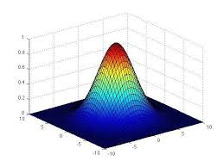

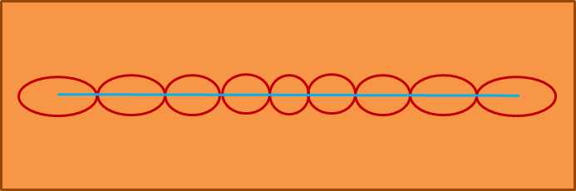
Quality Assessment activities - comparison to ground truth – Step 1: Understand data
Conical scanner – constant FOV, ellipses oriented to sub satellite point
Cross-track scanner – variable FOV, ellipse
perpendicular to satellite ground-track
Radar (ground truth) FOV
Must be weighted by Gaussian distribution of signal:
H01
Size of FOV
Depends on
signal frequency
H02

Slide 5
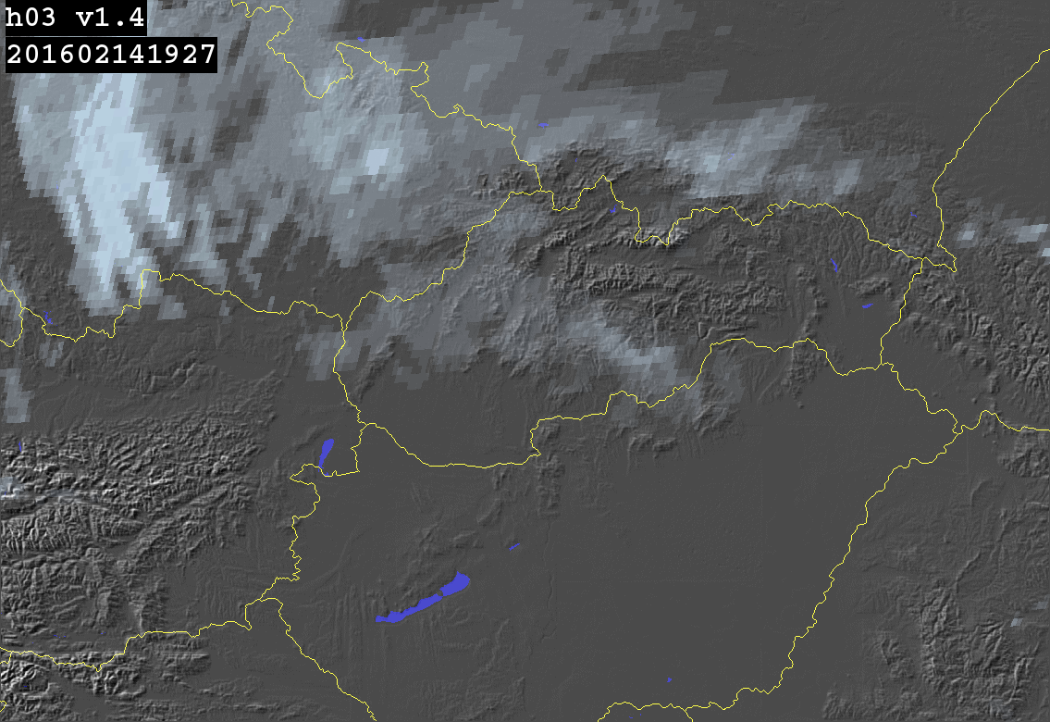
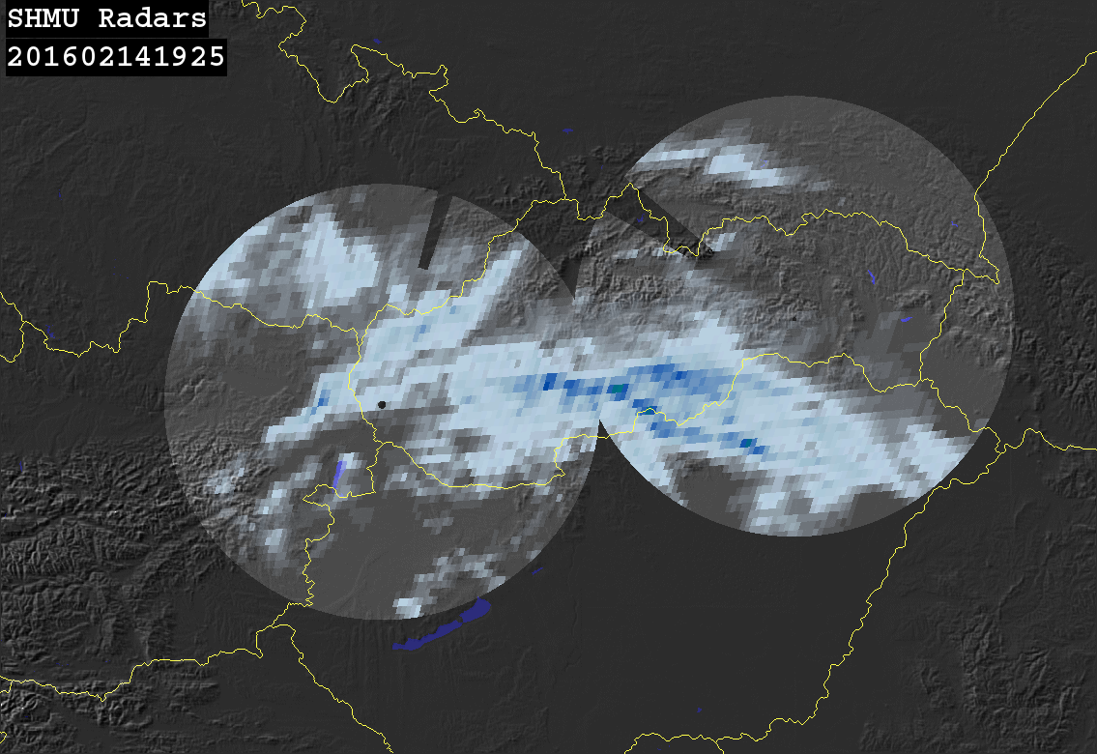
Quality Assessment activities - comparison to ground truth – Step 1: understand data
H01, H02 merged with MSG SEVIRI -> H03, H05 in regular or so called Meteosat view projection grid, ground truth data averaged directly over satellite FOV’s pixels, or after re-projection to common grid:
H03 and/or H05
Extract data
???
Comparison, statistics, evaluation
Notes:
H01, H02 merged with MSG SEVIRI -> H03, H05 in regular or so called Meteosat view projection grid, ground truth data averaged directly over satellite FOV’s pixels, or after re-projection to common grid:

Slide 6
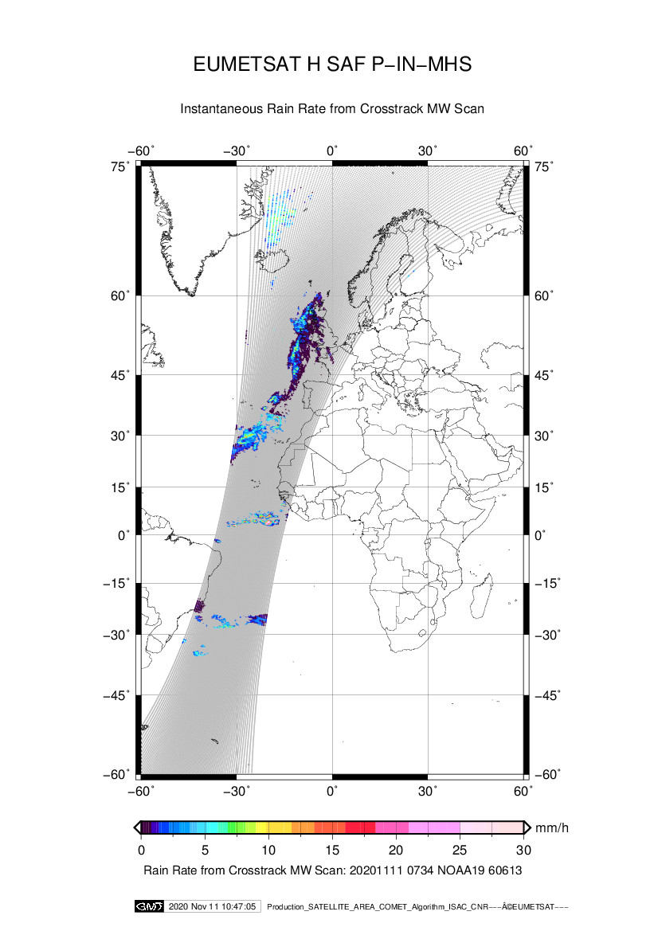
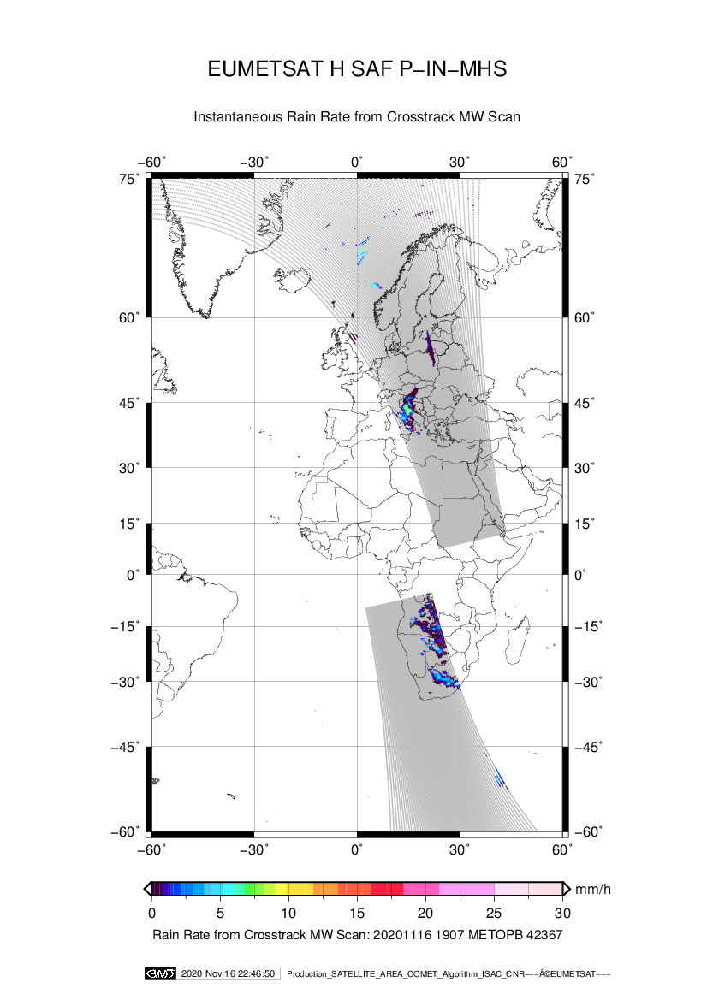
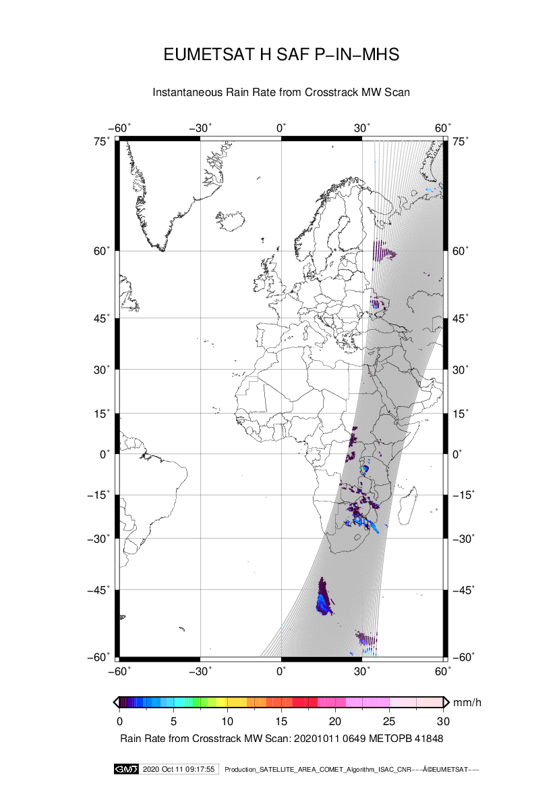
Quality Assessment activities - comparison to ground truth - STEP 2: collect time/space data
Selection of proper satellite overpass and, extract date and time, extract geolocation and product data …
Satellite Precipitation
Quality index
Longitude Latitude
Scan time
Ground Precipitation
Quality index
Longitude Latitude
Scan Time

Slide 7
Quality Assessment activities - comparison to ground truth - STEP 2: collect time/space data
Selection of proper satellite overpass and, extract date and time, extract geolocation and product data …
Comparison pixel by pixel -> statistics, evaluation ->
Final validation
Satellite Precipitation
Quality index
Longitude Latitude
Scan time
Ground Precipitation
Quality index
Longitude Latitude
Scan Time

Slide 8
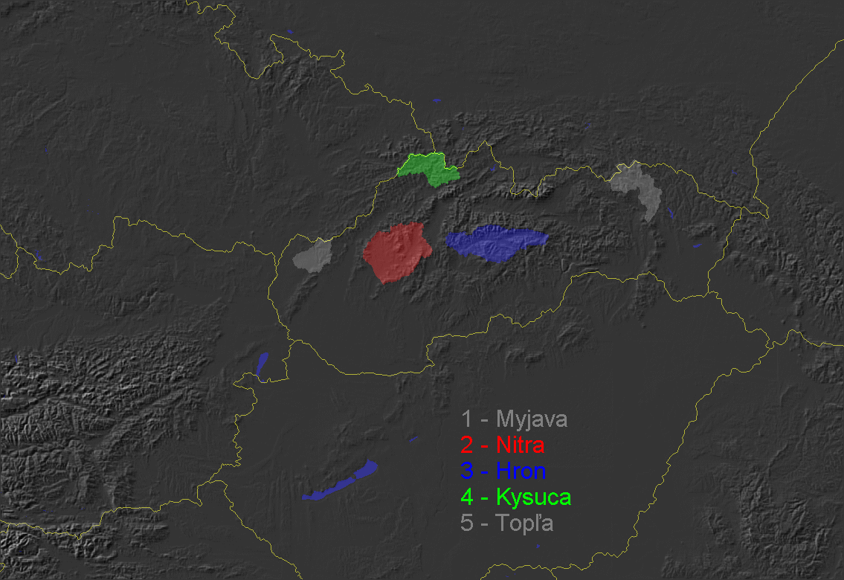
Quality Assessment activities - comparison to ground truth - STEP 2: collect time/space data
More then areal comparison pixel by pixel for hydrologically useful products is:
Instantaneous precipitation sumed into accumulated values and used as
«Long time series» processing and fitting satellite versus radar/gauge integrated data:

Slide 9
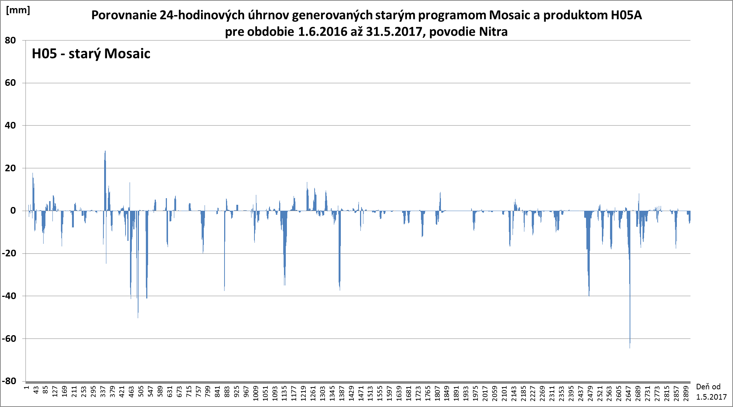
Work with accumulated precipitation from satellite:
How to see the difference between satellite and groud data?
Period 1.6.2016 – 31.5.2017 Nitra river basin
Radar data without quality control and corrections
Over versus under – estimation of precipitation by satellite product is shown in this plot for H05 24-hours accumulated precipitation: We observe high under estimation up to -40 to -60 mm per day in few days in 2017 summer season.

Slide 10
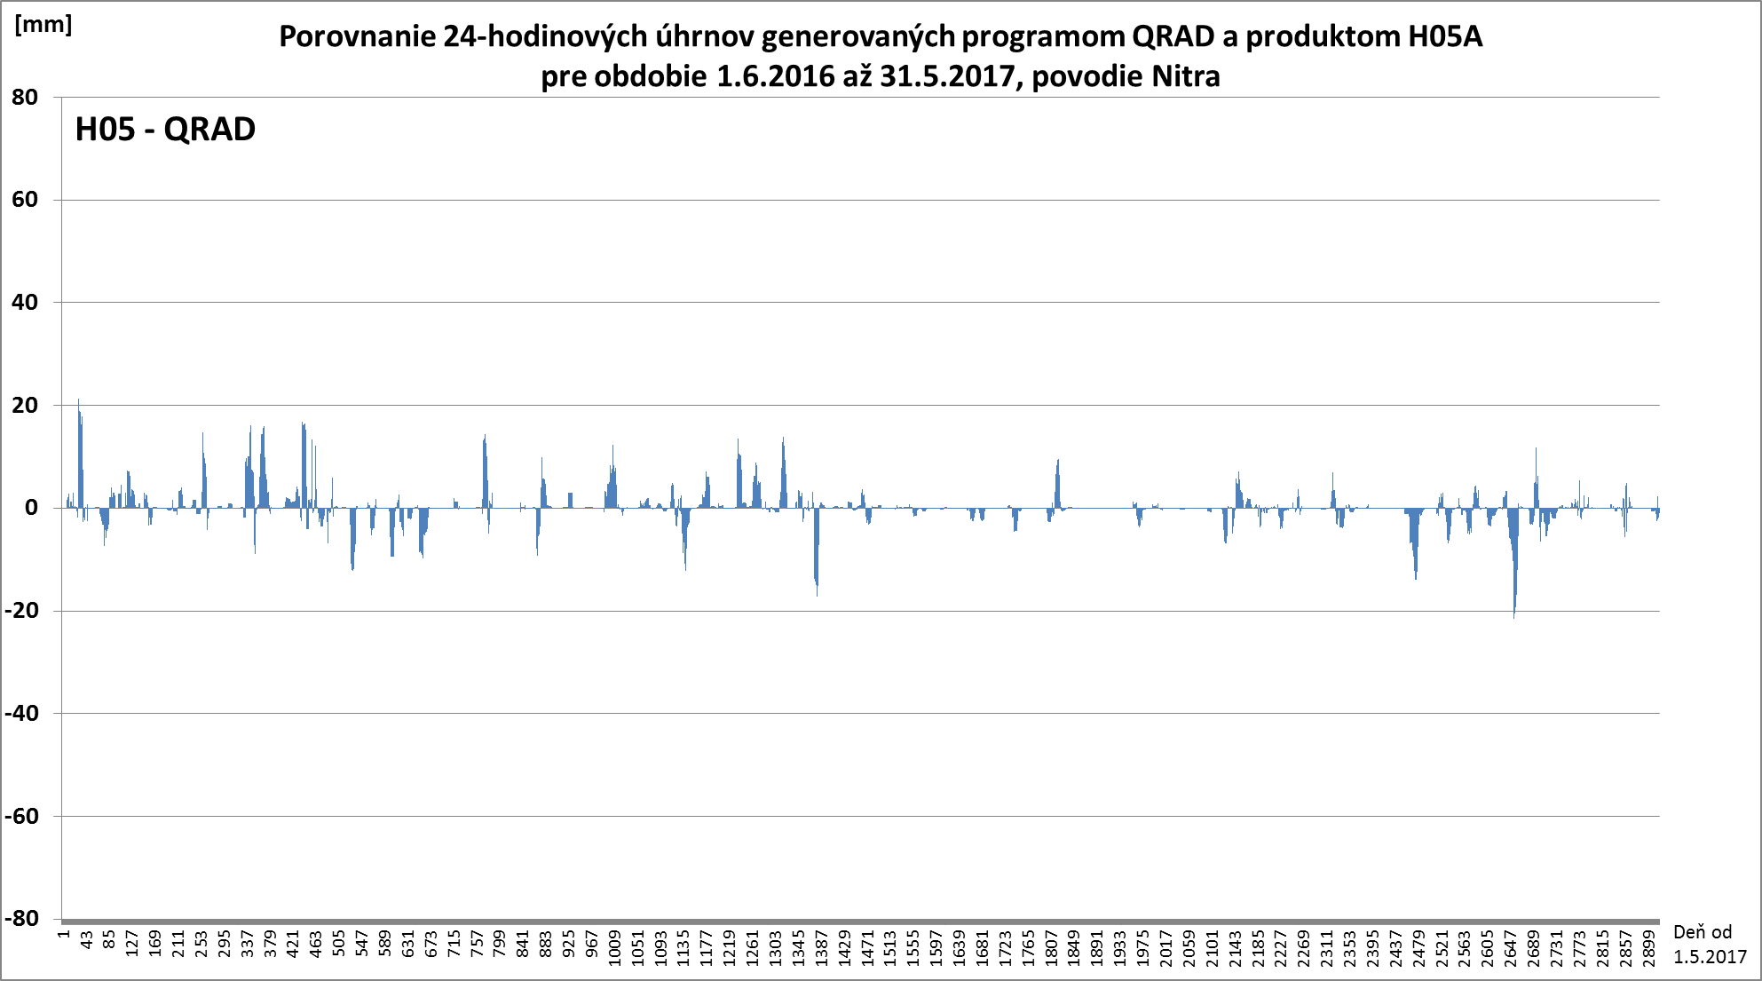
Work with accumulated precipitation from satellite:
How to see the difference between satellite and groud data?
Period 1.6.2016 – 31.5.2017 Nitra river basin
Radar data with quality control and corrections
Over versus under – good agreement between over and under estimation deviations
After the quality control and correction of radar data.

Slide 11
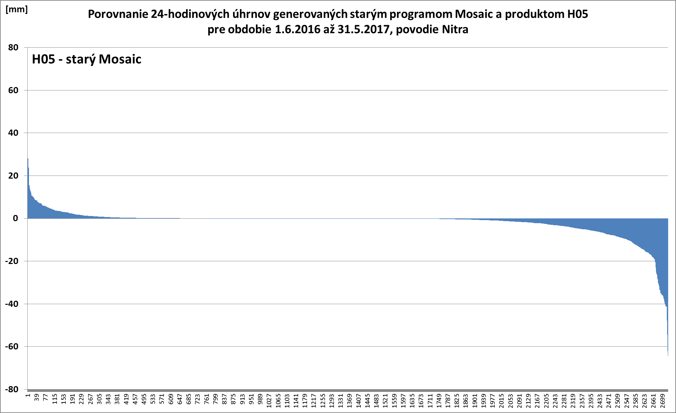
Work with accumulated precipitation from satellite:
How to see the difference between satellite and groud data?
Period 1.6.2016 – 31.5.2017 Nitra river basin
Radar data without quality control and corrections
Lower positive
deviations
Higher negative
deviations
Deviations are ordered from positive to negative and according the deviation values ...

Slide 12
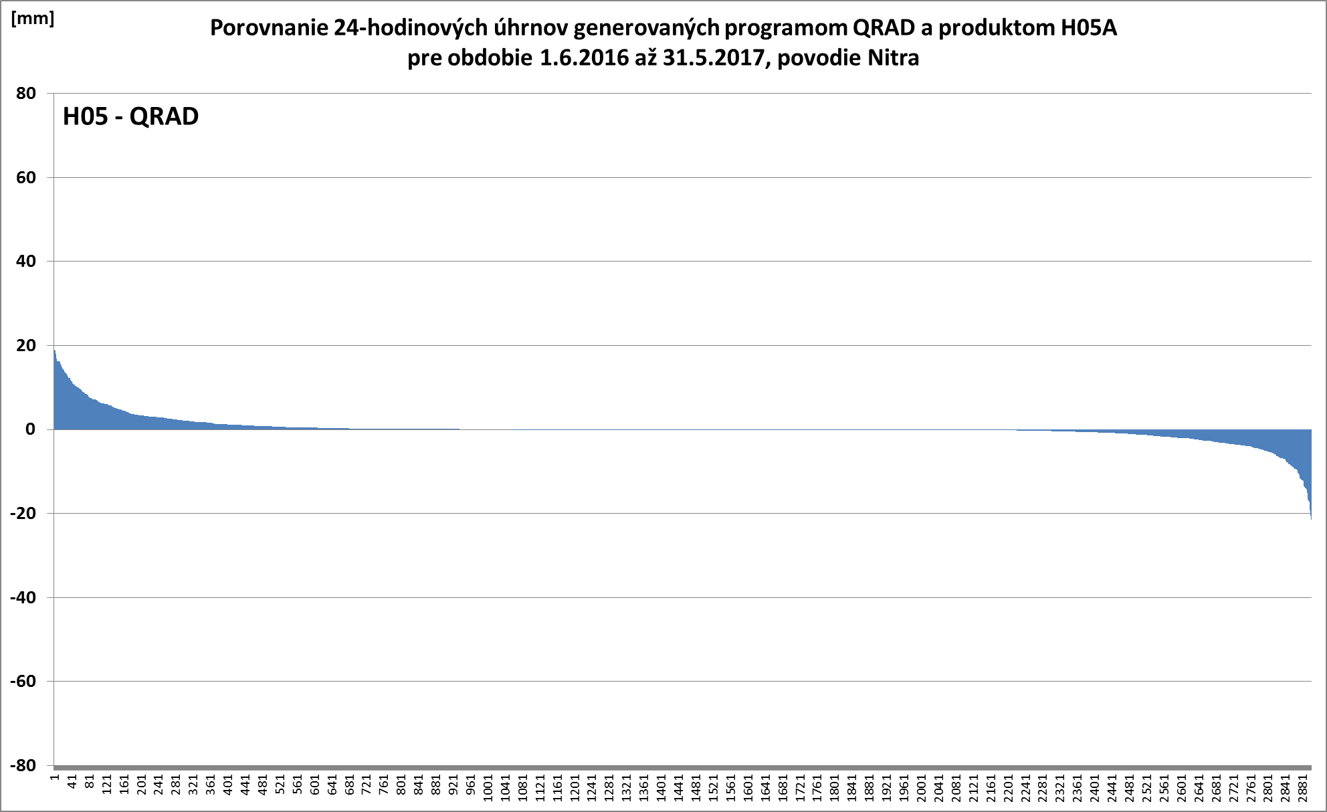
Work with accumulated precipitation from satellite:
How to see the difference between satellite and groud data?
Period 1.6.2016 – 31.5.2017 Nitra river basin
Radar data with quality control and corrections
Positive and negative deviations became equivalent, radar data fit realistic values
and showing that satellite data are realistic
Deviations are ordered from positive to negative and according the deviation values ...

Slide 13
Quality Assessment activities - comparison to ground truth - STEP 2: collect time/space data
Using data from the QRAD Software Package (SHMÚ, created by Ladislav Méri) for validation we should get more reliable results on the quality of H05 than in the past, when we used radar data from simple merging software that essentially maximized precipitation values at each point where data from more than one radar was available.

Slide 14
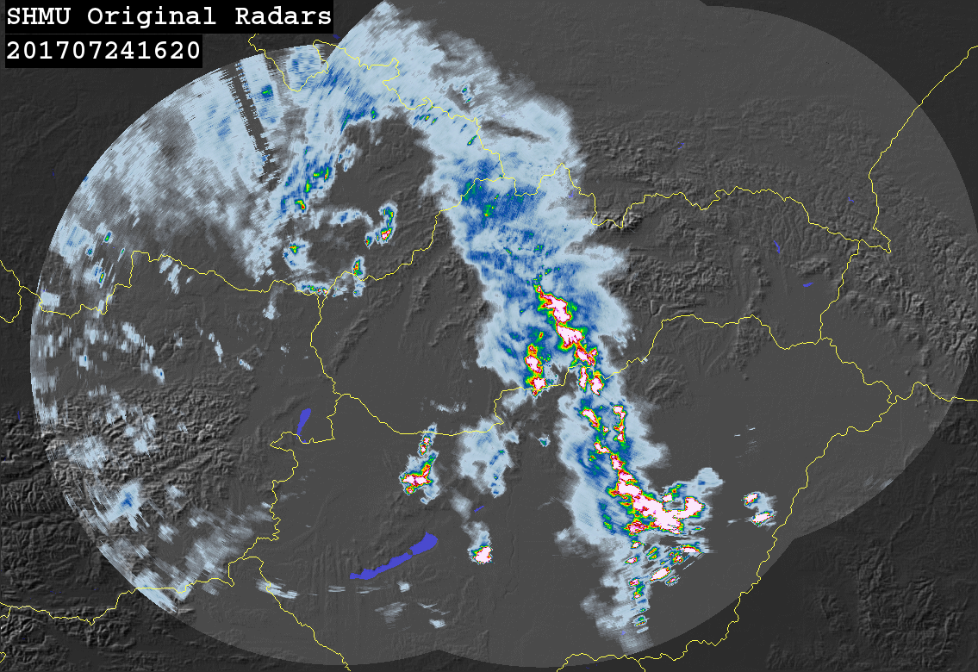
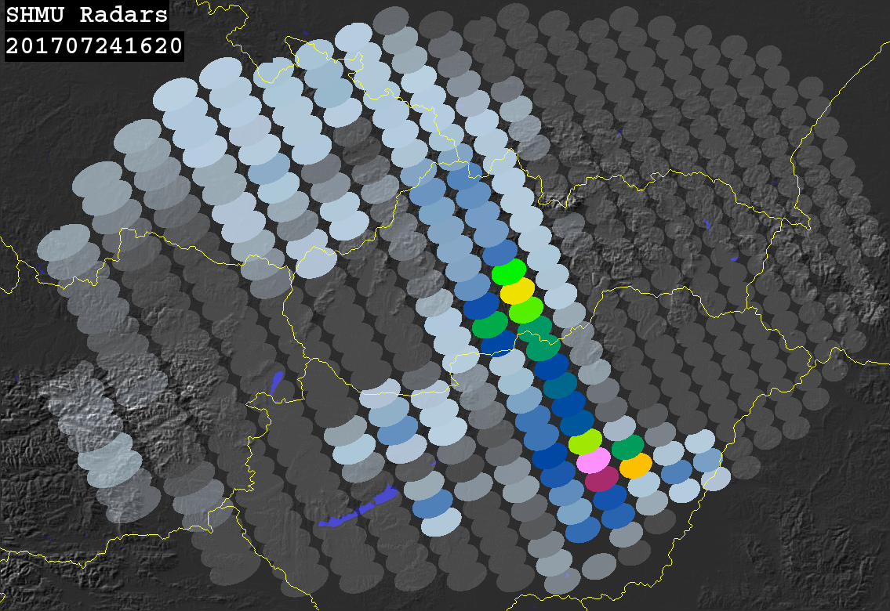
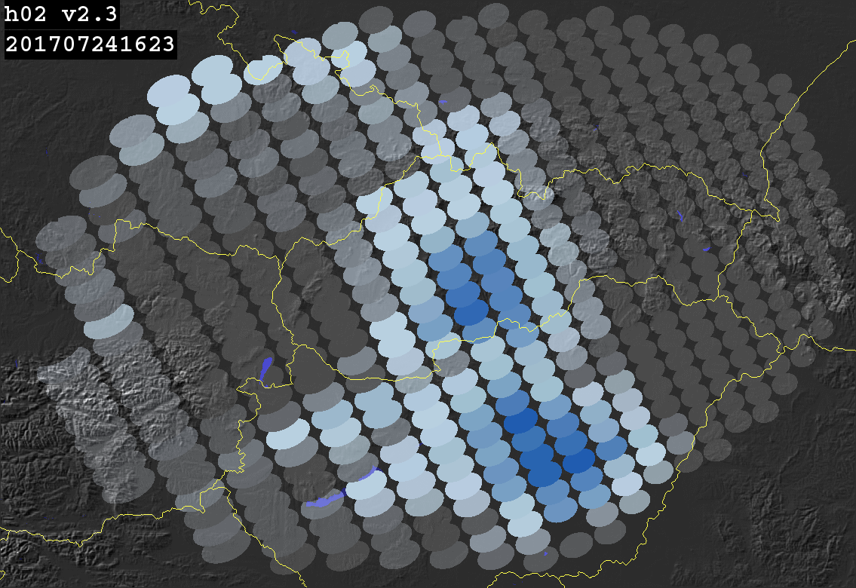
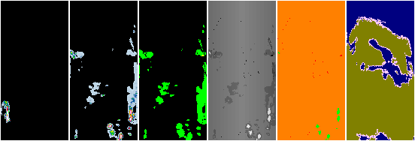
How to properly overlay satellite and radar data? - different resolution, different coverage, different sensitivity of rain signal in FOV
Weighted values of radar pixels
Radar data must be up-scaled to the resolution of
satellite grid including signal distribution inside FOV:
Mask/QI/Conf/Phase/PCP/radar data and QI

Slide 15
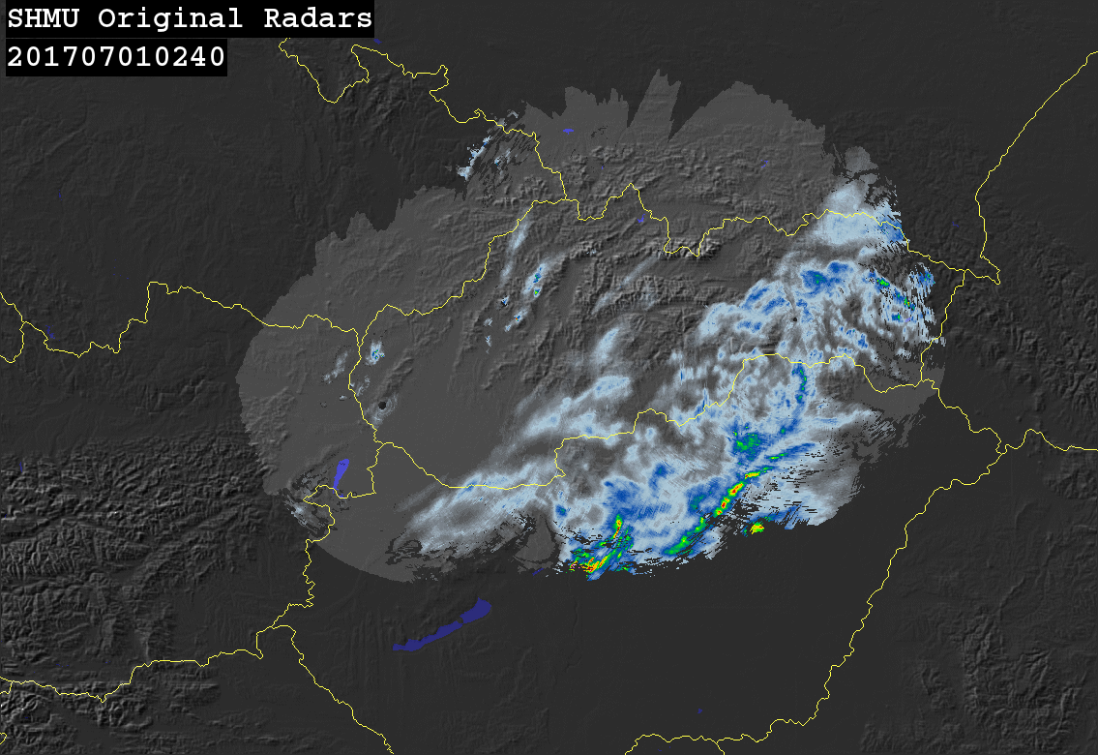
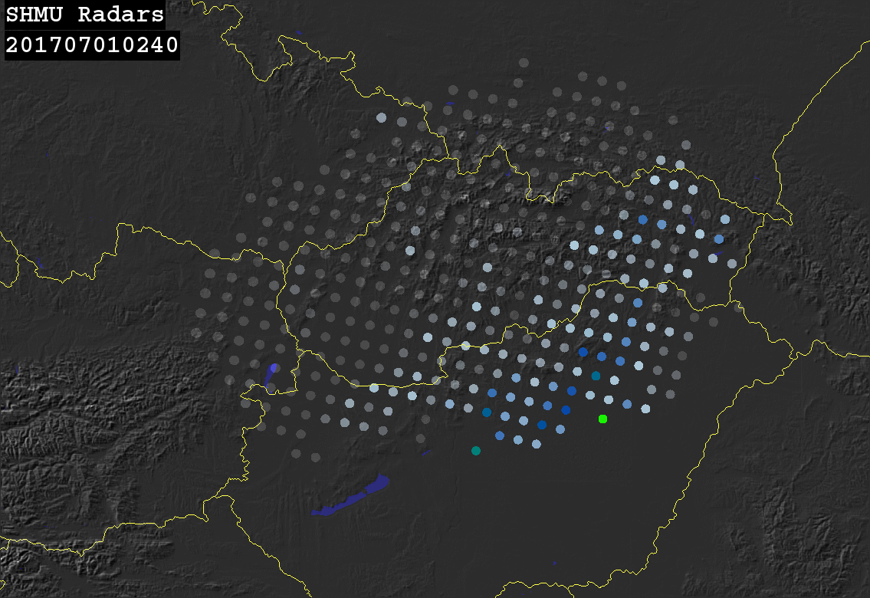
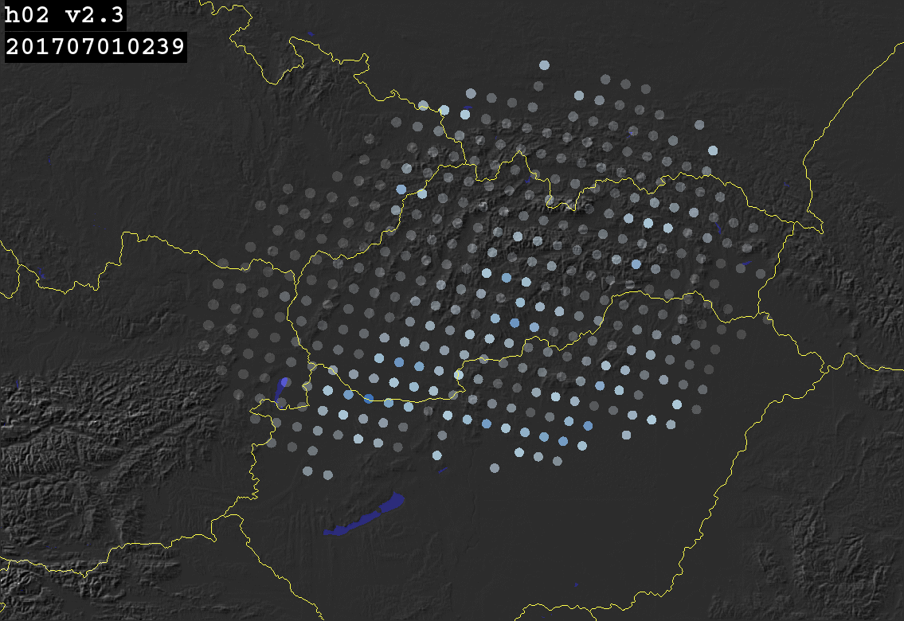
How to properly overlay satellite and radar data? - different resolution, different coverage, different sensitivity of rain signal in FOV
Weighted values of radar pixels
Radar data must be up-scaled to the resolution of
Satellite grid including signal distribution inside FOV
Mask/QI/Conf/Phase/PCP/radar data and QI

Slide 16
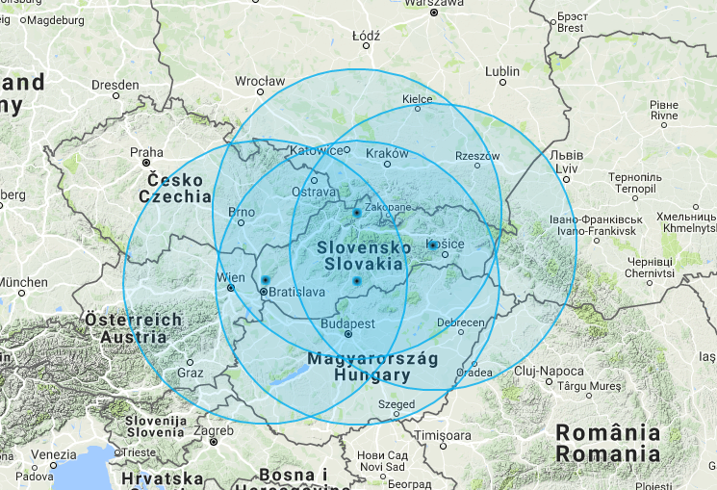
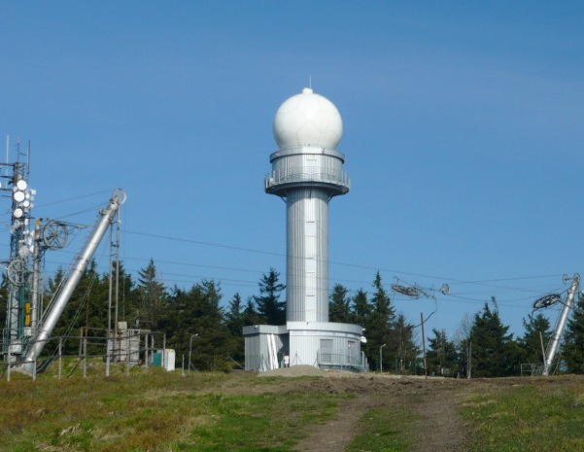
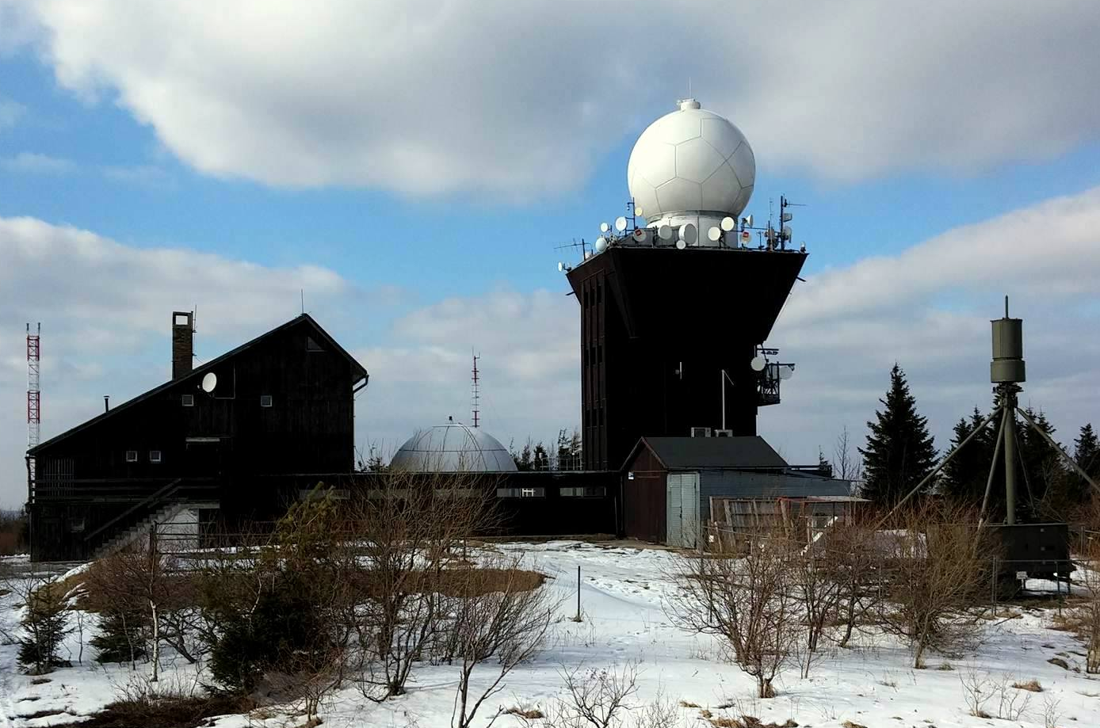

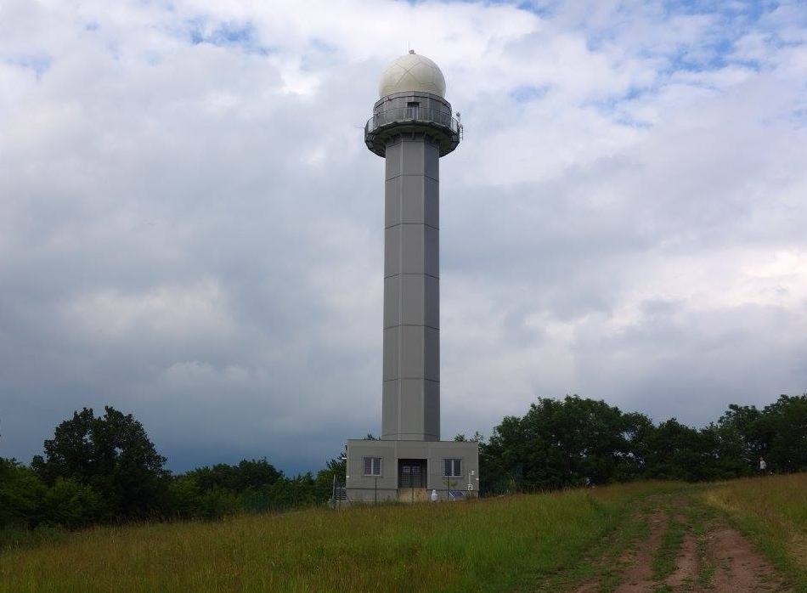
Slovak Ground Reference Data
Homogeneous network of 4 dual-pol C-band radars (since 2016)
Composites of precipitation intensities @ 1km res. every 5 minutes
Kubínska hoľa
Kojšovská hoľa
Malý Javorník
Španí laz
Notes:
In Slovakia, the H-SAF precipitation products are validated against radar data. The Slovak radar network consists of 4 identical dual polarization C-band radars whose locations and coverage are shown on the map.
As reference data for validation, composites of derived precipitation intensities with 1km horizontal resolution and 5 minutes time step are used.

Slide 17
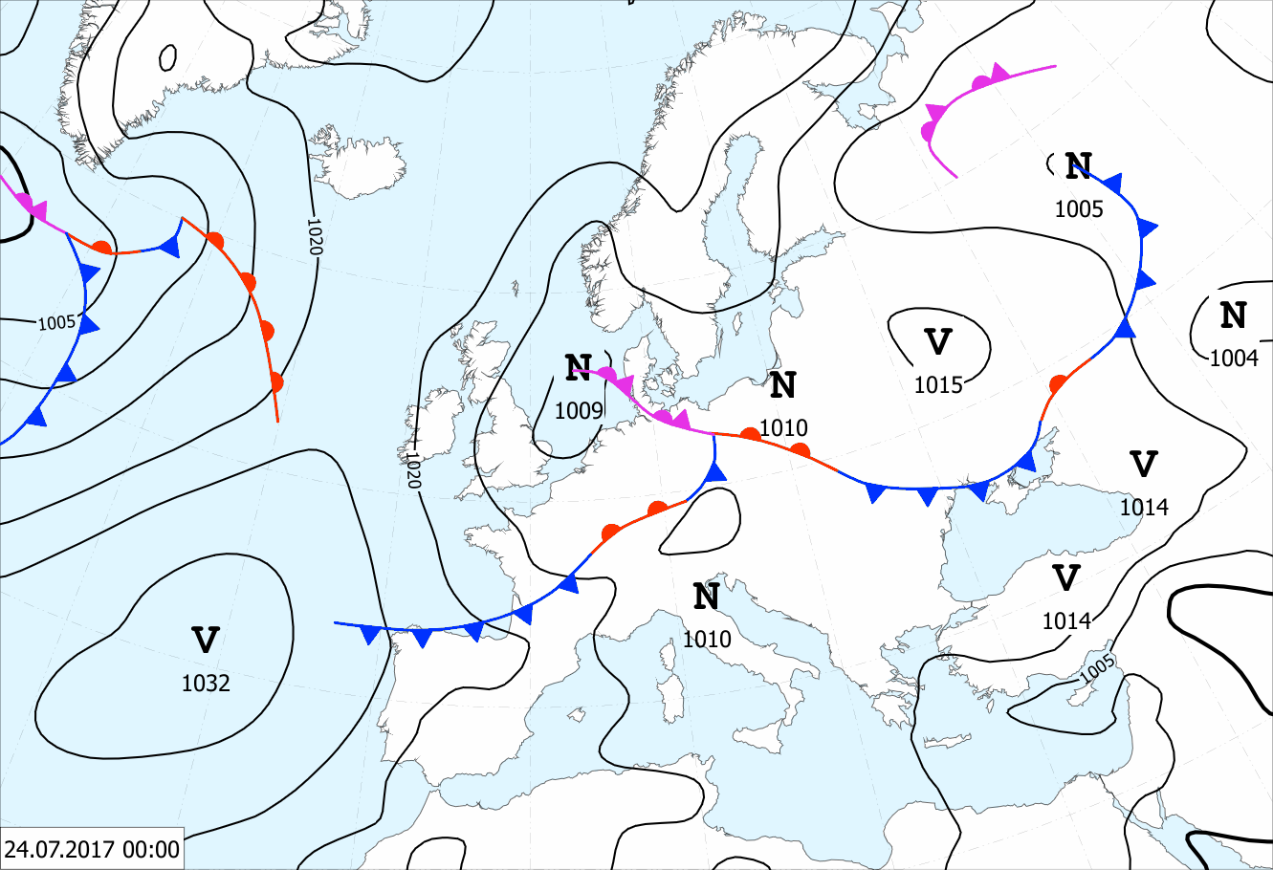
Case study: Slovakia 24th of July 2017
Storms over central Europe were initiated in advection of warm and humid air from south:
Notes:
Meteorological event introduction: Storms over central Europe were initiated in advection of warm and humid air from south.
The bluish ellipse depicts the studied area.

Slide 18
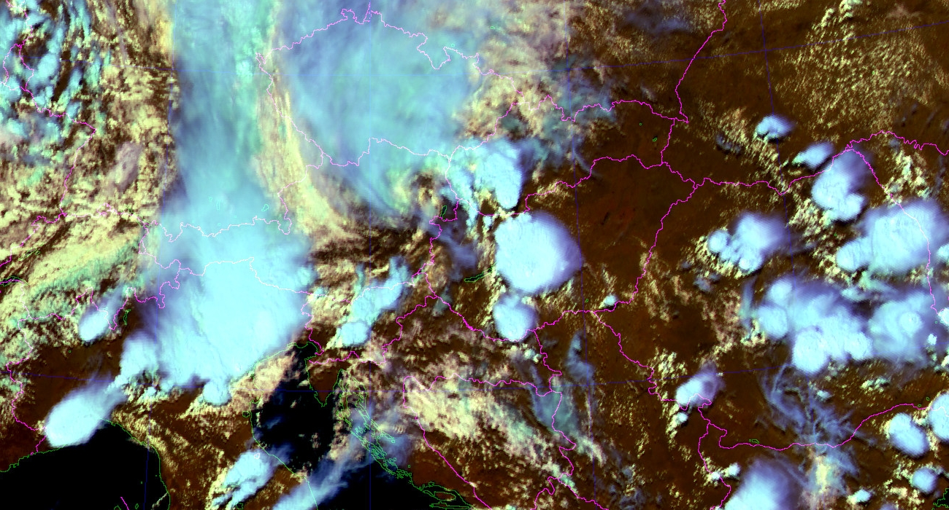
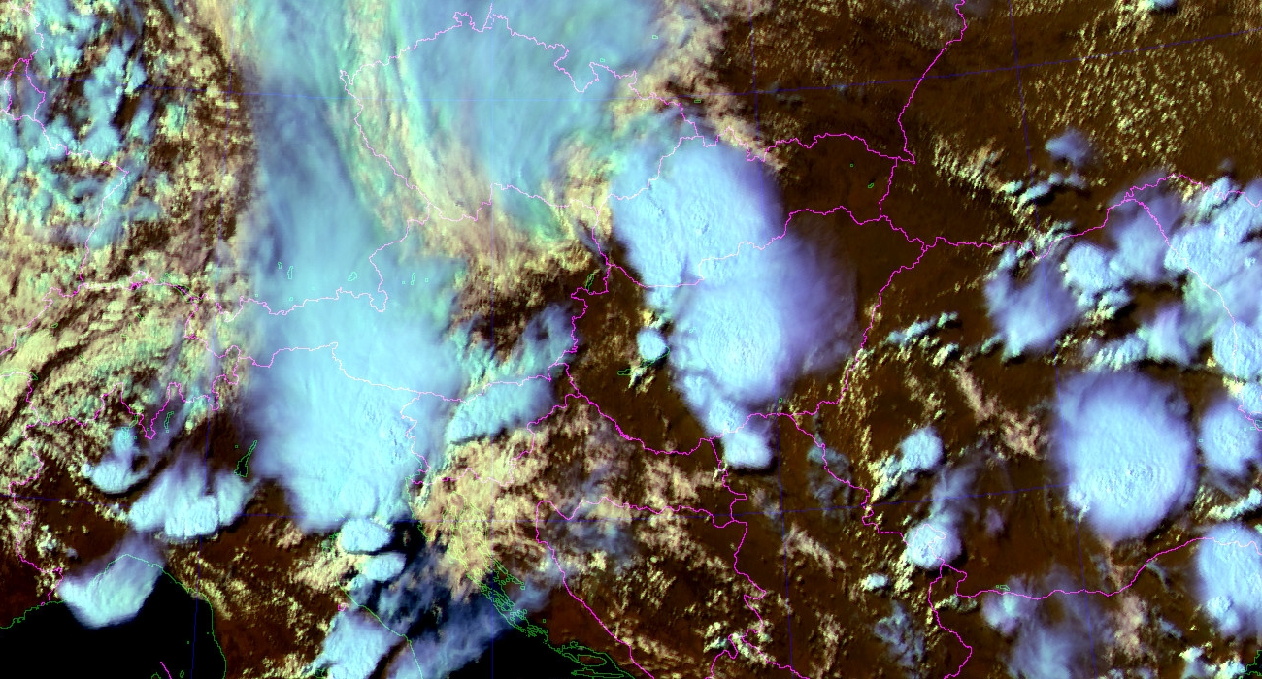
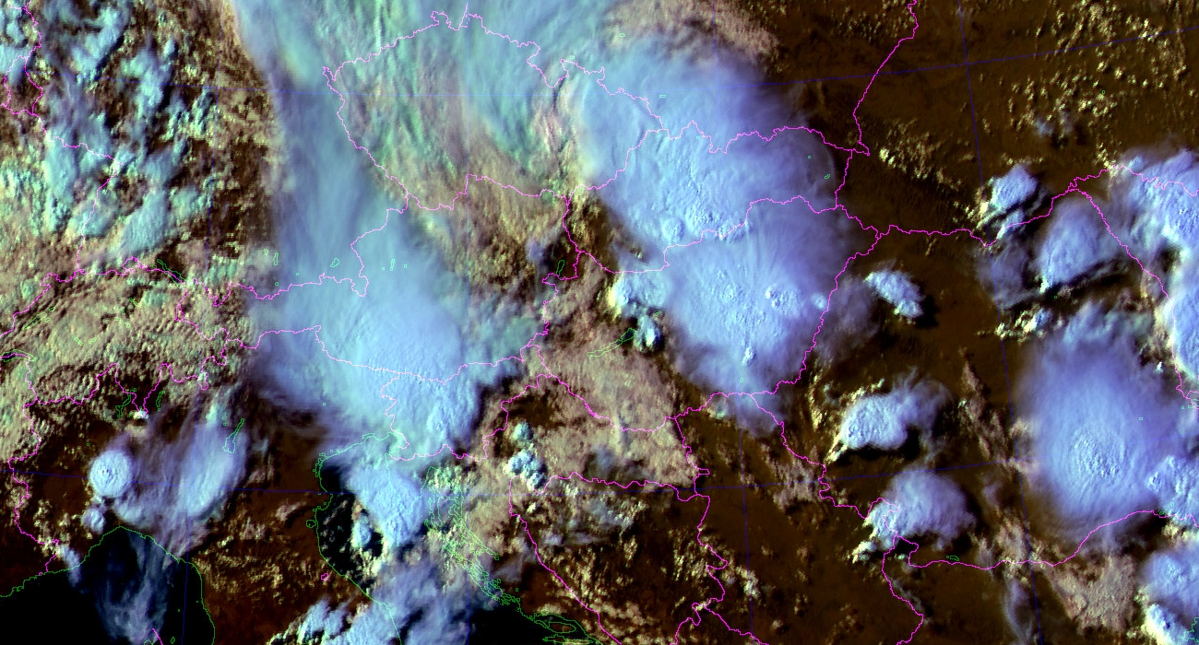
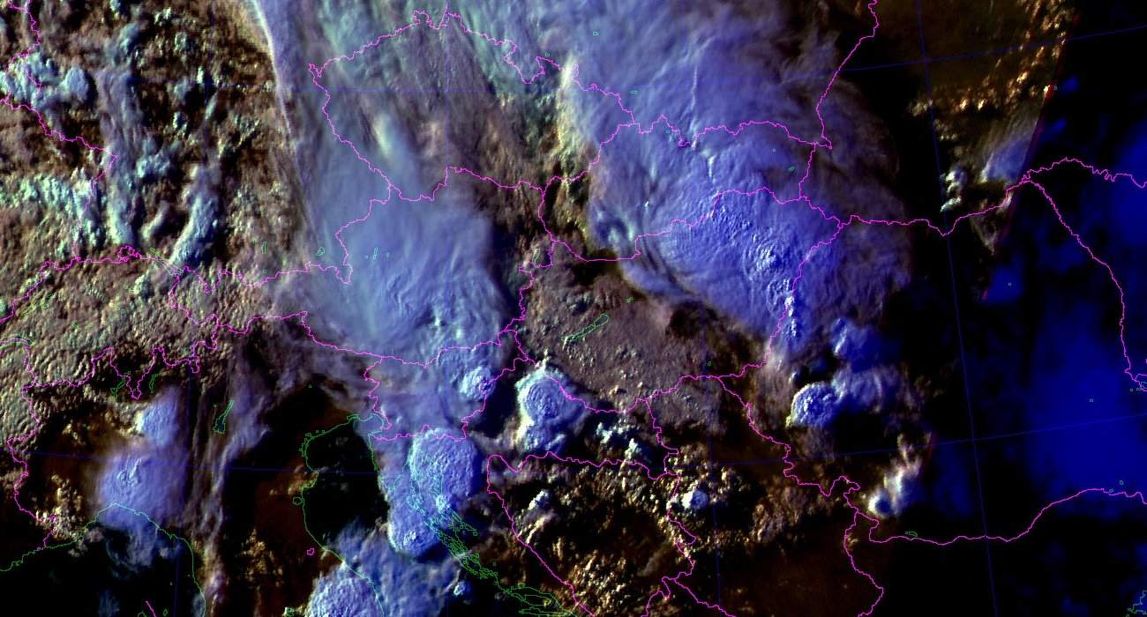
Case study: Slovakia 24th of July 2017
HRV/IR/NIR RGB MSG composite shows development of storms over central Europe:
Notes:
This slide shows development of storms over Central Europe on an RGB composite from MSG.

Slide 19
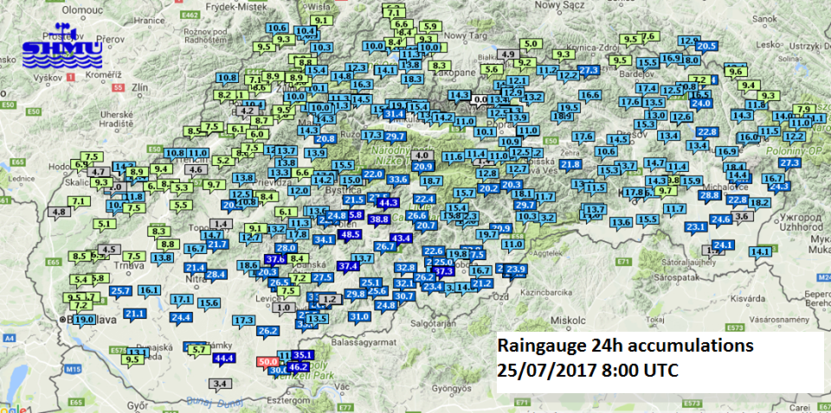
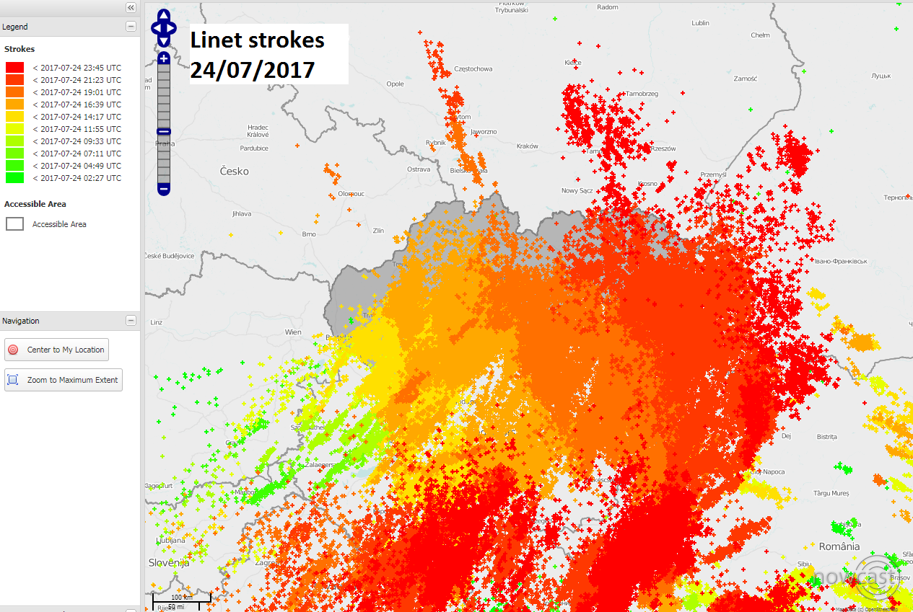
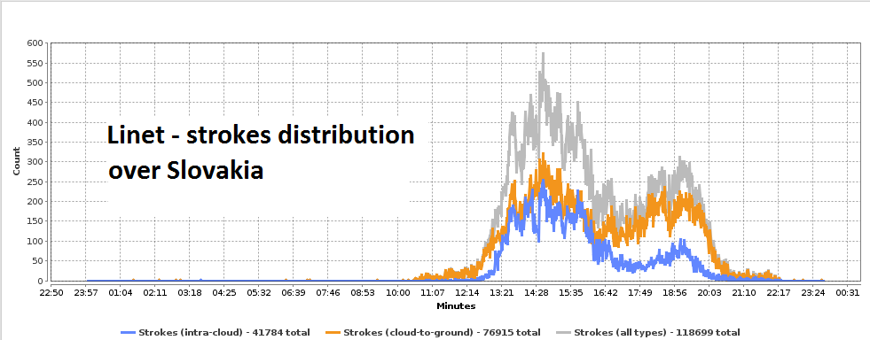
Case study: Slovakia 24th of July 2017
Data from raingauge & lightning detection network:
Notes:
As shown on the map of 24 hour precipitation totals from Slovak raingauge network from this event, the most significant precipitation, up 50 mm, fell in the southern part of central Slovakia.
There was also quite strong lightning activity during these storms as shown on the map with strokes detected throught the whole day by Linet network.

Slide 20
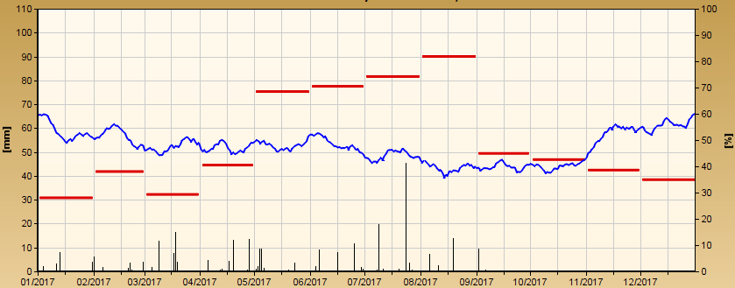
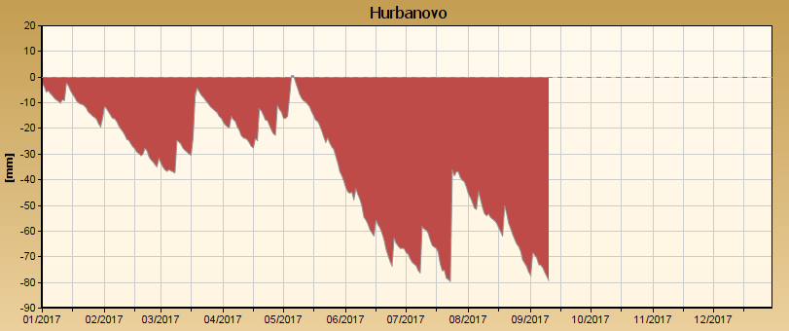
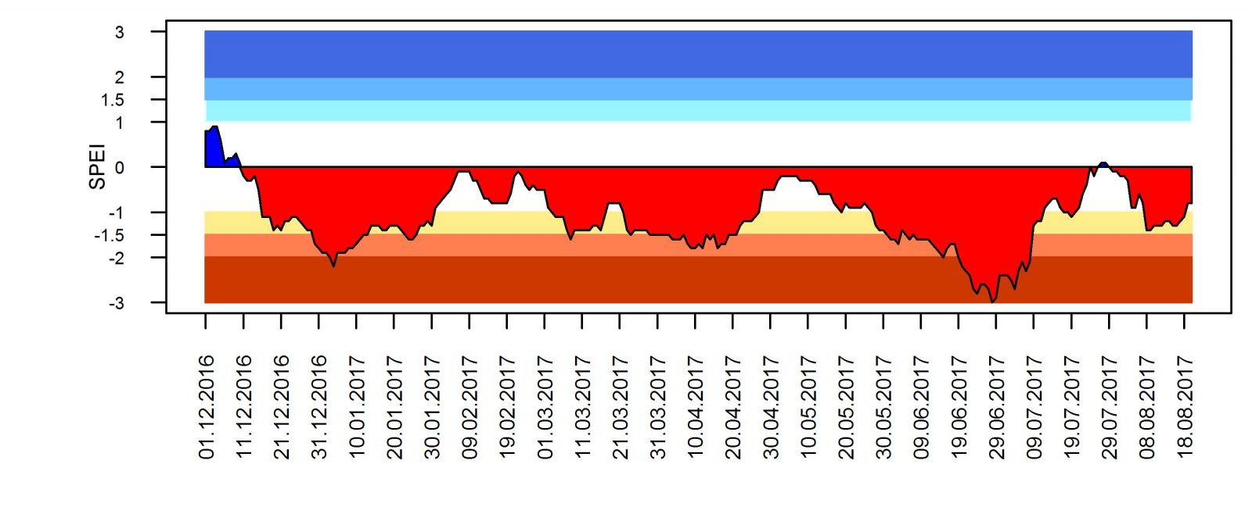
Case study: Slovakia 24th of July 2017
These plots show rain events in south Slovakia in 2017 (Hurbanovo station):
Green arrow shows the most significant rain event in 2017 with total amount of rain about 50 mm.
Similar even
stronger event
October 2020!
Green arrow shows the same event which reduced long duration drought in Southern Slovakia. Deficit of precipitation was
decreased from -80 mm to -40 mm.
Standardized Precipitation-Evapotranspiration Index
Total duration of drought
in this region is just more
than 230 days.
Notes:
This precipitation event was important because it ocurred during / after? long dry period and helped partially reduce high precipitation deficit in agricultural regions of Slovakia. E.g. at station Hurbanovo the deficit was reduced from -80 to -40 mm as depicted by the green arrow in the chart below.
The period of precipitation deficit in this region, by the way, still continues and currently lasts more than 230 days.

Slide 21
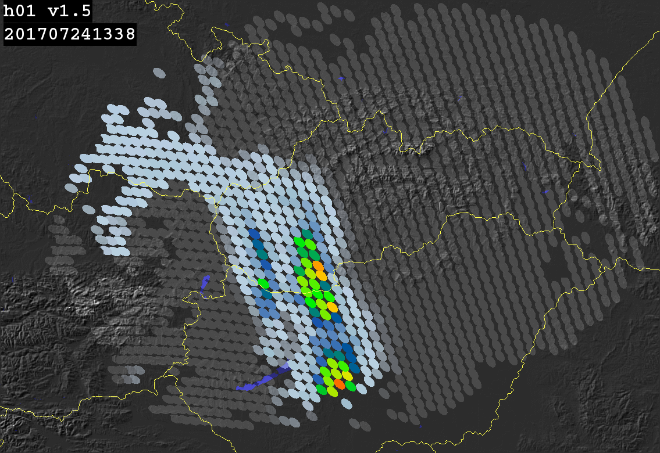
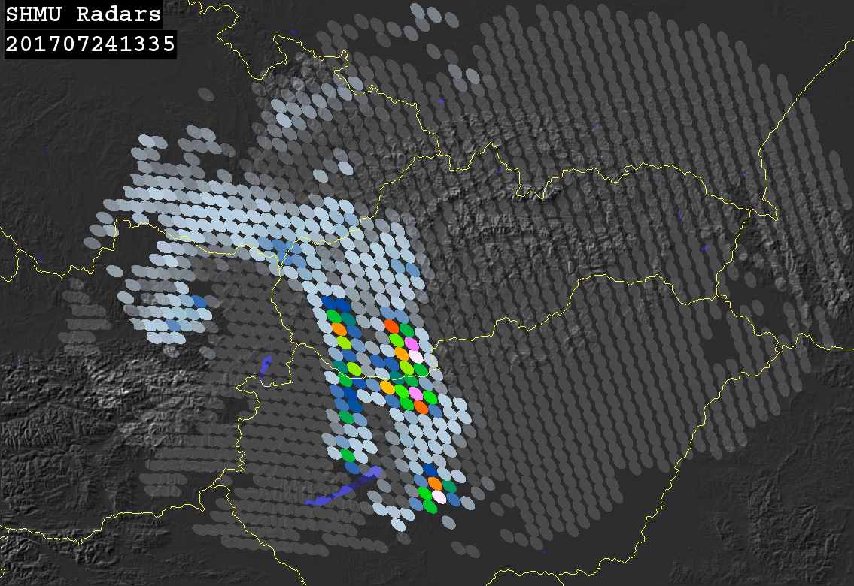
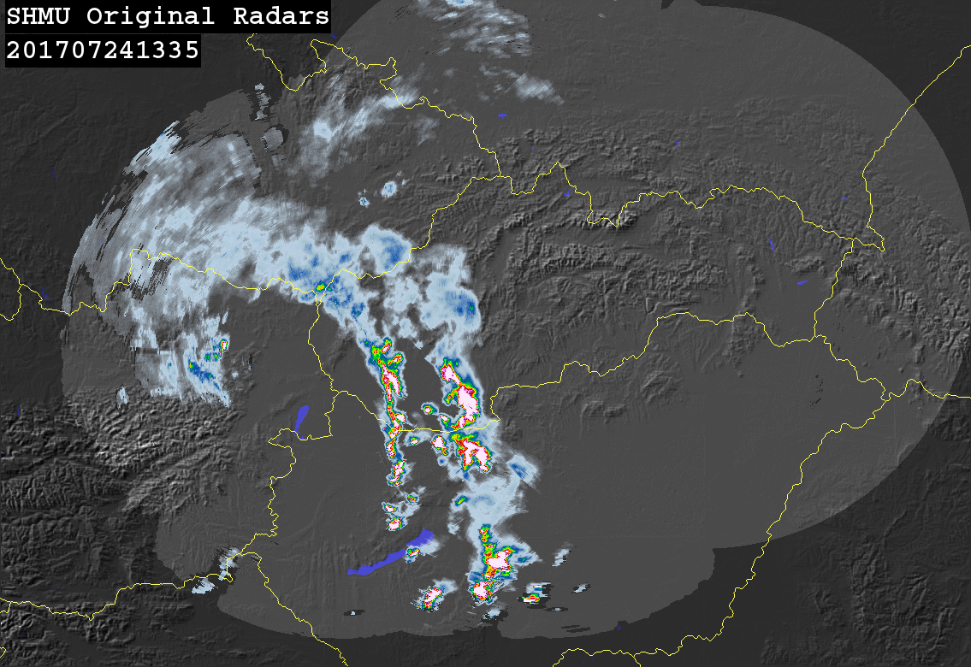
Case study: Slovakia 24th of July 2017
Product H01A and SK-radar network rain intensities comparison: 13:35 UTC
≥ 0.25 mm/h
≥ 1 mm/h
POD
FAR
CSI
1.000
0.341
0.659
0.995
0.322
0.676
Notes:
This slide shows example of precipitation field by H-SAF product H01A (on the left) and corresponding radar data upscaled into the satellite IFOVs (on the upper-right). The original radar precipitation field is shown below.
The precipitation patterns detected by satellite product and radars matched very well what is confirmed by high POD and relatively low FAR values at both intensity thresholds.

Slide 22
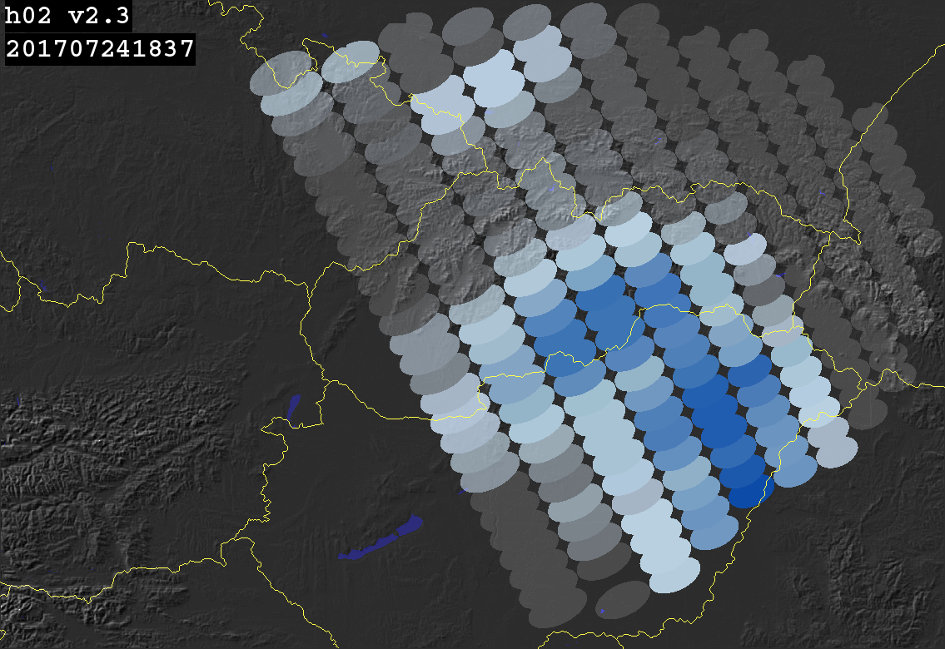
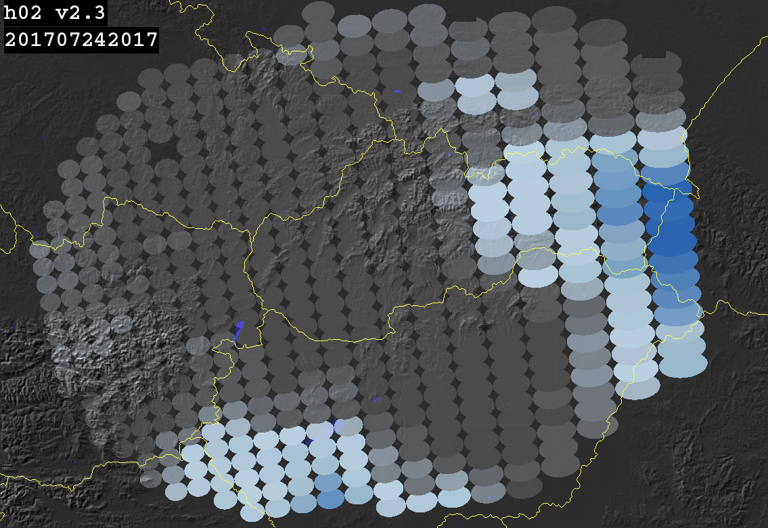
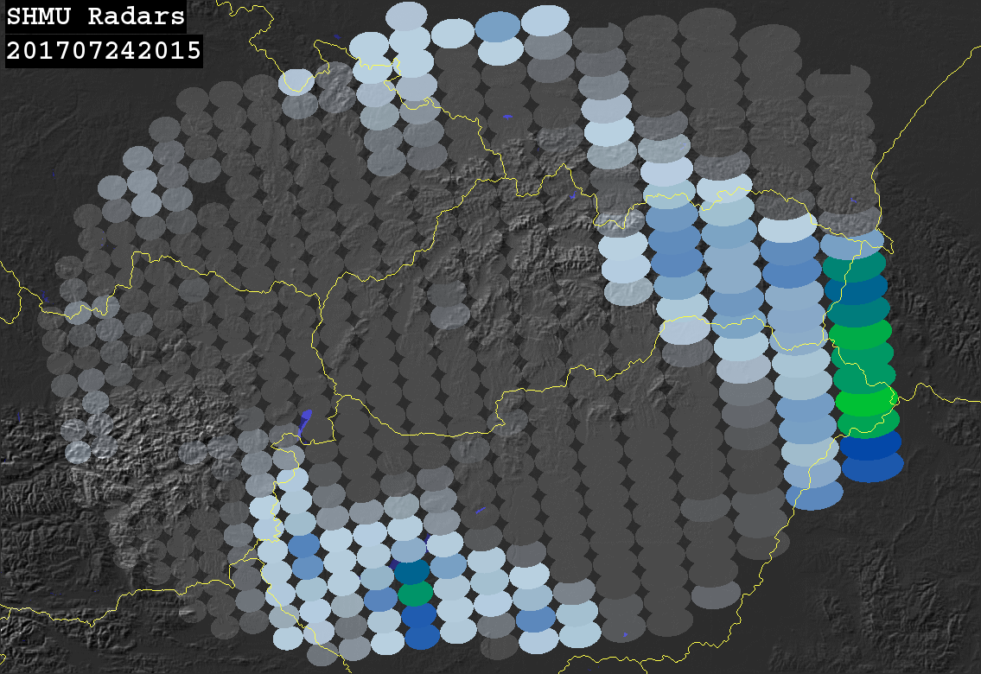

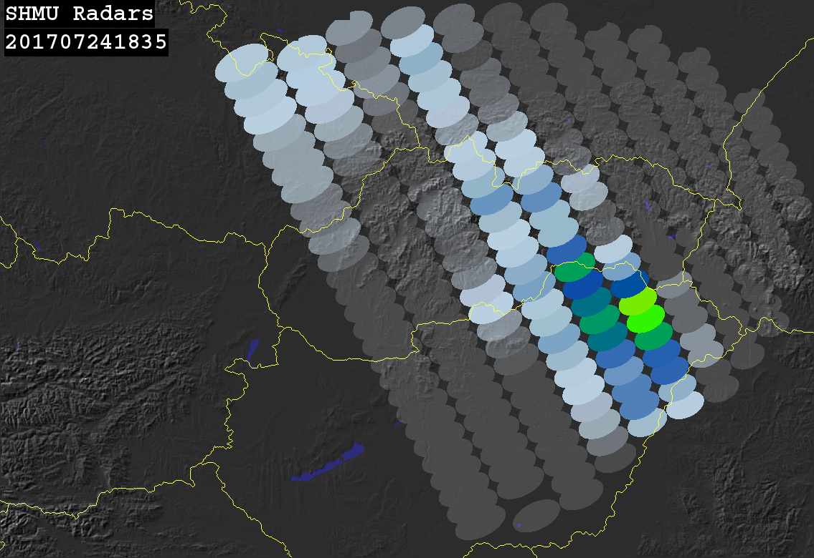

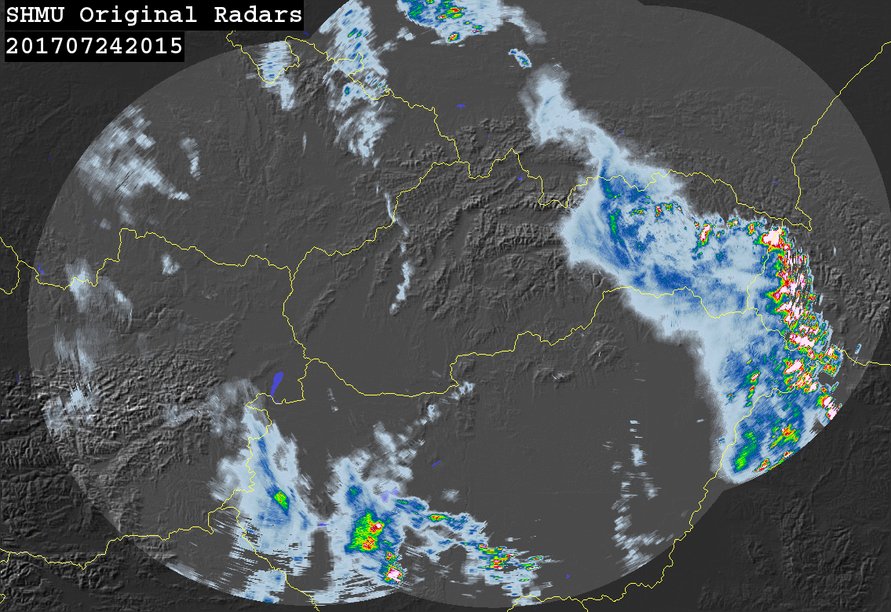
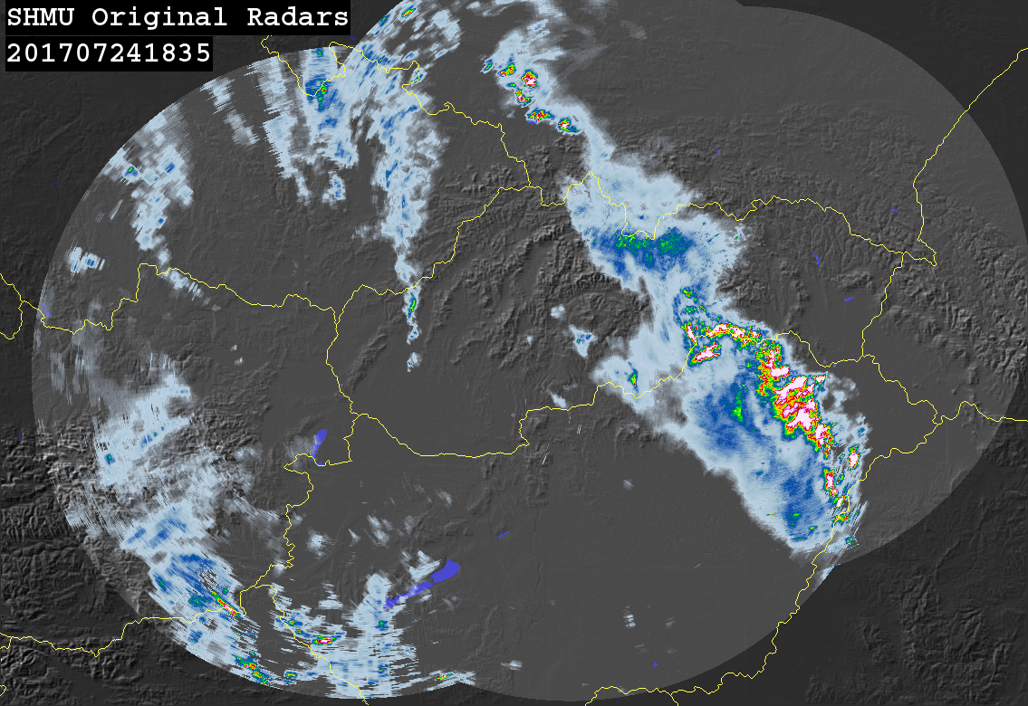
Case study: Slovakia 24th of July 2017
Product H02A and SK-radar network rain intensities comparison:
16:20 UTC
20:15 UTC
18:35 UTC
≥ 0.25 mm/h
≥ 1 mm/h
POD
FAR
CSI
1.000
0.339
0.661
0.647
0.326
0.493
Notes:
In case of product H02A, there is again a good match of precipitation patterns although the maximum intensities in the satellite product are slightly lower compared to radars.

Slide 23
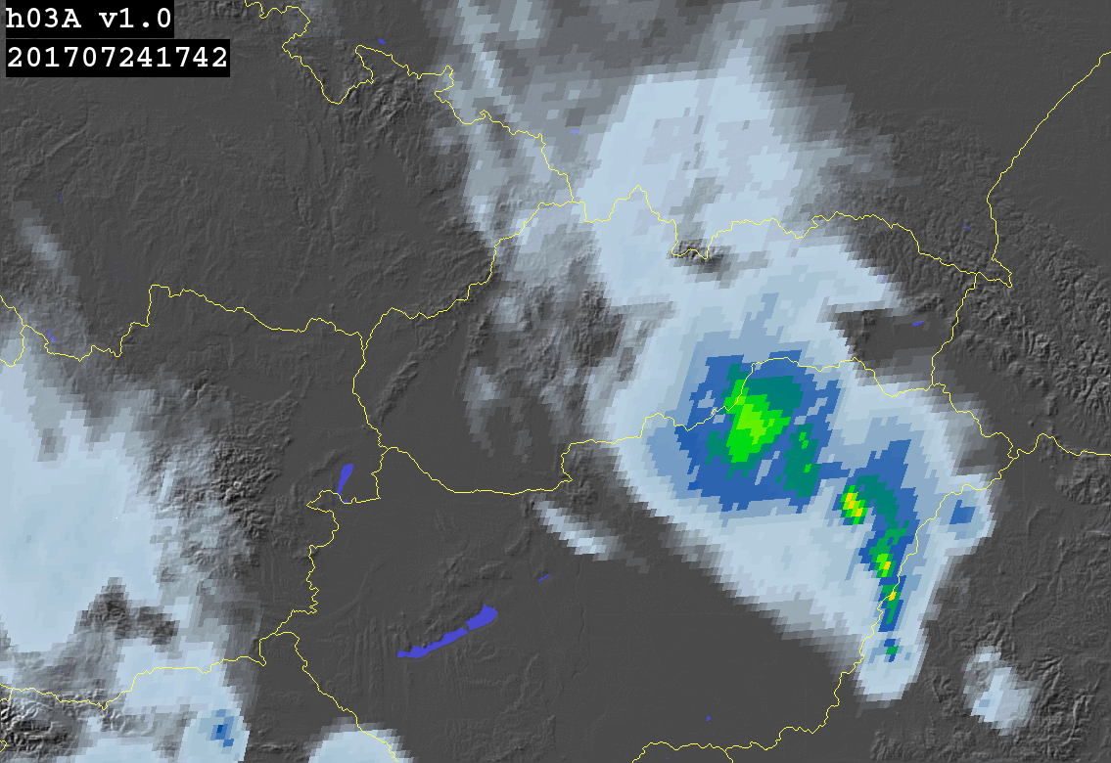
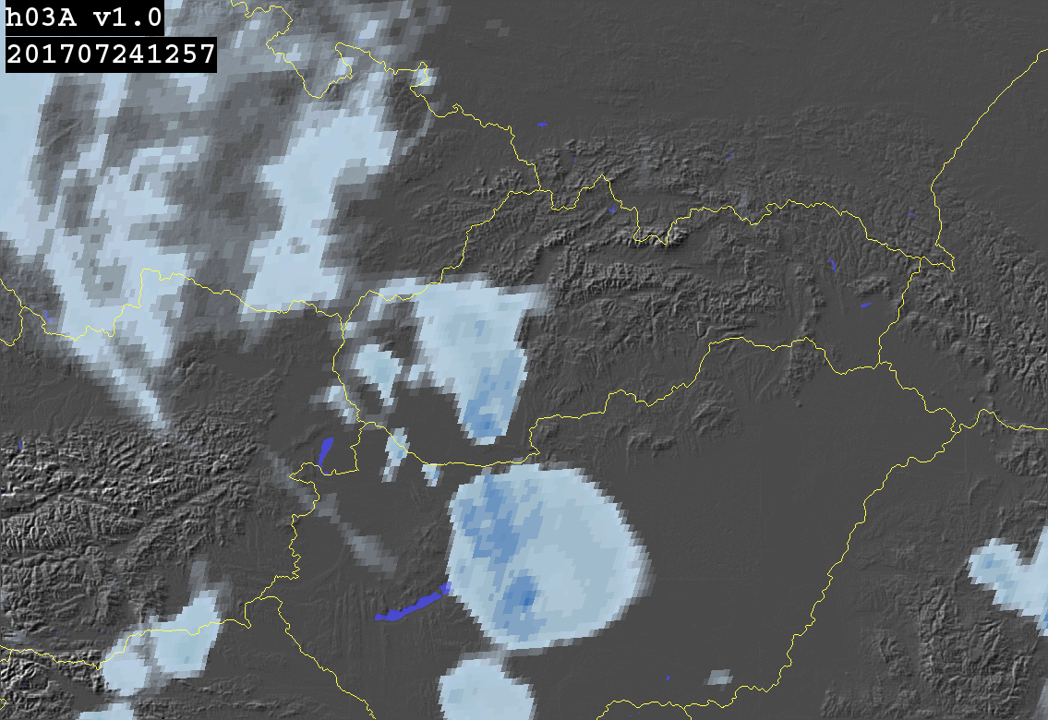
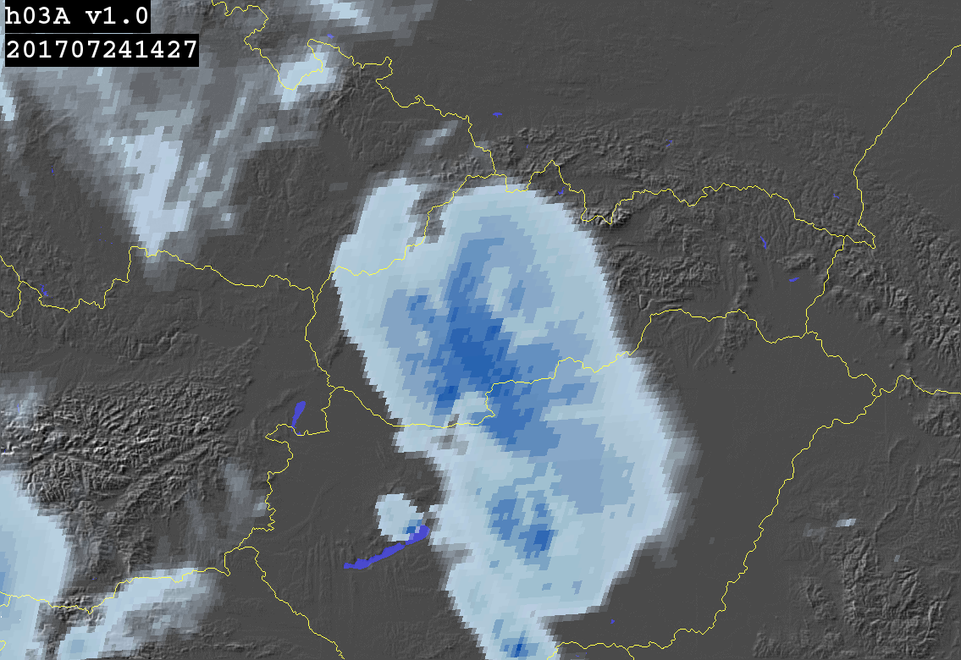
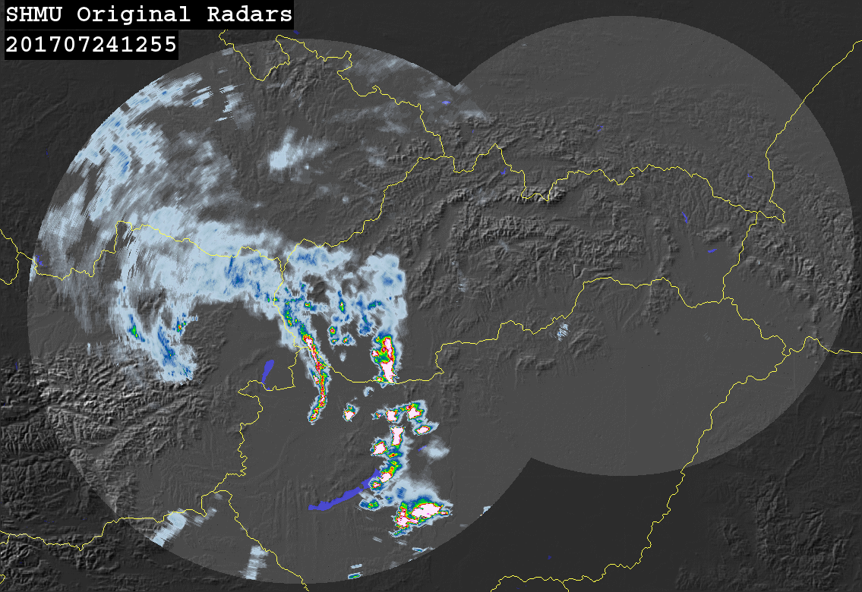
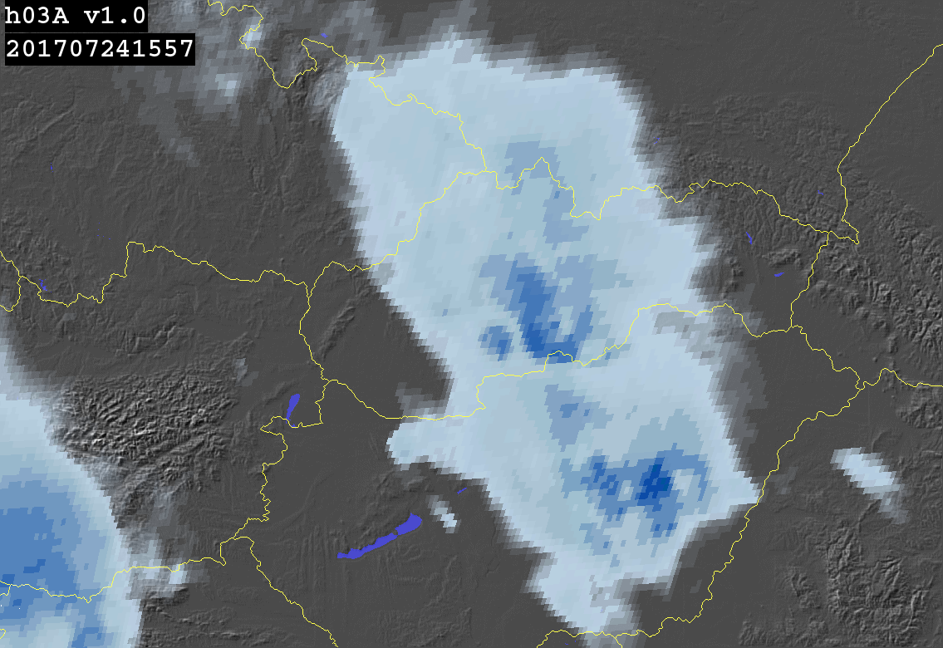
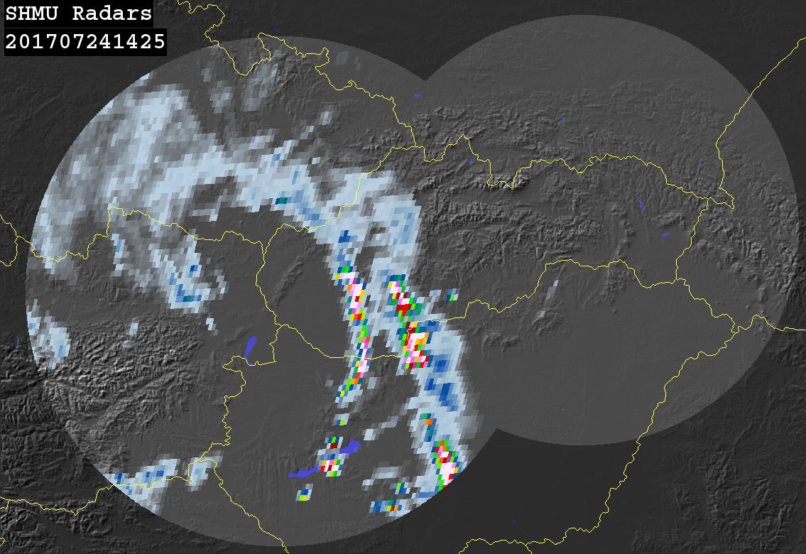
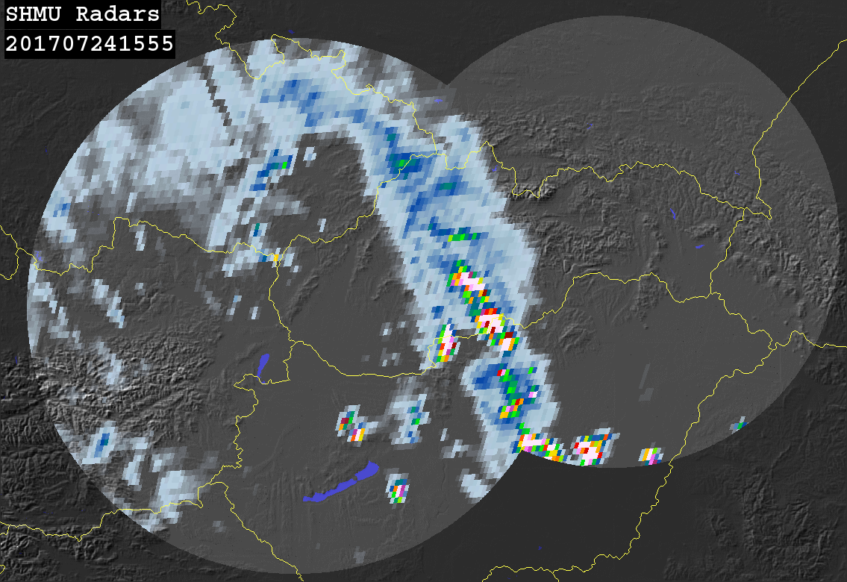





Case study: Slovakia 24th of July 2017
12:45 UTC
14:15 UTC
15:45 UTC
Product H03A and SK-radar network rain intensities comparison:
17:30 UTC
≥ 0.25 mm/h
≥ 1 mm/h
POD
FAR
CSI
0.795
0.838
0.156
0.705
0.875
0.119
Notes:
This slide show the same comparison for product H03A. The patterns match still relatively well except for often false detection of precipitation by the satellite product, especially due to detection of Cb anvils.
This corresponds with higher FAR value at both precipitation thresholds.

Slide 24
Case study: Slovakia 24th of July 2017
Probability Density Functions for H01, H02 and H03:
Log(N)
Log(N)
Log(N)
mm/h
mm/h
mm/h
Notes:
These charts compare probabilty density functions of H01, H02 and H03 product with the radars. We can see that the highest intensities detected by radars are missing in the satellite products. However at lower precipitation intensities the distribution curves are matched very well, especially in case of products H02 and H03.

Slide 25
Case study: Slovakia 24th of July 2017
Results of continuous statistics for H01:
Precipitation (mm/h) | 0.25 – 1 | 1 – 10 | ≥ 10 | ≥ 0.25
No. of satellite obs. | 179 | 559 | 62 | 800
No. of radar obs. | 104 | 378 | 45 | 527
Mean Error (mm/h) | 1.769 | 1.320 | -5.141 | 0.857
Multiplicative bias | 3.781 | 1.391 | 0.753 | 1.198
Correlation coefficient | 0.144 | 0.456 | 0.587 | 0.739
URD-RMSE (%) | 665.8 | 125.8 | 48.1 | 314.7
Fract. Stand. Error (%) | 410.4 | 102.2 | 50.9 | 102.0
Nash-Sutcliffe Coeff. | -149.15 | -1.50 | 0.12 | 0.524
Notes:
This slide shows overall results of selected statistical scores for the microwave product H01.
For overall precipitation above 0.25 mm/h, the Mean Error, Multiplicative bias and Correlation coefficient reached very good results. For heavy precipitation class with intensities above 10 mm/h, the results of mean error and multiplicative bias indicate underestimation of the satellite product, however the results for this class may not be statistically significant due to low number of compared values.

Slide 26
Case study: Slovakia 24th of July 2017
Results of continuous statistics for H02:
Precipitation (mm/h) | 0.25 – 1 | 1 – 10 | ≥ 10 | ≥ 0.25
No. of satellite obs. | 2030 | 1424 | 47 | 3501
No. of radar obs. | 784 | 1410 | 121 | 2315
Mean Error (mm/h) | 0.680 | -0.671 | -10.056 | -0.704
Multiplicative bias | 2.237 | 0.787 | 0.425 | 0.767
Correlation coefficient | 0.055 | 0.402 | 0.447 | 0.580
URD-RMSE (%) | 402.1 | 113.3 | 57.8 | 250.5
Fract. Stand. Error (%) | 317.2 | 81.5 | 70.1 | 118.9
Nash-Sutcliffe Coeff. | -66.67 | -0.632 | -1.477 | 0.309
Notes:
In case of product H02, the results of mean error and multiplicative bias for overall precipitation indicate slight underestimation of precipitation intensities compared to radars. Also, the correlation coefficient is slightly lower compared to product H01. On the other hand, H02 reached lower relative RMSE error than H01.

Slide 27
Case study: Slovakia 24th of July 2017
Results of continuous statistics for H03:
Precipitation (mm/h) | 0.25 – 1 | 1 – 10 | ≥ 10 | ≥ 0.25
No. of satellite obs. | 13039 | 23514 | 833 | 37386
No. of radar obs. | 10129 | 17236 | 2138 | 29503
Mean Error (mm/h) | 0.430 | -1.426 | -19.450 | -2.095
Multiplicative bias | 1.749 | 0.578 | 0.182 | 0.462
Correlation coefficient | 0.053 | 0.196 | 0.215 | 0.290
URD-RMSE (%) | 406.2 | 125.0 | 80.0 | 257.4
Fract. Stand. Error (%) | 323.2 | 101.9 | 123.6 | 215.9
Nash-Sutcliffe Coeff. | -73.03 | -1.352 | -0.70 | 0.023
Because of convective event MW products better reflect PCP then IR SEVIRI,
which are too smooth over the region catching cloud tops only!
Notes:
Here are the same statistical scores for product H03.

Slide 28
Upscaling algorithm
Coordinates transformation
Algorithm is based on single memory indexing. Advantage of this approach is low requirements on numerical calculations:
Rounding of floating point LAT, LON to INT values as grid index;
Values calculation
There are two possibilities, how to calculate output pixel value from input pixels:
Average value of all satellite pixels falling into output grid point – usable for continuous parameters
Select satellite pixel value with the most frequent occurrence over the output grid point – usable for discreet parameters
Continuous parameters:
precipitation intensity
percent confidence
Discreet parameters:
Observation quality
Cloud phase
Sea/coast/land mask

Slide 29



Comparison of different
Regular grid densities:
DPR and H02 Land mask overlap:
Example of H02 precipitation product
with 0.25°, 0.10° and 0.05° steps
0.25°:
0.10° :
0.05° :

Slide 30
Methodology
DPR
Re-gridded variables
Latitude
Longitude
Precipitation
Quality
Phase
Surface type
Timestamp
Precipitation
Quality
Phase
Surface type
Timestamp
Ifovs density
Prec std
….
Regular grid
0.25° x 0.25°
for IR products
(H03,H05,H15…)
Pixel representativeness
Time differences
…..
HSAF
0.50° x 0.50°
for MW products
(H01,H02,H18…)
Precipitation
Quality
Phase
Surface type
Timestamp
Ifovs density
Prec std
….
Latitude
Longitude
Precipitation
Quality
Phase
Surface type
Timestamp
Binary files output

Slide 31
Upscaling algorithm
Density of input versus output grid points (see examples on next slides)
Additional filter included to the software:
Fill-in residual empty pixels repeating the same calculation steps –
calculate average value from surrounding pixels (e.g. 3x3 pixels)
or select the value with the highest frequency of occurrence
Task is done using output from the first run as new input for the second run.
Region for validation is defined in configuration file: h02B_DPR_config.cfg
Lon_E =60 # Longitude East [degrees]
Lon_W =-60 # Longitude West [degrees]
Lon_step =0.25 # Longitude Step regular grid [degrees]
Lat_S =-60 # Latitude South [degrees]
Lat_N =75 # Latitude North [degrees]
Lat_step =0.25 # Latitude Step regular grid [degrees]

Slide 32
Memory management - just for information (for software developers)
Proposed shared memory IDs and parameter types
by Marco Petracca in table:
Log file dpr_regulargrid.log:
Original DPR x,y-dimensions: 49 7932
Shmid for 201 = 70058008 : p_DPR_lon
shmid for 202 = 70025239 : p_DPR_lat
shmid for 207 = 70156316 : p_DPR_pcp
shmid for 216 = 70090778 : p_DPR_lst
shmid for 212 = 70123547 : p_DPR_phase
Regular LON, LAT grid size: 799 x 799
shmid for 503 = 70385699 : p_dpr_prec_gridded
shmid for 506 = 70418468 : p_dpr_clph_gridded
shmid for 507 = 70451237 : p_dpr_flag_gridded
Log file h02_regulargrid.log:
Original h02 x,y-dimensions: 876 90
shmid for 101 = 69632000 : p_h02_lon
shmid for 102 = 69664780 : p_h02_lat
shmid for 103 = 69697549 : p_h02_pcp
shmid for 104 = 69763087 : p_h02_obsq
shmid for 105 = 69828625 : p_h02_conf
shmid for 106 = 69795856 : p_h02_clph
shmid for 107 = 69730318 : p_h02_flag
Regular LON, LAT grid size: 799 x 799
shmid for 403 = 69861394 : p_h02_prec_gridded
shmid for 405 = 69894163 : p_h02_conf_gridded
shmid for 404 = 69926932 : p_h02_obsq_gridded
shmid for 406 = 69959701 : p_h02_clph_gridded
shmid for 407 = 69992470 : p_h02_flag_gridded

Slide 33

Overlapping of DPR and H02
products:
Precipitation
DPR and H02 Precipitation overlap:
DPR and H02 Precipitation overlap:
Example of data in regular grid with lower density (0.25°)
Region:
LON_West = -60.0°
LON_East = 60.0°
LAT_South = -80.0°
LAT_North = 80.0 °
DPR precipitation:
H02 precipitation:
Precipitation
intensities

Slide 34


Overlapping of DPR and H02
products:
Cloud phase
DPR and H02 Cloud phase overlap:
Example of data in regular grid with lower density (0.25°)
Region:
LON_West = -60.0°
LON_East = 60.0°
LAT_South = -80.0°
LAT_North = 80.0 °
DPR Cloud phase:
H02 Cloud phase:
Precipitation
Phase liquid/solid

Slide 35


Overlapping of DPR and H02
products:
Land mask
DPR and H02 Land mask overlap:
Example of data in regular grid with lower density (0.25°)
Region:
LON_West = -60.0°
LON_East = 60.0°
LAT_South = -80.0°
LAT_North = 80.0 °
Sea/coast/land
DPR Land mask:
H02 Land mask:

Slide 36
Matching data in time and space
Matched data in shared memory blocks use keys 503, 506, 507, 403, 404, 405, 406 and 407 as input to program dpr-h02_matching.c, which generate binary data for statistics:
<region>-h02B_gpm_<yyyymm>_lat.out.gz
<region>-h02B_gpm_<yyyymm>_lon.out.gz
<region>-h02B_gpm_<yyyymm>_dpr.out.gz
<region>-h02B_gpm_<yyyymm>_cnf.out.gz
<region>-h02B_gpm_<yyyymm>_clp.out.gz
<region>-h02B_gpm_<yyyymm>_scl.out.gz
<region>-h02B_gpm_<yyyymm>_num.out.gz
<region>-h02B_gpm_<yyyymm>_sat.out.gz
<region>-h02B_gpm_<yyyymm>_sda.out.gz
<region>-h02B_gpm_<yyyymm>_grq.out.gz
<region>-h02B_gpm_<yyyymm>_day.out.gz
<region>-h02B_gpm_<yyyymm>_obq.out.gz
Core code for matching:
dTsec =*(dpr_Tsec+i+j*grid_LON_size);
hTsec =*(h02_Tsec+i+j*grid_LON_size);
deltat = dTsec - hTsec ;
dprec =*(dpr_prec+i+j*grid_LON_size);
hprec =*(h02_prec+i+j*grid_LON_size);
if (dprec>=0 & hprec>=0 & fabs(deltat)<=MaxTimeDifference)
{
write_to_bin_files()
}
//Outputs for validation: Shared memory blocks …with pre-shared key numbers:
// Precipitation 403 503
// Confidence 405 505
// Quality 404 504
// Prec. phase 406 506
// Surface mask 407 507
// Number of pixels 408 508
// Time sec 499 599

Slide 37
Conclusions
Quality assessment of the product is crucial before product will be used because:
Validation methodology is complex and requires work with data
Detailed description users can find in PUM (Products User’s Manual)
This lesson is just an example how to deal with H-SAF PCP data and products
Users are encouraged to ask for data and products to be:
implemented in NHMS operational processing chains
Available for operational qualitative and quantitative usage
Whatever you are interested in what you find in this presentation and I have not
been able to answer now for a short time, I or my colleagues will be happy to answer you
via the emails listed on the first slide.

