Slide 1

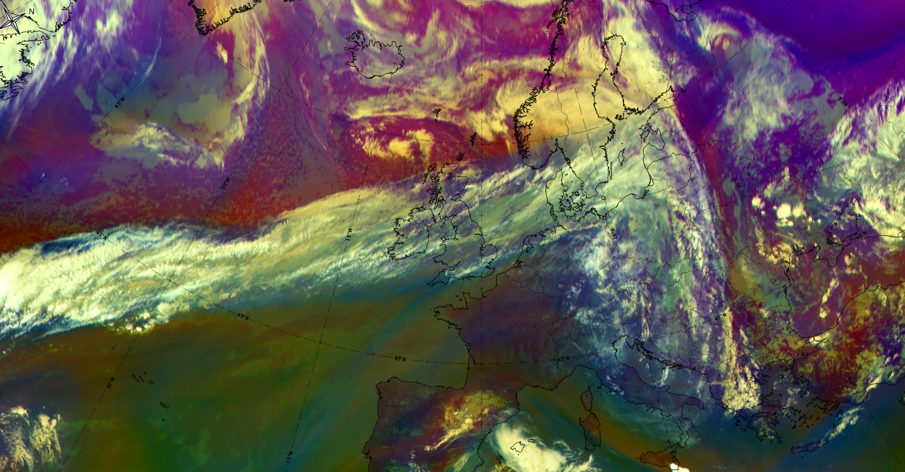
Frontal- and sub frontal Structures
Ab Maas

Slide 2
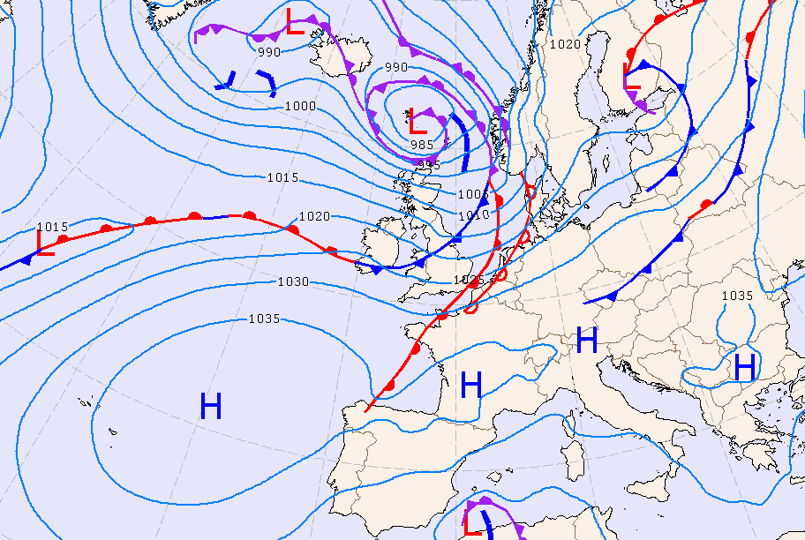
FRONTS
Bergen school:
3 main types: Warm Front, Cold Front and Occlusion
Sub types: Split Cold Front,
Upper Warm Front
WF
OCCL
OCCL
CF
WF
CF
WF

Slide 3
COLD FRONT
Arctic Cold Front
Cold Front
Cold Front in Cold Advection
Cold Front in Warm Advection
Split Front
WARM FRONT
Detached Warm Front
Warm Front Band
Warm Front Shield
OCCLUSION
Back-Bent Occlusion
Cold Air Development
Instant Occlusion
Occlusion: Cold Conveyor Belt Type
Occlusion: Warm Conveyor Belt Type
In SatManu:
13 types of Fronts
Ana
Kata
Veronika Zwatz-Meise

Slide 4
The most common frontal sub-structures:
*Front Decay
*Front Intensification by Jet Crossing
*Rapid Cyclogenesis
*Secondary Low Centers in Occlusions Cloud Bands
*Upper Wave
*Wave
Veronika Zwatz-Meise

Slide 5
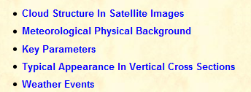
Five chapters

Slide 6
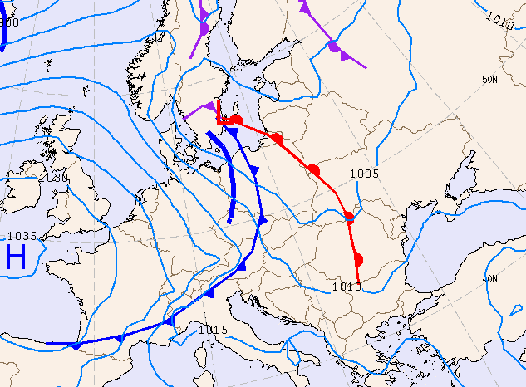
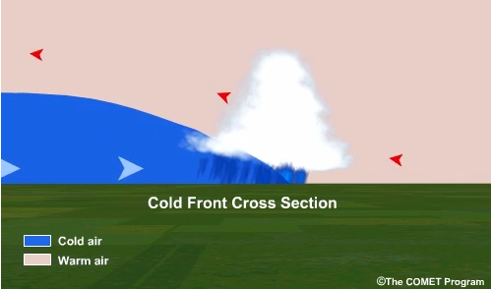
Cold Front
6 types
Arctic Cold Front
Ana Cold Front
Kata Cold Front
Cold Front in Cold Advection
Cold Front in Warm Advection
Split Front

Slide 7
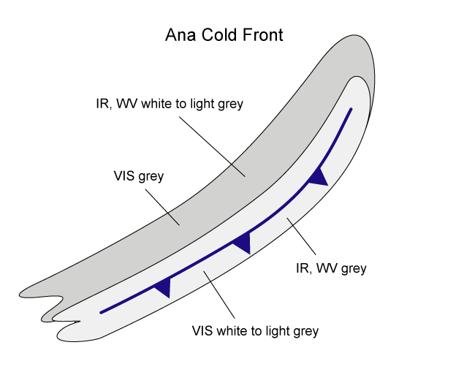
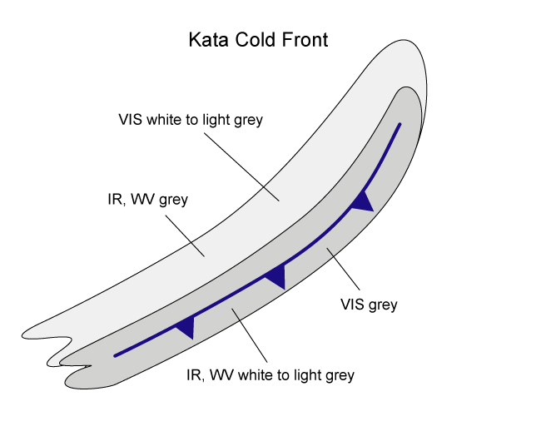
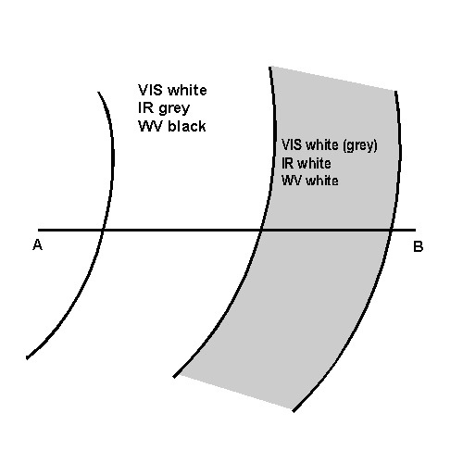
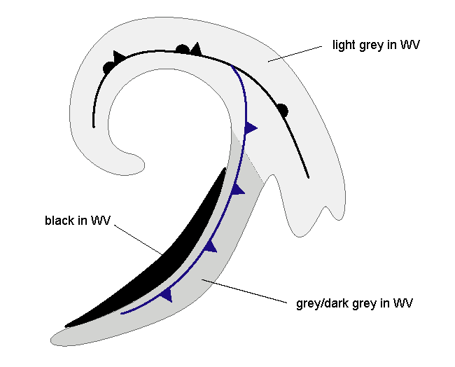
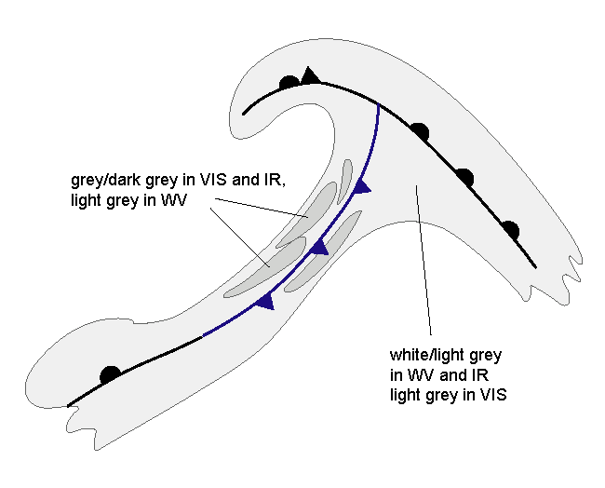
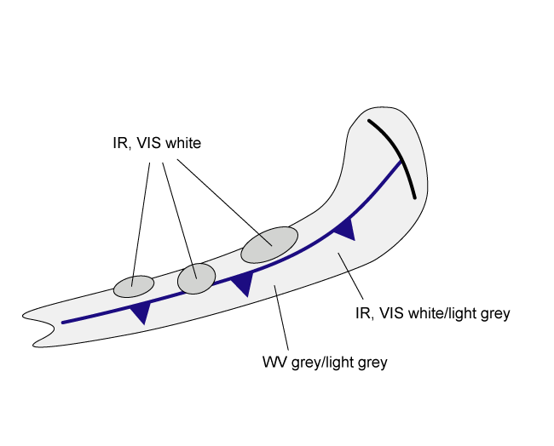
Cold Front: Cloud Structure In Satellite Images
Split Front
CF in CA
CF in WA
Arctic CF
IR
White to light grey
in VIS
IR
White to light grey
in VIS

Slide 8
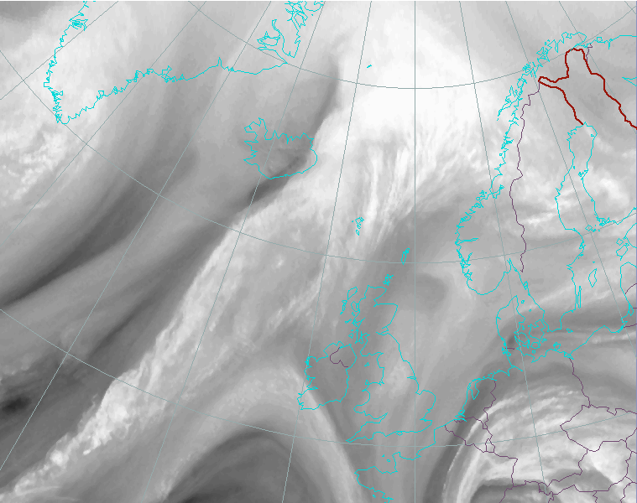
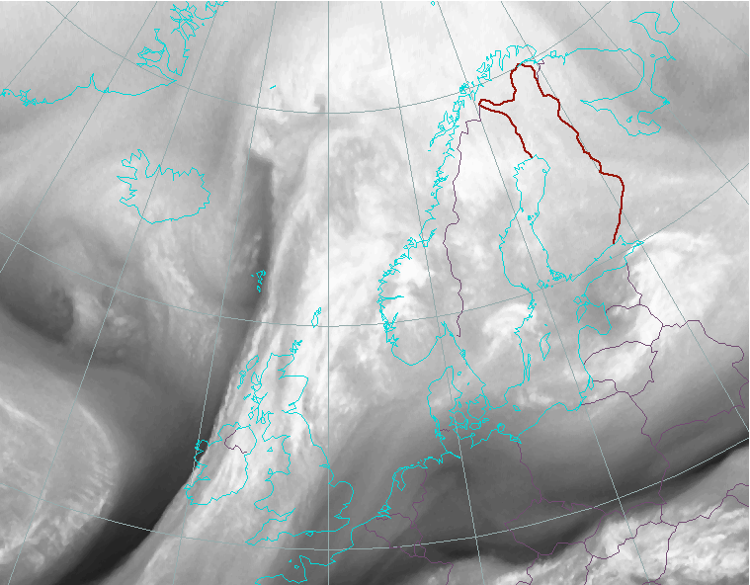
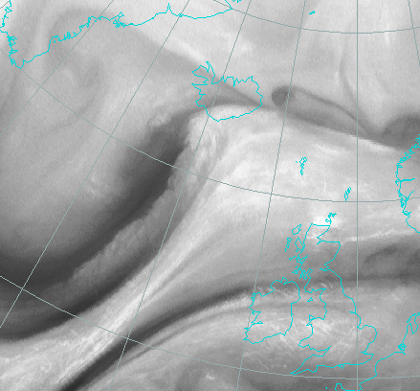
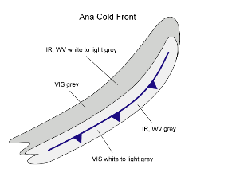


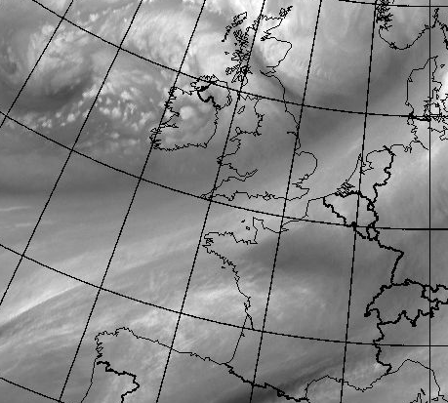
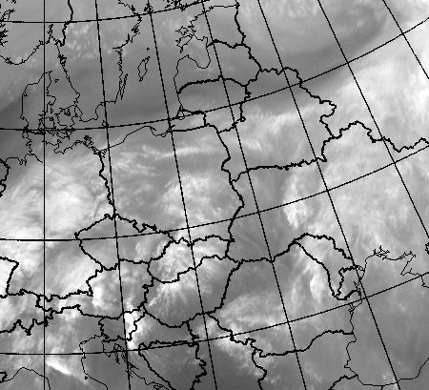
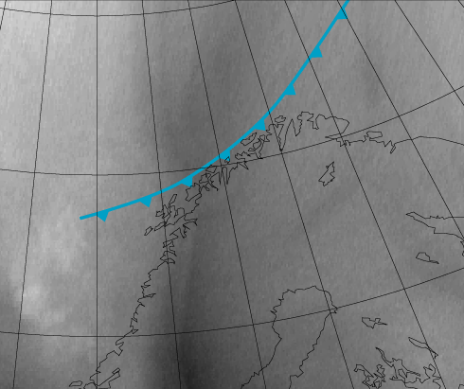

Cold Front: Cloud Structure In Satellite Images (WV)
Ana CF
Kata CF
Split CF
CF in CA
CF in WA
Arctic CF

Slide 9
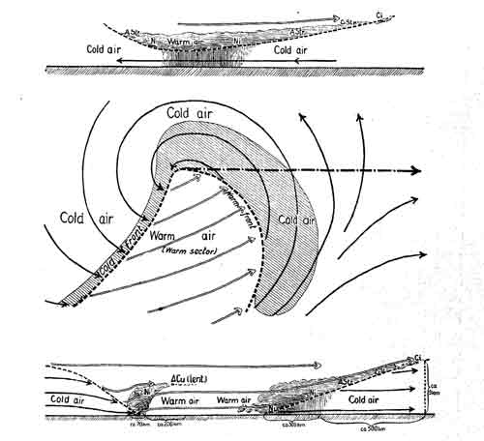
Physical background
Frontal system according to Bjerknes
Cold Front

Slide 10
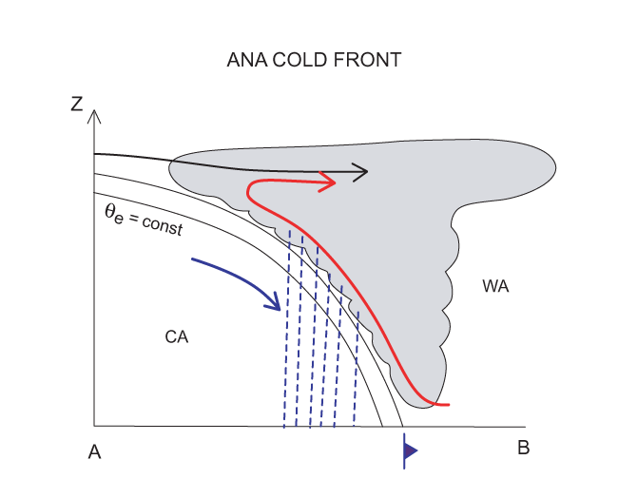
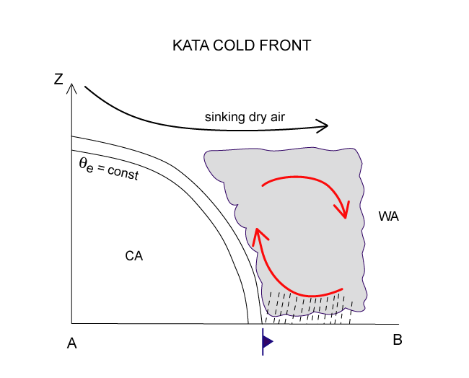
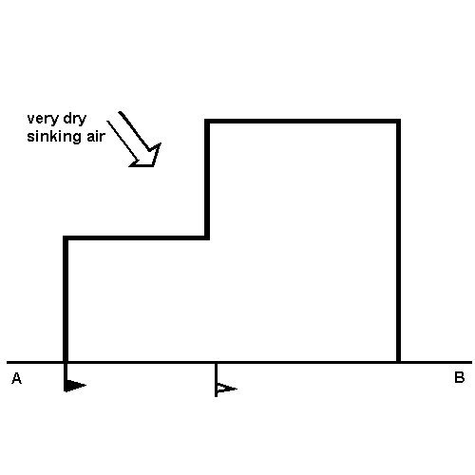
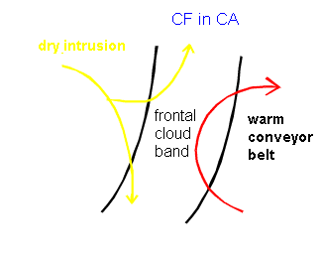
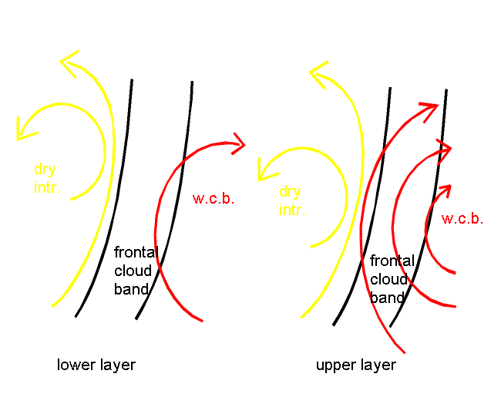
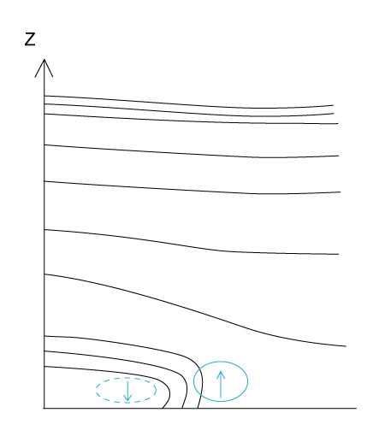
Cold Front: Meteorological Physical Background
Split Cold Front
CF in WA
Arctic CF

Slide 11
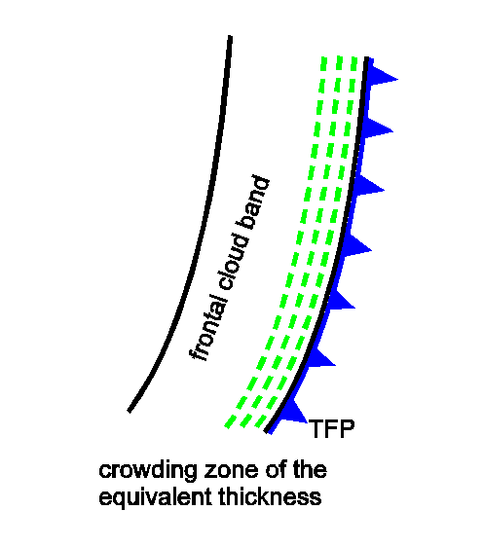
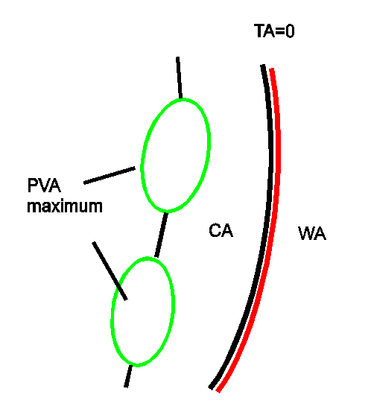
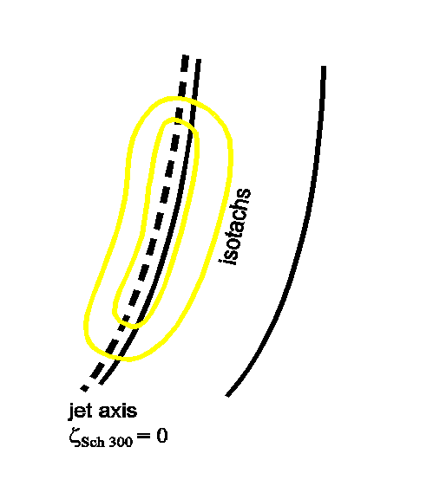
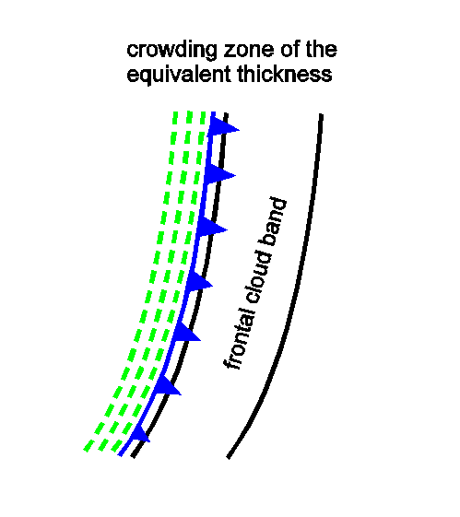
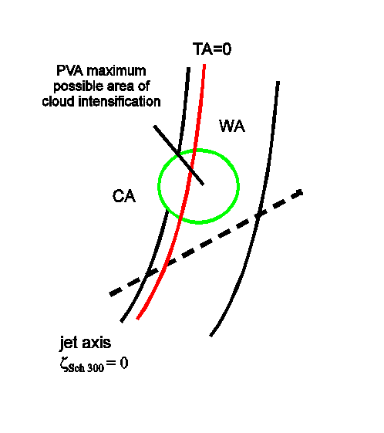
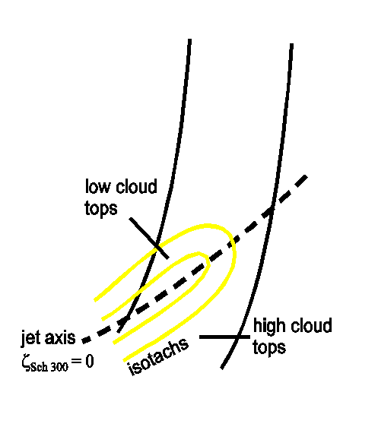
Cold Front: Key Parameters
Ana Front
Kata Front

Slide 12
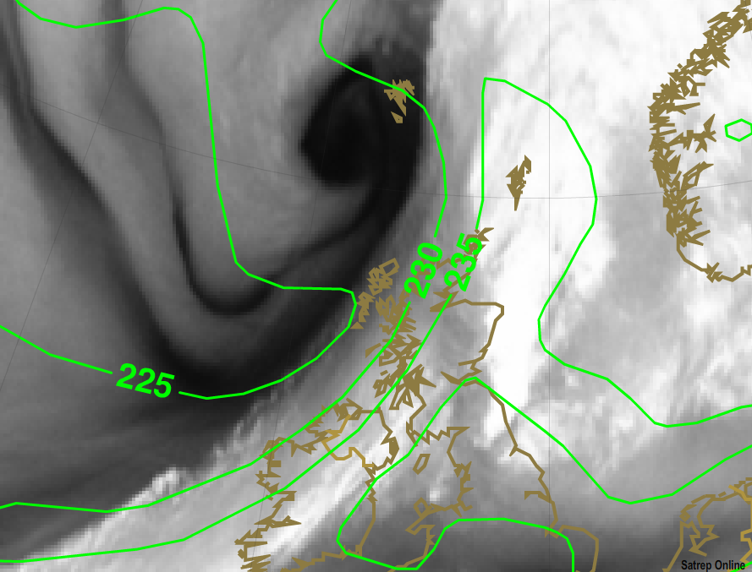
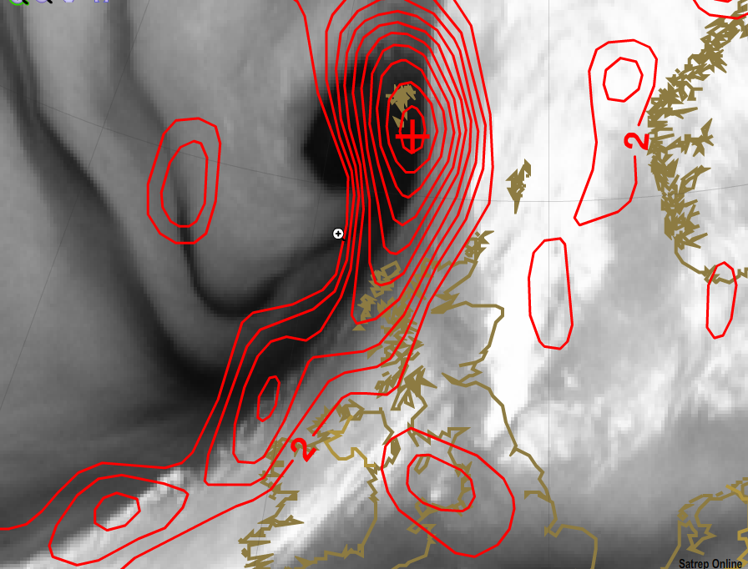
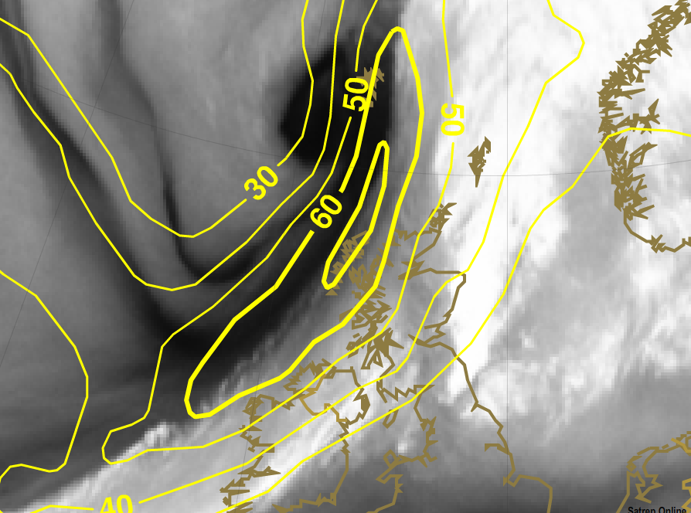
Ana Cold Front
Important Key parameters
Equivalent
thickness
PVA
300hPa
Isotachs
300hPa

Slide 13
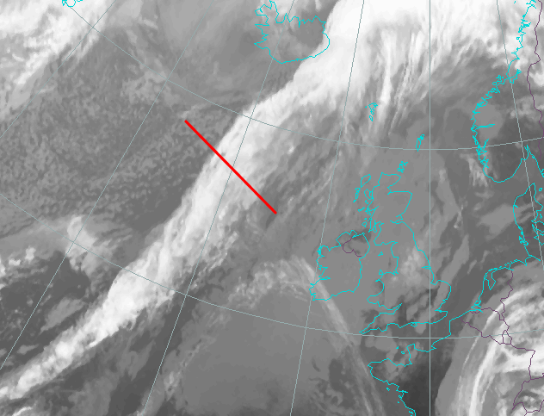
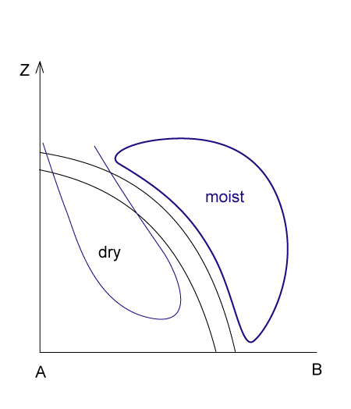
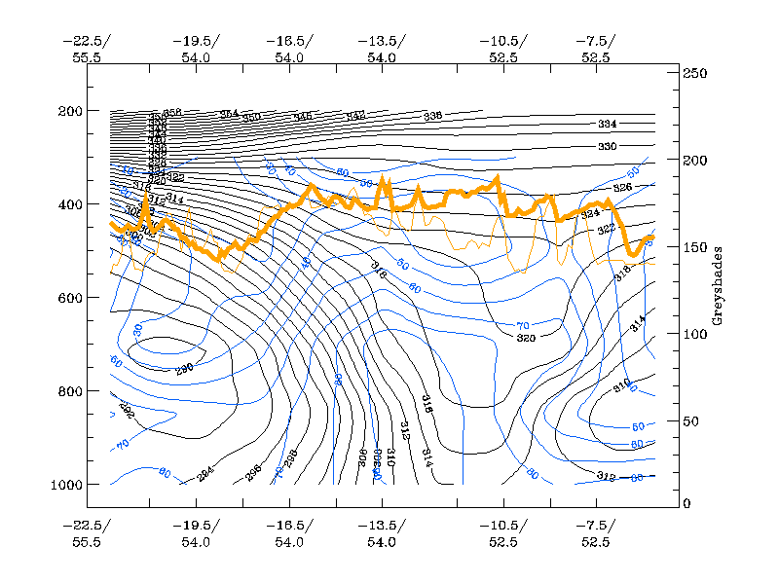
Ana front
dry
moist

Slide 14
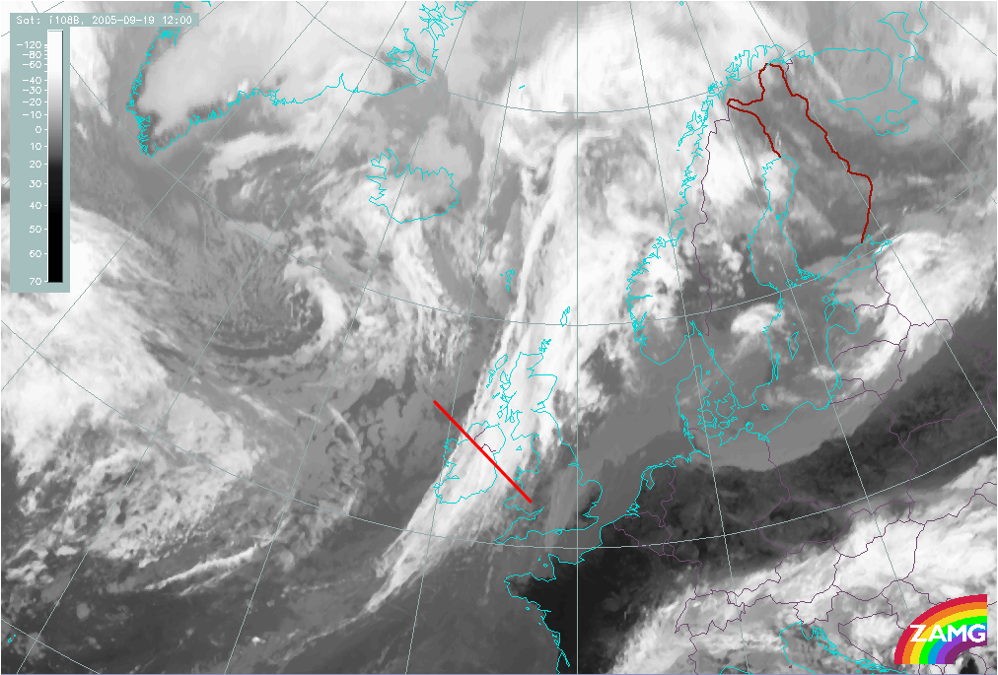
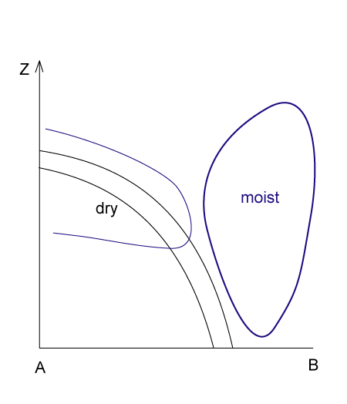
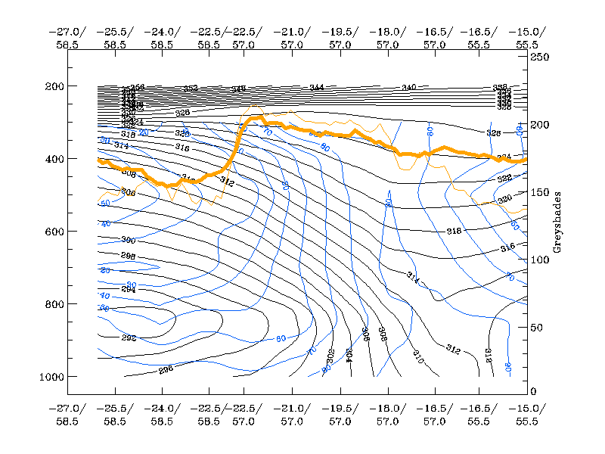
Kata front
Moist
Dry

Slide 15
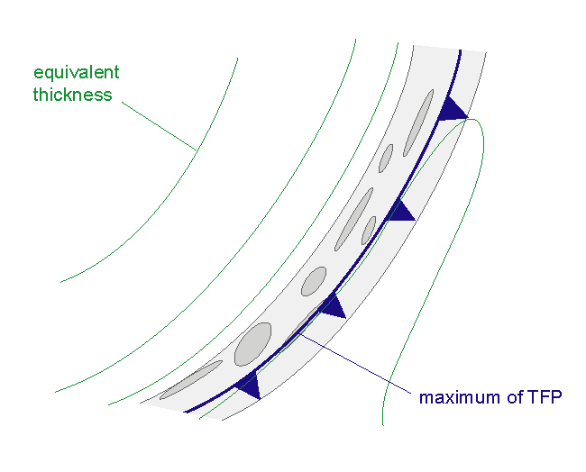
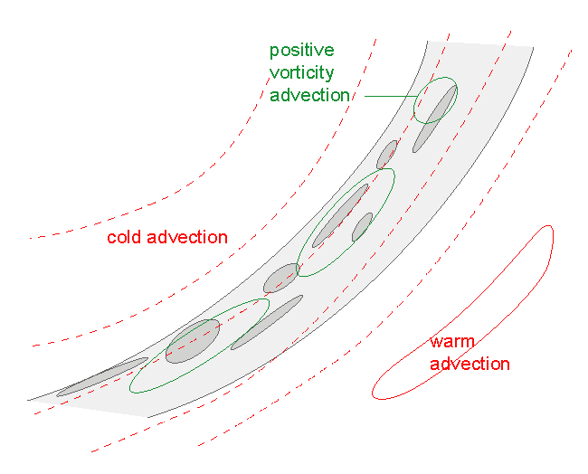
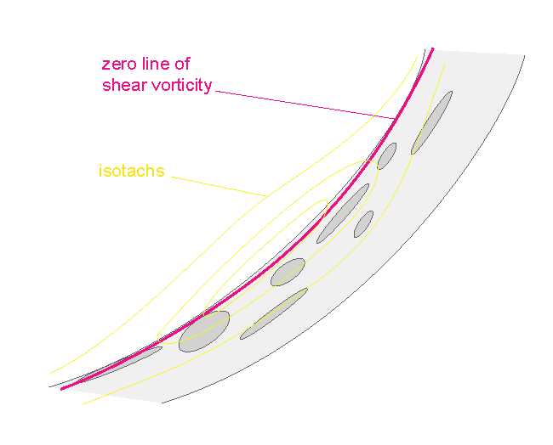
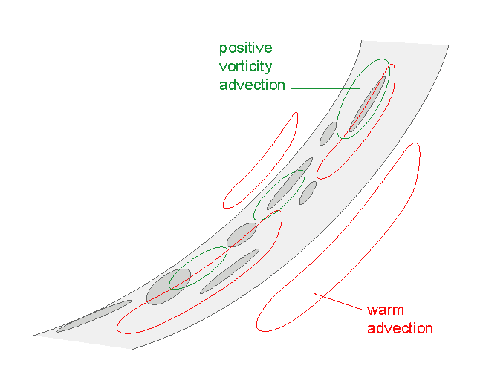
Cold Front: Key Parameters
CF in CA
CF in WA

Slide 16
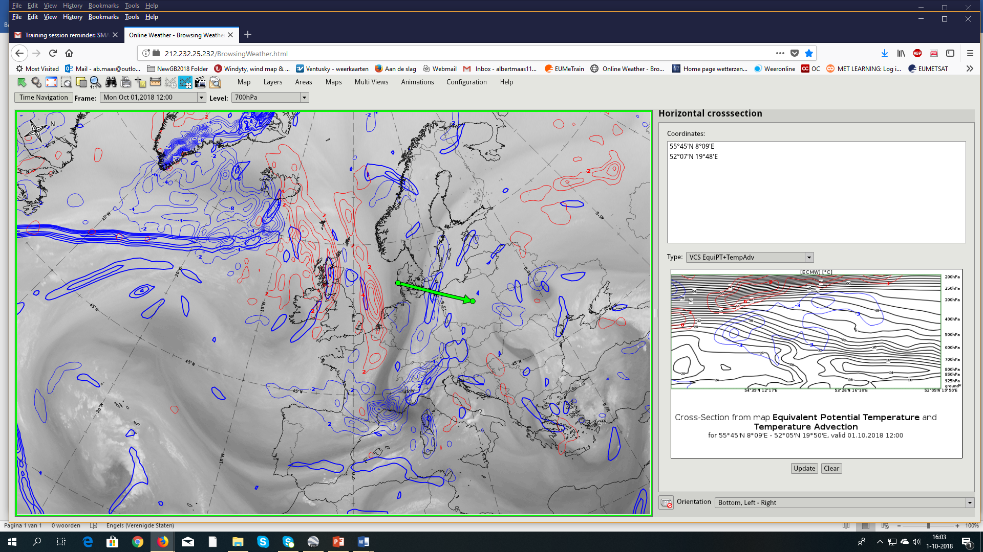
CF in CA
Temperature advection 700hPa
01-10-
2018
12utc

Slide 17
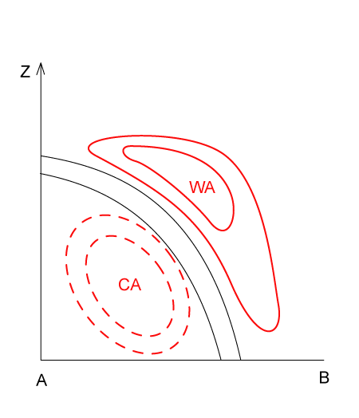
Vertical Cross Section
CF and CA
WA
CA

Slide 18
Vertical Cross Section
CF and WA

Slide 19
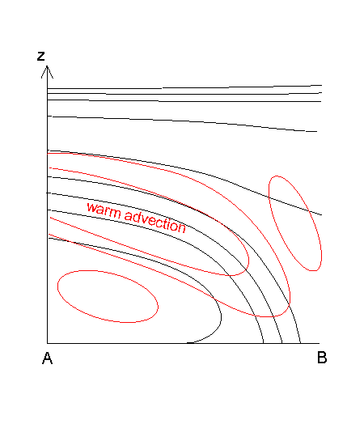
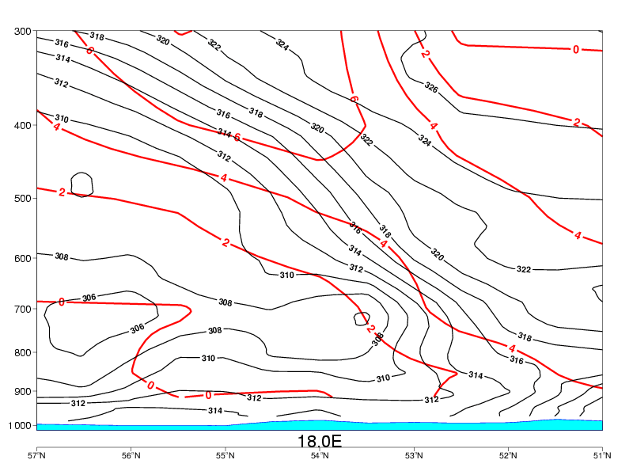
Vertical Cross Section
TA CF in WA
WA
CA

Slide 20
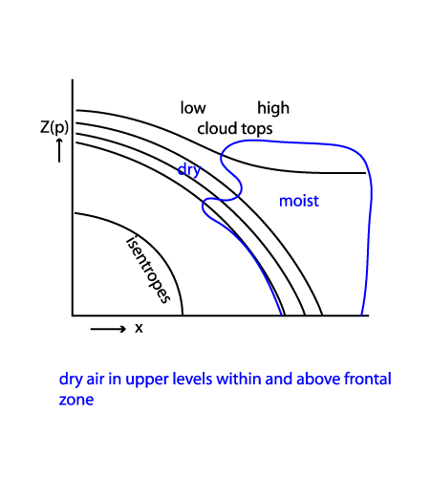
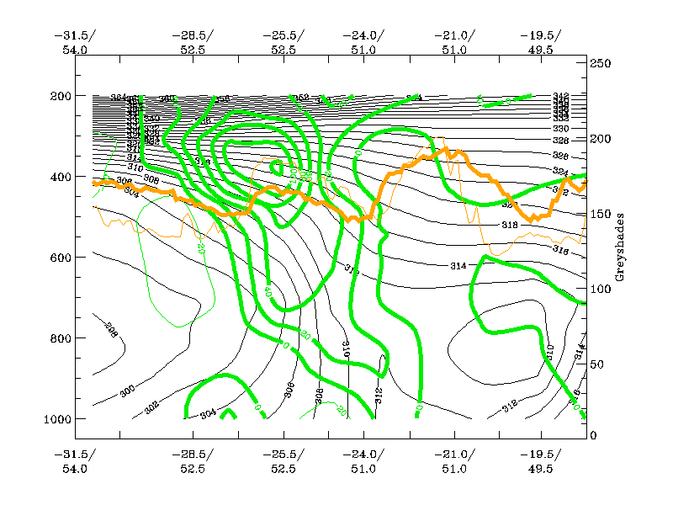
Vertical Cross Section
Moist distribution Split Front

Slide 21


Vertical Cross Section
TA in Artic Front
CA

Slide 22






Cold Fronts: Weather Events

Slide 23

Ana
Kata
3 types of WF’s

Slide 24

WARM FRONTS:
WARM FRONT BAND
WARM FRONT SHIELD
DETACHED WARM FRONT

Slide 25



WF Band
Warm Fronts:
Cloud Structures in
Satellite Images
WF Shield
Detached WF
WV White
WV Grey
WV White

Slide 26



Warm Fronts:
Cloud Structures in
Satellite Images (WV)
Detached WF
WF Band
WF Shield

Slide 27

Warm Front Shield

Slide 28
Physical background
Frontal system according to Bjerknes
Warm Front

Slide 29




Warm Fronts: Meteorological Physical Background
Warm Front
Warm Fronts: Conveyor Belts
WF SHIELD

Slide 30
Warm Fronts: Meteorological Physical Background
Conveyor Belts
Warm Front Band

Slide 31

Warm Fronts: Meteorological Physical Background
Conveyor Belts
Warm Front Shield
Often 2 WCB’s

Slide 32

Warm Fronts: Meteorological Physical Background
Conveyor Belts/Relative Streams
Detached Warm Front

Slide 33






Warm Fronts: Key Parameters
WF Band WF Shield Detached WF
TA TA TA
Isotachs Isotachs Isotachs

Slide 34

WF Shield
TA and Isotachs

Slide 35



Warm Front: Weather events

Slide 36



Weather Events in a WF Shield

Slide 37

Frontal substructures
Why are they important?
*They often show new developments within fronts which might (or
might not) lead to structural changes of frontal systems and its weather phenomena.
*They are often the first signs for ongoing physical processes within the fronts even before they are reflected in model fields.
*It is important to check the satellite images in the perspective of such new developments

Slide 38

Front decay
Airmass RGB

Slide 39

Front decay and Isotachs
REx

Slide 40


Front decay
Cross Section

Slide 41


Waves and Upper Waves
According to the Manual on Satellite meteorology:
*Upper Waves are cloud bulges at the rear edge of Cold Front cloud bands. They are associated with upper level processes and do not develop.
*Waves are cloud bulges at the rear edge of Cold Front cloud bands, indicating the initial stage of secondary cyclogenesis.
How can we differentiate between these 2 wave types?
Upper
Wave
Wave

Slide 42
Upper Wave
Wave
Moderate rising motion - mainly at upper levels | Distinct rising motion and ageostrophic circulation within the cloud band
Narrow and pronounced trough at upper levels to the rear of the frontal cloud band | Significant surface trough or separate low; upper level trough to the rear of the frontal cloud band
Cold advection at lower levels due to domination of the relative streams from behind the Cold Front | Dominating Warm Conveyor Belt leads to maximum of temperature advection (WA) at lower levels
Dominating upper relative stream; rising over Wave bulge, sinking behind | Dominating rising Warm Conveyor Belt over the Wave bulge at middle to upper levels
Sinking of potential vorticity indicates tropopause folding, no PV >=1 units at middle and low levels of the troposphere | Sinking of potential vorticity indicates tropopause folding, leading to PV > 1 units at middle and low levels causing stronger circulation at lower and middle levels.

Slide 43




Waves and PVA 300hPa
Waves and TA 700 hPa
CA
max

Slide 44




LE
Jet axis
RE
PV Max
Isotachs 300hPa

Slide 45


Cross Section
PV
TA

Slide 46


22-01-2018 00utc
12 hrs later
21-01-2018 18utc
6 hrs later

Slide 47

Omega and Weather
22-01-2018 00utc

Slide 48

⇒developement of thicker and mostly more convective clouds
Frontal intensification by jet crossing (FI)

Slide 49

Frontal intensification by jet crossing (FI)
Isotachs 300hPa, TFP, and PVA
23 – 03 – 2018 18utc

Slide 50



Cross section
Most important
Parameter
Vorticity Advection

Slide 51

Omega and Weather

Slide 52


