Slide 1
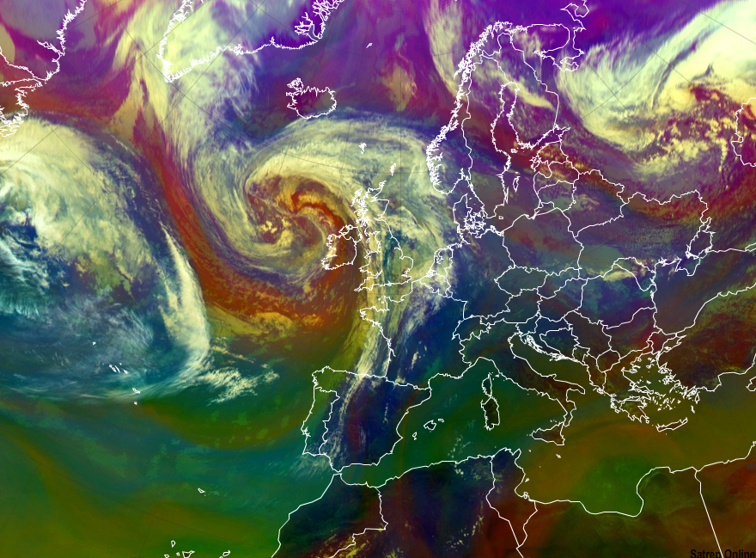
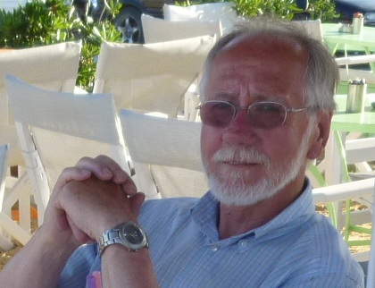

Introduction Conceptual Models
Sat(rep)Manu(al)
Ab Maas

Slide 2

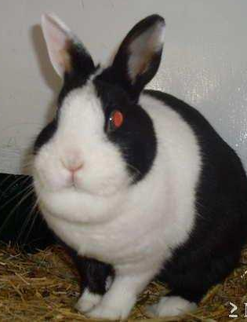
A conceptual model is a model made of the composition of concepts, which are used to help people know, understand, or simulate a subject the model represents. Some models are physical objects; for example, a toy model which may be assembled, and may be made to work like the object it represents or a simple model of a meteorological phenomenon.

Slide 3
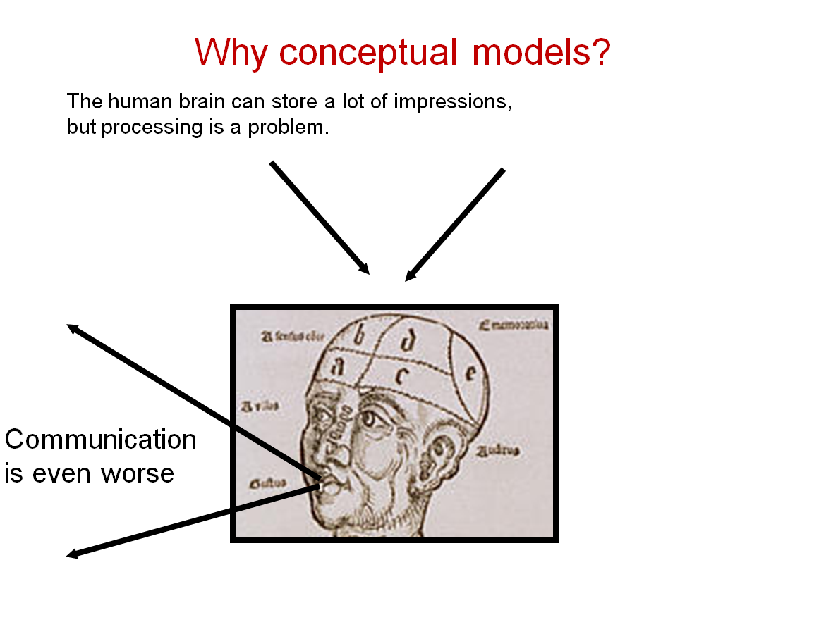

Slide 4
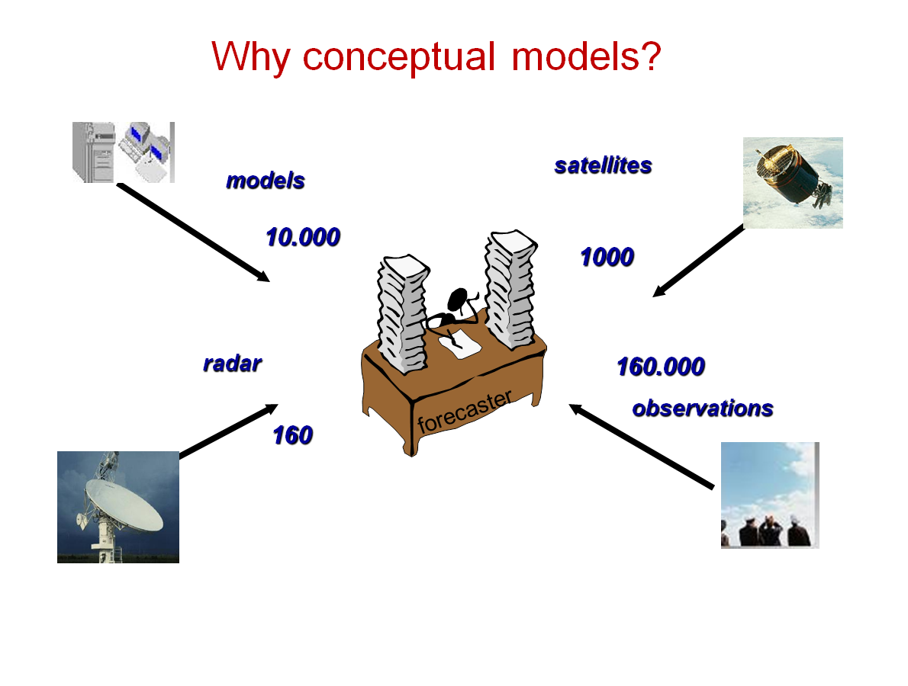
Why CM’s in forecasting??

Slide 5
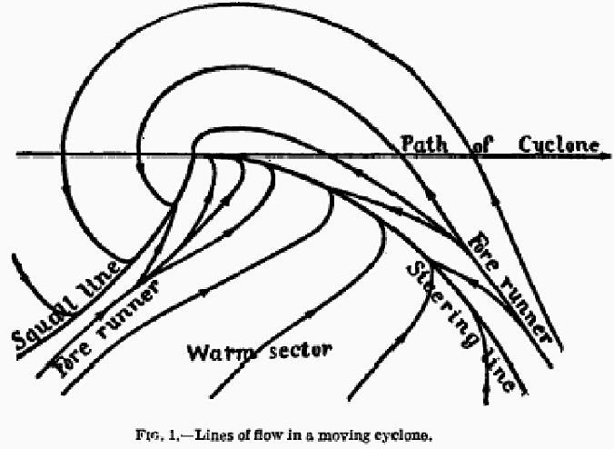
CM of a cyclone with fronts.
Bjerknes 1918
CM’s are not new

Slide 6
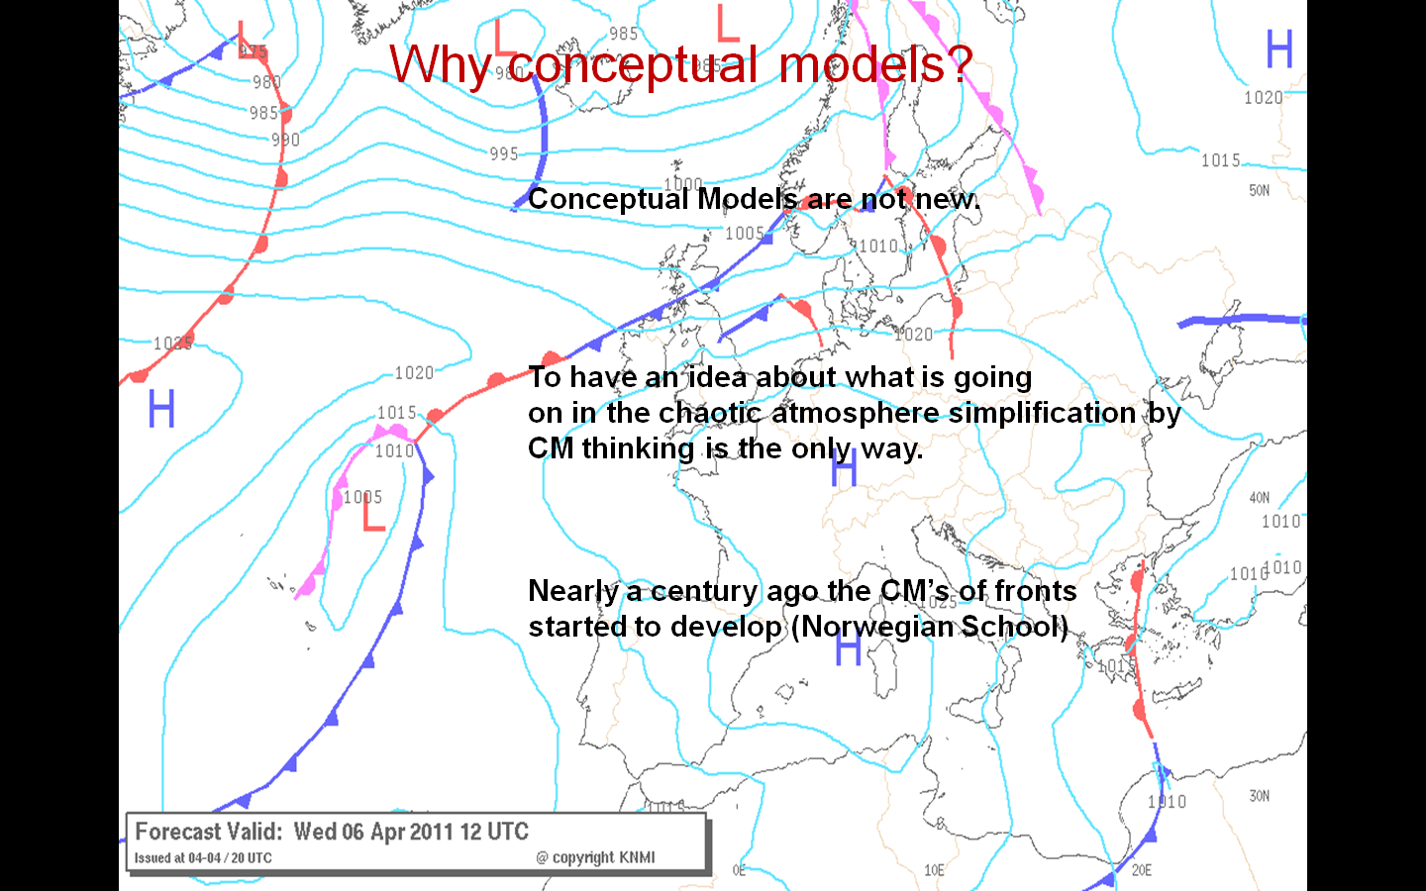

Slide 7


Slide 8
Conceptual models are abstractions of weather phenomena used for teaching and research.
Give scientists and forecasters a common language
Synthesize lots of data and analysis into a visual schematic.
Distill important processes and structures
Omit unimportant details and variability among individual cases
Prof. David Schulz

Slide 9
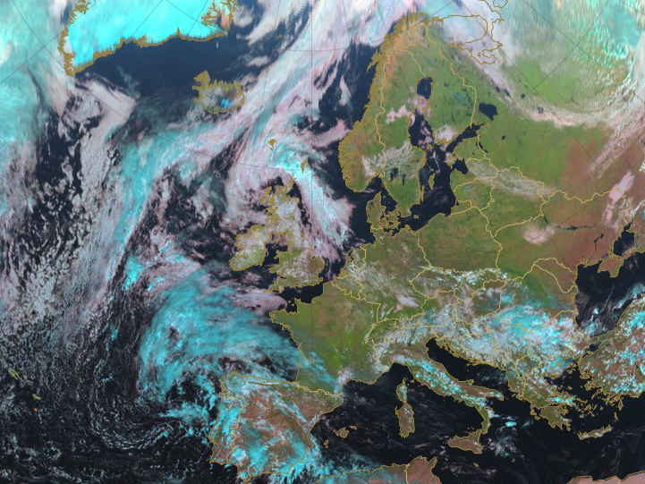
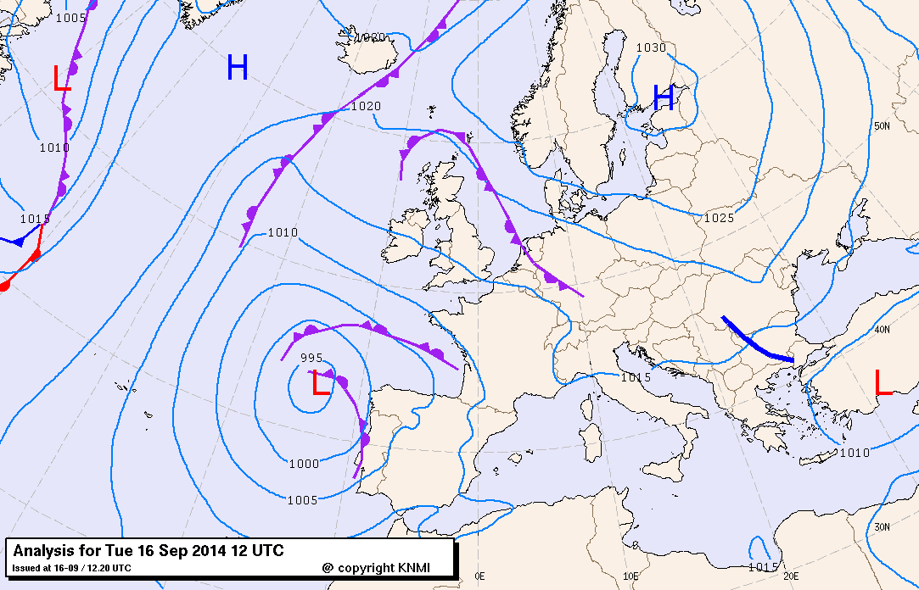
Satellites showed that there is
much more than fronts alone

Slide 10
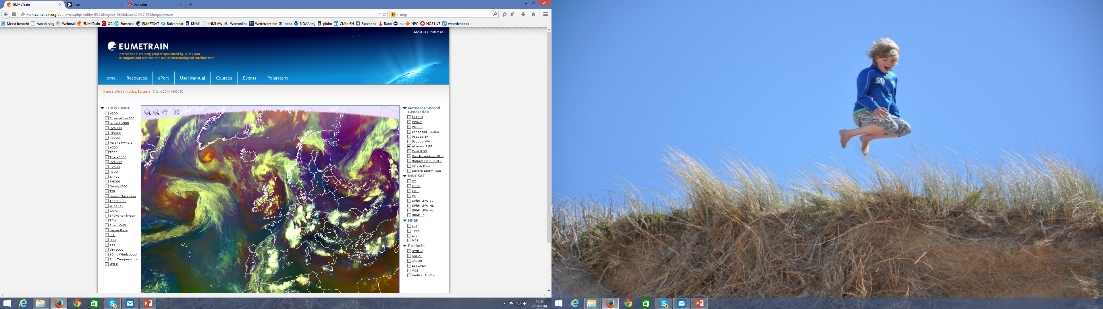
Much More!!

Slide 11
What’s This??

Slide 12
What’s this??
And this??

Slide 13
What’s this??
And this??
And this??
Frequently looking at Sat. Images makes you skilled
in pattern and shape recognizing

Slide 14
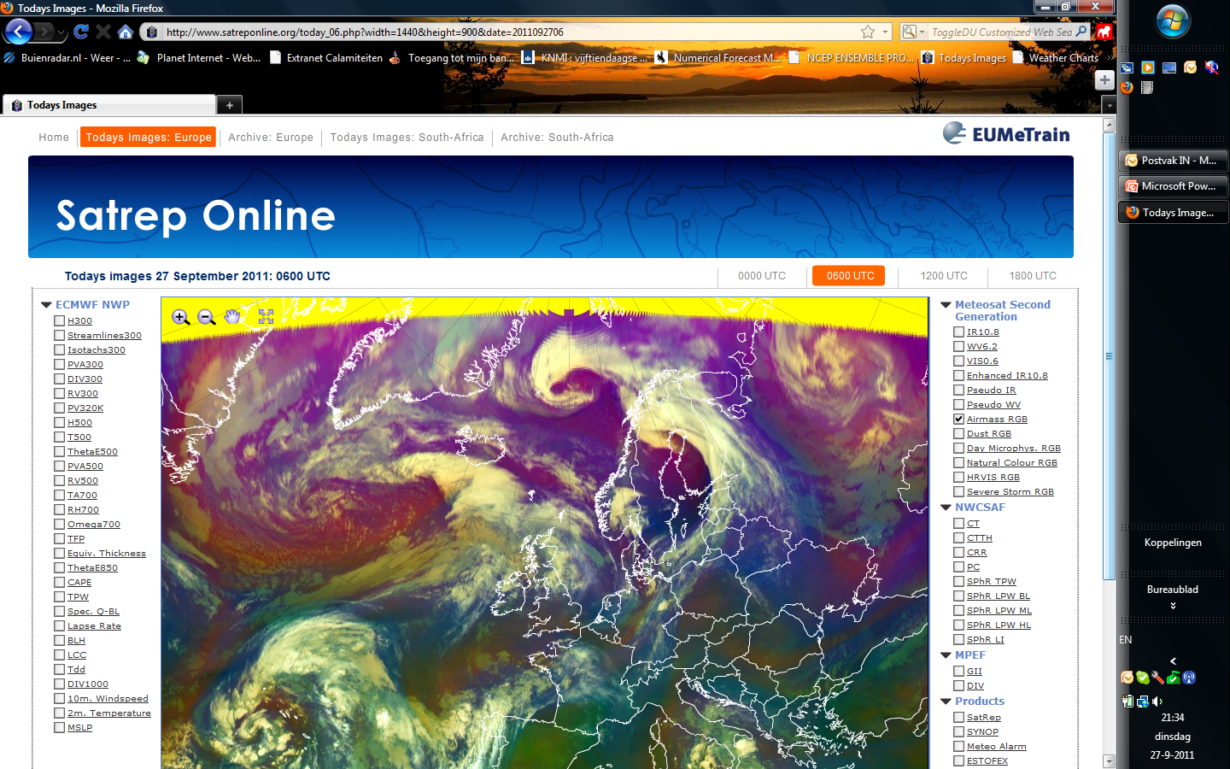
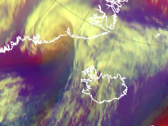
Similarities in shape and patterns in
Cloud configurations give the first ideas
of certain Conceptual Model

Slide 15
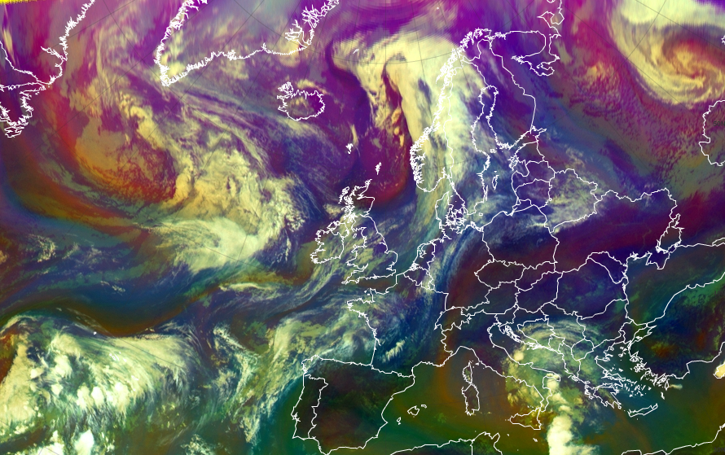
Using Satellite Images as a basis for analyzing CM’s
Combine Sat. info with NWP data and observations
Dr. Veronika Zwatz-Meise

Slide 16
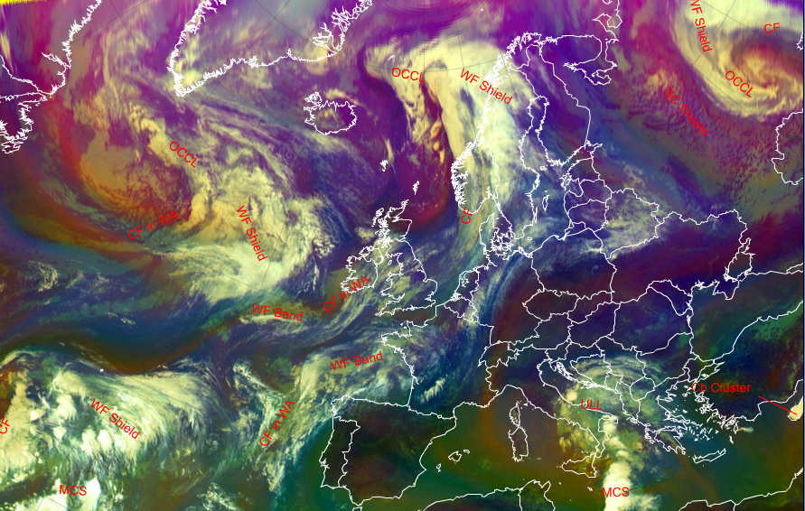
First guess of CM’s from Sat. Image alone

Slide 17
First guess of CM’s from Sat. Image alone
Occlusion
Cold Front
Warm Front
Upper level Low
Mesoscale
Convective
System

Slide 18
How to analyze a
Conceptual Model?
First!
Cloud feature
Here frontal system

Slide 19
Occlusion
Warm Front
Knowledge of the
Physical background
(Here CF, WF and
Occlusion)
Cold Front

Slide 20
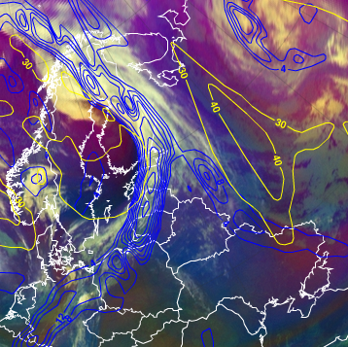
Isotachs
Cloud feature in
combination with relevant model parameters(Thermal Front Parameter (TFP) and Isotachs 300 hPa)
Checking first guess
TFP

Slide 21
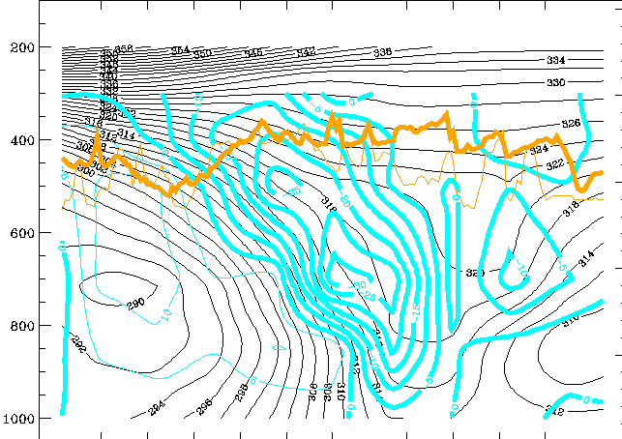
Cross Section
(potential temperature and vertical velocity (ω))

Slide 22
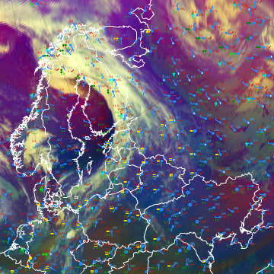
Cloud feature
in combination
with observations
Weather events

Slide 23
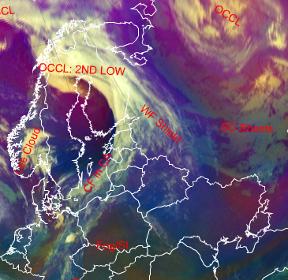
Conceptual
Models
After investigation
Confirmation
Achieving a 3D –
or even 4D-mental
weather picture.

Slide 24
Construction of a Conceptual Model in SatManu
I. Appearance in Satellite Data
Learn about how to recognise and detect.
II. Meteorological Physical Background
Find out more about the meteorlogical and physical background.
III. Key Parameters
Learn which key parameters to use for monitoring.
IV. Typical Appearance In Vertical Cross Sections
Find out the typical appearance in vertical cross sections.
V. Weather Events
Explore the weather events.
VI. References

Slide 25
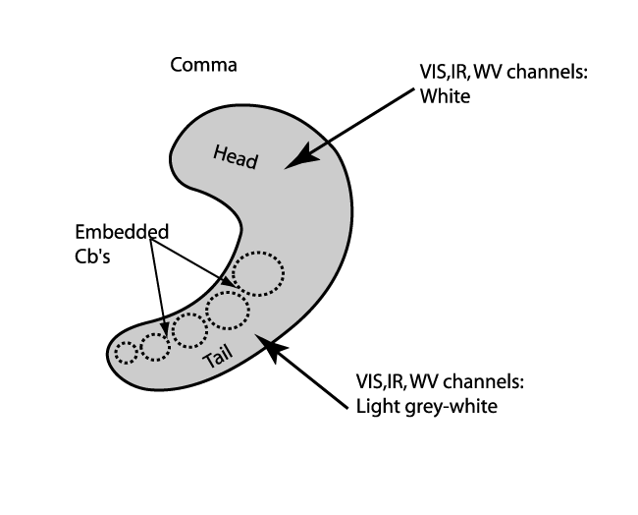
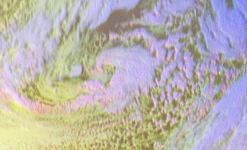
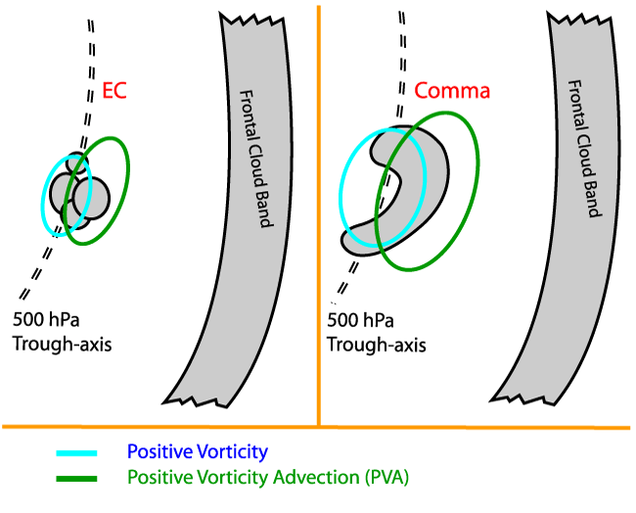
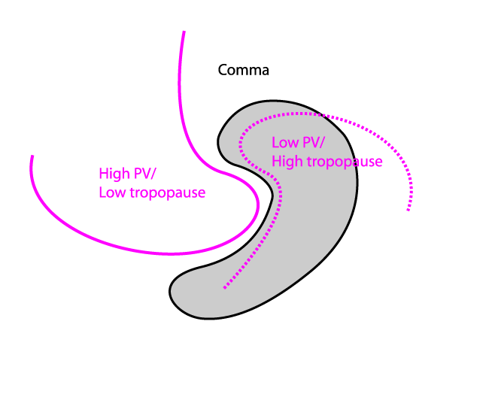
Construction of a Conceptual Model in SatManu
Cloud Structure in Satellite Image
Physical Background

Slide 26
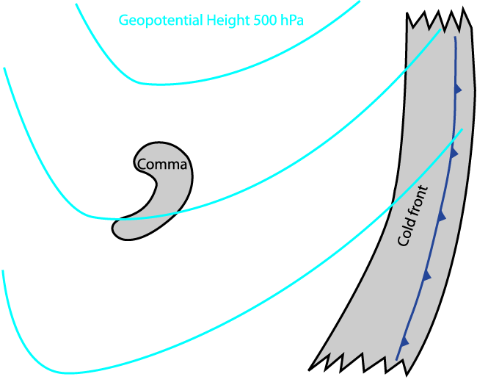
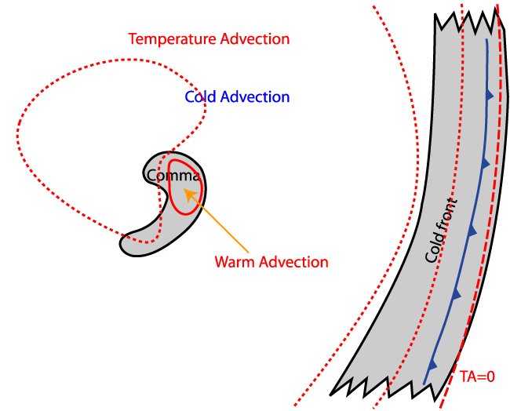
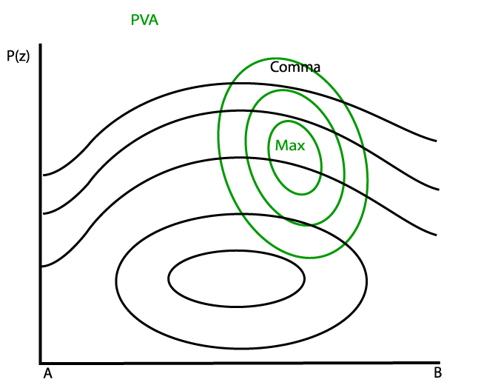
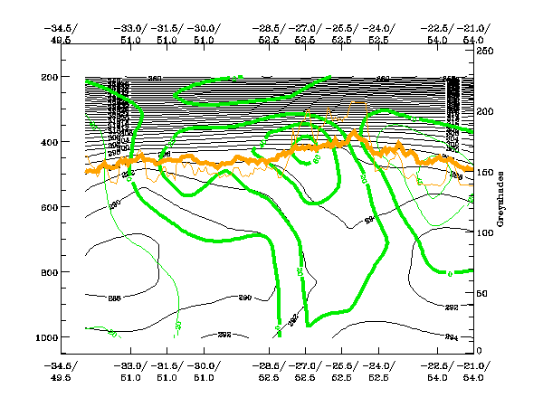
Construction of a Conceptual Model in SatManu
Key Parameters
Cross Sections

Slide 27
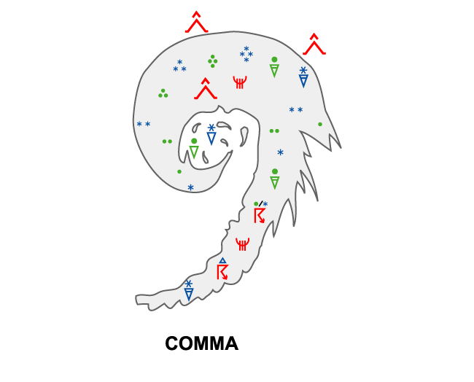
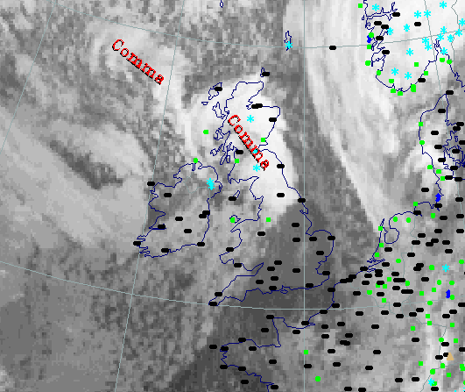
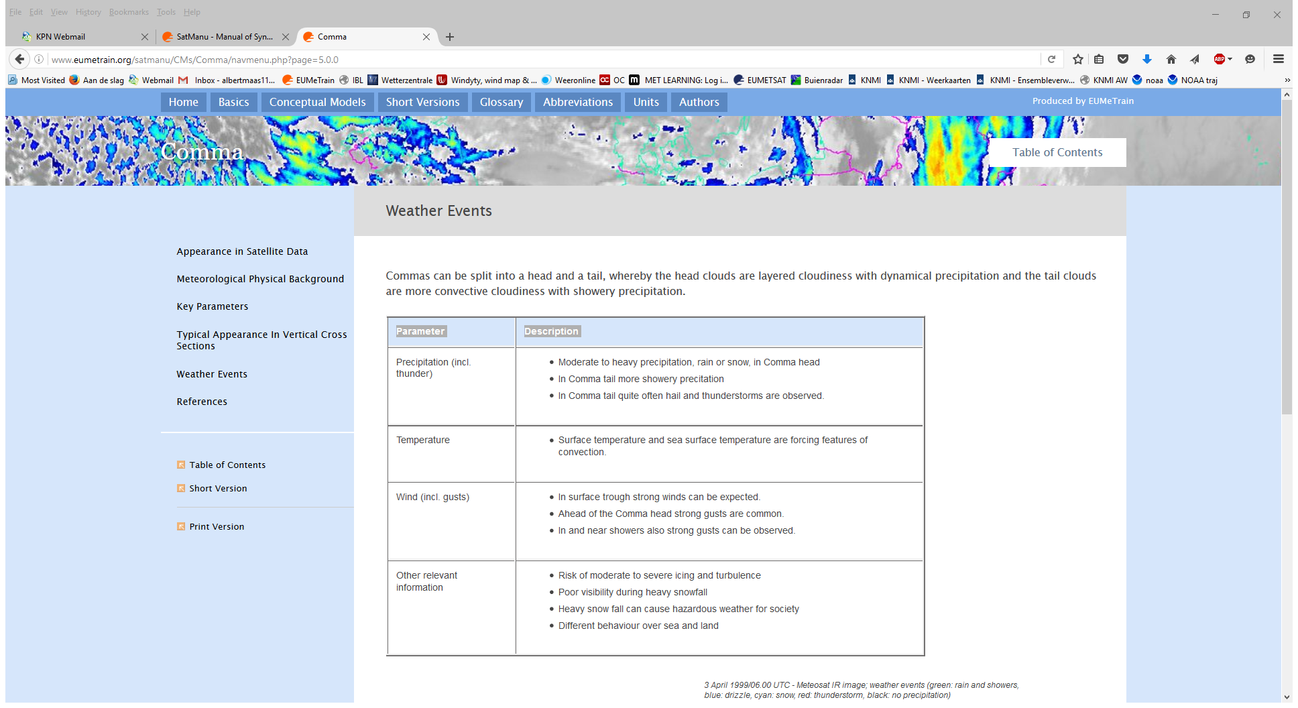
Construction of a Conceptual Model in SatManu
Weather Events

Slide 28
References
General Meteorology and Basics
FORBES, LOTTES (1985): Classification of Mesoscale Vortices in Polar Airstreams and the Influence of the Large-scale Environment on their Evolutions, Tellus, 37A, 132 - 155
RASMUSSEN (1979): The Polar Low as an Extratropical CISK Disturbance, Quart. J. Royal Meteor. Soc., 105, 531-549
REED (1979): Cyclogenesis in Polar Air Streams, Monthly Weather Review, 107, 38-52
TURNER, LACHLAN-COPE, THOMAS (1993): A Comparison of Arctic and Antarctic Mesoscale Vortices, J. Geophysical Research, 98, D7, 13019-13034
General Satellite Meteorology
CARLETON, CARPENTER (1989): Satellite climatology of Polar Lows and Broadscale Climatic Associations for the Southern Hemisphere, Int. J. Climatology, 10 (3), 219-246
CLAUD ET AL (1993): Satellite Observations of a Polar Low over the Norwegian Sea by Special Sensor Microwave Imager, Geosat, and TIOS-N Operational Vertical Sounder, J. Geophysical Research, 98, C8, 14487-14506
Specific Satellite Meteorology
BROWNING (1993): Evolution of a Mesoscale Upper Tropospheric Vorticity Maximum and Comma Cloud from a Cloud-free Two-dimensional Potential Vorticity Anomaly, Quar. J. Meteor. Soc., 119, 513, 883-906
CRAIG (1992): A Study of Two Cases of Comma-Cloud Cyclogenesis Using a Semigeostrophic Model, Monthly Weather Review, 2942-2961
REED (1979): A Case study of Comma Cloud Development, Monthly Weather Review, 114, 1681-1695
REED (1979): A Further Case study of Comma Cloud Development, Monthly Weather Review, 114, 1696 -17

Slide 29
53 Conceptual models are described
COLD FRONT
Arctic Cold Front
Cold Front
Cold Front in Cold Advection
Cold Front in Warm Advection
Split Front
WARM FRONT
Detached Warm Front
Warm Front Band
Warm Front Shield
OCCLUSION
Back-Bent Occlusion
Cold Air Development
Instant Occlusion
Occlusion: Cold Conveyor Belt Type
Occlusion: Warm Conveyor Belt Type
BAROCLINIC BOUNDARY
Baroclinic Boundary
SUBSTRUCTURES IN FRONTS and INITIAL STAGES OF CYCLOGENESIS
Front Decay
Front Intensification by Jet Crossing
Rapid Cyclogenesis
Secondary Low Centres in Occlusion Cloud Bands
Upper Wave
Wave
NON-FRONTAL SYNOPTIC SCALE PHENOMENA
Deformation Band
Thickness Ridge Cloudiness
Upper Level Low
Warm Conveyor Belt
MESOSCALE PHENOMENA
Comma
Convergence Cloudiness
Enhanced Cumulus
Jet Fibres
Open Cell Convection and Closed Cell Convection
Polar Low
CONVECTIVE WEATHER FEATURES
Cumulonimbus Cluster
Cumulonimbus (Cb) and Mesoscale Convective System (MCS)
CONVECTIVE WEATHER FEATURES IN TYPICAL SYNOPTIC ENVIRONMENT
At the Leading Edge of Frontal Cloud Bands
Enhancement of Convection by PV
Fair Weather Conditions
The Warm Sector
The Warm Sector: Spanish Plume
OROGRAPHICAL WEATHER FEATURES
Barrage Cloud
Orographic Effects on Frontal Cloudiness
Lee Cloudiness
WIND RELATED PHENOMENA
Foehn
Piteraq
Bora
LOW CLOUDS
Cloud Streets
Fog and Stratus
Stratocumulus Sheets
WV
Dark Stripes
Water Vapour Vortices
SMALL SCALE CONCEPTUAL MODELS
Coastal Convergence
Convergence Lines Over Seas and Lakes
Non-orographic Convergence Lines
Orographically Induced Convergence Lines
Sea-Breeze

Slide 30
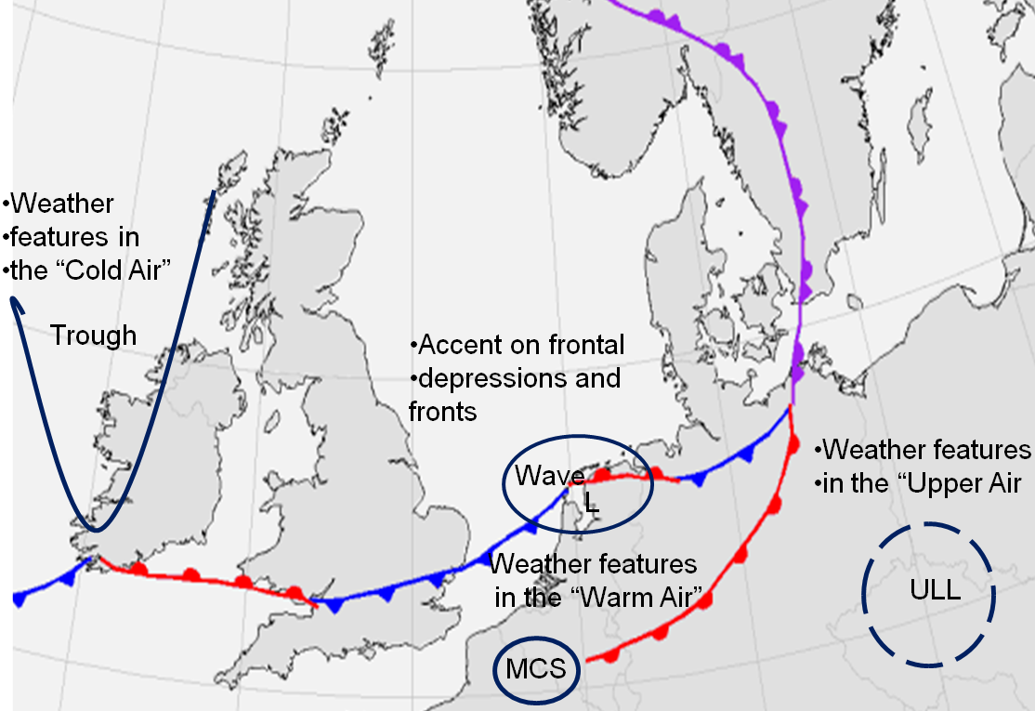
Conceptual models and air masses

Slide 31
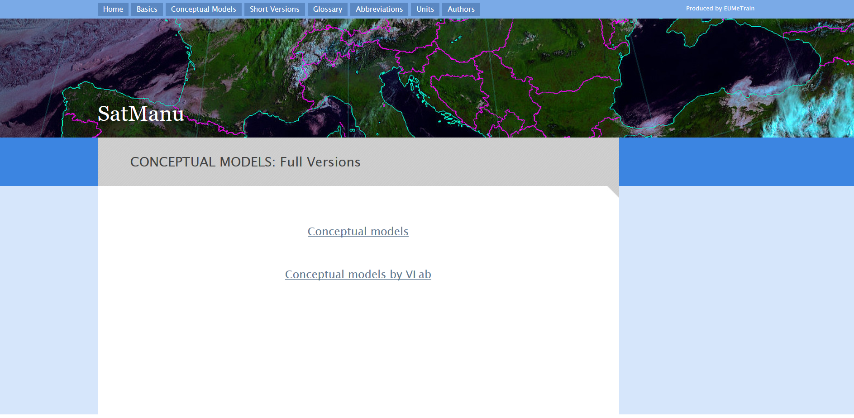
The construction of the manual

Slide 32
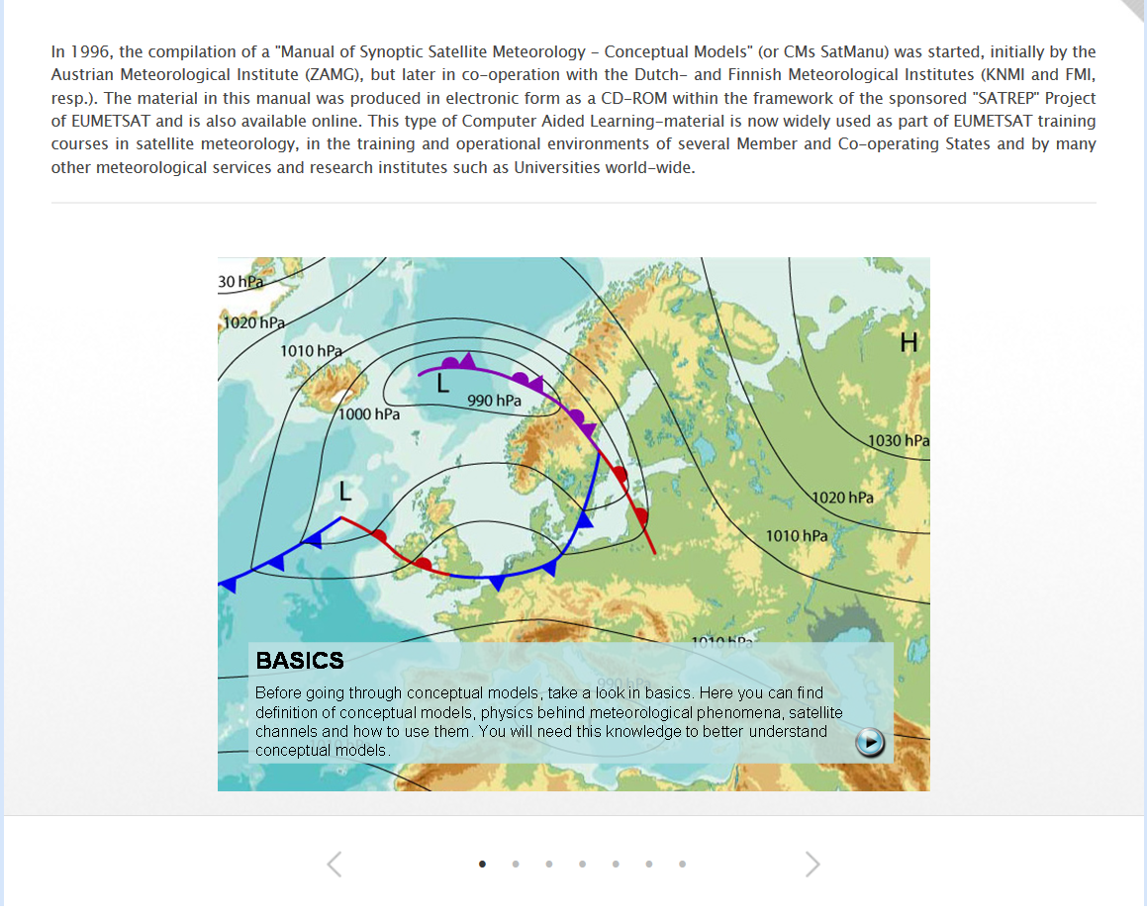
Home Page

Slide 33
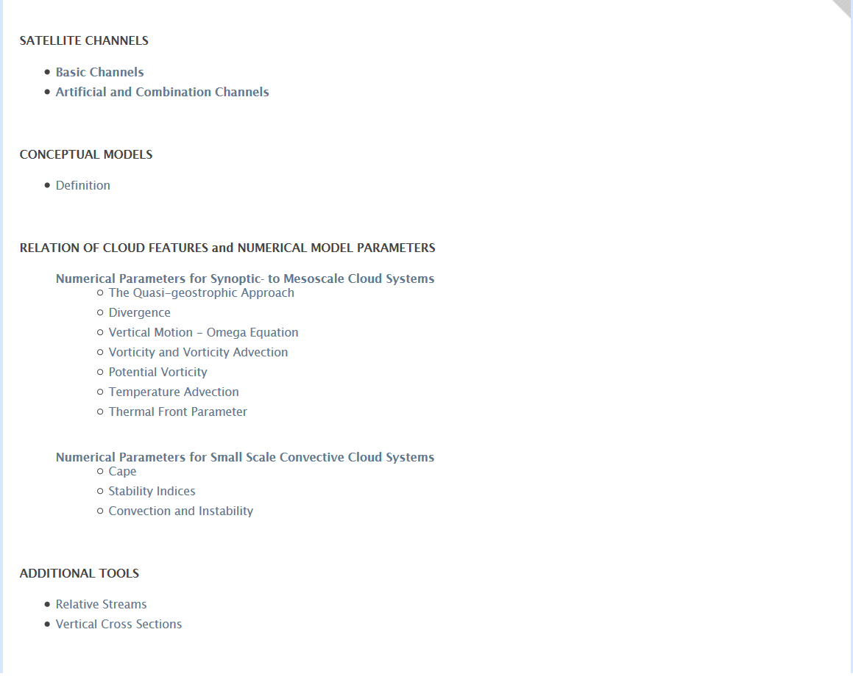
BASICS

Slide 34
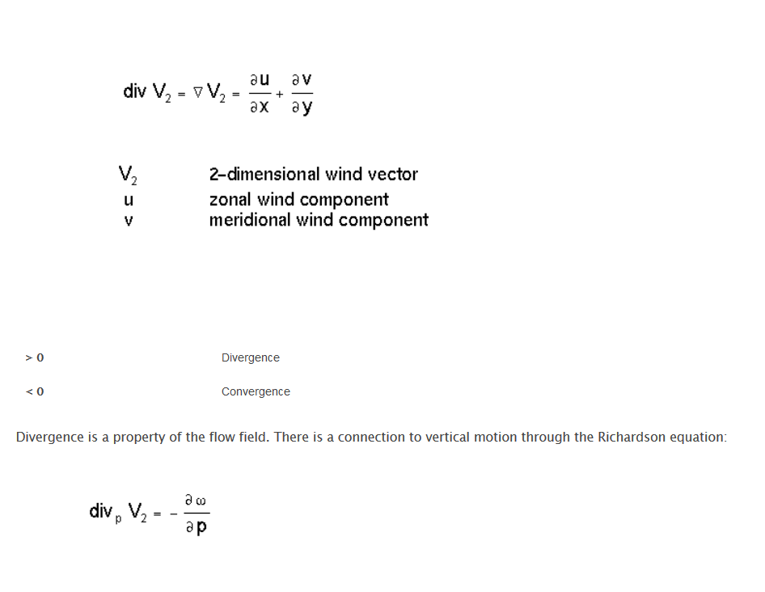
DIVERGENCE

Slide 35
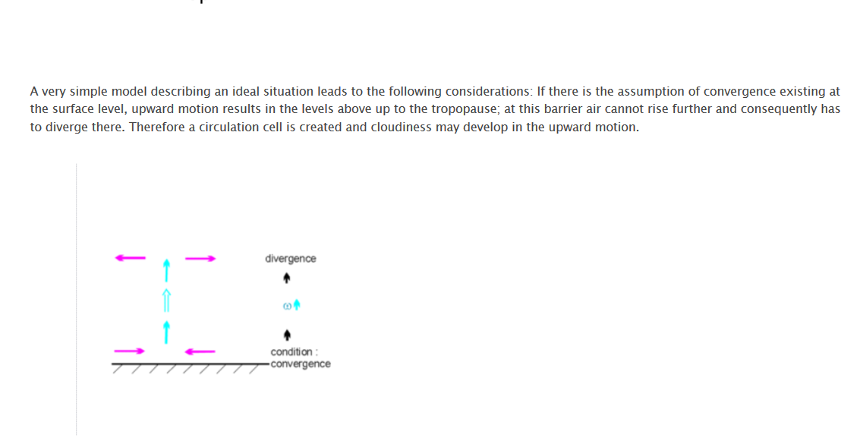
DIVERGENCE
Dynes scheme

Slide 36
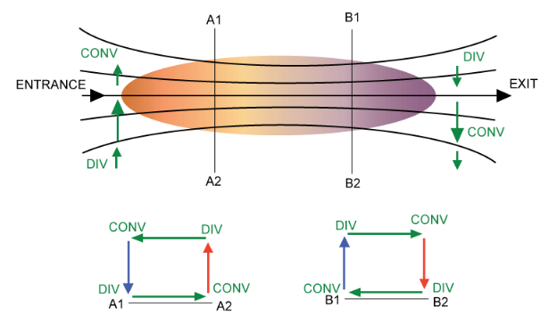
Divergence and Jetstreaks

Slide 37
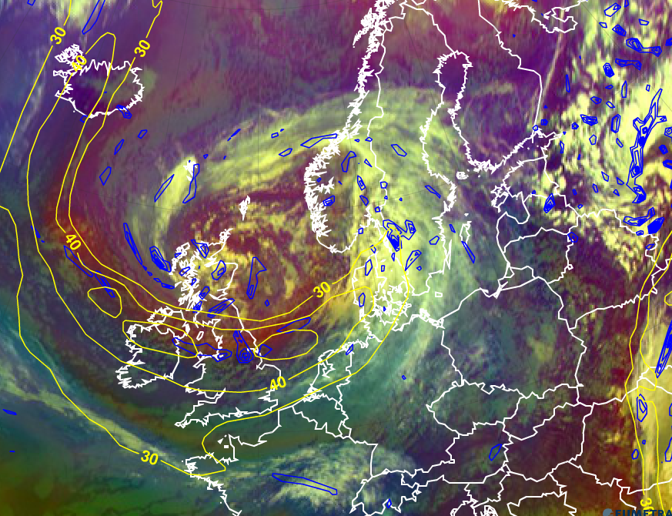
Yellow: isotachs 300hPa
Blue: Divergence 300hPa
Left
Exit
JET

Slide 38
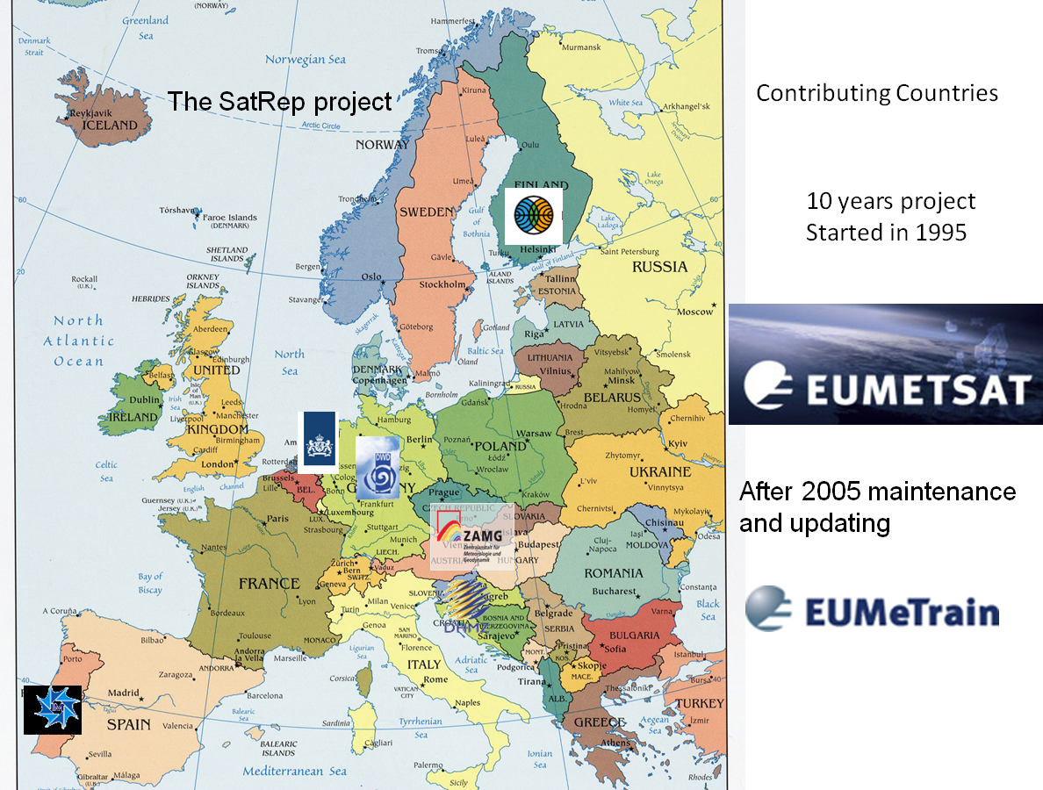

Slide 39
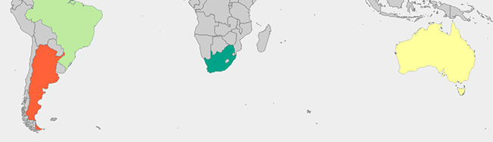
Conceptual Models for Southern Hemisphere (CM4SH)
Argentina Brazil South Africa Australia

Slide 40
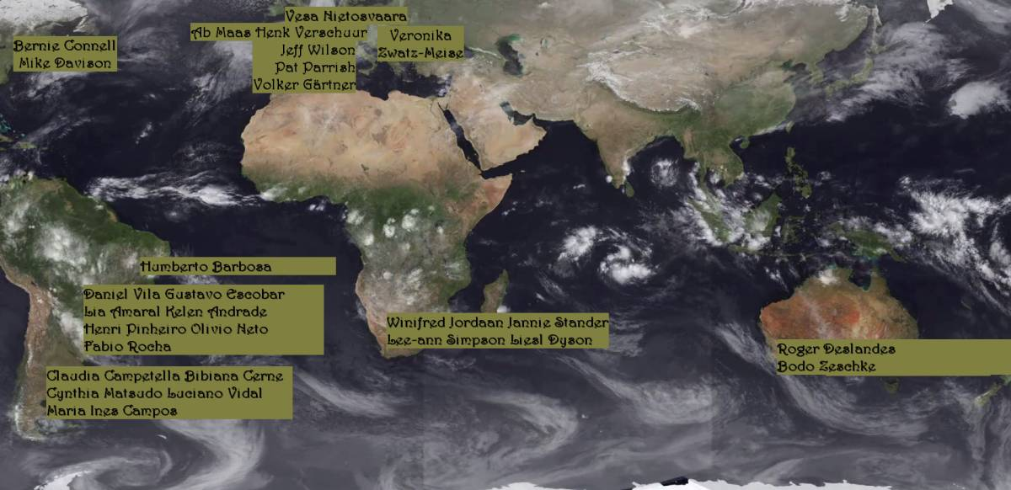
Project team: CoE experts
Review: CIRA + NOAA Funding: WMO+EUMETSAT

Slide 41
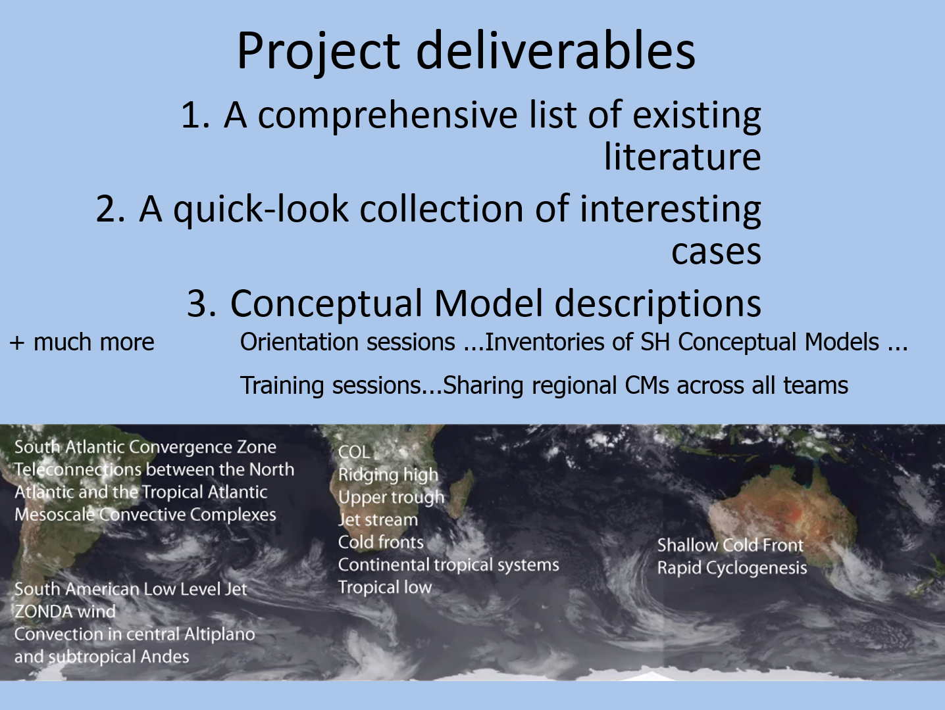

Slide 42
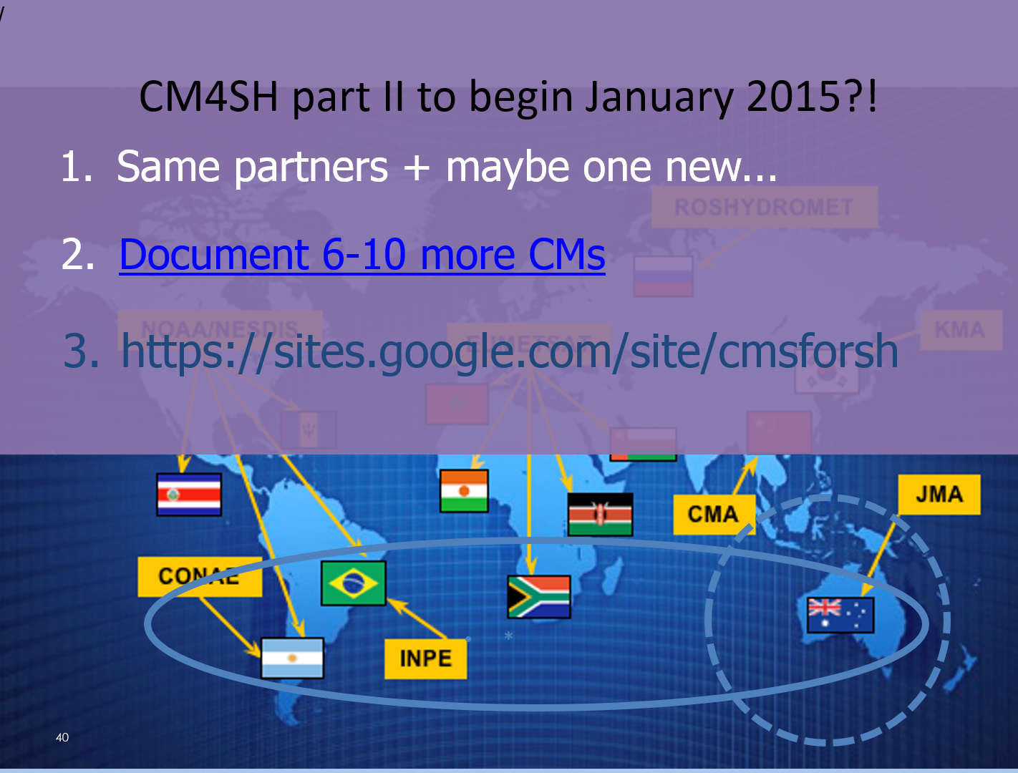

Slide 43
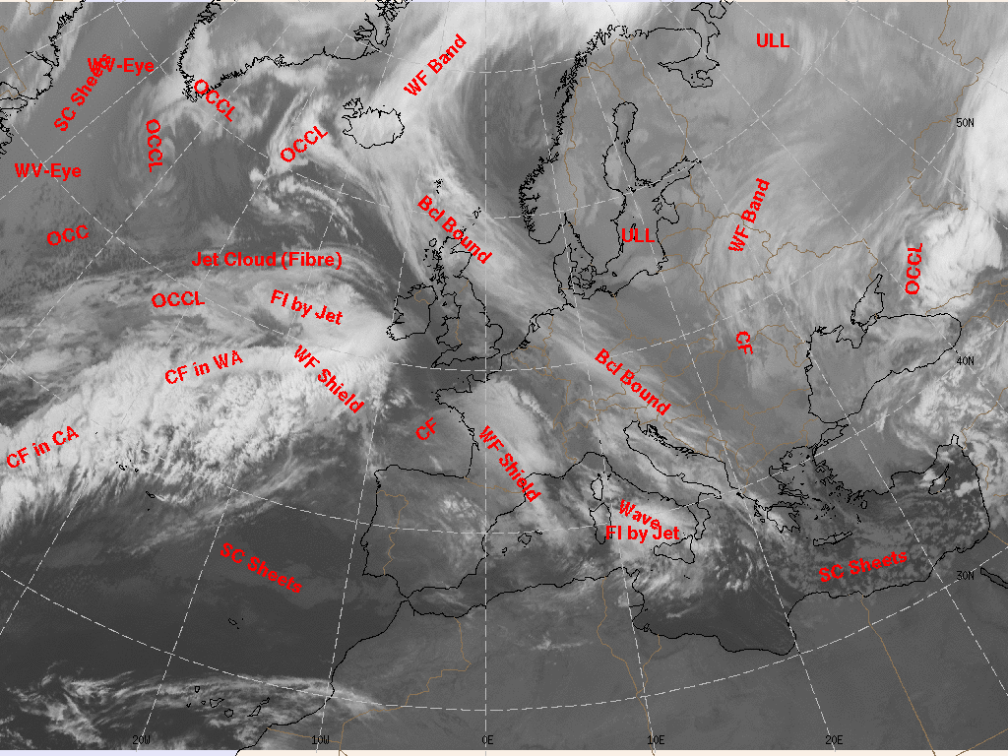
Why conceptual models
in forecasting?
SatRep

Slide 44
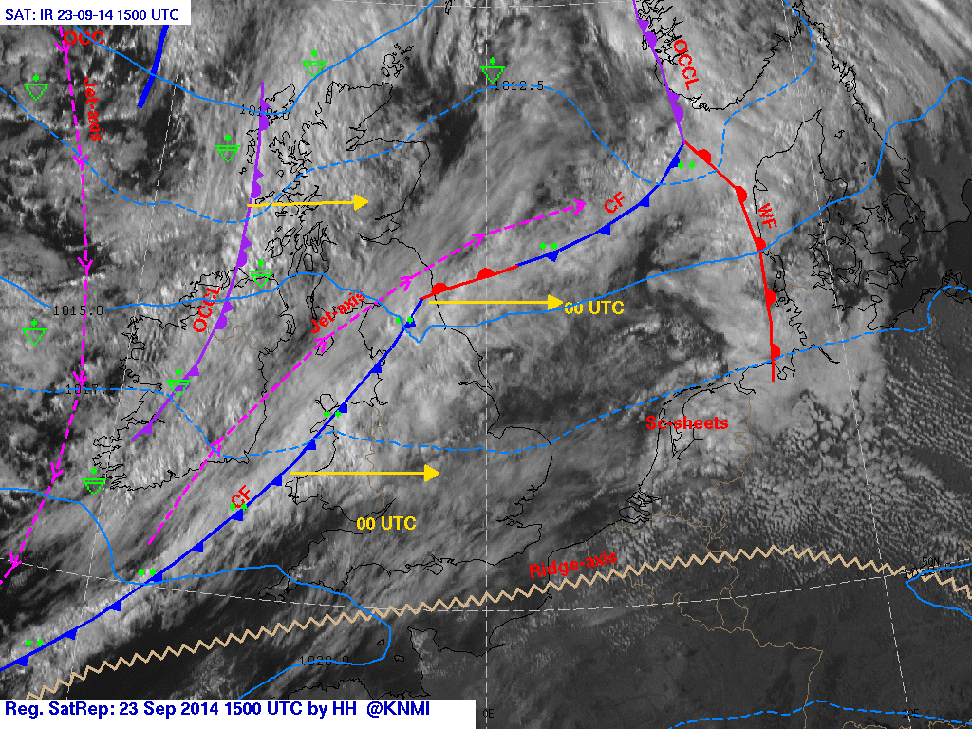
Why conceptual models in forecasting?
Regional SatRep

Slide 45
Why conceptual models in forecasting?
*CM’s are not perfect… but…
*Help you to understand the most important Weather Phenomena
*Help you to keep alert in the nowcast period
*Help you in cases the NWP output is not confirm the reality
*Always think for your self as the expert.
*NWP output is also not perfect.
*But the combination of the two improve your forecast substantially
*Both can still be improved and broadened.
*Challenge to you ??

Slide 46
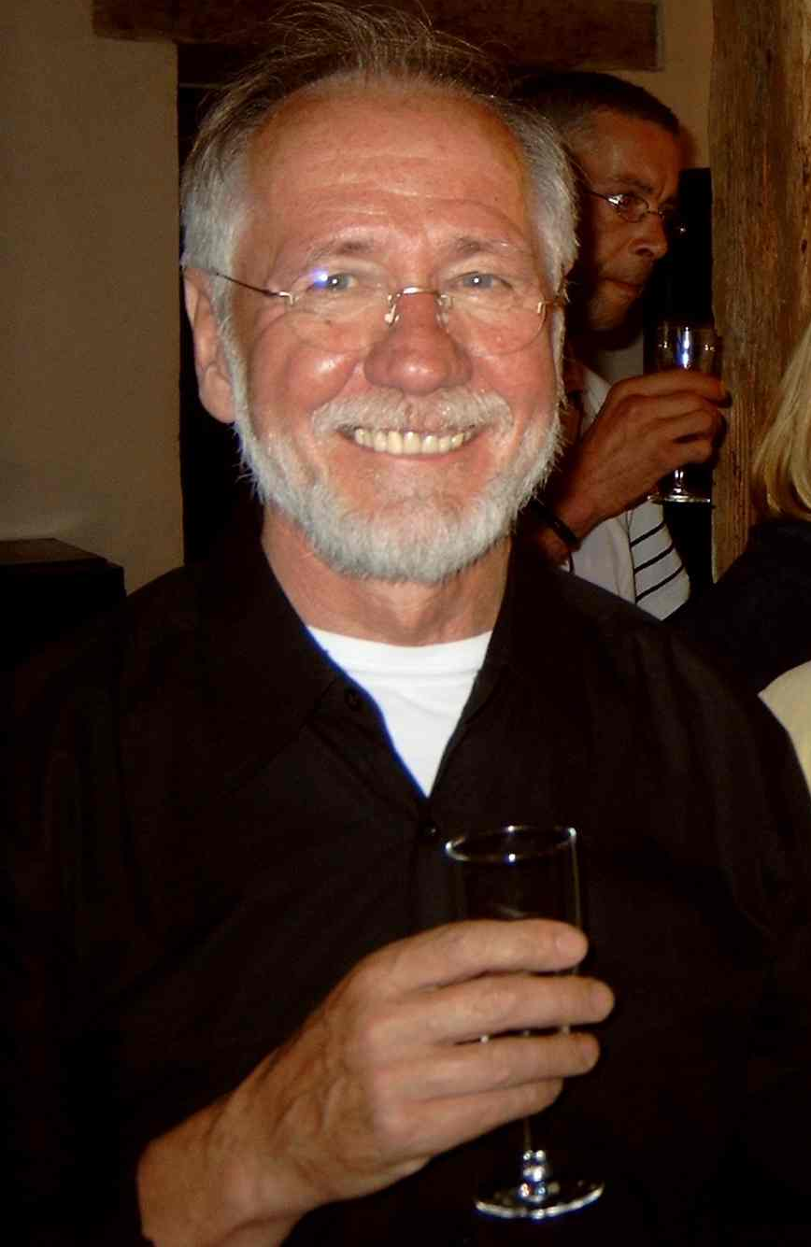
Thank You For
Your Attention

