Slide 1
World Wide Weather Briefing – Event Week 2013 Satellite Imagery Interpretation of Severe Thunderstorms in the USA.
Dan Bikos
Cooperative Institute for Research in the Atmosphere (CIRA)
Fort Collins, Colorado, USA

Slide 2
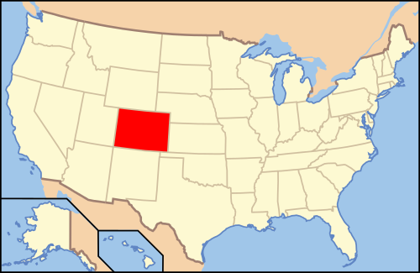
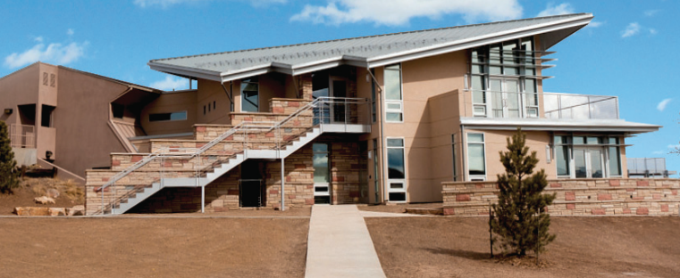
My Location
+
Fort Collins, Colorado

Slide 3
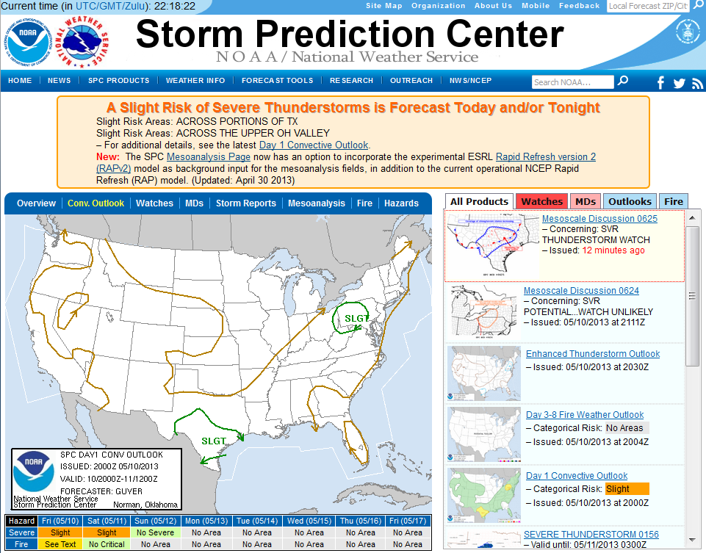
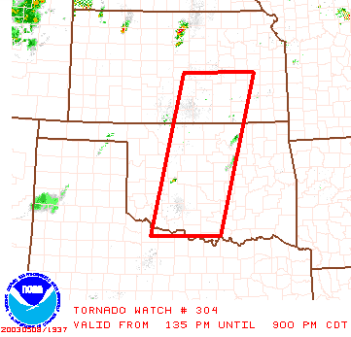
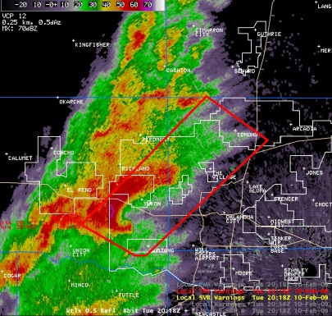
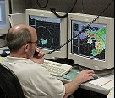
National Weather Service Severe Thunderstorm Products
Storm Prediction Center (SPC) in Norman, Oklahoma
Issues:
Convective Outlooks
Severe Thunderstorm and Tornado watch boxes
National Weather Service Forecast Offices (122 nationwide) issue Severe Thunderstorm / Tornado warnings.
These are “take action” statements when severe thunderstorms are occurring and about to strike your location.

Slide 4
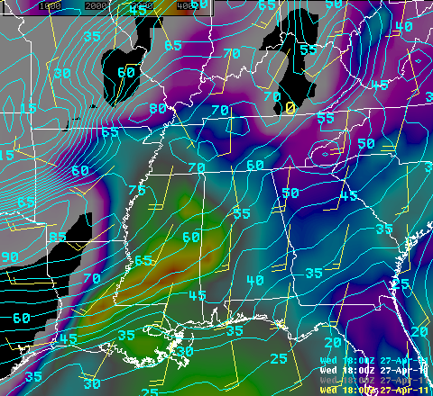
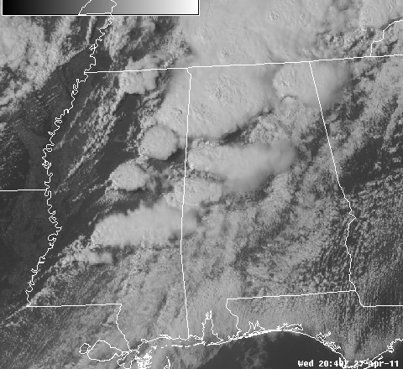
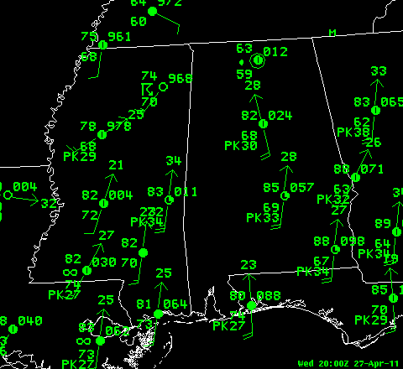
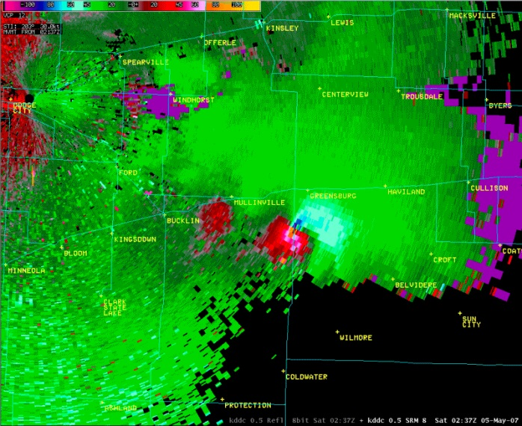
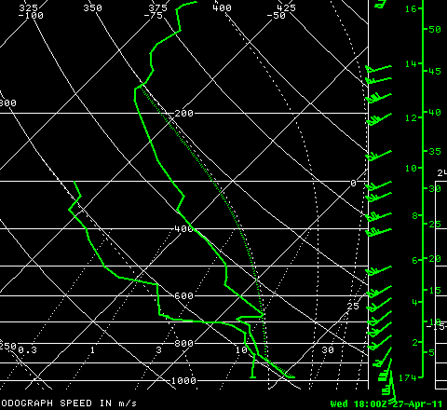
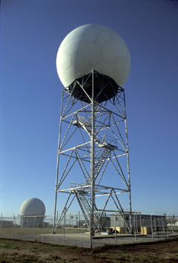
Tools for Severe Thunderstorm Forecasting / Warnings
NWP Model Output
Satellite Imagery
Surface Observations
Radar
Upper Air
Soundings

Slide 5
Objectives
Focus will be on satellite applications.
Much information can be obtained from satellite imagery:
Air mass identification.
Identification of changes in the pre-storm environment.
Monitor the changing environment during the nowcast time period.
Particularly useful in data void regions.

Slide 6
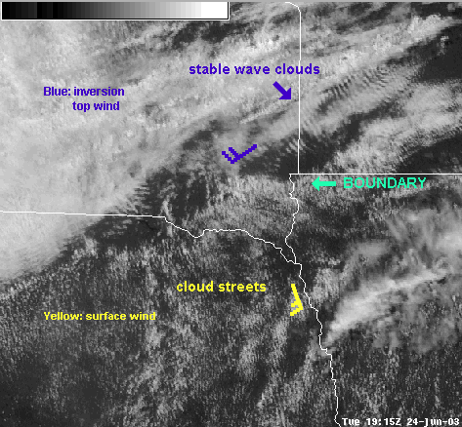

Slide 7
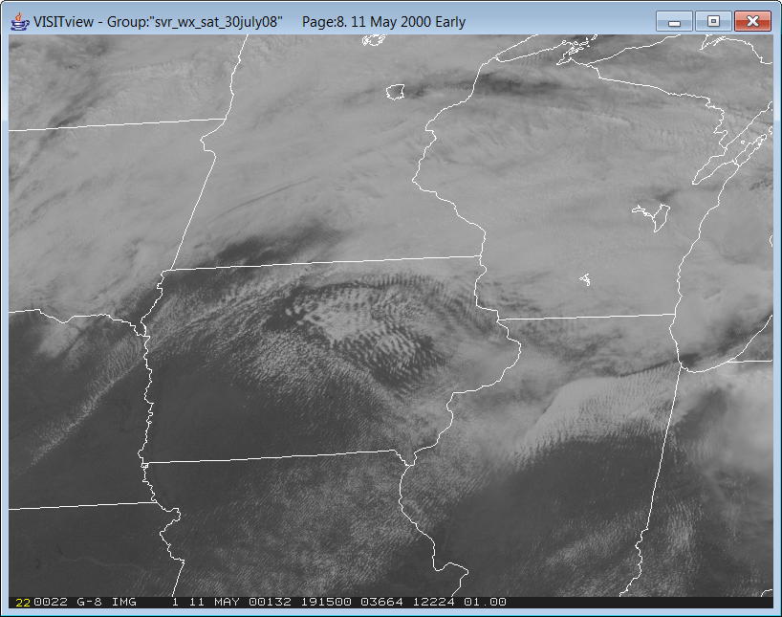

Slide 8
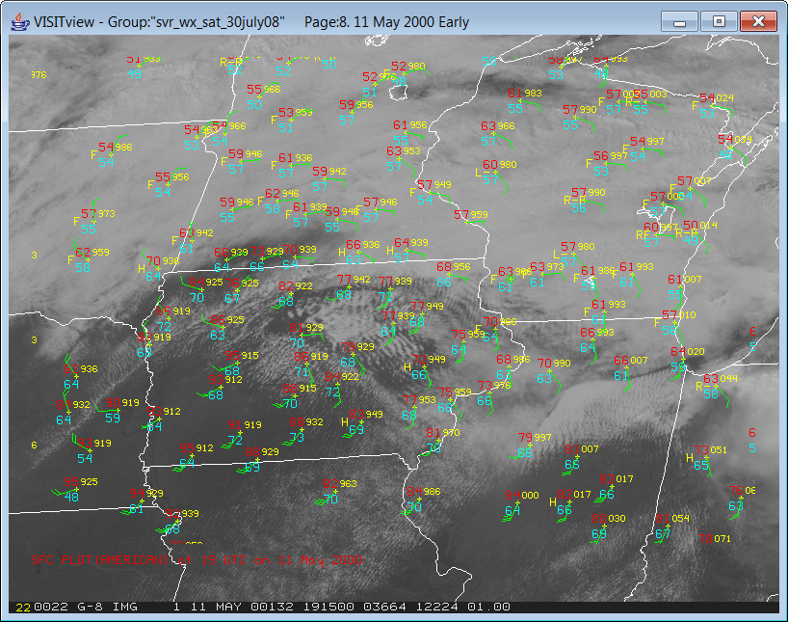

Slide 9
<Animation1>

Slide 10
May 5, 2008 Example <Animation2>

Slide 11
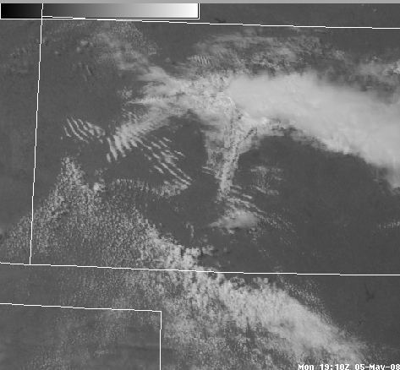

Slide 12
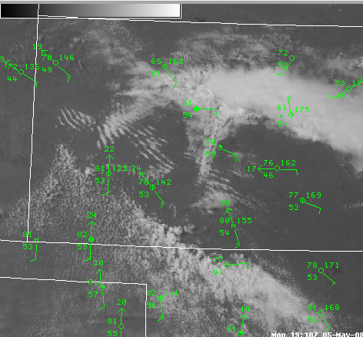

Slide 13
<Animation3>

Slide 14
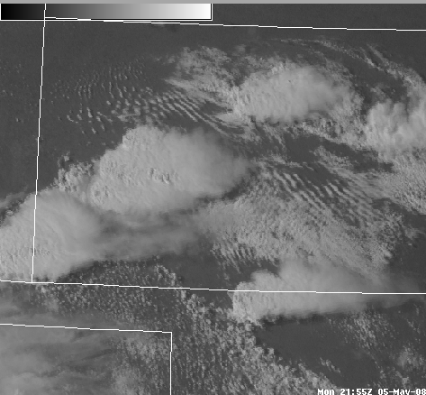
Hail diameter size (cm)
2.5 cm
10.8 cm

Slide 15
June 9, 2005 Example <Animation4>

Slide 16
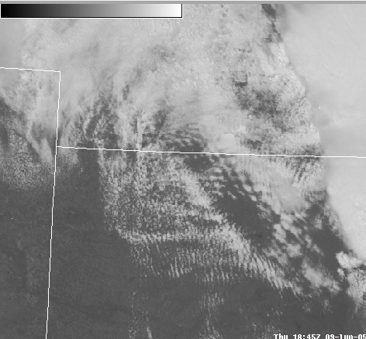

Slide 17
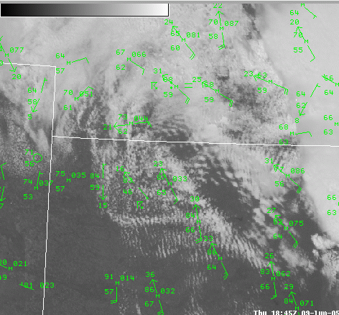

Slide 18
<Animation5>

Slide 19
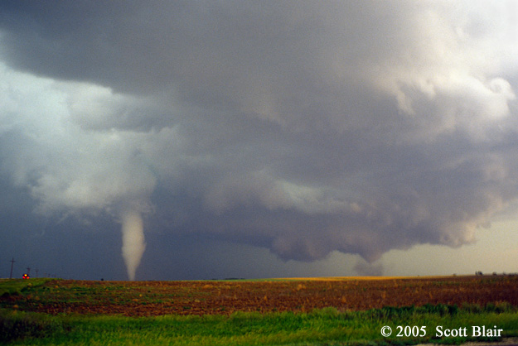
Photo by Scott Blair, from http://www.targetarea.net

Slide 20
June 24, 2003 Example <Animation6>

Slide 21
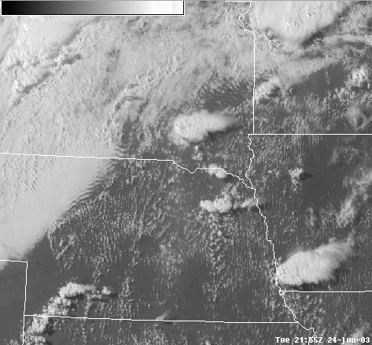

Slide 22
<Animation7>

Slide 23
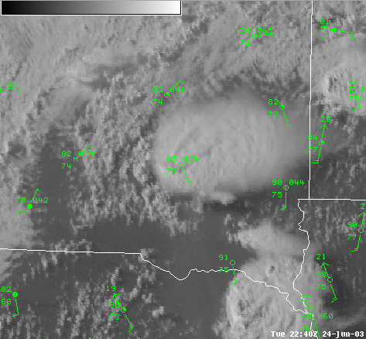

Slide 24
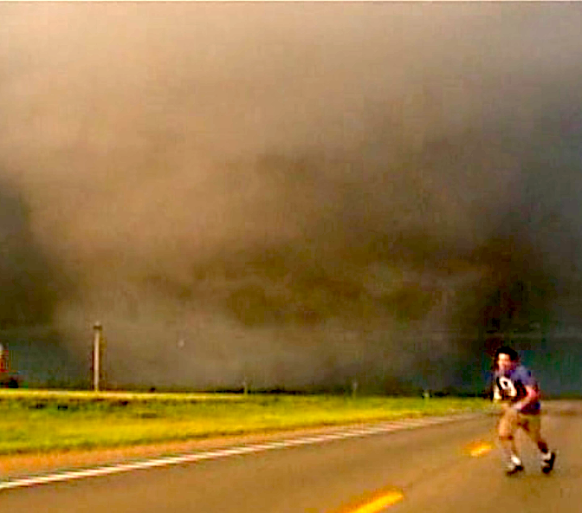
© Alexandre Fierro

Slide 25
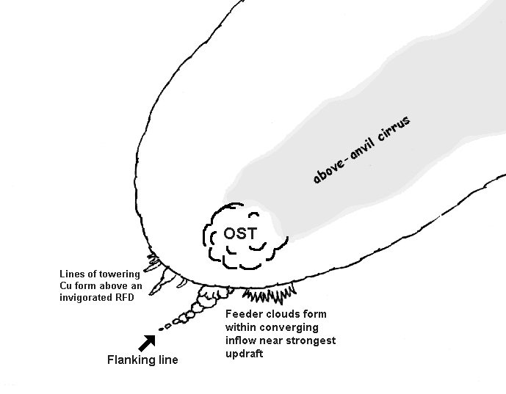

Slide 26
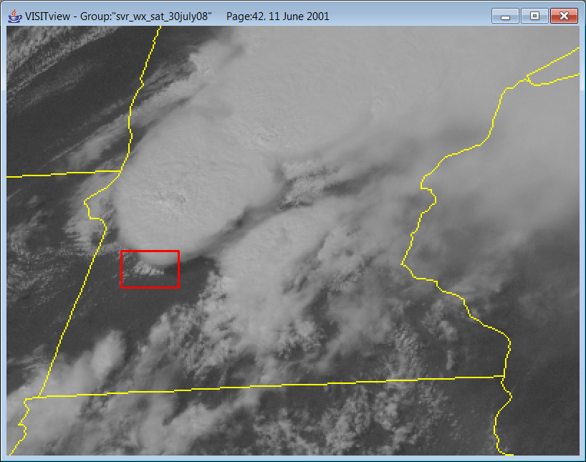
Inflow Feeder Clouds

Slide 28
May 20, 1998 Example <Animation8>

Slide 30
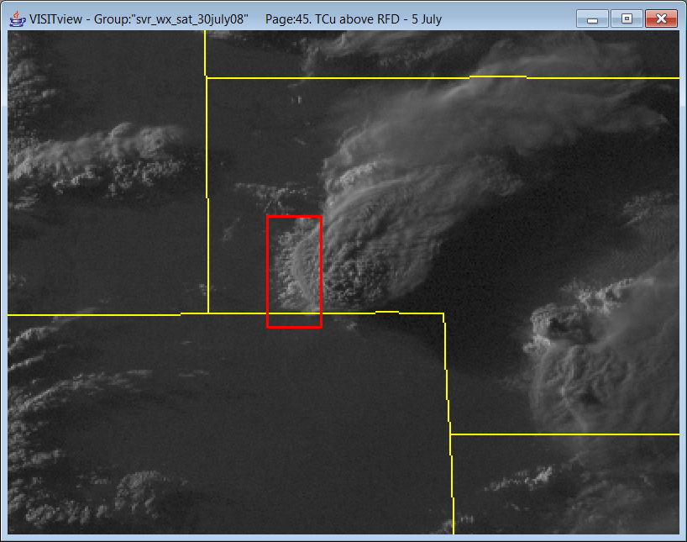
Towering Cumulus above the Rear-Flank Downdraft (RFD)

Slide 31
<Animation9>

Slide 32
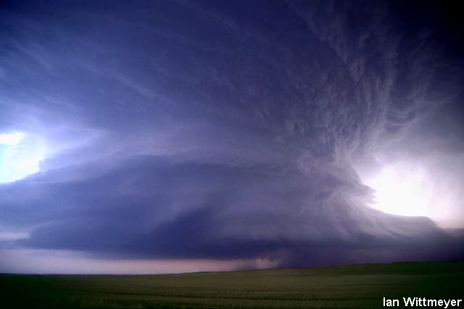
Hail diameter size = 7 cm
F3 tornado slightly after this time

Slide 33
July 24, 2000 Example <Animation10>

Slide 34
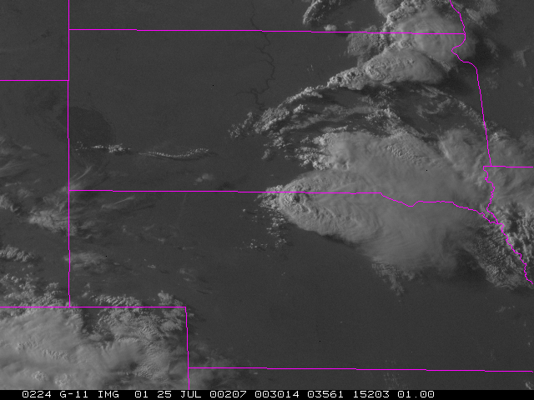
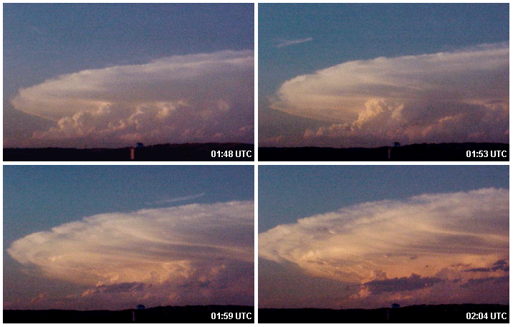
+

Slide 35
Summary
Much information can be obtained from satellite imagery:
Air mass identification.
Identification of changes in the pre-storm environment.
Monitor the changing environment during the nowcast time period.
Particularly useful in data void regions.

