Slide 1
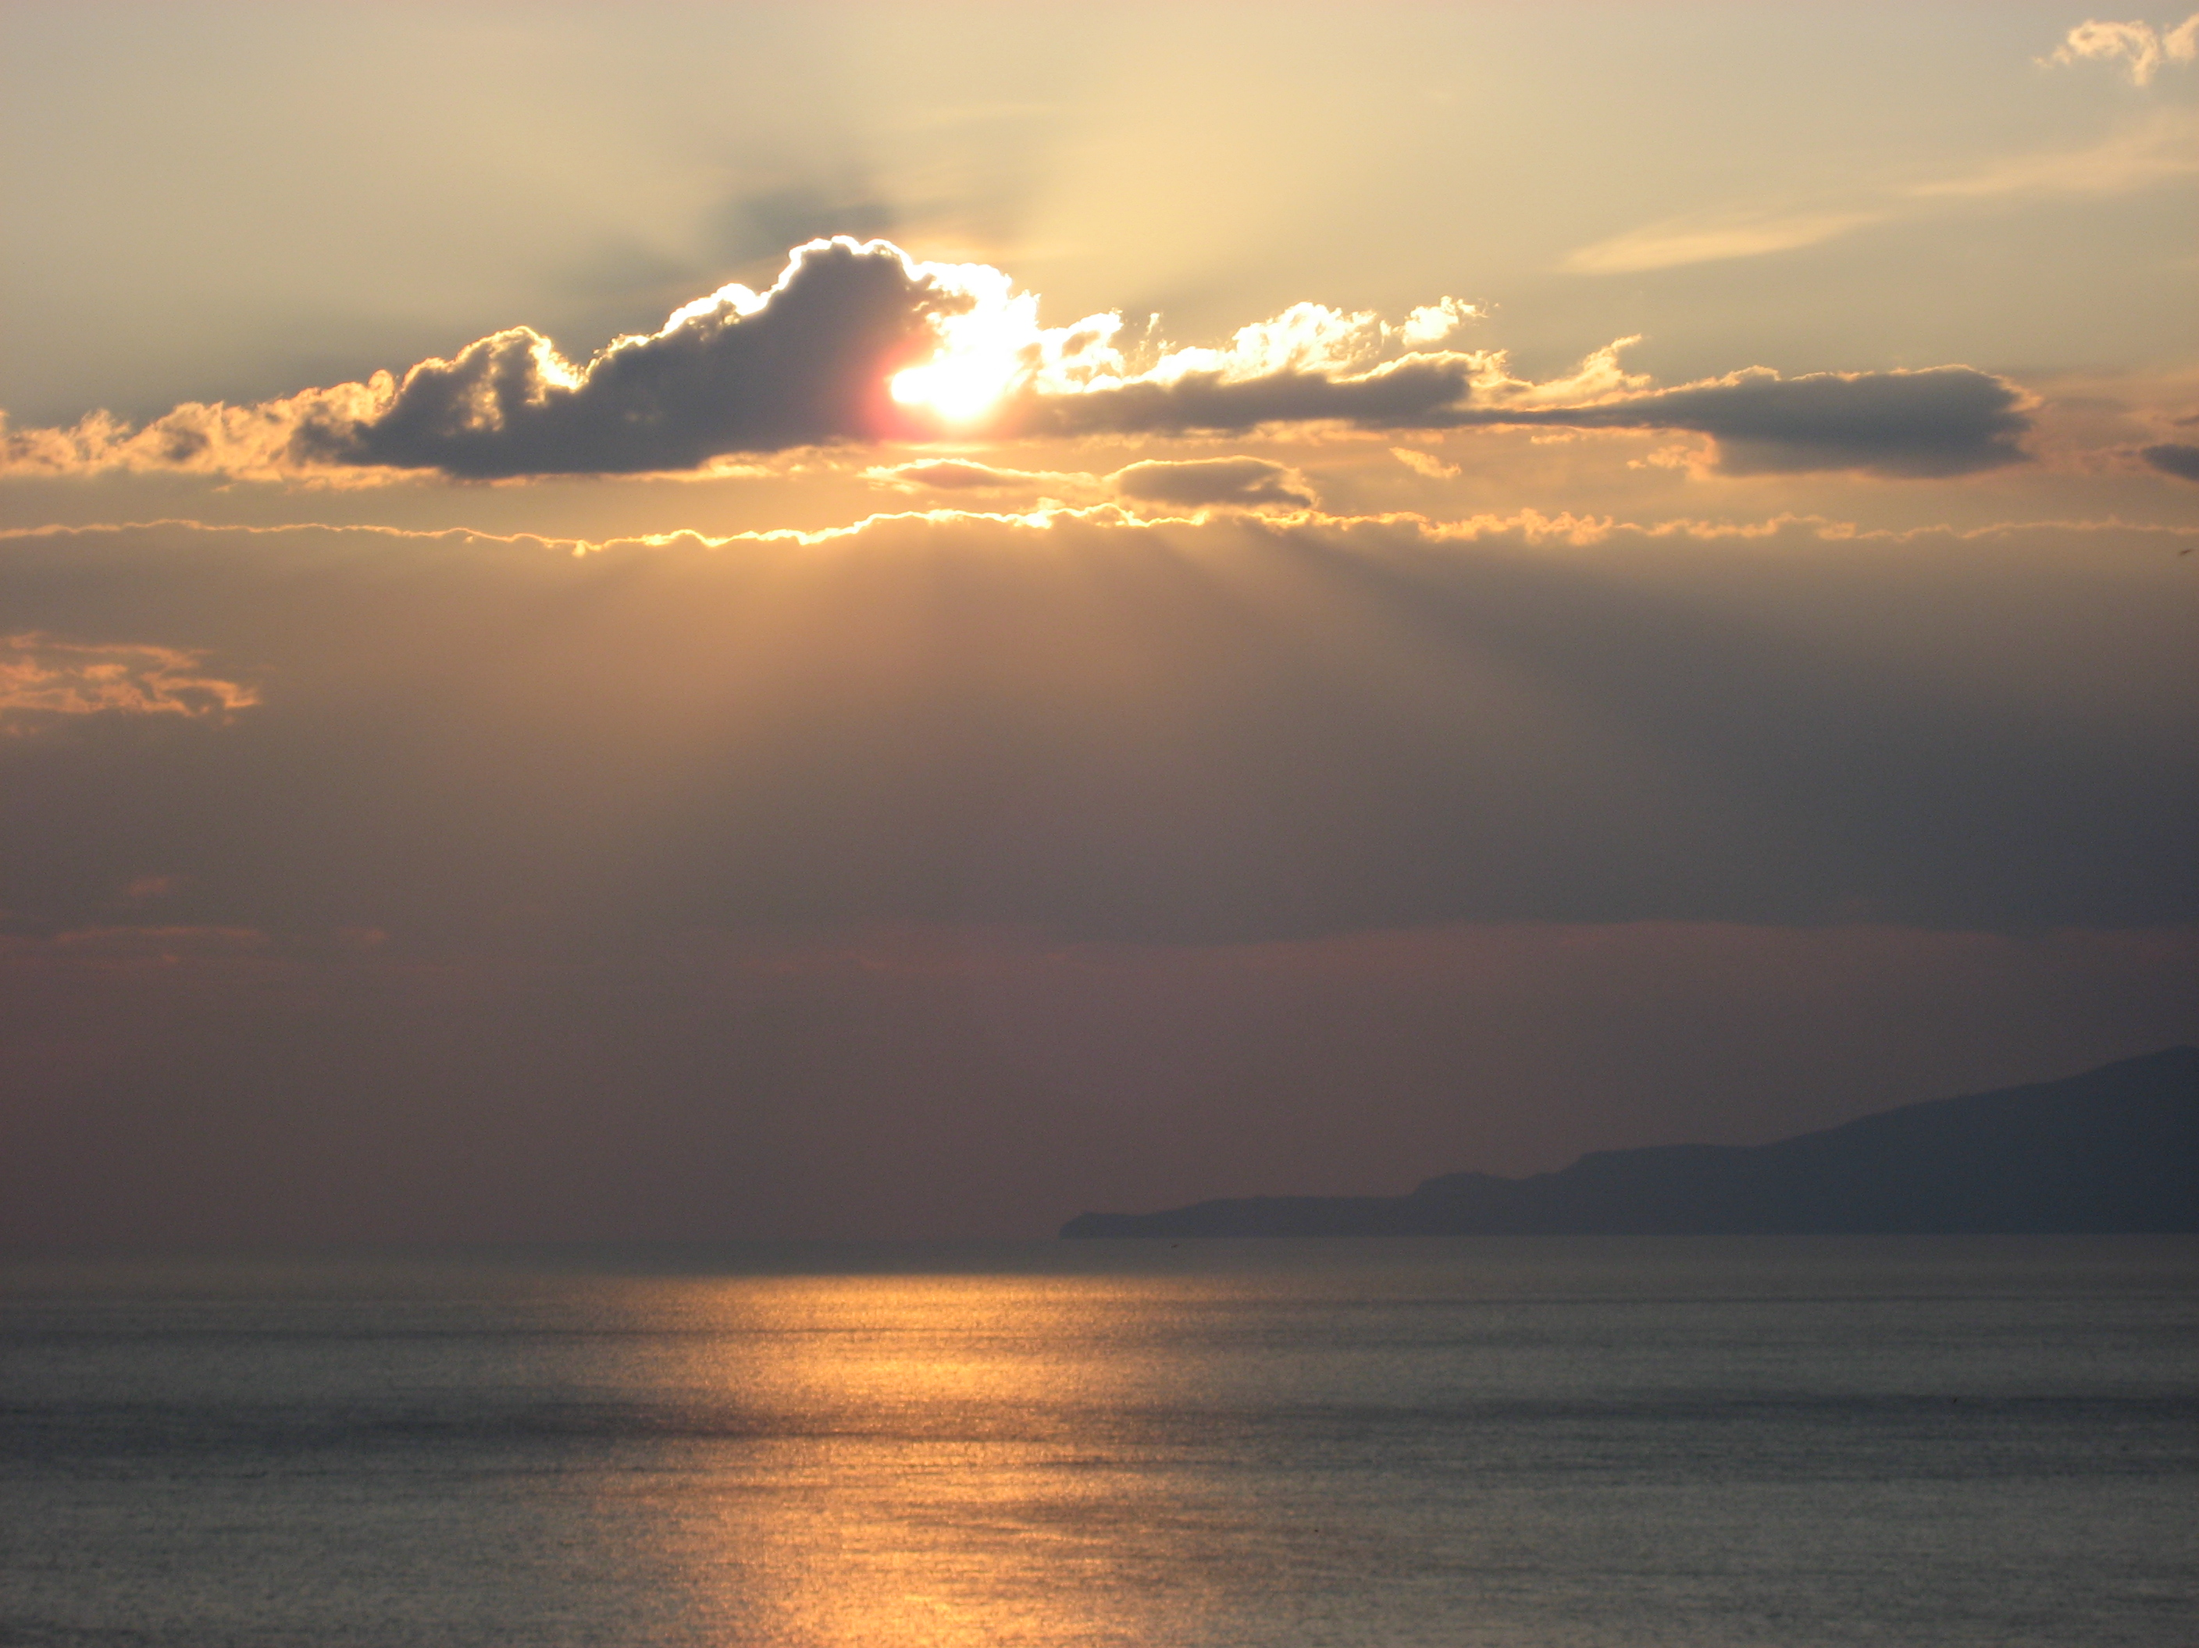
Atmospheric Sounding with AIRS and ATOVS
Ralf Bennartz
AOS/CIMSS/SSEC
University of Wisconsin – Madison

Slide 2
Outline
What we want to know and why we need it?
What does a satellite really observe (a.k.a. The radiative transfer equation)
Weighting functions
AIRS, AMSU examples

Slide 3
What do we want to know?
Weather forecasting? What data is needed for NWP model initialization (assimilation)?
Source: Kelly and Thepaut, 2007 ECMWF Newsletter 113

Slide 4
Why are satellite data important for forecasts?
Forecast skill strongly dependent on satellite data
E.g. Southern hemisphere: Day 3-4 forecasts now as good as Day 1 forecasts without satellite data.
Source: Kelly and Thepaut, 2007 ECMWF Newsletter 113

Slide 5
What does a satellite observe?
Detects number of photons per exposure time at a given wavelength (or wvl range)traveling from viewing direction into detector
No. of photons, direction, per time → RADIANCE
We need to physically and quantitatively understand the relation between observed radiance and state of the atmosphere
Radiative Transfer Equation

Slide 6
Non-scattering
θ_{S}
Temperature

Slide 7
Important variables

Slide 8
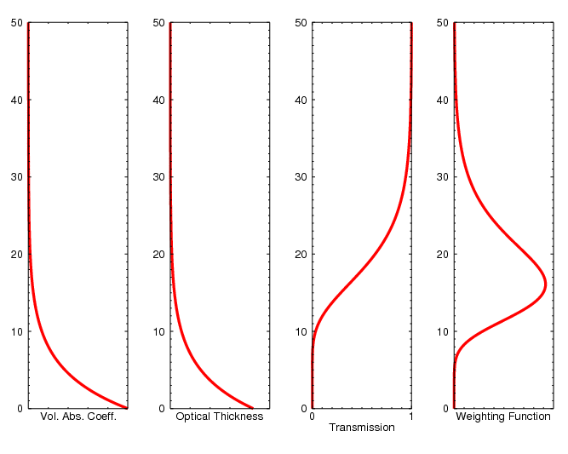
Weighting Functions

Slide 9
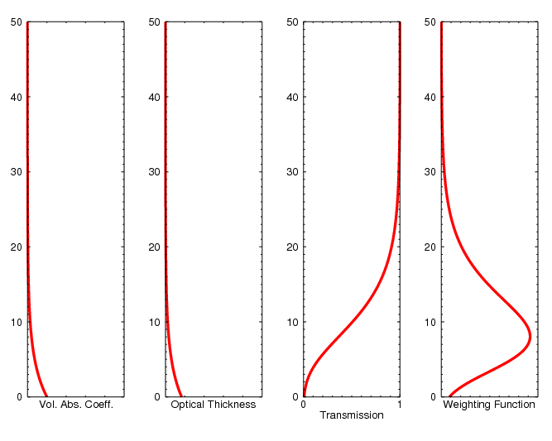
Weighting Functions

Slide 10
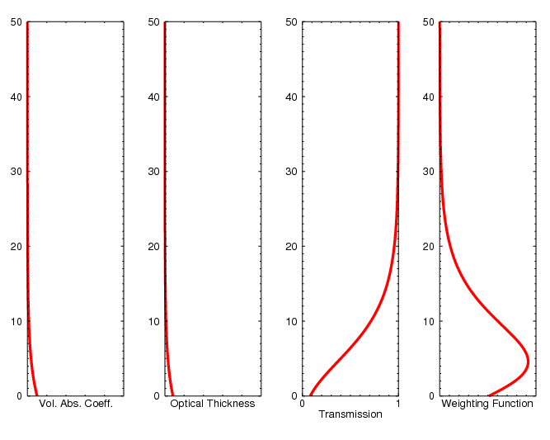
Weighting Functions

Slide 11
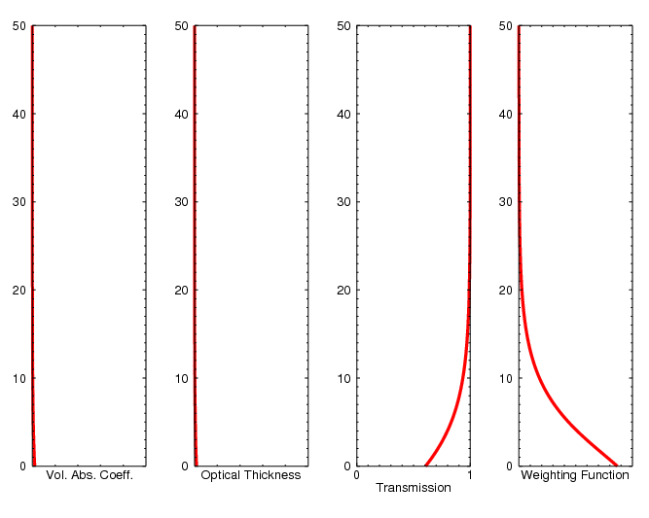
Weighting Functions

Slide 12
Recap
Assume non-scattering radiative transfer in the infrared and microwave
Absorption coefficient tells us how efficiently a gas absorbs AND emits.
Transmission (between two points A and B) tells us what fraction of radiation will ‘survive’ (i.e. not be absorbed
Weighting function tells us where the radiation observed originated in the atmosphere. Allows us to relate observed radiance to layers/levels in the atmosphere
Next: AIRS, AMSU applications

Slide 13
Example: Atmospheric InfraRed Sounder (AIRS)
Provides data since mid 2002
Temperature and water vapor profiles available globally about once every 12hours
Spatial resolution about 15 km horizontally
Accuracy T : ±1K @ dz=1km
Accuracy RH : ±10% @ dz=1km
Other, similar instruments out there. Data continuity high priority for NOAA and EUMETSAT

Slide 14
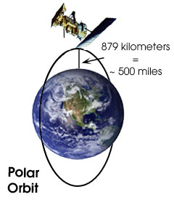
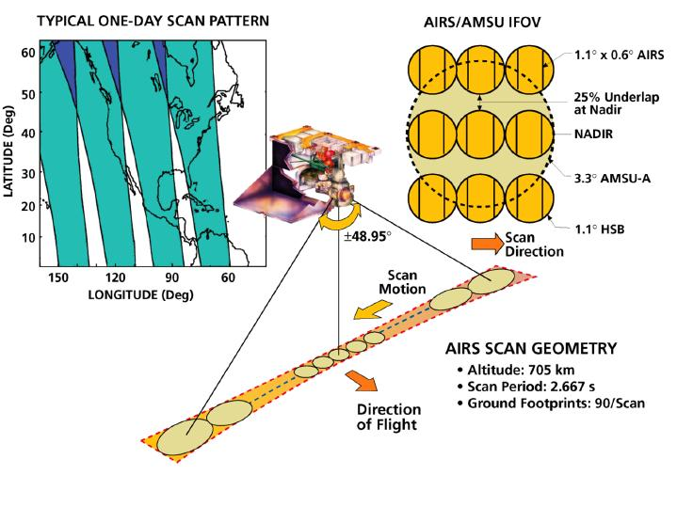
Example: Atmospheric InfraRed Sounder (AIRS)
2378 channels
3.7-15.4 micron
dL/L=1200

Slide 15
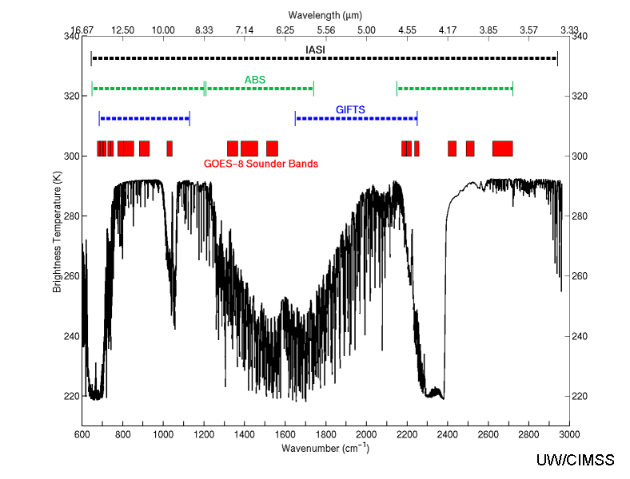
Example: Atmospheric InfraRed Sounder (AIRS)
AIRS

Slide 16
AIRS radiance movie here
AIRS_longwave_......

Slide 17
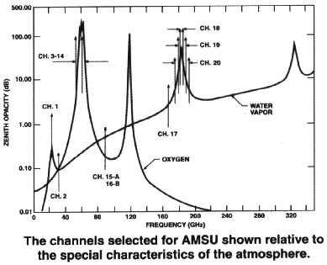

Slide 18
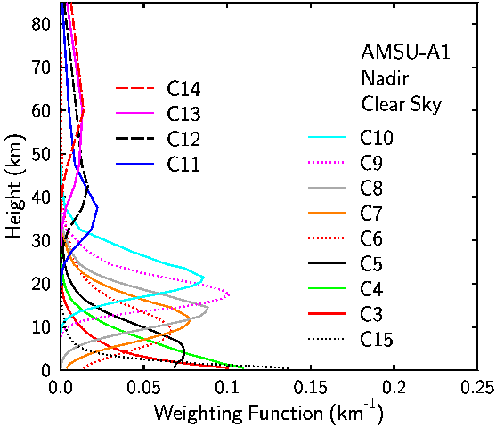

Slide 19
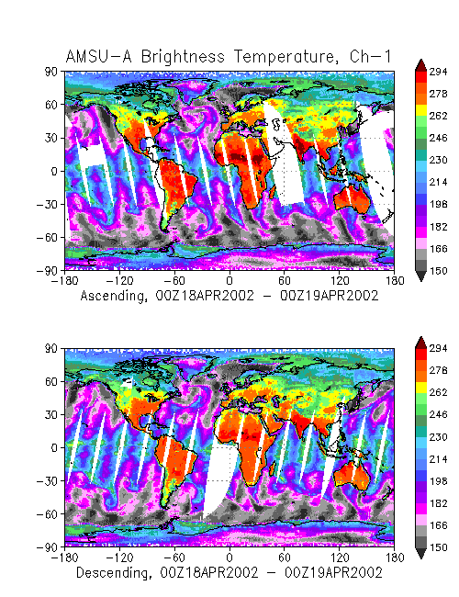

Slide 20
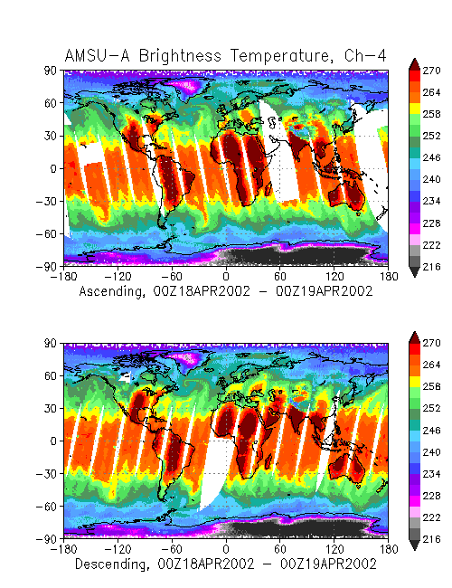

Slide 21
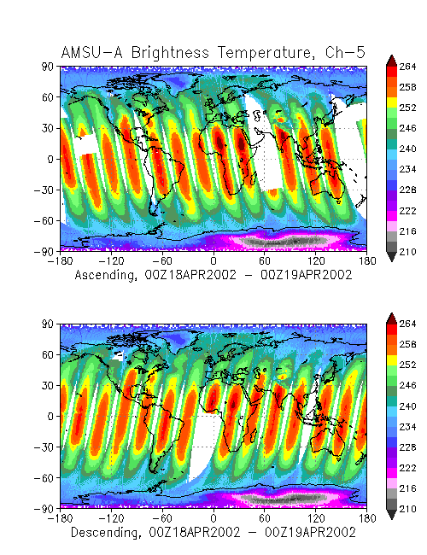

Slide 22
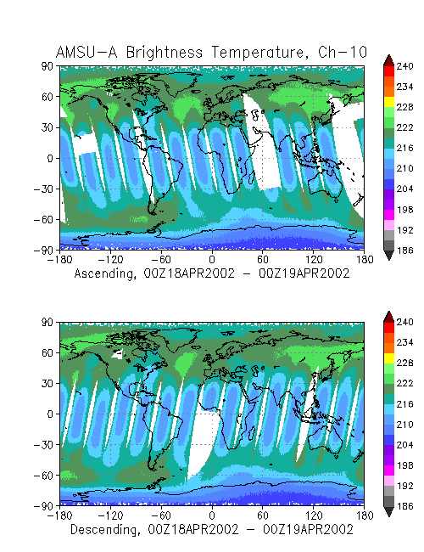

Slide 23
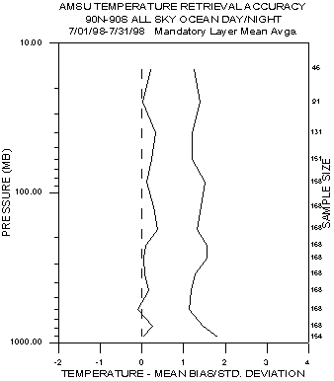

Slide 24
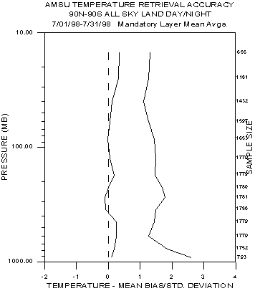

Slide 25
Various Temp and other Water movies here
temp_500
Temp_1000
Water_1000
Usa_slice

Slide 26
Example: Operational NOAA AMSU+AIRS Soundings
http://www.orbit.nesdis.noaa.gov/smcd/opdb/poes/ATOVS_soundings.php

