Slide 1


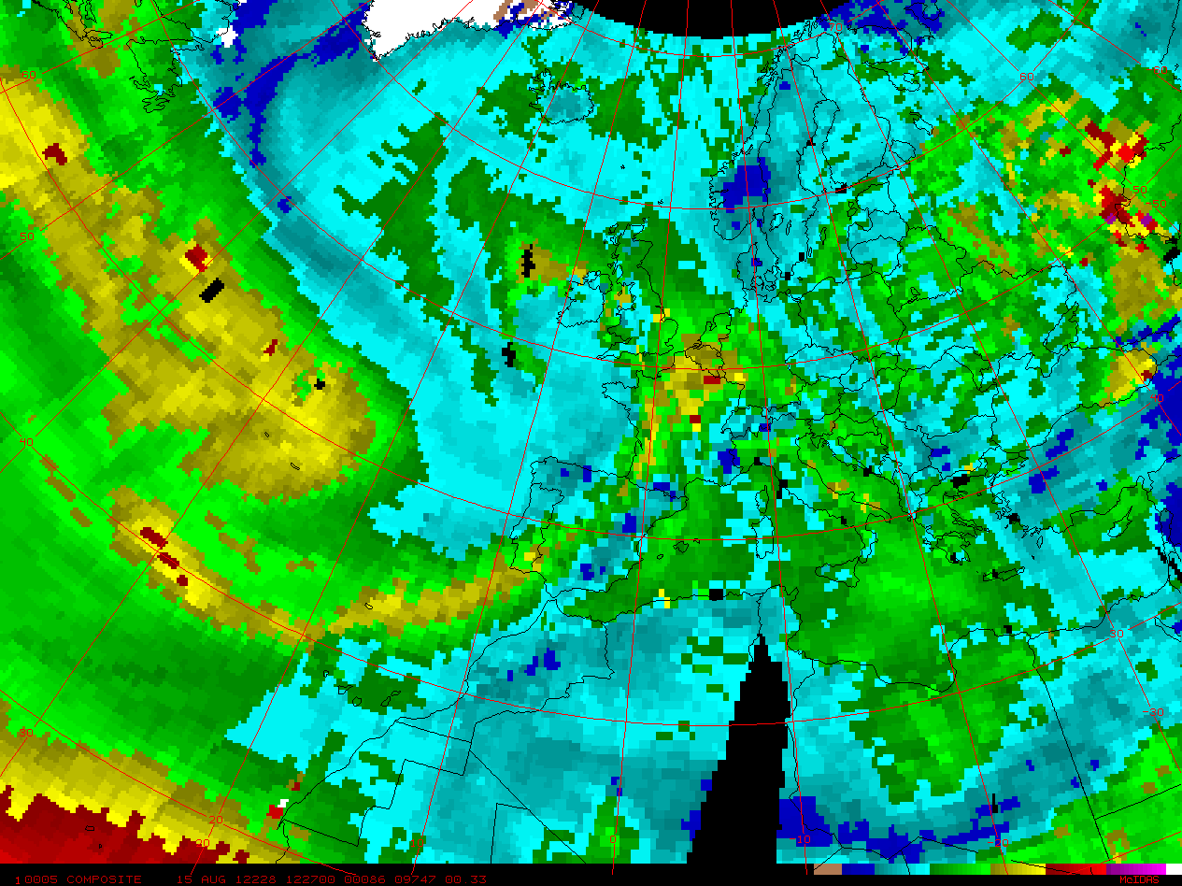
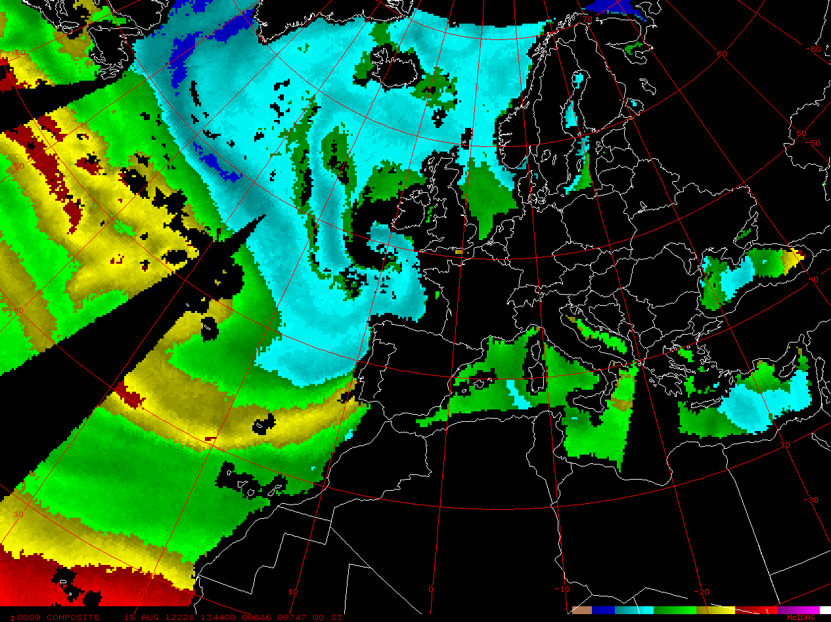
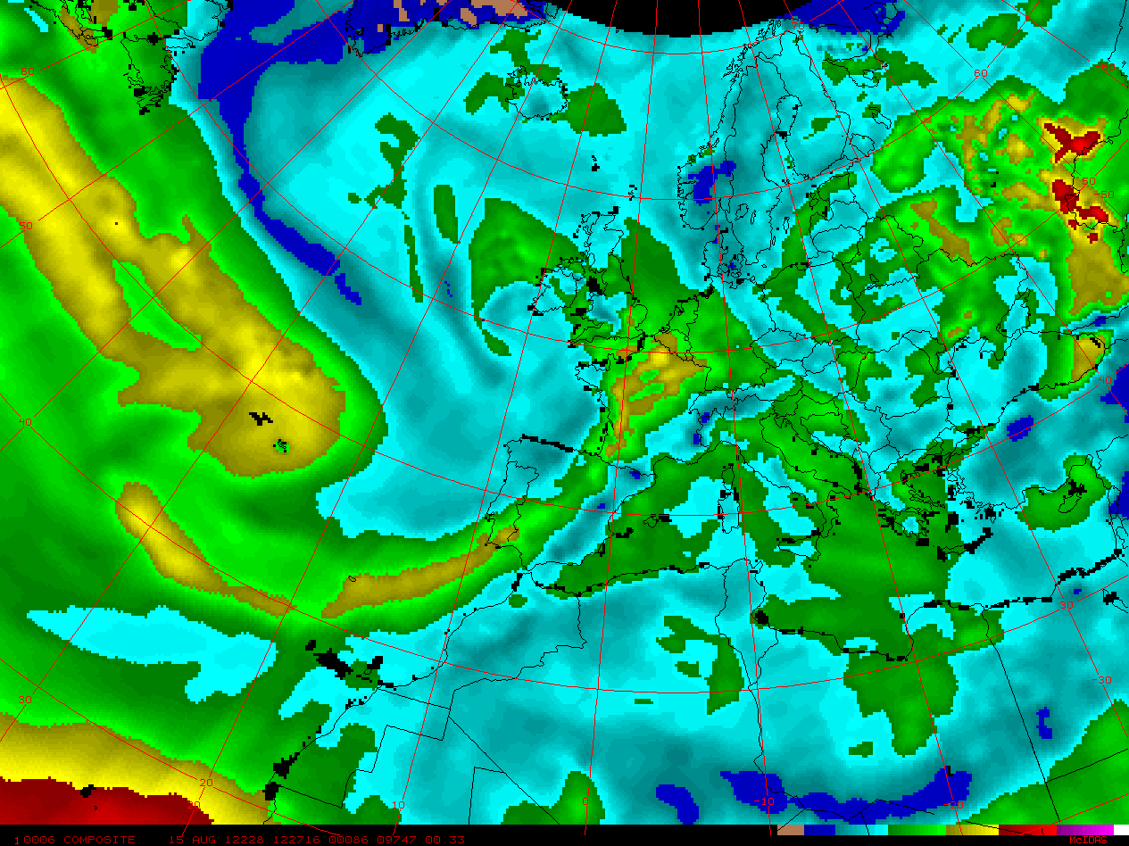
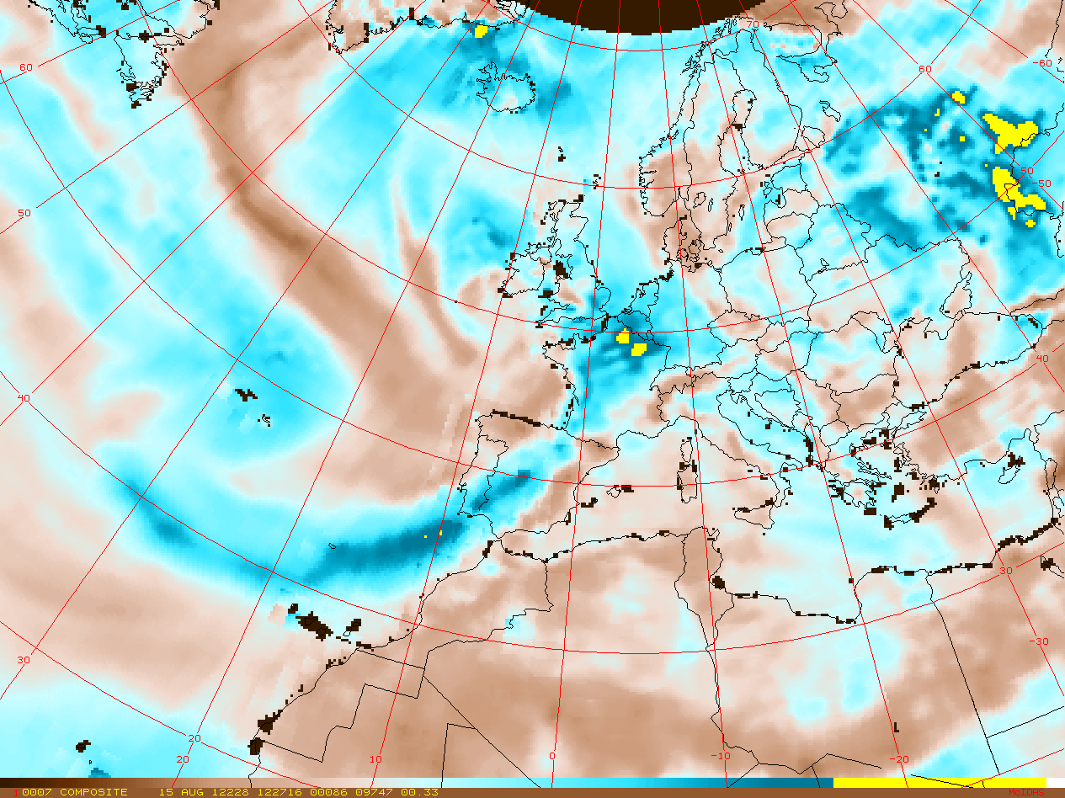



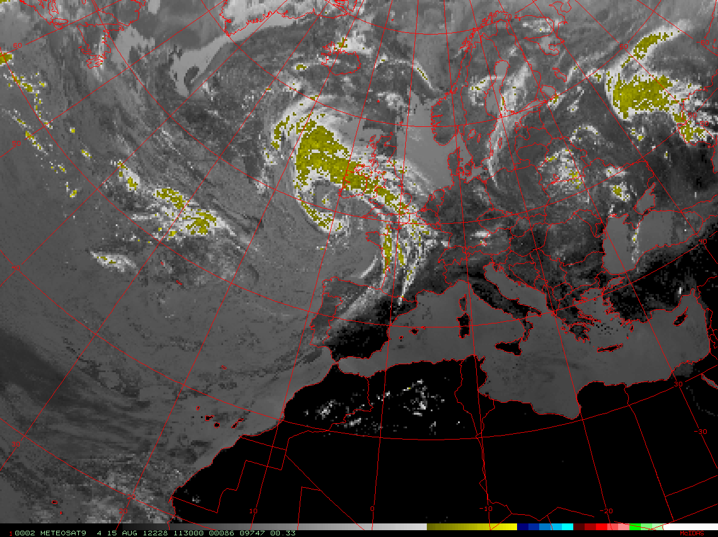
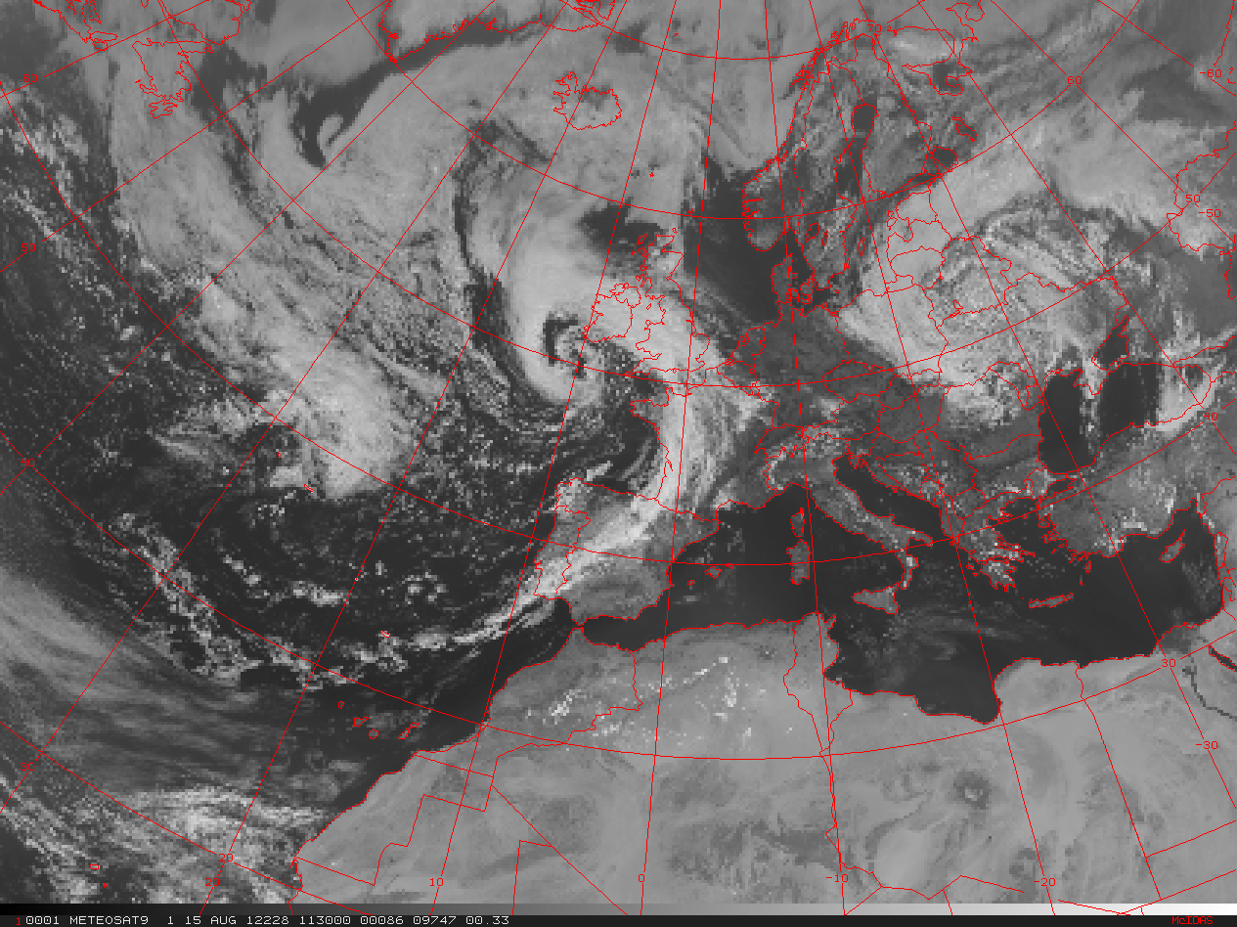
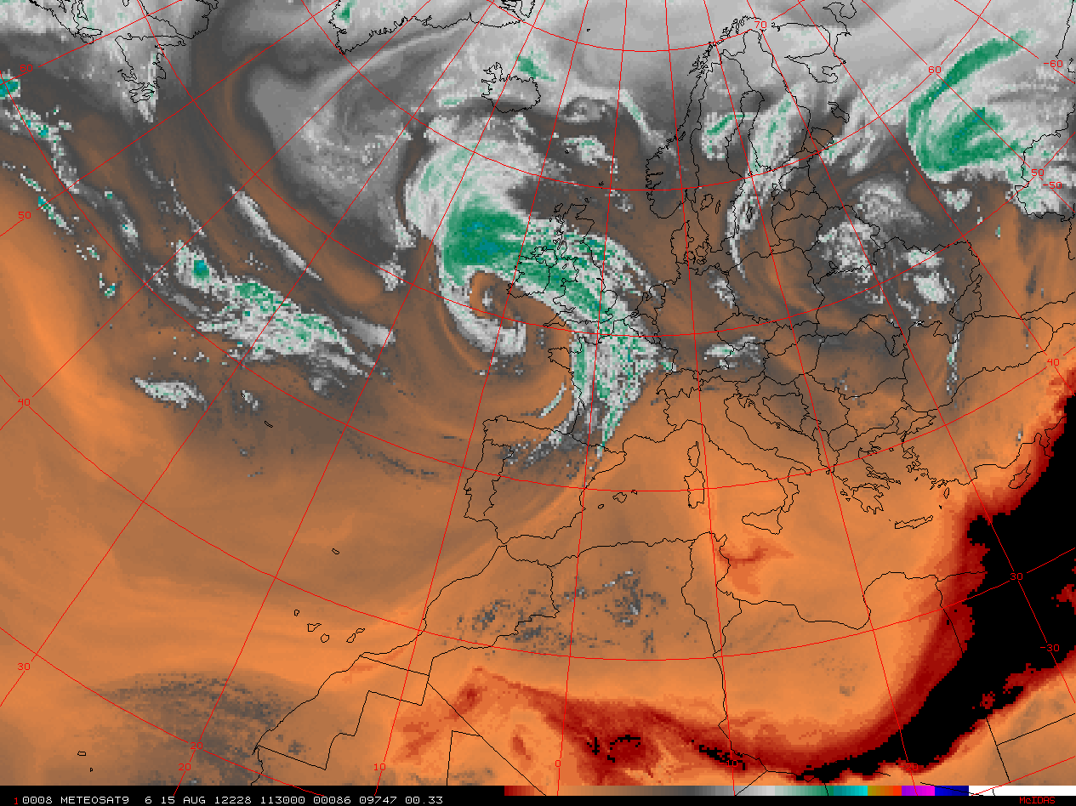

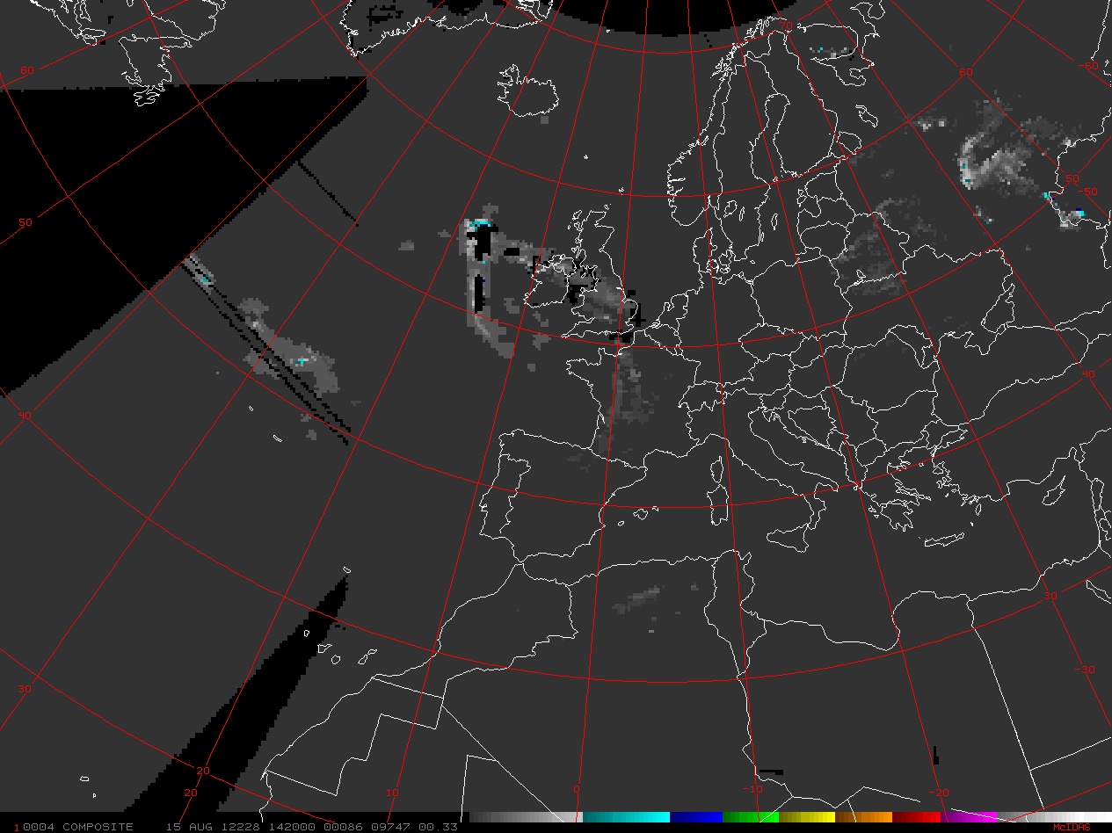
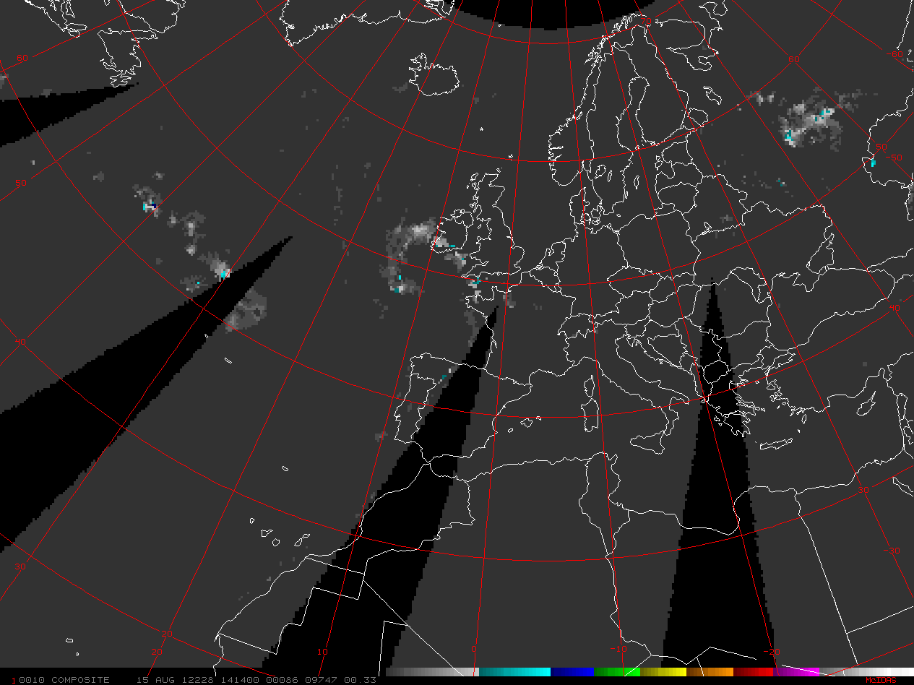
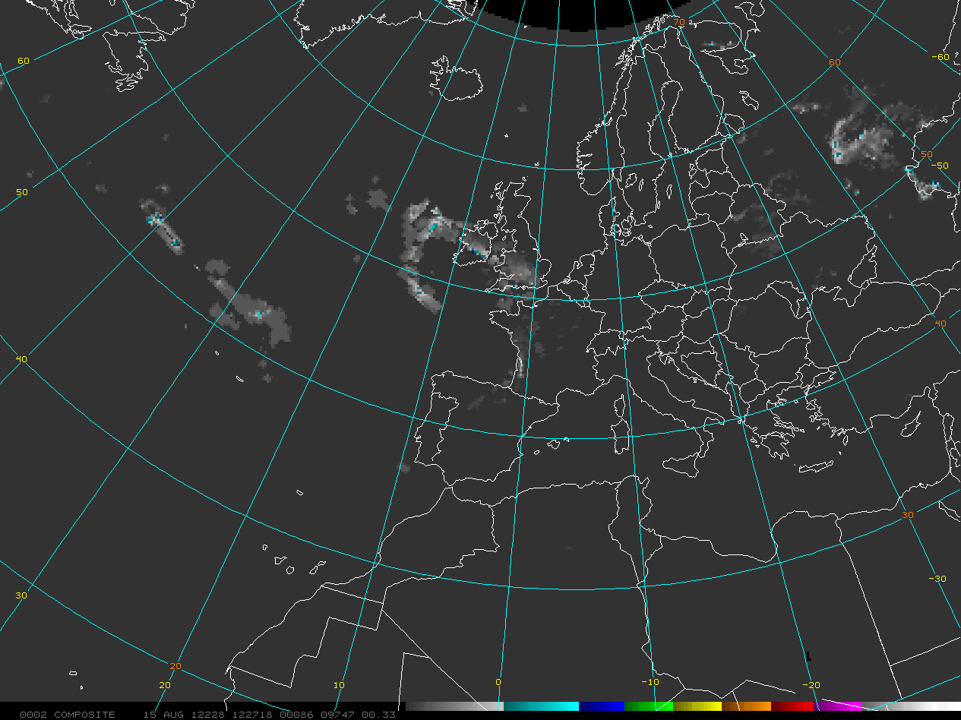
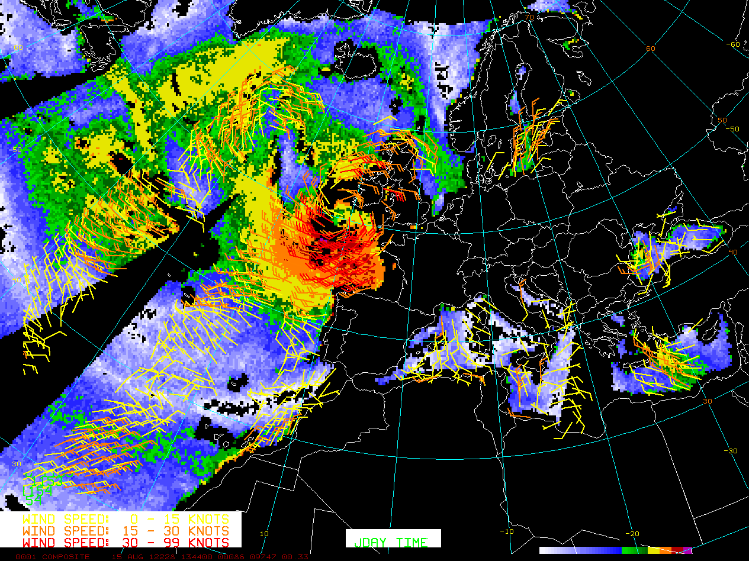
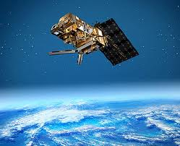
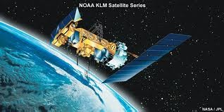
Overview of Microwave Products - AMSU, MHS, SSMIS and Blended Total Precipitable Water and Rain Rate
Sheldon Kusselson National Oceanic and Atmospheric Administration (NOAA) National Environmental Satellite Data and Information Service (NESDIS) Office of Satellite Product and Operations (OSPO) / Satellite Product and Services Division (SPSD) Satellite Analysis Branch (SAB)
MIRS AMSU-A TPW
SSMIS TPW
Blended TPW
Blended TPW Percent of Normal
Contributions by
Limin Zhao Ralph Ferraro Bob Kuligowski Stanley Kidder John Forsythe
Aug 15, 2012
MSG IR
MSG Visible
MSG Water Vapor
AMSU-B MHS Rain Rate
SSMIS Rain Rate
Blended Rain Rate
ASCAT and SSMIS Winds
EUMETSAT Polar Satellite Week
Session 1 - Precipitation I - 5 November 2012
ftp://satepsanone.nesdis.noaa.gov/Presentations/Other/Polar_Satellite_Week_Session1.ppt
MetOp

Slide 2
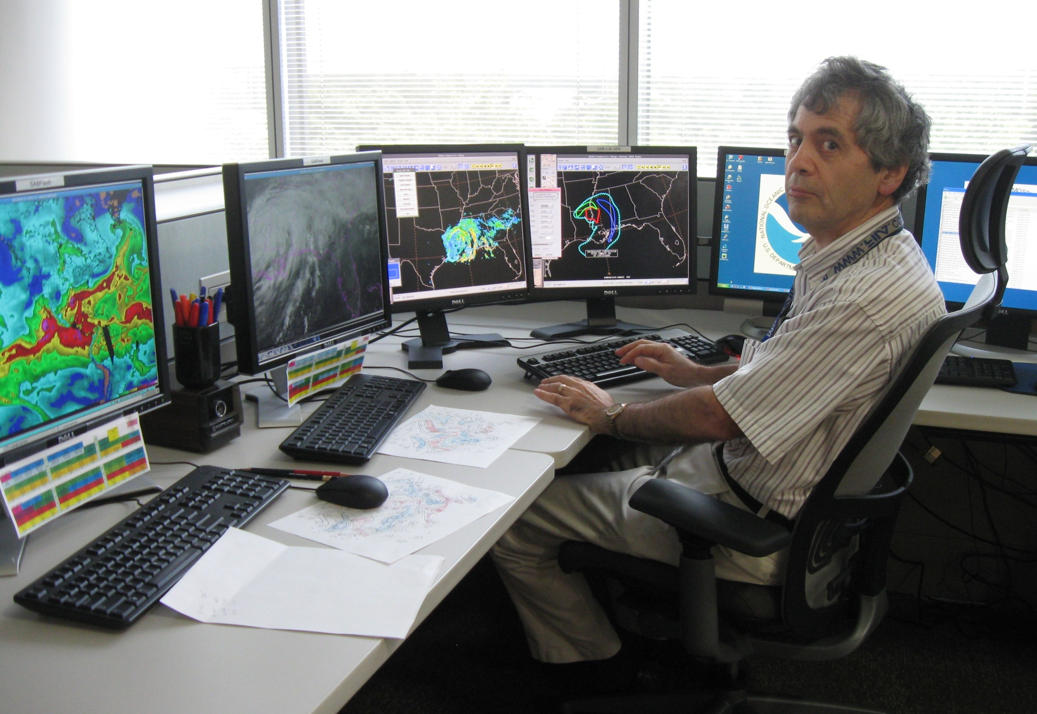
Hello! My name is Sheldon Kusselson, NOAA satellite meteorologist
Notes:
For 20 years I have been using and incorporating low earth orbiting microwave satellite products into my analysis and helping forecasters improve and make more time forecasts of hazardous weather.

Slide 3
Session Outline
- Importance of Low Earth Orbiting (LEO) Microwave Products
- The LEO Satellites
- Overview of LEO TPW, RR and winds applications;
comparisons with
- Overview of Blended TPW and RR GEO imagery
- The Madiera Flood Event: TPW and RR applications
Notes:
Operational LEO Satellites with microwave sensors

Slide 4
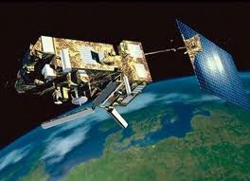
WHY? WHY? WHY?
?
?
?
Use Low Earth Orbiting (LEO) Satellite Data/Imagery
3
Notes:
It took satellite analysts, even forecasters in my country, especially away from the ocean areas, to look at and incorporate polar orbiting microwave products into their analyses

Slide 5



LEO to complement and/or supplement GEO
LEO
MIRS AMSU-A TPW
SSMIS TPW
Blended TPW
Blended TPW Percent of Normal
GEO
Aug 15, 2012
MSG IR
MSG Visible
MSG Water Vapor
LEO
SSMIS Wind Speed & ASCAT
AMSU-B MHS Rain Rate
SSMIS Rain Rate
Blended Rain Rate
Value added information to improve analysis and forecasts
4
Notes:
LEO Microwave and GEO
Compare and Contrast
To complement and/or supplement EUMETSAT geostationary satellite imagery, conventional observations and computer model data. Value added information to help improve meteorological analyses and forecasts
LEOs
Global Coverage (102 minutes)
2 images a day per satellite
Imagery 1-3 hours after data time
Microwave sees through clouds
TPW even in cloudy/light rain areas
Rain Rates more objective / accurate
Resolution: 15 - 78 km
GEOs
Regional Coverage 1/5 of globe
2 to 4 images per hour
Imagery 5 - 30 minutes after data time
Sees only cloud tops
RGB Air Mass but in clear
Rain Rates more subjective (cloud tops)
Resolution: 1 - 4 km
no one type of satellite fits all our analysis and forecast needs

Slide 6
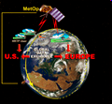
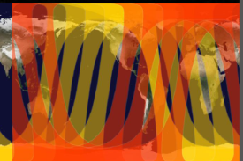



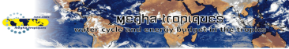

Satellites with Microwave Sensors
- Primary Operational
- METOP-A 0930LT / 2130LT; NOAA -19 0130LT / 1330LT
- DMSP SSMIS F-17 0530LT / 1730LT; F-18 0800LT / 2000LT LT=Local Time
- Operational Back-up
- NOAA-18 , 17, 16 and 15
- DMSP SSMIS F-16
- Operational Replacements for N-19 and METOP-A in 2013
- Suomi NPP and METOP-B
- Semi-Operational or Research Now and/or Future
- NASA Tropical Rainfall Measuring Mission (TRMM) Microwave Instrument (TMI)
- CloudSat http://www.nasa.gov/mission_pages/cloudsat/main/index.html
- WindSat http://www.nrl.navy.mil/WindSat/DataProducts.php
- Megha-Tropiques http://meghatropiques.ipsl.polytechnique.fr/
- GCOM-W1 http://www.jaxa.jp/projects/sat/gcom_w/index_e.html
6
Notes:
NOAA-METOP Swath width = 2340 km; 833 km height
DMSP SSMIS Swath width = 1707 km; 833 km height
NASA Tropical Rainfall Measuring Mission (TRMM) Microwave Instrument (TMI) Swath width = 870 km height = 400 km
NOAA-18 (similar to 19), 17, 16 (similar to 15) and 15 (0530 LT /1730 LT)
DMSP SSMIS F-16 0630LT / 1830LT

Slide 7
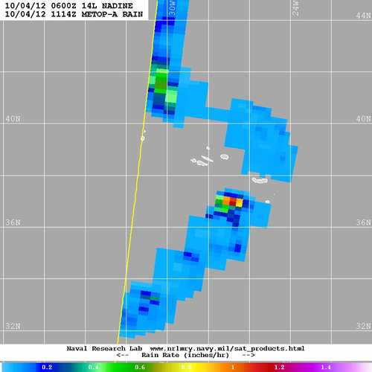
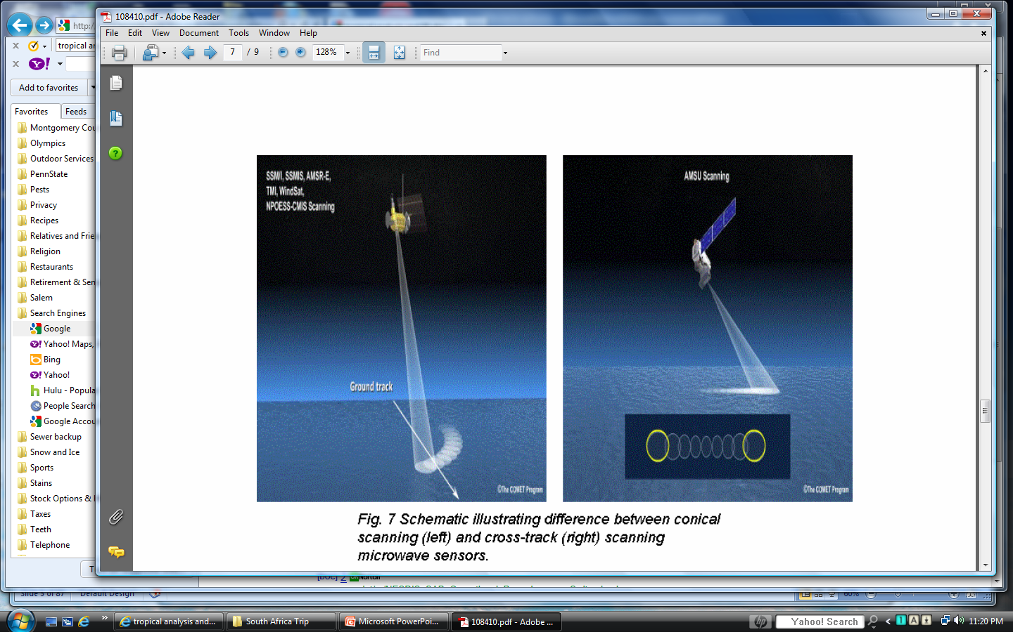
NOAA and METOP AMSU/MHS Satellites have Cross-track Scanning
The COMET Program
Cross-track scanners have wider scan swaths,
but
resolution can degrade toward the edge of scan
in/hr
5 10 15 20 25 30 35 mm/hr
Notes:
Cross-track scanners have wider scan swaths,
but
resolution can degrade toward the edge of scan

Slide 8
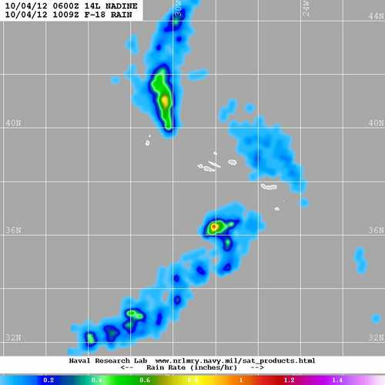
DMSP SSMIS Satellites have Conical Scanning
The COMET Program
Conical scanning produces narrower scan widths.
but
maintains footprint resolution across the entire scan
in/hr
5 10 15 20 25 30 35 mm/hr
Notes:
Conical scanning produces narrower scan widths.
but
maintains footprint resolution across the entire scan

Slide 9
LEO Microwave Imagery Products
Total Precipitable Water (TPW)
- NOAA AMSU-A
- NOAA and MetOp MIRS AMSU-A/MHS
- DMSP SSMIS
Rain Rate (RR)
- NOAA and MetOp AMSU-B MHS
- DMSP SSMIS
Wind
- MetOp ASCAT
- DMSP SSMIS
Notes:
All imagery shown in this part is from the morning of August 18, 2012

Slide 10

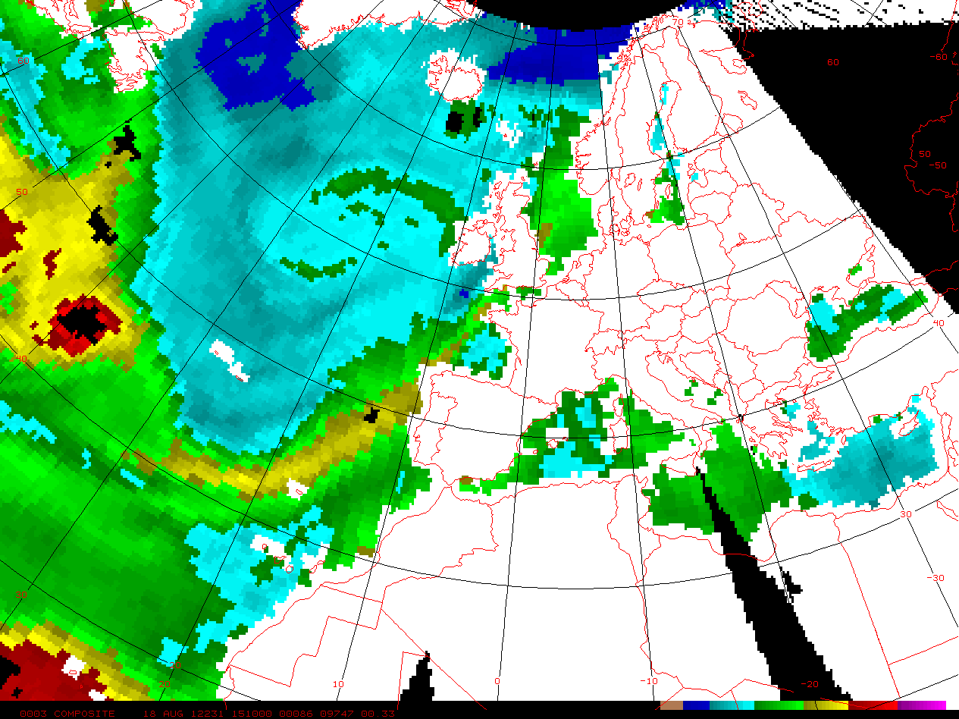
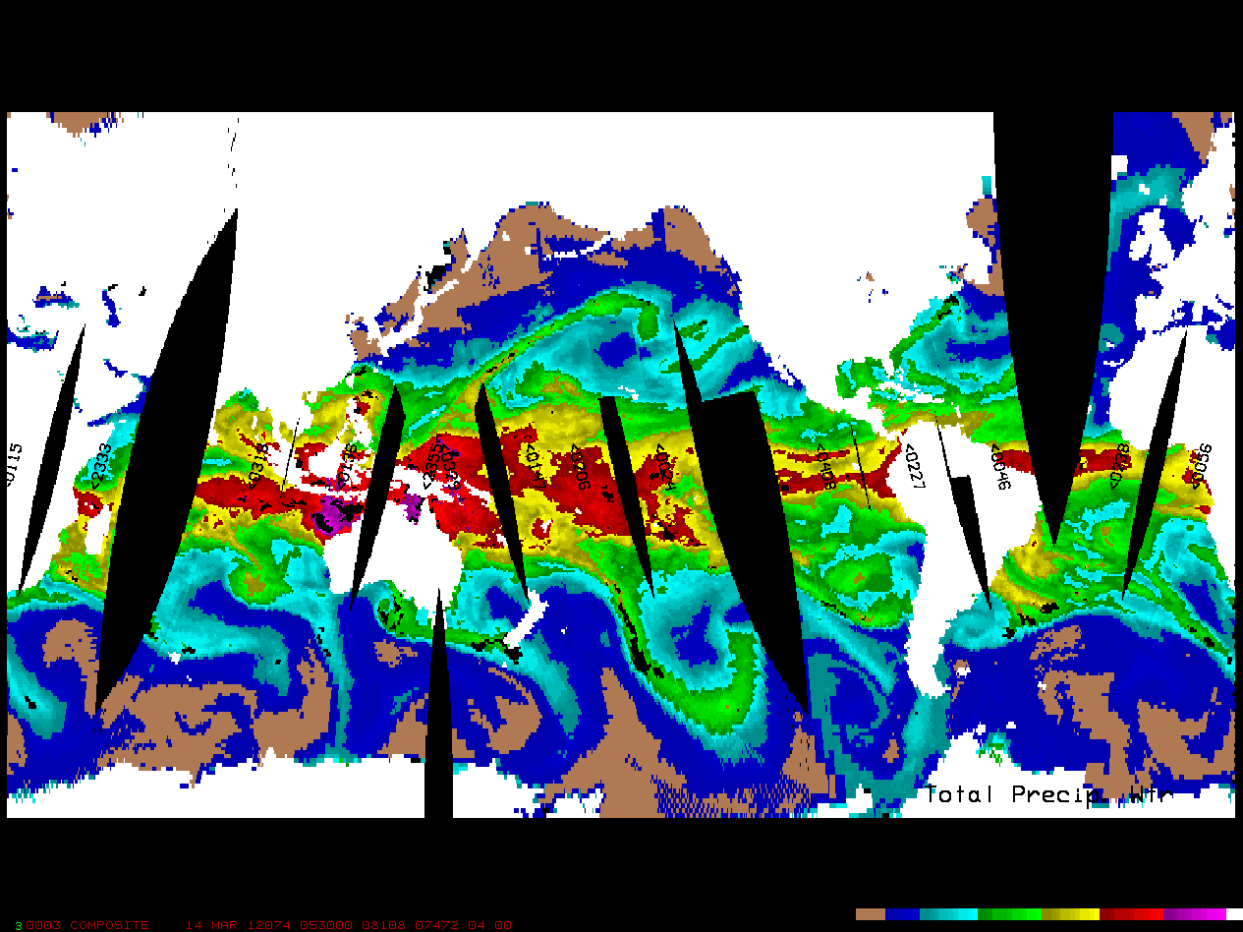
AMSU-A Total Precipitable Water (TPW)
morning passes 18 August 2012
NOAA/MetOp Composite
Range of amount: 1 to 75 mm
Resolution: 45 km (at Nadir)
Satellites: METOP-A, NOAA -19, 18, 17, 16 and 15
New Imagery: 4 to 6 hours
Most accurate MW product
Analysis Applications
Locating max TPW areas and following trends
Overlaying low level winds for moisture transport
Forecast Applications
TPW plume with tropical origins relates to heavy precipitation (Kusselson 1993).
6 12 25 38 50 62 mm
Total atmospheric moisture measured over water that would be available to fall as precipitation.
http://www.orbit.nesdis.noaa.gov/corp/scsb/mspps/overview.html
http://www.ssd.noaa.gov/poes/neatl/ampw-l.jpg
http://www.ssd.noaa.gov/poes/neatl/flash-ampw.html
Notes:
Since most of the moisture in atmosphere is below 3 km, TPW is useful for precisely locating concentrations of moist low level air, one of the most important ingredients necessary for generating
and sustaining heavy precipitation. (Kusselson 1993).
MSPPS = Microwave Surface and Precipitation Products System

Slide 11
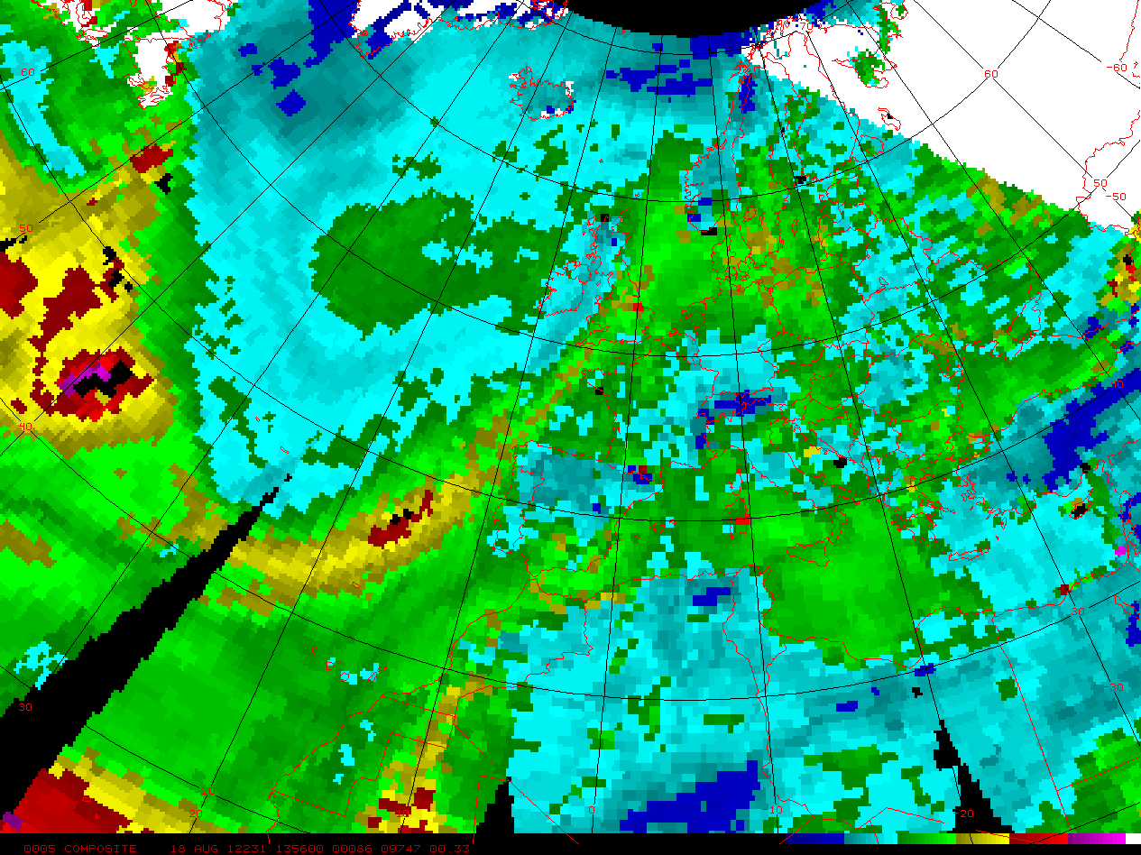
AMSU-A/MHS MIRS Total Precipitable Water (TPW)
morning passes 18 August 2012
NOAA/MetOp Composite
Range of amount: 1 to 75 mm
Resolution: 45 km (at Nadir)
Satellites: METOP-A, N-19, & 18
New Imagery: 6 to 8 hours
Most accurate MW product
Analysis Applications
Locating max TPW and following trends
Overlaying low level winds for moisture transport
Forecast Applications
TPW plume with subtropic origins relates to heavy precipitation (Kusselson 1993).
6 12 25 38 50 62 mm
Total atmospheric moisture measured over land and water that would be available to fall as precipitation.
http://mirs.nesdis.noaa.gov/
http://www.ospo.noaa.gov/Products/atmosphere/mirs/tpw.html
http://www.osdpd.noaa.gov/ml/mirs/Poes.html
Notes:
The operational Microwave Integrated Retrieval System (MIRS) aims to upgrade the NESDIS current operational Microwave Surface and Precipitation Products System (MSPPS) and build a one-stop shop for microwave products from various satellites with different instrumental configurations. With the capability of providing optimal and physically-based retrievals of atmospheric and surface state parameters, the operational MIRS will produce advanced near-real-time surface and precipitation products in all-weather and over all-surface conditions using brightness temperatures from the microwave instruments, which include AMSU-A and AMSU-B/MHS instruments on board of NOAA and EUMETSAT polar orbiting satellites, SSMIS on DMSP polar satellites and ATMS/CIM on NPP/NPOESS. The targeted operational products will include: vertical profiles of temperature and moisture, rainfall rate, total precipitable water, cloud liquid water, snow cover, snow water equivalent, sea ice concentration, ice water path, surface emissivity spectra and land surface temperature.

Slide 12
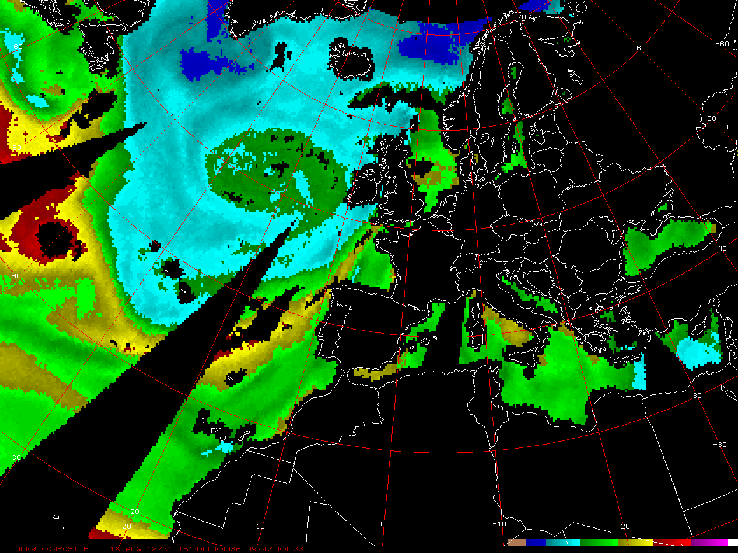

SSMIS Total Precipitable Water (TPW)
morning passes 18 August 2012
DMSP SSMIS Composite
Range of amount: 1 to 75 mm
Resolution: 40 x 60 km
Satellites: SSMIS F-16, 17, & 18
New Imagery: 3 to 12 hours
Most accurate MW product
Analysis Applications
Locating max TPW areas and following trends
Overlaying low level winds for moisture transport
Forecast Applications
TPW plume with tropical origins relates to heavy precipitation (Kusselson 1993).
6 12 25 38 50 62 mm
Total atmospheric moisture measured over water that would be available to fall as precipitation.
http://nsidc.org/data/docs/daac/ssmis_instrument/index.html
12
http://www.ssd.noaa.gov/poes/neatl/sspw-l.jpg
http://www.ssd.noaa.gov/poes/neatl/flash-sspw.html
Notes:
Since most of the moisture in atmosphere is below 3 km, TPW is useful for precisely locating concentrations of moist low level air, one of the most important ingredients necessary for generating and sustaining heavy precipitation (Kusselson 1993).
Total Precipitable Water Path Measurement of atmospheric total precipitable water path by the SSMI relies on the differnces between the 19v and 22v channels. Water vapor is a good emitter, making it appear warmer than the ocean background on the 22v, while 19v doesn't show a corresponding increase. The water vapor algorithm takes advantage of the 22.235 GHz water vapor absorption/emission line. TPW is one of the SSMI's most accurate products. http://www.osdpd.noaa.gov/ml/mirs/Dmsp.html
http://www.osdpd.noaa.gov/ml/spp/sharedprocessing.html#WV

Slide 13
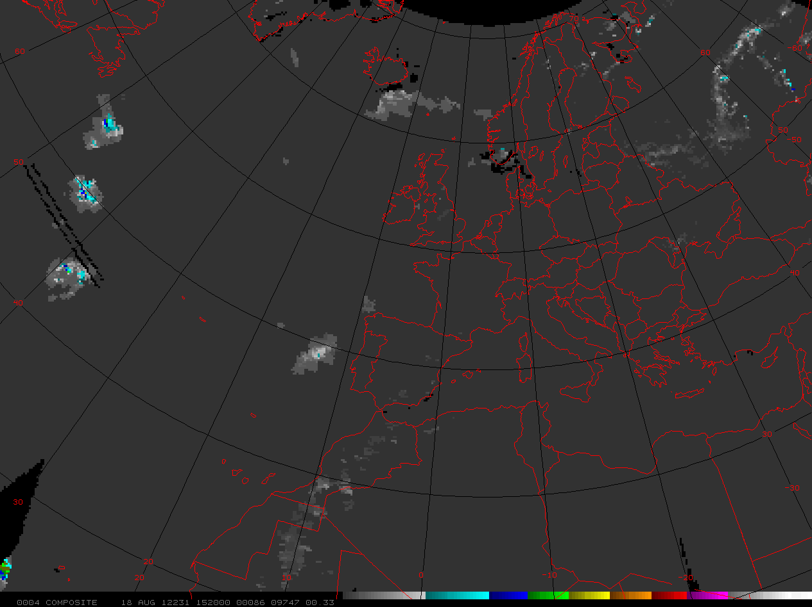
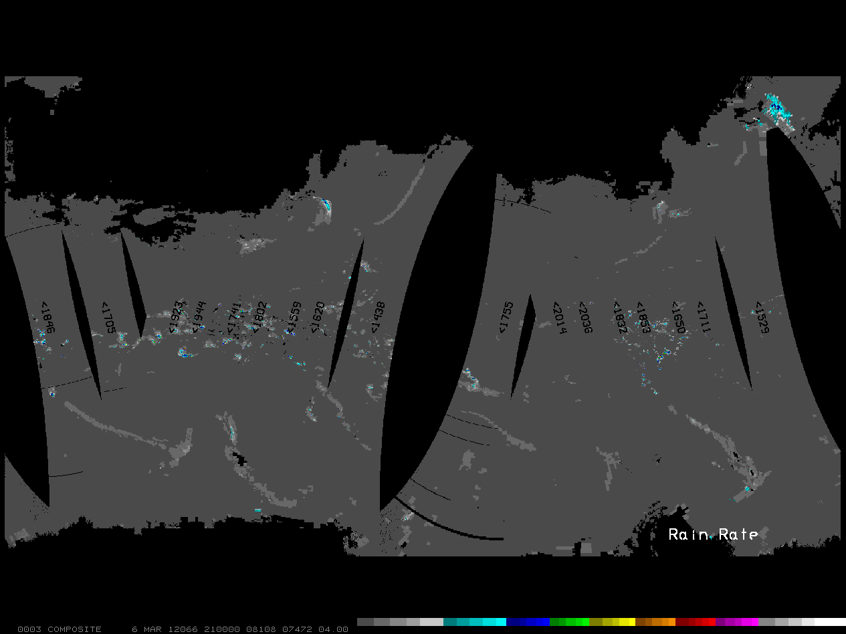
Microwave Humidity Sounder (MHS) AMSU-B Rain Rate (RR)
morning passes 18 August 2012
NOAA/MetOp Composite
Range of amount: 1 to 35 mm/hr
Polarization: Single
Resolution: 15 km (nadir)
Satellites: METOP-A, N-19 & 18
New Imagery: 4 to 6 hours
Estimates useful for identifying:
areal extent
intensity
trends
6 13 19 25 32 38 44 mm/hr
Instantaneous areal (resolution) average rainfall projected over an hour
http://www.orbit.nesdis.noaa.gov/corp/scsb/mspps/overview.html
13
http://www.ssd.noaa.gov/poes/neatl/amrr-l.jpg
http://www.ssd.noaa.gov/poes/neatl/flash-amrr.html
Notes:
Estimates are useful for identifying the areal extent and intensity both over the data sparse water areas and over land areas where radar and observational rain gauge coverage is inadequate
http://www.osdpd.noaa.gov/ml/mspps/rainprd.html
http://www.osdpd.noaa.gov/ml/spp/sharedprocessing.html#RR

Slide 14
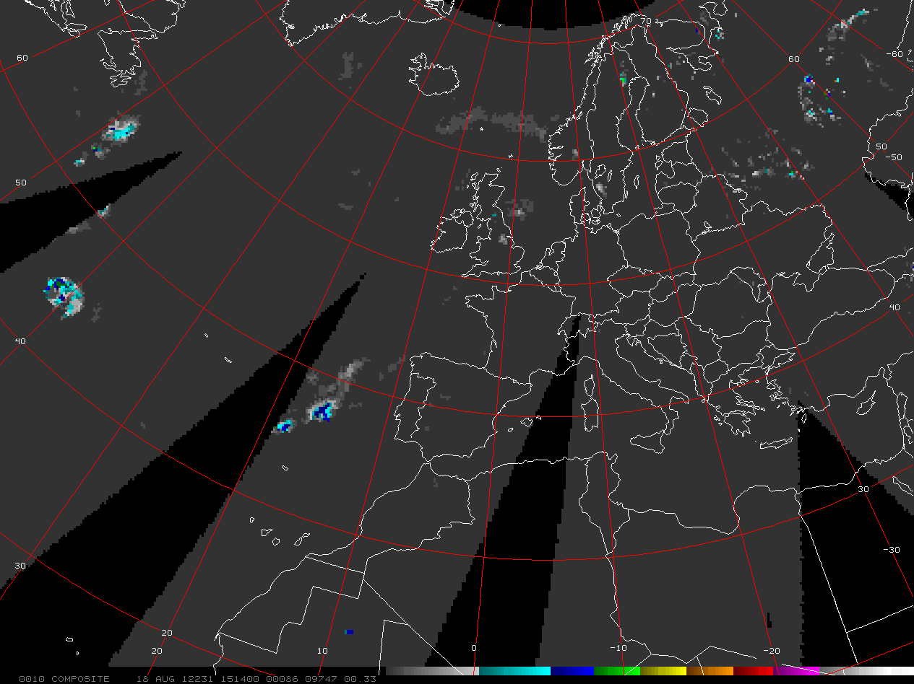
SSMIS Rain Rate (RR)
morning passes 18 August 2012
DMSP SSMIS Composite
Range of amount: 1 to 35 mm/hr
Polarization: Dual
Resolution: 13 x 15 km
Satellites: SSMIS F-16, 17 & 18
New Imagery: 3 to 12 hours
Estimates useful for identifying:
areal extent
intensity
trends
6 13 19 25 32 38 44 mm/hr
Instantaneous areal (resolution) average rainfall projected over an hour
http://www.orbit.nesdis.noaa.gov/corp/scsb/mspps/overview.html
14
http://www.ssd.noaa.gov/poes/neatl/ssrr-l.jpg
http://www.ssd.noaa.gov/poes/neatl/flash-ssrr.html
Notes:
Estimates are useful for identifying the areal extent and intensity both over the data sparse water areas and over land areas where radar and observational rain gauge coverage is inadequate
http://www.star.nesdis.noaa.gov/smcd/jcsda/SDS/algorithm/algorithm.html#rr

Slide 15
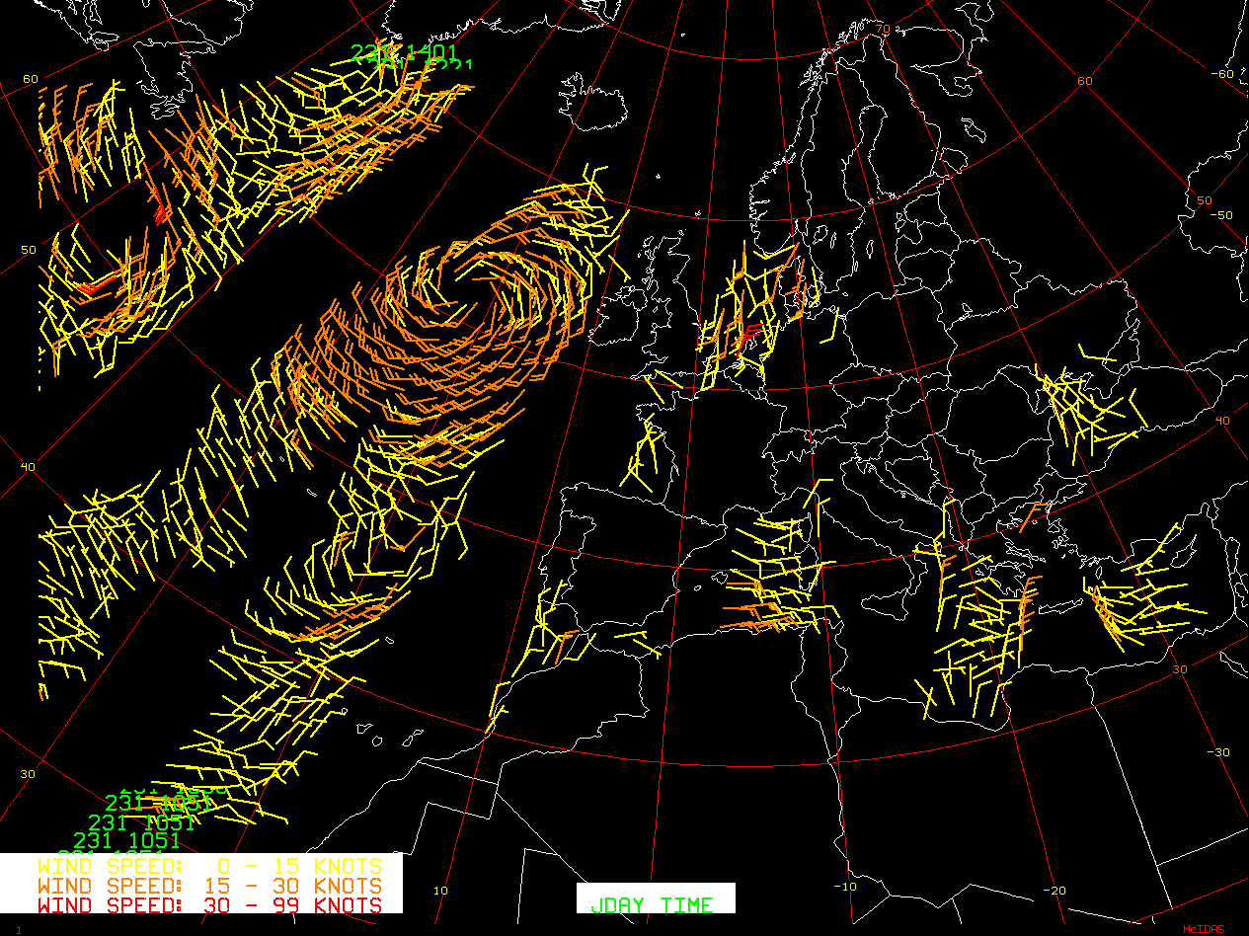

ASCAT Wind Speed & Direction
morning passes 18 August 2012
METOP-A ASCAT
Two 500 km swaths
Heights of wind speed: 10 m
Resolution: 12.5 / 25 km
Range of Speed: 0 to 180 kph
New Imagery: 12 hours
Most reliable: 0 to 90 kph
Analysis Applications
low level inflow/moisture advection for heavy rain production
Intensity and location of circulation centers
location of fronts/ boundaries
The Advanced SCATterometer (ASCAT) measures wind speed AND direction over the oceans
http://oiswww.eumetsat.org/WEBOPS/eps-pg/ASCAT/ASCAT-PG-4ProdOverview.htm
15
http://manati.orbit.nesdis.noaa.gov/datasets/ASCATData.php latest ASCAT
Notes:
Analysis Applications:

Slide 16
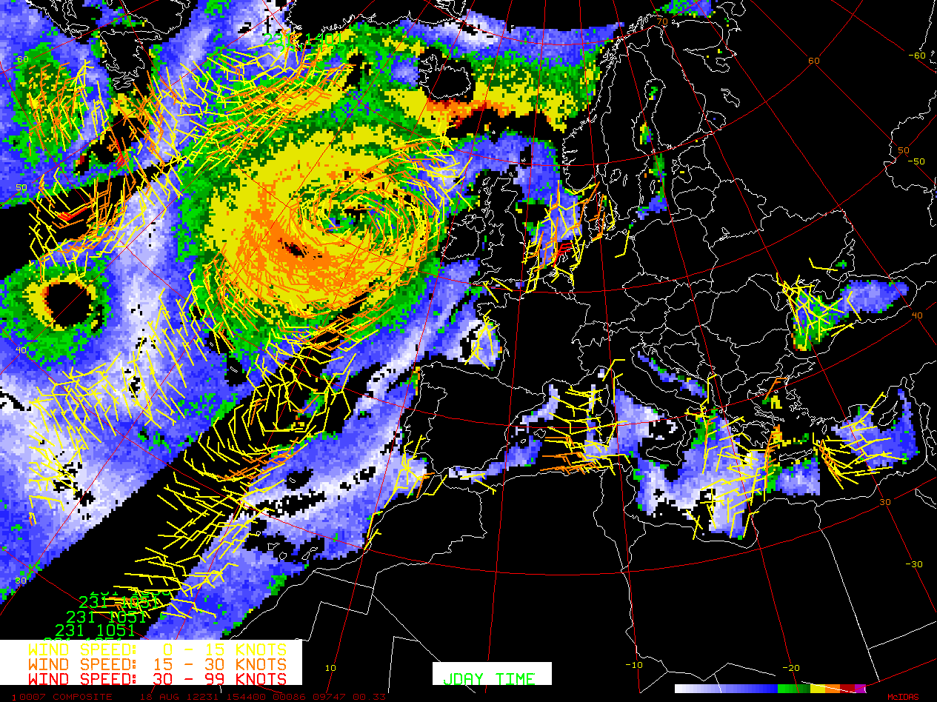
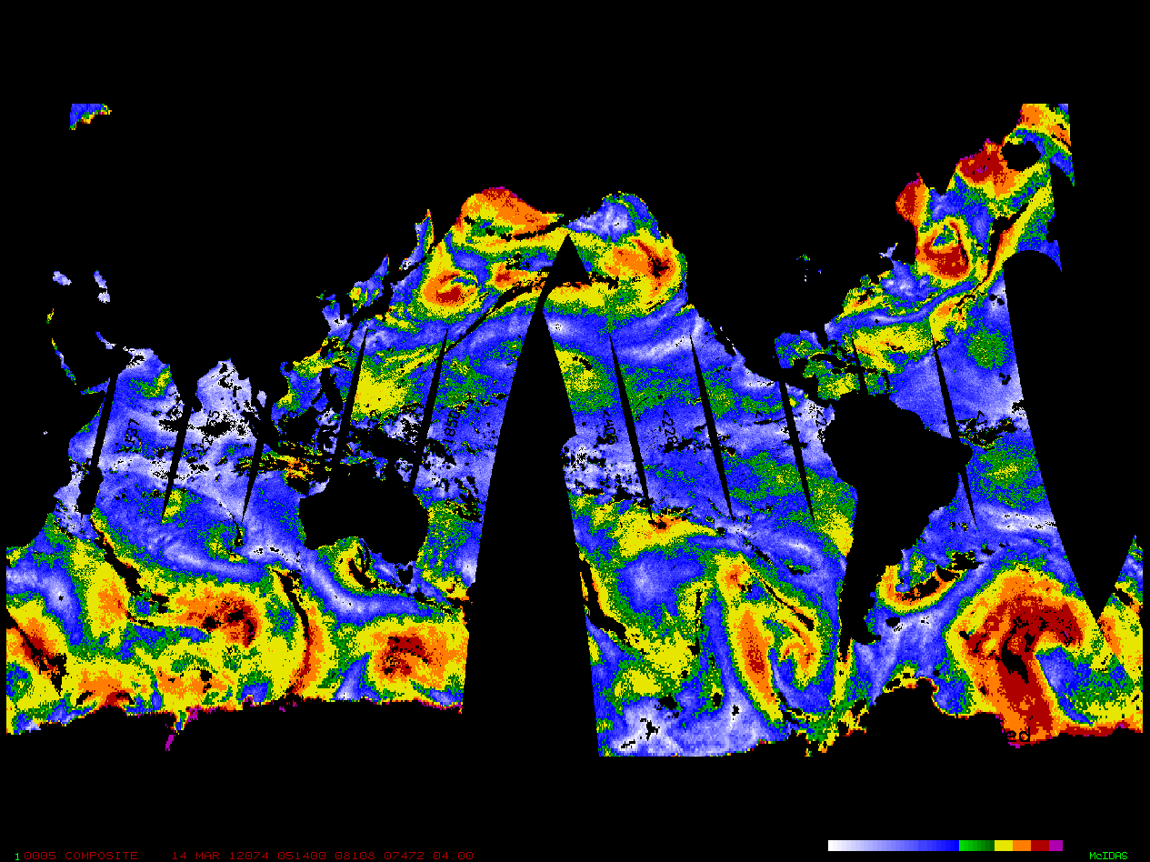
ASCAT Wind Speed & Direction on SSMIS Winds
morning passes 18 August 2012
DMSP SSMIS Composite
Range of speed 0 to 90 kph
Resolution: 25 km
Satellites: F-16, 17 and 18
New Imagery: 9 to 11 hours
Analysis Applications
Max Wind Speed (WS) for best low level inflow
WS trends for low level inflow
Forecast Applications
Highest WS = best inflow = heavy rain
Increasing and/or Persistent WS max = heavy rain
- (Kusselson 1993).
kph 25 45 55 70 75+ land/ice/rain
Ocean surface winds depict only wind speeds at an elevation of 19.5m
16
http://www.ssd.noaa.gov/poes/neatl/sswd-l.jpg
http://www.ssd.noaa.gov/poes/neatl/flash-sswd.html
Notes:
Satellite senses the ocean roughness/capillary waves and an algorithm converts to wind speed
Analysis Applications
Locating max Wind Speed areas for best low level inflow
Following Wind Speed trends for inc/dec low level inflow
Forecast Applications
Location of highest winds speeds; when advected inland is a good first guess for locating the best low level inflow and resultant heavy rain
Increasing and/or persistent wind speed max areas offshore; these are often a contributor to heavy precipitation over land
http://www.star.nesdis.noaa.gov/smcd/jcsda/SDS/algorithm/algorithm.html#ws
http://www.osdpd.noaa.gov/ml/spp/ssmis.html

Slide 17
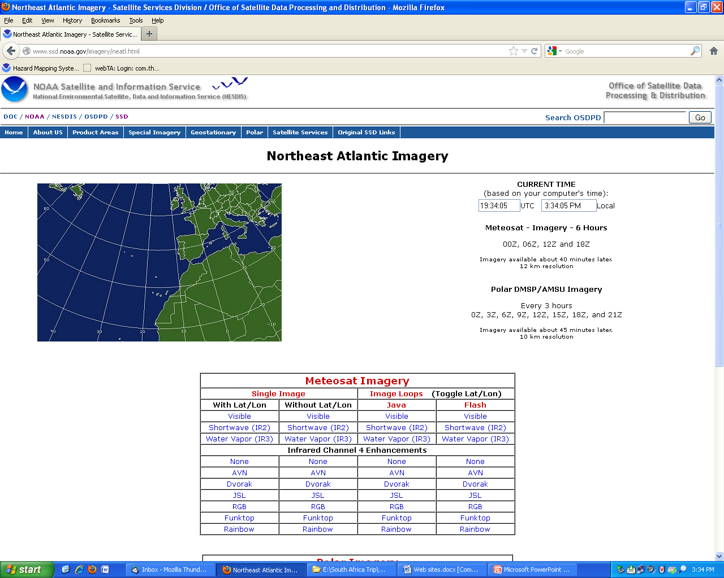
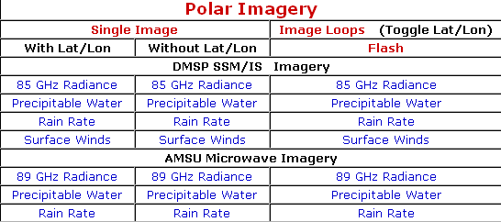
LEO complimenting GEO http://www.ssd.noaa.gov/imagery/neatl.html

Slide 18
LEO Blended Microwave Precipitation Products
Total Precipitable Water (TPW)
- Blended TPW
- Blended TPW Percent of Normal
Rain Rate (RR)
- Blended RR

Slide 19



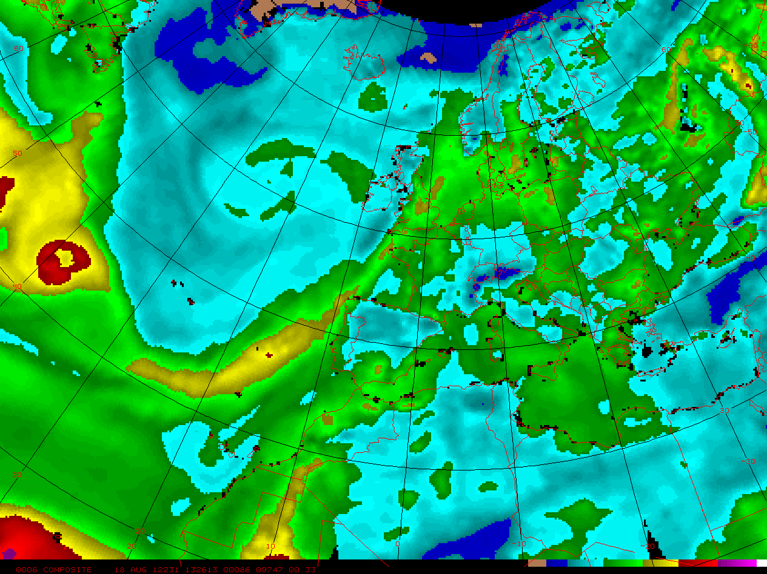


LEO Satellites to produce a Blended TPW Product
N15, 16, 17, 18, 19 & METOP AMSU-A over water
SSMIS F16, 17, & 18 over water
N18, 19 & METOP MIRS AMSU-A over land
DMSP SSMIS F-16
NOAA 15, 16, 17, 18, 19 & METOP AMSU-A
water only
Blended Total Precipitable Water
Dec 20, 2008
18 August 2012
NOAA 18, 19 & METOP MIRS AMSU-A
DMSP SSMIS F-17 & 18
land only
6 12 25 38 50 62 mm
19
Notes:
Remains of Gordon in far left. Benefits of a Blended TPW Product. Histogram method and biases known between the different satellites and a smoothing technique to produces one TPW product that is made to look like NOAA-19.

Slide 20
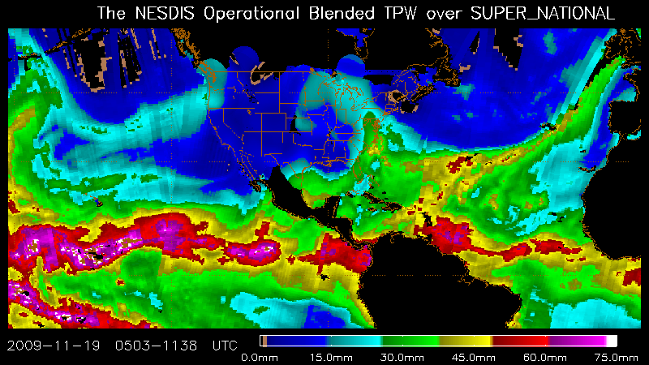
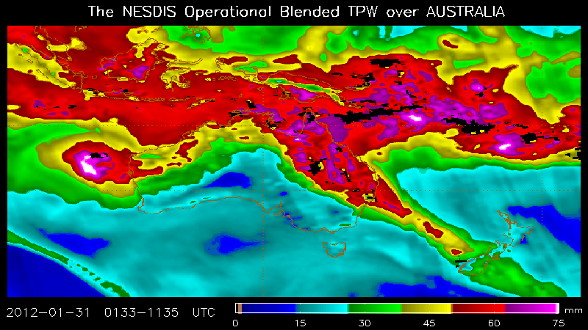
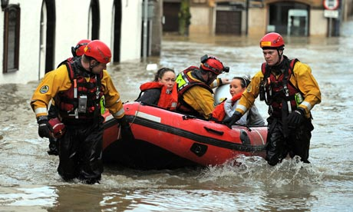
Total Precipitable Water (TPW) Concepts and Applications
TPW Satellite Signature
Moisture plume or “atmospheric river”
Concentration of highest amount of
low level moisture - pattern recognition
TPW Applications
Blended TPW 12 UTC 19 Nov 2009
Low level flow parallel through highest
moisture for longest distance can lead to
heavy precipitation
Stronger the low level flow, the
stronger chance of heavy precipitation
Most ideal for heavy precipitation:
long fetch of low level winds
parallel the moisture plume; upper level
forcing and strong orographics along or
at end of plume
Sharper the moisture gradient,
increased chance of severe weather
and/or heavy precipitation
The Results
Andrew Yates/AFP/Getty Images
Notes:
Most recognizable satellite signature for TPW??? The moisture plume or “atmospheric river” of moisture. TPW applications I have used since the beginning of the microwave era 20 years ago??? Low level flow (900 to 700 hPa) through the highest moisture (river) for the longest distance can many times lead to heavy rainfall downstream. Stronger the low level inflow (and this is the reason LEO winds are an important addition, the stronger the chance of heavy precipitation as long as first point in TPW Applications is true.
Most ideal and almost always leads to heavy rainfall that can cause flash flooding??? Long fetch of low level winds parallel AND through the highest moisture (plume) along with upper level forcing close by…diffluence will also help and strong orographics along or at the end of the plume. Sharper the moisture gradient on western and north side of plume, the increased chance of severe weather and/or heavy precipitation.
Merged TPW image is from 12 UTC 20 Feb 2010 and results rainfall from 06 UTC 19 Feb to 00 UTC 21 Feb 2010.

Slide 21
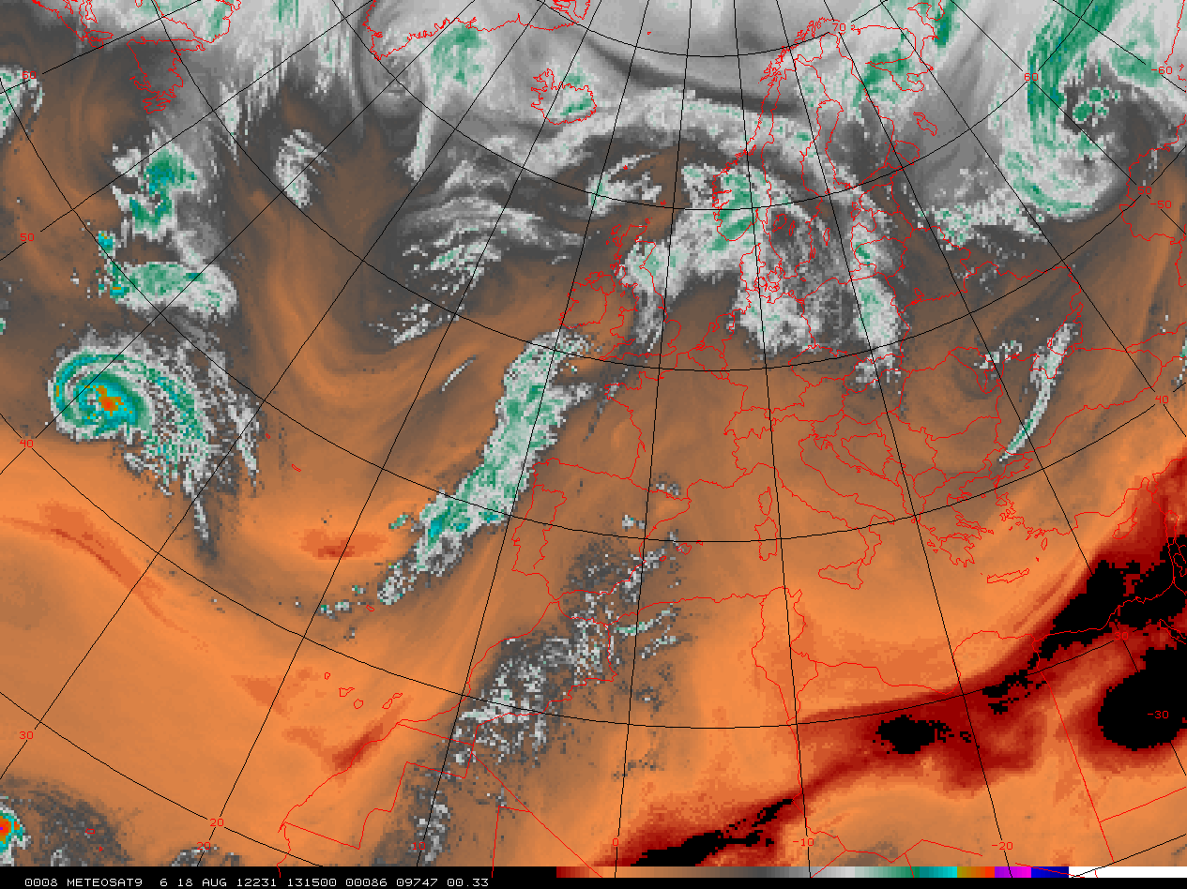



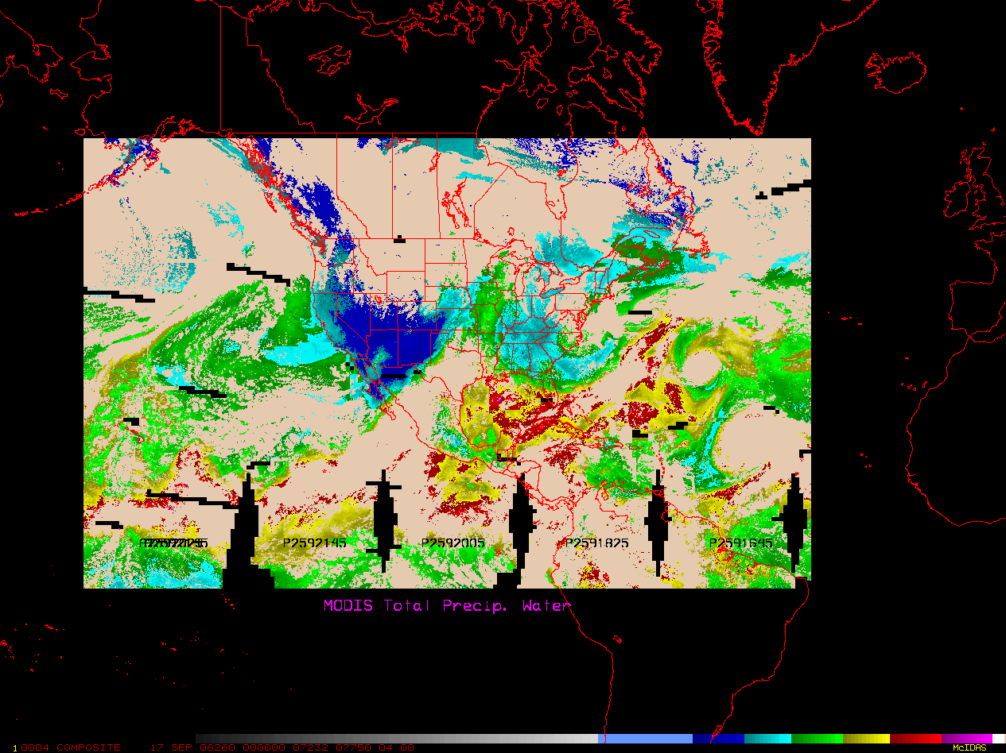
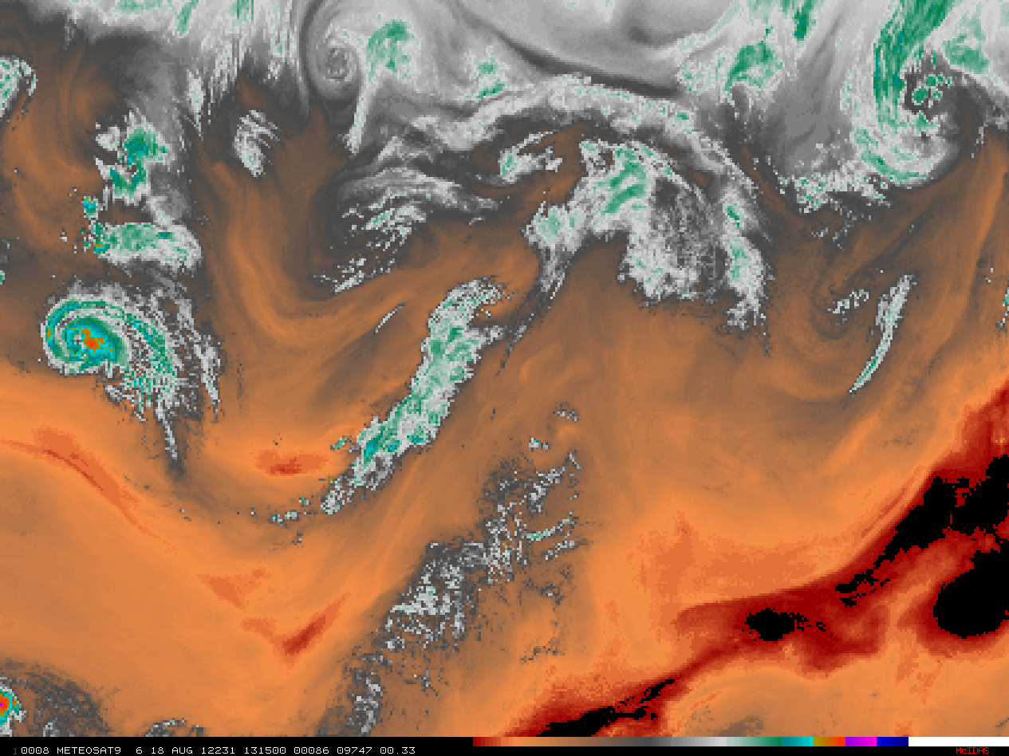
Blended Total Precipitable Water (TPW) and
Geostationary 6.25µ Water Vapor (WV)
Compare and Contrast; Complement and Supplement
0400-1000 UTC 18 August 2012 Blended TPW
1130 UTC 18 August 2012 METSAT WV
Hurricane Gordon
L
- - - - - - - - - - - -
- - - - - - - - - - - - - - -
6 12 25 38 50 > 62 mm
<<<<<<< lower moisture higher moisture >>>>>>>>
TPW
Geostationary 6.25µ WV
Total moisture
Moisture 3000-8000 m
Senses low/mid level moisture
Senses mid/high level moisture
Identifying moisture plumes
Identifying jets, troughs, short waves
For moisture transport 700 - 900hPa
Moisture transport 300 - 600hPa

Slide 22

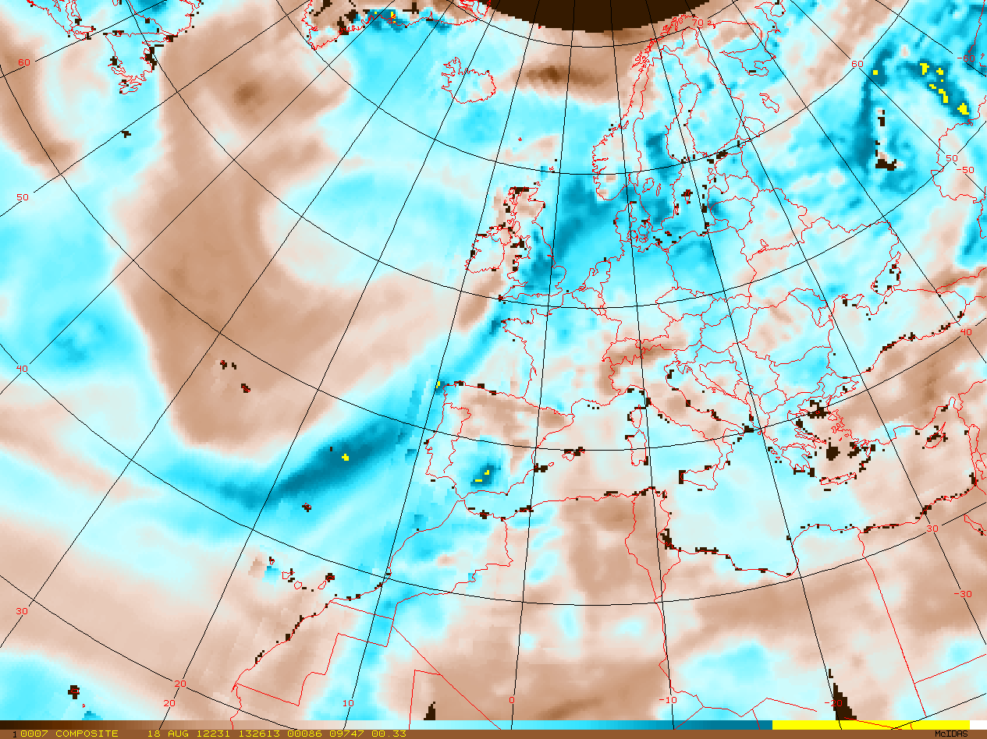
Blended Total Precipitable Water (TPW)
Blended TPW Product is compared to a climatology – NASA Water Vapor project 1988-1999
Brown = below normal
Aqua = above normal
Yellow 200+%
150% related to 2 standard
deviations above normal
High impact events more
easily seen
6 12 25 38 50 >62 mm
Blended TPW Percent of Normal
18 August 2012

Slide 23
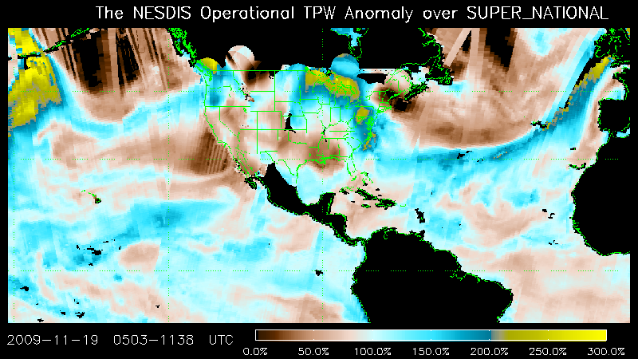
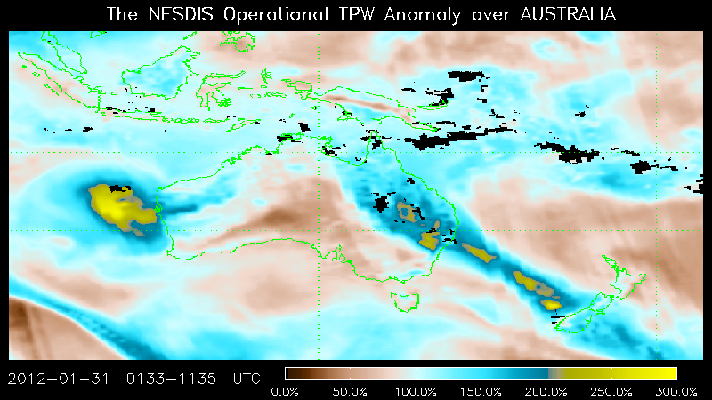
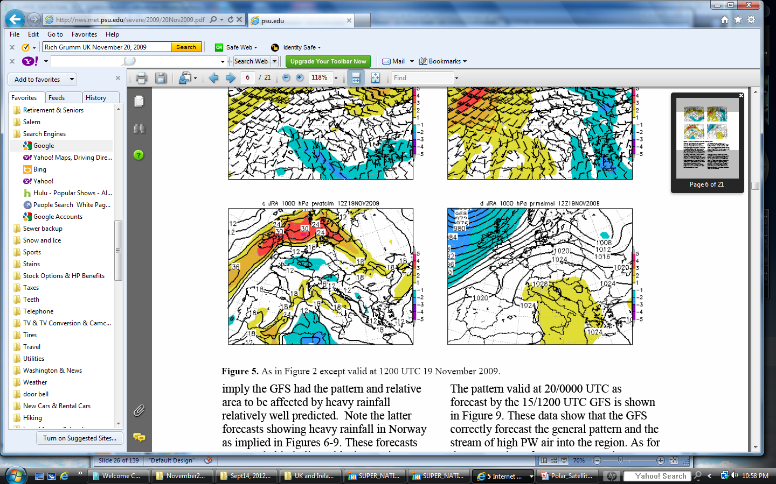
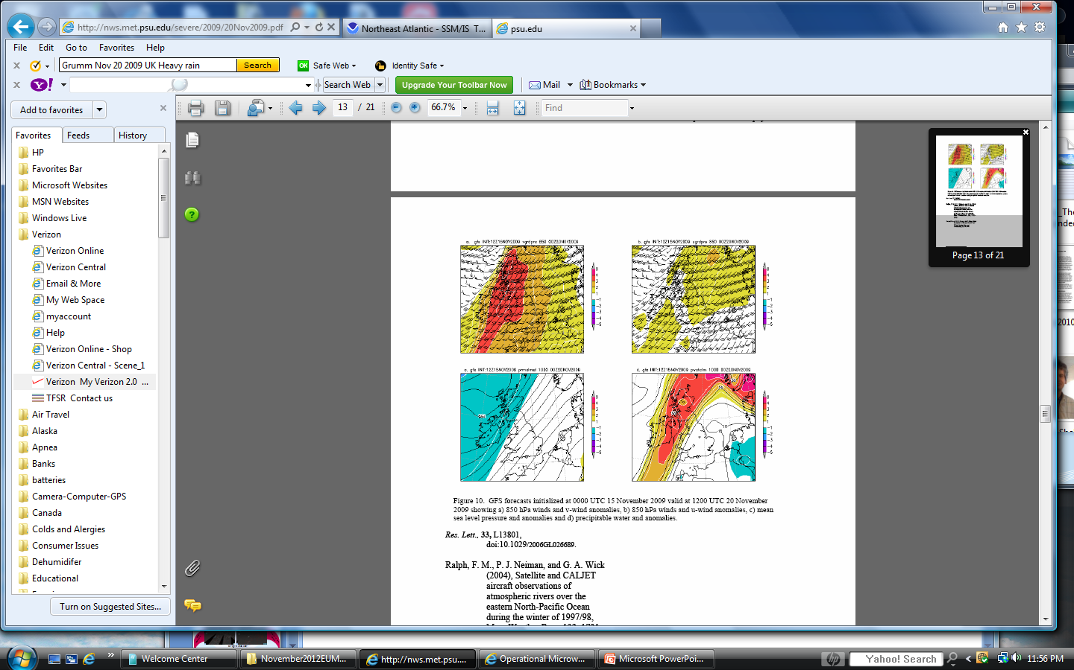
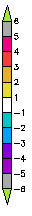


TPW Percent of Normal Concepts and Applications
TPW Percent of Normal
Higher the percentage of normal, increased potential for heavy rain/flooding
Increasing and/or persistent above normal moisture can lead to increased heavy rain/
flood potential
Blended TPW % of Normal 12 UTC 19 Nov 2009
Sharp gradient between below and above normal moisture can lead to increased chance of severe weather and/or heavy rain/flash flood
NCEP GFS TPW and Anomaly Forecast for 12 UTC 19 Nov 2009
+5 +4 +3 +2 +1 -1 -2 -3 -4
The addition of model anomaly guidance can increase forecast confidence
23
http://nws.met.psu.edu/ensembles/global.html

Slide 24
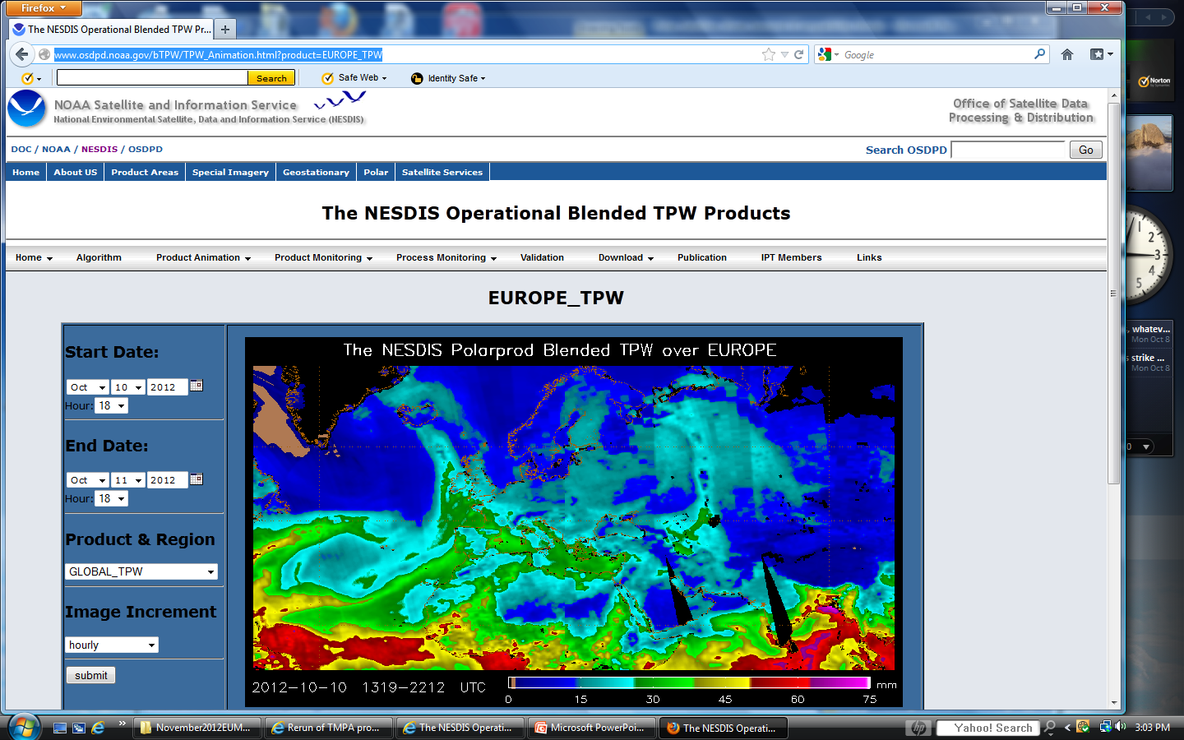
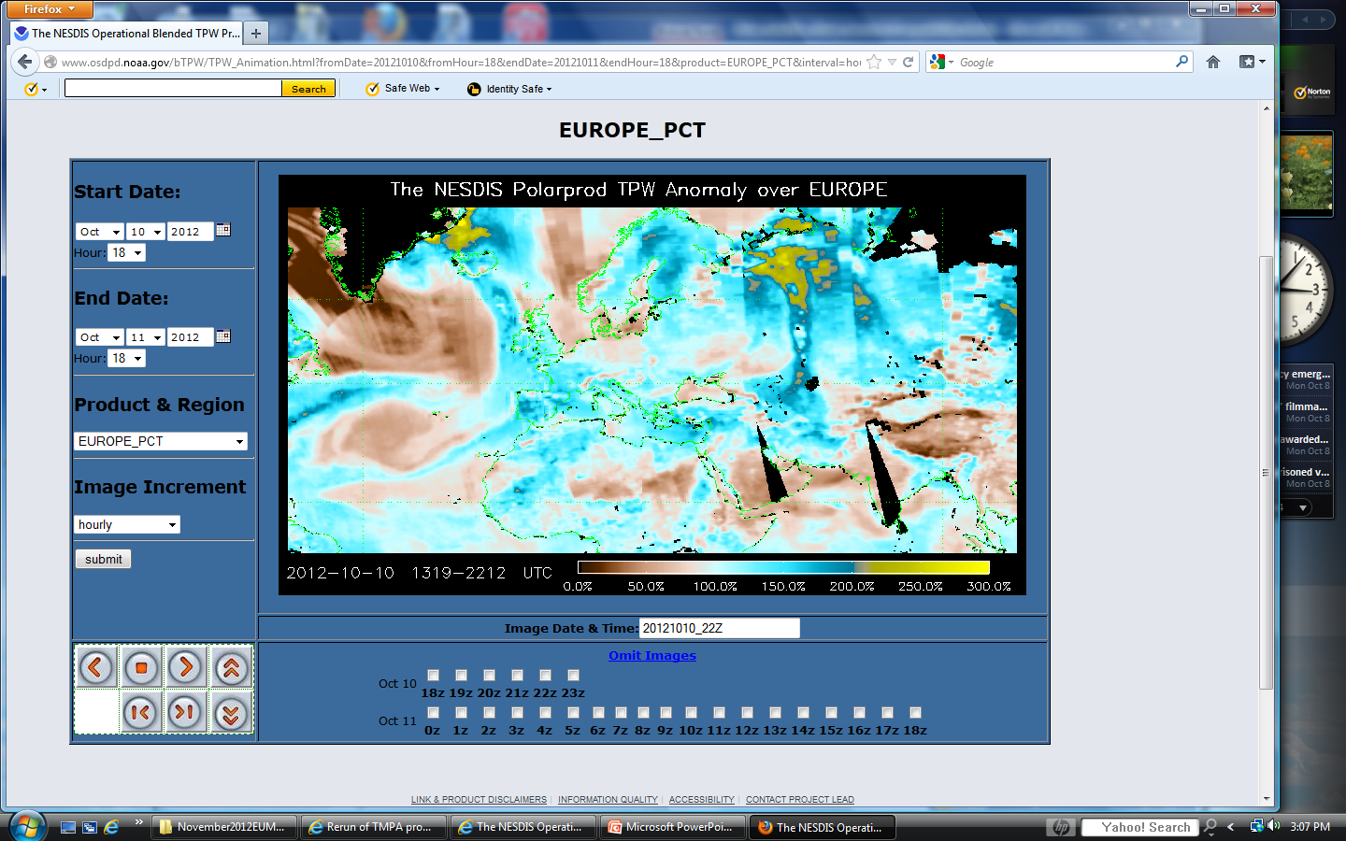
NOAA Blended TPW Products on Internet http://www.osdpd.noaa.gov/bTPW
http://www.osdpd.noaa.gov/bTPW/TPW_Animation.html?product=EUROPE_TPW
Blended TPW
Blended TPW Percent of Normal
http://www.osdpd.noaa.gov/bTPW/TPW_Animation.html?product=EUROPE_PCT

Slide 25
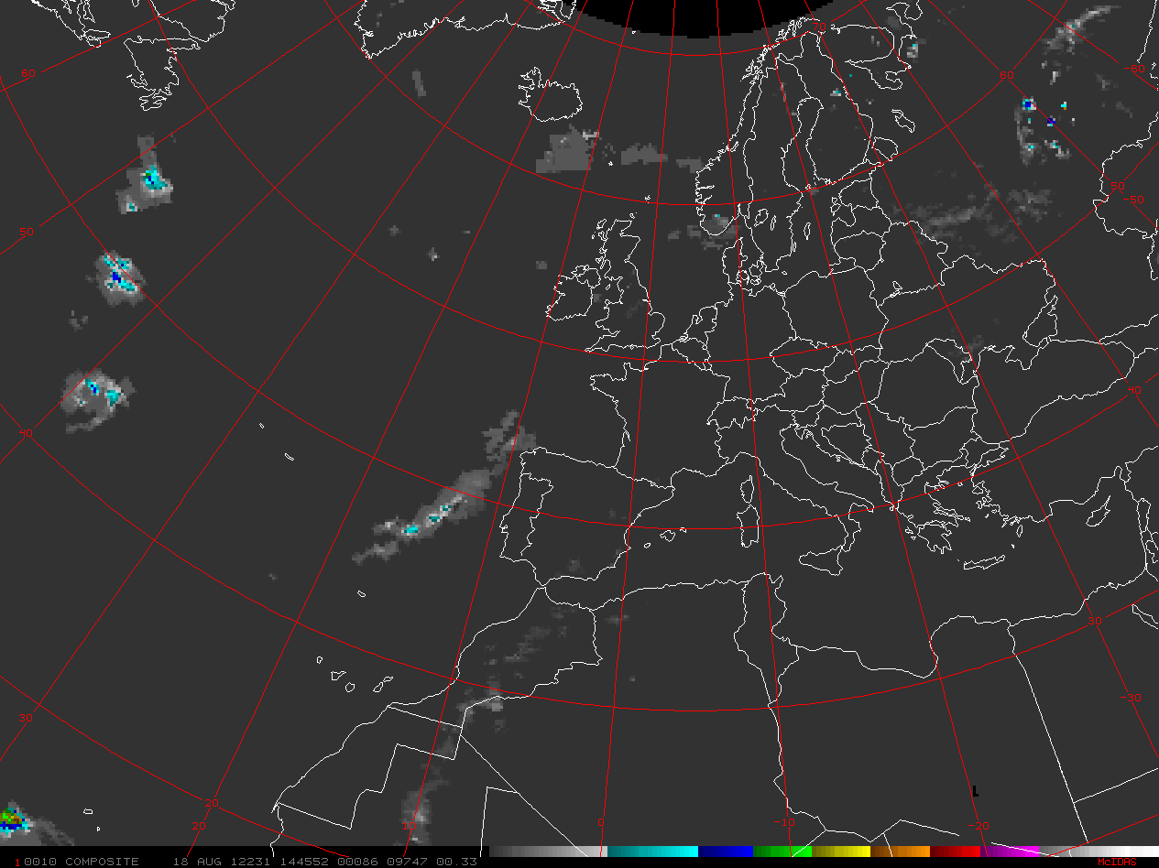
LEO Satellites Used to produce a Blended Rain Rate (RR) Product
SSMIS F16, 17, 18
NOAA 18, 19 & METOP-A MHS AMSU-B
DMSP SSMIS F-16
NOAA 18, 19 MHS AMSU-B
Blended Rain Rate
18 August 2012
DMSP SSMIS F-17& 18
METOP MHS AMSU-B
6 13 19 25 32 38 44 mm/hr
25
Notes:
The blended rain rate (RR) product is produced hourly by blending together recent rain rate retrievals from passive microwave instruments on six polar-orbiting satellites, including POES NOAA-18, NOAA-19 and Metop-A, and also DMSP F16, F17 and F18. The blended RR eliminates the bias between those data sets and provides a unified, meteorologically significant rain rate field for satellite analysts and weather forecasters. The product is generated with the latest 12 hours worth of rain rate retrievals from multi-satellites/algorithms and output with a Mercator projection with 16-km resolution at the equator.

Slide 26
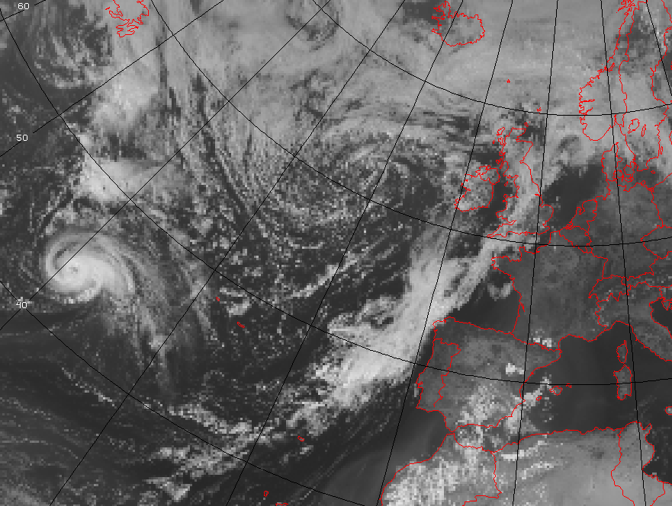

METSAT VIS 1200 UTC 18 August 2012
MPE 1200 UTC 18 August 2012
Blended RR 1000-1445 UTC 18 August 2012
6 13 19 25 32 38 44 mm/hr
Notes:
Always good to have more than one source of satellite data to help with your analysis of precipitation.

Slide 27

NOAA Blended Rain Rate Product on the Internet http://www.ospo.noaa.gov/Products/atmosphere/brr
http://www.ospo.noaa.gov/Products/atmosphere/brr/brr_loops.html?product=EU&maptype=RR

Slide 28









Blended Rain Rate
0900 UTC 20 February 2010
AP
AP
6 13 19 25 32 38 44 mm/hr
AP
The Madiera Flood Event: Use of TPW and RR
Blended Total Precipitable Water (TPW)
0600 UTC 20 Feb 2010
Blended TPW Percent of Normal
0600 UTC 20 Feb 2010
The Madeira Island Floods of 20 February 2010 http://nws.met.psu.edu/severe/2010/20Feb2010.pdf
The 20 February 2010 Madeira flash-floods: synoptic analysis and extreme rainfall assessment http://www.nat-hazards-earth-syst-sci.net/12/715/2012/nhess-12-715-2012.pdf

Slide 29









“Atmospheric River” and low level moisture advection pattern recognition
Morning of 8 January 1995 DMSP SSM/I TPW F-10 & 11
15 30 45 > 60 mm
The Results
L
~1200 UTC 20 February 2010 Blended TPW
6 12 25 38 50 62 mm

Slide 30


NOAA Blended Total Precipitable Water (TPW) Loop 1800 UTC 18 Feb to 1800 UTC 20 Feb 2010

Slide 31

NOAA Blended TPW Percent of Normal Loop 1800 UTC 18 Feb to 1800 UTC 20 Feb 2010

Slide 32






Unusually strong high level jet crossing moisture plume
polar jet
250 hPa polar-subtropical jet
Merged TPW
subtropical jet
850 hPa low level jet
Unusually strong low level jet parallel highest moisture for maximum moisture transport
12 UTC 20 Feb 2010
AP
early morning 20 Feb 2010
mid morning 20 Feb 2010
midday 20 Feb 2010
early afternoon 20 Feb 2010
15 km Blended RR
6 13 19 25 32 38 mm/hr
Why rain estimates useful?
1.
2.
3
6 km NASA AMSR-E RR
1518 UTC/20
1336 UTC/20
5 10 15 20 25 mm/hr
Notes:
Unusually strong high level jet crossing moisture plume -----→
Unusually strong low level jet parallel highest moisture for maximum moisture transport -----→

Slide 33

I want your analyses and forecasts to be the best !
e-mail:
Sheldon.Kusselson@noaa.gov
Sheldon.Kusselson@verizon.net
Thank you for your attention. Any more questions
??
??
Notes:
By knowing and understanding LEO satellite derived microwave and Blended products and using them with GEO satellite imagery, your analysis and forecasts will be the best. It has been a pleasure to introduce to LEO and Blended products…any further questions?

Slide 34
Some Questions??? to see how much you have learned
True or False - LEO MW satellite imagery complements GEO and provide value added
information to improve analyses and forecasts.
Name one type of scanning strategy on MW LEO satellites. _________________
True or False - MW sensors used to produce the TPW products measure total moisture in the middle and high levels of atmosphere.
True or False - MW Rain Rates are instantaneous areal average rainfall projected over an hour.
ASCAT provides information on wind ______ and _____ so that when used with TPW provide information on moisture advection and potential heavy rainfall.
GEO satellite sensors/imagery see only to the ______ of clouds, while LEO MW sensors/imagery can see ________ the clouds.
Name one benefit of using blended RR or TPW. _________________
LEO MW TPW is best for identifying _______ level moisture, while GEO Water Vapor is best at identify ________ level moisture.
Name a product that compares Blended ______ to a climatology. __________________

