Slide 1
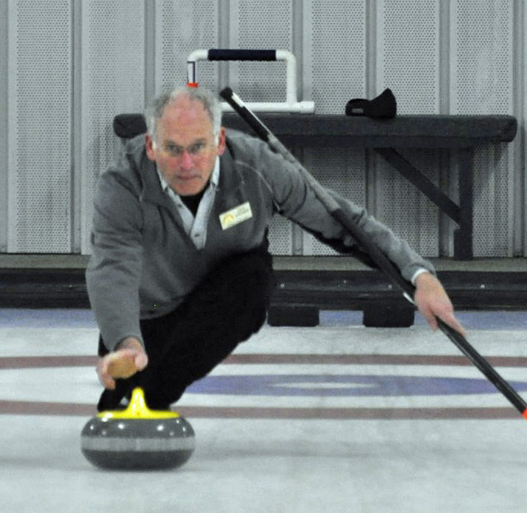
Overview of Cloud Products
Steve Ackerman
Director, Cooperative Institute for Meteorological Satellite Studies
University of Wisconsin-Madison

Slide 2
Outline
Introduction
A bit of history
Current Popular Vis/IR Imagers
Basic in cloud Approaches
Sanity and Consistency Checks
Validation
Comparison to active sensors
Summary

Slide 3
What is a cloud?
Depends on detection objective….
What are three ways that we detect objects using our visual sensors (eyes and brain)?

Slide 4
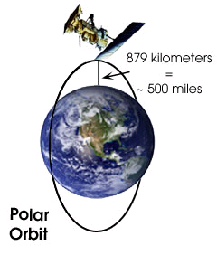
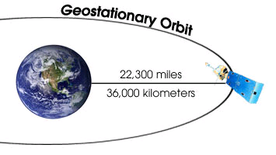
Polar Orbit vs. Geostationary
Closer to Earth – higher spatial resolution
Many are sun-synchronous

Slide 5
The first imagers on satellites

Slide 6
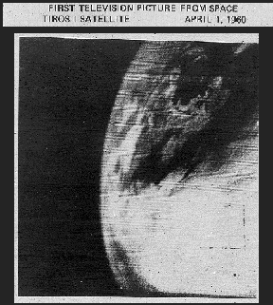
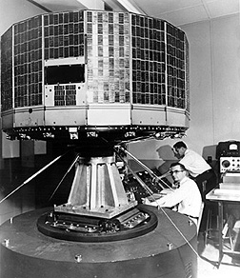
IGY satellite experience paved way for visible cloud mapping with polar orbiting TIROS launched 1 Apr 1960
Notes:
IGY satellite experience helped pave the way for cloud mapping TIROS in 1960. Parallel Nimbus (research) and ESSA (operational) satellite series promoted rapid evolution to higher capability platforms. 450 miles above the earth, TIROS broadcast its data globally – open data policy assured that TIROS would become a most popular ambassador of the US

Slide 7
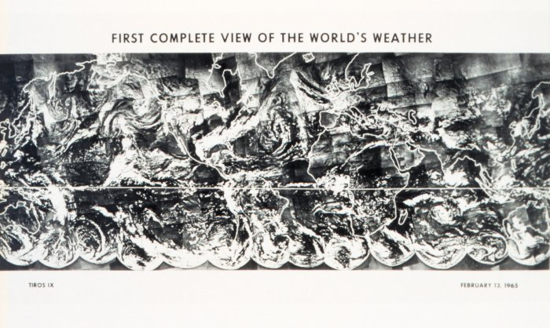
Global Cloud Cover (February 13, 1965)

Slide 8
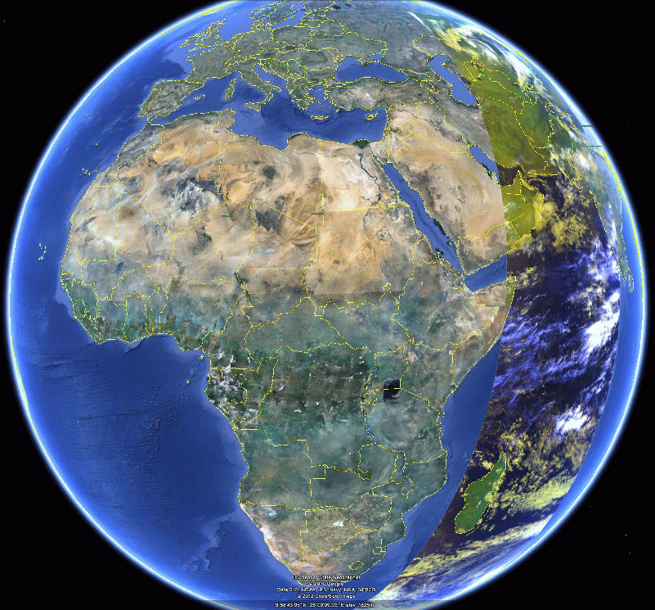
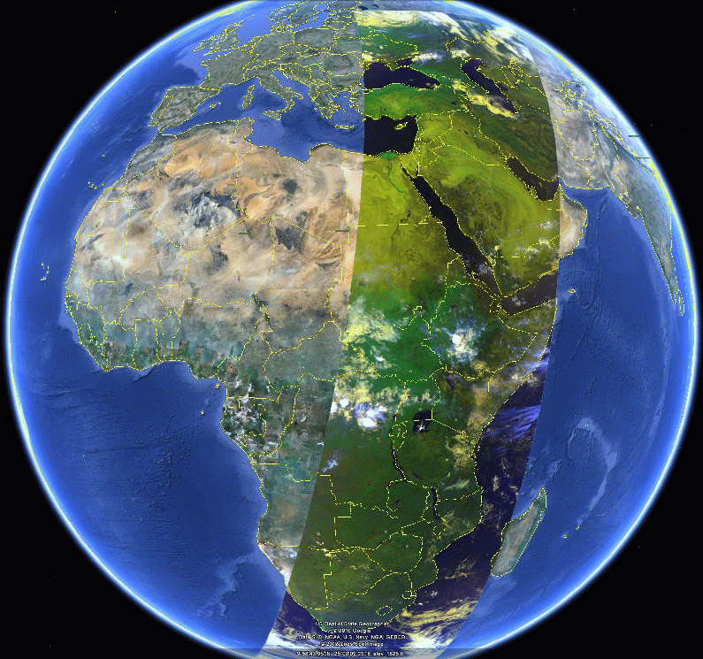
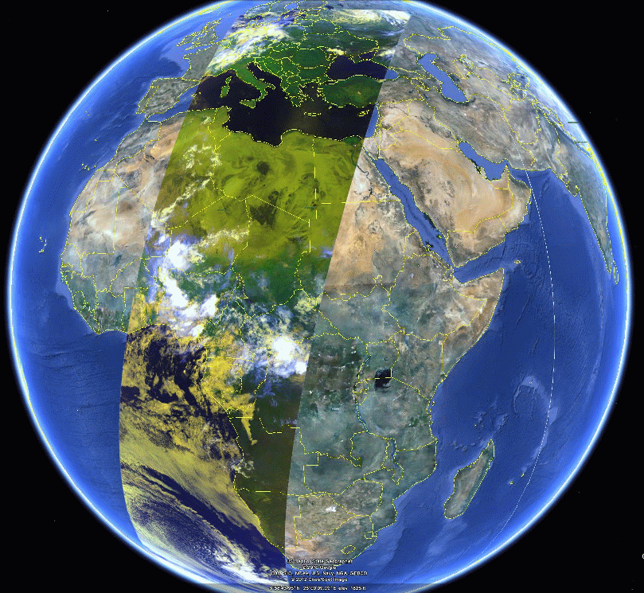
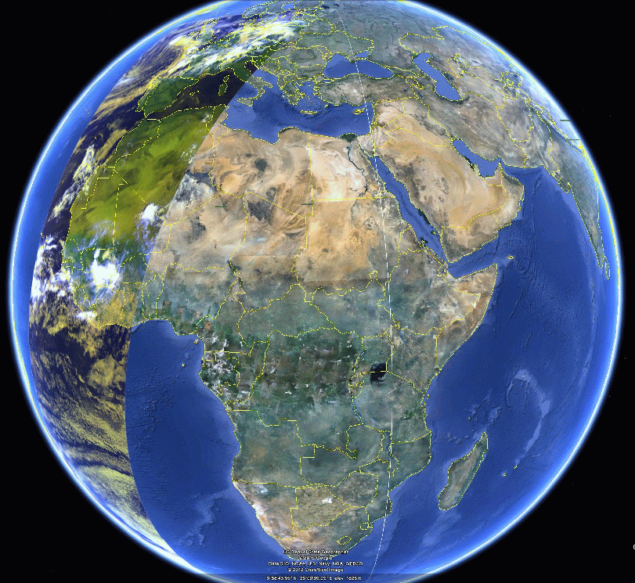
Introduction to the AVHRR
Flown since November 1978, Extend to 2025+ with METOP-C.
AVHRR/1: 4 channels (063, 0.86, 3.75 and 11 μm).
AVHRR/2: 5 channels (0.63, 0.86, 3.75, 11 and 12 μm)
AVHRR/3: (1998-present) a 6th channel at 1.6 μm that sometime replace the 3.75 μm during the day.
Global long-term data: GAC data which has a nominal resolution of 4 km. METOP provides global 1km data.
Temporal sampling is roughly 4xday but since 2000, this has increased to 6x or 8x.
Example Coverage of 4 successive METOP-A Orbits

Slide 9
MODIS
The MODIS (Moderate Resolution Imaging Spectroradiometer) measures radiances at 36 wavelengths including infrared and visible bands with spatial resolution 250 m to 1 km.
MODIS “cloud mask” algorithm uses conceptual domains according to surface type and solar illumination including land, water, snow/ice, desert, and coast for both day and night.
A series of threshold tests attempts to detect instrument field-of-view scenes with un0bstructed views of surface.
Notes:
Quick overview – don’t spend much time.

Slide 10
Cloud detection Threshold approach
Each test returns a confidence (F ) ranging from 0 to 1.
Similar tests are grouped and minimum confidence selected [min (F_{i} ) ]
Quality Flag is
Four values; , >.66, >.95 and >.99
Notes:
Quick overview

Slide 11
Cloud detection based on Bayesian classifier
A Bayesian method works by testing the probability that a measured radiance vector has come from a clear or cloudy pixel. Statistics are known based on lidar or simulations.
Notes:
Quick overview

Slide 12
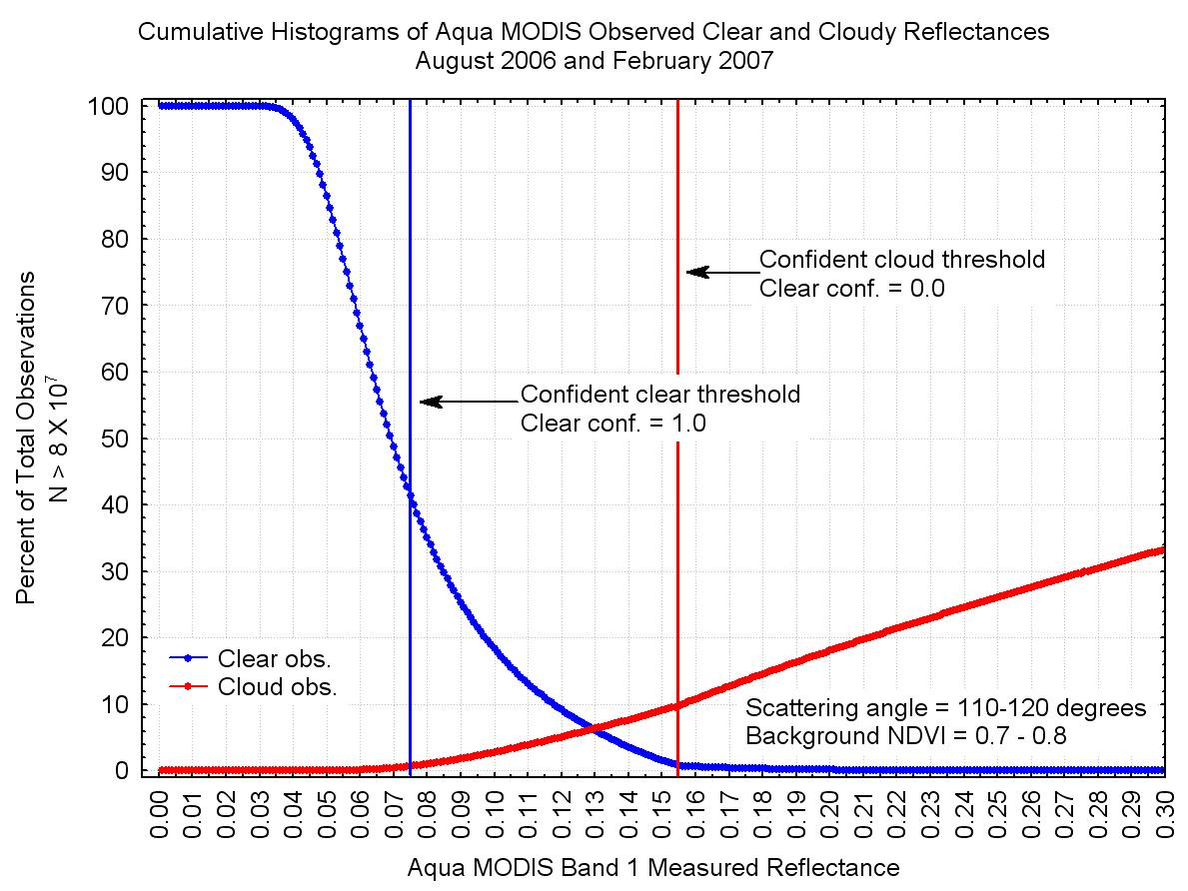

Slide 13
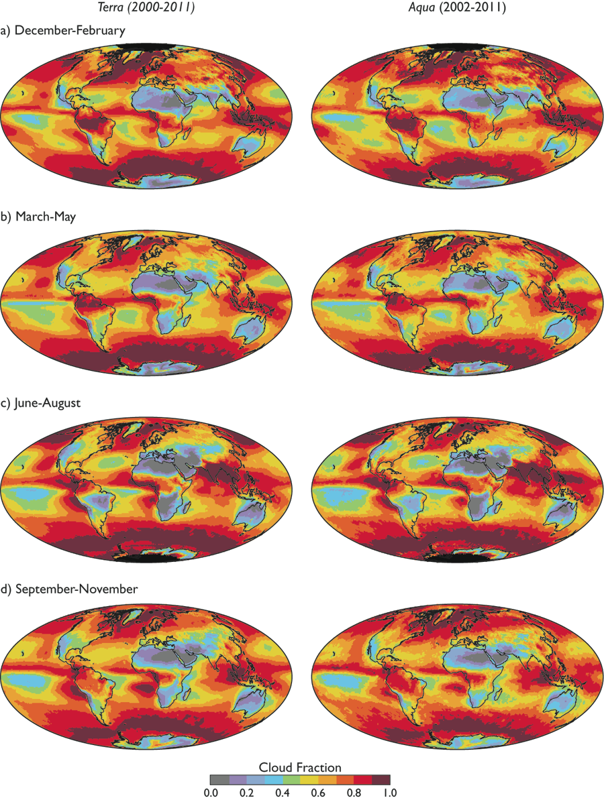
Global Cloud Cover
Global Cloud cover from the two MODIS instruments.

Slide 14
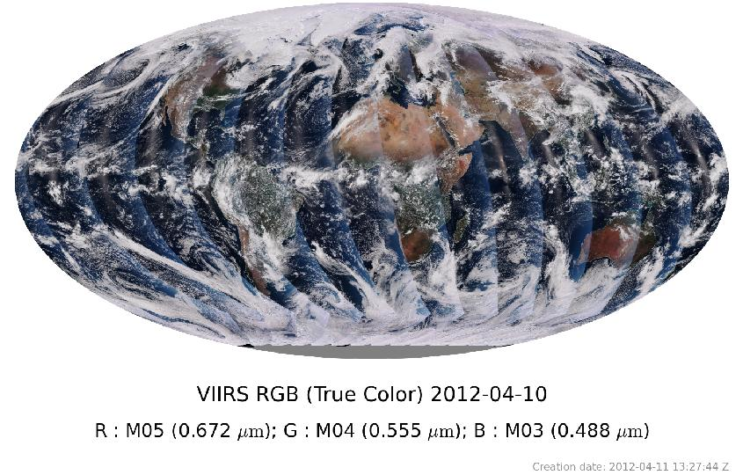
VIIRS Global View
VIIRS Team

Slide 15
Validation…. Assume a truth
How do we validate our cloud detection algorithm?
Compare with visual observations, lidar ground based observations, CALIOP, other satellites.

Slide 16
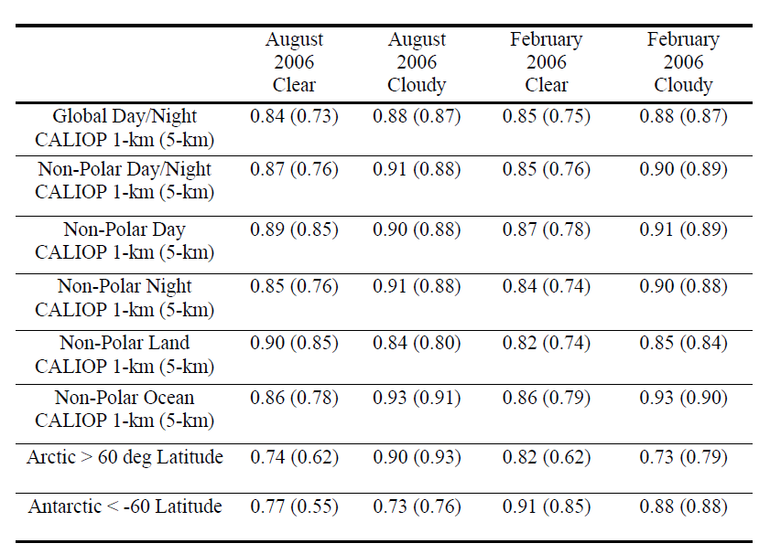
The global fractional agreement of cloud detection between MODIS and CALIOP for August 2006 and February 2007. The results are separated by CALIOP averaging amount, with the 5 km averaging results in parenthesis, as well as day, night and surface type. From Holz et al 2008.

Slide 17
Comparison with active systems…
Generally good agreement.
Optical depth threshold of ~0.3-0.4 over land (not including thin cirrus alone bit)
Detection a function of scene
Polar regions at night still a problem for passive systems.
Understanding strengths and weakness makes for a good data set!

Slide 18
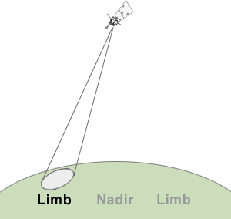
MODIS view angle dependence…
View angle dependence is a issue will all sensors.
FOV size
Optical depth
In some cases, as large as 25%.
One option is to restrict viewing geometry.
How does viewing on the limb impact cloud detection?

Slide 19
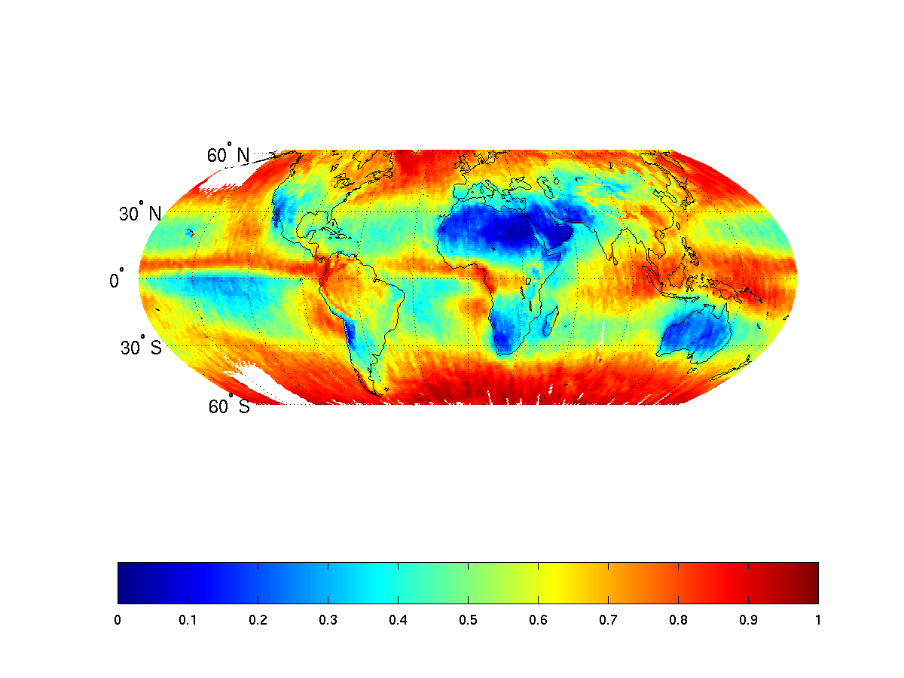
Mean Cloud Fraction for view < 10 degree
Notes:
Demo view angle dependences.

Slide 20
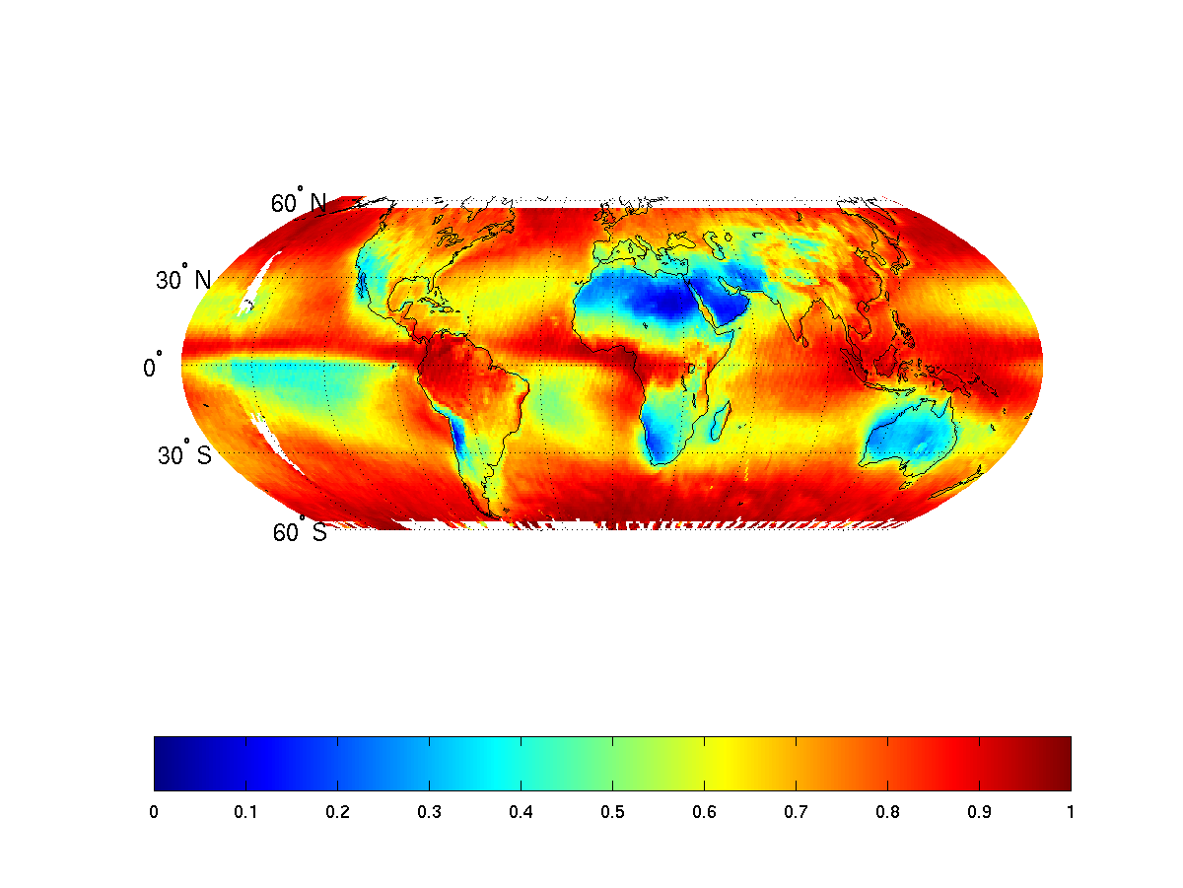
Mean Cloud Fraction for view > 70 degree
Notes:
Demo view angle dependences.

Slide 21
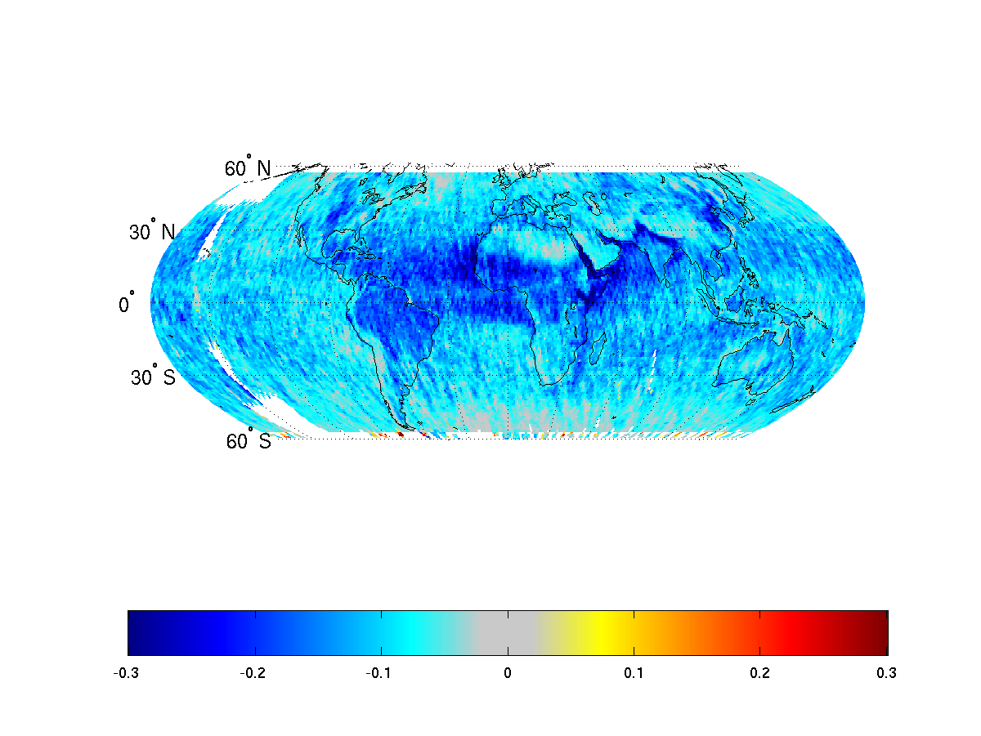
Mean Cloud Fraction difference
Impact is just perspective, projected a 3-D field on a 2-D plane, and increased detection of thin cloud or aerosol.
Notes:
Demo view angle dependences – somewhat of an extreme case. What does this look like if we compare 10 with 35-45 degrees?

Slide 22
Comparison of the AVHRR Cloud Climatologies EUMETSAT’s CM-SAF and NOAA’s PATMOS-x

Slide 23
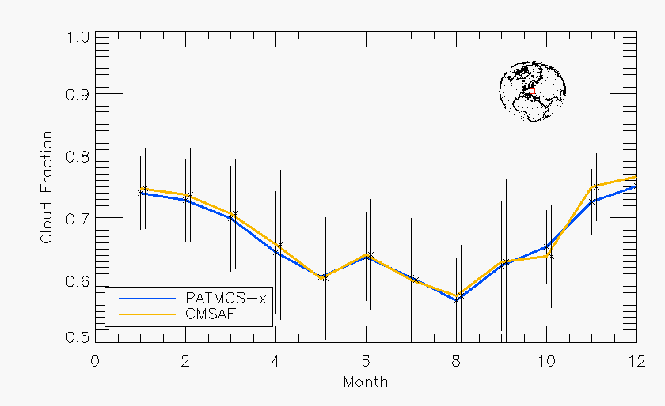
Cloud Fraction Seasonal Cycle (Poland)

Slide 24
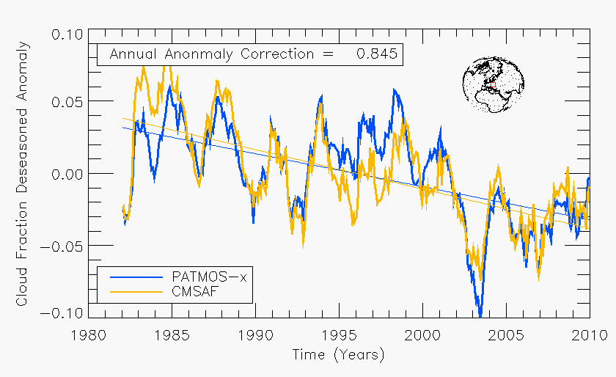
Cloud Fraction Anomalies (Poland)

Slide 25
MODIS capability for regional studies…

Slide 26
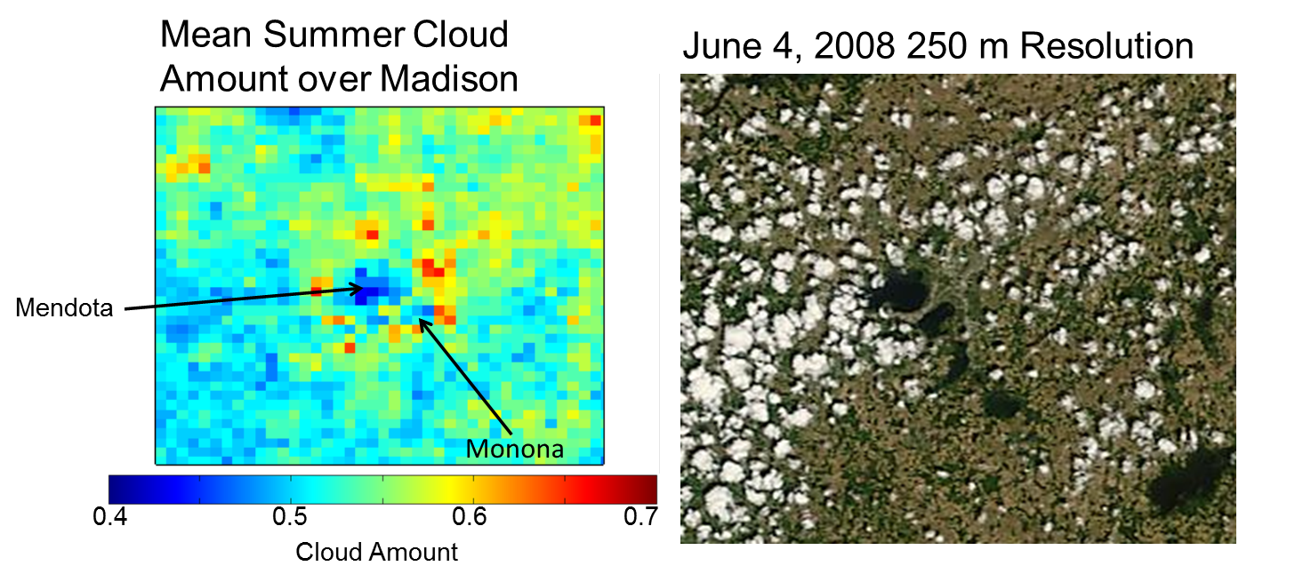
Satellite Climate Studies
Extremely high resolution data shows the suppression of clouds over the lakes during the summer in Madison. The increase in summer cloud cover over other developed areas is also evident in the MODIS data record

Slide 27
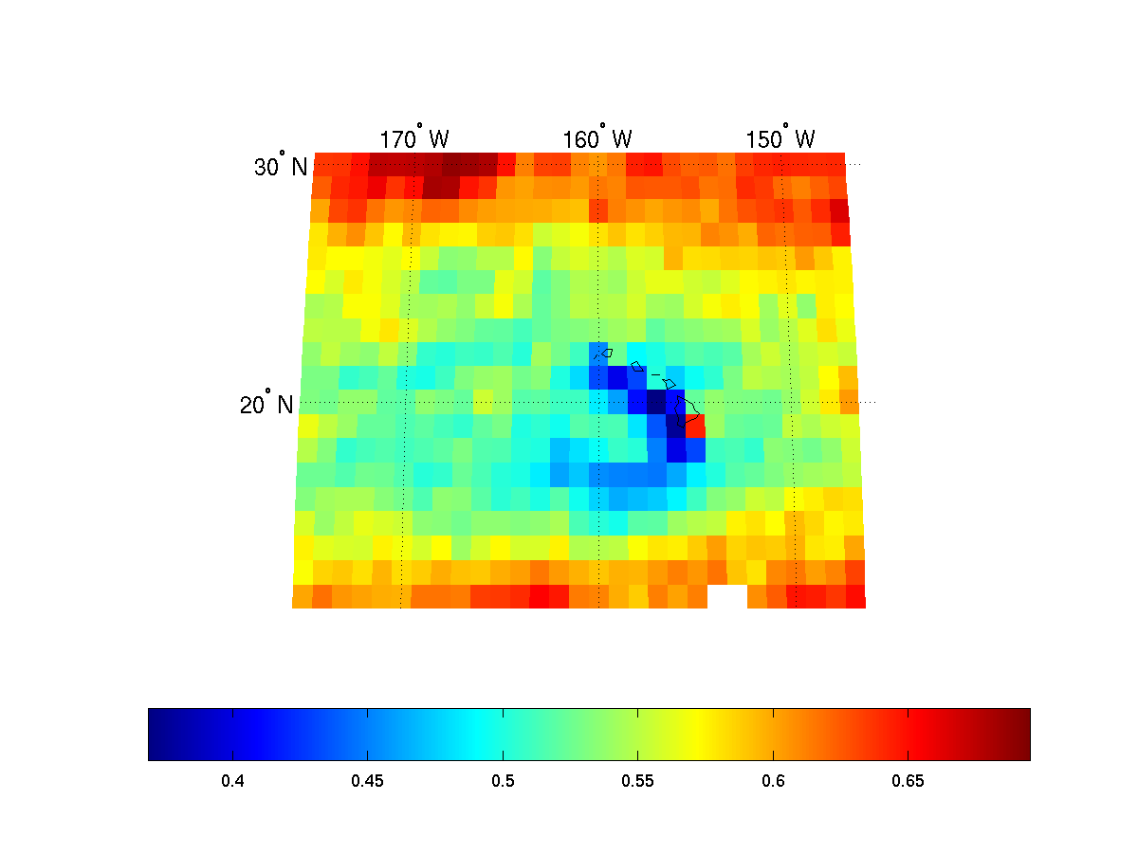
Annual Cloud amount around Hawaiian Islands
Lee side of Hawaiian Islands has reduced cloud cover
Upslope
Cloud fraction in 1 degree grids
Alliss

Slide 28
Once cloud is detected, what else do we need to know about the cloud…
Cloud phase (water or ice)
Cloud water/ice content
Cloud droplet/crystal size
Cloud top
Cloud type
Cloud optical thickness
….

Slide 29
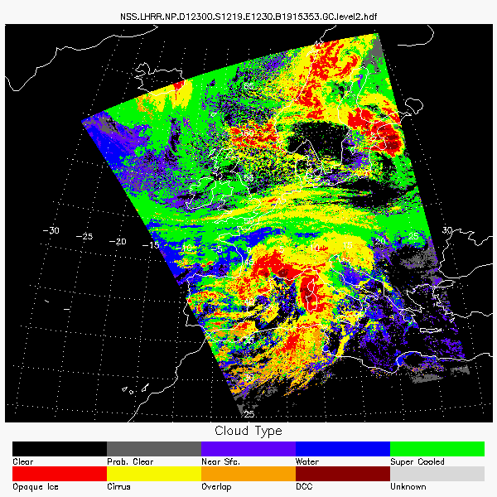



PATMOS-x Cloud Typing Example over Europe (NOAA-19, October, 27, 2012)
PATMOS-x cloud types are defined radiometrically, not meteorologically. Cloud types are based on the opaque/transparent and ice/water signatures available from the AVHRR. Overlap detection is limited to thin cirrus over lower clouds.

Slide 30
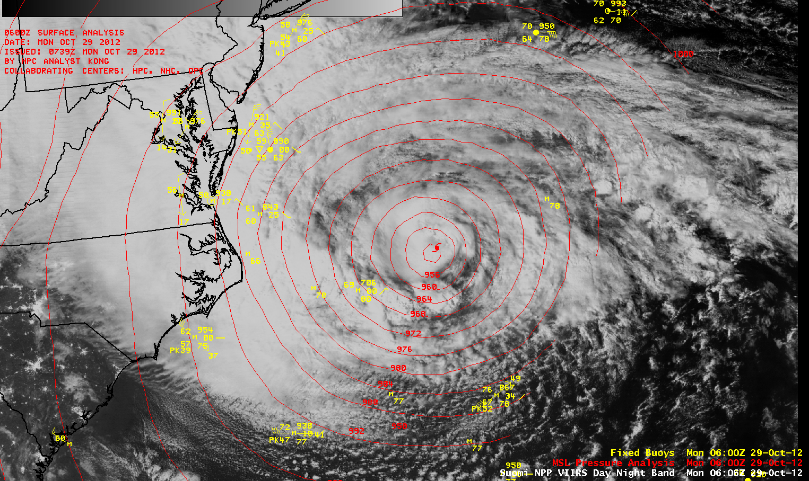
Nightime – Suomi-NPP VIIRS

Slide 31
Summary
Cloud coverage varies with:
the spatial resolution of the instrument
spectral resolution of the instrument
viewing geometry and scene illumination.
MODIS, AVHRR dependencies have be quantified
The dependence of cloud detection on calibration and improvements requires a need to monitor changing instruments and satellites. Needed for long-term monitoring of cloud amount.
MODIS cloud detection optical depth threshold ~ 0.4
Level-3 properties are accurately capturing small spatiotemporal scale variability. Be careful in your averaging choices!

