Slide 1
How to retrieve surface radiation and surface albedo from satellites?
Rebekka Posselt, Aku Riihelä
With support from:
Richard Müller, Jörg Trentmann
Notes:
I suggest modifying the title to
How to retrieve surface radiation and surface albedo from satellites
RP: done

Slide 2
Outline
PART I
Solar radiation (SIS, SID)
MagicSol – Retrieval for historical radiation datasets
LookUpTable radiation retrieval
Longwave radiation (SDL)
AVHRR-CLARA (GAC) algorithm (very short)
PART II
Surface albedo (SAL)

Slide 3
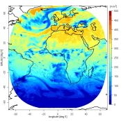
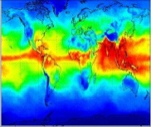
Retrieval Overview
Variables
Algorithm
Sensor
Satellite
Satellite-
orbit
Satellite-
orbit
Satellite
Sensor
Algorithm
Variables
Cloud
Albedo
AMSU
+
HIRS
(ATOVS)
Atmospheric
Watervapour &
temperature
MAGIC
MVIRI
IAPP
Solar
Surf. Rad.
R
E
T
R
I
E
V
A
L
S
NOAA
SAF-NWC/
PPS
Cloud
Macro-
physics
MFG
METOP
Solar &
Thermal
Surf. Rad
AVHRR
CPP
Cloud
Micro-
physics
G2R
Geo-
stat.
Solar &
Thermal
Surf. Rad.;
Cloud forcing
Polar
Cloud
Macro-
physics
SAF-
NWC/
MSG
SEVIRI
P2R
Cloud
Micro-
physics
CPP
MSG
DMSP
Solar &
Thermal
Rad. at
Top
-of-atm.
Water- &
Energy-
Fluxes
Over ocean
ToA-Rad
GERB
SSM/I
HOAPS
Notes:
IAPP: International ATOVS Processing Package, NC schickt noch Paper
*ATOVS = AMSU-A + AMSU-B(MHS) + HIRS
Please highlight the contents of this presentation
RP: already done, Surface Albedo Fehlt !?

Slide 4

Part I
Surface radiation retrievals
Rebekka Posselt
(MeteoSwiss)
Contact me at: rebekka.posselt@meteoswiss.ch

Slide 5
Outline
PART I
Solar radiation (SIS, SID)
MagicSol – Retrieval for historical radiation datasets
LookUpTable radiation retrieval
Longwave radiation (SDL)
AVHRR-CLARA (GAC) algorithm (very short)
PART II
Surface albedo (SAL)

Slide 6
MagicSol
Retrieval for historical radiation datasets
Historical = Meteosat 2 – 7 (1983 – 2005)
= MVIRI instrument
Benefits:
  23 years of high resolution data → climatology
Challenges:
  Only three available channels (VIS, IR, WV)
  Satellite operations not designed for climate studies
    Different satellites (inhomogeneities)
    Poorly documented (M2-4 → missing calibration)

Slide 7
MagicSol
Retrieval for historical radiation datasets
Historical = Meteosat 2 – 7 (1983 – 2005)
= MVIRI instrument
Benefits:
  23 years of high resolution data → climatology
Challenges:
  Only three available channels (VIS, IR, WV)
  Satellite operations not designed for climate studies
    Different satellites (inhomogeneities)
    Poorly documented (M2-4 → missing calibration)
Self-calibration

Slide 8
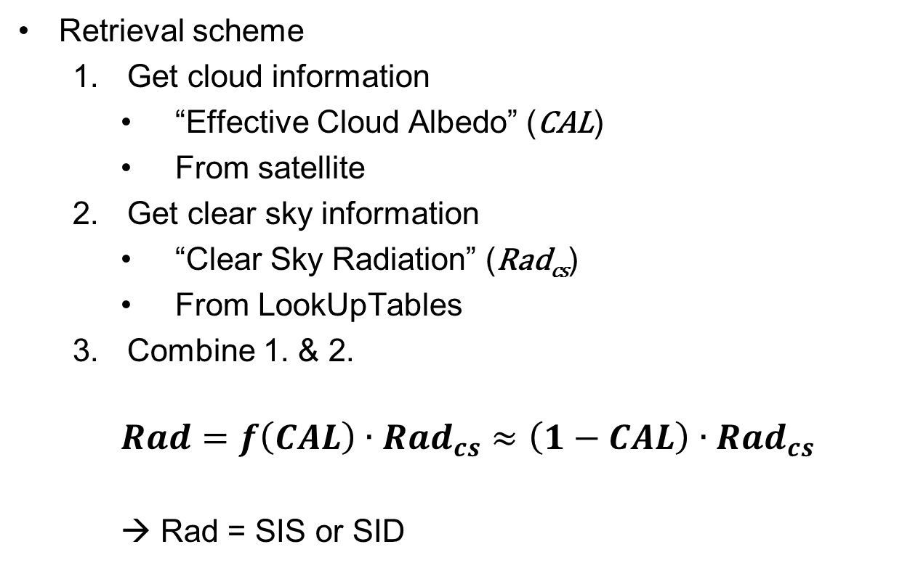
MagicSol
Retrieval for historical radiation datasets
Retrieval scheme
  Get cloud information
    “Effective Cloud Albedo” (CAL)
    From satellite
  Get clear sky information
    “Clear Sky Radiation” (Rad_{cs})
    From LookUpTables
  Combine 1. & 2.
    $$Rad=f\left(CAL\right)∙{Rad}_{cs}≈\left(1−CAL\right)∙{Rad}_{cs}$$
    → Rad = SIS or SID

Slide 9
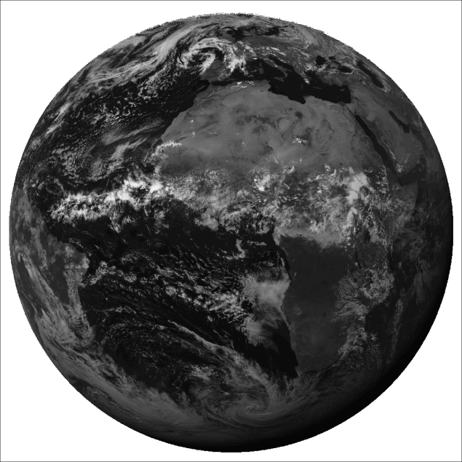
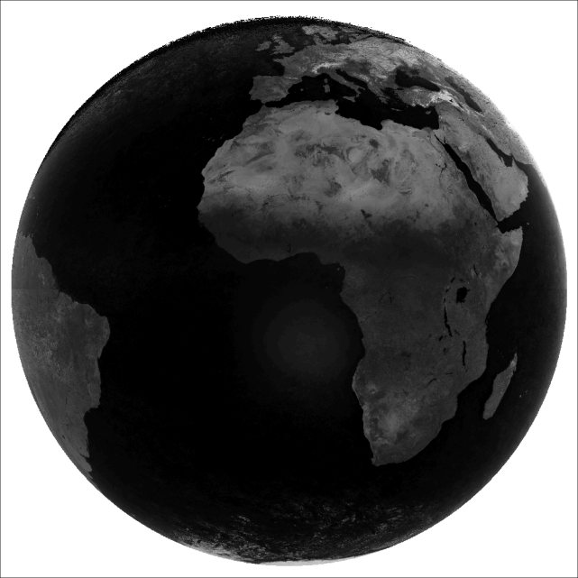
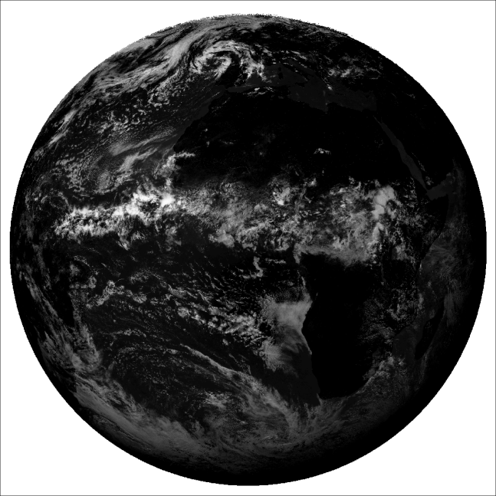
MagicSol
Retrieval for historical radiation datasets
Get cloud information
  Get clear sky = cloud free = surface only image from a series of original images (usually the darkest pixel in the series)
Original image (clouds and surface) = ρ
Clear sky image (clouds removed, only surface) = ρ_{min}
Cloud image (surface removed, only clouds)

Slide 10

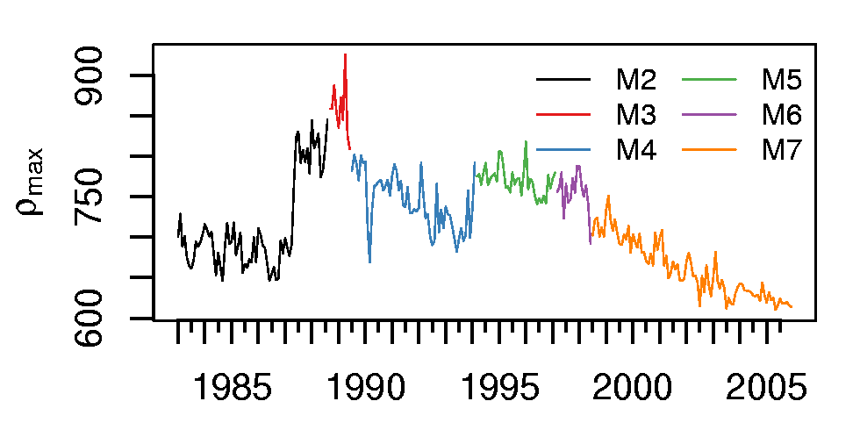
MagicSol
Retrieval for historical radiation datasets
Get cloud information
  Get Selfcalibration via ρ_{max} = 95% percentile of all counts in target region (South Atlantic)
Original image

Slide 11


MagicSol
Retrieval for historical radiation datasets
Get cloud information
  All information together give the “effective cloud albedo” (CAL, a.k.a. cloud index) → Heliosat method
    $CAL=\frac{ρ−ρ_{min}}{ρ_{max}−ρ_{min}}$
Cloud image
~ Maximum range of pixel brightnesses

Slide 12
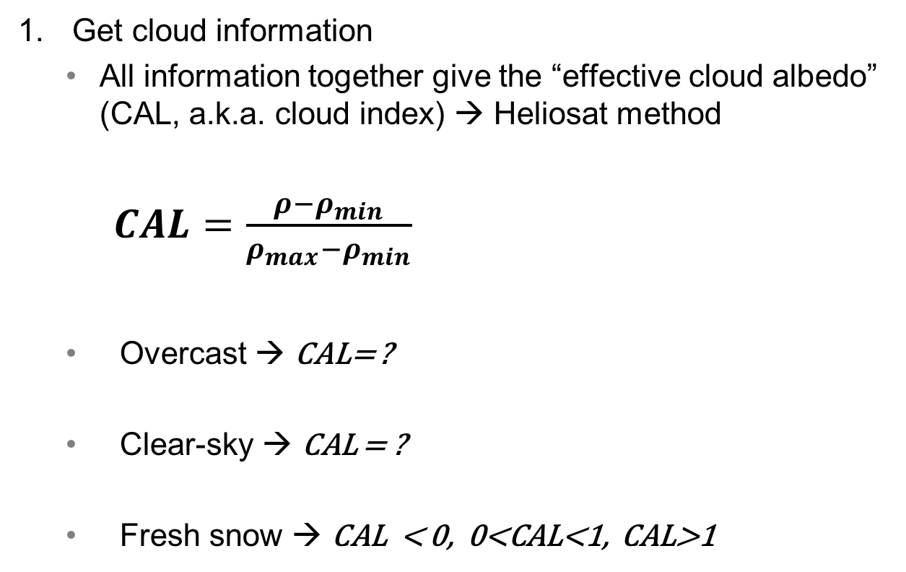
MagicSol
Retrieval for historical radiation datasets
Get cloud information
  All information together give the “effective cloud albedo” (CAL, a.k.a. cloud index) → Heliosat method
    $CAL=\frac{ρ−ρ_{min}}{ρ_{max}−ρ_{min}}$
  Overcast → CAL= ?
  Clear-sky → CAL = ?
  Fresh snow → CAL < 0, 0<CAL<1, CAL>1
Cloud image
~ Maximum range of pixel brightnesses
Notes:
Question to the participants:
CAL for Overcast and clear sky conditions?
What happens with freshly fallen snow? Cal < 0, 0<cal<1, cal>1

Slide 13
MagicSol
Retrieval for historical radiation datasets
Get clear sky radiation (gnu-magic)
LookUpTables
  Fast
  → Obtained from a Radiative Transfer Model
Atmospheric State
Aerosols (climatology)
Water vapour (reanalysis)
Ozone
LookUpTable
Surface Albedo
Climatology
Interpolation
Rad_{cs}
Müller et al. (2009)
http://sourceforge.net/projects/gnu-magic

Slide 14
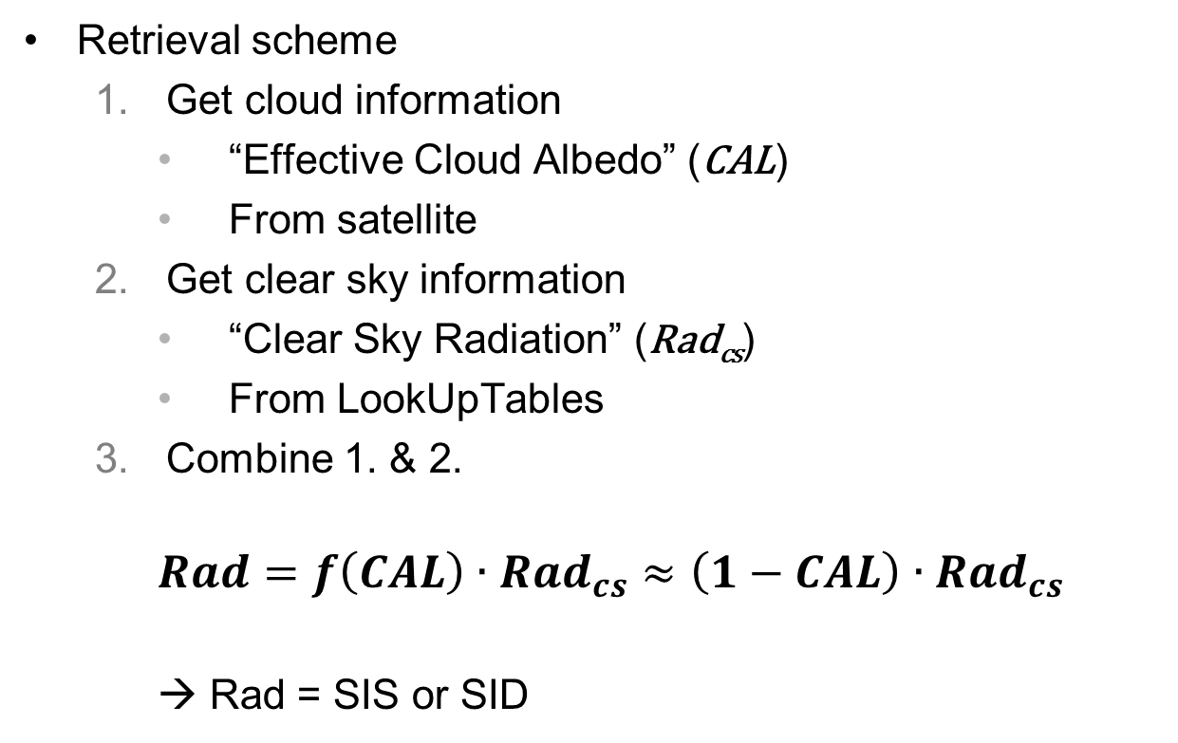
MagicSol
Retrieval for historical radiation datasets
Retrieval scheme
  Get cloud information
    “Effective Cloud Albedo” (CAL)
    From satellite
  Get clear sky information
    “Clear Sky Radiation” (Rad_{cs})
    From LookUpTables
  Combine 1. & 2.
    $$Rad=f\left(CAL\right)∙{Rad}_{cs}≈\left(1−CAL\right)∙{Rad}_{cs}$$
    → Rad = SIS or SID

Slide 15
Outline
PART I
Solar radiation (SIS, SID)
MagicSol – Retrieval for historical radiation datasets
LookUpTable radiation retrieval
Longwave radiation (SDL)
GAC algorithm (very short)
PART II
Surface albedo (SAL)

Slide 16
LookUpTable radiation retrieval
Used for
  Operational (= regularly updated) radiation products
  AVHRR-CLARA (GAC) radiation dataset
Benefits:
  Physical approach
  Applicable to geostationary and polar orbiting satellites
Challenges:
  Multispectral information required for cloud detection
  Auxiliary data required (e.g., surface albedo)
Notes:
The benefits and challenges refer to the operational products and not to the look-up table approach… Please remove/modify, this retrieval has also been used for GAC which is (at least is supposed to be) a dataset…
You could still include benefits/challenges of the retrieval methods:
+ physical approach
+ applicable to polar-orbiting satellite data
- multispectal information required for cloud detection
- auxiliary data required (surface albedo)
RP: changed/updated slide

Slide 17
LookUpTable radiation retrieval
Retrieval scheme
  Cloud detection
  Cloud free: use clear-sky gnu-magic (see MAGICSOL)

Slide 18
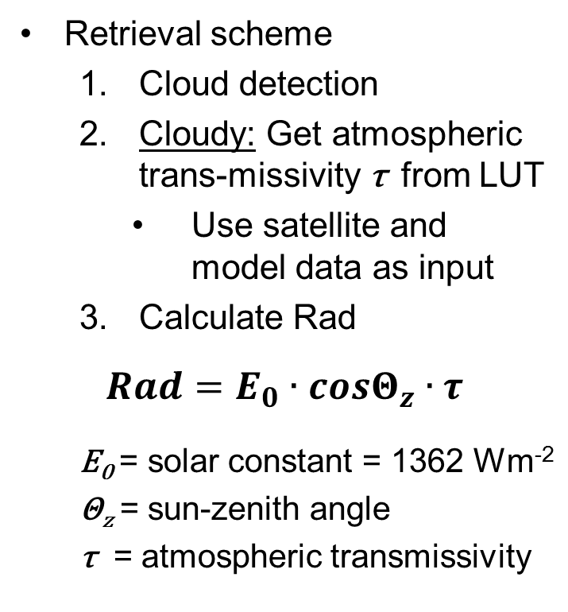
LookUpTable radiation retrieval
Retrieval scheme
  Cloud detection
  Cloudy: Get atmospheric trans-missivity τ from LUT
    Use satellite and model data as input
  Calculate Rad
$$Rad=E_{0}∙cosΘ_{z}∙τ$$
  E₀ = solar constant = 1362 Wm⁻²
  Θ_{z} = sun-zenith angle
  τ = atmospheric transmissivity
Notes:
You might mention this in the presentation, but it might be good to also include it in the slides, that this scheme first separates clear-sky and cloudy-sky scenes using the cloud detection.
RP: which cloud detection?
Based on this information, either the clear-sky gnu magic is used or the look-up table is applied.

Slide 19
LookUpTable radiation retrieval
Retrieval scheme
  Cloud detection
  Cloudy: Get atmospheric trans-missivity τ from LUT
    Use satellite and model data as input
  Calculate Rad
$$Rad=E_{0}∙cosΘ_{z}∙τ$$
  E₀ = solar constant = 1362 Wm⁻²
  Θ_{z} = sun-zenith angle
  τ = atmospheric transmissivity
known
known
use cloud-magic
Notes:
You might mention this in the presentation, but it might be good to also include it in the slides, that this scheme first separates clear-sky and cloudy-sky scenes using the cloud detection.
RP: which cloud detection?
Based on this information, either the clear-sky gnu magic is used or the look-up table is applied.
RP: changed slides

Slide 20
LookUpTable radiation retrieval
Get atmospheric transmissivity τ (cloud-magic)
TOA albedo
GERB (CM SAF RMIB) or GERB-like-SEVIRI
AVHRR-CLARA (GAC) broadband albedo
LookUpTable
Atmospheric State
Aerosols (climatology)
Water vapour (NWP DWD)
Ozone
Cloud fraction (SAFNWC)
Interpolation
Surface Albedo
Climatology
Atmospheric
Transmissivity τ
Müller et al. (2009)
http://sourceforge.net/projects/gnu-magic
Notes:
The ToA Albedo is either derived from GERB or GERB-like-SEVIRI or by converting the AVHRR-radiance to broadband Albedo, maybe this information can be added to the box. The surface albedo in the look-up table is not derived from SEVIRI, but rather comes from a climatology, which indeed is a major issue and (hopefully) will be resolved in the next GAC release and possibly also in the operational chain (will be Heliosat, soon, anyway…).
RP: updated slide

Slide 21
LookUpTable radiation retrieval
Retrieval scheme
  Cloud detection
  Cloudy: Get atmospheric trans-missivity τ from LUT
    Use satellite and model data as input
  Calculate Rad
$$Rad=E_{0}∙cosΘ_{z}∙τ$$
  E₀ = solar constant = 1362 Wm⁻²
  Θ_{z} = sun-zenith angle
  τ = atmospheric transmissivity
Cloud free: use clear-sky gnu-magic (see MAGICSOL)

Slide 22
Outline
PART I
Solar radiation (SIS, SID)
MagicSol – Retrieval for historical radiation datasets
LookUpTable radiation retrieval
Longwave radiation (SDL)
AVHRR-CLARA (GAC) algorithm (very short)
PART II
Surface albedo (SAL)
Arctic-SAL
Notes:
For the sake of time (and not to confuse people) I would suggest not to explain the retrieval of SDL in detail, but rather have only one slide with the information that the SDL is mainly determined by the T and humidity in the lower levels, which cannot be observed from satellite (VIS, IR). Hence, all SDL products from satellite, including from CM SAF, use major information from external data, e.g., from NWP or reanalysis. Only cloud information from satellite slightly modifies the SDL from satellite compared to the original SDL from the used atmospheric model. I could provide you with a figure on the contribution to SDL as a function of height (Ohmura, 2001) I believe…
RP: very short SDL now, see next slide

Slide 23
AVHRR-CLARA (GAC) SDL retrieval - very short
GAC = “global area coverage”
= AVHRR instrument (1982-present), polar orbiting
SDL mainly determined by Temperature and humidity close to the earth’s surface
  Cannot be observed by satellites
  all SDL products from satellites need additional data (e.g., reanalysis, NWP)
CM SAF GAC SDL uses ERA Interim SDL as basis
Cloud information of GAC are used to refine ERA SDL

Slide 24
Outline
PART I
Solar radiation (SIS, SID)
MagicSol – Retrieval for historical radiation datasets
LookUpTable radiation retrieval
Longwave radiation (SDL)
GAC algorithm (very short)
PART II
Surface albedo (SAL)

Slide 25
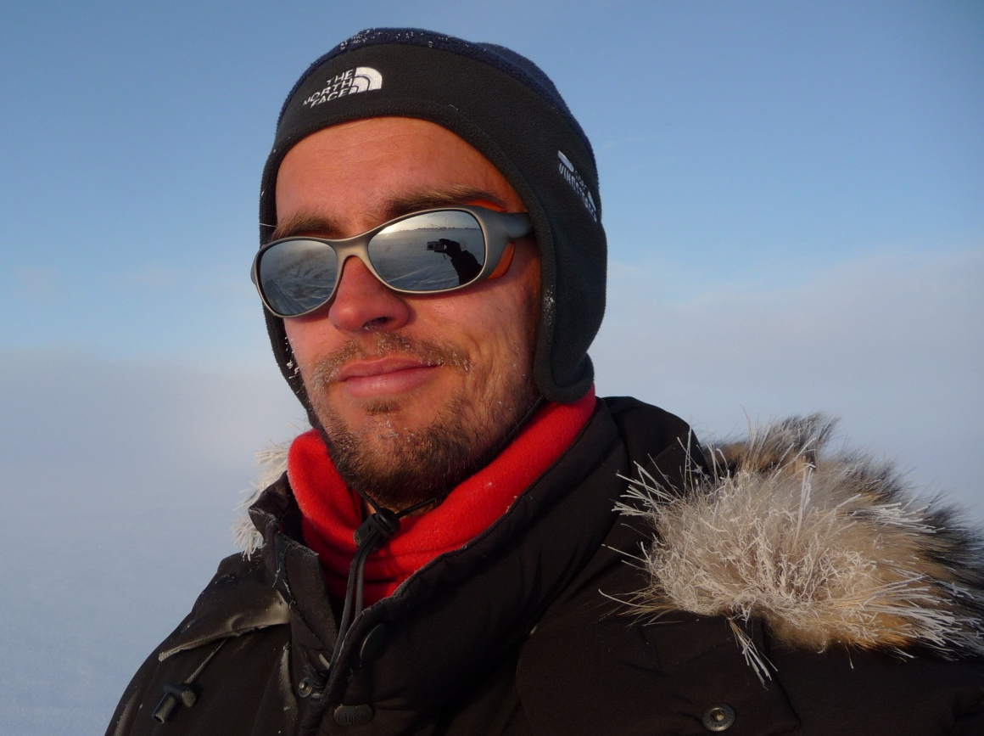
PART II
SAL retrieval algorithm
Aku Riihelä
FMI

Slide 26
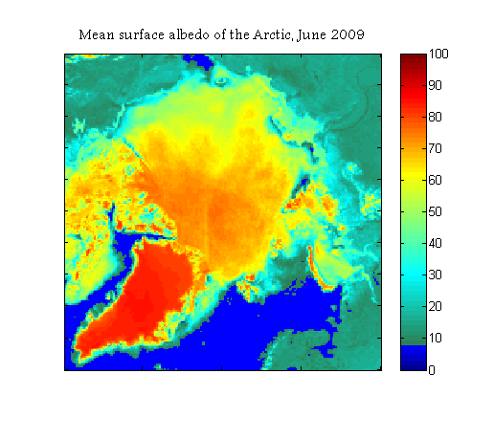
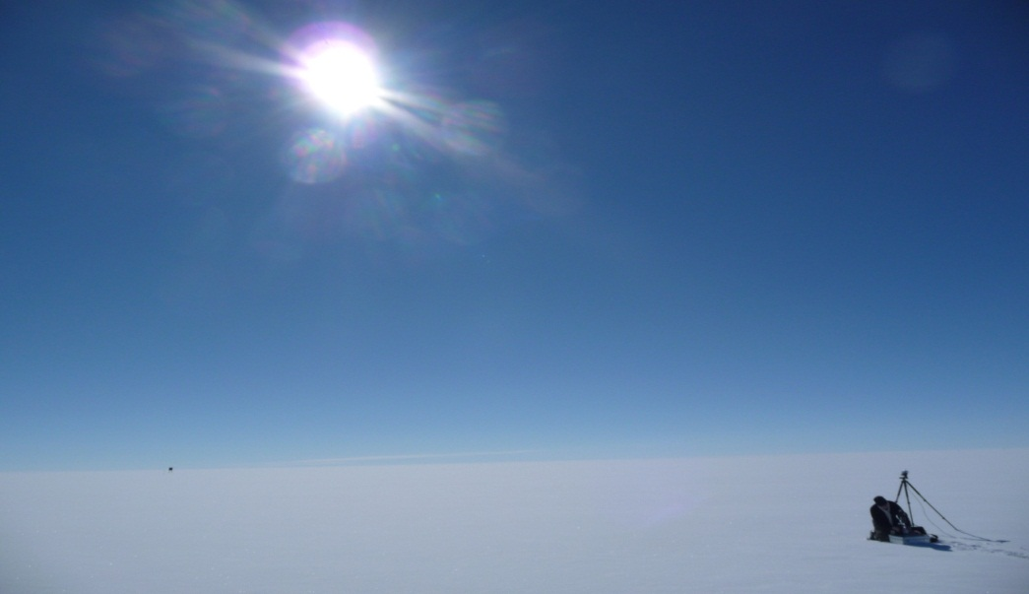
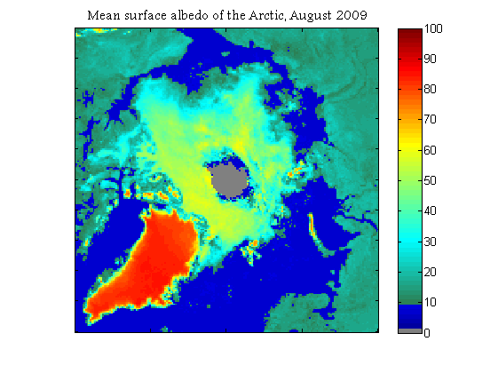
Surface albedo
Radiation budget at surface:
E_{net} = SW↓ – α * SW↓ + LW ↓ - LW↑
The resulting net energy is available for surface heating, snow melt,
heat fluxes etc.
SW↓ - α* SW↓ + LW ↓ - LW ↑

Slide 27
The SAL algorithm
A shortwave black-sky surface albedo product
  Black-sky = direct solar flux only, all atmospheric effects removed
A radiometric and geolocation correction for topography effects on AVHRR images
Dedicated algorithms for vegetated surfaces, snow/ice, and water
Atmospheric correction with SMAC
BRDF correction over vegetated surfaces
Notes:
Maybe you want to define what is ‘black-sky surface albedo’?
AR: Defined.

Slide 28
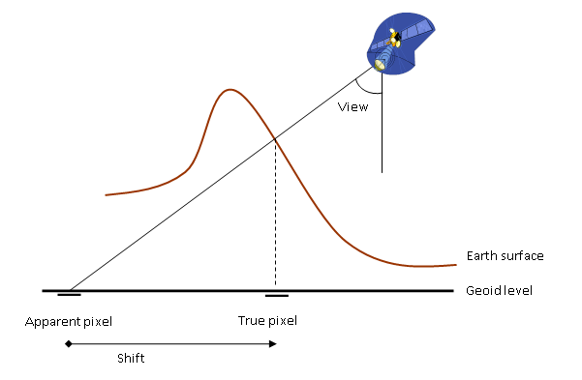
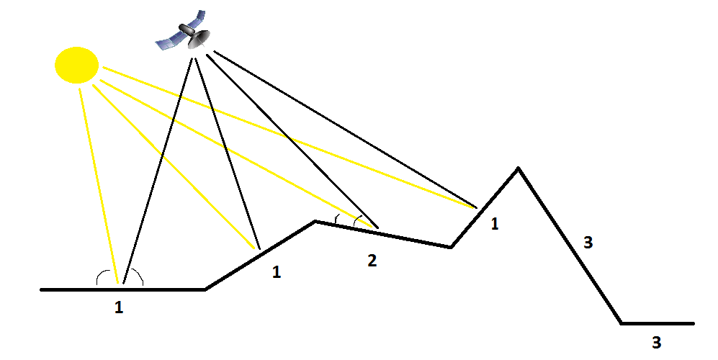
0. Topography correction
In the first part, we correct the geolocation of the AVHRR pixels for the true terrain height effects using a global DEM
In the second part, we correct the observed reflectances for effects caused by the various slopes and shadowed areas in an AVHRR pixel

Slide 29
1. Atmospheric correction
Atmospheric effects need to be removed from the observed TOA reflectances
We use the Simplified Model for Atmospheric Correction (SMAC) [Rahman & Dedieu, 1994].
Required Inputs
  Visible + near IR TOA reflectances
  Aerosol Optical Depth (AOD) content of the atmosphere (set constant to 0.1)
  Total ozone column (O3) (constant at 0.35 (atm cm))
  Total column water vapour and surface pressure (taken from atmospheric model, ECMWF / DWD (g/cm^2))
CM SAF Event Week, Surface radiation retrieval
29

Slide 30

2. BRDF correction
Applied the model of Roujean (1992) with an update by Wu et al. (1995).
The model considers the bidirectional reflectance of a surface to consist of three ”kernels”:
$$ρ=k_{0}+k_{geo}f_{geo}+k_{vol}f_{vol}$$

Slide 31
2. BRDF correction
Applied the model of Roujean (1992) with an update by Wu et al. (1995).
The model considers the bidirectional reflectance of a surface to consist of three ”kernels”:
$$ρ=k_{0}+k_{geo}f_{geo}+k_{vol}f_{vol}$$
k terms describe the reflectance contributions from:
nadir-viewing & overhead Sun situation (k0),
geometric and volume scattering terms k1 and k2.
The f terms describe the dependency of the model from the viewing/illumination geometry of the scene.
Generic vegetation canopy!
Notes:
Maybe a little less information is sufficient for this audience…

Slide 32
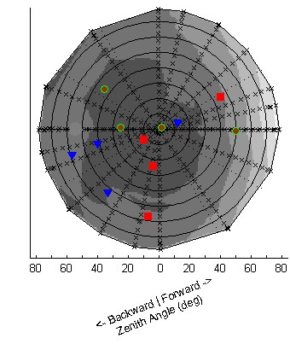
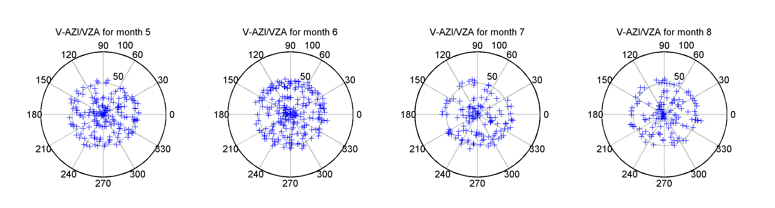
2.5. Anisotropy sampling of snow
The reflectance anisotropy properties of snow vary widely with snow type!
  Very difficult to model universally without universal data on snow physical characteristics
Our solution: sample the anisotropy directly and consider the mean of the samples to represent the albedo.
The strategy works if we have enough samples of the BRDF…which fortunately is the case when using AVHRR in the high latitudes (where snow exists)!
Reflectance sampling distribution at Summit Camp, Greenland Ice Sheet, summer 2005
Notes:
Try to put less text on the slide!

Slide 33
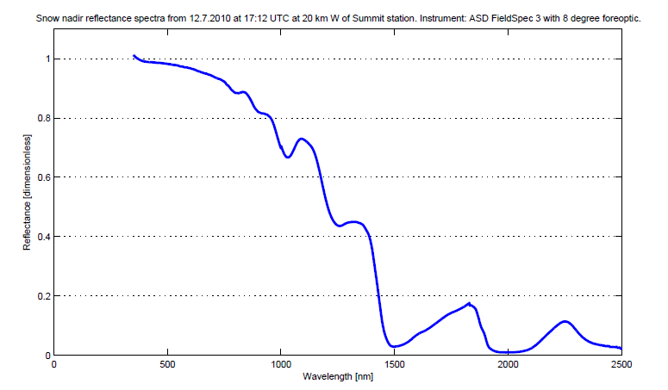
3. Narrow-to-broadband conversion
Satellite imagers cover only a part of the solar spectrum – algorithms needed to convert observed (spectral) albedo to full broadband albedo!
NTBC algorithms separated by instrument (SEVIRI / AVHRR) and land cover (vegetation, snow, water)
Vegetation-AVHRR:
Liang (2000)
Vegetation-SEVIRI:
Van Leeuwen & Roujean (2002)
Snow:
Xiong et al. (2002)
Water (LUT-based):
Jin et al. (2004)
AVHRR channels 1 & 2

Slide 34
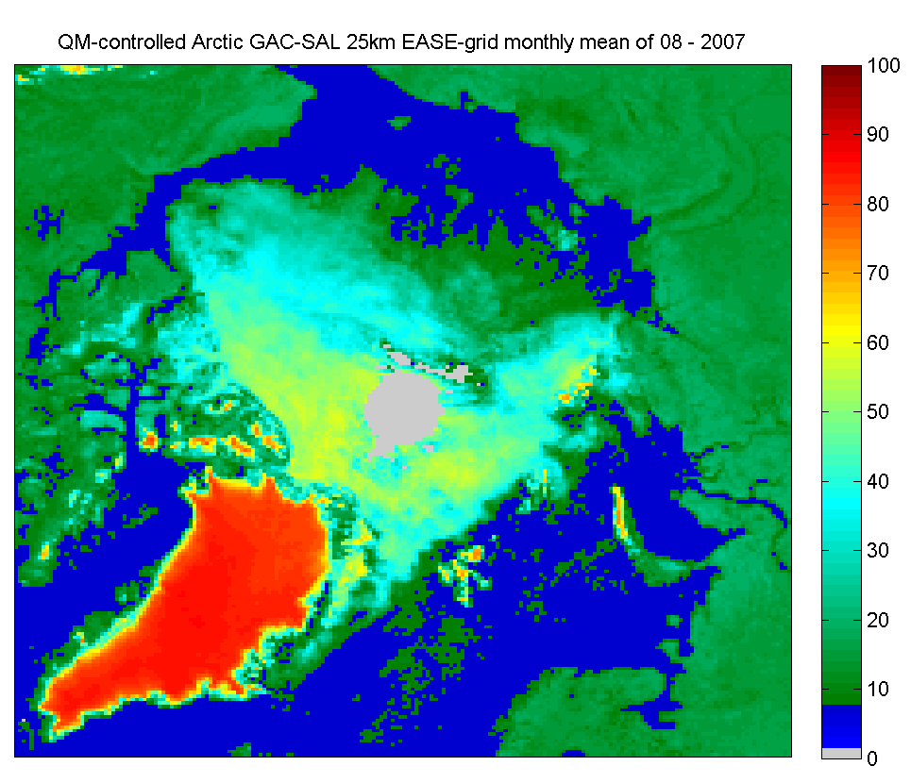
When all is said and done…
We have retrieved a broadband black-sky surface albedo for a satellite image*
The instantaneous images are then projected into a common map grid and averaged over a pentad/week/month to create the product we distribute to You, the user.
* Multiple images required for a robust snow albedo retrieval

Slide 35
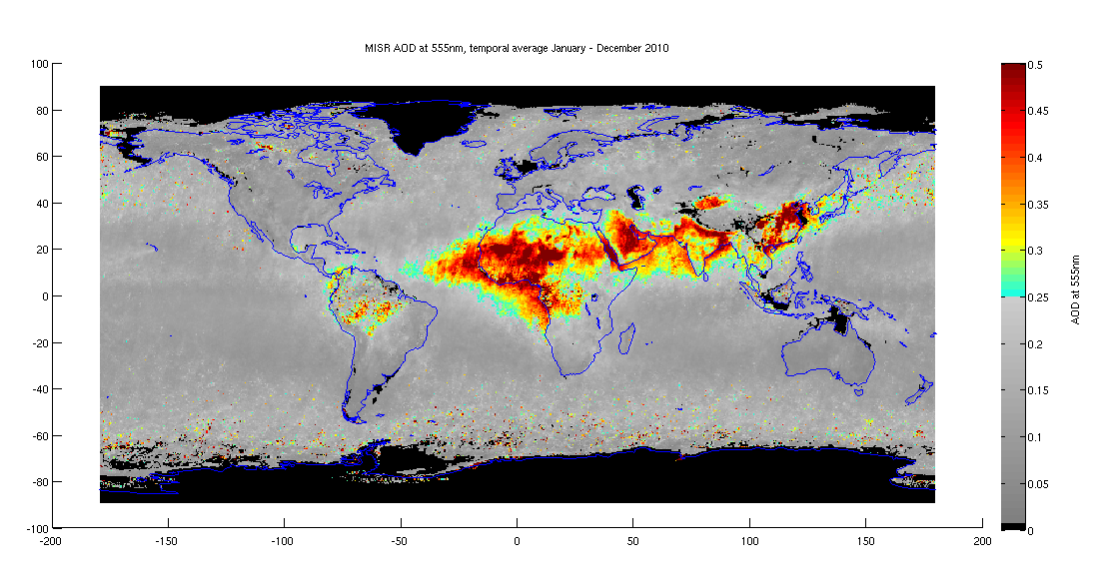
Limitations of the algorithm
Sun Zenith Angle of the scene has to be less than 70 degrees and the Viewing Zenith Angle (of the satellite) less than 60 degrees
  Retrievals would be unreliable outside these bounds
Cloud masking errors do occur sporadically
  Cloud reflectance propagates into an albedo ”retrieval”
Aerosols and O3 concentrations currently constant in retrievals
  Increased uncertainty over areas where AOD is high (see figure below)
  O3 effect is much smaller than the aerosol effect
Coarse resolution (15 km², 0.25 degrees, 25 km²⁾ may not allow for accurate small-scale studies
Problems using SAL?
You can contact me at aku.riihela@fmi.fi

Slide 36

Thanks for tuning in!

