Slide 1

CLARA – the 28 year global AVHRR dataset
CM SAF cloud, surface albedo and surface radiation products from AVHRR 1982-2009
Karl-Göran Karlsson
SMHI, Sweden
Outline:
The historical global AVHRR dataset
- sensor, satellites, resolution and radiance calibration
Description of CLARA cloud products
Description of CLARA surface albedo products
Description of CLARA surface radiation products
Outlook

Slide 2
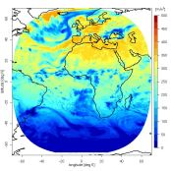
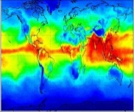
Retrieval Overview
Variables
Algorithm
Sensor
Satellite
Satellite-
orbit
Satellite-
orbit
Satellite
Sensor
Algorithm
Variables
Cloud
Albedo
AMSU
+
HIRS
(ATOVS)
Atmospheric
Watervapour &
temperature
MAGIC
MVIRI
IAPP
Solar
Surf. Rad.
R
E
T
R
I
E
V
A
L
S
NOAA
SAF-NWC/
PPS
Cloud
Macro-
physics
MFG
METOP
Solar &
Thermal
Surf. Rad
AVHRR
CPP
Cloud
Micro-
physics
G2R
Geo-
stat.
Solar &
Thermal
Surf. Rad.;
Cloud forcing
Polar
Cloud
Macro-
physics
SAF-
NWC/
MSG
SEVIRI
P2R
Cloud
Micro-
physics
CPP
MSG
DMSP
Solar &
Thermal
Rad. at
Top
-of-atm.
Water- &
Energy-
Fluxes
Over ocean
ToA-Rad
GERB
SSM/I
HOAPS
Notes:
IAPP: International ATOVS Processing Package, NC schickt noch Paper
*ATOVS = AMSU-A + AMSU-B(MHS) + HIRS

Slide 3
Available operational Products and Datasets
Clouds
Macrophysics
Microphysics
Time range: 2005 – now Coverage: MSG full disk;
Arctic & Europe (AVHRR)
Clouds
Cloudalbedo
MAGICSOL
(Surf.Rad.Dataset)
Meteosat
full disk
1983 - 2005
Surface Radiation
Solar incoming & reflected
CM SAF
Data
Surface Radiation
Solar incoming & reflected
Thermal outgoing & netto
Radiation Budget
Time range: 2005 - now
Coverage: MSG full disk;
N-Atlantic & Europe (AVHRR)
Clouds
Macrophysics
Microphysics
AVHRR-CLARA
Global
Coverage
1982 - 2009
Climate
Datasets
Operational
Products
Surface Radiation
Solar incoming & reflected
Thermal outgoing & netto
Radiation Budget
Top-of-Atmosphere Radiation
Solar & Thermal
Time range: 2004 – now
Coverage: MSG full disk & Arctic
HOAPS
Globally over
ice free ocean
1987 - 2006
Watervapour and
Energyfluxes
Watervapour
and temperature
Profiles
Time range: 2004 – now
Coverage: Global

Slide 4
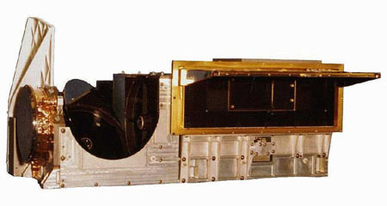
The historical AVHRR data set
The Advanced Very High Resolution Radiometer – AVHRR
Channel Number | Wavelength (micrometers) AVHRR/1 NOAA-6,8,10 | Wavelength (micrometers) AVHRR/2 NOAA-7,9,11,12,14 | Wavelength (micrometers) AVHRR/3 NOAA-15,16,17,18 NOAA-19, Metop-A
1 | 0.58-0.68 | 0.58-0.68 | 0.58-0.68
2 | 0.725-1.10 | 0.725-1.10 | 0.725-1.10
3A | - | - | 1.58-1.64
3B | 3.55-3.93 | 3.55-3.93 | 3.55-3.93
4 | 10.50-11.50 | 10.50-11.50 | 10.50-11.50
5 | Channel 4 repeated | 11.5-12.5 | 11.5-12.5

Slide 5
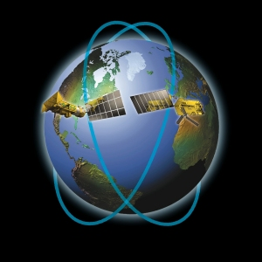
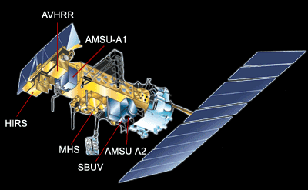
The historical AVHRR data set
AVHRR is carried by polar orbiting NOAA and Metop satellites
NOAA satellite and its payload
- Operating in sun-synchronous orbits for two
orbit constellations 6 hours apart
- NOAA observations at fix local solar times
(7:30/17:30 and 13:30/01:30)
- Metop observations at 10:00/22:00
Orbit configuration of NOAA and Metop satellites

Slide 6
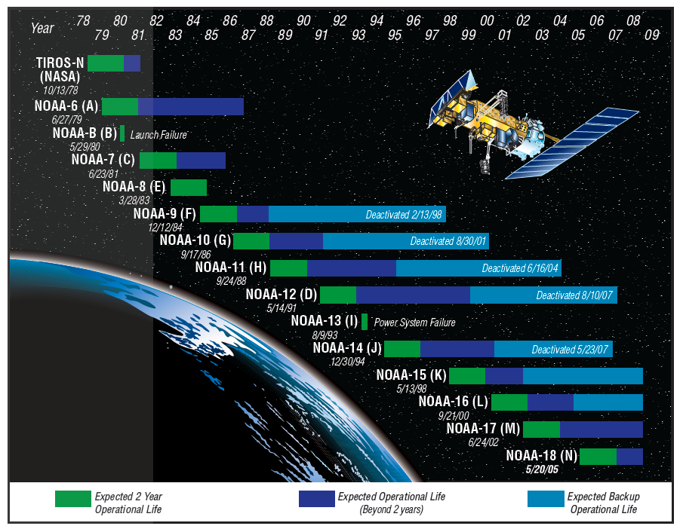
The historical AVHRR data set
All NOAA satellites used in the CM SAF CLARA dataset 1982-2009
Courtesy of Andrew Heidinger, NOAA

Slide 7
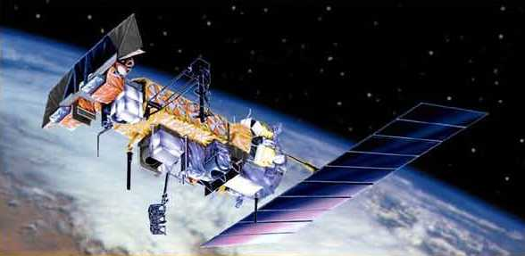
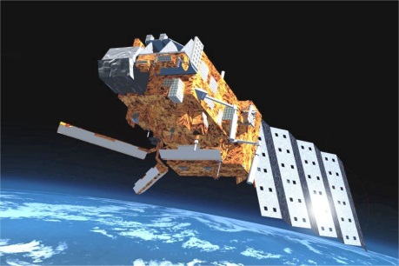
The historical AVHRR data set
All NOAA satellites used in the CM SAF CLARA dataset 1982-2009
NOAA-19 in 2009
Metop-A since July 2007
Courtesy of Andrew Heidinger, NOAA

Slide 8
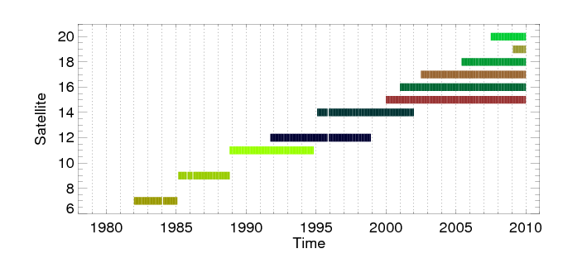
The historical AVHRR data set
All NOAA satellites used in the CM SAF CLARA dataset 1982-2009
- Available time periods for each satellite
Metop-A
Note: Often referred to as the GAC dataset = Global Area Coverage AVHRR data provided in a reduced resolution of 4 km
CLARA = CM SAF cLouds, Albedo and RAdiation dataset
All CLARA products delivered in netCDF format in August 2012

Slide 9
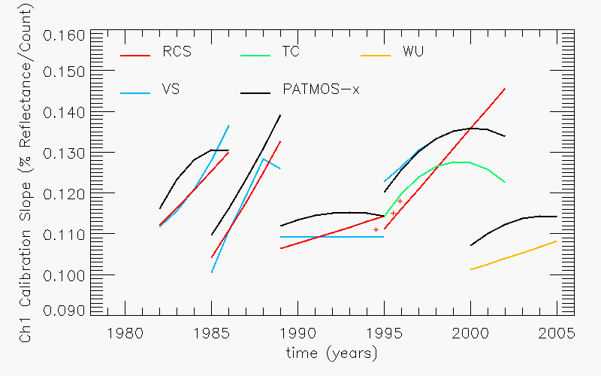
The historical AVHRR data set
Definition of a consistent radiance dataset (Fundamental Climate Data Record – FCDR)
CM SAF relies on PATMOS-x FCDR (Heidinger et al., IJRS, 2010)
Example of time dependent corrections of calibration constants in AVHRR channel 1
(PATMOS-x black curve) – derived from MODIS and surface site comparisons

Slide 10
CLARA Cloud products
List of all cloud products:
PRODUCT NAME | PRODUCT CODE | PRODUCT ACRONYM
Fractional Cloud Cover | CM-05 | CFC
Cloud Top level | CM-17 | CTO
Cloud Optical Thickness | CM-34 | COT
Cloud Phase | CM-38 | CPH
Liquid Water Path | CM-43 | LWP
Ice Water Path | CM-47 | IWP
Joint Cloud property histogram | CM-11 | JCH

Slide 11
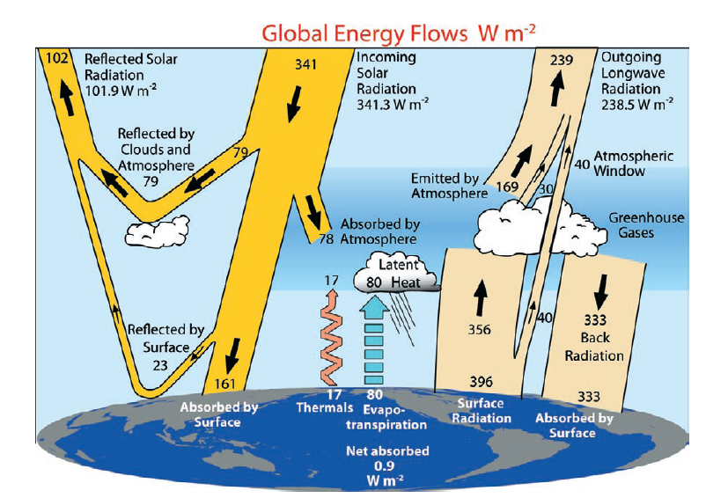
CLARA Cloud products
Cloud products
Trenberth at al., BAMS, 2009
Notes:
This slide could be used to introduce the 8 different CLARA surface radiation data sets…

Slide 12
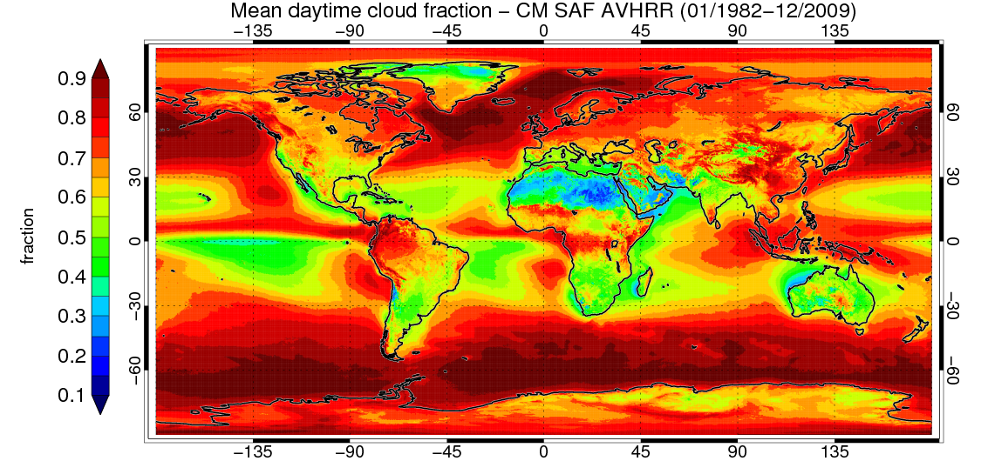
CLARA Cloud products
Cloud product composition and options
Spatial grid 1: - Global latitude-longitude grid with 0.25 degree resolution

Slide 13
CLARA Cloud products
Cloud product composition and options
Spatial grid 2: - Two Polar grids with 25 km resolution
(illustrated later for surface albedo products)

Slide 14
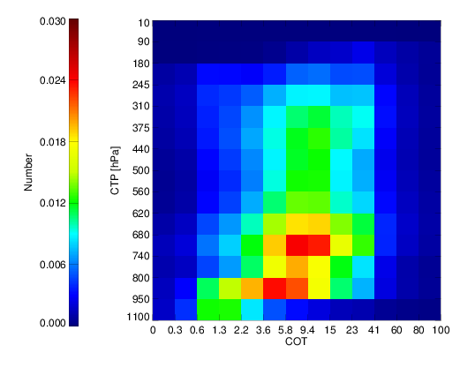
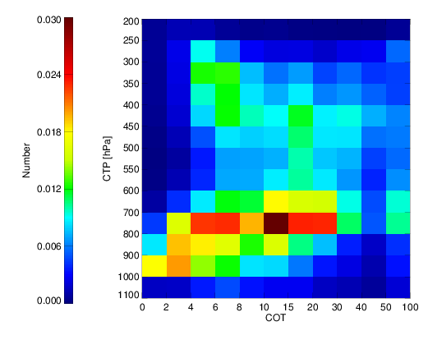
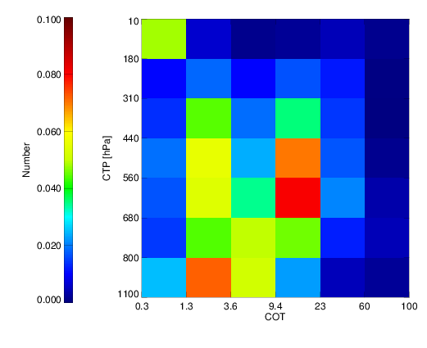
CLARA Cloud products
Cloud product composition and options
Spatial grid 3: - Joint histograms defined in 1 degree grid resolution
CM SAF
MODIS
ISCCP
Example of JCHs for March 2007 based on all global grid points and for all clouds
- Observe that results can be compiled for user-defined subsets of grid points (regions)!

Slide 15
CLARA Cloud products
Cloud product composition and options
Temporal options:
- Products including all data (all orbits) means that averages have been
composed with a latitude-dependent temporal resolution
(normally 4 observations per day at the equator increasing up to 28
observations per day at the pole)
- Sub-setting the dataset is possible, e.g. select results from
- Individual satellites
- Only daytime results (solar zenith angles below 80 degrees)
- Only night-time results (solar zenith angles above 95 degrees)
Metadata and auxiliary datasets:
- Products include additional information about e.g. statistical distributions,
uncertainties and background information (e.g., topography and land mask)

Slide 16

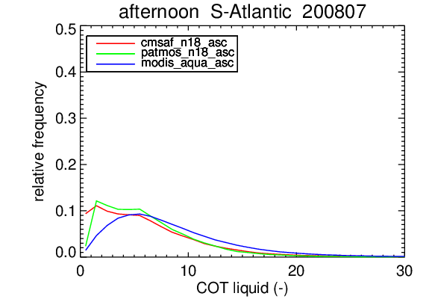
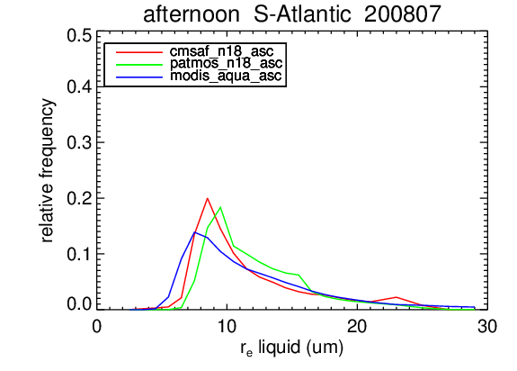
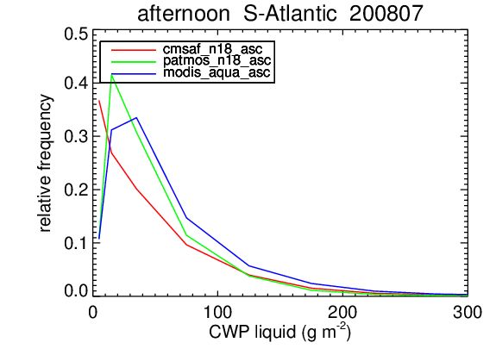
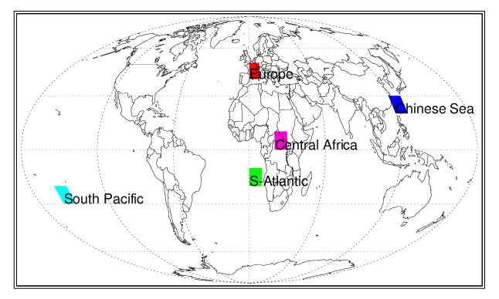
CLARA evaluation: South Atlantic – liquid water clouds
CLARA Cloud products
Notes:
Most ideal cloud type. Relatively good agreement. MODIS has larger average COT because they do clear-sky restoral, i.e. remove cloud edges from processing.

Slide 17
CLARA evaluation: Summary of results
CLARA Cloud products
Accuracy requirements are target CM SAF requirements
Achieved accuracies given for independent datasets (black) and other satellite-based datasets (blue)
Notes:
Most ideal cloud type. Relatively good agreement. MODIS has larger average COT because they do clear-sky restoral, i.e. remove cloud edges from processing.

Slide 18
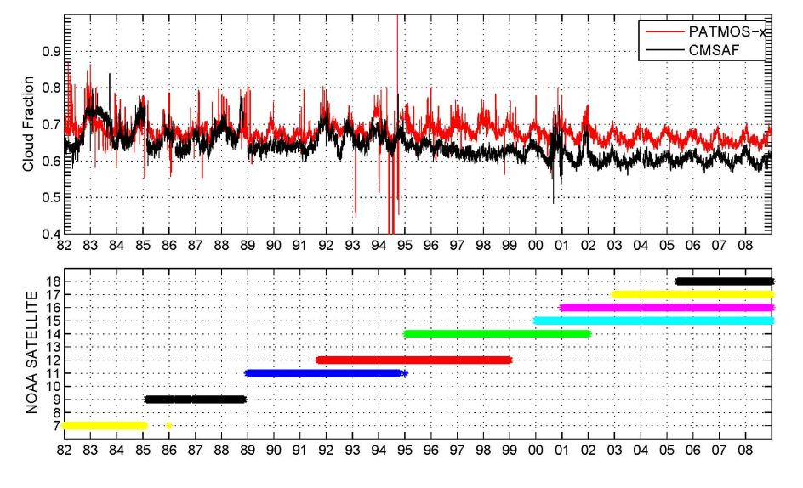
CLARA usage: Warning on global trend analysis
CLARA Cloud products
Decreasing trend in global cloud fraction mainly a result of changed observation frequency (more observations in the last ten years in morning and evening when cloud detection is more problematic)
- Daytime-only and night-time only results show no trend!
Notes:
Most ideal cloud type. Relatively good agreement. MODIS has larger average COT because they do clear-sky restoral, i.e. remove cloud edges from processing.

Slide 19
CLARA Cloud products
Strengths:
Global coverage of seven different cloud properties for the longest time record available from satellites
Best observational coverage over Polar Regions (high quality observations in the Polar summer)
Rigorously evaluated products – using both independent and other satellite based datasets
Best quality found for mid- and high latitudes and over all oceans
Weaknesses
Latitude-dependent time sampling (two observations per day and satellite at the Equator increasing to 14 at the Poles)
Some products relying on reflected solar radiation – only daytime!
Global trend analyses not possible yet
- Limited coverage in the first part of the period
- Cloud amounts underestimated over Polar regions in Polar winter
- Daytime cloud amounts overestimated over subtropical land areas
Notes:
Most ideal cloud type. Relatively good agreement. MODIS has larger average COT because they do clear-sky restoral, i.e. remove cloud edges from processing.

Slide 20
CLARA surface albedo
List of surface albedo products:
PRODUCT NAME | PRODUCT CODE | PRODUCT ACRONYM
Surface albedo | CM-60 | SAL

Slide 21
CLARA surface albedo
SAL
Trenberth at al., BAMS, 2009
Notes:
This slide could be used to introduce the 8 different CLARA surface radiation data sets…

Slide 22

CLARA-SAL
CLARA surface albedo
A shortwave black-sky surface albedo product covering 1982-2009 from AVHRR-GAC
Monthly and pentad (5-day) means with full global coverage
Dedicated algorithms for vegetated surfaces, snow/ice, and water
A radiometric and geolocation correction for topography effects on AVHRR images

Slide 23
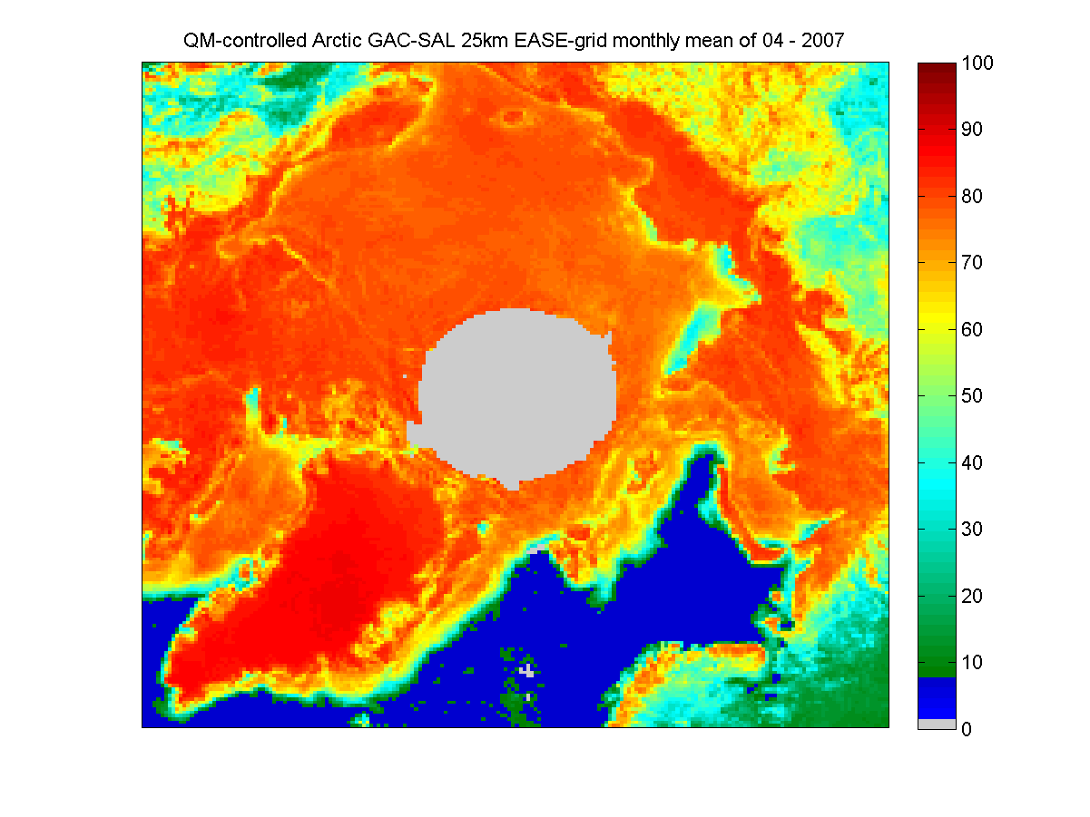
Product example; Arctic albedo April 2007
CLARA surface albedo

Slide 24
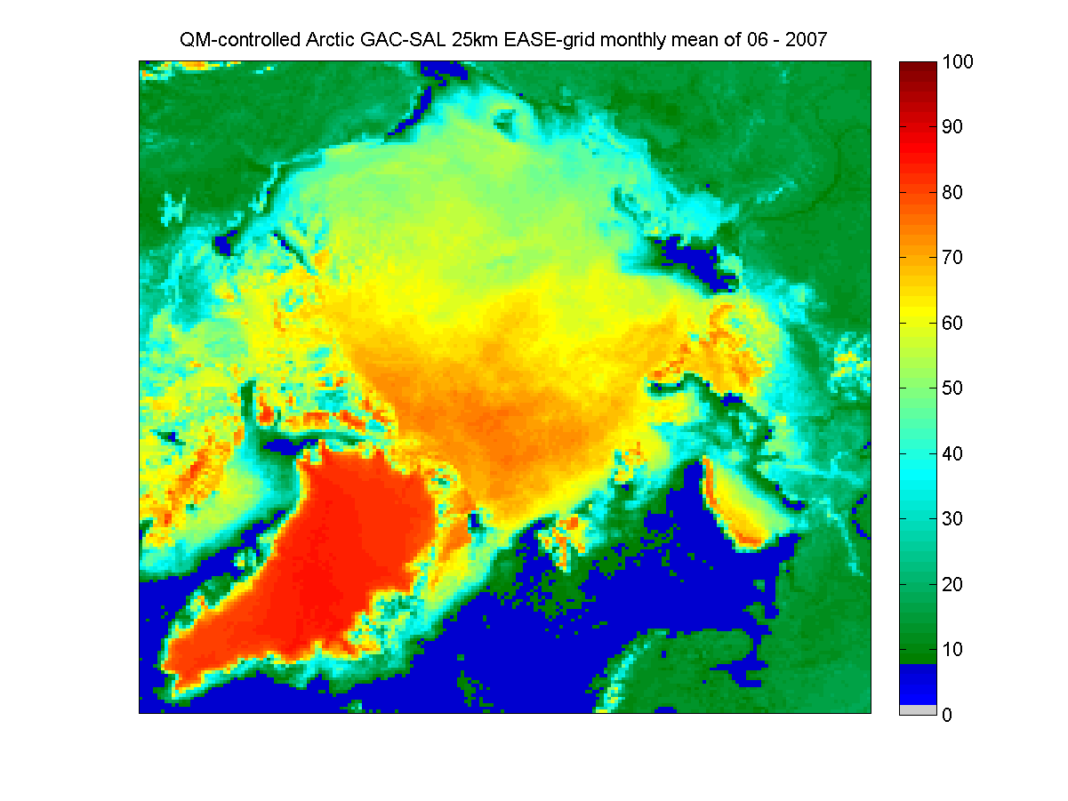
Product example; Arctic albedo June 2007
CLARA surface albedo

Slide 25
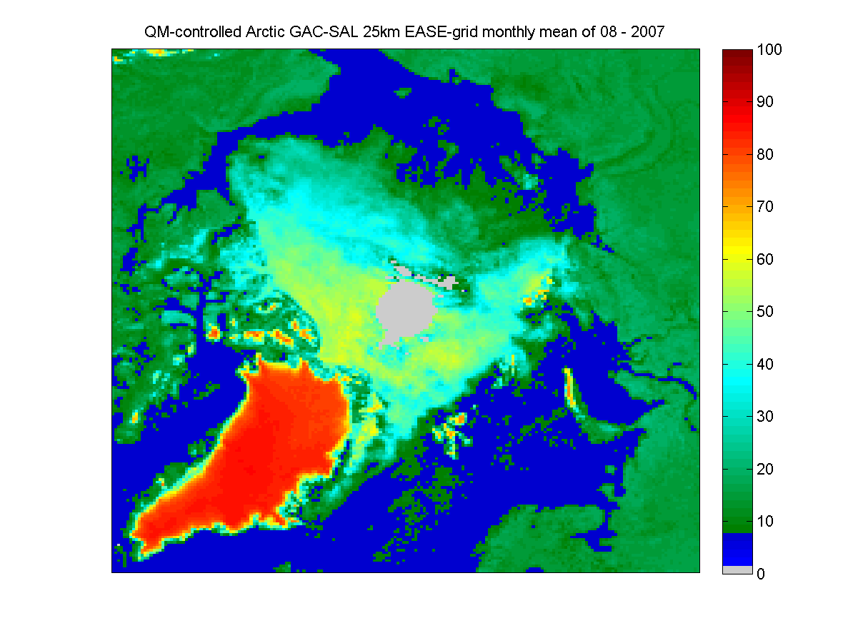
Product example; Arctic albedo August 2007
CLARA surface albedo
Full animation of 5-day values available for download covering 2007-2009!

Slide 26
CLARA-SAL edition 1 strengths & weaknesses
CLARA surface albedo
Global coverage
First 28-year record of Arctic (and Antarctic) sea ice albedo
Based on homogenized AVHRR radiances
Validation shows 10-15% retrieval accuracy over most natural surfaces
Retrievals uncertain over regions with high aerosol loading
Retrievals also uncertain when Sun Zenith Angle is close to 70 degrees
Usage recommendations:
Use the SAL supplementary data – number of observations and standard deviation can help find and remove uncertain retrievals from your analysis.
Avoid using over Sahara and other regions where AOD content is high and variable.
Best validation results found over sea ice and snow – highest value there?

Slide 27
CLARA surface radiation
List of all surface radiation products:
PRODUCT NAME | PRODUCT CODE | PRODUCT ACRONYM
Surface Incoming Shortwave | CM-52 | SIS
Surface Net Shortwave | CM-67 | SNS
Surface Outgoing Longwave | CM-76 | SOL
Surface Downward Longwave | CM-81 | SDL
Surface Net Longwave | CM-88 | SNL
Surface Radiation Budget | CM-95 | SRB
Cloud Radiative Effect Shortwave | CM-100 | CFS
Cloud Radiative Effect Longwave | CM-101 | CFL

Slide 28
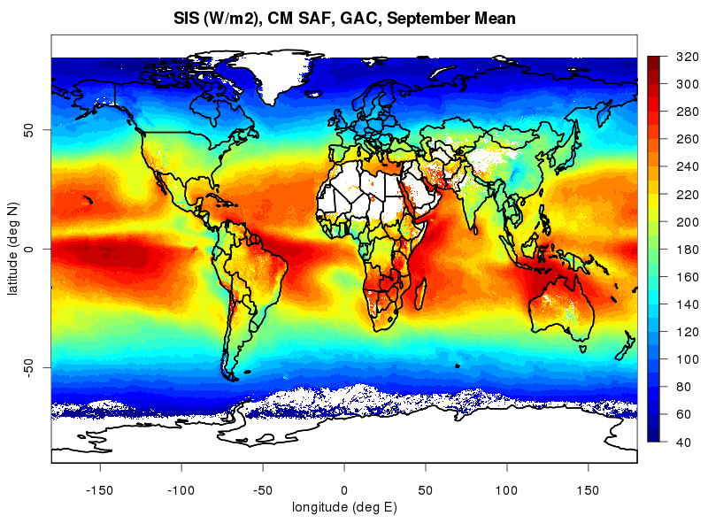
CLARA surface radiation
Polar-Orbiting
Based on AVHRR-GAC, using a LUT approach
(Mueller et al.,2009)
Available 1982 to 2009
0.25° spatial resolution
daily, monthly
Variables:
  Surface radiation budget
Results using monthly mean Surface Incoming Solar Radiation (SIS)
Algorithms to be presented by Rebekka Posselt on Wednesday!

Slide 29
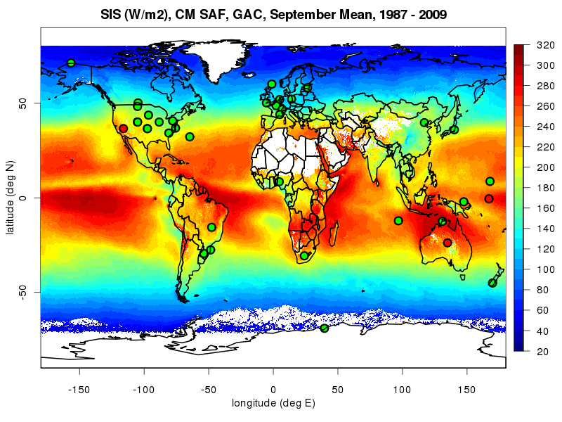
Validation CLARA - SIS
CLARA surface radiation

Slide 30
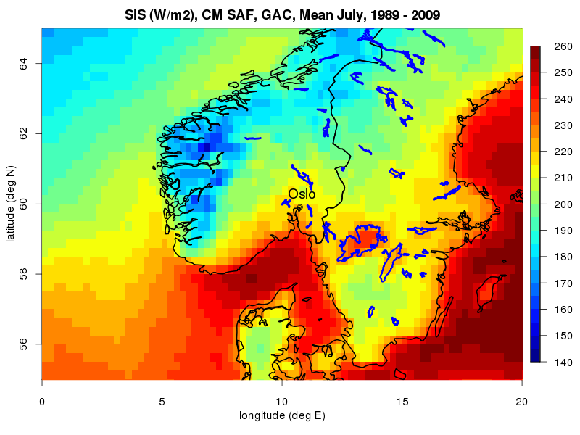
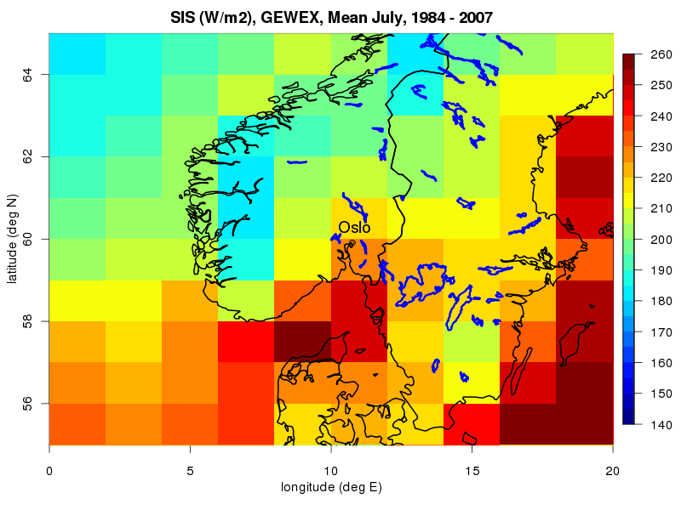
About applications CLARA - SIS
CLARA surface radiation
Surface Irradiance, Mean July, CM SAF
Reduced solar radiation in Western Norway, local effects visible (e.g., Fjords)
Enhanced radiation over the Baltic Sea and inland lakes.
GEWEX SRB data misses details due to coarse resolution.

Slide 31
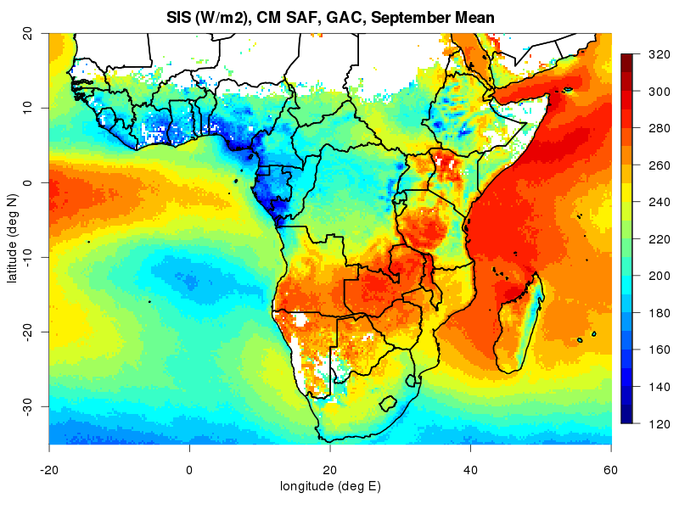
Large-scale results CLARA - SIS
CLARA surface radiation

Slide 32
Large-scale results CLARA - SIS
CLARA surface radiation
Close up
region
Notes:
It would be great to have the same plot also for the cloud fraction and the surface albedo, but I guess this will not work out before the Event Week… Anyway, I will do that later and provide you with the plots, there will surely be more GAC presentation in the upcoming weeks/months.

Slide 33
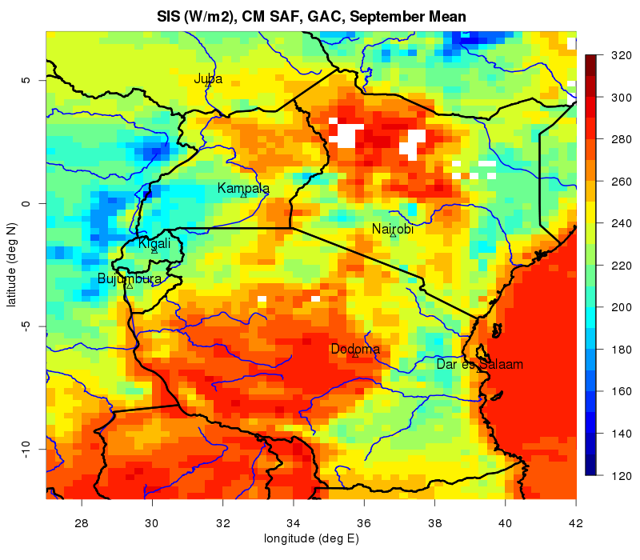
Local-scale results CLARA - SIS
CLARA surface radiation

Slide 34
CLARA surface radiation
Strengths:
Global coverage at moderate spatial resolution (0.25 deg, alternative global data sets have much lower spatial resolution (1 deg))
Good quality (accuracy and stability), long time series
Numerous consistent parameters available (clouds, surface albedo, short- longwave surface radiation)
Weaknesses
A lot of missing data in surface solar radiation data set -> be careful when calculating spatial and temporal averages!
Longwave radiation data set relies on ERA-Interim reanalysis data -> could be problematic for model evaluation
For very local applications, spatial resolution might not be sufficient -> check out the Meteosat surface radiation data set (but only for Europe, Africa, parts of South America available!)

Slide 35
CLARA - Outlook
CLARA Edition 2 (released 2015):
Regional cloud detection deficiencies solved or mitigated
Cloud effective radius new official product
Enhanced product dataset (Level 2 + Level 2b)
Improved consistency between products
SAL improvements in atmospheric correction, sea ice identification and use of a more dynamic land cover dataset.
Improvement of surface radiation products over bright surfaces and improved corrections for the longwave surface radiation products
CLARA Edition 3 (released 2017):
Extended back to 1978 (AVHRR/1)
Methods for correcting effects of orbital drift
Improved error characterization (e.g. probabilistic cloud mask and modelled uncertainties from OE techniques)

Slide 36

The end

