Slide 1
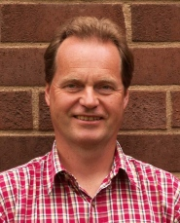
CLOUD RETRIEVAL
An overview of CM SAF cloud retrieval methods
Karl-Göran Karlsson SMHI, Sweden
Outline:
How do we observe clouds from space?
Which cloud properties can be observed from space?
Which satellites and sensors are most useful?
Which retrieval methods are used in the CM SAF?

Slide 2
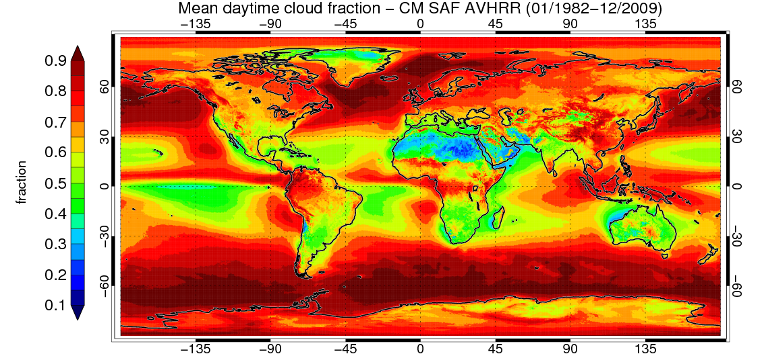
CLOUD RETRIEVAL
Could you please click on the map and indicate where you are?
(Maybe we can deduce which participant gets most sunshine!)

Slide 3
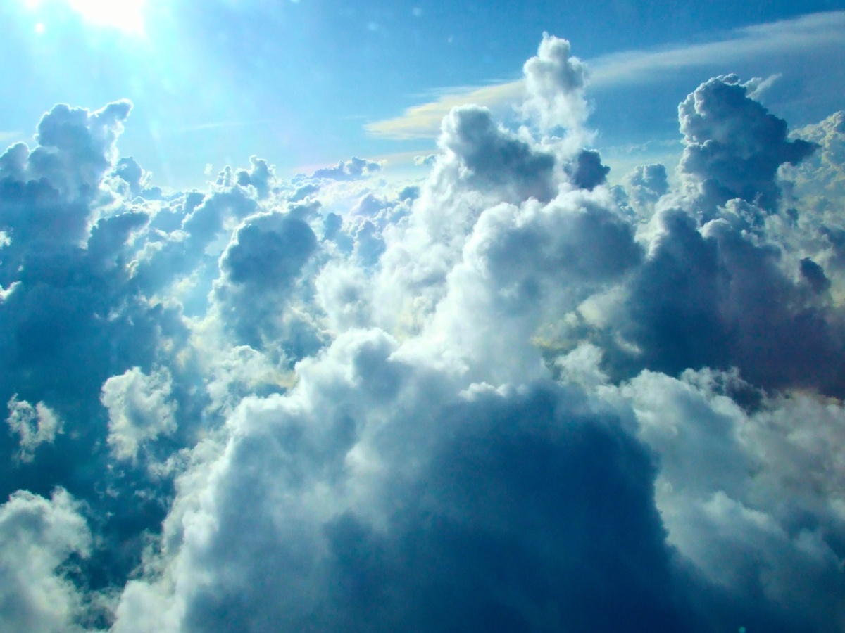
What is a cloud?
What makes us observe them?
Photo by Karin Dalziel

Slide 4
What is a cloud?
A collection of liquid or frozen particles floating in the atmosphere and sustained by vertical motion (updrafts)
What makes us observe them?
We identify clouds by their ability to reflect sunlight and by the temperature of their cloud tops, i.e., their brightness in visible and thermal imagery!
Photo by Karin Dalziel

Slide 5
Observation of clouds
What other conditions need to be fulfilled for successful cloud detection from space (please tick!)?
Clouds must be precipitating
Rocket engines must be active
The atmosphere itself must be transparent
No airplanes should intersect at observation time
International Space Station must be out of sight
Clouds must appear brighter than the Earth surface
Migrating birds must be on ground
No rainbows should interfere
Cloud tops must be colder than the Earth surface
No Quidditch games allowed at observation times

Slide 6
Observation of clouds
What other conditions need to be fulfilled for successful cloud detection from space (please tick!)? Correct choices:
Clouds must be precipitating
Rocket engines must be active
The atmosphere itself must be transparent
No airplanes should intersect at observation time
International Space Station must be out of sight
Clouds must appear brighter than the Earth surface
Migrating birds must be on ground
No rainbows should interfere
Cloud tops must be colder than the Earth surface
No Quidditch games allowed at observation times
x
x
x

Slide 7
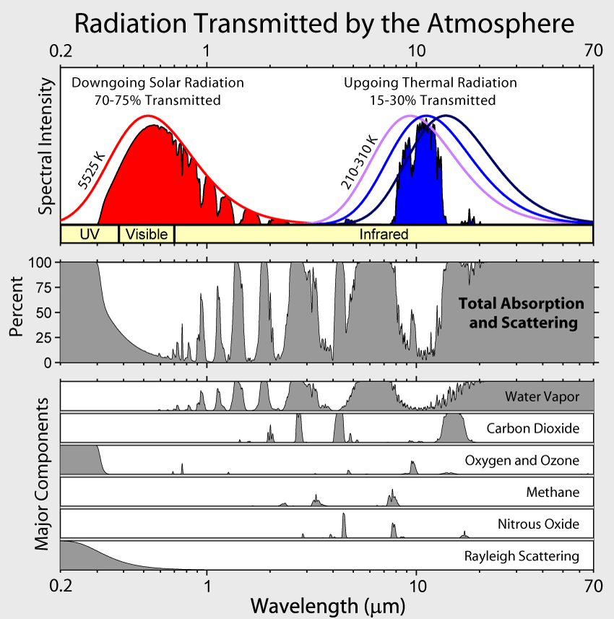
Observation of clouds
We need a transparent atmosphere to be able to observe clouds in imagery!

Slide 8
Observation of clouds
We need a transparent atmosphere to be able to observe clouds in imagery!
Common spectral bands: 0.6 μm, 0.8 μm, 1.6 μm, 3.7 μm, 8.7 μm, 11 μm and 12 μm.

Slide 9
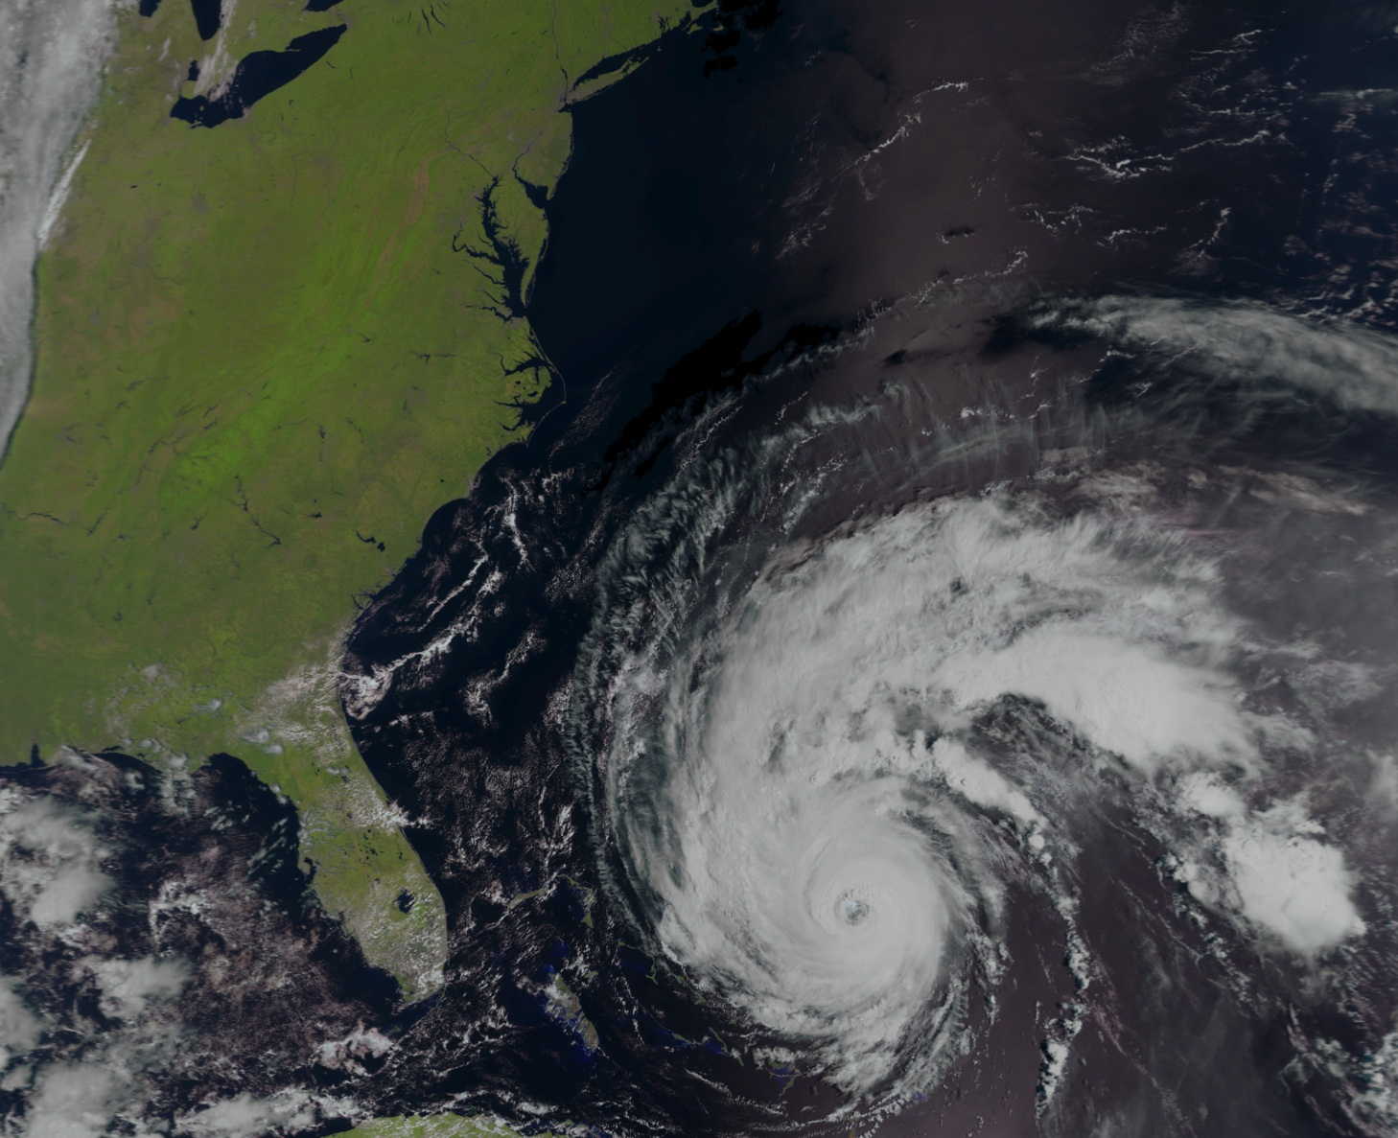
Observation of clouds
We need contrast between clouds and other objects to be able to detect clouds in imagery!

Slide 10
Observation of clouds
Are there clouds that could remain undetected?

Slide 11
Observation of clouds
Are there clouds that could remain undetected?
Yes, there are actually several occasions when this might occur:
Bright clouds over bright surfaces, e.g., over snow-covered or desert surfaces
Cold clouds over cold surfaces, e.g. over almost all polar surfaces in the polar winter + thin cirrus clouds over snow-covered surfaces
Extreme cases: Low clouds are warmer than the surface (e.g., stratus clouds over the Arctic ocean in polar summer)
Warm clouds in twilight situations

Slide 12
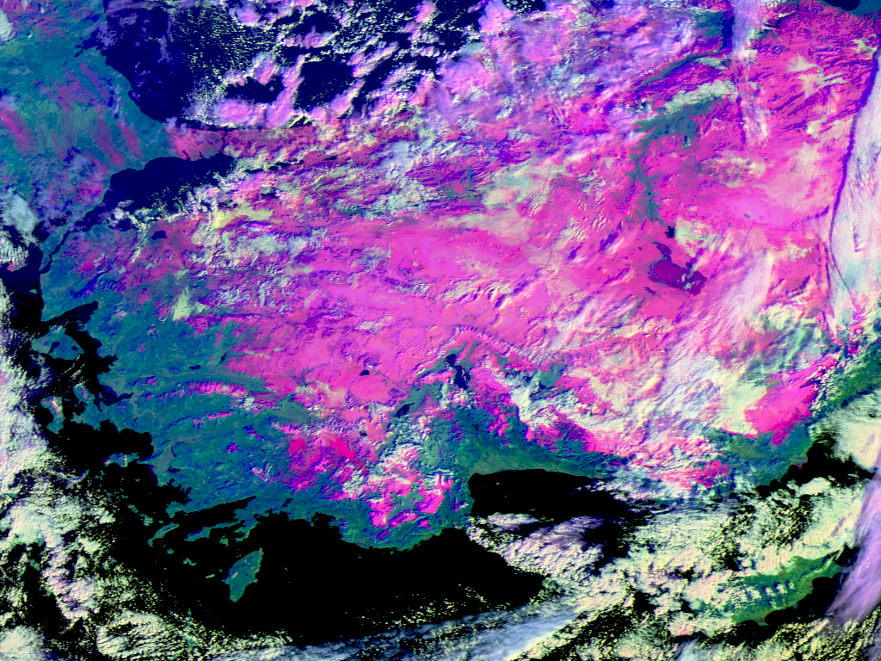
Optimal detection of clouds
Use differences in the appearance of clouds in different spectral channels!
Example below over Turkey: Clouds over snow-cover (magenta) can easily be detected if utilising that they reflect in the 1.6 micron channel while snow is not!!!
Metop-A RGB
Composite
17 January 2012
VIS0.6, NIR1.6, IR11.0
07:49:00 UTC

Slide 13
Optimal detection of clouds
Use differences in the appearance of clouds in different spectral channels!
Example below over Turkey: Clouds over snow-cover (magenta) can easily be detected if utilising that they reflect in the 1.6 micron channel while snow is not!!!
➔ USE MULTISPECTRAL METHODS!!!
Metop-A RGB
Composite
17 January 2012
VIS0.6, NIR1.6, IR11.0
07:49:00 UTC

Slide 14
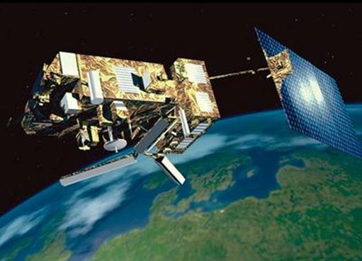
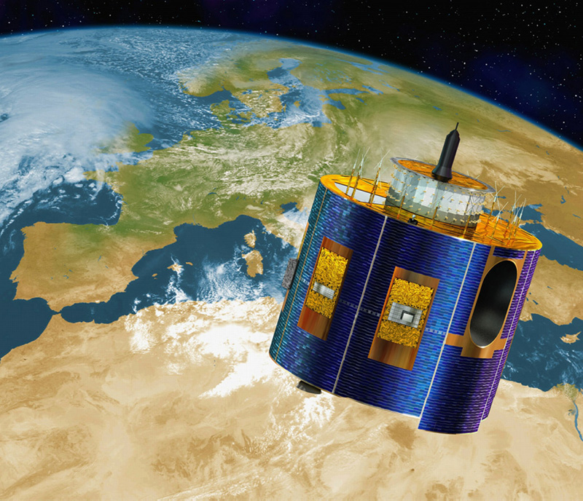
Suitable sensors for cloud screening
The main objective for the EUMETSAT CM SAF is to use sensors from operational weather satellites for climate monitoring.
Most suitable image sensors is then AVHRR on polar orbiting NOAA/Metop satellites and SEVIRI on the geostationary METEOSAT satellite
The Metop-A satellite carrying AVHRR imager with 6 spectral bands
The METEOSAT satellite carrying SEVIRI imager with 12 spectral bands

Slide 15
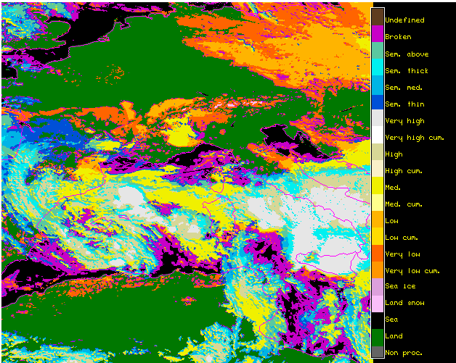
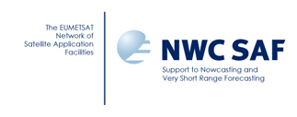
Basic cloud screening in CM SAF
Two multispectral cloud processing methods are used in the CM SAF:
The PPS (Polar Platform System) and MSG cloud processing packages provided by the EUMETSAT Nowcasting SAF project
Example of NWC SAF MSG cloud type product from 14 October 2003
(animation available for download!)

Slide 16
Basic cloud screening in CM SAF
Common basic methodology for the PPS (Polar Platform System) and MSG cloud processing packages:
Multispectral thresholding, i.e., a pixel is labelled cloudy if radiances exceed thresholds in a number spectral channels or channel combinations (e.g. radiance differences)
Thresholds depend on illumination conditions, viewing angles and the atmospheric background state (taken from ERA-Interim)
For several tests, thresholds are based on simulations of radiances from cloud-free surfaces

Slide 17
Basic cloud screening in CM SAF
PPS (Polar Platform System) and MSG cloud processing packages –
Major features used in cloud screening:
Clouds are brighter than Earth surfaces in visible channels
Clouds are colder than Earth surfaces in infrared channels
Water clouds reflect radiation at short-wave infrared channels (1.6 micron and 3.7 micron) while Earth surfaces do not reflect
Thin ice clouds are less transparent at longer infrared wavelengs, i.e., cirrus can be detected using difference between 11 and 12 micron channels
Water clouds at night are not black-bodies in 3.7 micron channel, i.e., can be detected using difference between 3.7 and 11 micron
Pixel-size clouds can be detected using simple texture measures

Slide 18
Cloud top determination
Cloud height retrievals from passive imagers in space are difficult. Why?

Slide 19
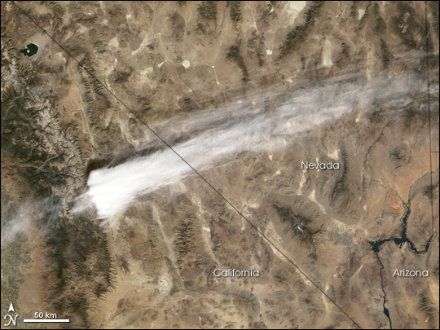
Cloud top determination
Cloud height retrievals from passive imagers in space are difficult. Why?
One major reason:
We measure the vertically integrated (i.e., along the line of sight) radiation that enters the sensor detector in space ➔ If we observe a thin transparent cloud, radiation contributions come in various proportions from the cloud itself and all underlying clouds/surfaces!

Slide 20
Cloud top determination
Cloud height retrievals from passive imagers in space are difficult. Why?
One major reason:
We measure the vertically integrated (i.e., along the line of sight) radiation that enters the sensor detector in space ➔ If we observe a thin transparent cloud, radiation contributions come in various proportions from the cloud itself and all underlying clouds/surfaces!
Another fundamental problem:
Even if the cloud is opaque (thus, we are able to estimate the true cloud top temperature), this temperature can often be found at several altitudes in the atmosphere (due to inversions)

Slide 21
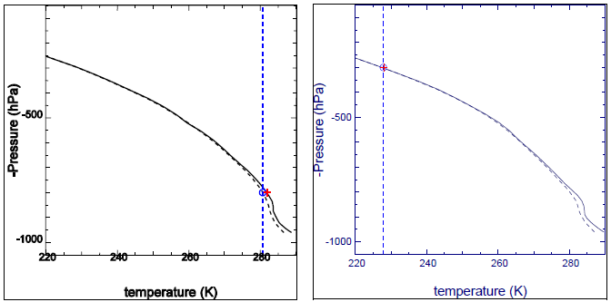
Cloud top determination
Methods used for the CM SAF datasets (still based on NWC SAF packages):
For opaque clouds (negligible brightness temperature difference between 11 and 12 micron channels):
Matching of measured brightness temperatures (horizontal dashed line) with simulated ones (dashed curve, using radiative transfer methods like RTTOV) and reference profiles from ERA-Interim(solid curve)
Cloud top for low-level cloud
Cloud top for high-level cloud

Slide 22
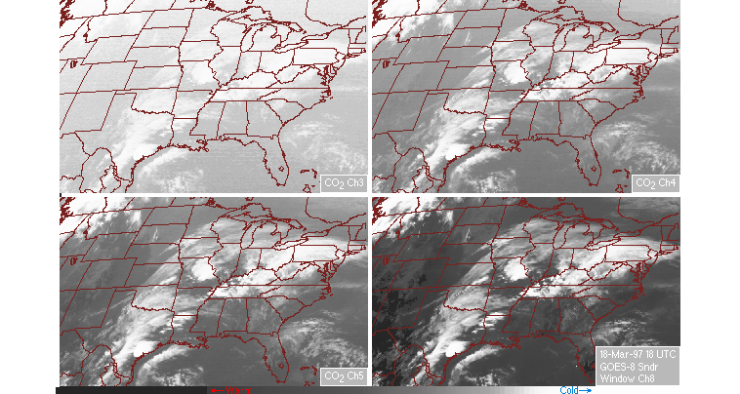
Cloud top determination
Methods used for the CM SAF datasets (still based on NWC SAF packages):
For semi-transparent clouds: Alternative 1 (MSG)
Form quotas of radiances in two channels with different transmissivities – the quota is a function of pressure in an atmosphere without temperature inversions (called Radiance Ratioing or CO₂ slicing– only applicaple to MSG SEVIRI!)
Sounding channel (only high clouds visible)
Window channel (’All’ clouds visible)

Slide 23
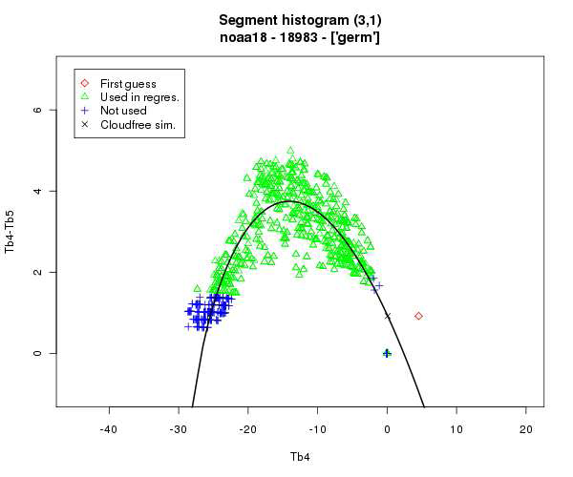
Cloud top determination
Methods used for the CM SAF datasets (still based on NWC SAF packages):
For semi-transparent clouds: Alternative 2 (PPS)
Create plot of brightness temperature differences between 11 and 12 micron channels over a sub-segment of the image – then, fit an arch curve (polynomial) to find out the corresponding (opaque) cloud top temperature
Cloudy pixels for one cloud layer with varying cloud thickness
Retrieved cloud top temperature
x

Slide 24
Cloud Physical Products (CPP)
What can we say about cloud properties on the cloud particle scale?
CM SAF datasets include a set of cloud products that we call Cloud Physical Products (CPP). These are
Cloud Optical Thickness
Cloud Effective Radius
Cloud Phase
Liquid Water Path
Ice Water Path
= Integrated dimensionless extinction coefficient
= ’Average’ particle size
= Liquid or frozen
= Integrated liquid substance in kgm⁻²
= Integrated ice substance in kgm⁻²

Slide 25
Cloud Physical Products (CPP)
Basic principles for CPP retrievals:
Reflectance of clouds at a non-absorbing wavelength in the visible region (VIS: 0.6 or 0.8 micron) is strongly related to the optical thickness
Reflectance of clouds at an absorbing wavelength in the near-infrared region (NIR: 1.6 or 3.7 micron) is primarily related to particle effective radius
Ice clouds absorb more (reflects less) radiation at NIR wavelengths

Slide 26
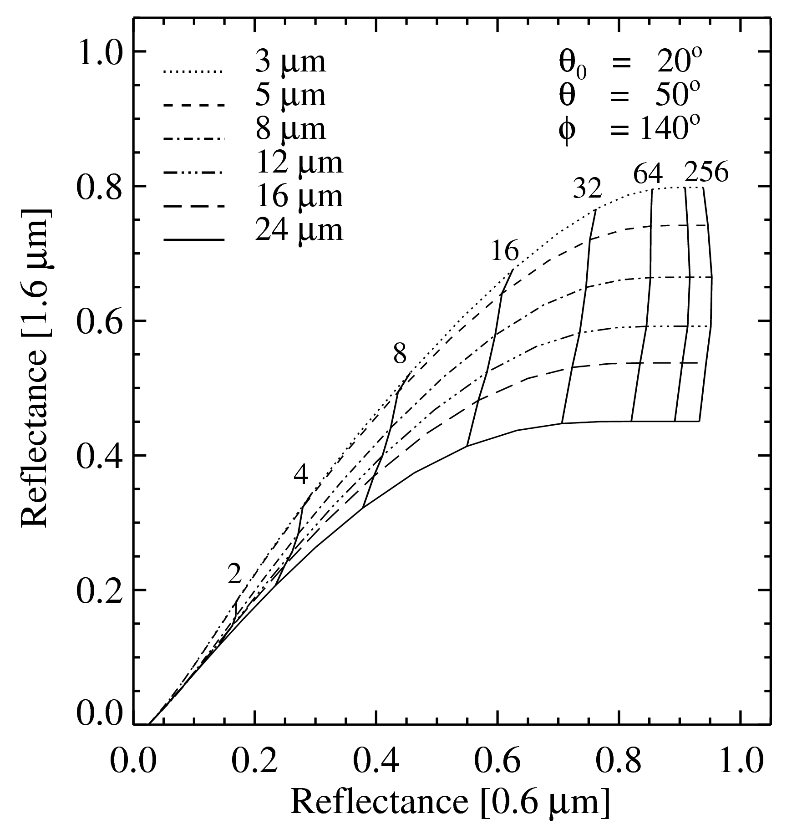
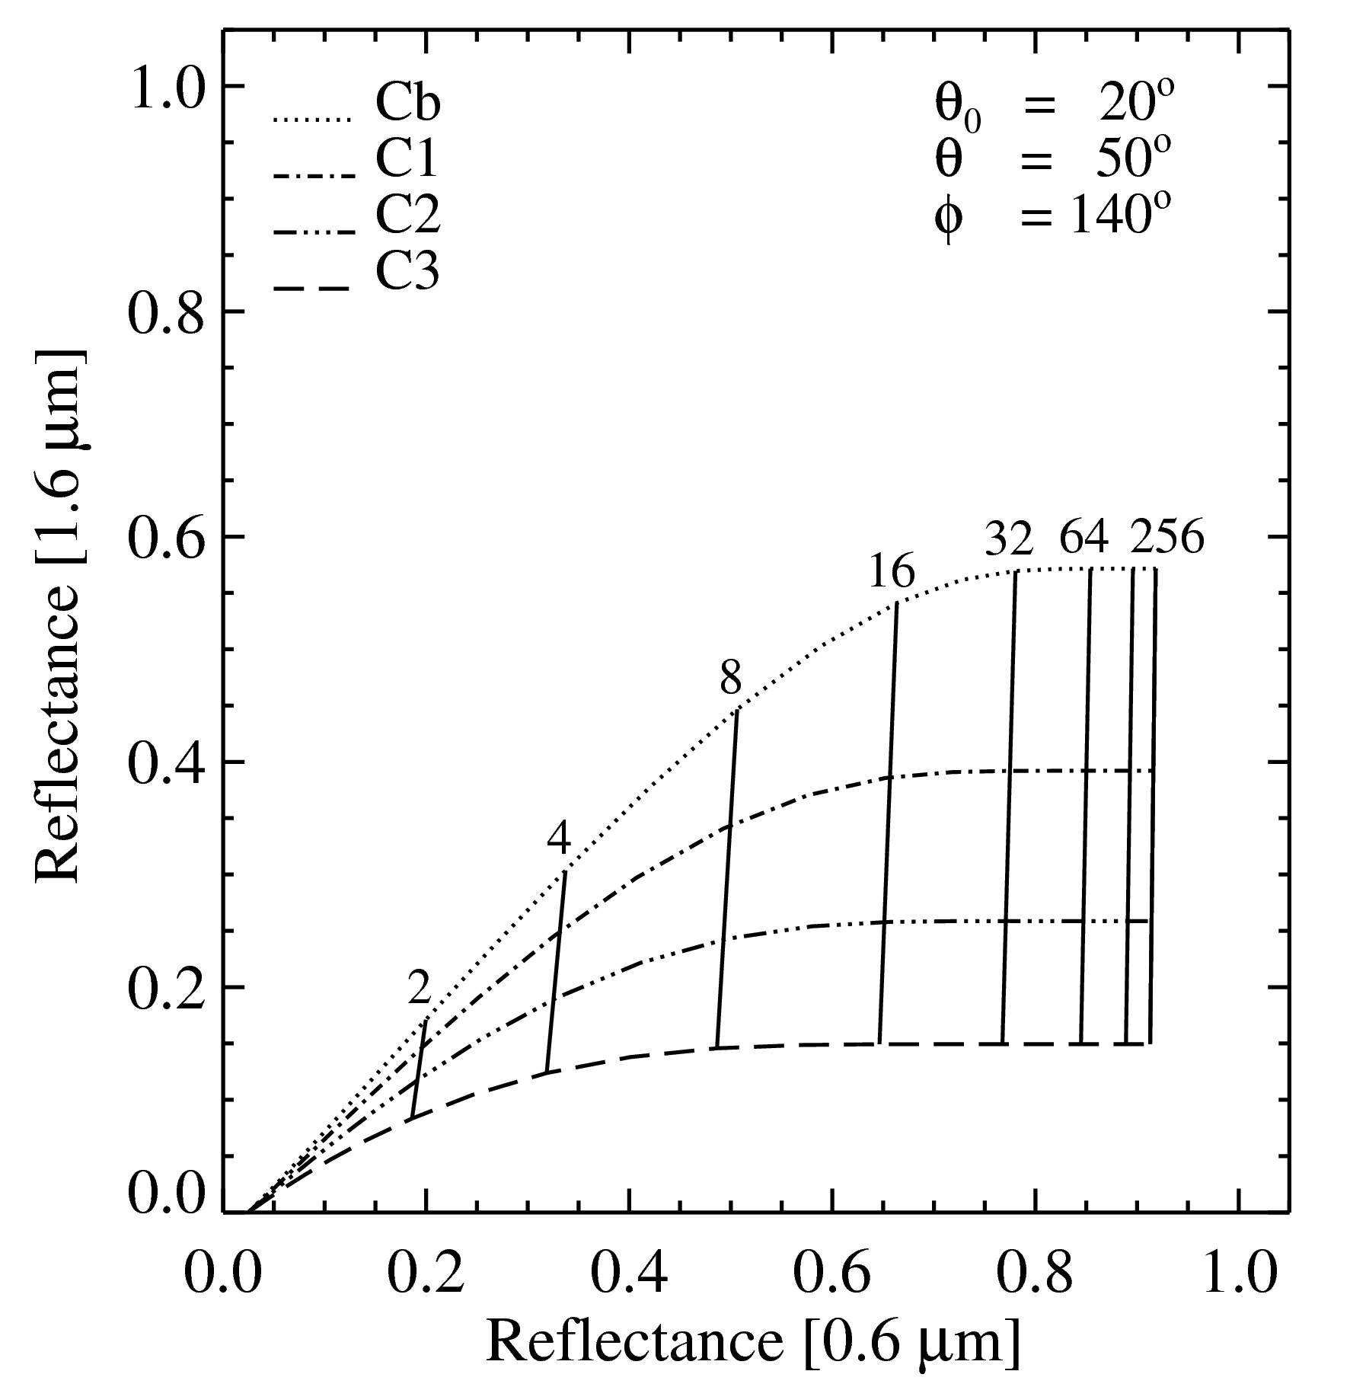
Cloud Physical Products (CPP)
Practical implementation: Search in lookup tables (LUT) with simulated radiances for water clouds (left) and ice clouds (right)
Curves show optical thickness values vertically and effective radii horizontally
Radiance transfer simulations made with DAK (Doubling-Adding KNMI model)
Water clouds
Ice clouds

Slide 27
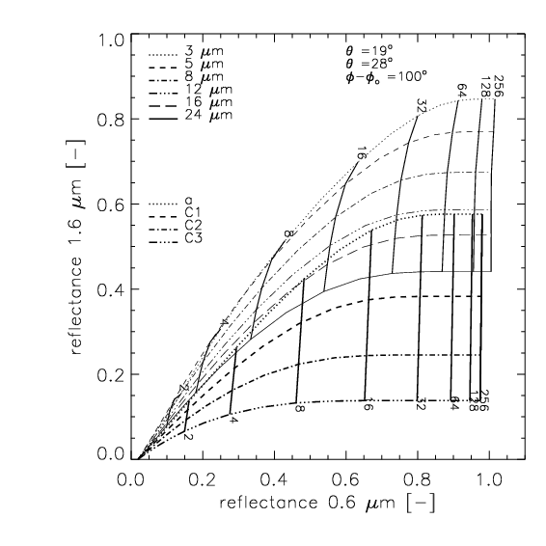
Cloud Physical Products (CPP)
Strategy including method when simulations overlap:
Try both phases
Use also cloud-top temperature (CTT) threshold
water
ice

Slide 28
Cloud Physical Products (CPP)
Computation of liquid (LWP) or ice water (IWP) paths:
Products derived from optical thickness τ and effective radius r_{e} using the following parameterisation
where ρ is density.

Slide 29
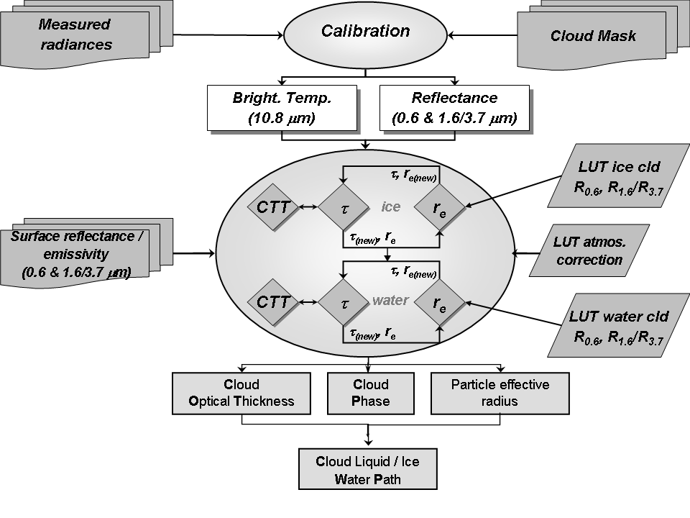
Cloud Physical Products (CPP)
Flow chart for CPP retrievals:

Slide 30
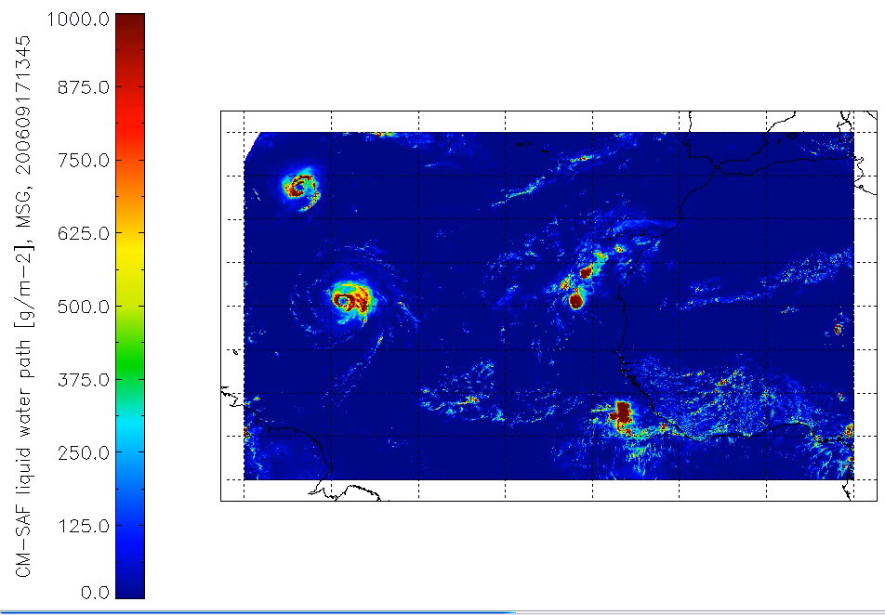
Cloud Physical Products (CPP)
Demonstration of liquid water path product (hurricane Helene Feb 2009):
(SEVIRI animation available for download!)

Slide 31
Conclusions
Multispectral analysis of SEVIRI and AVHRR radiances allows efficient cloud detection and cloud type identification - NWC SAF algorithms used by CM SAF - Some problems at twilight and in cold winter situations
Cloud top determination is more difficult and requires sophisticated methods heavily depending on radiative transfer calculations
Deeper analysis of cloud properties on the microscale is possible by use of near-infrared and and short-wave infrared channels at 1.6 and 3.7 microns - CM SAF relying on methods developed by KNMI

Slide 32

The end

