Slide 1
Sting Jets
Geraint Vaughan
University of Manchester

Slide 2

Who am I?
Professor of Atmospheric Science, University of Manchester
Director of Weather research, National Centre for Atmospheric Sciences
Researcher in atmospheric dynamics and active remote sensing (radar, lidar)

Slide 3
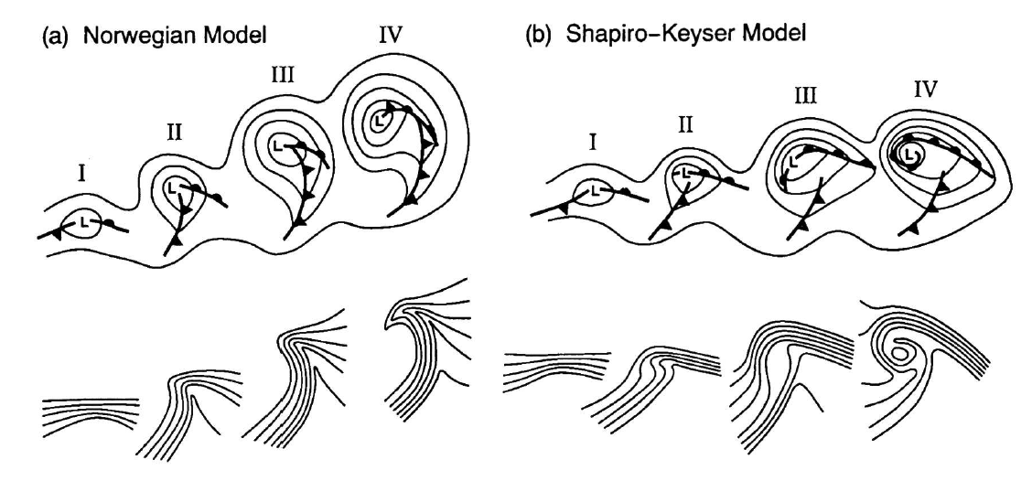
Models of cyclogenesis
Schultz et al 1998

Slide 4
Models of cyclogenesis
Bent-back warm front
Frontal fracture
Seclusion
Schultz et al 1998

Slide 5
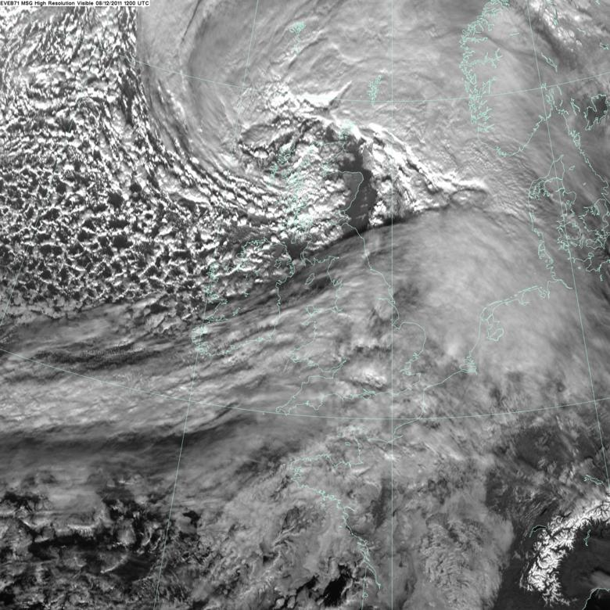
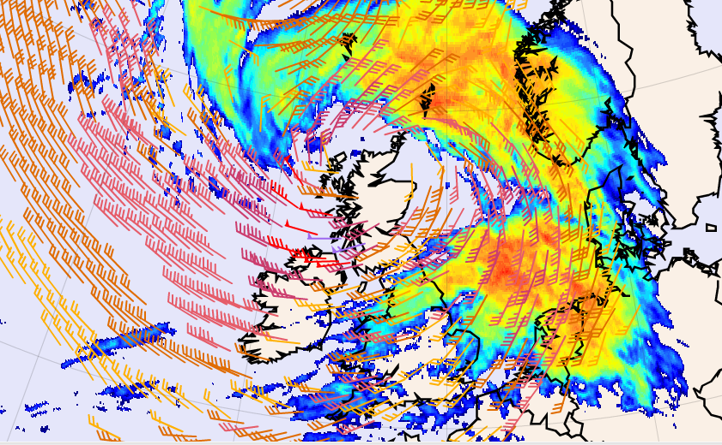
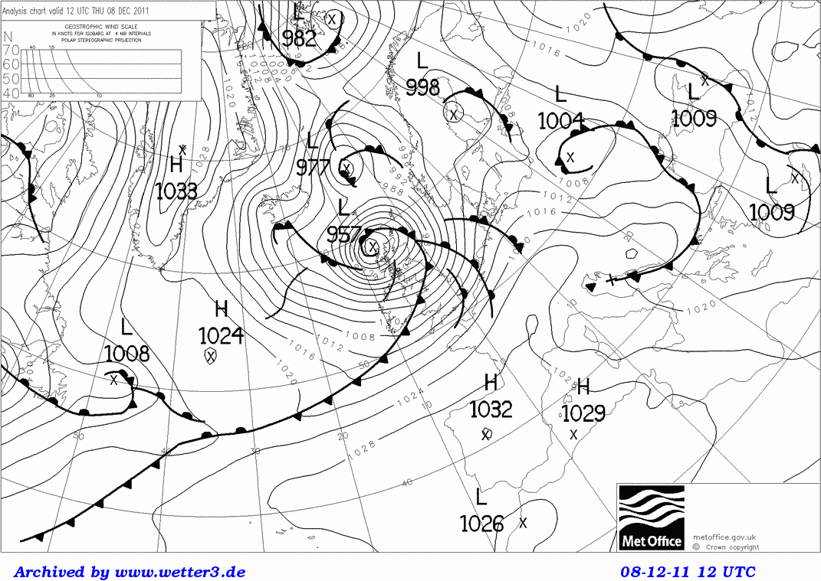
‘The poisonous tail’
Visible satellite image (MSG) and ECMWF surface winds superimposed on IR image for 12 Z, Dec 8th 2011.
Strongest surface winds just south of the tip of the cloud head

Slide 6
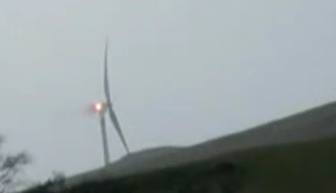
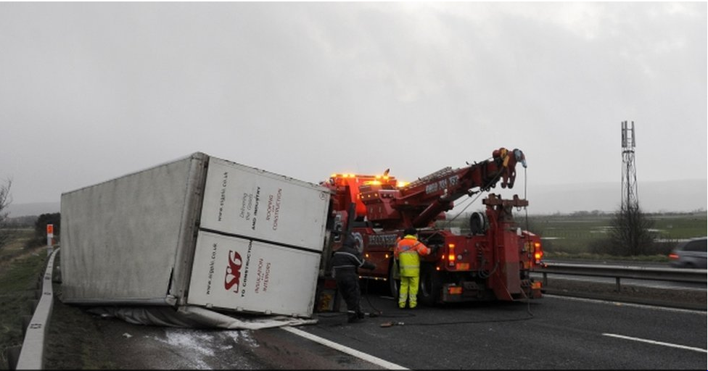
‘The poisonous tail’
Grønås (1995) – ‘the strongest winds ever recorded in (the Norwegian) region have been linked to bent-back occlusions. Such a structure has been called the poisonous tail of the bent-back occlusion, after F. Spinnangr’.
http://www.bbc.co.uk/news/uk-16115139
http://www.bbc.co.uk/news/uk-scotland-16108672

Slide 7
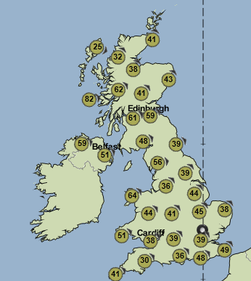
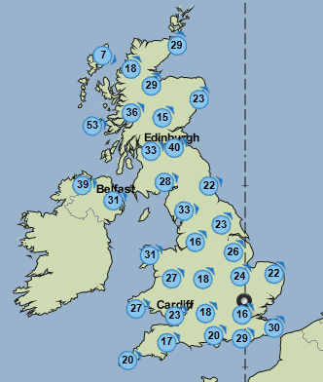
Strong wind region is narrow. Most damaging winds ~ 100 km swath
12 Z Gusts, mph
12 Z Mean wind, mph
230 km
Met Office website

Slide 8
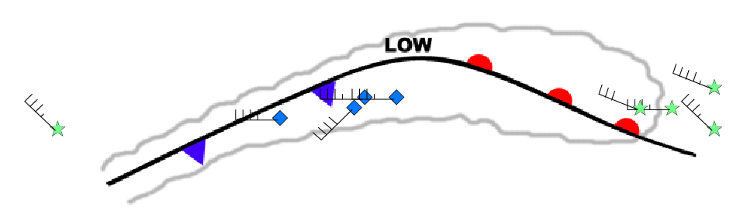
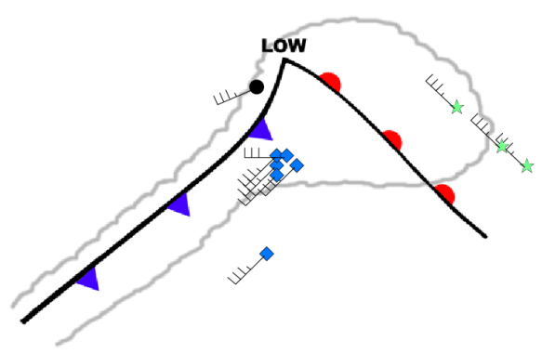

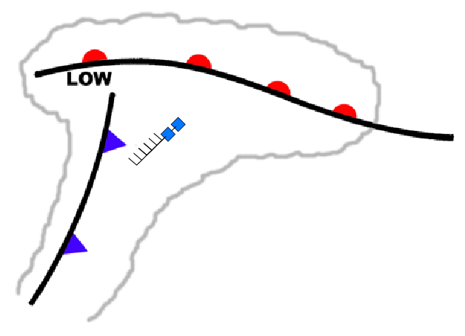
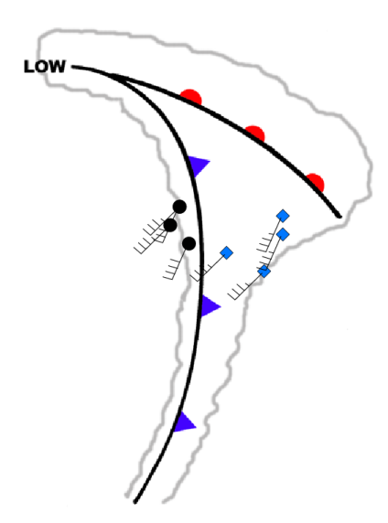
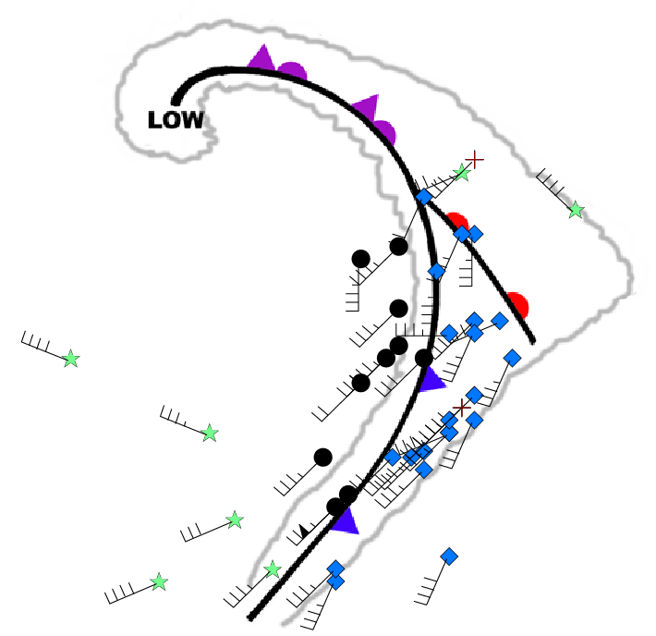
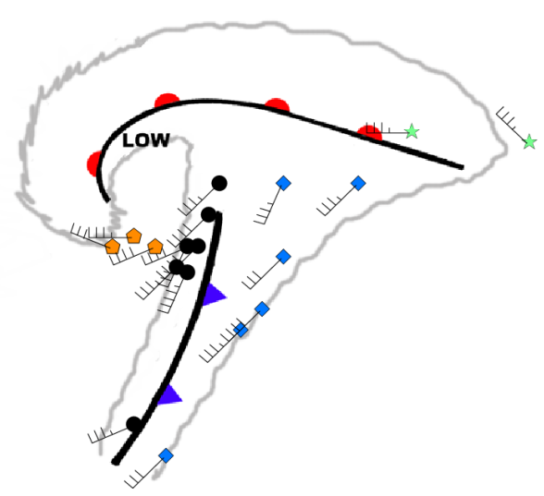
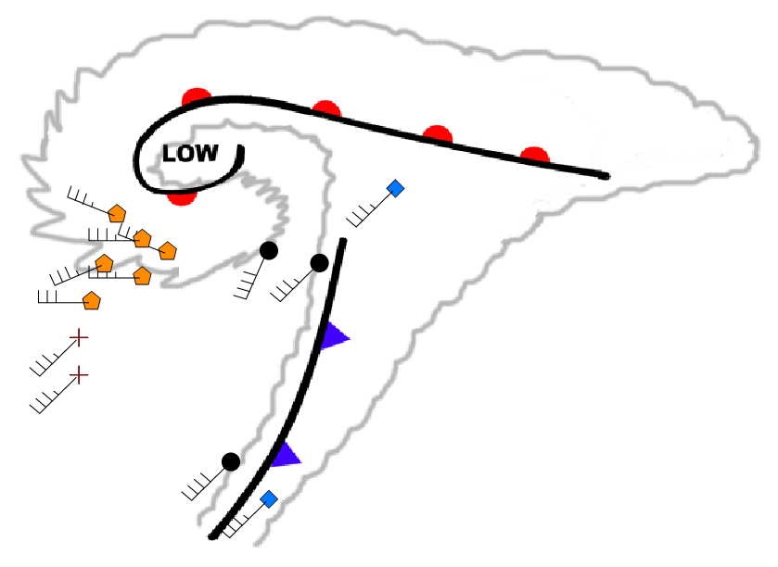
Where do we observe the strongest wind in a cyclone?
Winds in lower troposphere, 2-4 km altitude
Incipient cyclone
NM stage II
Post Frontal
SK stage II
SK stage III
SK stage IV
NM stage III
NM stage IV
Parton et al 2010, based on VHF wind profiler data from Aberystwyth

Slide 9
Summary
The strongest winds in a cyclone can occur after the cold front, in the southern quadrant of an extratropical cyclone
This is particularly so for cyclones developing according to the Shapiro-Keyser model – frontal fracture, strong bent-back warm front / occlusion and seclusion
This was known to the Bergen meteorologists and is well recognised by forecasters.
So what is a sting jet?

Slide 10
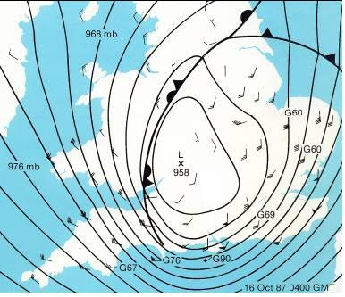
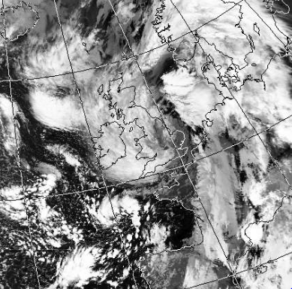
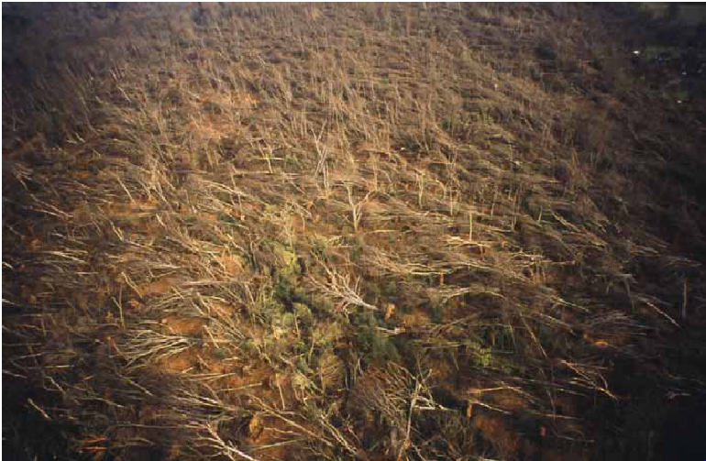
The Great Storm of 1987: ‘The sting at the end of the tail’
The Great Storm struck northern France and Southern England in the early hours of 16 Oct 1987. With surface wind gusts in excess of 40 m s⁻¹ in places there was very extensive damage
AVHRR image, 0440 Z, from
NEODAAS, Uni. Of Dundee
Risk Management Solutions, 2007

Slide 11
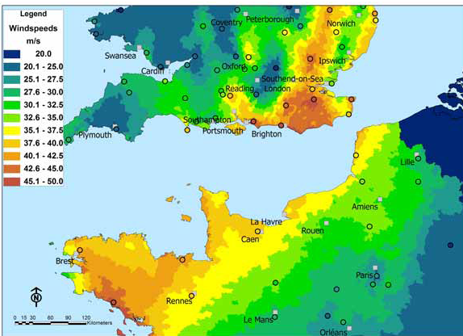
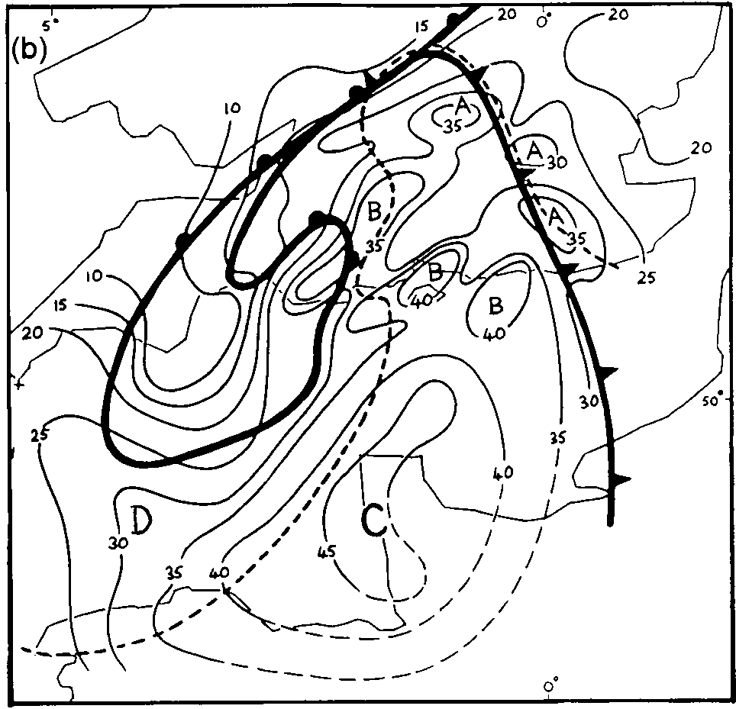
Detailed analysis: Keith Browning’s 2004 paper
seclusion
Risk Management Solutions, 2007: peak gust wind speed in m s⁻¹ .
Browning’s mesoanalysis for 0130 Z: contours are gust maxima, m s⁻¹
Four areas of extremely strong gusts identified:
A: Shallow Cb on the leading edge of the dry intrusion (here shown as a cold front)
B: Region of shallow, non-precipitating convection beneath the dry intrusion
C: Main area, identified by Browning as the ‘sting jet’
D: Low-level cyclonic airflow circulating storm (cold conveyor belt)
Browning, 2004

Slide 12
Why were the winds so strong?
Gradient wind in region C was 43 ± 10 m s⁻¹ :
Rapidly deepening low intensified pressure gradient
Rapid north-eastward motion of low
So we would expect strong winds in this quadrant of the storm
But, Browning noticed an association between the region of strongest gusts and the cloud head suggesting that slantwise convection also played a part
Browning, 2004

Slide 13
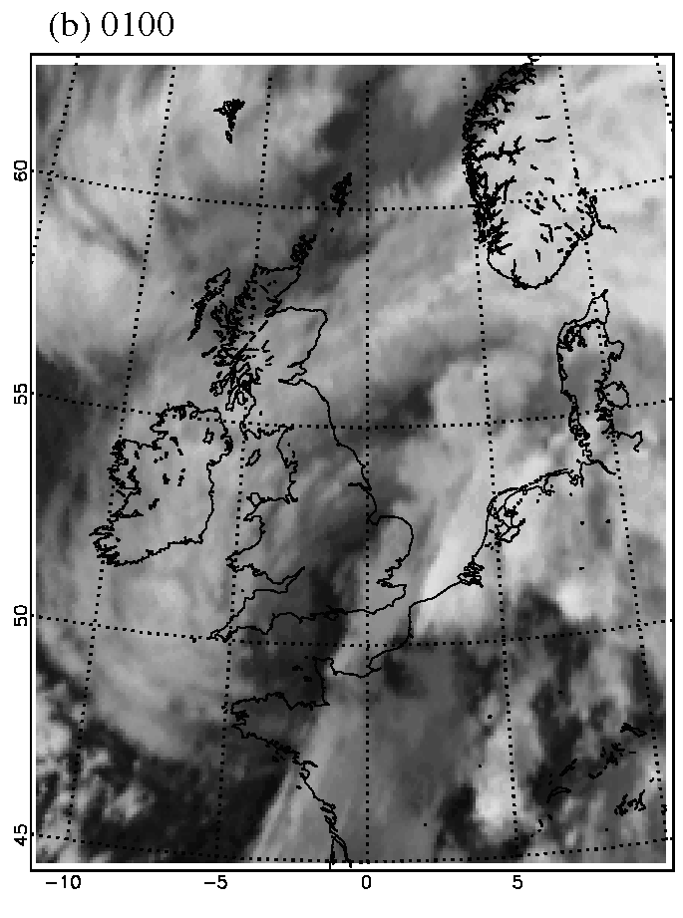
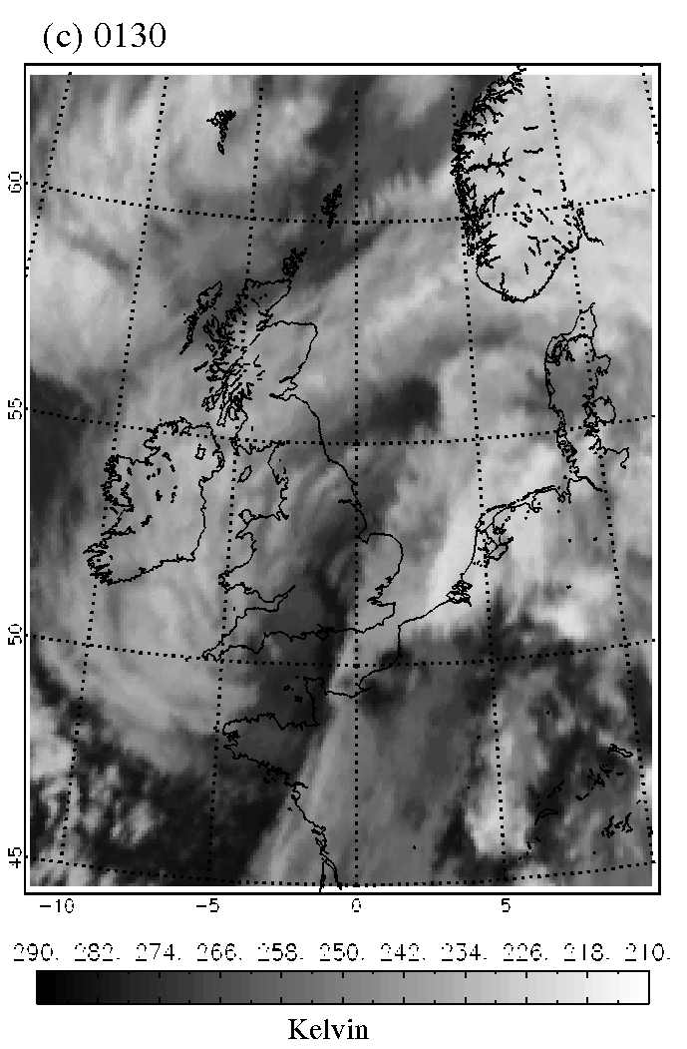
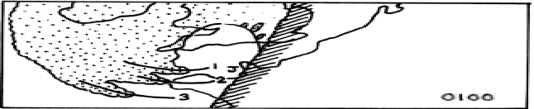
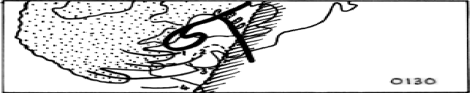
Satellite images
Note banded cloud head. Maximum gusts occurred consistently up to 100 km ahead of these bands.
Browning, 2004

Slide 14
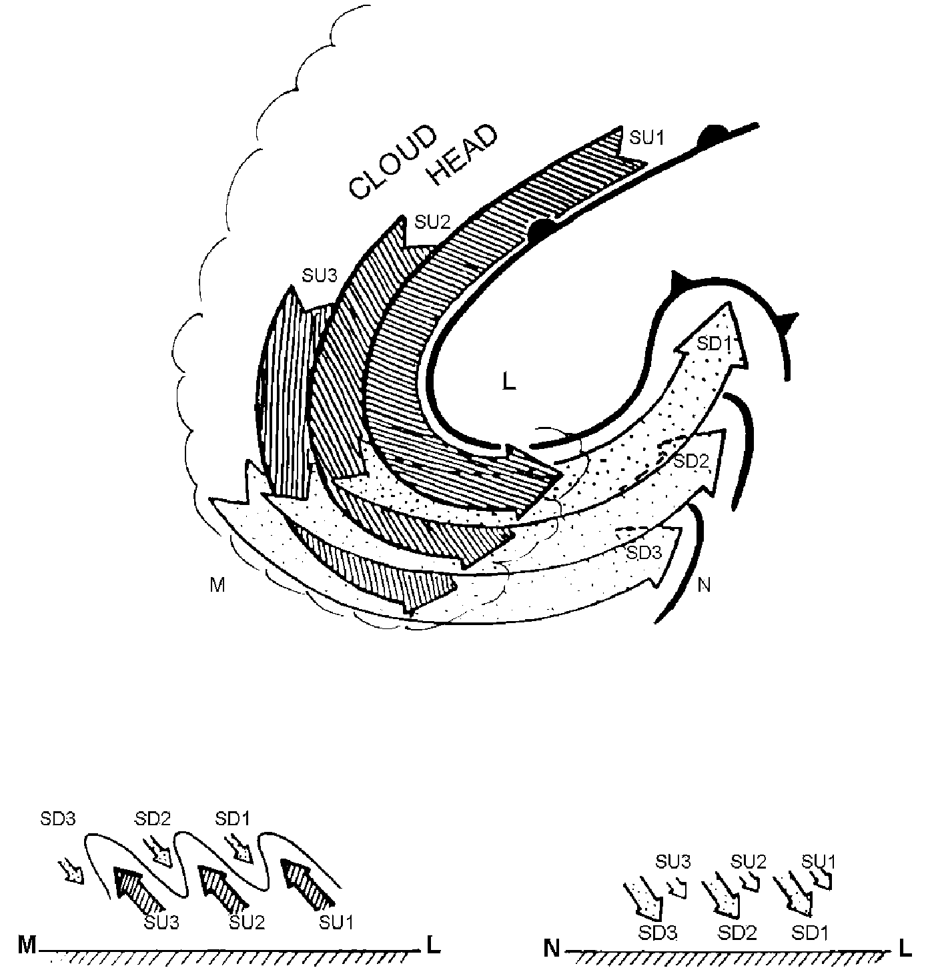
Hypothesis
Slantwise motions produce banding in cloud head
Descending branches interleaved with ascent
Snow falling into descending branches cools them further and drives descent
The term ‘sting jet’ refers to fast-moving air descending from the tip of the cloud head into the dry slot ahead of it
But: the sting jet is only present for a few hours during the history of a storm
Browning, 2004

Slide 15
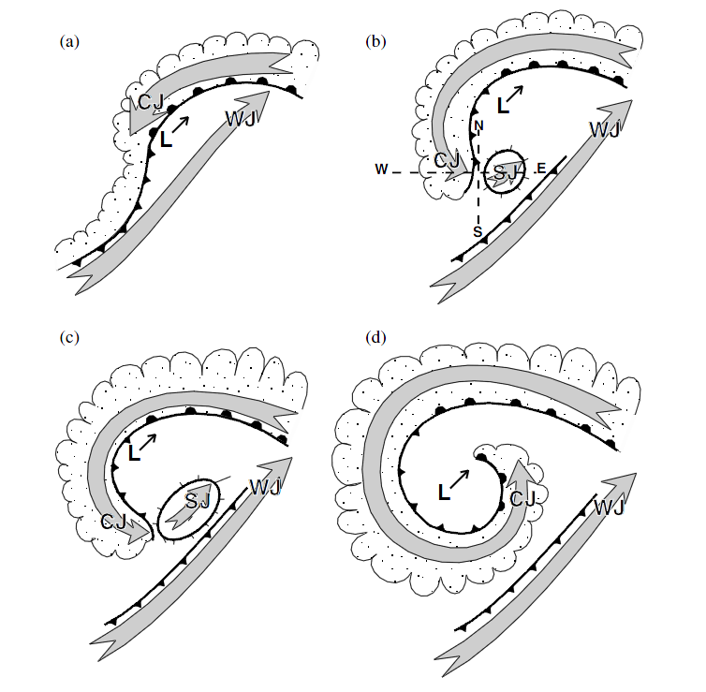
Conceptual model of storm development
WJ: warm conveyor belt
CJ: Cold conveyor belt
SJ: Sting jet
Cross-sections along W-E and N-S shown on next slide
Clark et al, 2005

Slide 16
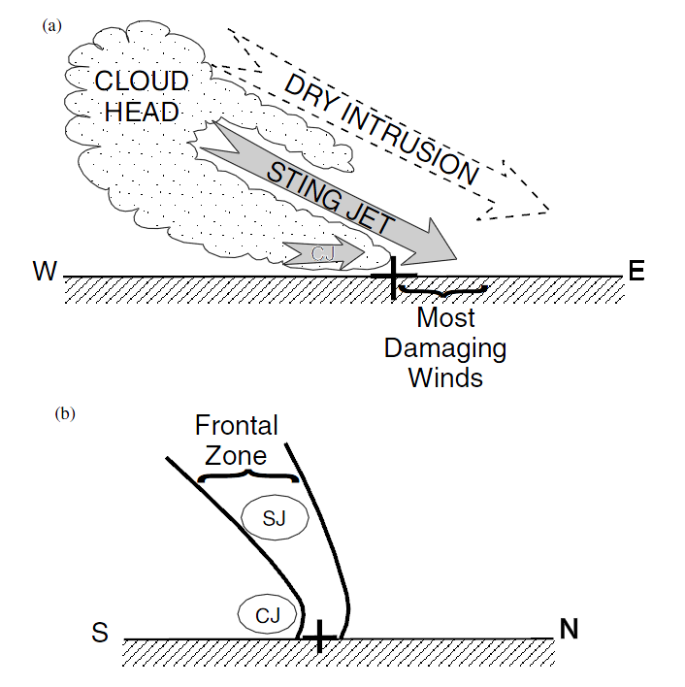
Cross-section
Cross-sections through the frontal fracture region of an extratropical cyclone
(a) The west–east section shows the sting jet (SJ) descending from mid levels within the cloud head, beneath the descending dry intrusion and above the cold-conveyor-belt jet (CJ).
(b) The south–north section shows the SJ as a distinct jet lying within the frontal zone separate from and above the CJ which lies close to the surface behind the frontal zone.
Clark et al, 2005

Slide 17
Summary
Damaging winds occur south of the cyclone centre
Much of this can be explained by the gradient wind
Banding at the tip of the cloud head suggests slantwise circulation
Slantwise circulation can lead to damaging wind gusts ahead of the cloud head
Look out for banding in the cloud head!

Slide 18
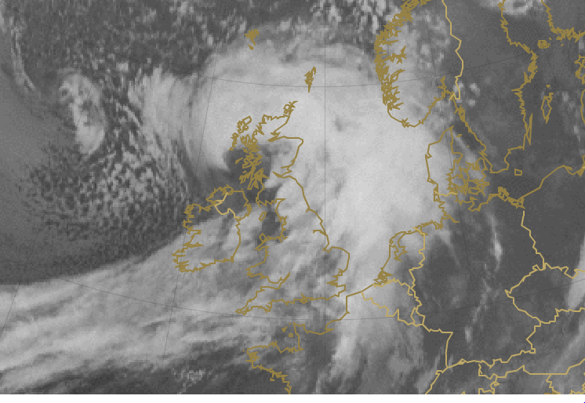
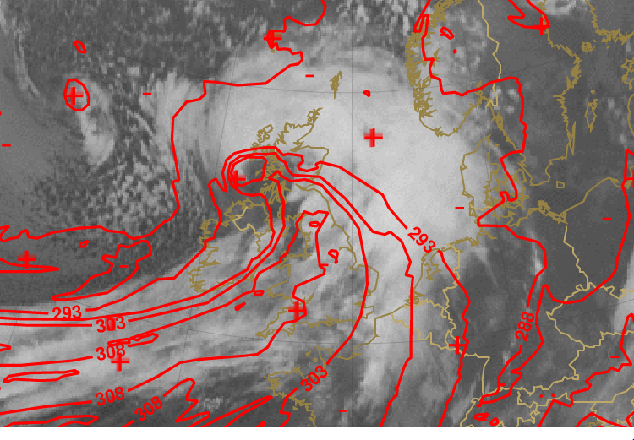
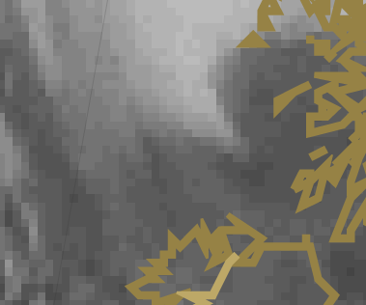
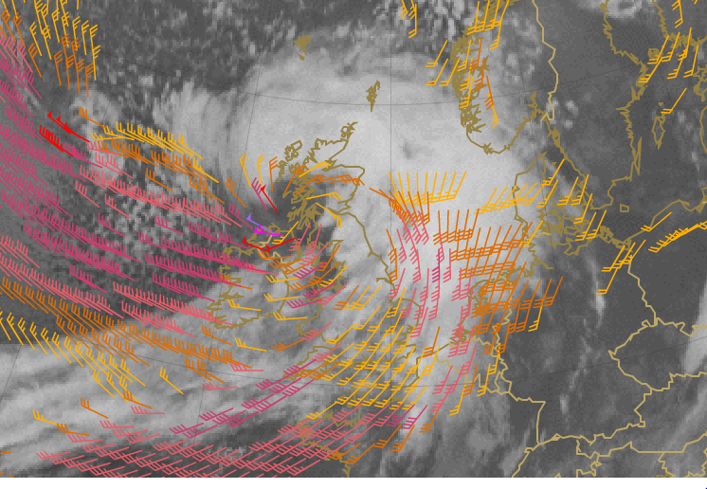
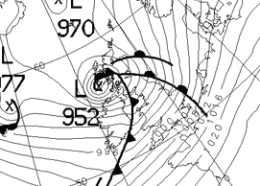
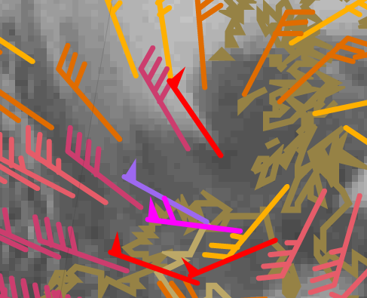
Example: 3 January 2012
0600
850 mb Θ_{e}
Seclusion
Max gusts at Islay were at 0645, 40 m s⁻¹
10 m wind
0600

Slide 19
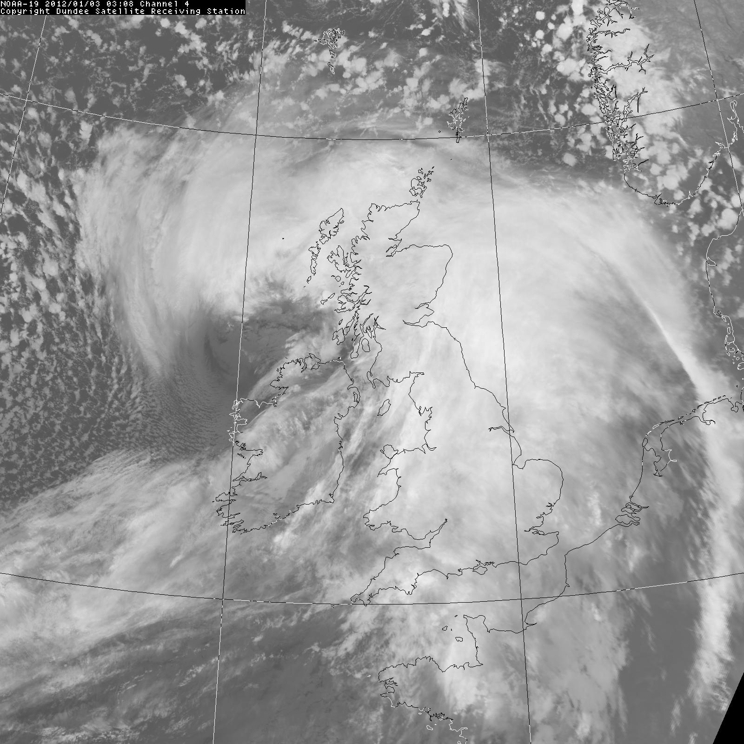
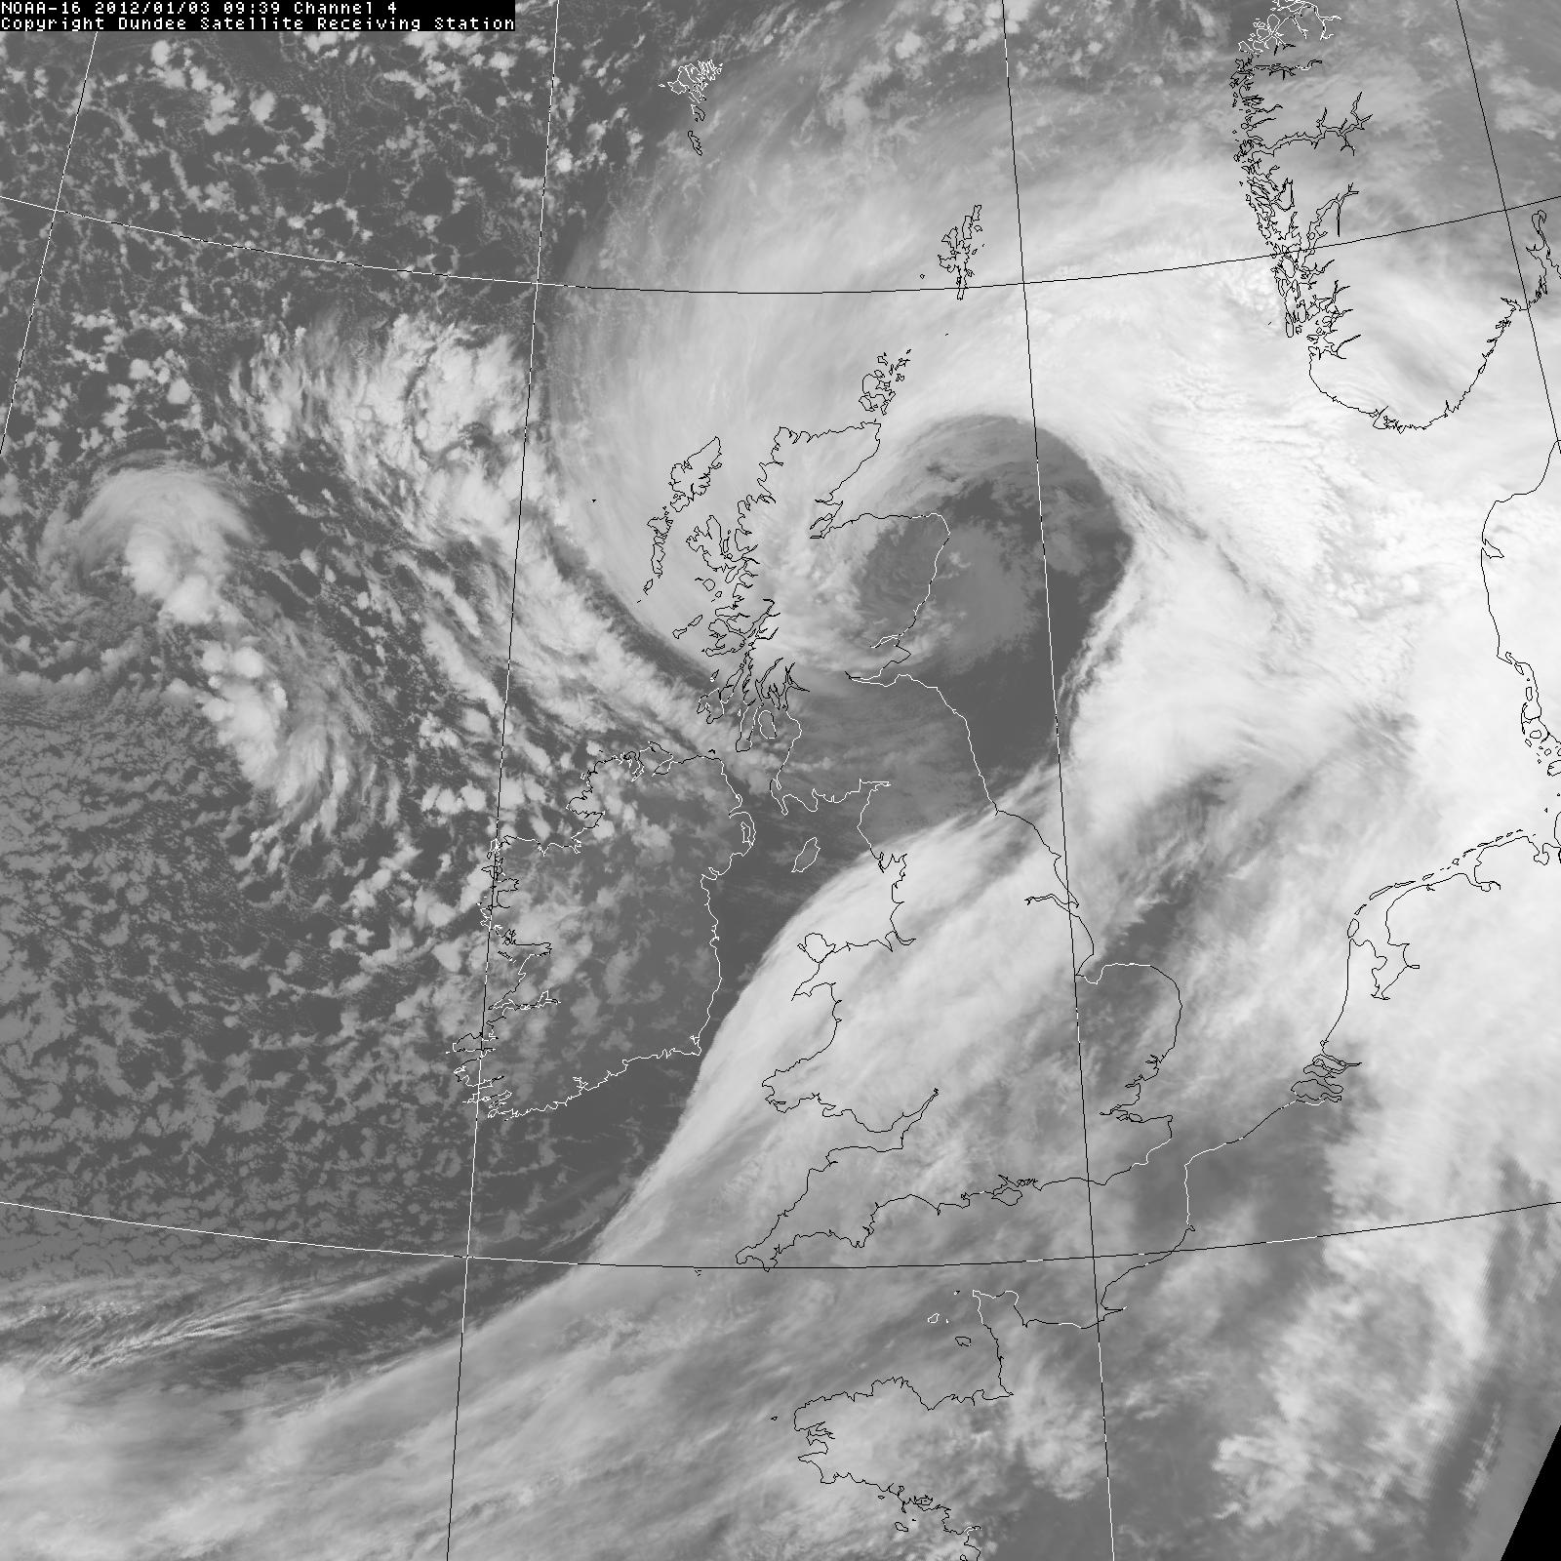
AVHRR infra-red images
0308
0939
Max gusts at Edinburgh were at 0930, 32 m s⁻¹
Banding developing
Banding well established
NEODAAS, Uni. Of Dundee

Slide 20
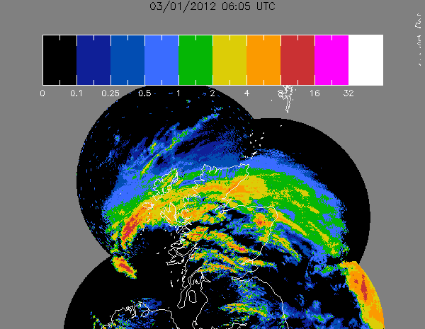
Was it forecast?
Yes! UKMO issued warnings of an impending sting jet
High-resolution models (25 km or better) gave good guidance but forecasters had to use conceptual models to interpret them
Position and strength of sting jet hard to forecast – damaging wind swath only 40 km wide!!
Heavy snowfall also occurred in this event, especially in bent-back front.
Precipitation radar composite image, UKMO
Tim Hewson, 2012 (EGU poster)

Slide 21
Role of the boundary layer
Examples have shown that the cold conveyor belt and the sting jet together cause a narrow band of very high winds just south of the cloud head.
This leads to damaging gusts at the surface
But the sting jet descends - and descent causes warming. So we would expect a strong inversion above the boundary layer inhibiting downward transport of momentum
Evaporative cooling during descent will mitigate this process
Surface gusts occur in bursts
Browning and Field 2004

Slide 22
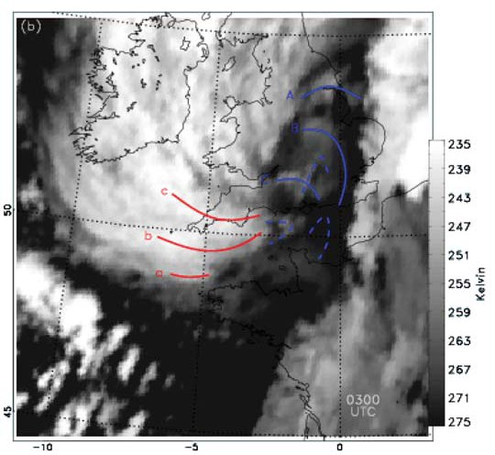
Browning and Field’s analysis of the great Storm
Browning and Field proposed that each of the cloud bands (in red) gave rise to a separate sting jet pulse
Each of these was associated with a boundary-layer convergence line (marked in blue)
Strongest gusts were south-east of these lines, where dry, high-momentum air was being mixed into the boundary layer.
In this case strong gusts occurred in clear air, not associated with clouds
Browning and Field 2004

Slide 23
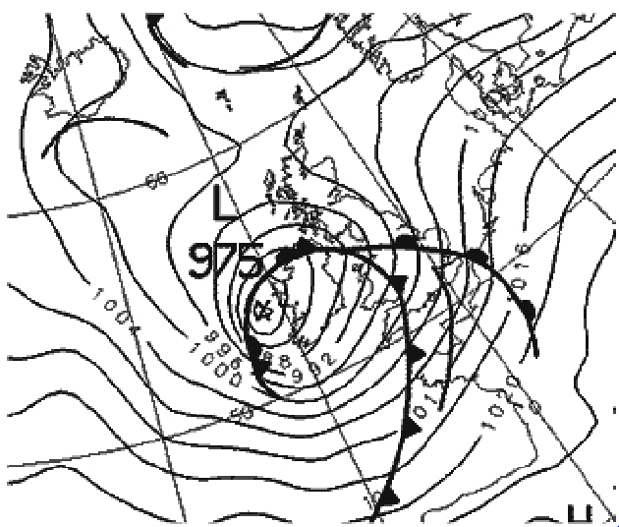
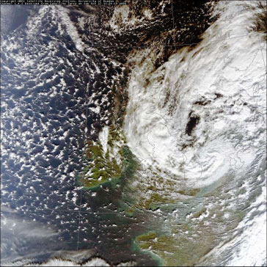
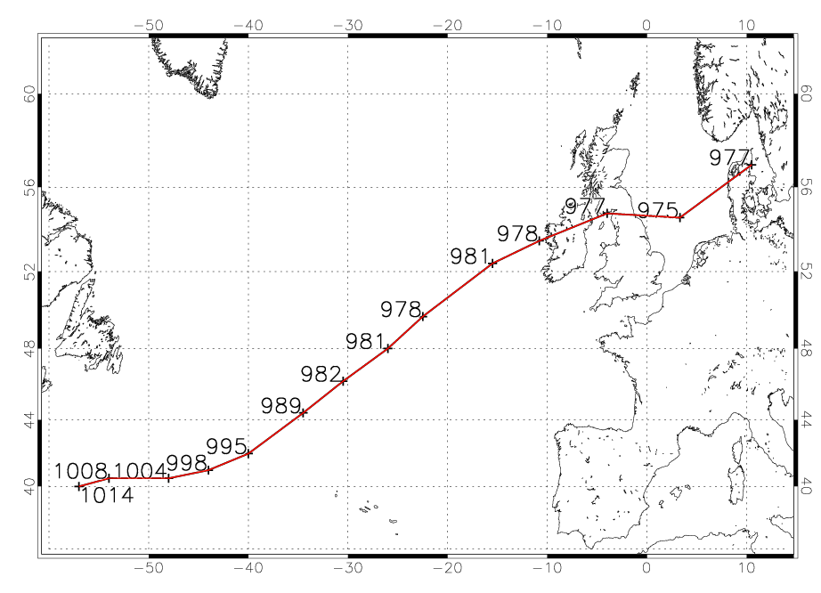
Windstorm Jeanette, 27 October 2002
00 27th October
MODIS false-colour image, 1134
Parton et al 2009

Slide 24
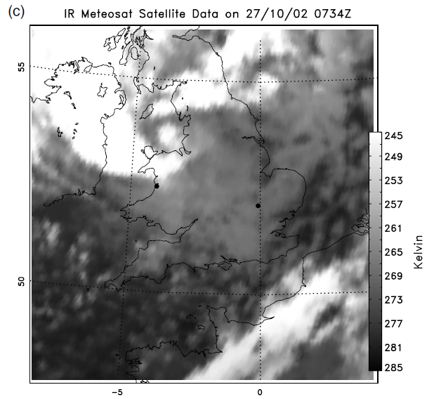
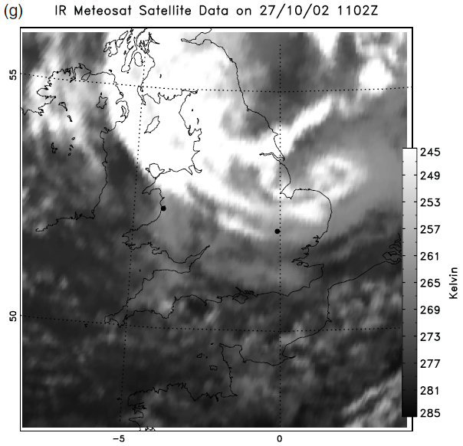
Cloud head passing over UK
Aberystwyth
Cardington
Banding in cloud head just north of Aberystwyth
Prominent banding in cloud head over eastern England
Parton et al 2009

Slide 25
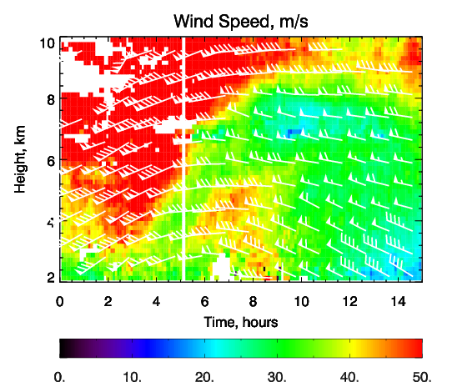
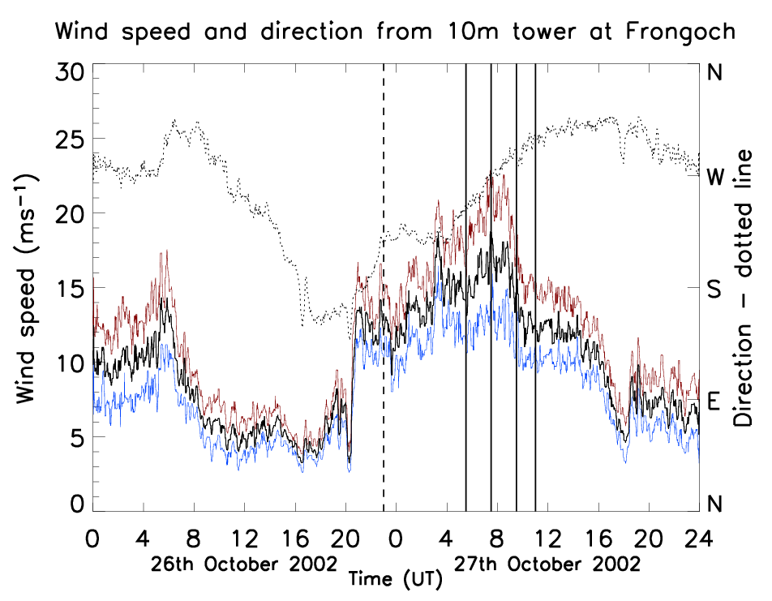
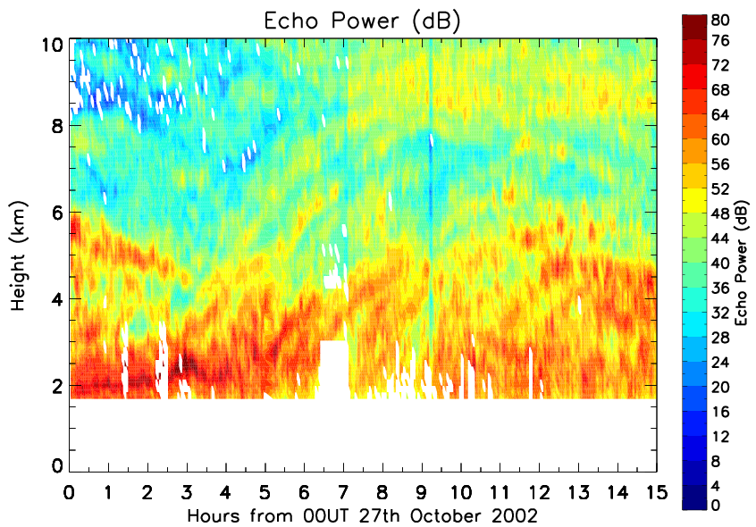
Observations at Aberystwyth: VHF wind profiler and surface met
Cold front
SJ
CCB
Above: surface gusts up to 22 ms⁻¹ (red curve)
Wind profiler shows bands in echo power consistent with the idea of slantwise circulations
Sting jet didn’t descend to the surface here
Parton et al 2009

Slide 26
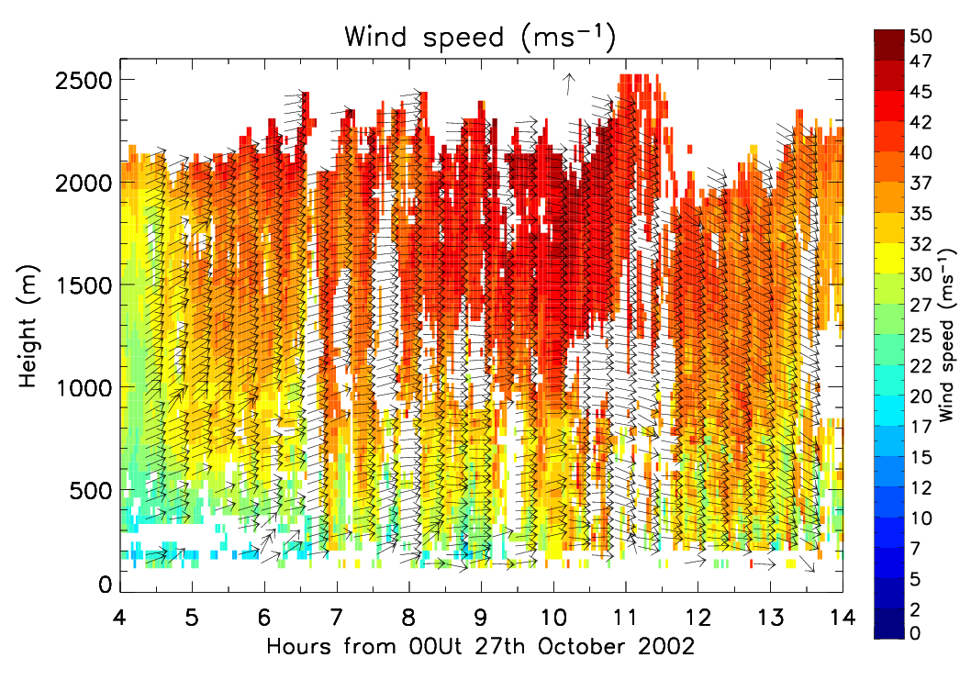
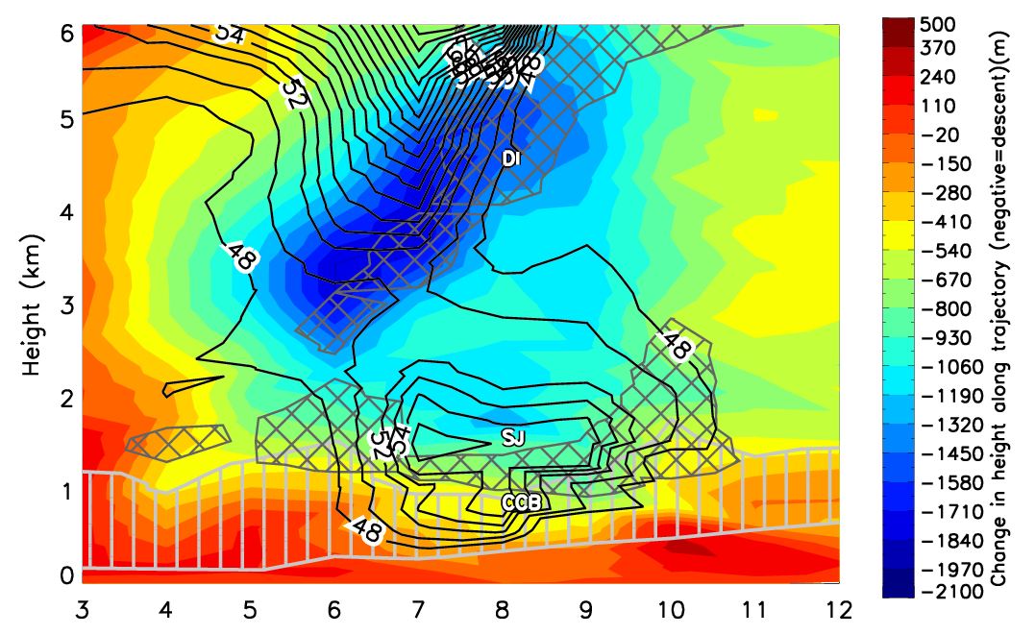
Observations at Cardington
UHF wind profiler observations at Cardington, showing wind maximum ~ 50 m s⁻¹ at 2 km, and plumes of high momentum reaching towards the surface
High-resolution model simulation of this event, showing both the CCB and Sting Jet
Colours: recent descent of air, m
Solid lines: wind speed, m s⁻¹
Cross-hatching: potential vorticity > 1.5 PVU
Vertical hatching: relative humidity > 80%
Parton et al 2009

Slide 27
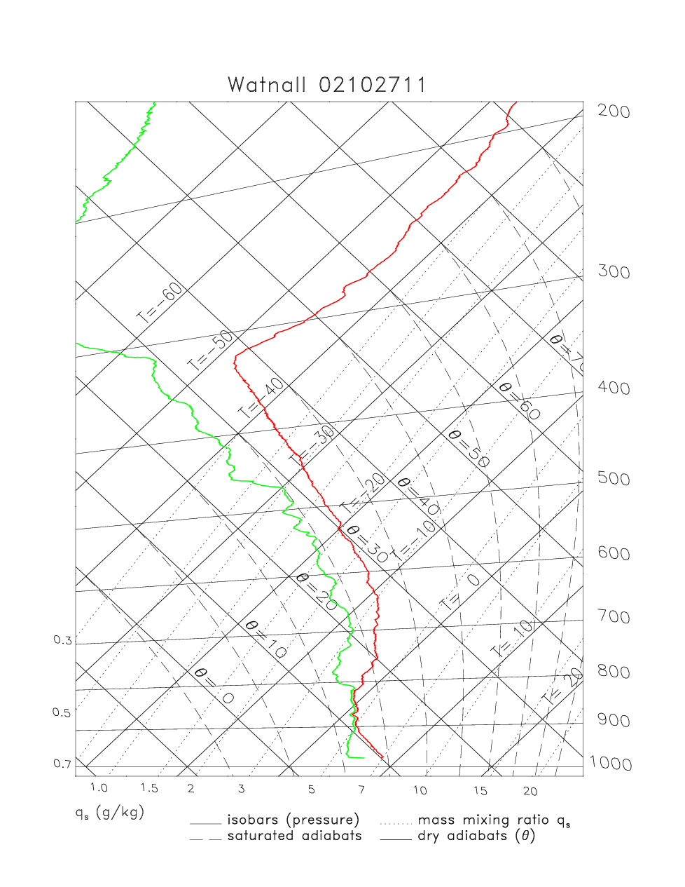
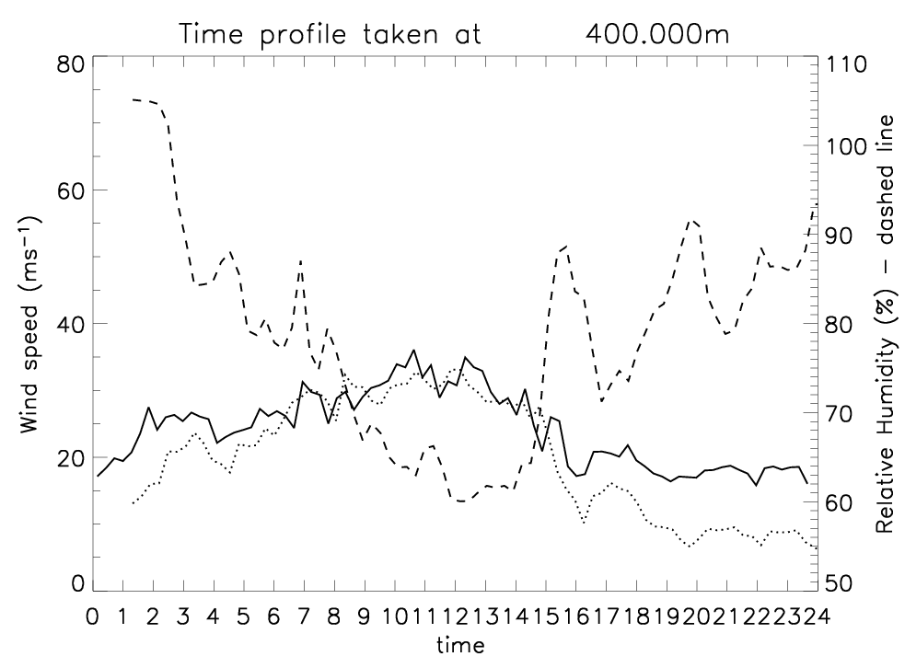
Effect of boundary layer
RH
U₄₀₀
U₁₀
Solid: wind at 400 m; Dotted: Wind at 10 m
Dashed: relative humidity
Strong mixing in lowest 400 m during passage of CCB/SJ
Near-neutral stability in bottom km
Parton et al 2009

Slide 28
Summary of Boundary Layer
Descending air can lead to an inversion at the top of the boundary layer in a SJ case
CCB is less likely to exhibit this
Wind profiler showed plumes of strong winds below 1000 m.
Need to consider stability of BL when forecasting damaging winds.

Slide 29
References
Browning, K. A.,The sting at the end of the tail: Damaging winds associated with extratropical cyclones. Quart. J. Roy. Meteorol. Soc. 130, 375-399, 2004.
Browning, K. A. and M. Field, Evidence from Meteosat imagery of the interaction of sting jets with the boundary layer. Meteorol. Appl. 11, 277–289, 2004.
Clark, P. A., K. A. Browning and C. Wang, The sting at the end of the tail: model diagnostics of fine-scale three-dimensional structure of the cloud head. Quart. J. Roy. Meteorol. Soc. 131, 2263-2292, 2005.
Grønås, S., The seclusion intensification of the New Year’s Day storm, 1992. Tellus 47A, 733-746, 1995.
Parton, G., G. Vaughan, E. G. Norton, K. A. Browning and P. A. Clark. Wind profiler observations of a sting jet. Quart. J. Roy. Meteorol. Soc., 135, 663–680, 2009.
Parton, G., A. Dore and G. Vaughan, A climatology of mid-tropospheric mesoscale strong wind events as observed by the MST Radar, Aberystwyth. Meteorol. Appl. . 17, 340-354, 2010.
Risk Management Solutions, The Great storm of 1987: 20-year retrospective www.rms.com/publications/Great_Storm_of_1987.pdf
Schultz, D. M., D. Keyser and L. F. Bosart, The effect of large-scale flow on low-level frontal structure and evolution in midlatitude cyclones, Mon. Wea. Rev., 126, pp. 1767–1791, 1998.

