Slide 1



Upper-level fronts
tropopause disturbances
and convection
Prof. Geraint Vaughan
Bogdan Antonescu
Centre for Atmospheric Science
School of Earth, Atmospheric and Environmental Sciences

Slide 2

the meteorological effects of folding
intensification of cyclones
damaging surface winds
convection
promotion
suppression

Slide 3

Deep, moist convection requires a triad of ingredients: moisture, conditional instability and a source of lift.
- Doswell (1987)

Slide 4
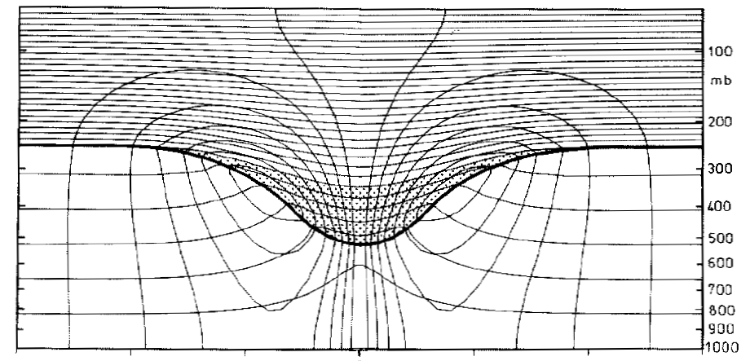
Simple picture: upper-level PV maximum
motion
Descent behind
Ascent ahead of upper-level PV maximum
After Hoskins et al.1985

Slide 5
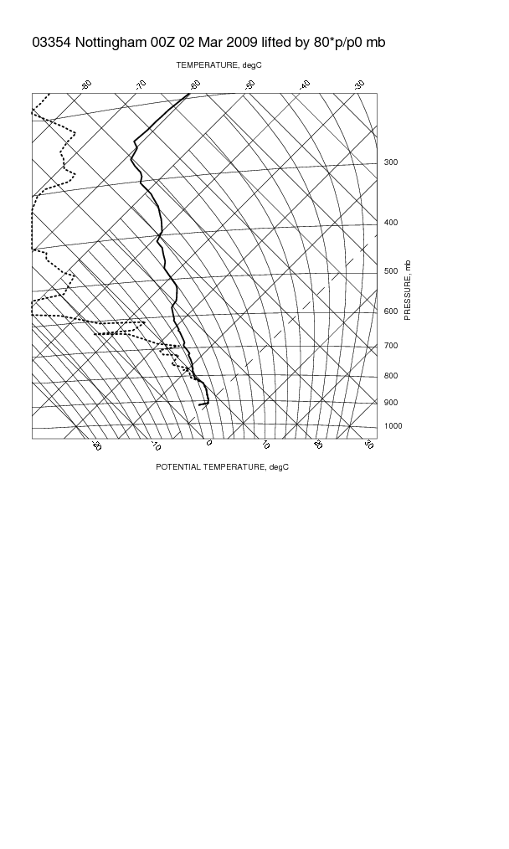
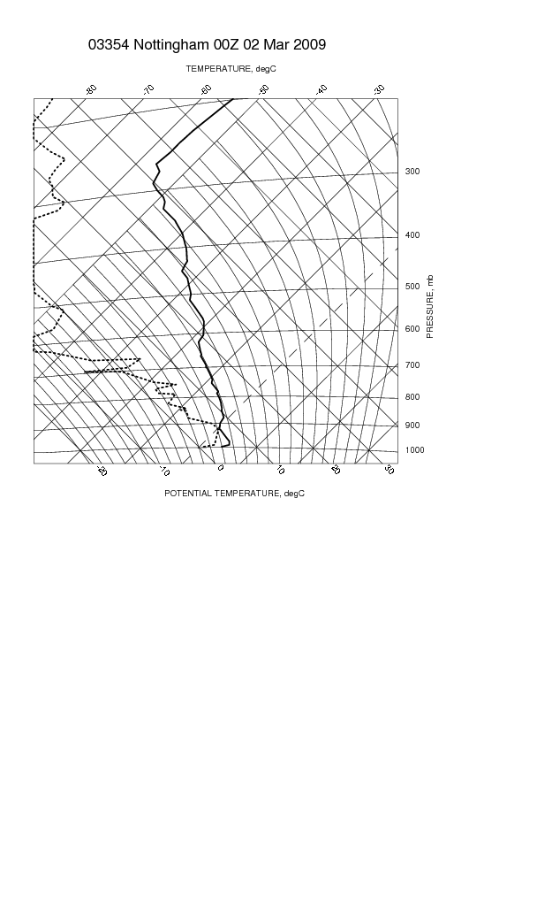
Effect of lifting profile
Convectively unstable
Stable

Slide 6
Problems with simple model
Upper-level PV anomaly isn’t just a basin
Tropopause folds are dry, stable layers extending into the troposphere
After Mel Shapiro, in Hoskins et al (1985)

Slide 7
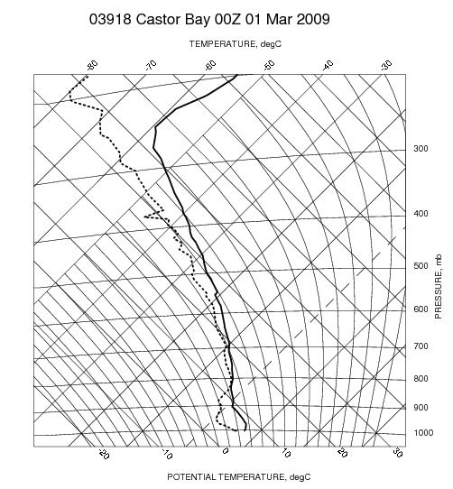
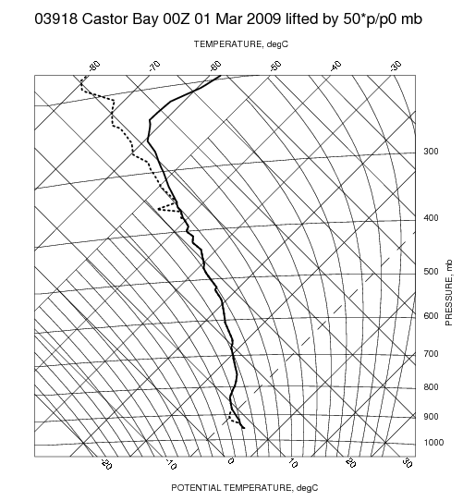
Problems with simple model
Potential instability relies on dry air aloft
A moist profile becomes more stable if lifted!

Slide 8
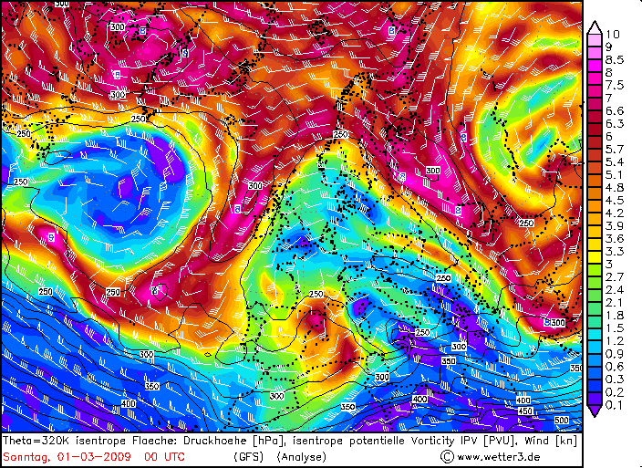
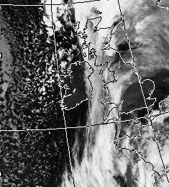
Problems with simple model
Ascending motion is in general slantwise
0215 1/3/09

Slide 9
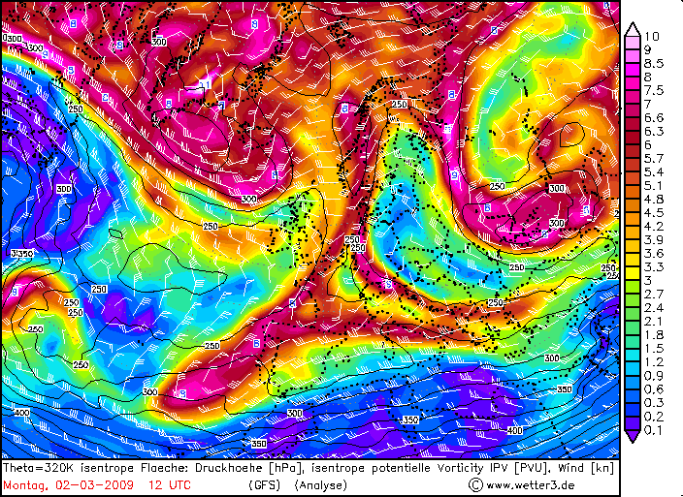
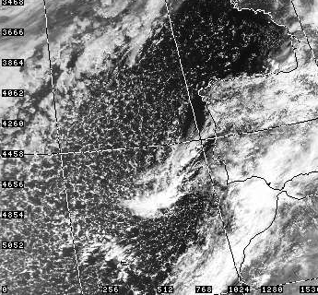
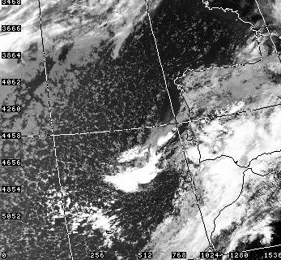
Convection isn’t always at the leading edge of the PV anomaly
315K PV 2/3/09
AVHRR Vis image
AVHRR IR image
Leading Edge
Beneath anomaly

Slide 10
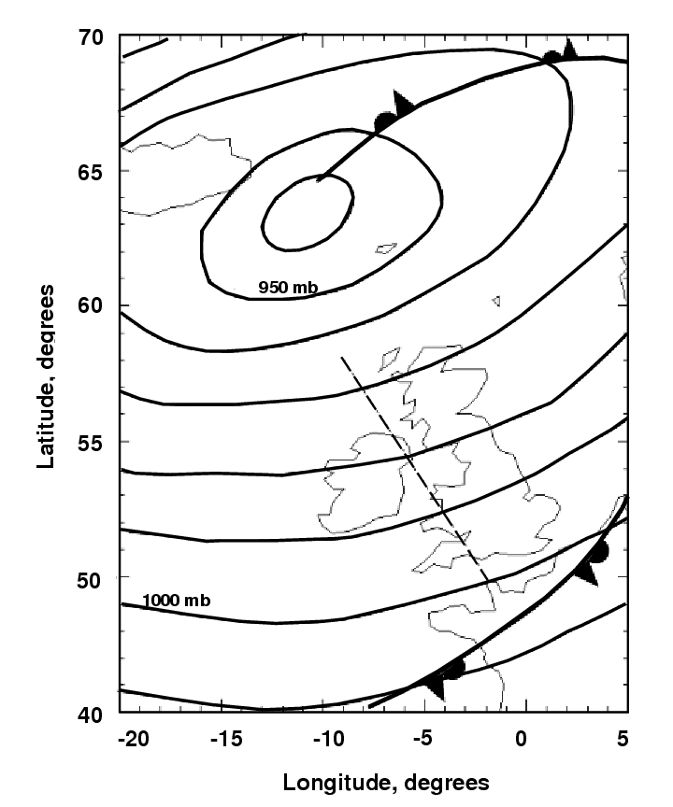
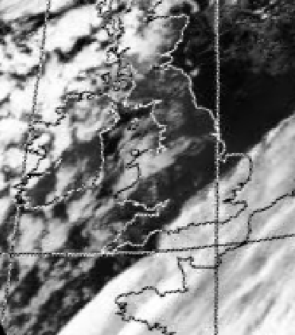
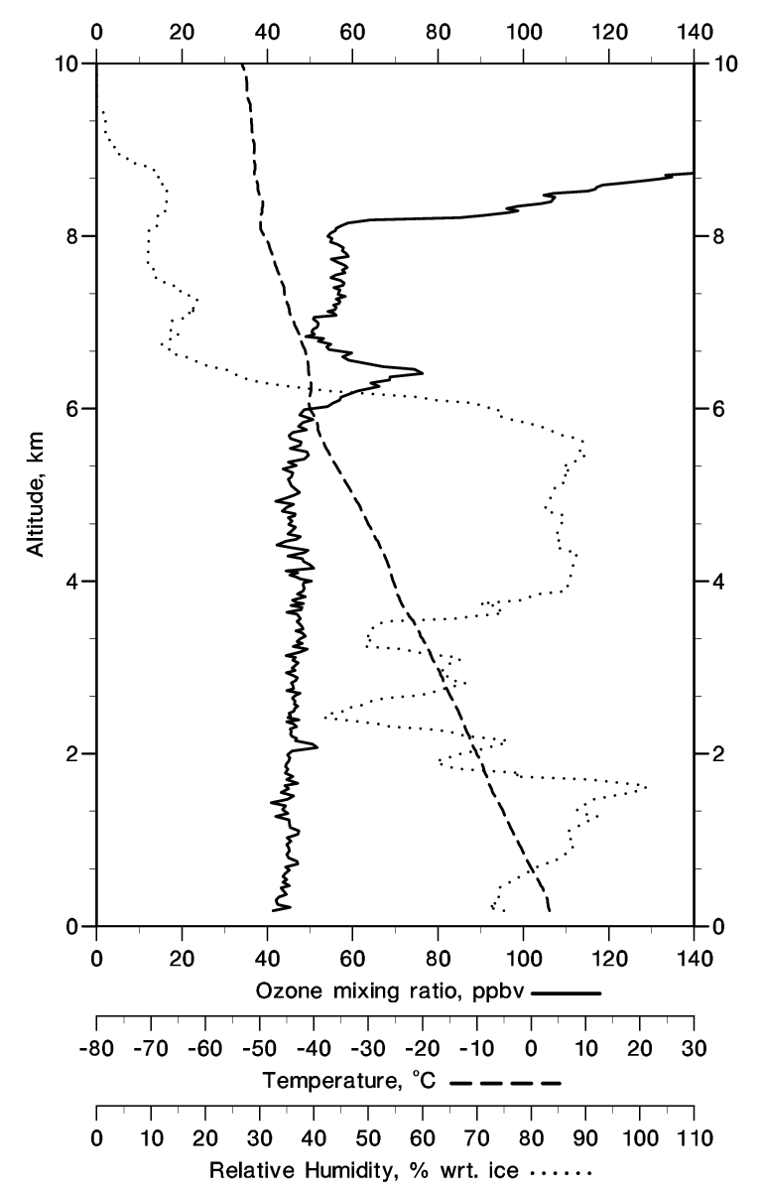
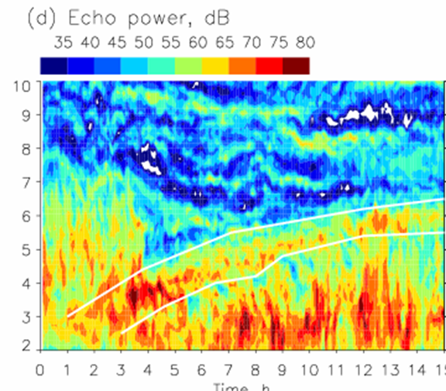
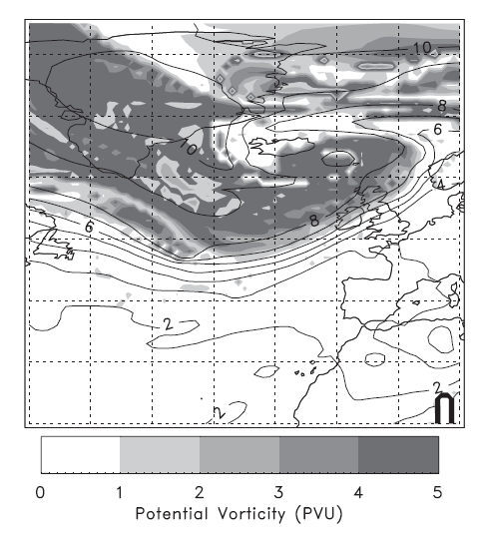
Tropopause folds can cap convection
Deeper convection
Ozone sonde, 1700
Shallower convection
Front

Slide 11
Dry intrusions can release convection
Scalloped line: eastern edge of dry intrusion over-running cold front
Colours: Meteosat IR image; orange < -28°C. A and B are regions of thunderstorms confirmed by sferic observations
Browning and Roberts 1994

Slide 12

tropopause folds
dry
static
stability
high PV
moisture
conditional instability
lift
deep, moist convection

Slide 13

Enhanced convection on the eastern side of a trough through release of potential instability
- Danielsen (1968)
Convective destabilization by a tropopause fold
- Griffiths et al. (2000)
Convection forced by a descending dry layer and low-level moist convergence
- Russell et al. (2008)

Slide 14
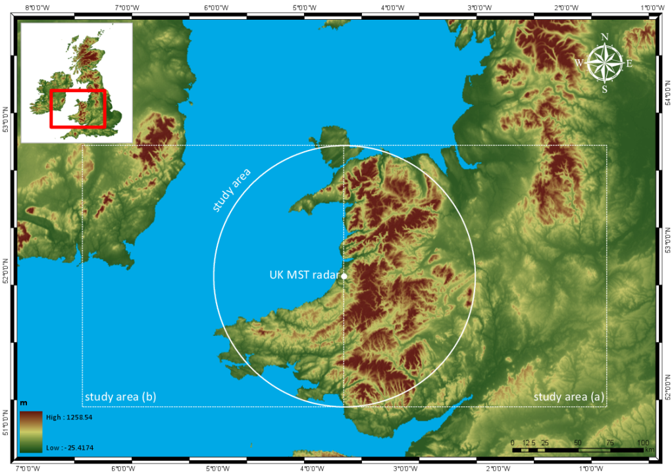
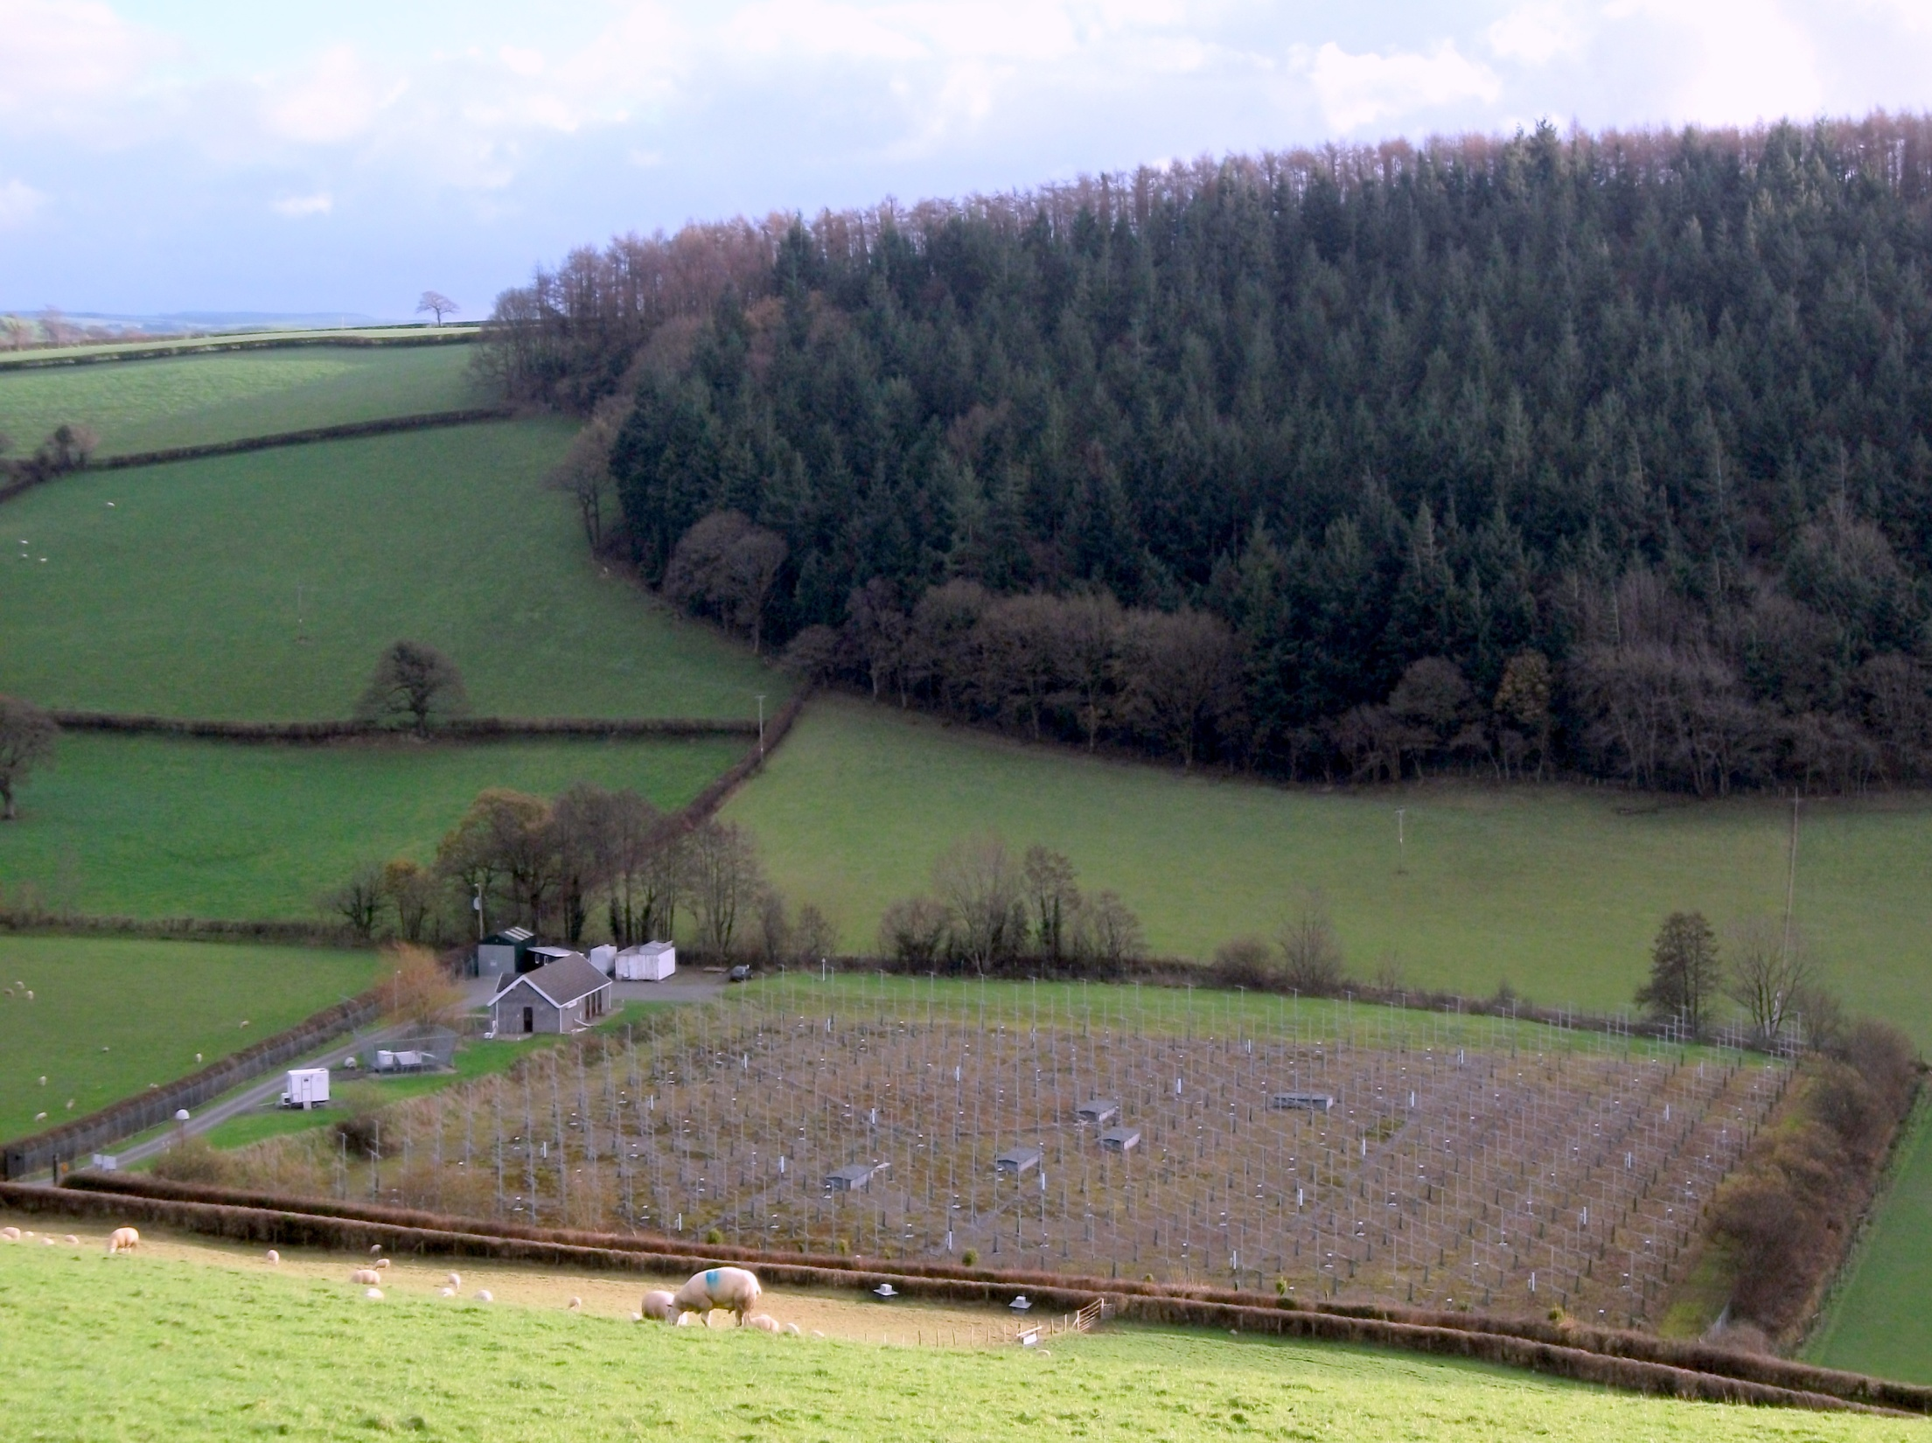
TROSIAD
Tropopause folding
stratospheric intrusions
and deep convection
The MST radar provides
measurements of the
vertical as well as the horizontal
components of the wind

Slide 15

TROSIAD
case study
29/11/2011

Slide 16
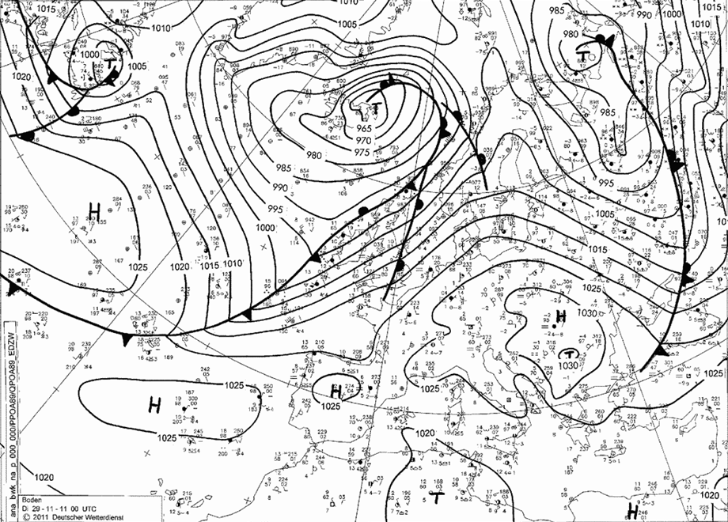
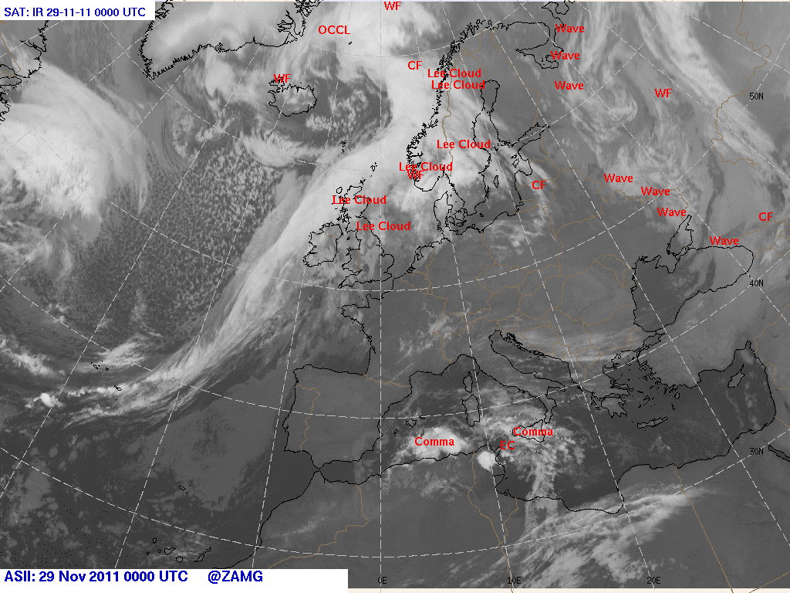

Cold front W of Ireland
$$© \text{http}\text{://}\text{www}\text{.}\text{wetter}\text{3.}\text{de}$$
0000 UTC

Slide 17
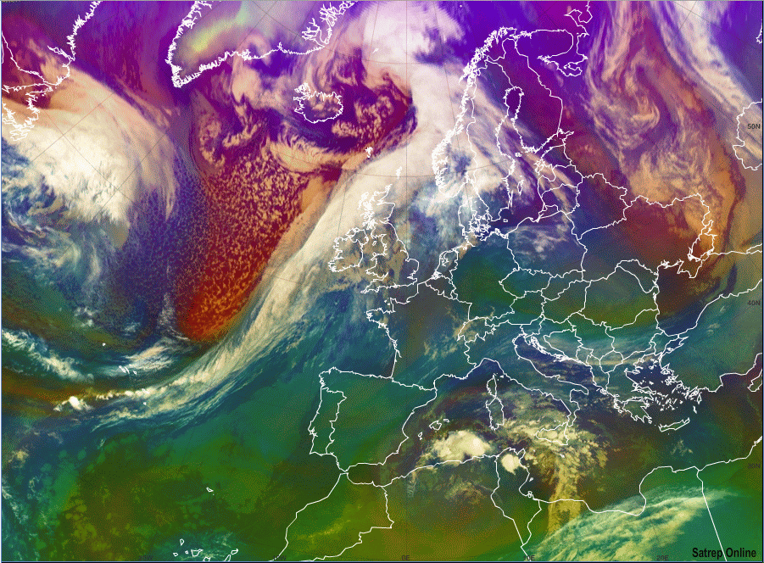

cold air mass
low tropopause
mid level
clouds
dry descending stratospheric air
high level
clouds
0000 UTC
Meteosat 8 - Airmass RBG

Slide 18
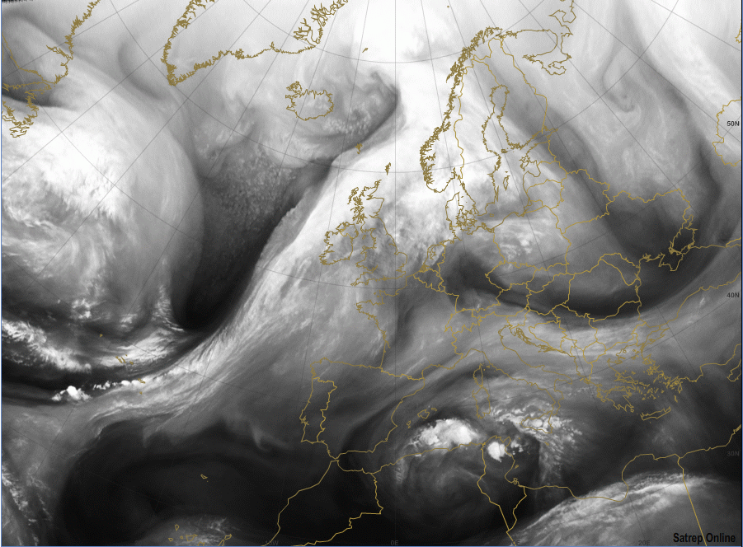
dry descending stratospheric air
0000 UTC
MSG VW 6.2 µm

Slide 19
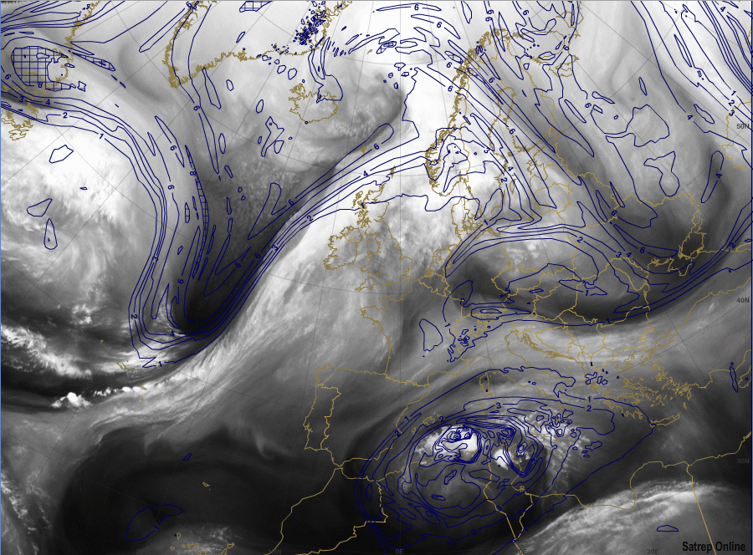
dry descending stratospheric air
PV at 320K
>2 PVU
0000 UTC
MSG VW 6.2 µm

Slide 20
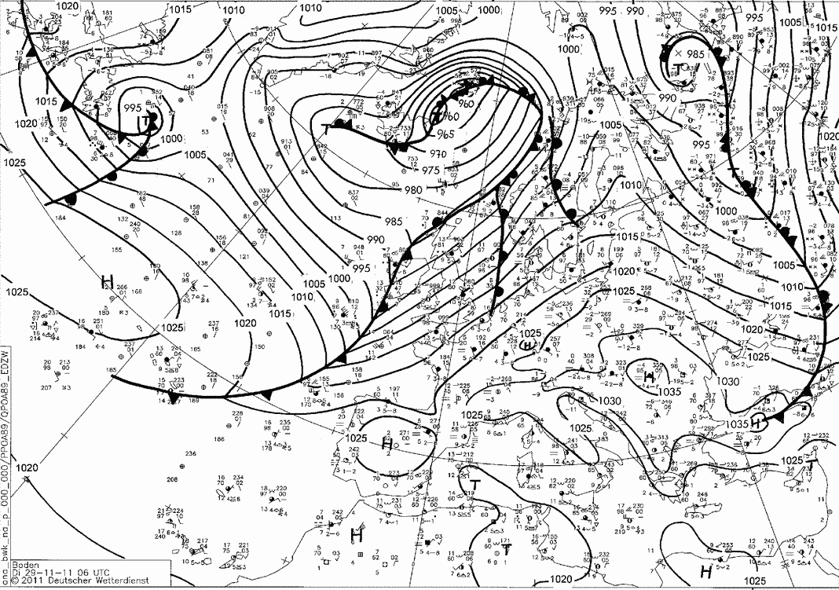
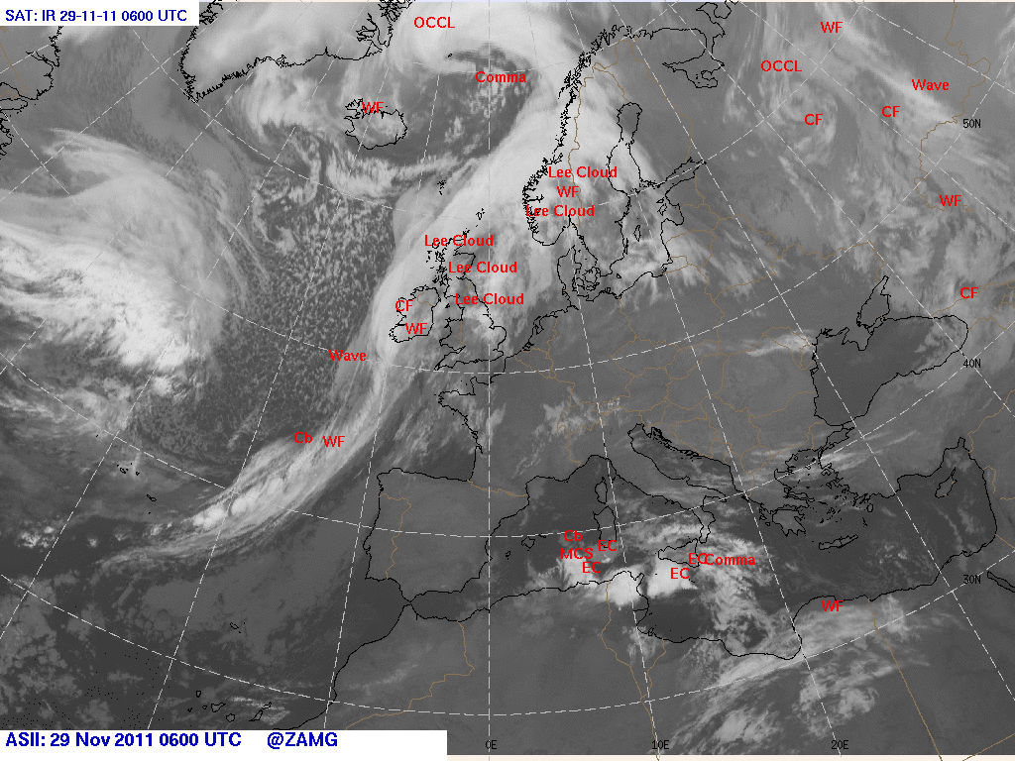
Cold front W of Ireland
$$© \text{http}\text{://}\text{www}\text{.}\text{wetter}\text{3.}\text{de}$$
0600 UTC

Slide 21
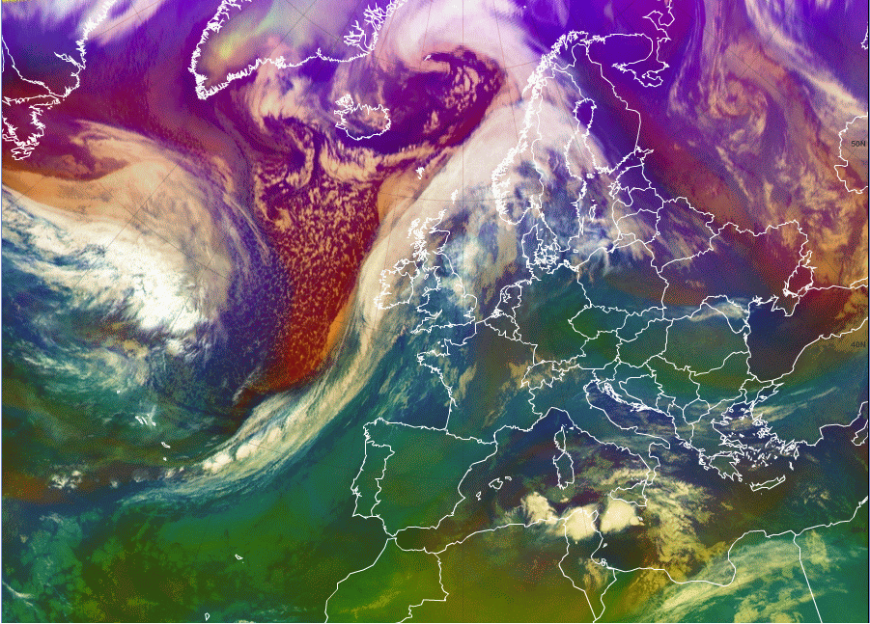
cold air mass
low tropopause
dry descending stratospheric air
0600 UTC
Meteosat 8 - Airmass RBG

Slide 22
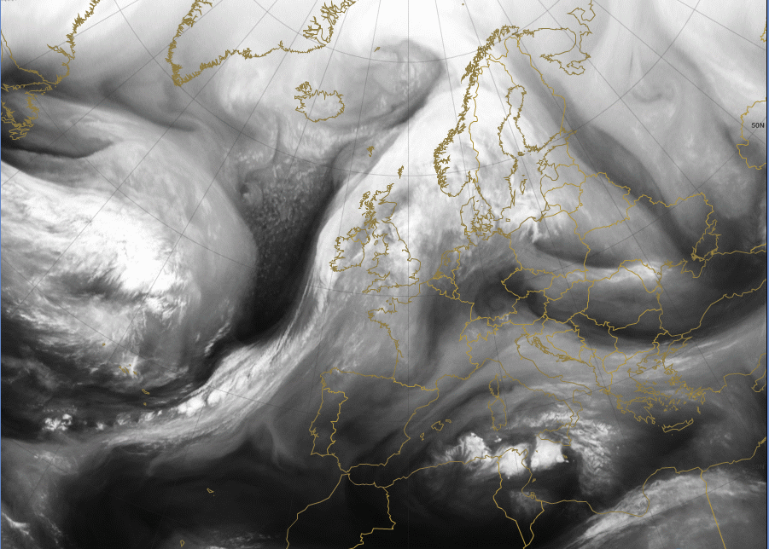
dry descending stratospheric air
wave
0600 UTC
MSG VW 6.2 µm

Slide 23
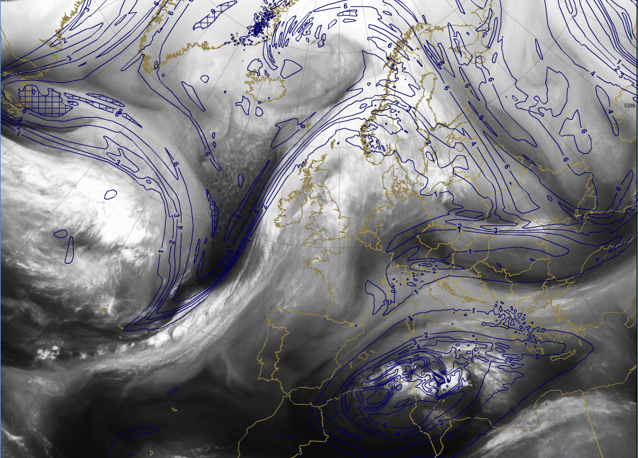
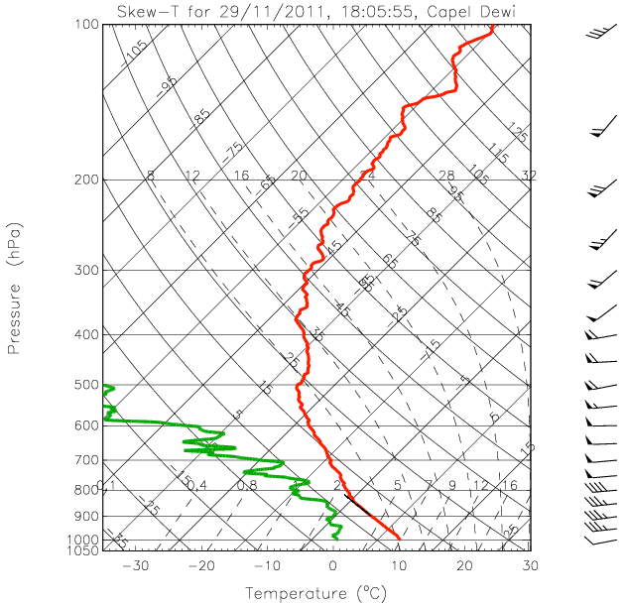
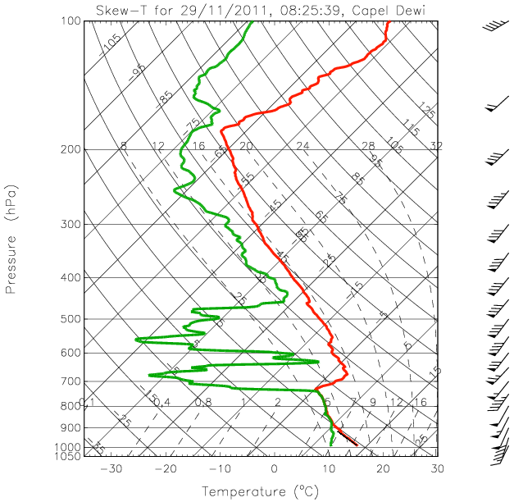
PV at 320K
>2 PVU
dry descending stratospheric air
wave
0600 UTC
MSG VW 6.2 µm

Slide 24
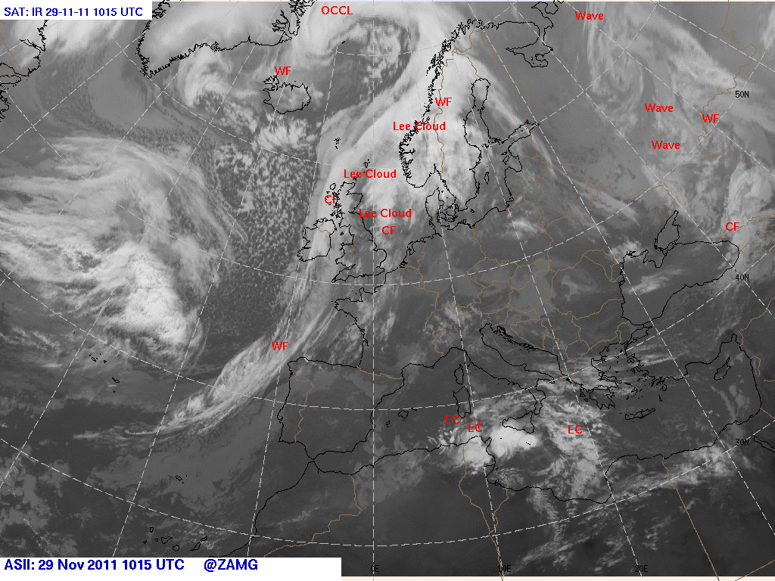
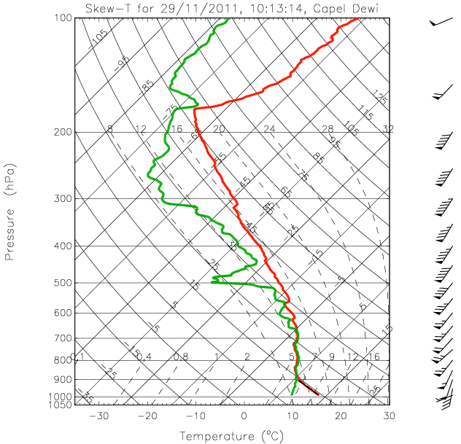
1015 UTC

Slide 25
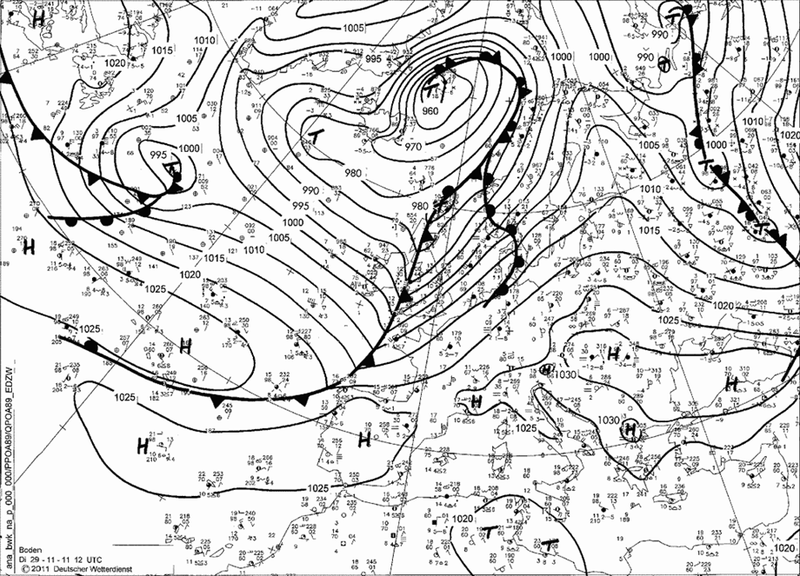
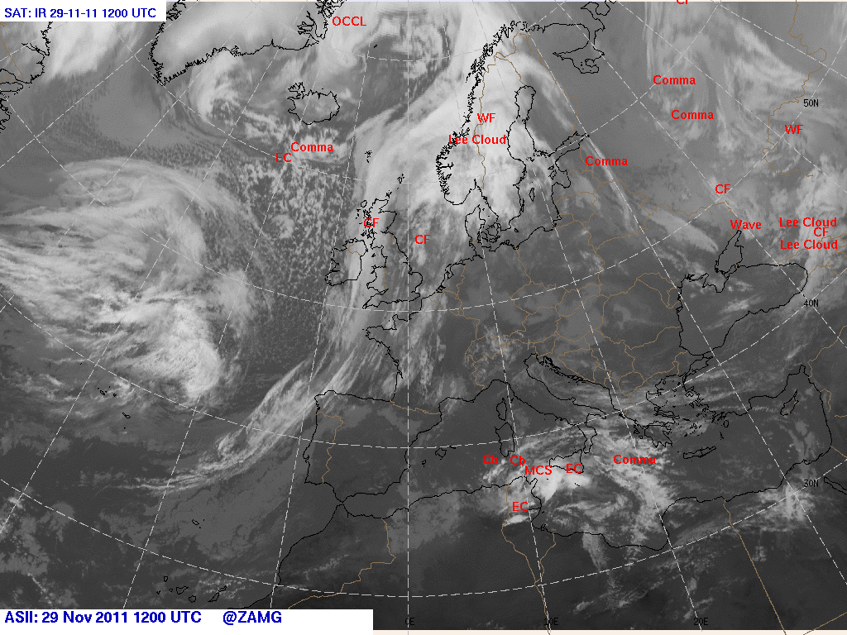
Cold front over Wales
$$© \text{http}\text{://}\text{www}\text{.}\text{wetter}\text{3.}\text{de}$$
1200 UTC

Slide 26
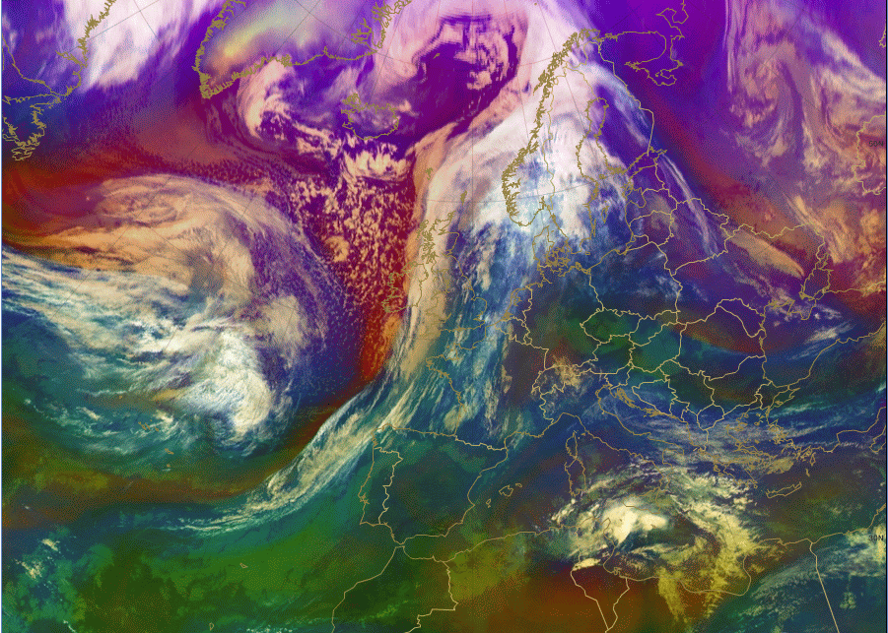
cold air mass
low tropopause
mid level
clouds
dry descending stratospheric air
high level
clouds
1200 UTC
Meteosat 8 - Airmass RBG

Slide 27
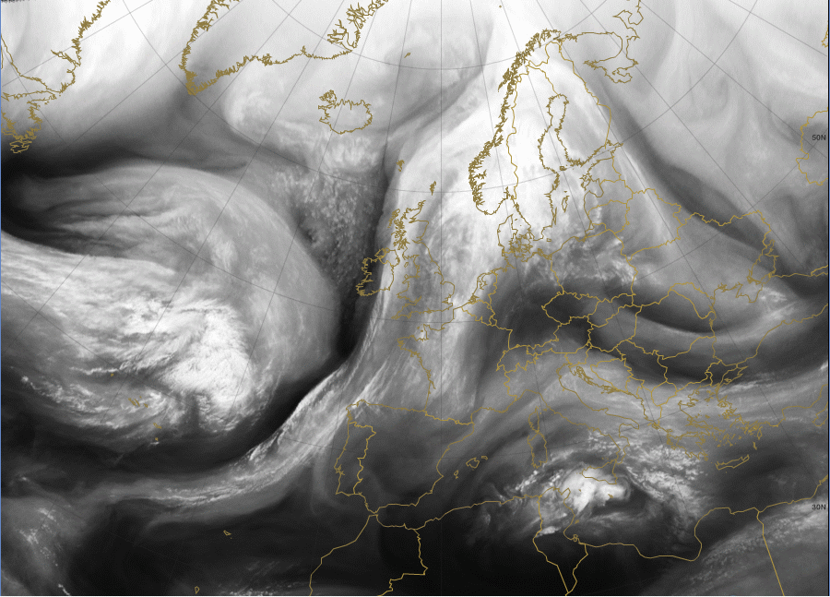
dry descending stratospheric air
1200 UTC
MSG VW 6.2 µm

Slide 28
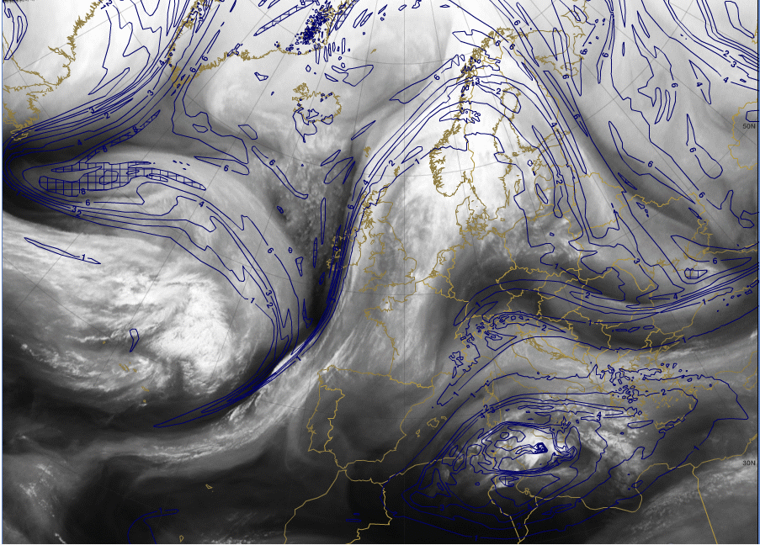
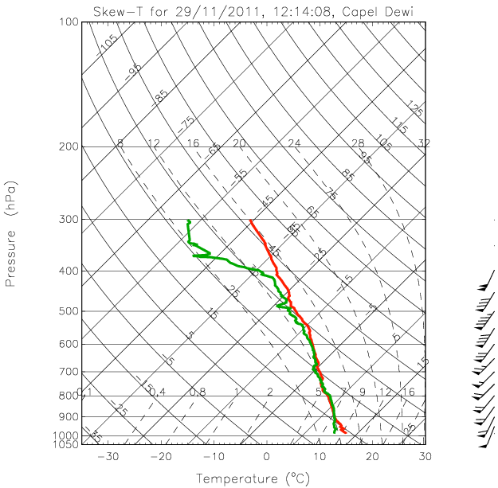
PV at 320K
>2 PVU
dry descending stratospheric air
Upper level trough axis
(300 hPa)
1200 UTC
MSG VW 6.2 µm

Slide 29
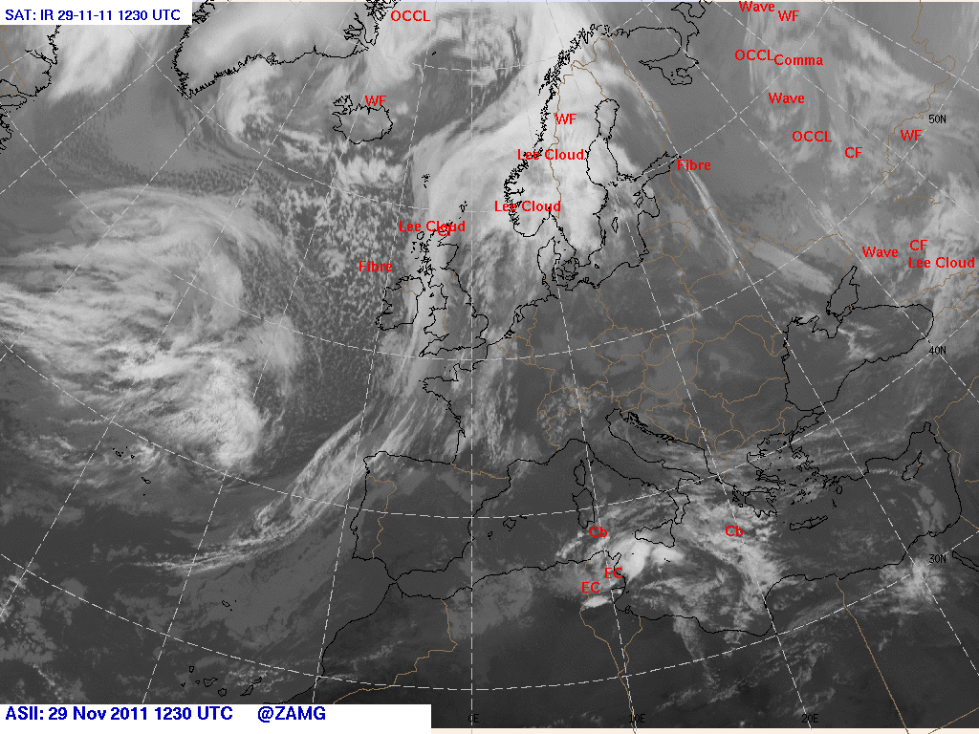
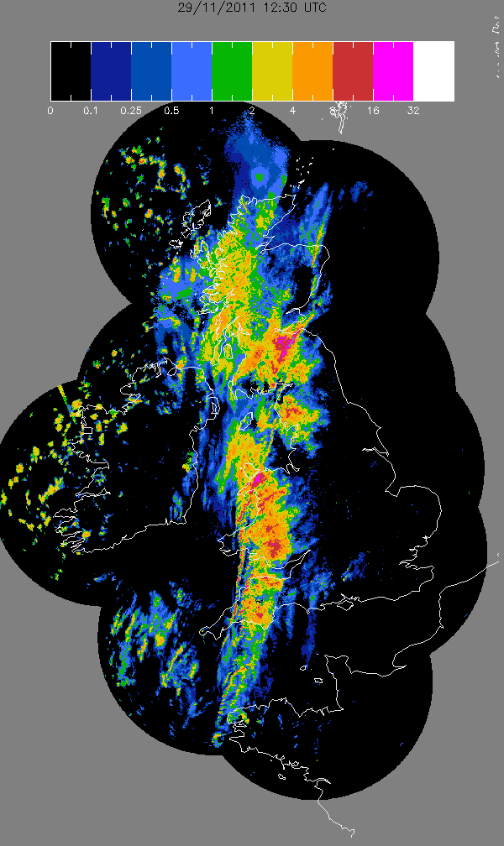

Narrow band of intense precipitation
IR and NIMROD data
1230 UTC

Slide 30
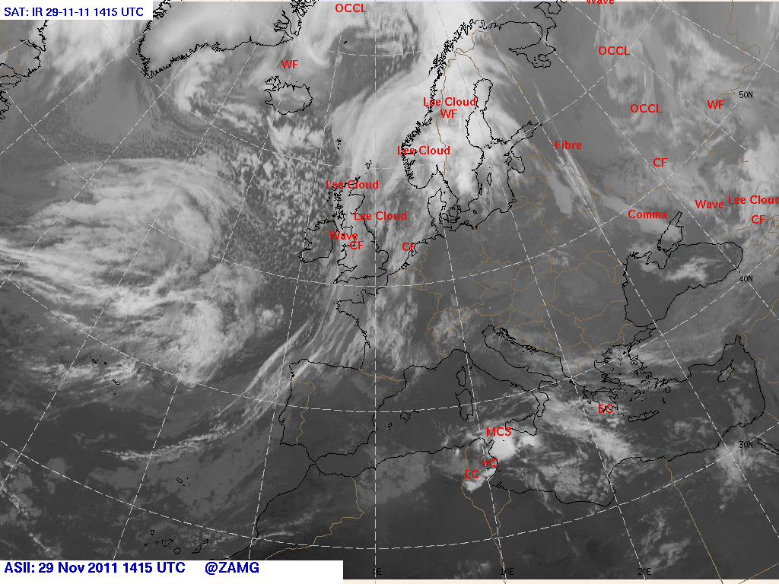
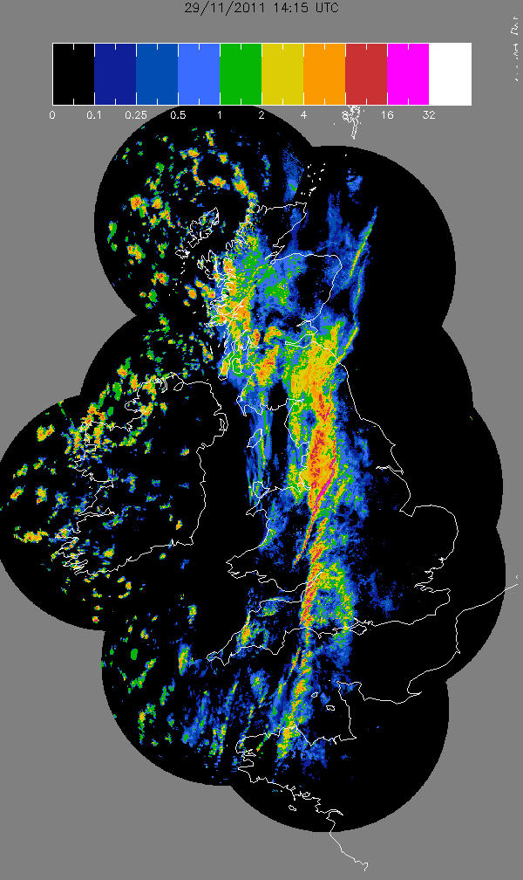
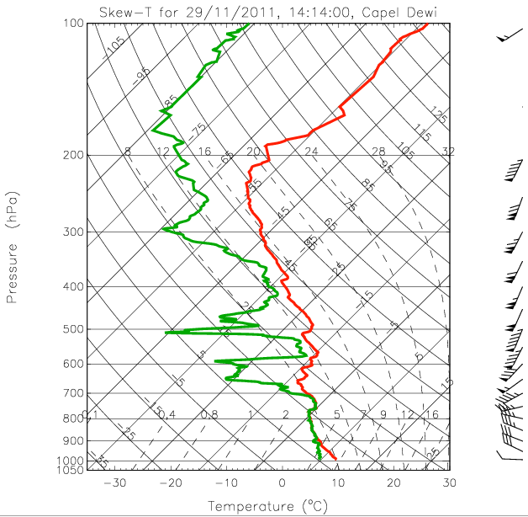
IR and NIMROD data
1415 UTC

Slide 31
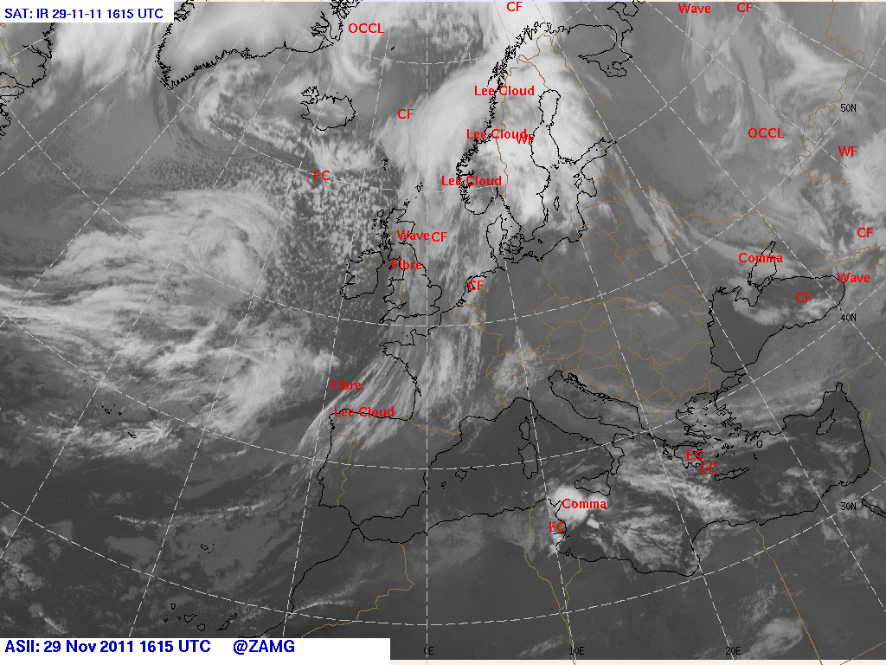
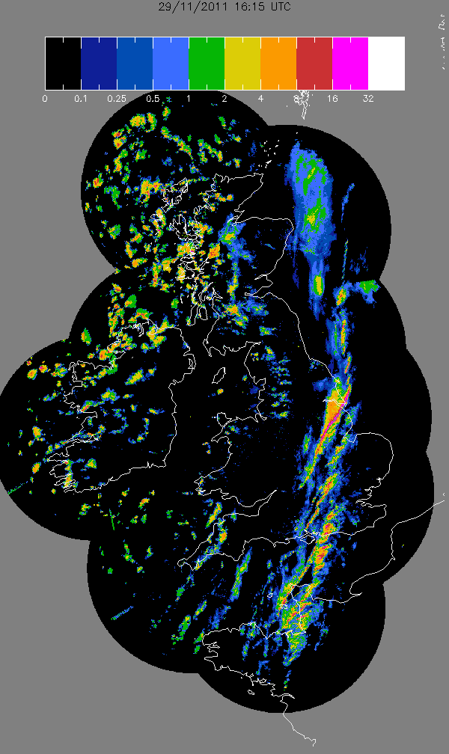
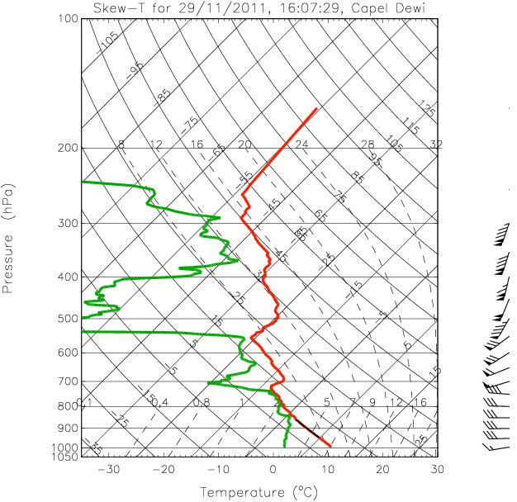
isolated cells beneath the
PV anomaly
IR and NIMROD data
1615 UTC

Slide 32
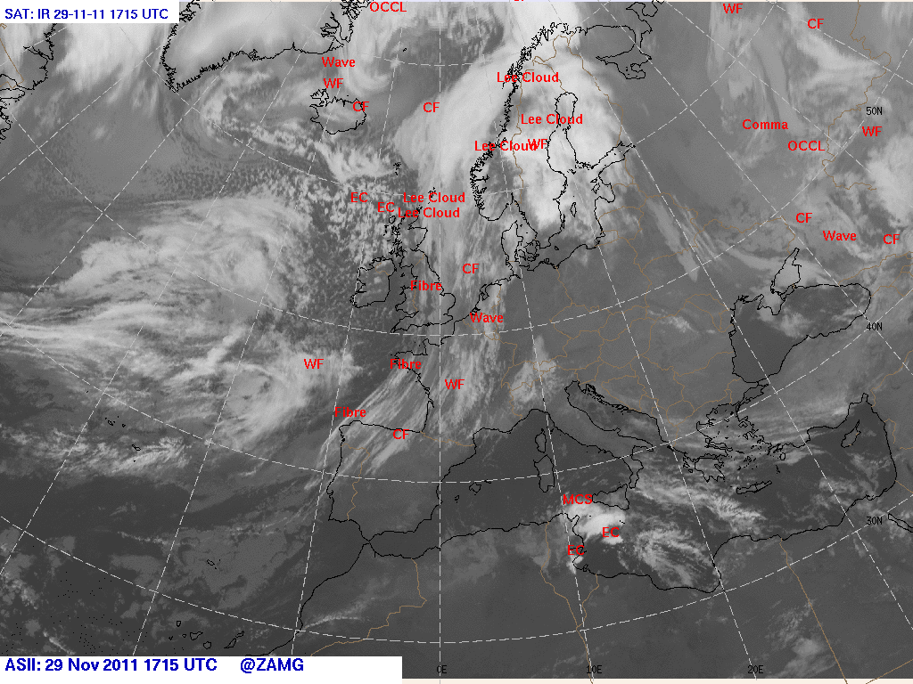
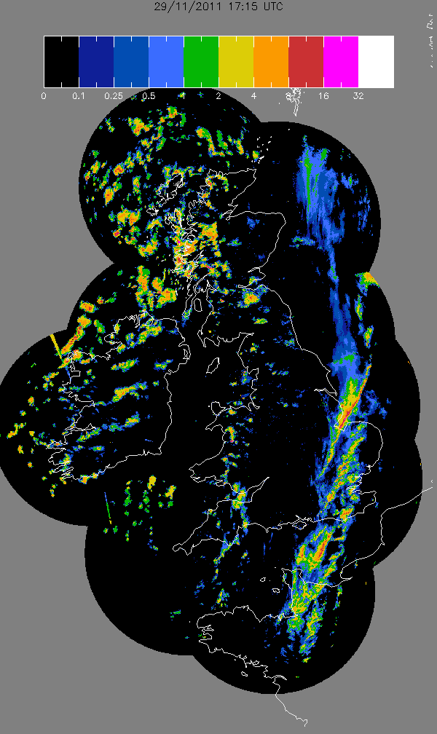
isolated cells beneath the
PV anomaly
IR and NIMROD data
1715 UTC

Slide 33
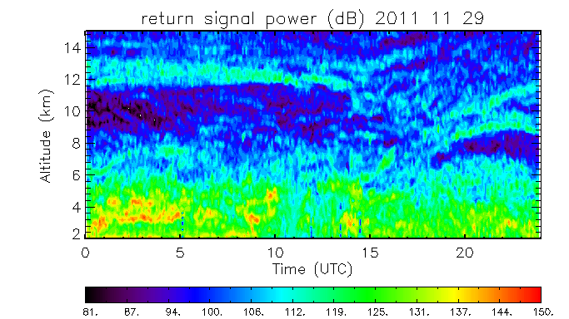

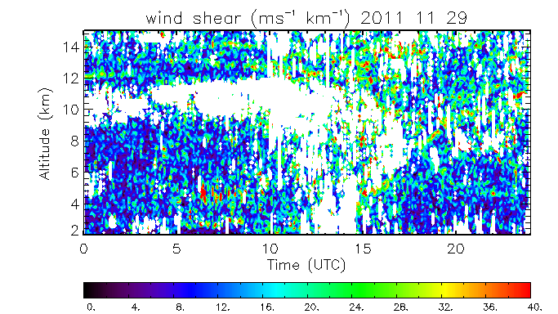
1600 UTC
tropopause fold
1800 UTC
Wind profiler data
http://www.metoffice.gov.uk/science/specialist/cwinde/profiler/

Slide 34

From
case studies to
climatology toward
a conceptual model

Slide 35
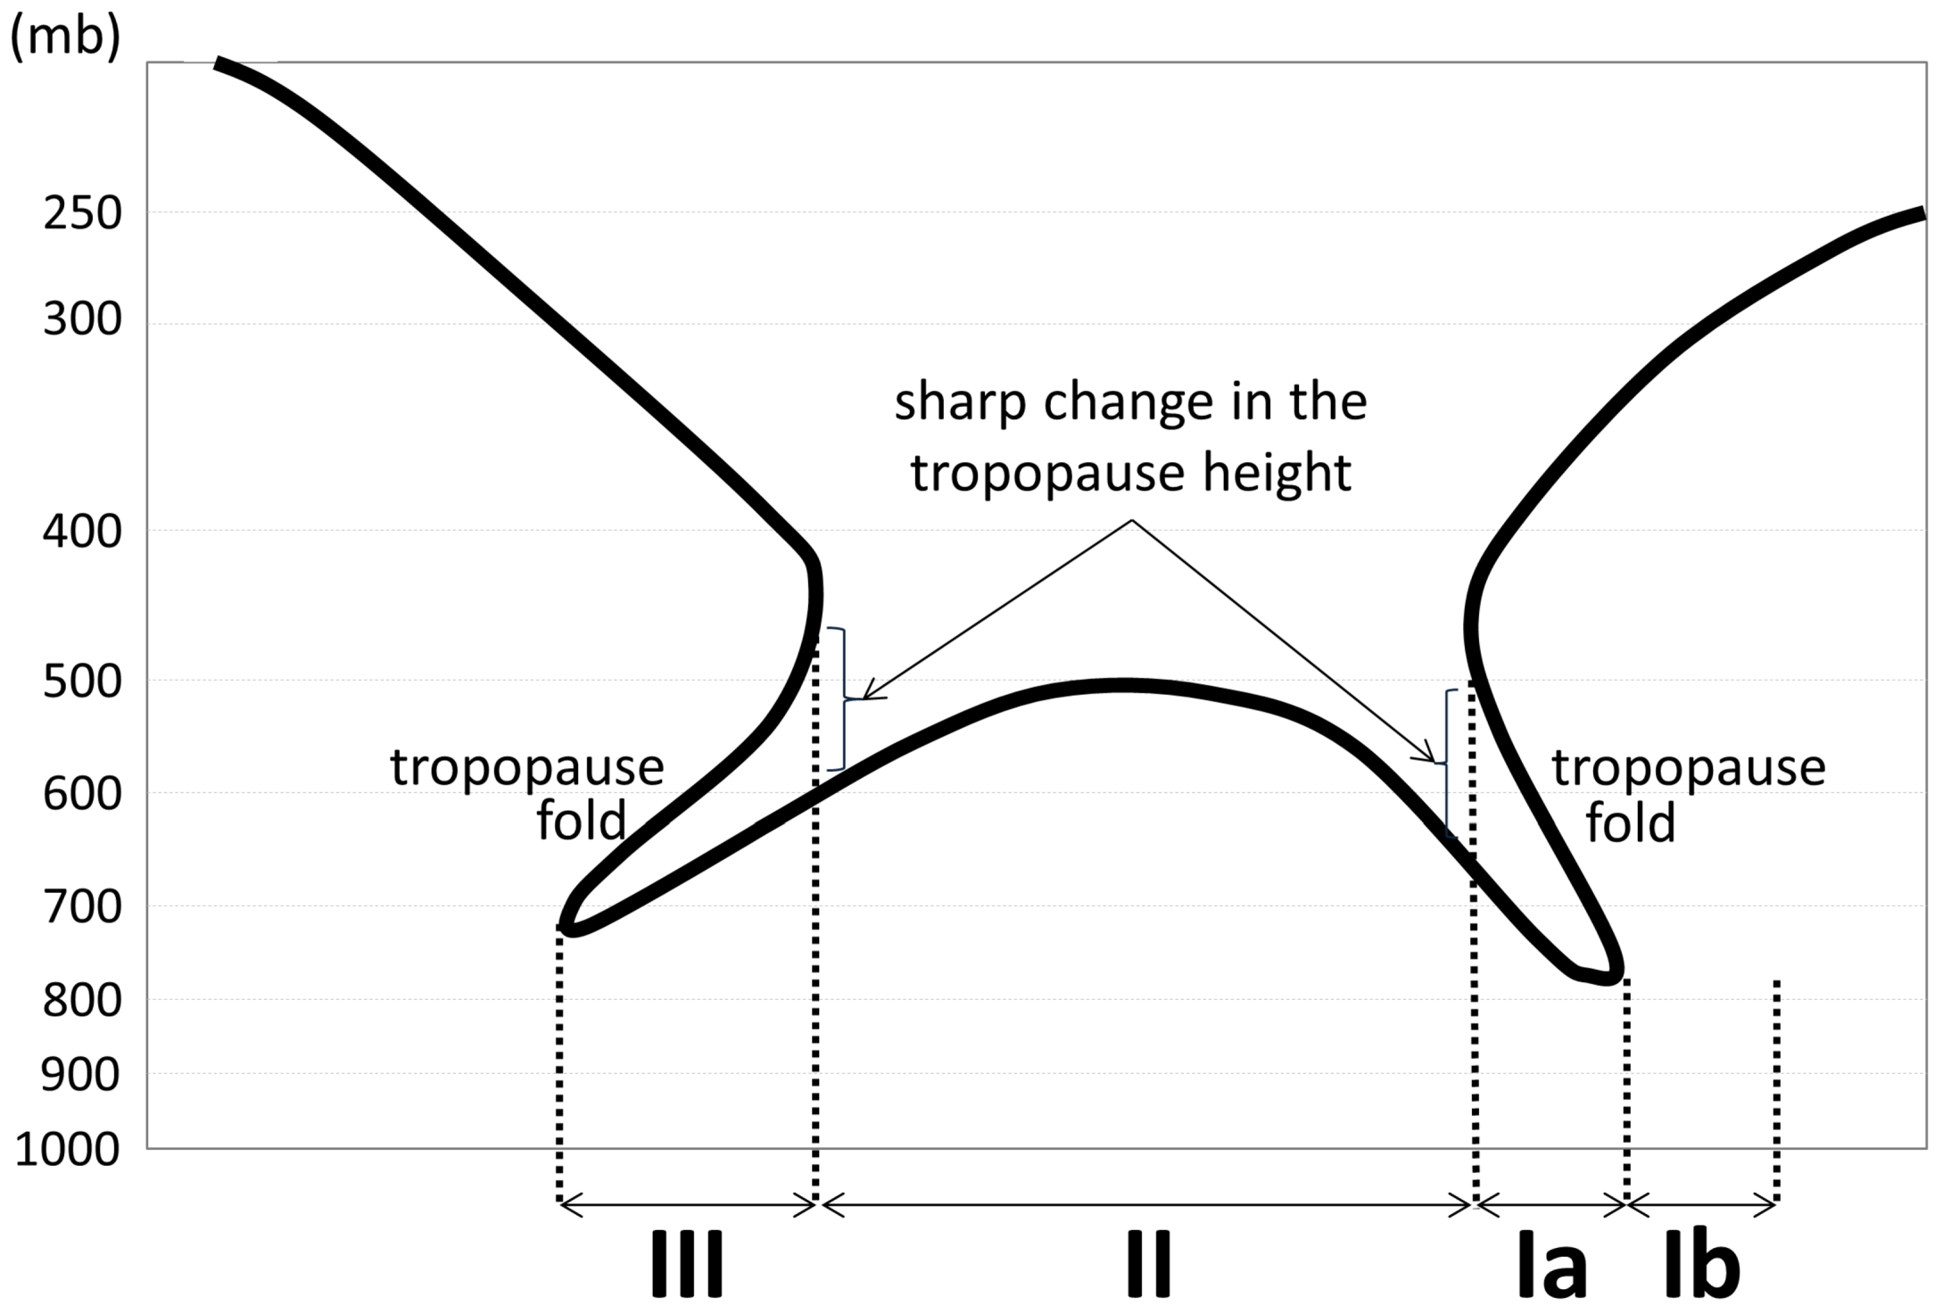
Four regions were defined for the
classification of convective storms associated
with tropopause folds
sharp change in the
tropopause height
tropopause
fold
tropopause
fold
III
II
Ia
Ib

Slide 36

From the 55 tropopause folds in region I,
67% were associated with convective storms
%
III
II
Ia
Ib

Slide 37
In region III, the percentage of folds
associated with convective storms is 33%
%
III
II
Ia
Ib

Slide 38
References
Carr, F. and J. Millard, 1985: A composite study of comma clouds and their association with severe weather over
the Great Plains. Mon. Wea. Rev., 113, 370–387.
Danielsen, E. F., 1964: Project Springfield Report. 97 pp. DASA 1517, Defence Atomic Support Agency Rep., Washington D.C. (USA).
Danielsen, E. F., 1968: Stratospheric-tropospheric exchange based on radioactivity, ozone and potential vorticity. J. Atmos. Sci., 25, 502–518.
Gallus, W. A., N. A. Snook, and E. V. Johnson, 2008: Spring and summer severe weather reports over the Midwest as a function of convective mode: A preliminary study. Wea. Forecasting, 23, 101–113.
Griffiths, M., A. J. Thorpe, and K. A. Browning, 2000: Convective destabilization by a tropopause fold diagnosed using potential-vorticity inversion. Quart. J. Roy. Meteor. Soc.,126, 125–144.
Johns, R., 1982: A synoptic climatology of northwest flow severe weather outbreaks. Part I: Nature and signiﬁcance.
Mon. Wea. Rev., 110, 1653–1663.
Johns, R., 1984: A synoptic climatology of northwest flow severe weather outbreaks. Part II: Meteorological parameters and synoptic patterns. Mon. Wea. Rev., 112, 449–464.
Russell, A., G. Vaughan, E. G. Norton, C. J. Morcrette, K. A. Browning, and A. M. Blyth, 2008: Convective inhibition beneath an upper-level PV anomaly. Quart. J. Roy. Meteor. Soc., 134, 371–383.
Russell, A., G. Vaughan, E. G. Norton, H. M. A. Ricketts, C. J. Morcrette, T. J. Hewison, K. A. Browning, and A. M. Blyth 2009: Convection forced by a descending dry layer and low-level moist convergence. Tellus A, 61, 250–263.

