Slide 1
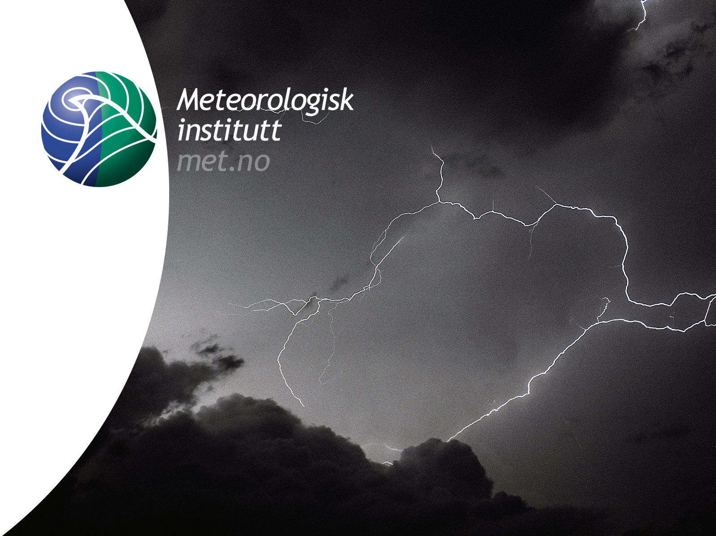
Forecasting Polar Lows
Gunnar Noer
The Norwegian Meteorological Institute in Tromsø

Slide 2
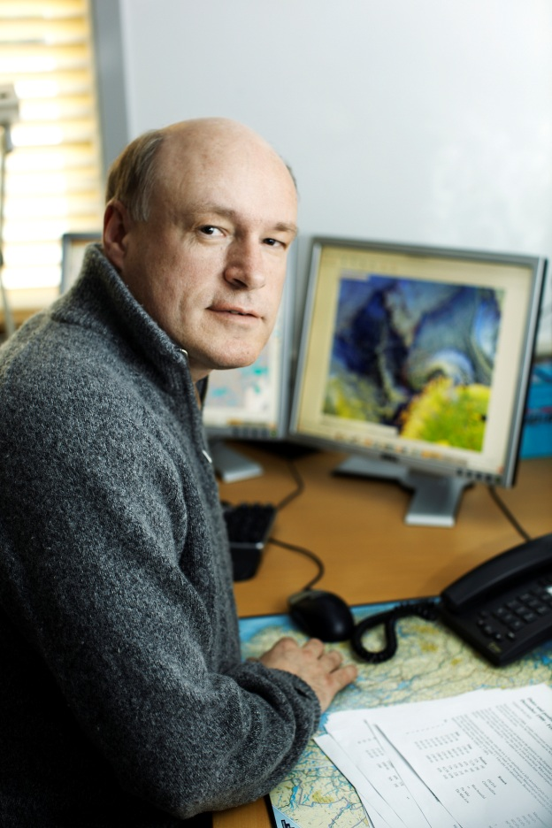
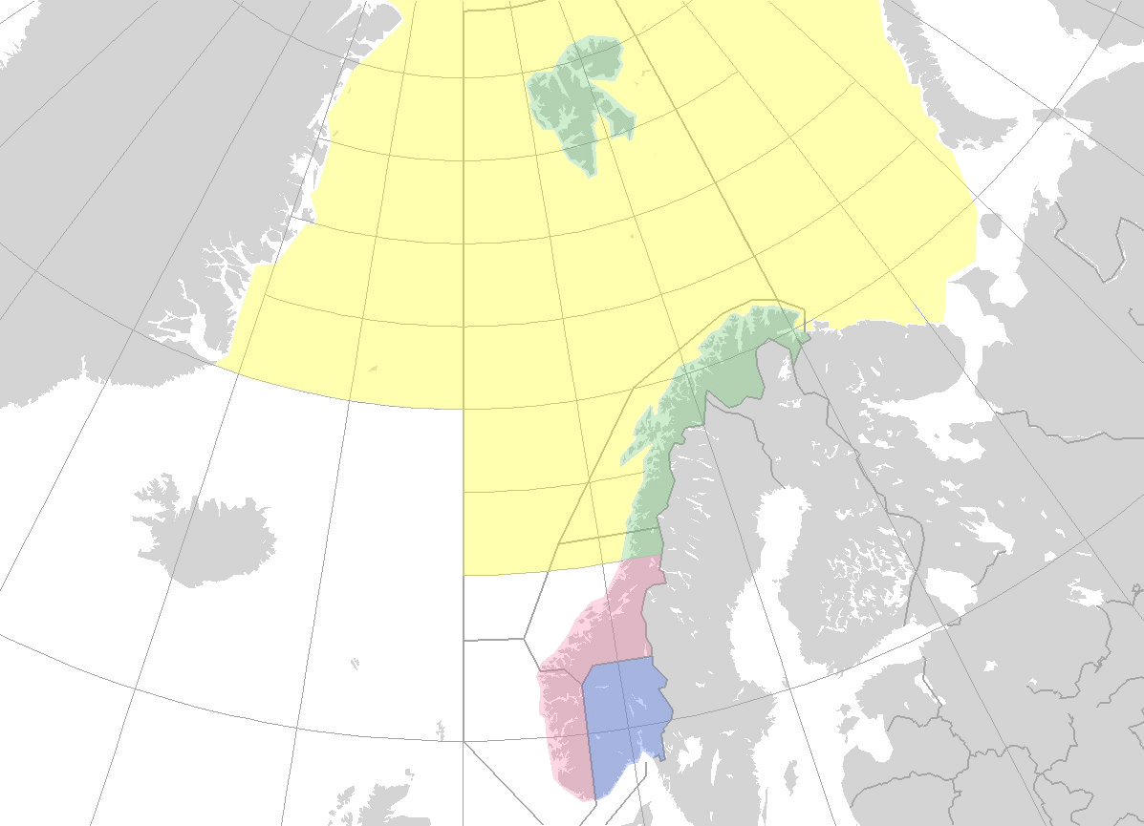


Longyearbyen
Hopen
Bear Island
Jan Mayen
Tromsø
Gunnar Noer
Senior forecaster / developer for polar meteorology
The Norwegian Meteorological Instute
Forecasting division of Northern Norway
met.no
Oslo
Bergen

Slide 3
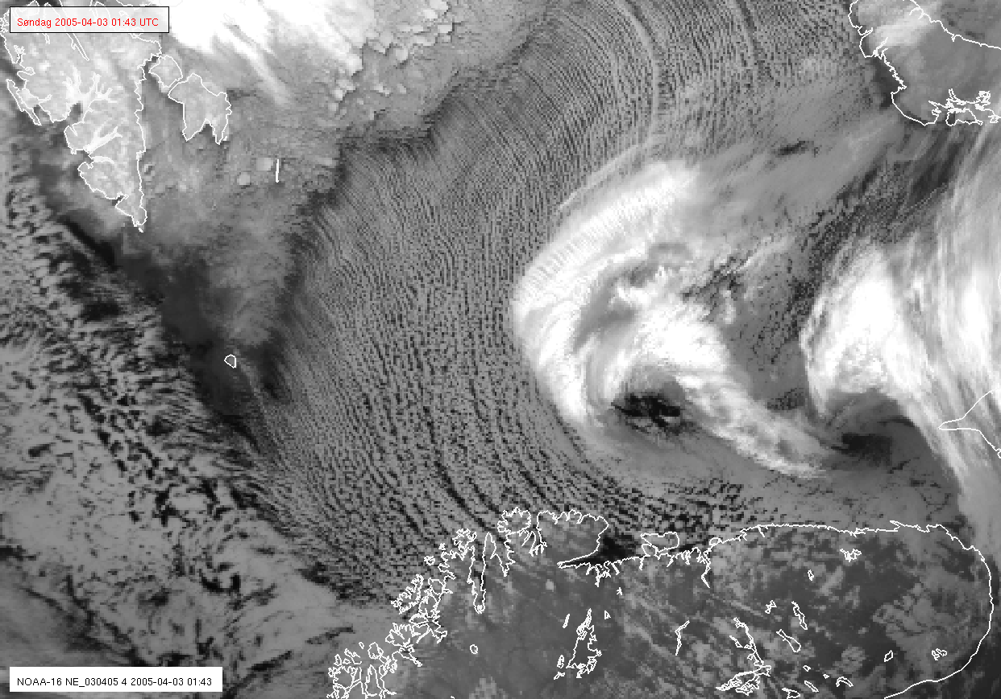
Agenda:
Definition
Key processes
Climatology
Forecasting
Observing the PL by satellites

Slide 4
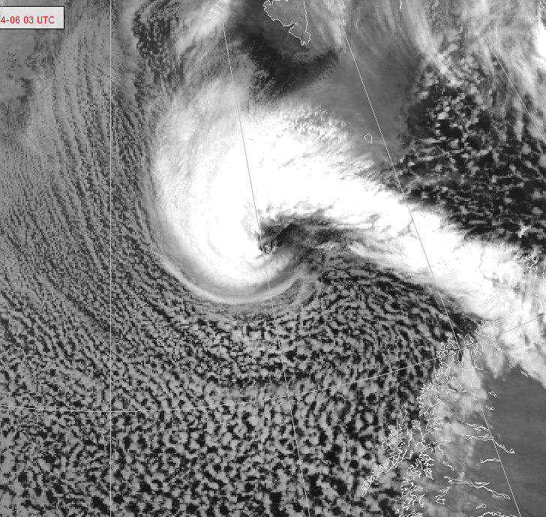
Definition of the polar low
(European Polar Low Work Group)
’A small, but fairly intense low in maritime areas’
In cold air outbreaks (CAO) north of the polar front
Diameter 100 – 600km
Cyclonic curvature

Slide 5
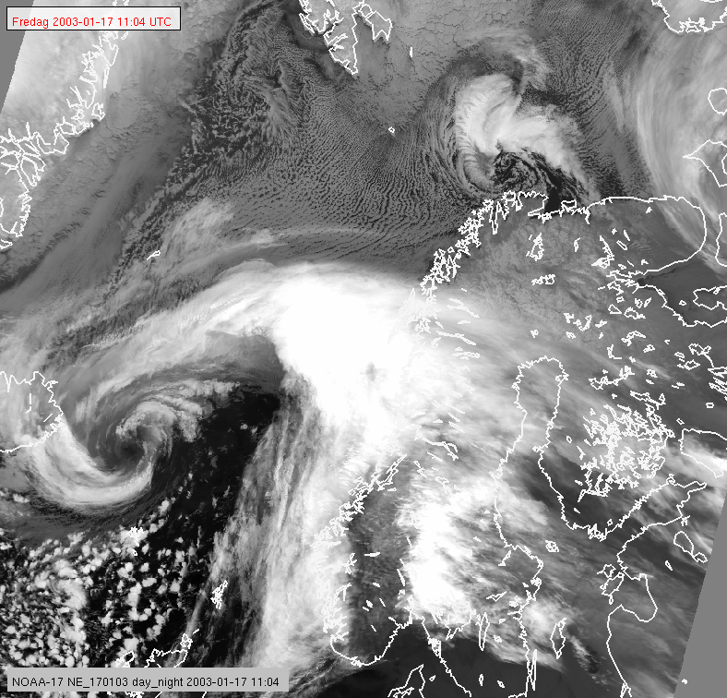
Cold air outbreak
Polar low
Synoptic
low

Slide 6
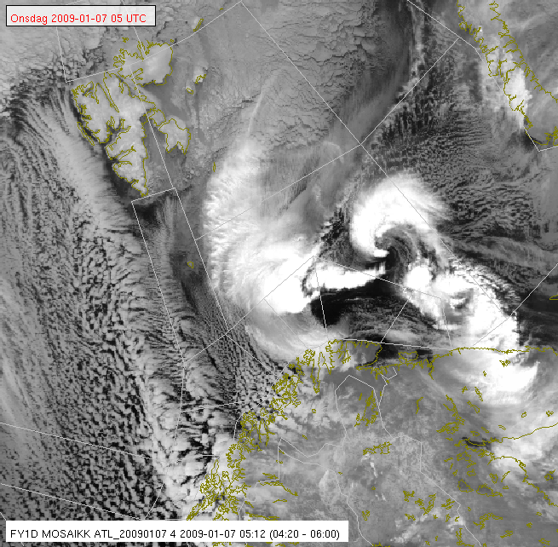
The weather in a polar low:
Strong wind in western and northern parts
  Average observed max wind 42kt
  25% have 50kt or more
  Dense snow fall
  Horizontal visibility < 100m
  Vertical visibility < 100ft
  Cb, icing and turbulence
Eastern half usually less dramatic:
  Clear eye
  Off shore winds

Slide 7
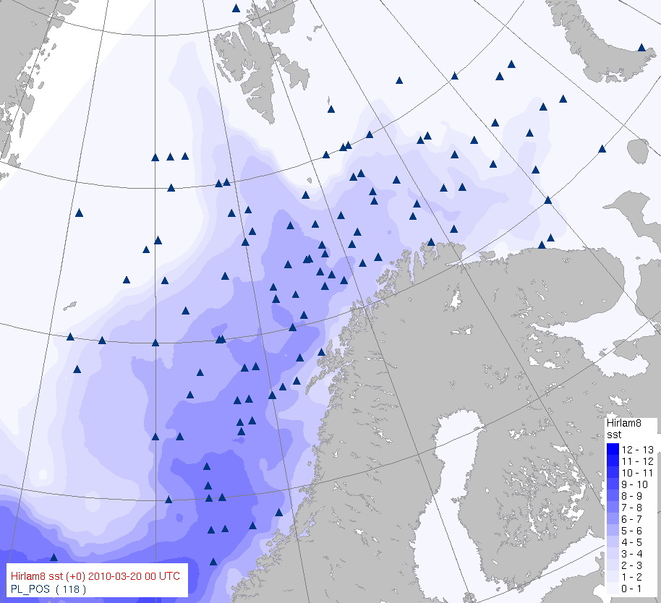
Climatology of the polar low:
Areas:
Norwegian Sea/ Barents Sea
Japan Sea, Bering Sea
West of Greenland, Ungava bay
Northeastern Pacific

Slide 8
Key processes:
Polar Lows develop from areas of instability:
  Baroclinic, convective
  Occlusions, troughs, convergence lines, etc.
Destabilization of the lower layers, surface to 850 hPa:
  Cold Arctic air is advected over warmer waters
  Supply from the sea surface of latent and sensible heat
Further destabilization of upper layers
  Passage of cold air aloft
  Unrestricted convection up to 400-500hPa
  Upper trough in the Z500 hPa, with PVA and stretching of the column

Slide 9
Forecasting methodology:
Look for:
Cold air outbreaks at low levels, -cloud streets, etc.
Area of low level instability: Convergence zone, occlusion, Cb cluster, etc.
Cold trough at 500hPa with PVA
SST – T₅₀₀ ≥ 44°C (can be less)
Polar lows usually situated at the fringes of the cold cores.

Slide 10
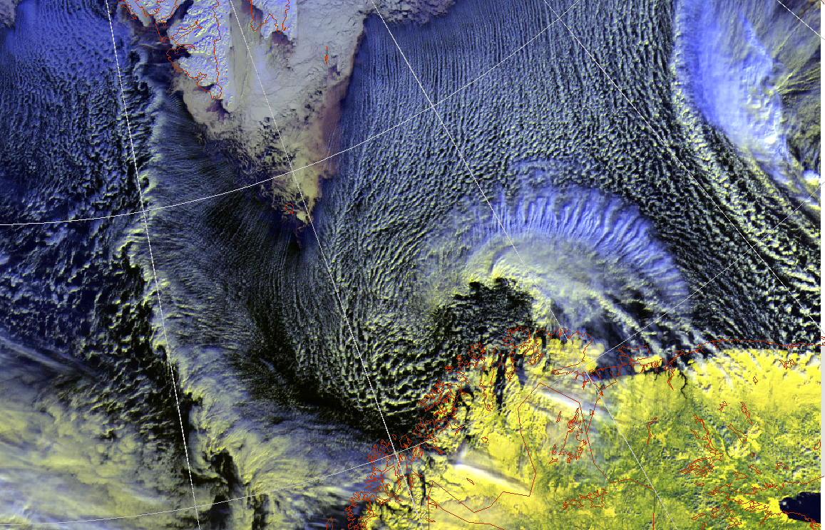
Cloud streets
1. The cold air outbreak

Slide 11
Old occlusions
Circulations
Convergence lines
2. Low level disturbances

Slide 12
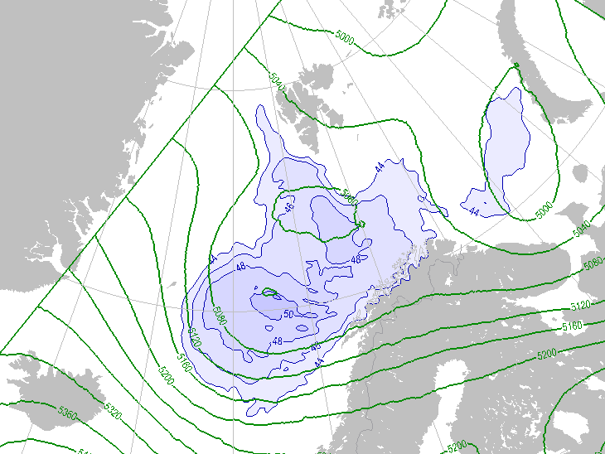
The cold upper trough:
Trough @ Z500hPa with positive vorticity advection
SST- T500hPa ~ 44 to 50°C

Slide 13
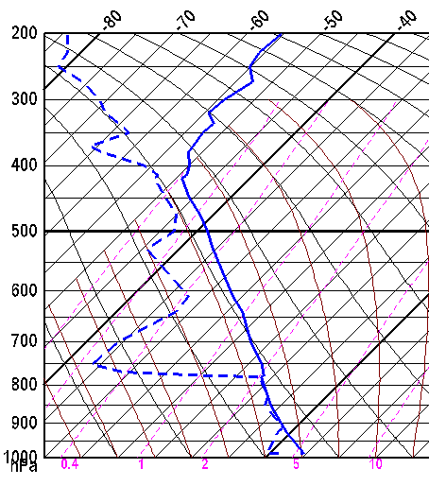
SST – T₅₀₀ ≥ 44˚C
- with exceptions !
How cold ?

Slide 14
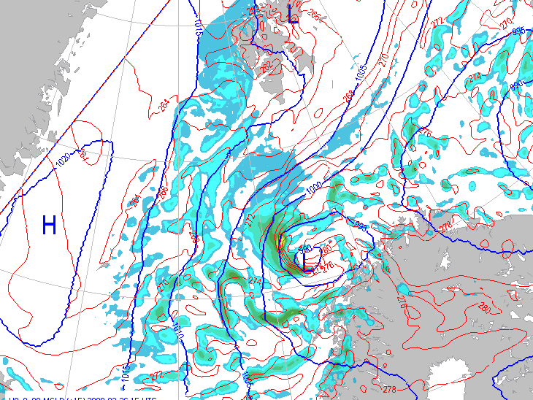
Development in the model:
MSLP signature
Precipitation and cloud bands
Baroclinic zones, as seen from thickness or in the equivalent potential temperature @ 850 hPa

Slide 15
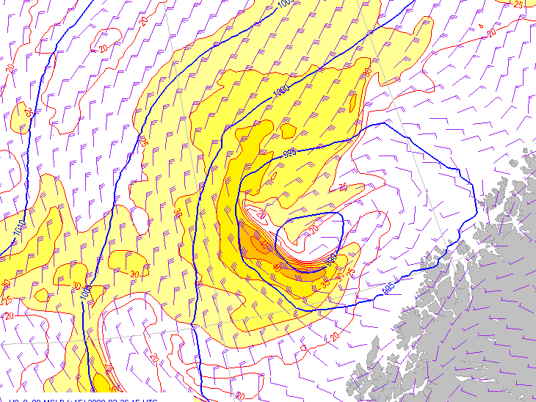
Surface wind :
! Sharp shear zones
! Check position of the model

Slide 16
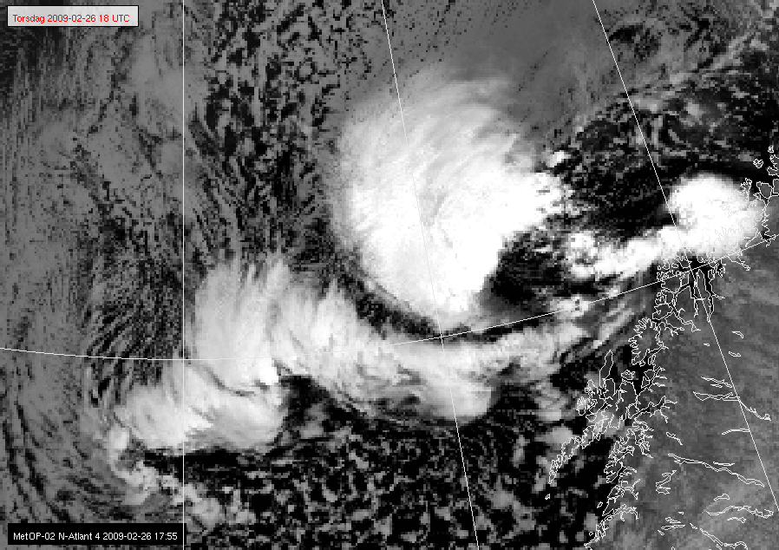
Observing polar lows from satellites
Polar orbiting (North of 70 degrees North)
AVHRR infrared or visible

Slide 17
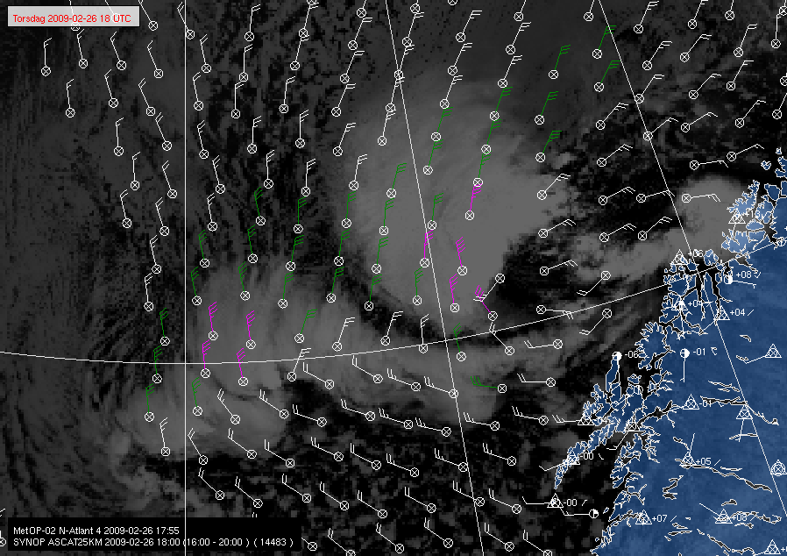
Using the Ascat for wind
Scatterometer winds observations from Ascat or Oceansat

Slide 18
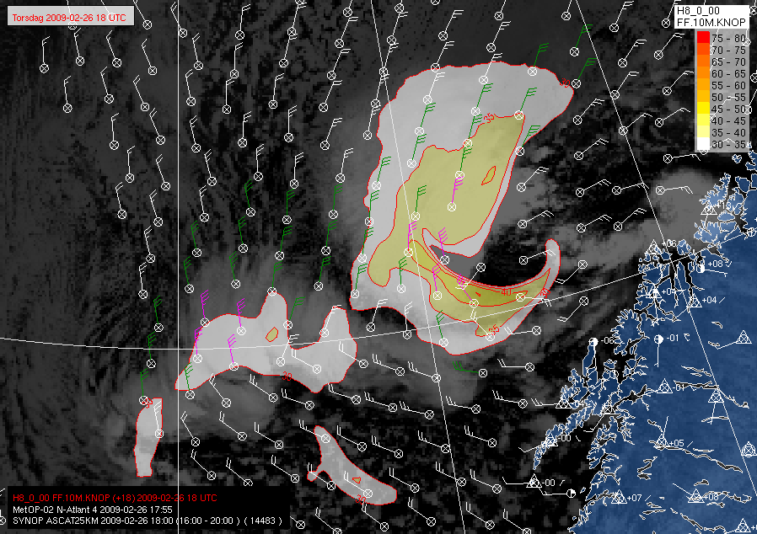
Using the Ascat for wind
Hirlam 8km model winds vs. Ascat
Are both lows captured ?

Slide 19
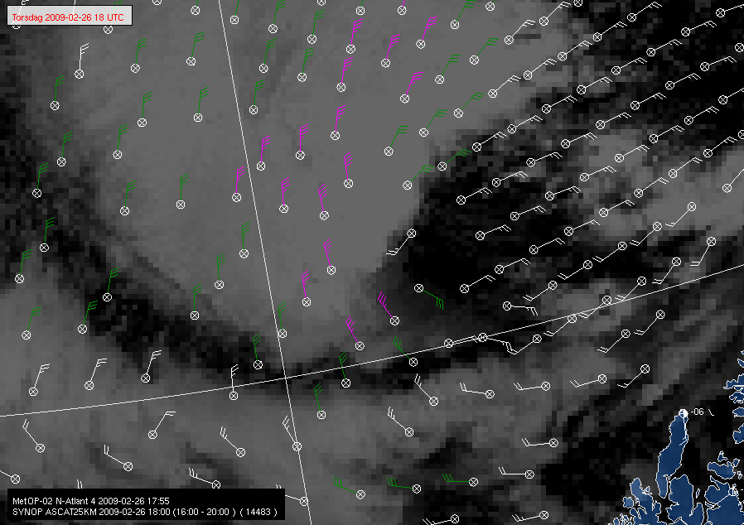
Scatterometer wind:
Absolute wind speed OK
Ambiguity in wind direction
Contaminated by rain
Insensitive to snow

Slide 20
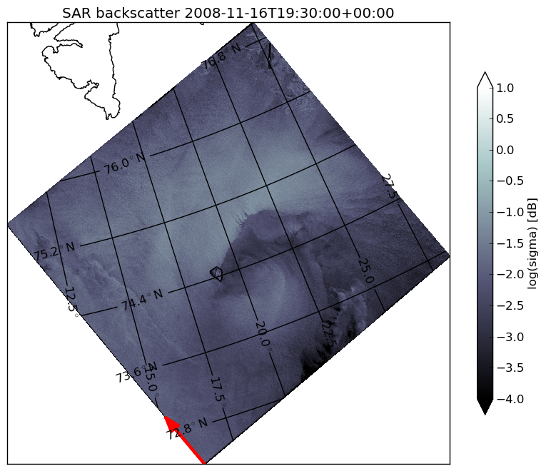
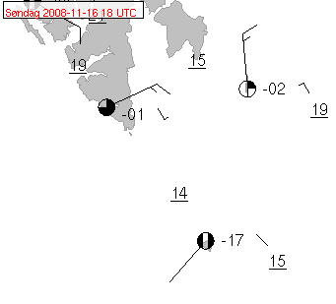
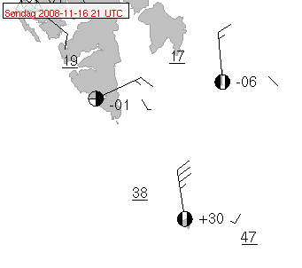
Polar lows seen from SAR:
18 utc
21 utc
19:30 utc
Shear zone ~ 1-3 km, time to increase ~ 1-10 minutes

Slide 21
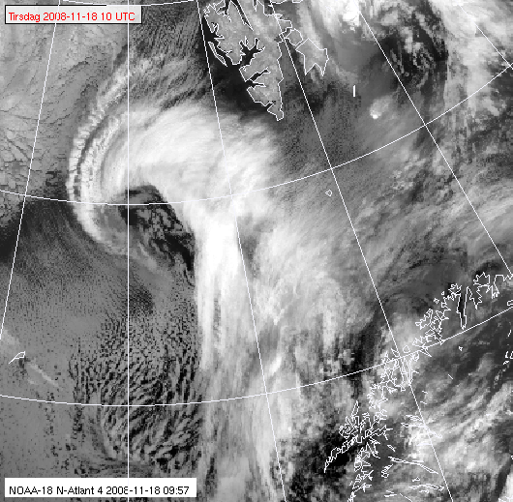
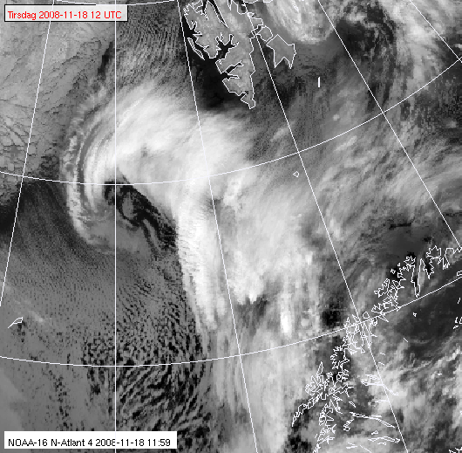
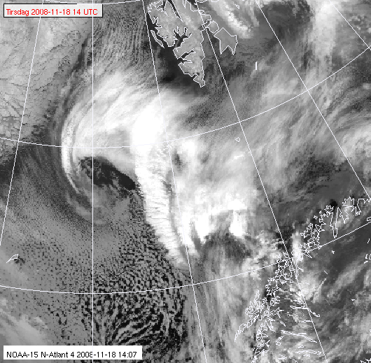
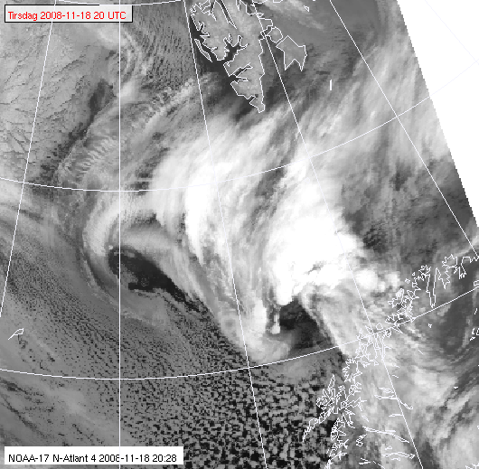
The 18.Nov. 2008 low: Early detection by SAR?
10 utc
12 utc
14 utc
20 utc

Slide 22
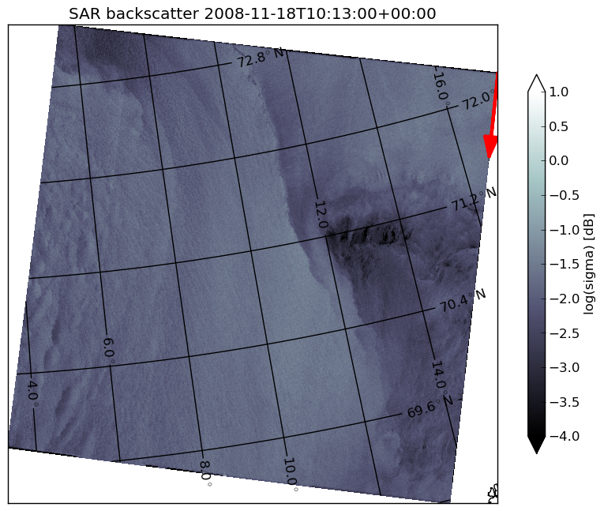
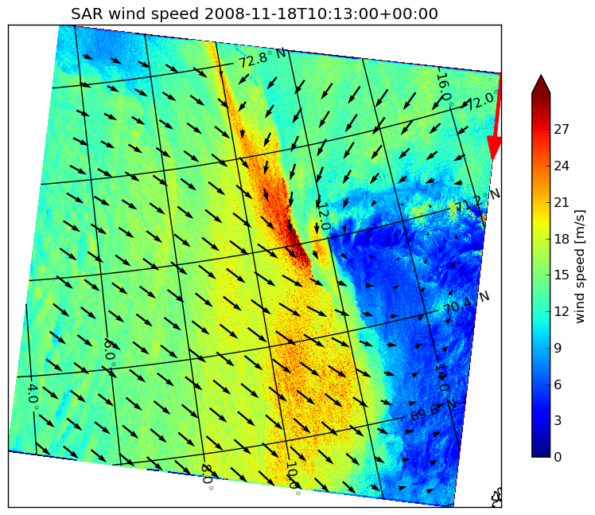
Surface signature in the SAR ?
10 utc

Slide 23
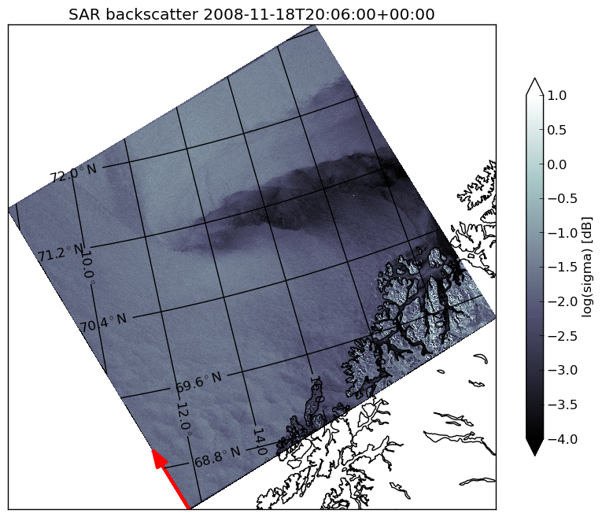
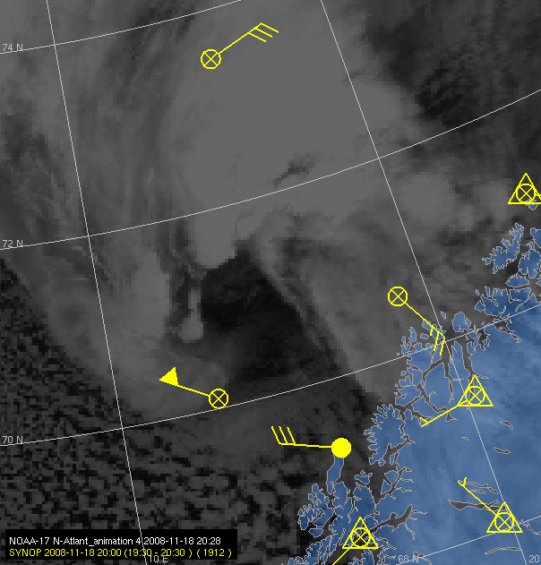
AVHRR vs. SAR
Signature of the polar low at surface vs. cloud top

Slide 24
Summary on polar lows:
Small, fairly intense lows in the marine Arctic in the winter
Forecasting:
  Cold air outbreaks
  Areas of deep convective instability
Observing the polar low from satellites:
  AVHRR IR and visible for general cloud top
  Ascat for absolute wind speed
  SAR for qualitative detailed studies

Slide 25
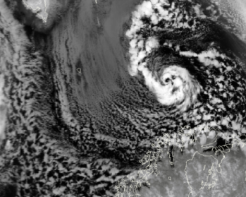
Questions ?
polarlow.met.no www.yr.no

