Slide 1
Land Surface Analysis SAF (LSA SAF) products and applications: Current status and the way forward
Pedro Viterbo
Instituto de Meteorologia, Lisboa, Portugal
Acknowledgments: Isabel Trigo & the LSA SAF consortium

Slide 2
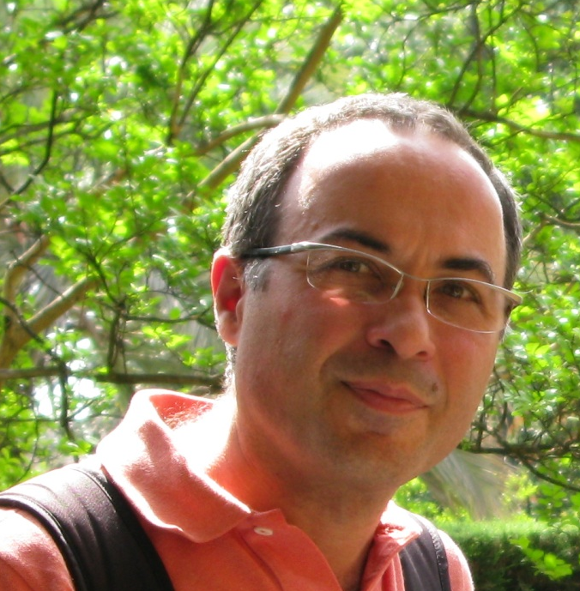
Layout
Overview of the LSA SAF: now
Applications
User needs
Overview of the LSA SAF: future
This is me

Slide 3
Layout
Overview of the LSA SAF: now
Applications
User needs
Overview of the LSA SAF: future

Slide 4
LSA SAF in a nutshell
EUMETSAT Satellite Applications Facility on Land Surface Analysis: Dedicated to algorithm development, validation and operational production of land surface related products (primarily) based on European meteorological satellites (MSG and METOP)
Real time operations (i.e., some products are available every 15 min, ~1 hour after observed)
Effective use of MSG and EPS data related to:
LAND
LAND-ATMOSPHERE Interactions
BIOSPHERIC Applications
Timely provide:
Products
User support
Reviewed (~annually) by technical and scientific review panels

Slide 5






The Land SAF Consortium
A consortium of 7 Institutions in 6 countries
Instituto de Meteorologia (IM), Portugal
Meteo-France (MF), France
Royal Meteorological Institute (RMI), Belgium
Finnish Meteorological Institute (FMI), Finland
Karlsruhe Institute of Technology
IDL, University of Lisbon
UV, University of Valencia
Organisation principles
Algorithms developed and validated by one of the patners
Algorithms handed over to IM for integration and production
Operational chain in Lisbon

Slide 6



Land SAF Chronogram
MetOp-B
MetOp-C
MetOp-A
Meteosat-11 (MSG-4)
Meteosat-9 (MSG-2)
Meteosat-10 (MSG-3)
MTG-1
MTG-S
Meteosat-8 (MSG-1)
99
00
01
02
03
04
05
06
07
08
10
11
12
13
14
15
16
17
18
19
20
21
22
Development Phase:
Sep 1999
Initial Operations Phase:
Feb 2005
Continuous Development & Operations Phase:
Mar 2007
Continuous Development & Operations Phase 2:
Mar 2012

Slide 7
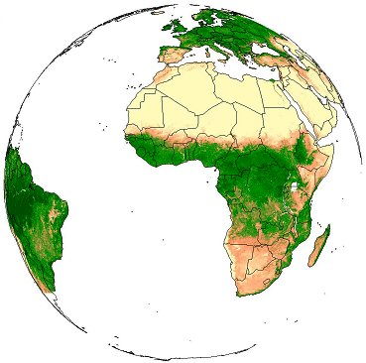
LSA SAF MSG products
Surface Radiation
Surface Water Balance
LST
↓LongWave Flux
Snow Cover
Albedo
↓ShortWave Flux
Evapotranspiration
Vegetation
Wild fires
Fraction Veg Cover
Fire Detection
LAI
Fire Radiative Power
fAPAR
Fire Risk (Europe)
Increased level of maturity

Slide 8
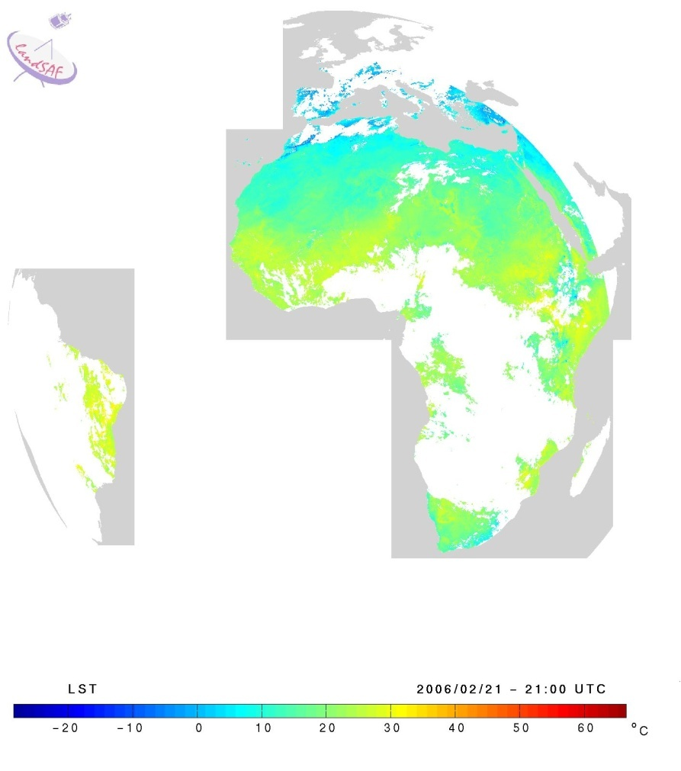
Product characteristics
All products have a quality flag (a-priori error bar for LST) field associated
All products have a User Manual and a comprehensive Validation Report
4 production areas for MSG
-Europe
- N. Africa
- S. Africa
- S. America
SEVIRI resolution
Variable time resolution
-15 min to 10 days
EPS products generation for a subset of variables

Slide 9
Additional information & service components
Users (> 500 registered users)
Numerical Weather Prediction
Update parameters, Assimilation & Forecast Verification (ECMWF, MF, INM, IM, …)
Agriculture & Forestry (JRC)
Research (e.g. AMMA, U. Leicester)
Environmental Monitoring
Hydrology
(...)
Help desk
Regular workshops (biennally since 2002; Toulouse) for user feedback and evolution of user requirements

Slide 10
Cooperation and training activities
Cooperation with other SAFs
Shared validation of fluxes with CM and OSI SAF
Use of other SAF’s parameters to improve LSA SAF products (e.g., H-SAF soil moisture to improve LSA SAF ET)
Cooperation with MPEF
Production of Fire Radative Power, developped at EUMETSAT HQ
Demonstrated flexibility of overall software architecture
Geoland-2 (FP7 project, 2008-2012): LSA SAF partners are consortium members; Constellation of geostationary satellites (see poster)
Work closely with key users
JRC (agrimetereological applications, VEGA intercomparison)
ECMWF for Fire Radiative Power
Training
One training event in Mozambique
Modules developed for EUMETRAIN
Regular participation in remote sensing courses in Brazil
...

Slide 11
Layout
Overview of the LSA SAF: now
Applications (from the LSA SAF Workshop 2010, Toulouse)
User needs
Overview of the LSA SAF: future

Slide 12
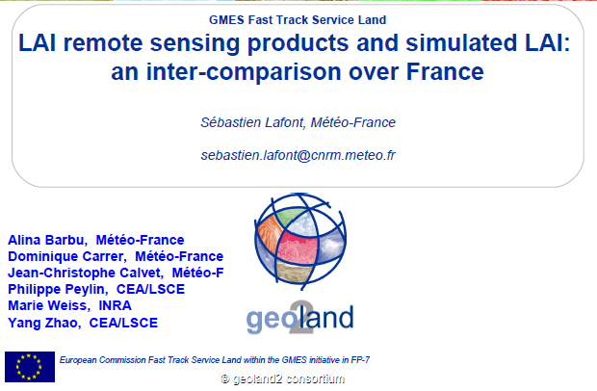
Leaf Area Index

Slide 13
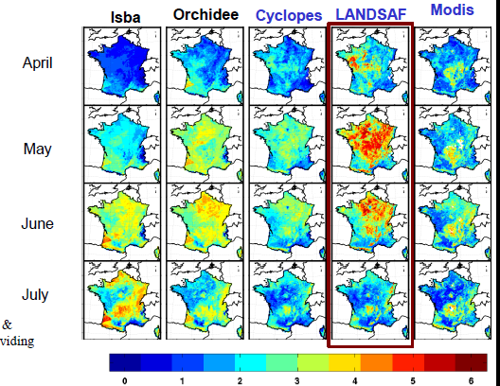
LAI: Comparison with models and other remote sensing products
MODELS
Remote sensing

Slide 14
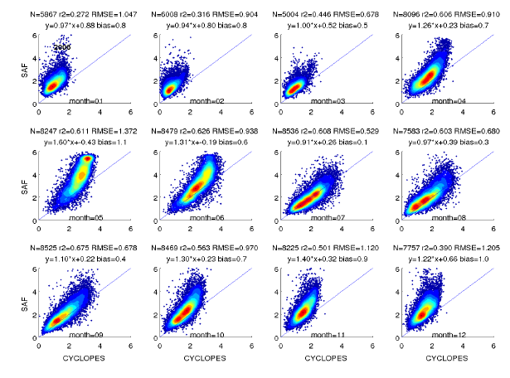
Monthly scatter plots (SAF vs. CYCLOPES): LAI over France, 2006
Jan
Feb
Mar
Apr
Jun
Jul
Aug
May
Sep
Oct
Nov
Dec

Slide 15



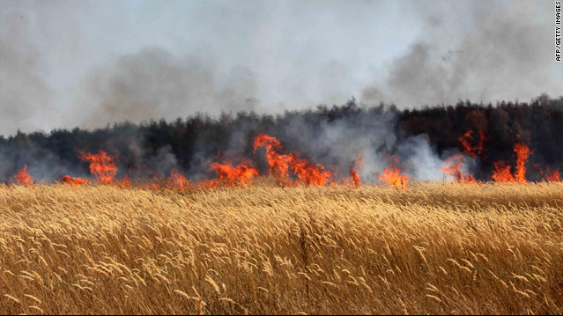
Global Fire Emission Monitoring with Fire Radiative Power in the MACC Project
Johannes W. Kaiser, A. Heil, M.G. Schultz, G.R. van der Werf,
M.J. Wooster, W. Xu, more MACC partners and Gareth Roberts
Russia, August 2010

Slide 16
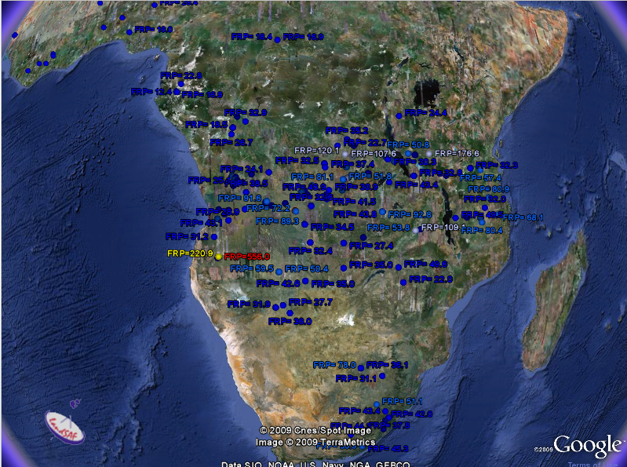
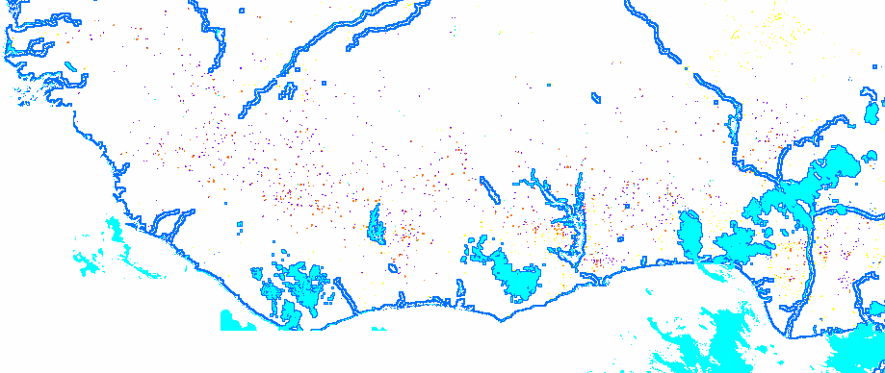

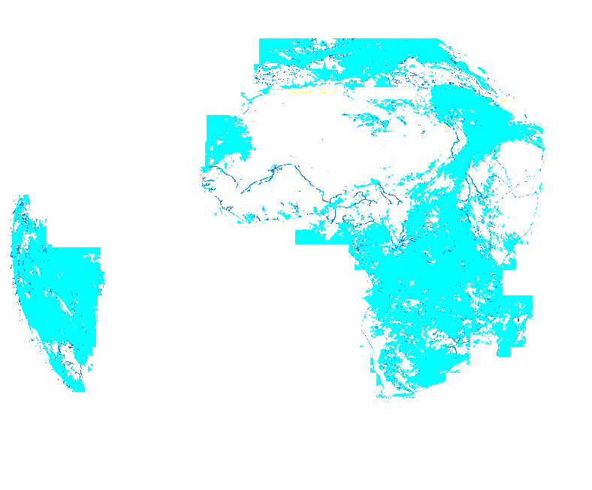

Fire Radiative Power
Algorithm:
Detects pixels containing active fires
Reports their time/location and
Fire Radiative Power (in MW)
Input:
VIS, MIR + TIR data
Cloud mask (SAF NWC)
Landcover map
15-min
FRP ∝ Combustion rate
∝ Smoke release
→ CO₂eq emissions
FRP-Quality:
reports the processing status of each pixel
VALUE MEANING
----------------------------------------
0 NOT POT FIRE
1 FRP OK
2 FRP SAT
3 CLOUDY
4 SUN GLINT
5 SUN GLINT RATIO
6 NO BCK
7 BAD BCK
8 CLOUD EDGE
254 NOT PROCESSED
1
3
4
8

Slide 17
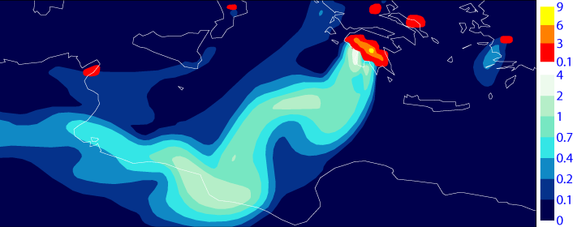
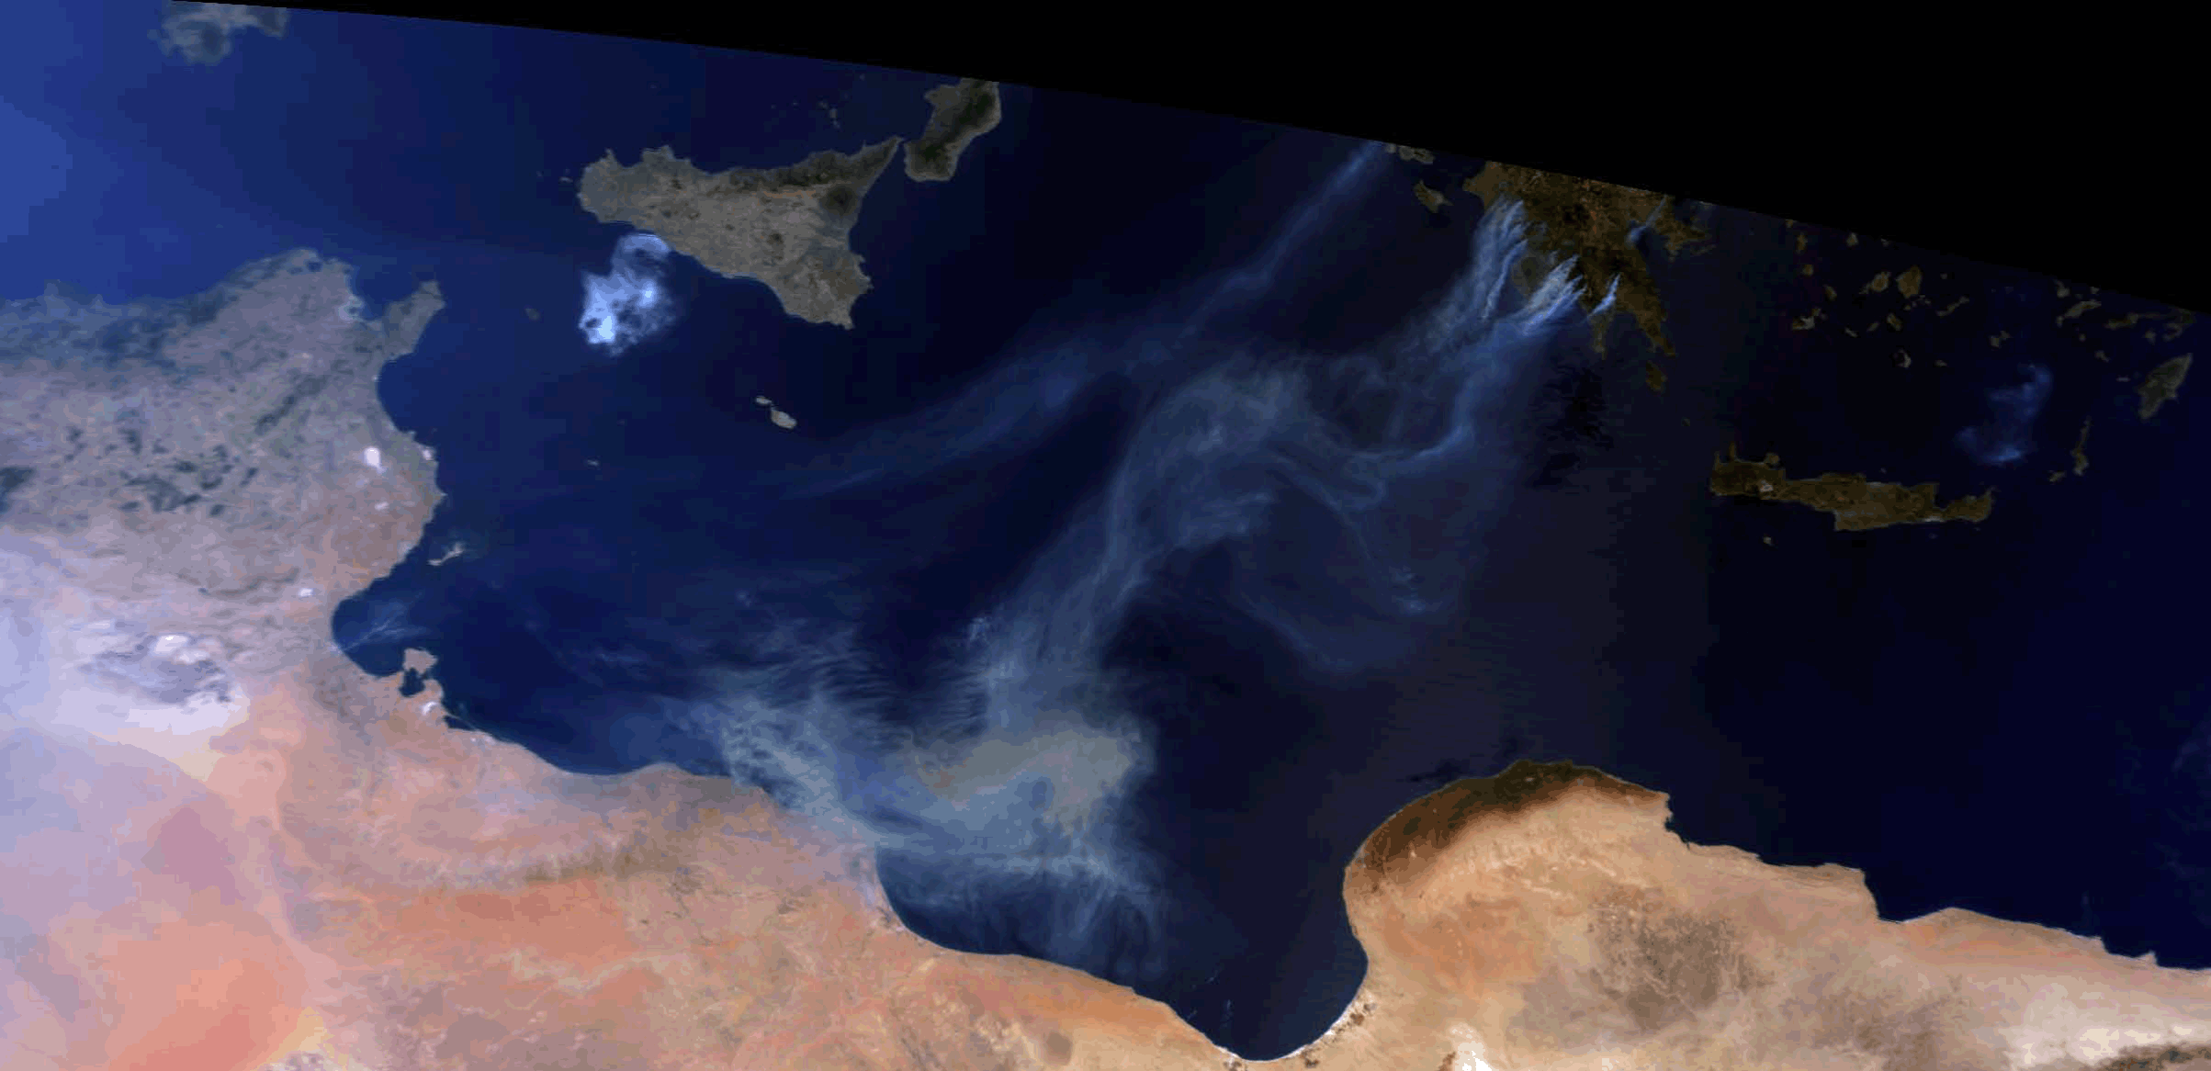
Modelled AOD of Greek Fire Plumes, August 2007
MODIS
26 August 10:00
Emissions calculated from Fire Radiative Power observed by SEVIRI on Meteosat.
Emission factors from Andreae & Merlet 2001 and Ichoku & Kaufman 2005.
Run at 25km global resolution, typical for regional models.
2007-08-25 12:05
Notes:
We want to forecast plumes from forest fires similarly, but need to get emission from satellite obs. Fire diurnal cycle needed to generate smoke plume “pulses” in forecast.

Slide 18

First results of the LAND-SAF project* on reference crop evapotranspiration
Henk de Bruin¹ and Isabel Trigo²
Associate Professor Emeritus, Wageningen University, The Netherlands; Visiting Professor King's College, London, UK; Freelance Consultant Bilthoven, The Netherlands
²) Instituto de Meteorologia, Lisbon, Portugal
*Project VS0802
With contributions of P. GAVILAN, A. MARTÍNEZ-COB, M. P. GONZÁLEZ DUGO M. A. JITAN, T. ENKU NIGUSSIE C. VAN DER TOL and A. GIESKE

Slide 19
Agrometeorological application: MSG reference crop evaporation
Background
About 80% of available fresh water is used for agriculture, e.g., for irrigation in semi-arid areas
In order to estimate crop water requirements, FAO developed a semi-empirical method (Allen et al. 1998):
ET_{c}=K_{c} ET₀
Example for 5 May 2008
Crop factor
Reference crop evaporation
Thanks to H. deBruin, U. Wageningen

Slide 20
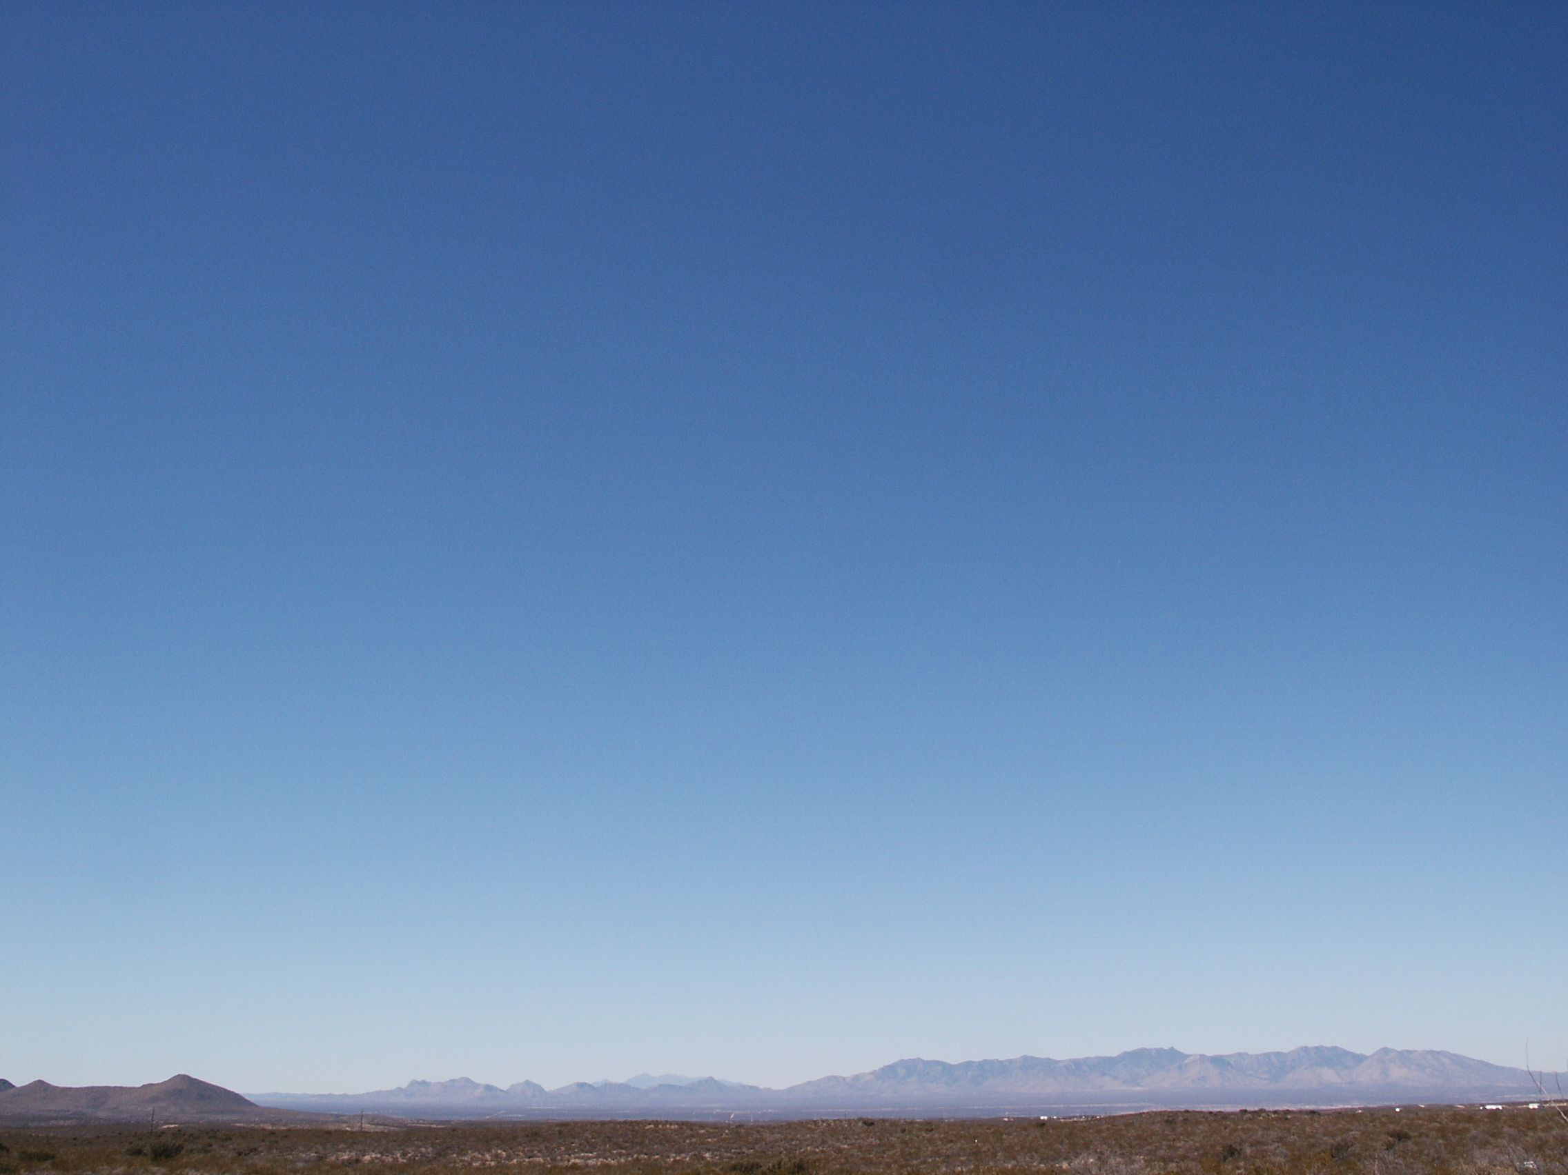
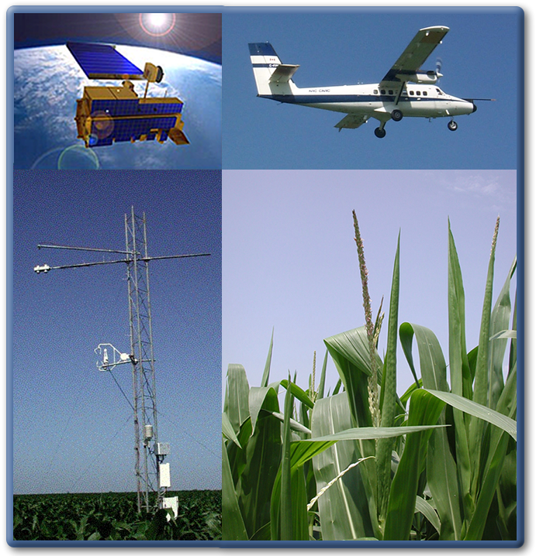
Mapping Daily Evapotranspiration using Geostationary and Polar Orbiting Satellite Imagery
M.C. Anderson, W.P. Kustas
USDA-ARS, Hydrology and Remote Sensing
J.M. Norman
U Wisconsin-Madison, Soil Science
C. Hain, J.R. Mecikalski
U Alabama-Huntsville, Atmospheric Science
G. d’Urso, M.P. Gonzalez-Dugo, C. Cammalleri, J. Cristobal

Slide 21

Atmosphere-Land Exchange Inverse (ALEXI)
Available energy
ET = (R_{NET} - G) - H
Regional scale
ΔT_{RAD} - GOES, MSG
T_{a} - ABL model
Surface temp:
Air temp:

Slide 22
ALEXI TSEB-ABL Coupling
z
PROCEDURE:
θ_{sounding}
Apply TSEB at 2 times
during morning
Estimate T_{A1} & T_{A2} at
blending height
t₂
Compute required
∫H(t)dt
t₂
t₁
∫H(t)dt
Revise H₁ & H₂
z_{blend}
t₁
H₁
H₁
H₂
H₂
Temperature
T_{A1}
T_{RAD1}
T_{A2}
T_{RAD2}

Slide 23
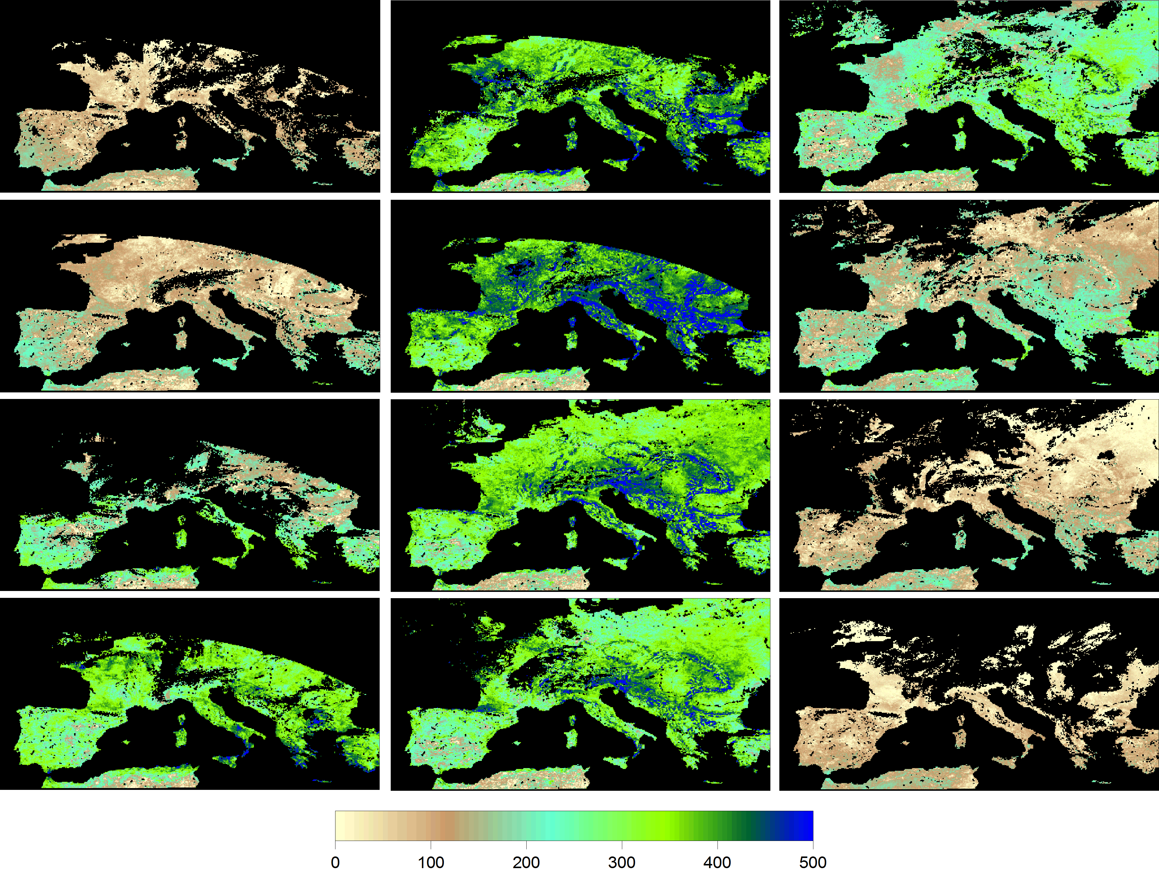
ALEXI – Europe (Meteosat 3-10km)
JAN
MAY
SEP
FEB
JUN
OCT
MAR
JUL
NOV
APR
AUG
DEC
Latent heat (Wm⁻²)

Slide 24
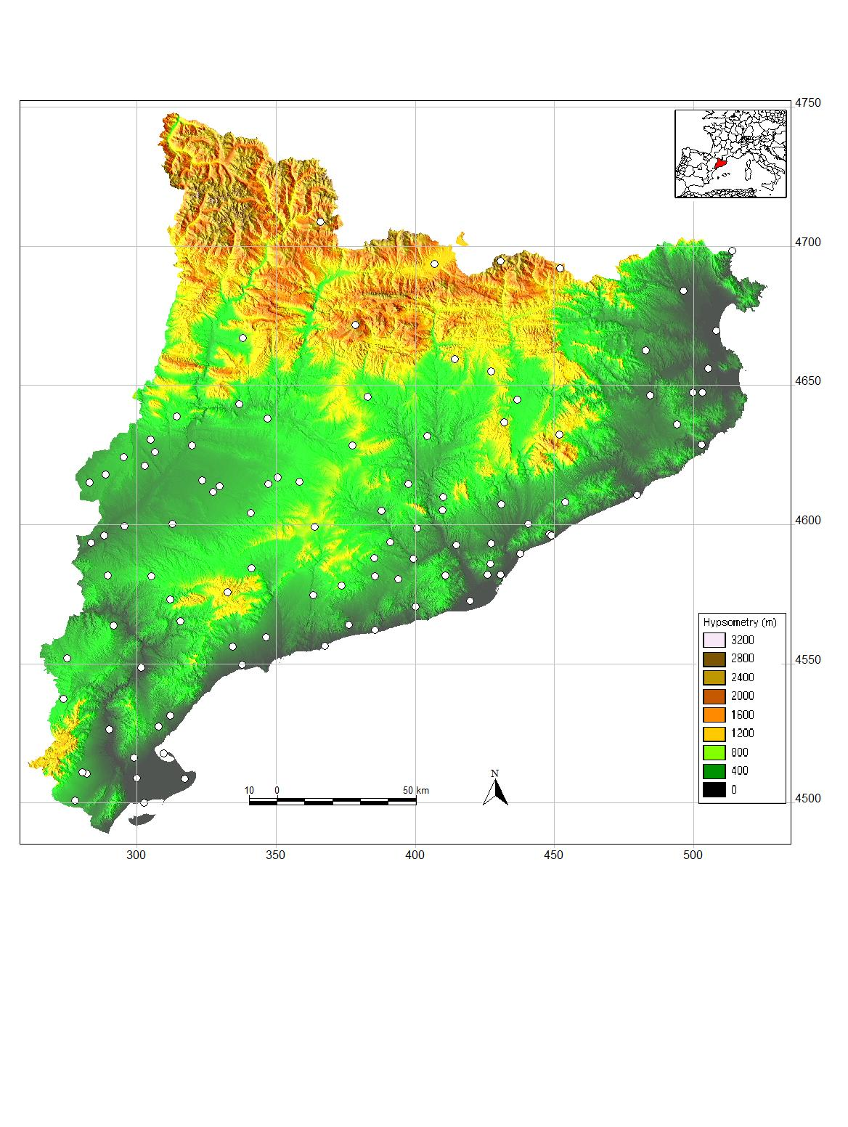

Land SAF insolation evaluation
Catalan Meteorological Service
www.meteocat.com
Flat terrain (100 stations)
Hilly terrain (40 stations)
J. Cristobal

Slide 25
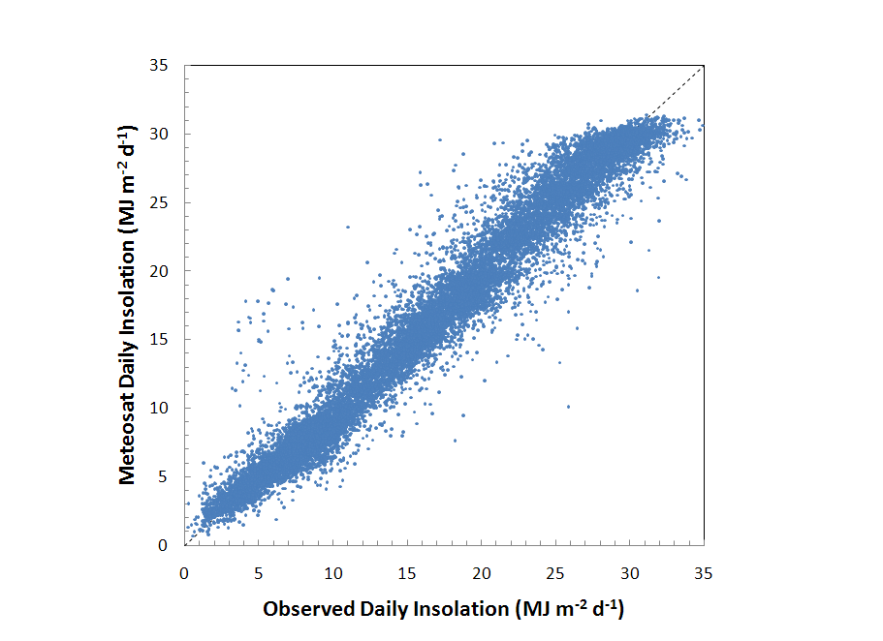
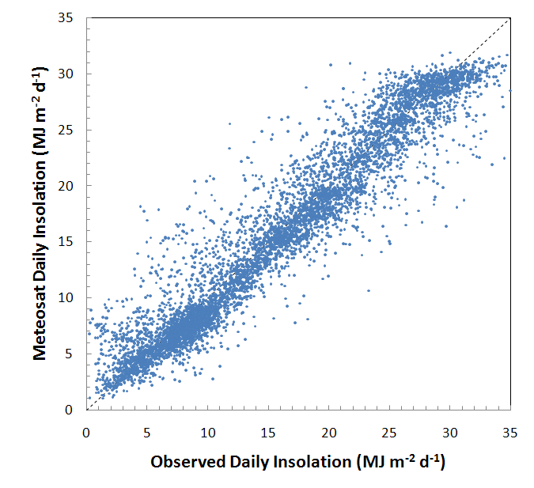
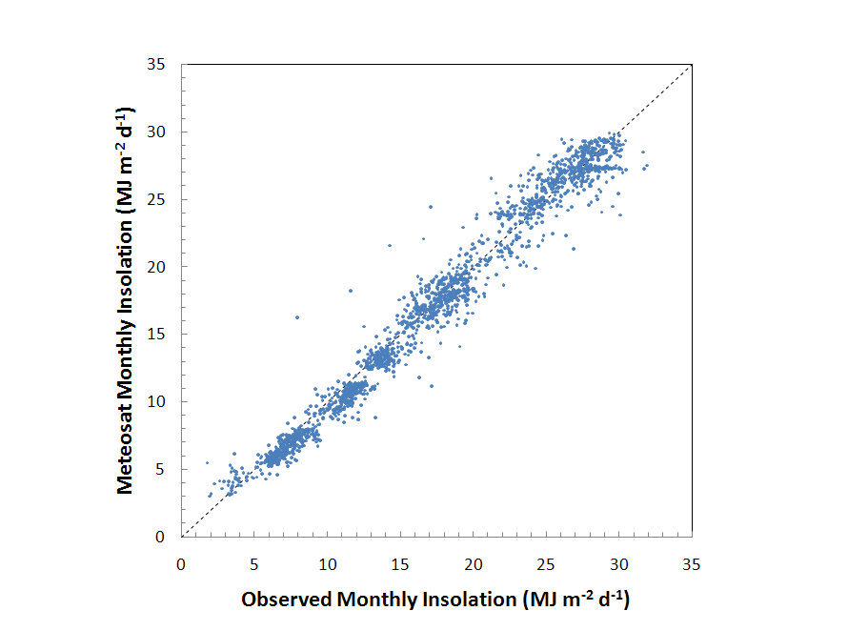
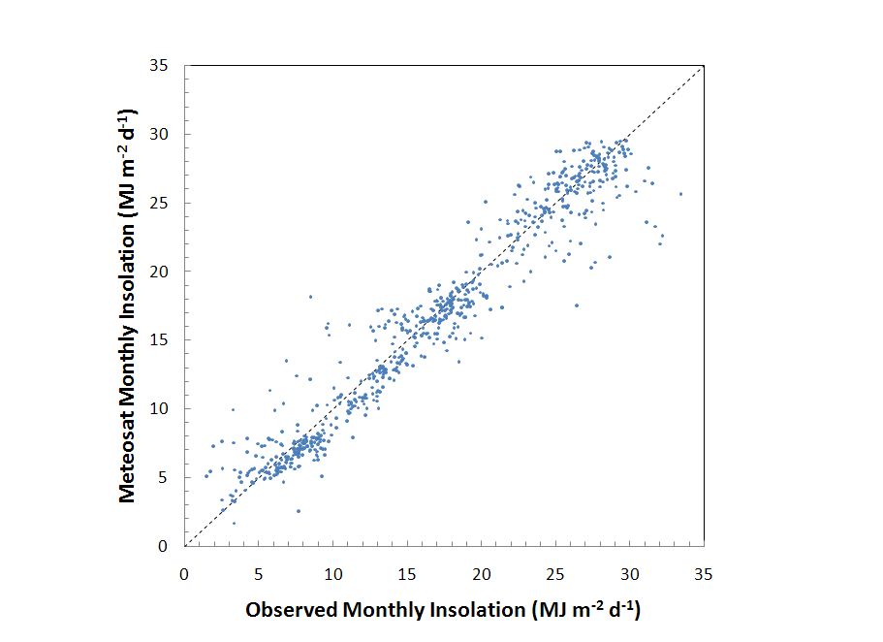
Flat terrain
(100 stations)
Hilly terrain
(40 stations)
Daily
RMSE: 2.2 (10%)
R²: 0.96
RMSE: 2.5 (15%)
R²: 0.92
Monthly
RMSE: 1.3 (7%)
R²: 0.97
RMSE: 2.0 (12%)
R²: 0.94

Slide 26
Assessment of Met Office forecasting models with SEVIRI LSTs
LSA SAF workshop
J. M. Edwards, Toulouse, 16th November

Slide 27
Motivation
Near-surface air temperatures (1.5/2 m) are an important output from NWP models and are assimilated.
LST is more closely linked to the surface flux budget, but can differ substantially from T1.5m
SEVIRI data offer good temporal resolution and more homogeneous spatial coverage under clear skies
Can comparison with retrieved LSTs help to improve the representation of near-surface behaviour in the model?

Slide 28
Forecasting Models
Global Model:
Run to T+120
Horizontal resolution 40 km (recently → 25 km)
Vertical resolution: L38 (recently → L70)
North-Atlantic European Model (NAE)
Resolution 12 km
Run to T+48
Covers whole of Europe and much of north Atlantic
(To be superseded by higher resolution global model in next few years)

Slide 29
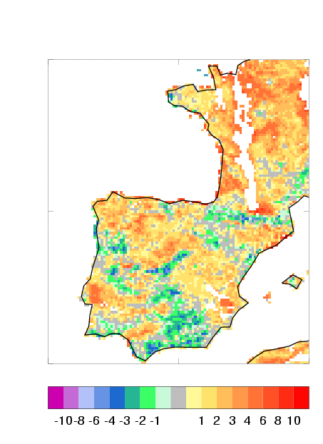
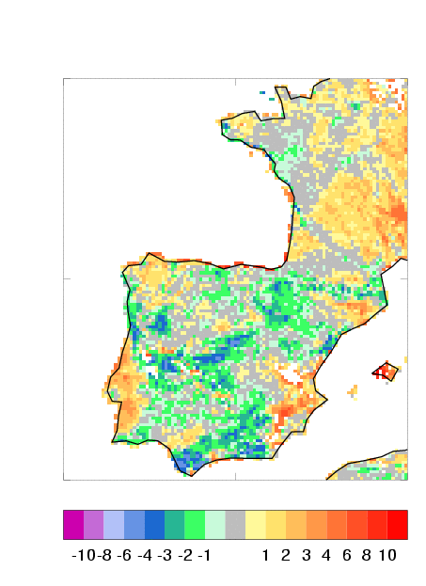
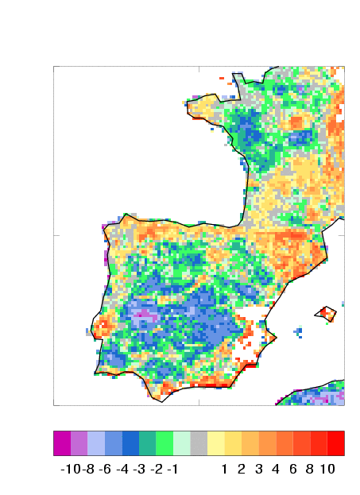
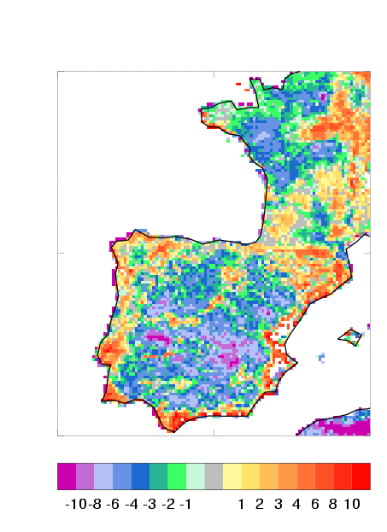
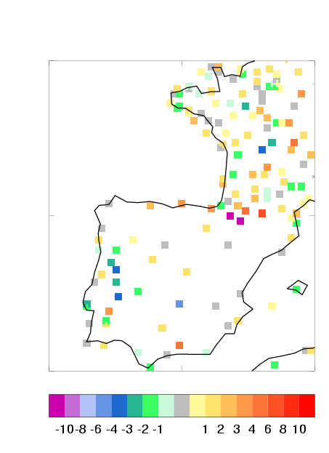
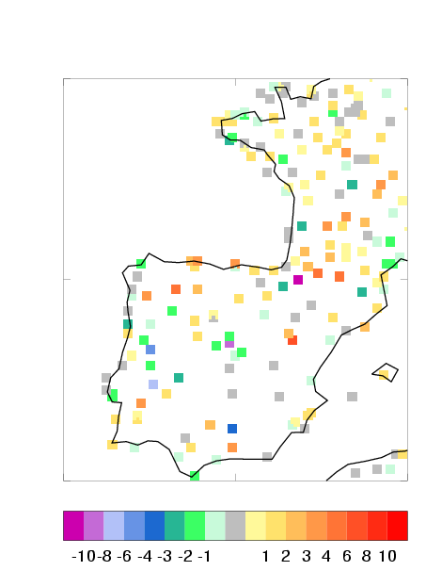
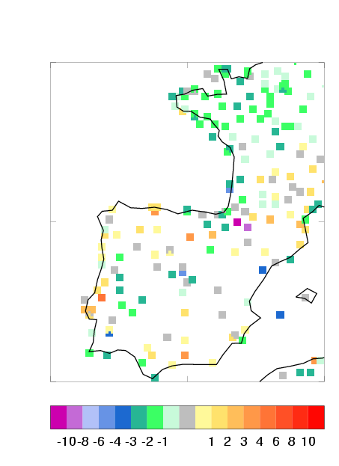
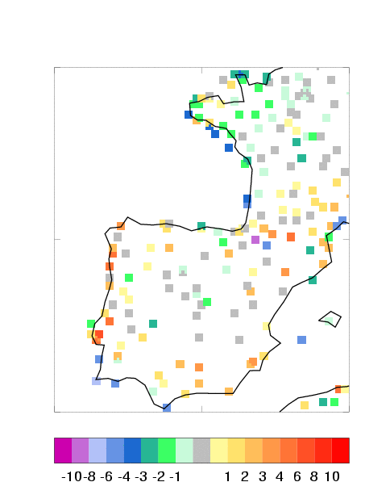
22nd July 2008: 00, 06, 09, 12 UTC

Slide 30
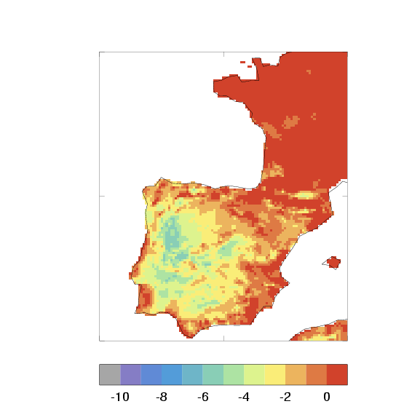
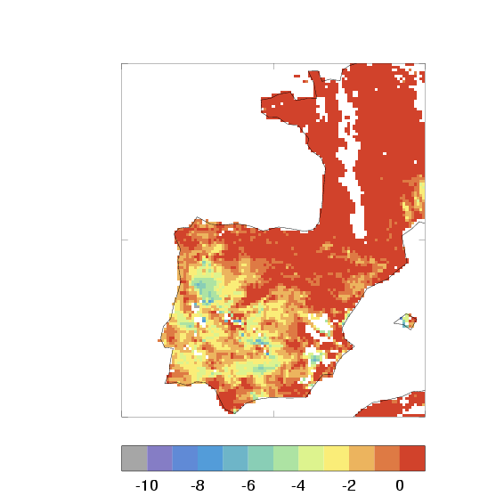
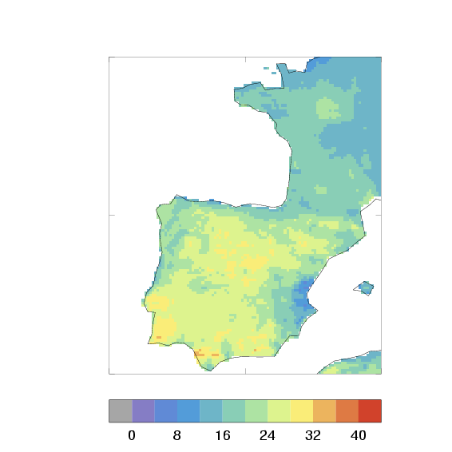
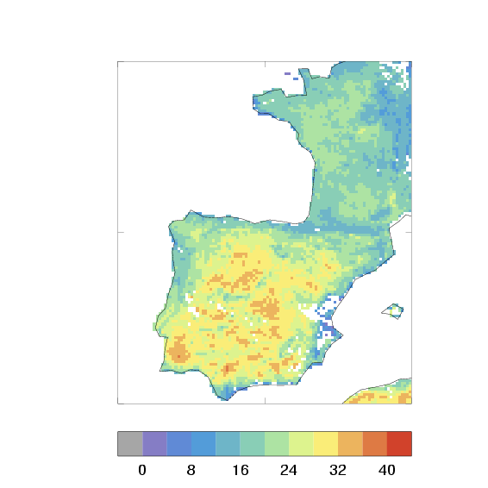
22nd July: ΔLST
NAE
SEVIRI
06-00 UTC
12-06 UTC

Slide 31
22nd July 2008: Summary
Model’s LST slightly warmer than SEVIRI’s at night, but SEVIRI believed to have a slight cold bias (Trigo et al. 2008)
Model’s LST significantly cooler than SEVIRI’s at noon – SEVIRI believed to have warm bias during the day, but model’s bias is rather larger than this
Errors in T1.5m much smaller than those in LST
Similar behaviour on other days in summer

Slide 32
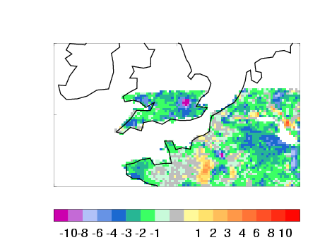
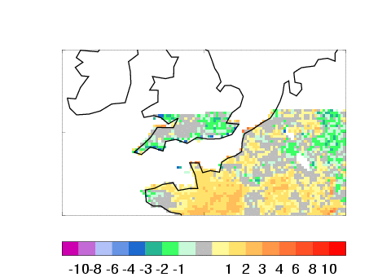
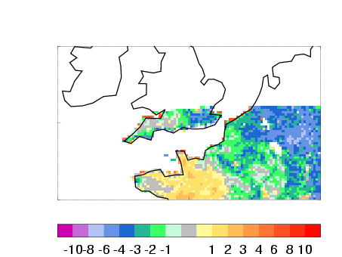
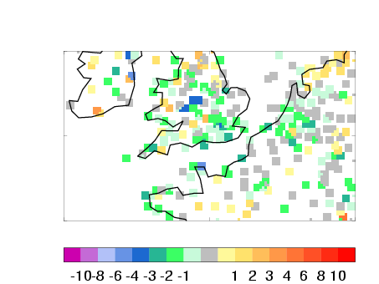
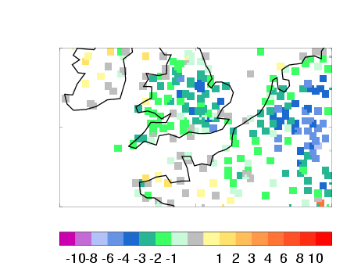
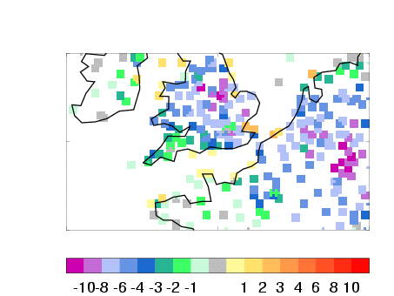
17th February 2008: 12, 16, and 17 UTC

Slide 33
17th February 2008: Summary
This weather system was associated with very light winds and clear skies
Comparison with SEVIRI suggests timing errors in the cooling of the surface through the evening transition in model – initially too slow then too fast
Errors in T1.5m larger in magnitude late in afternoon – evidence that model underestimates difference between air and surface temperature – decoupling of the surface.

Slide 34

Assimilation of LandSAF albedo product in a limited area NWP model
Jure Cedilnik
Environmental Agency of Slovenia / RC-LACE
Dominique Carrer
Jean-François Mahfouf
Jean-Louis Roujean
Météo France

Slide 35
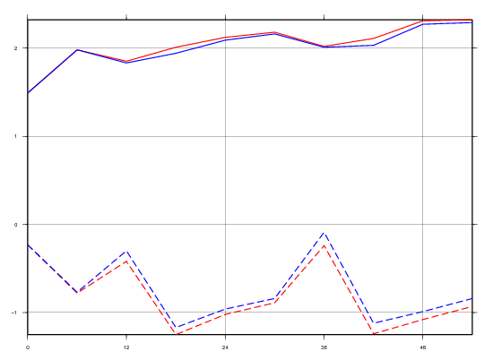
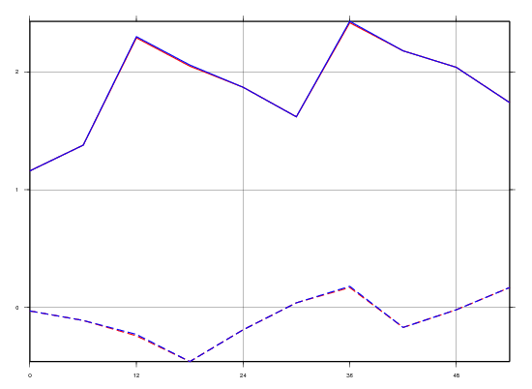
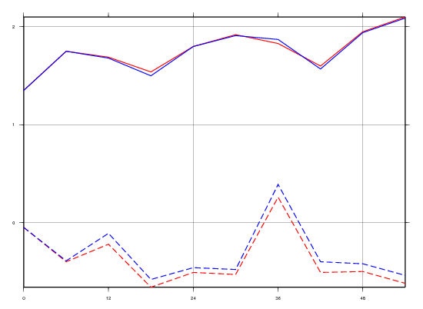
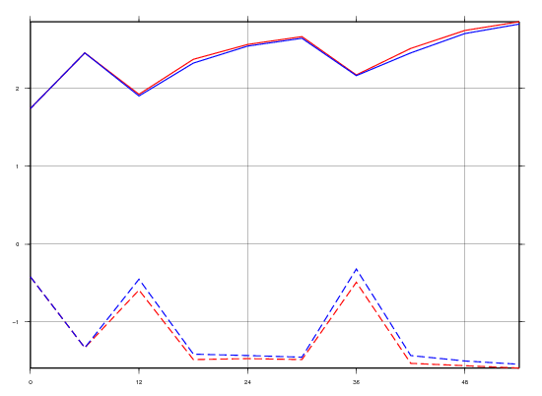
Scores for 2m temperature (I)
March
June
RMSE
Blue = LandSAF albedo assimilation
Red = reference
bias
September
forecast time ->
December

Slide 36
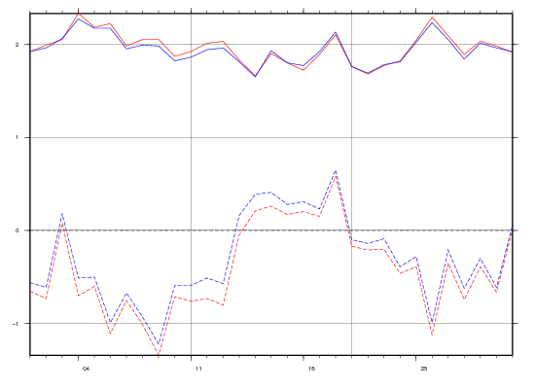
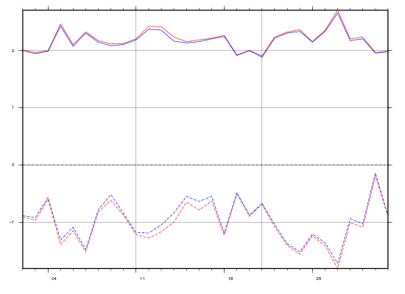
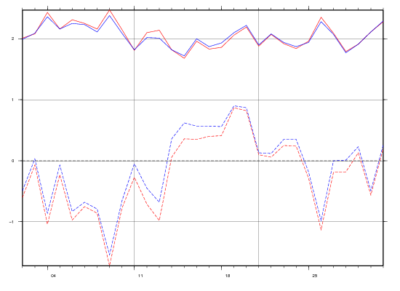
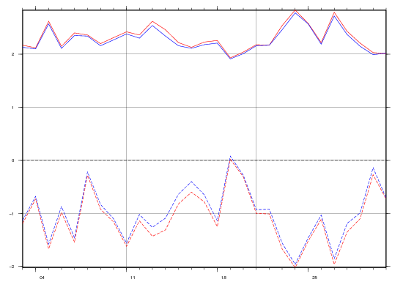
Scores for 2m temperature (II)
March @+12h
March @+24h
Blue = LandSAF albedo assimilation
Red = reference
day in March 2007 ->
March @+36h
March @+48h

Slide 37
Layout
Overview of the LSA SAF: now
Applications
User needs (from the LSA SAF User workshop, Toulouse 2010)
Overview of the LSA SAF: future

Slide 38
Working group 1: Forest, vegetation & fires
Product accuracy fine, but there is a need for evaluation of consistency over time to assure multi-annual product assessment
Reprocessing was highly in demand for virtually every user present, to ensure consistency within time series
Validation efforts were discussed, and the importance of involving the users in validation activities
Adequacy of products: Most products fine for African users, but there is a need for further training to reach operational exploitation
Importance of flexible tools to address questions of data format, projection and dissemination
A few new products were suggested

Slide 39
Working group 2: Carbon & water fluxes
Improved data handling (area selection, projection, data format, converters needed, time composite)
Closing the surface energy budget very useful for many users. The request to have sensible and latent heat fluxes (and ground heat flux)
Need for surface carbon fluxes and direct and diffuse solar radiation fluxes

Slide 40
Working group 3: Surface radiation budget
Emissivity is a useful product for many applications, including NWP. The product should be available (and visible on the website)
Non-directional LST and all weather LST would be very useful
Albedo MSG enthusiastically supported
Partition of albedo into the bare soil and vegetated part of the pixel
Albedo in the photosynthetic active band
Albedo in the presence of snow should be given together with the snow-free (reference) albedo for the same pixel (NWP request)
Inclusion of a full range of biomes and regimes in the validation, recognizing also the challenges of acquiring in situ data

Slide 41
Layout
Overview of the LSA SAF: now
Applications
User needs
Overview of the LSA SAF: future (CDOP-2 and beyond)

Slide 42






LSA SAF current consortium
CDOP-2
Instituto de Meteorologia (IM), Portugal
Meteo-France (MF), France
Royal Meteorological Institute (RMI), Belgium
Finnish Meteorological Institute (FMI), Finland
IMK, University of Karlsruhe
IDL, University of Lisbon
UV, University of Valencia
CDOP-2 new members:
KCL (UK)
VITO (Belgium)

Slide 43
Family of products: CDOP-2
Surface Radiation
LST
↓LongWave Flux
↓ShortWave Flux
Albedo
Vegetation
State
Water stres
Wild fires
Fraction Veg Cover
Evapotranspiration
Fire Detection
LAI
Reference Evap
Fire Radiative Power
fAPAR
Fire Risk (Europe)
NDVI
MSG
Metop
Increased level of maturity

Slide 44
Land SAF Chronogram
MetOp-B
MetOp-C
MetOp-A
Meteosat-11 (MSG-4)
Meteosat-9 (MSG-2)
Meteosat-10 (MSG-3)
MTG-1
MTG-S
Meteosat-8 (MSG-1)
99
00
01
02
03
04
05
06
07
08
10
11
12
13
14
15
16
17
18
19
20
21
22
Development Phase:
Sep 1999
Initial Operations Phase:
Feb 2005
Continuous Development & Operations Phase:
Mar 2007
Continuous Development & Operations Phase 2:
Mar 2012

Slide 45
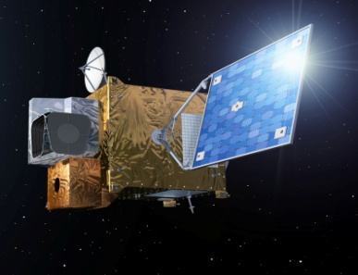
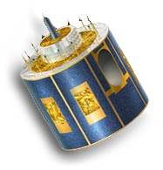
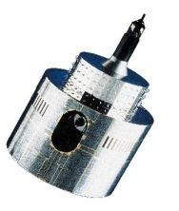
MTG to Secure Continuity of EUMETSAT Services
1977
2002
2016 and 2018
MOP/MTP
MSG
MOP/MTP
MSG
MTG-I and MTG-S
Observation missions:
- Flex.Comb. Imager: 16 channels
- Infra-Red Sounder
Lightning Imager
UVN
3-axis stabilised satellites
Twin Sat configuration
Class 2,5 - 3 ton
Observation missions:
- SEVIRI: 12 channels
GERB
Spinning satellite
Class 2-ton
Observation mission:
MVIRI: 3 channels
Spinning satellite
Class 800 kg
Implementation of the EUMETSAT Mandate
for the Geostationary Programme
Atmospheric Chemistry Mission (UVN-S4):
via GMES Sentinel 4

Slide 46
MTG Phase B System Conept Council decision at the 65th meeting
Phase B MTG Configuration
Twin Satellite Concept, based on 3-axis platforms
Imaging Satellites (MTG-I)
Sounding Satellites (MTG-S)
The payload complement of the MTG-I satellite consists of
• The Flexible Combined Imager (FCI), includes FDHSI
• …
Full Disk High Spectral resolution Imagery (FDHSI), global scales (Full Disk) over a repeat cycle of 10 min, with 16 channels, at spatial resolution of 1 km (8 solar channels) and 2 km (8 thermal channels)
MTG System specified to be operated in-orbit for 20 years, compared to 15 years for MSG.

Slide 47
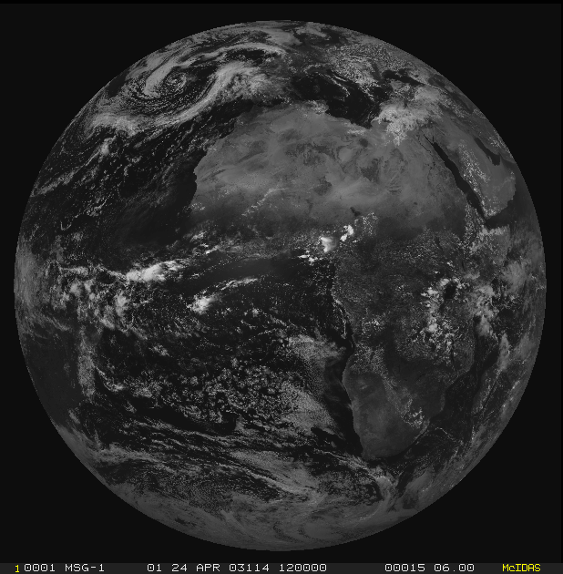


From MVIRI through SEVIRI to FCI on MTG
1=VIS0.6
12=HRV
2=WV6.2
3=IR10.8

Slide 48









From MVIRI through SEVIRI to FCI on MTG
1=VIS0.6
2=VIS0.8
12=HRV
3=NIR1.6
4=IR3.8
5=WV6.2
6=WV7.3
7=IR8.7
8=IR9.7
9=IR10.8
10=IR12.0
11=IR13.4

Slide 49

From MVIRI through SEVIRI to FCI on MTG
1=VIS0.4
2=VIS0.5
3=VIS0.6
4=VIS0.8
5=NIR0.9
6=NIR1.3
7=NIR1.6
8=NIR2.2
9=IR3.8
10=WV6.2
11=WV7.3
12=IR8.7
13=IR9.7
14=IR10.5
15=IR12.3
16=IR13.3

Slide 50








From SEVIRI to the FC Imager all SW channels at least at 1 km – 2 also at 500 m
VIS - 0.4
1 km
Aerosols
VIS – 0.5
1 km
Aerosols
FDHSI
&
HRFI
VIS - 0.6
0.5 km and 1 km
Surface Albedo
VIS - 0.8
1 km
Vegetation
New
New
NIR – 0.9
1 km
Total column
precipitable water
NIR - 1.3
1 km
Cirrus Clouds
NIR - 1.6
1 km
Snow/Ice/Phase
FDHSI
&
HRFI
NIR - 2.2
0.5 km and 1 km
Particle Size
Aerosols
New
New
New

Slide 51








From SEVIRI to the FC Imager all IR channels at least at 2 km – 2 also at 1 km
IR - 3.8
1 km and 2 km
Cloud µφ
Fire Applications
IR - 6.2
2 km
UT Water Vapour
IR - 7.3
2 km
MT Water Vapour
(Upper Level SO₂)
IR - 8.7
2 km
Cloud Phase
Volcanic Ash
Fire Applications
FDHSI
&
HRFI
IR - 9.7
2 km
Total Ozone
IR - 10.5
1 km and 2km
Surface Temperature
IR - 12.3
2km
Low Level Moisture
IR - 13.3
2 km
Cloud Top Height
FDHSI
&
HRFI

Slide 52


SEVIRI versus FCI on MSG and MTG MTG-FC Delivers Information on Smaller Scales
MSG
MTG Simulation
2005 06 25 11:57

Slide 53
LSA SAF Strategy for CDOP-2
Product & Service Continuation
Maintenance, quality monitoring & validation of MSG & EPS inherited products
Upgrade of existing algorithms for MTG data
New Algorithms / Products aim to:
Overcome known deficiencies of current products
Address requests from user community
Land surface modelling (carbon fluxes, hydrology)
Agriculture and forest applications
NWP
Climate studies
Environmental monitoring
Food security

Slide 54
User support
Toolbox to allow more friendly handling of data (NRT / off-line):
Selection of time window for processing
Definition of Regions of Interest and Projections
Product/channel selection
Data / image format

Training:
Applications of LSA SAF products
To be carried out in cooperation with other programmes (e.g., EUMETrain, EUMETSAT)

Slide 55
LSA SAF products and MTG
LSA SAF will use radiances from the (Full Disk) Imagery Mission, (SEVIRI follow-up)
Better spatial resolution will be of benefit to all LSA SAF products
Enhanced spectral characteristics vs. SEVIRI
FD-VIS 0.4 Better aerosol, should improve AL, SW flux, but also LW flux and LST
FD-IR 3.8/8.5 Extended dynamical range for fire applications
FD-IR 1.3 et al Improved cloud mask and cloud type specification
Impact on products
All products, given better clouds
Fire products
AL, radiative fluxes and LST, cascading into other products (VEGA, ET)
More competitive VEGA products with enhanced spatial resolution

Slide 56
CDOP-2 new products: A sample
Family | Product
LST & Emiss. | Isotropic LST, All weather LST, Reprocessed LST
Albedo | Soil / vegetation / snow free Albedo, Reprocessed Albedo
Surface radiation fluxes | Total and diffuse DSSF, Net LW radiation
Turbulent heat fluxes | Reference evapotranspiration, Sensible heat flux, and Latent heat flux
Vegetation parameters & properties | Vegetation index, Net Primary Production, Gross Primary Production, Canopy water content
Wild Fire Products | FRP pixel bias correction, Burnt area/vegetation recovery, Daily Fire Radiative Energy / Carbon Emissions, Reprocessed Fire Radiative Power

Slide 57
Summary, conclusions and perspectives
Aalgorithm development, validation and operational production of land surface related products from remote sensing data, with a particular emphasis on EUMETSAT satellites:
LAND
LAND-ATMOSPHERE Interactions
Land Biosphere Applications
Outlook
Strenghten our links with users, emphasis on collaborative efforts with key users, including targeted training efforts
CDOP-2 and plans for the upcoming MTG products
Product dissemination
Daily from our web site (http://landsaf.meteo.pt)
EUMETCAST
Further information
http://landsaf.meteo.pt
Trigo et al. 2011, Int. J. Rem. Sens., 32, 2725-2744
Other papers in the web site

Slide 58
Summary, conclusions and perspectives
Aalgorithm development, validation and operational production of land surface related products from remote sensing data, with a particular emphasis on EUMETSAT satellites:
LAND
LAND-ATMOSPHERE Interactions
Land Biosphere Applications
Outlook
Strenghten our links with users, emphasis on collaborative efforts with key users, including targeted training efforts
CDOP-2 and plans for the upcoming MTG products
Product dissemination
Daily from our web site (http://landsaf.meteo.pt)
EUMETCAST
Further information
http://landsaf.meteo.pt
Trigo et al., 2011, Int. J. Rem. Sens., 32, 2725-2744
Other papers in the web site
The users (you !) are on the driving seat

