Slide 1
LSA-SAF Event Week 2011
Session 6
ACTIVE FIRES AND BURNT AREAS
Carlos C. DaCamara
Associate Professor
IDL – University of Lisbon
Email: cdcamara@fc.ul.pt

Slide 2
BACKGROUND
Let us recall that the LSA SAF is currently disseminating on an operational basis the following products:

Slide 3
BACKGROUND
Let us recall that the LSA SAF is currently disseminating on an operational basis the following products:
the Fire Risk Mapping (FRM) product, that provides daily maps of meteorological fire risk over Mediterranean Europe;

Slide 4
BACKGROUND
Let us recall that the LSA SAF is currently disseminating on an operational basis the following products:
the Fire Risk Mapping (FRM) product, that provides daily maps of meteorological fire risk over Mediterranean Europe;
the Fire Detection and Monitoring (FD&M) product, that provides a continuous monitoring of fire activity over Africa and Europe;

Slide 5
BACKGROUND
Let us recall that the LSA SAF is currently disseminating on an operational basis the following products:
the Fire Risk Mapping (FRM) product, that provides daily maps of meteorological fire risk over Mediterranean Europe;
the Fire Detection and Monitoring (FD&M) product, that provides a continuous monitoring of fire activity over Africa and Europe;
the Fire Radiative Power (FRP) product that allows the estimation of carbon emissions from the vegetation fires.

Slide 6
LSA-SAF Event Week 2011
Session 6
Part 1
THE FD&M PRODUCT
Carlos C. DaCamara
Associate Professor
IDL – University of Lisbon
Email: cdcamara@fc.ul.pt

Slide 7
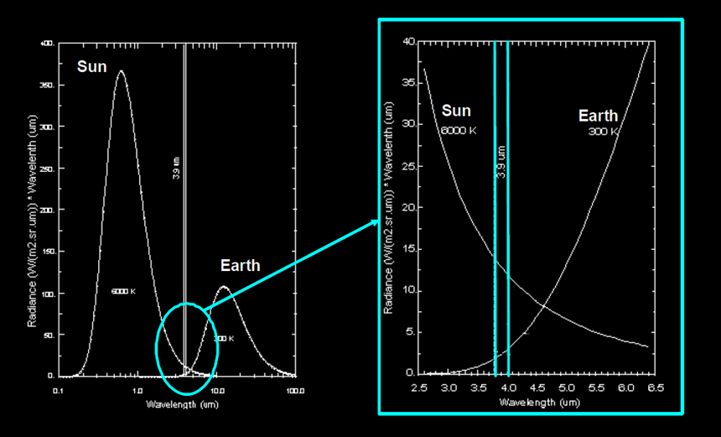
What is the 3.9 μm chanel?

Slide 8
Why is the 3.9 μm suitable?
451ºF = 233ºC = 506 K

Slide 9
Why is the 3.9 μm suitable?
WIEN’s DISPLACEMENT LAW
451ºF = 233ºC = 506 K

Slide 10
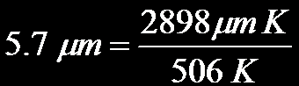
Why is the 3.9 μm suitable?
WIEN’s DISPLACEMENT LAW
451ºF = 233ºC = 506 K

Slide 11
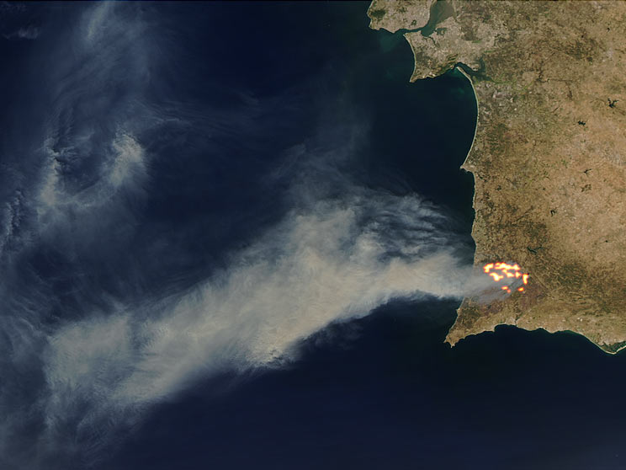
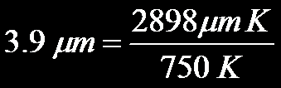
Why is the 3.9 μm suitable?
750 K

Slide 12
FiDAlgo
FD&M relies on FiDAlgo (Fire Detection Algorithm), an operational procedure that allows active fire detection in near-real-time, based on information from Meteosat-8/SEVIRI.

Slide 13
FiDAlgo
FD&M relies on FiDAlgo (Fire Detection Algorithm), an operational procedure that allows active fire detection in near-real-time, based on information from Meteosat-8/SEVIRI.
FiDAlgo is based on contextual algorithms that have been successfully developed for different sensors, namely NOAA/AVHRR and AQUA-TERRA/MODIS.

Slide 14
FiDAlgo
The procedure takes full advantage of information from Meteosat-8/SEVIRI, namely the improved characteristics:
in the temporal domain (one image every 15 minutes);
in the spatial domain (a sampling distance of 3 km at the sub-satellite point);
and in the spectral domain (12 channels).

Slide 15
FiDAlgo
Meteosat-8/9 data
1- Pre-processing
Land-water mask
Desert, urban zones and volcanoes mask
Channel | Purpose
R(0.6) | Cloud detection
R(0.8) | Cloud detection High reflective surfaces Sun Glint
Tb(3.9) | Active fire detection
Tb(10.8) | Active fire detection
Tb(12.0) | Cloud detection
2- Selection of potential fire pixels
3- Detection of contaminated pixels
Clouds
Highly reflective surfaces
Sun glint
4- Confirmation of active fire pixels
Contextual test

Slide 16
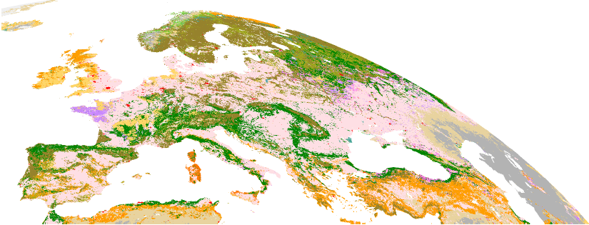
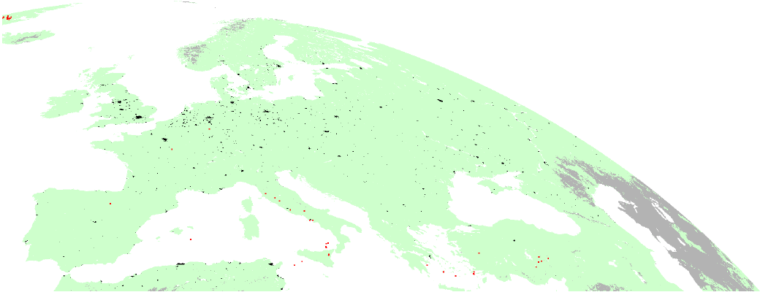
FiDAlgo
Landcover: GLC2000
Meteosat-8/9 data
1- Pre-processing
Land-water mask
Desert, urban zones and volcanoes mask
2- Selection of potential fire pixels
3- Detection of contaminated pixels
Clouds
Highly reflective surfaces
Sun glint
4- Confirmation of active fire pixels
Contextual test
Urban : Class 22 (black)
Desert: Class 19 (grey)
Water: Class 20 (white)
Volcanoes: Glob. Volc. Progr. (red)

Slide 17
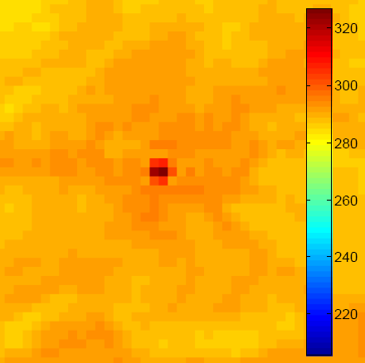
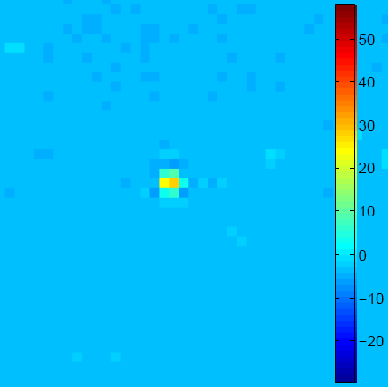
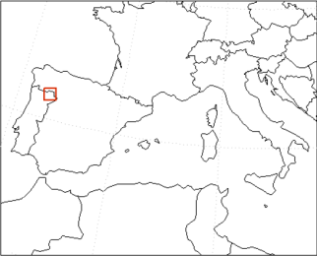
FiDAlgo
Tb(3.9)
Tb(3.9)-Tb(10.8)
Meteosat-8/9 data
1- Pre-processing
Land-water mask
Desert, urban zones and volcanoes mask
2- Selection of potential fire pixels
3- Detection of contaminated pixels
Clouds
Highly reflective surfaces
Sun glint
02/08/2008 – 20:00
Selection of pixels likely to contain an active fire may be achieved by applying appropriate thresholds to MIR and to differences between MIR and IR channels, on a pixel-by-pixel basis;
4- Confirmation of active fire pixels
Contextual test

Slide 18
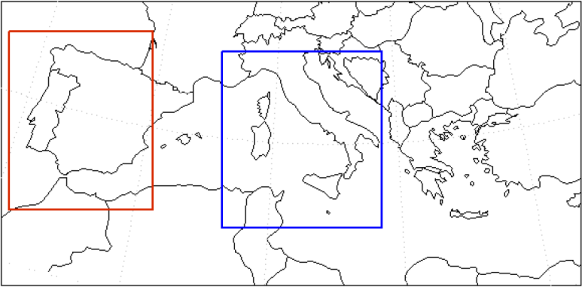
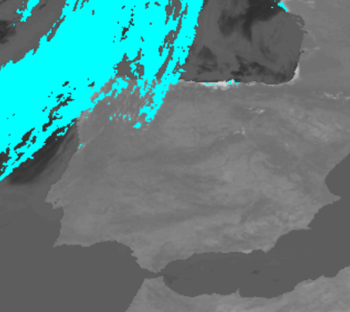
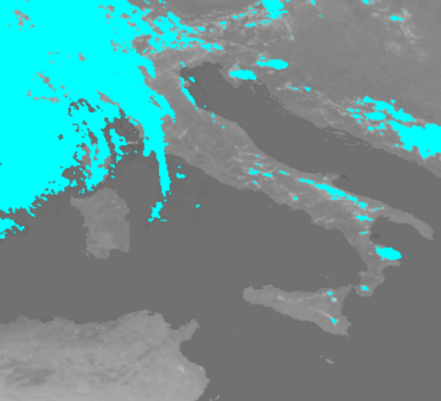
FiDAlgo
Cloud detection is based on the methodology developed by Saunders and Kriebel (1988).
Meteosat-8/9 data
1- Pre-processing
Land-water mask
Desert, urban zones and volcanoes mask
2- Selection of potential fire pixels
R(0.6)
R(0.6)
3- Detection of contaminated pixels
Clouds
Highly reflective surfaces
Sun glint
4- Confirmation of active fire pixels
Contextual test
01/07/2008 – 10:00
03/07/2008 – 12:00

Slide 19
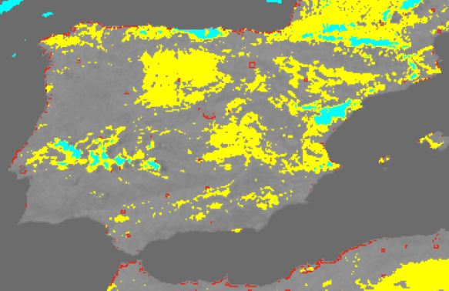
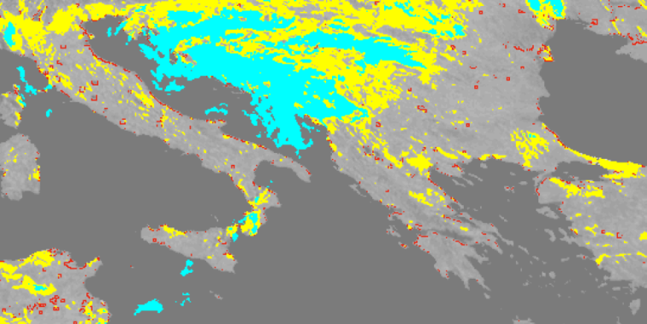
FiDAlgo
Meteosat-8/9 data
A given pixel is considered to be contaminated by sun glint if neighbouring pixels are 1) water bodies, 2) sparsely vegetated, 3) bare soils or 4) contaminated by clouds and if during daytime it fulfills the condition SZA > 40° and R(0.8) > 0.20
1- Pre-processing
Land-water mask
Desert, urban zones and volcanoes mask
2- Selection of potential fire pixels
3- Detection of contaminated pixels
Clouds
Highly reflective surfaces
Sun glint
REF(0.8)
REF(0.8)
4- Confirmation of active fire pixels
Contextual test
10/08/2008 – 06:00
25/08/2008 – 06:30

Slide 20
FiDAlgo
1- Definition of the background
Meteosat-8/9 data
The background is defined as a 5x5 pixel grid centered at the potential fire pixel.
1- Pre-processing
Land-water mask
Desert, urban zones and volcanoes mask
Valid background pixels are all those that were:
Neither masked in previous steps;
Nor identified as potential fire.
2- Selection of potential fire pixels
3- Detection of contaminated pixels
Clouds
Highly reflective surfaces
Sun glint
The number of valid neighbouring pixels in the grid must be at least three;
If there is an insufficient number of valid surrounding pixels, statistics are not computed and the pixel is kept classified as potentially containing a fire.
4- Confirmation of active fire pixels
Contextual test

Slide 21
FiDAlgo
2- Background statistics
Meteosat-8/9 data
Valid background pixels are used to compute a set of statistics that characterize the background, namely the mean and the absolute mean deviation of Tb(3.9) and ∆T, where: ∆T = Tb(3.9)-Tb(10.8)]
1- Pre-processing
Land-water mask
Desert, urban zones and volcanoes mask
3- Confirmation of active fire in central pixel
2- Selection of potential fire pixels
3- Detection of contaminated pixels
Clouds
Highly reflective surfaces
Sun glint
A potential fire pixel (central pixel in the grid) is confirmed as a pixel containing an active fire by comparing its spectral signature [Tb(3.9) and ∆T] against the radiative properties of the respective background.
4- Confirmation of active fire pixels
Contextual test
A full description of the algorithm may be found in:
Amraoui, M., C.C. DaCamara, & Pereira, J.M.C. (2010). Detection and monitoring of African vegetation fires using MSG-SEVIRI imagery. Remote Sensing of Environment, 114 (5), 1038-1052.

Slide 22
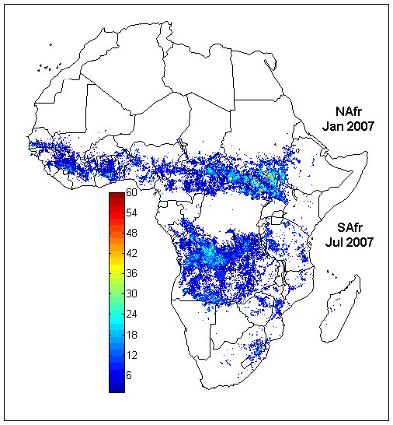
General results
AFRICA 2007
 | NAfr | SAfr
Active fires | 370239 | 325923
Fire pixels | 72536 | 73848
Fire pixels over North African (Nafr) and South African (Safr) windows, respectively during January and July 2007.
The color bar indicates, for each fire pixel, the number of identified active fires.

Slide 23
General results
MEDITERRANEAN EUROPE 2007
 | Summer 2007
Active fires | 31772
Fire pixels | 4195
Persistence of fires is given by the colour of the pixel:
Magenta: less than 2 hours
Green: between 2 to 10 hours
Black: above 10 h

Slide 24
General results
MEDITERRANEAN EUROPE 2008
 | Summer 2008
Active fires | 10497
Fire pixels | 3233
Persistence of fires is given by the colour of the pixel:
Magenta: less than 2 hours
Green: between 2 to 10 hours
Black: above 10 h

Slide 25
General results
MEDITERRANEAN EUROPE 2009
 | Summer 2009
Active fires | 17579
Fire pixels | 2976
Persistence of fires is given by the colour of the pixel:
Magenta: less than 2 hours
Green: between 2 to 10 hours
Black: above 10 h

Slide 26
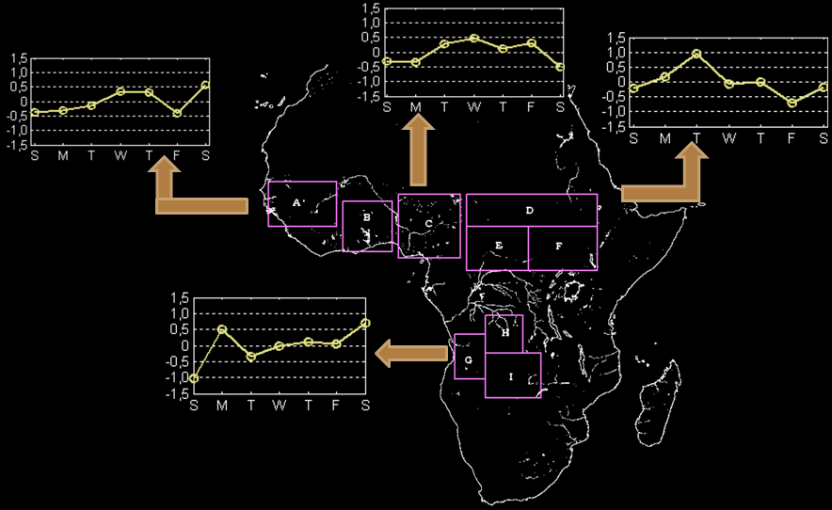
An unusual application: weekly fire activity…

Slide 27
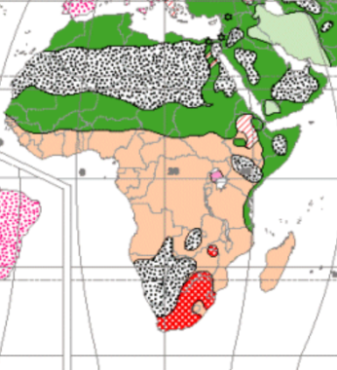
i.e. …

Slide 28
RELIGIONS FROM SPACE!
ISLAMIC
ANIMIST
ISLAMIC
CHRISTIAN

Slide 29
LSA-SAF Event Week 2011
Session 6
Part 2
BURNT AREAS
Carlos C. DaCamara
Associate Professor
IDL – University of Lisbon
Email: cdcamara@fc.ul.pt

Slide 30
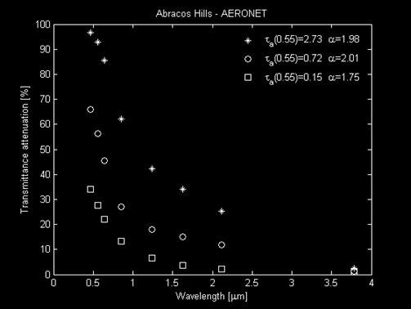
Why is MIR useful?
Is MIR perturbed by smoke?

Slide 31
Why is MIR useful?
MIR domain is seldom affected by smoke, allowing for unperturbed surface observations.
This is relevant during the dry season, when the atmosphere is very contaminated by smoke.

Slide 32
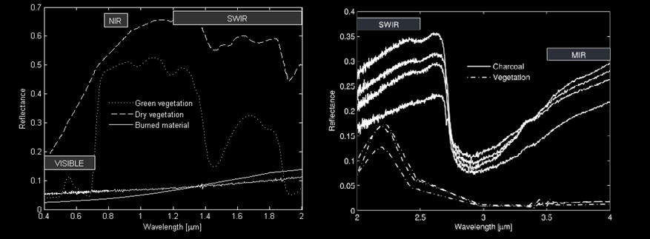
Why the MIR/NIR domain?
Is VIS a good discriminator of burned areas?

Slide 33
Why the MIR/NIR domain?
Is VIS a good discriminator of burned areas?
And SWIR?

Slide 34
Why the MIR/NIR domain?
Is VIS a good discriminator of burned areas?
And SWIR?
And NIR?

Slide 35
Why the MIR/NIR domain?
Is VIS a good discriminator of burned areas?
And SWIR?
And NIR?
And MIR?

Slide 36
Why the MIR/NIR domain?
In VIS, charcoal is mixed up with dense dark vegetation, water, dark soils, wetlands, cloud and terrain shadows.
Similar problems occur in the SWIR region.
MIR/NIR is the best bi-spectral region to discriminate between burned areas and other types of surfaces.

Slide 37
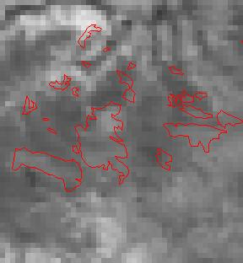
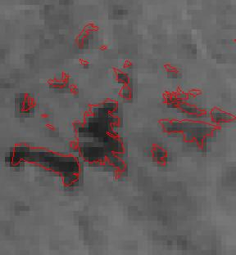
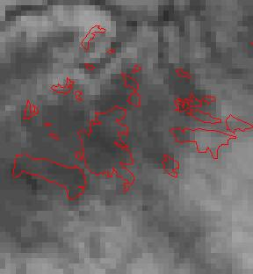
Why MIR/NIR domain?
RED
NIR
SWIR

Slide 38
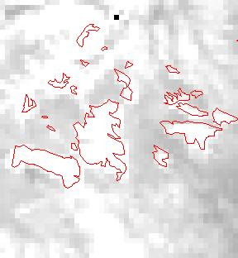
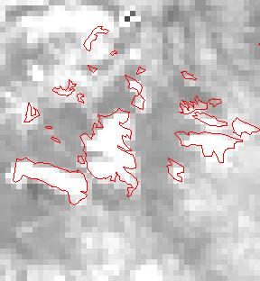
Why MIR/NIR domain?
RAD MIR
REFL MIR

Slide 39
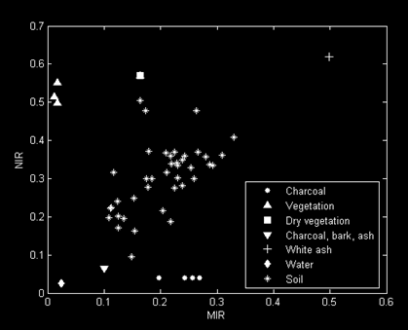
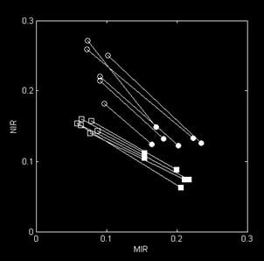
Towards an optimal index
Different materials/surfaces tend to form clusters in the MIR/NIR space
There is an overall displacement along the diagonal of the graph, up from vegetation down to burned materials across the soil surfaces
Laboratory measurements
MODIS pixels
Pre-fire
Post-fire

Slide 40
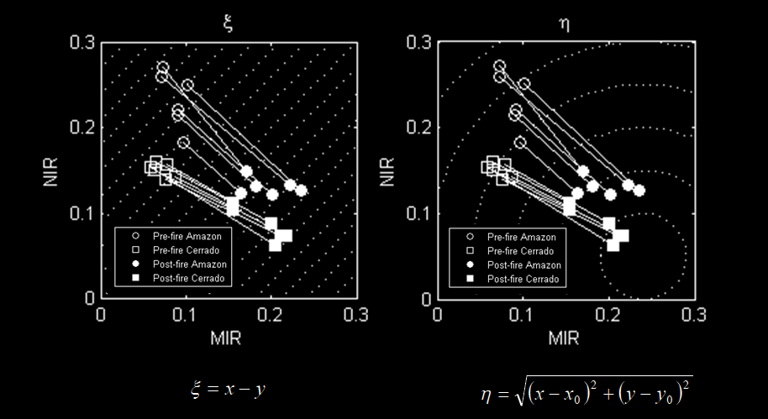
Towards an optimal index

Slide 41
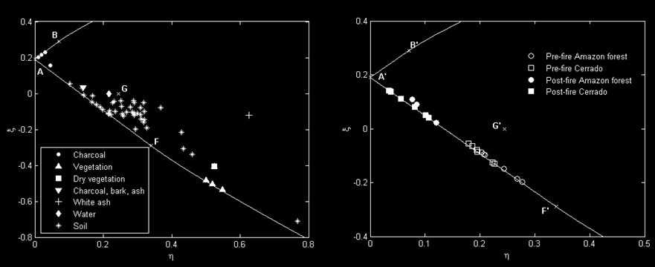
Development of a new space
There is a “natural constrain” in η/ξ space
Surfaces related to vegetation seem to align according to water content.
Other kind surfaces are dispersed outside the line

Slide 42
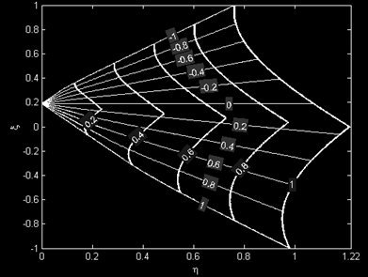
Development of a new index
Kite domain
V
W
V
The borders of the kite domain are coordinate curves
V - linear dependence on η
W – arc lengths along V

Slide 43
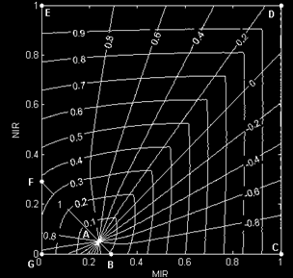
Development of a new index
Kite domain
Spider web
V
V
W
W
V
The borders of the kite domain are coordinate curves
Convergent point - Charcoal
MIR=0.24
NIR=0.03
V - linear dependence on η
W – arc lengths along V

Slide 44
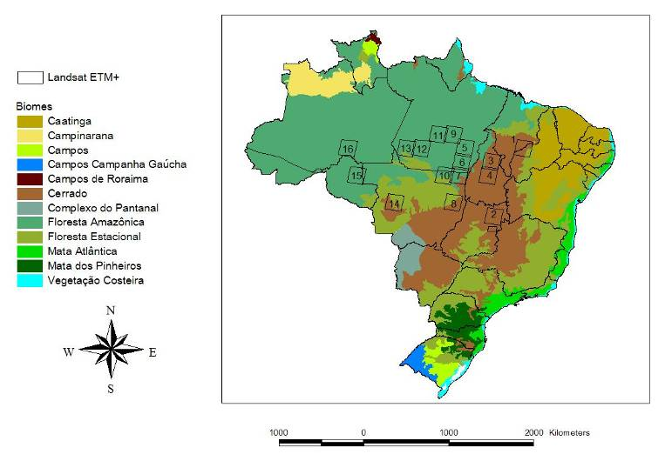
Validation – study area

Slide 45
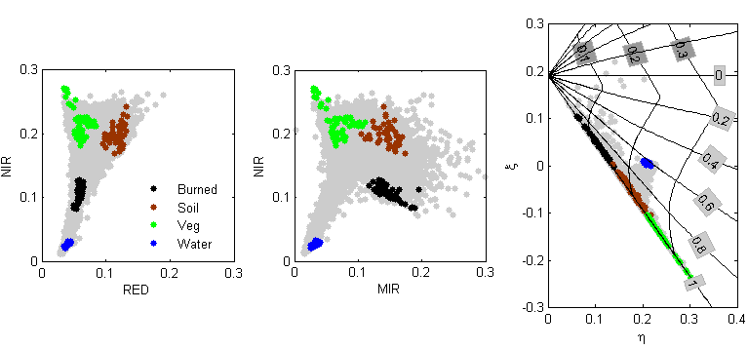
Validation
Cerrado
Supervised
Validation

Slide 46
Validation
Cerrado
Supervised
Validation

Slide 47
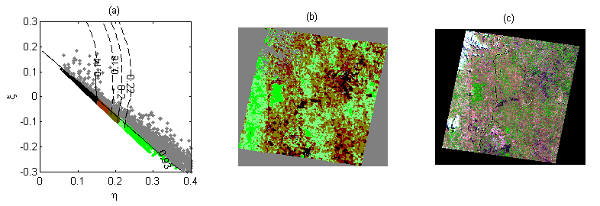
Validation
Cerrado
Supervised
Validation
V - cluster 1
Unsupervised
Validation
K-means
V – 2 clusters
W – 4 clusters
V - cluster 2
K-means in W (4 clusters)
W values
(grays pixels excluded by V)
RGB (543) Landsat
Ground truth

Slide 48
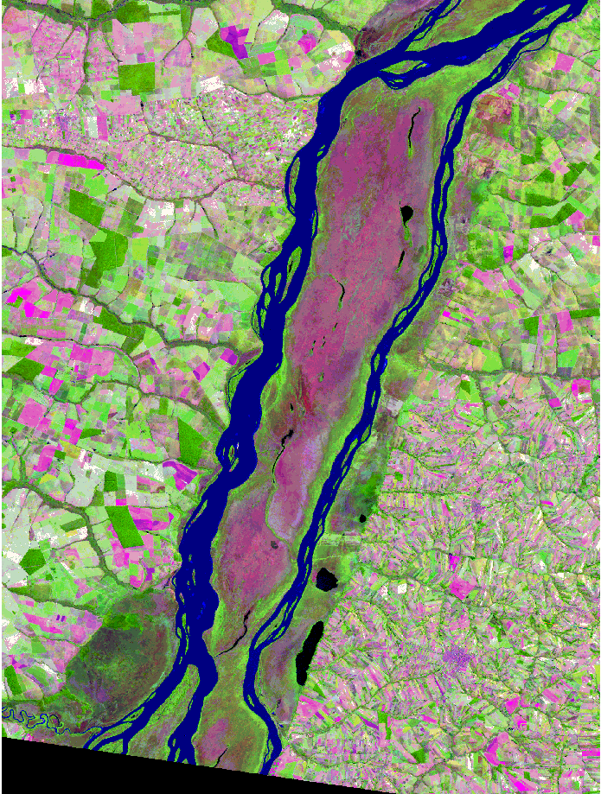
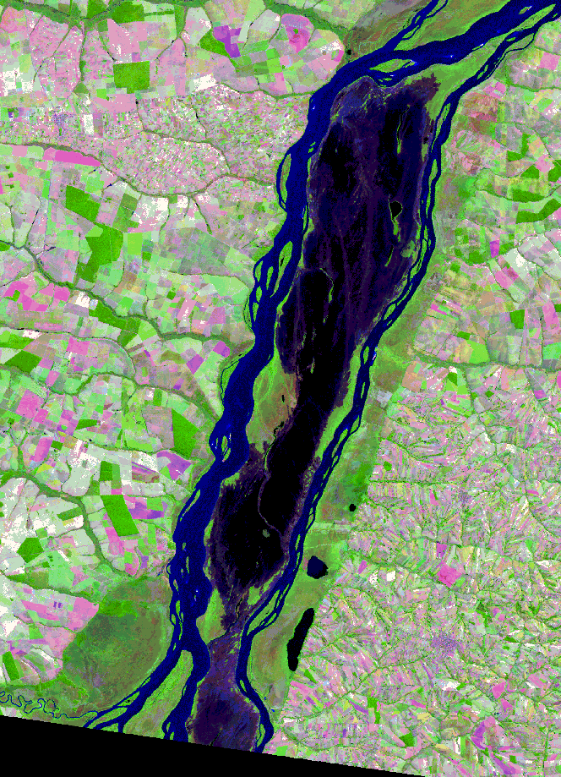
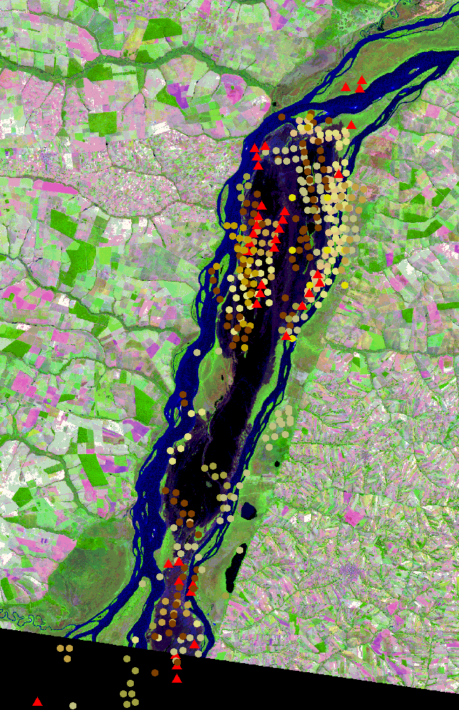
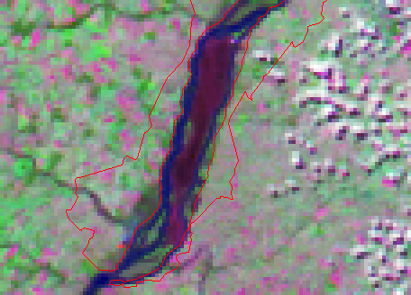
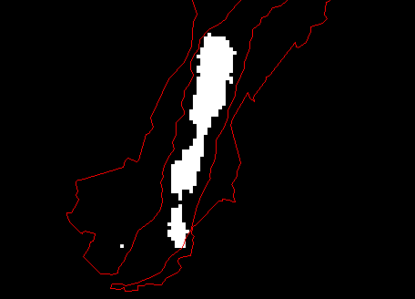
An Application
26th April
Parque Nacional Ilha Grande - PR
12th May
Hot spots
INPE
Landsat-TM (RGB 543)
MODIS RGB 721
12/MAIO
Simple threshold:
V>0.8 AND W<0.25

Slide 49
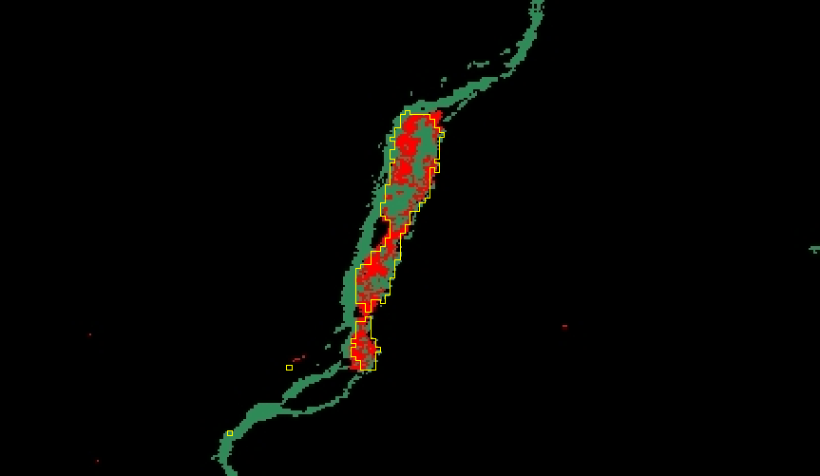
An Application
Parque Nacional Ilha Grande – PR – Brazil
MOD45
Index(V,W)
Simple threshold:
V>0.8 AND W<0.25

Slide 50
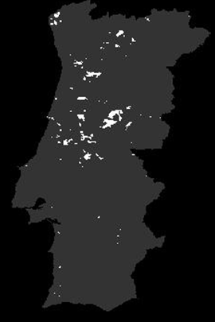
Pre- and post-fire vegetation dynamics
Gorgeous Year (GY)
Burnt areas in 2005

Slide 51
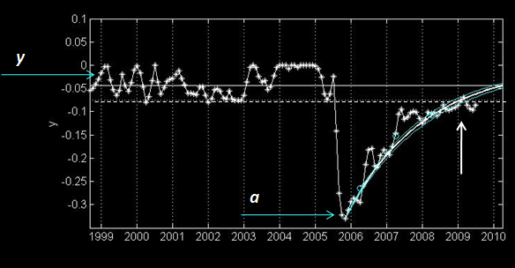
Model of post-fire vegetation recovery
t_{R}
a ⬄ recovery rate
t_{R} ⬄ recovery time

Slide 52
An application
Post-fire vegetation dynamics
t_{R}

Slide 53
An application
Post-fire vegetation dynamics
Fire damage
t_{R}
Is there any plausible relationship between recovery time and fire damage?

Slide 54
An application
Post-fire vegetation dynamics
Fire damage
t_{R}
Spatial patterns of recovery time seem to de determined by fire damage.

