Slide 1
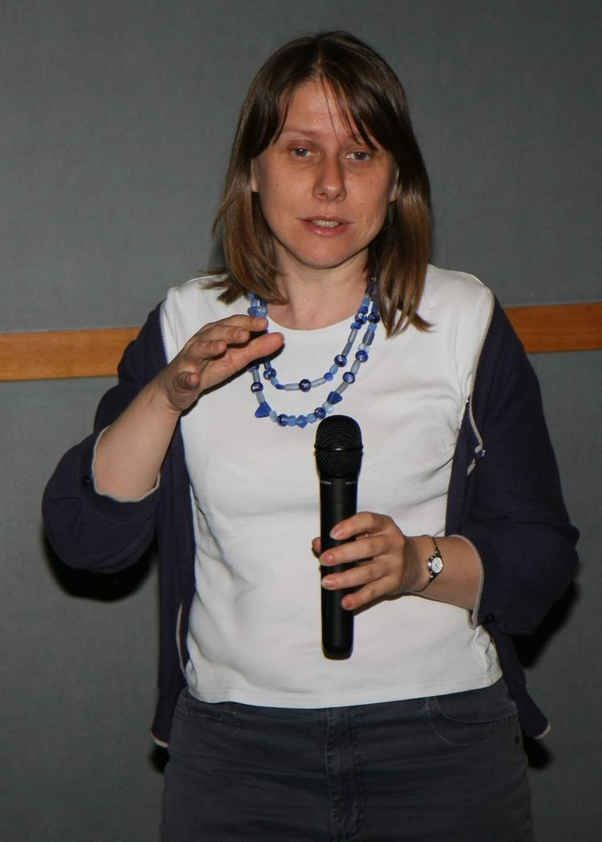
Sea surface height variation & mean sea level applications from radar altimetry
Vinca Rosmorduc, CLS / Aviso

Slide 2
Aviso?
Archiving, Validation and Interpretation of Satellite Oceanographic data
French Distributing and Archiving center for satellite altimetry data since 1992 (Topex/Poseidon launch)
Distribution of Altimetry & Doris precise location data
User Helpdesk
Information about Altimetry & Doris,
Promotion of users’ work
Outreach
http://www.aviso.oceanobs.com
aviso@oceanobs.com

Slide 3
Altimetry applications
Geodesy & geophysics
  Bathymetry
  Geodesy
  Tsunami
Ocean
  Large-scale circulation
  Ocean currents and eddies
  Operational oceanography
  Tides
  Mean Sea Level
Ice
  Ice sheets
  Sea ice
Climate
  ENSO
  NAO
  Decadal oscillations
Atmosphere, wind & waves
  Wind & waves
  Cyclones
  Rain
Hydrology & land
  Lake level
  Land
  River level
Coastal

Slide 4
Altimetry applications
Geodesy & geophysics
  Bathymetry
  Geodesy
  Tsunami
Ocean
  Large-scale circulation
  Ocean currents and eddies
  Operational oceanography
  Tides
  Mean Sea Level
Ice
  Ice sheets
  Sea ice
Climate
  ENSO
  NAO
  Decadal oscillations
Atmosphere, wind & waves
  Wind & waves
  Cyclones
  Rain
Hydrology & land
  Lake level
  Land
  River level
Coastal

Slide 5

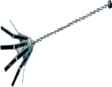








Past & current altimetry missions
First missions as early as the 70s: proof of concept
Geosat (1985-1989) first conclusive one
Since 1991-92, two continuous time series (ERS-1, ERS-2 & Envisat;
Topex/Poseidon, Jason-1, Jason-2)
Several missions planned in the future years, including ones using new concepts
Launches
1973 1978 1985 1991 1992 1995 1998 2001 2002 2008 2010 2011
Skylab Geos-3 Geosat ERS-1 Topex ERS-2 GFO Jason-1 Envisat Jason-2 Cryosat HY-2A
Seasat Poseidon
1974 1978 1989 1996 2006 2011 2008
Mission ends
Notes:
À mettre à jour

Slide 6
Satellite altimeters - present to future
Past missions (since 1991)
  France (CNES)/ USA (NASA) Topex/Poseidon(1992-2006)
  Europe (ESA) ERS-1 & 2 (1991-1996, 1995-2011)
  US Navy GFO
Altimeters in Orbit (October 2011)
  France (CNES)/ USA (NASA) Jason-1 (2001)
  Europe (EUMETSAT)/ France (CNES)/ USA (NASA/NOAA) Jason-2 (2008)
  Europe (ESA) Envisat, Cryosat-2 (2010)
  China (SOA) HY-2A (calibration phase) (2011)
Altimeters in Development
  India (ISRO)/France (CNES) SARAL – April 2012
  Europe (ESA) Sentinel-3A – 2013 – 1st of two
  Europe (EUMETSAT)/ France (CNES) /USA (NOAA) Jason-3 – 2014
  Europe (EUMETSAT, ESA) / France (CNES)? /USA (NOAA) Jason-CS 2017
  France (CNES)/U.S. (NASA) SWOT 2019

Slide 7
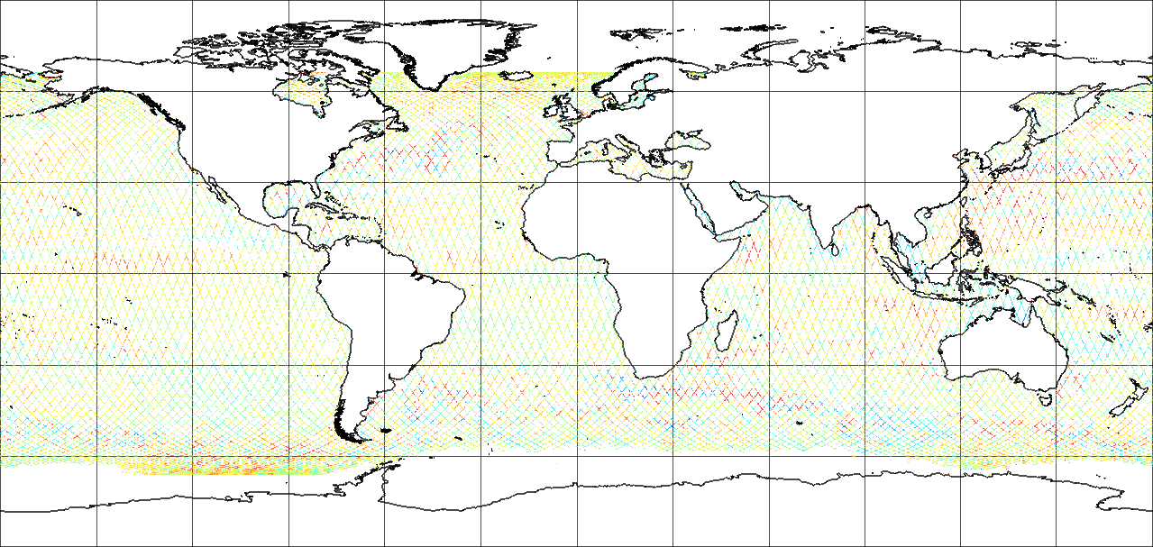
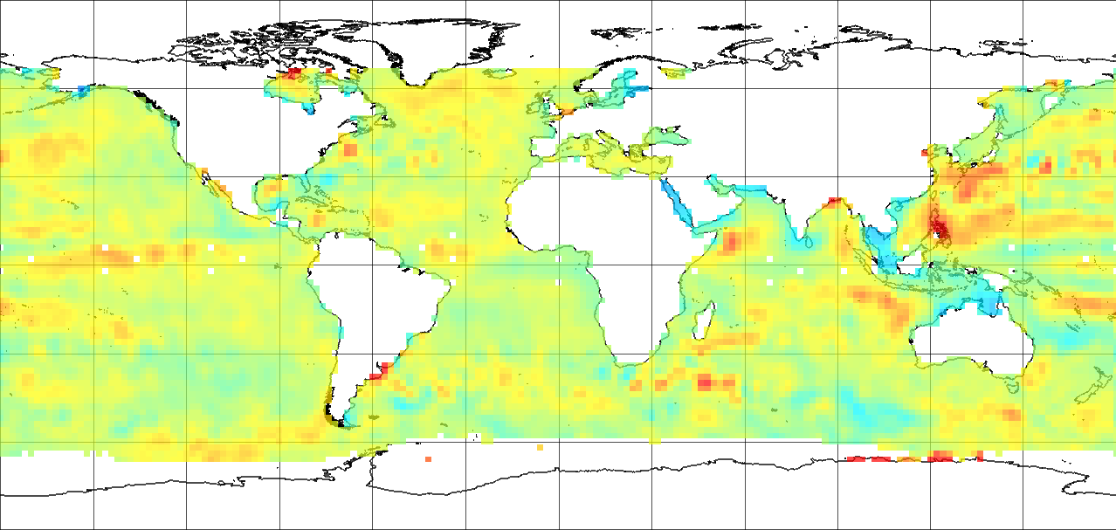
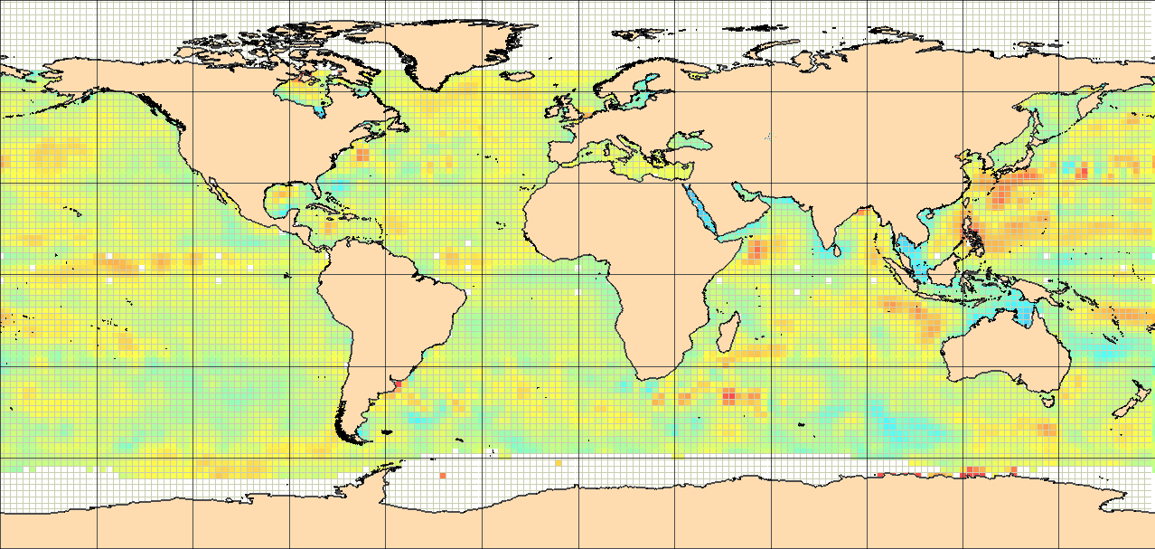
Data used
In the following, we will consider mostly results from “gridded merged sea level anomalies”
Gridded : the native altimetry data are a narrow thread, measured just under the satellite. However, one can interpolate between the track to generate a lon,lat grid of data
Merged: use of the data from several satellites at the same time
Along-track
Grid

Slide 8
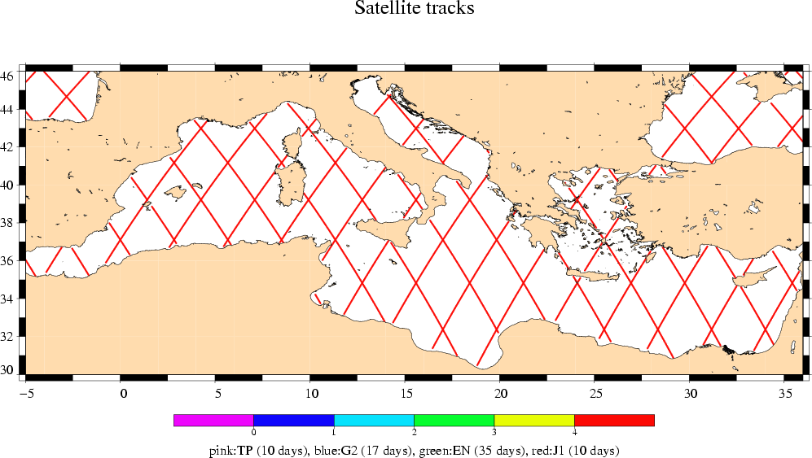
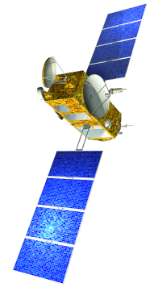
Merging several satellites: why?
Track selection for 4-19 Nov 2002
JASON

Slide 9
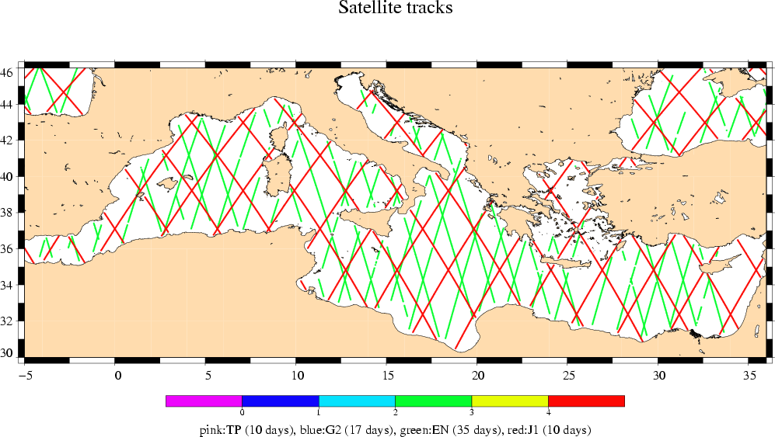
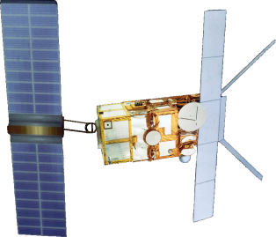
Merging several satellites: why?
Track selection for 4-19 Nov 2002
ERS/Envisat
JASON

Slide 10
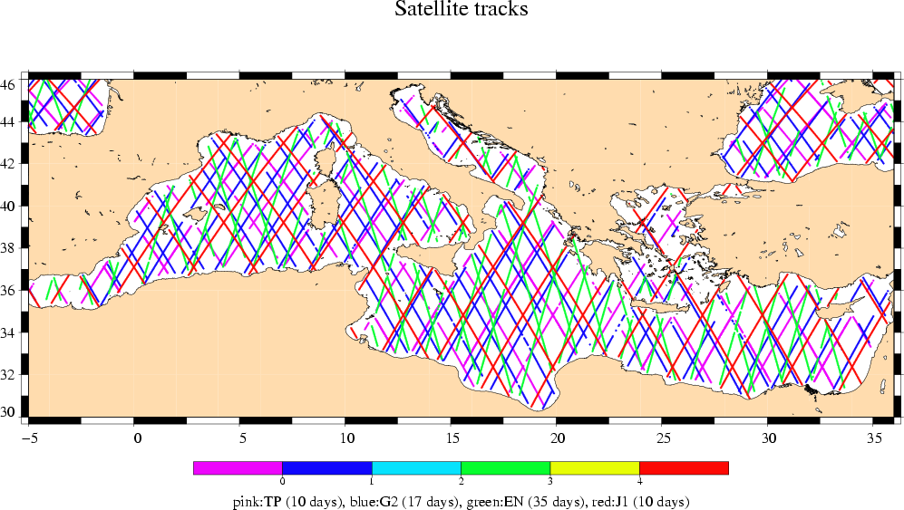
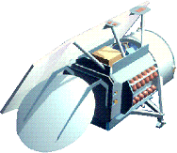
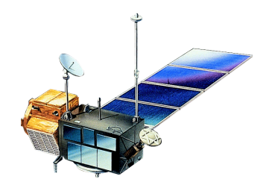
Merging several satellites: why?
Track selection for 4-19 Nov 2002
GFO
TP
ERS/Envisat
JASON

Slide 11
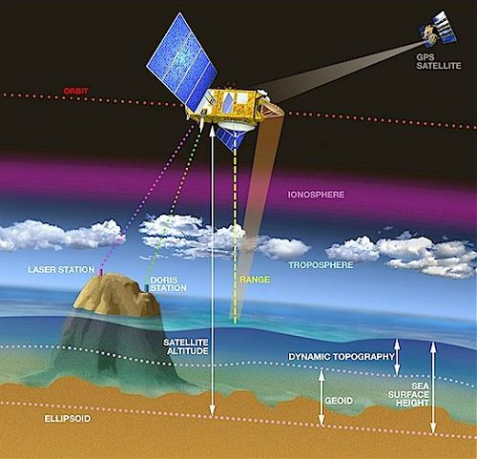
The principle of Altimetry
Satellite altimetry enables ocean topography (relief) and its variations to be determined to within a few centimetres.
Ocean topography , or “Sea Surface Height” is the difference between the satellite-to-ocean range (calculated by measuring the signal’s round-trip time) and the satellite’s position on orbit with respect to an arbitrary reference surface (a raw approximation of the Earth’s surface, called the reference ellipsoid)
Animation

Slide 12
Sea Level Anomalies
Sea Level Anomalies =
SSH – SSH_{mean}
SSH – MSS
SSH – (Mean Dynamic Topography + geoid)
= Sea surface height variations
Which reflects:
Temperature variations
Salinity variations
Currents variations
El Niño
Eddies and ocean circulation variations
Seasons
…
SLA
Mean
Sea
Surface
(SSH)

Slide 13
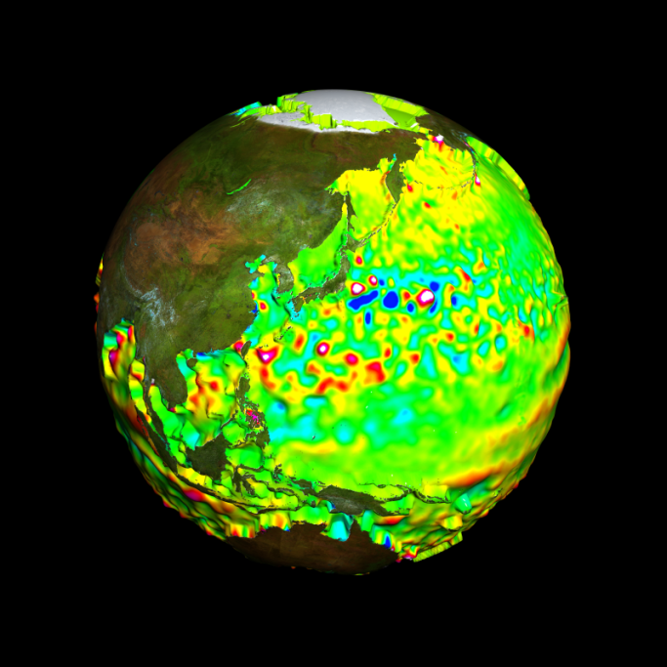
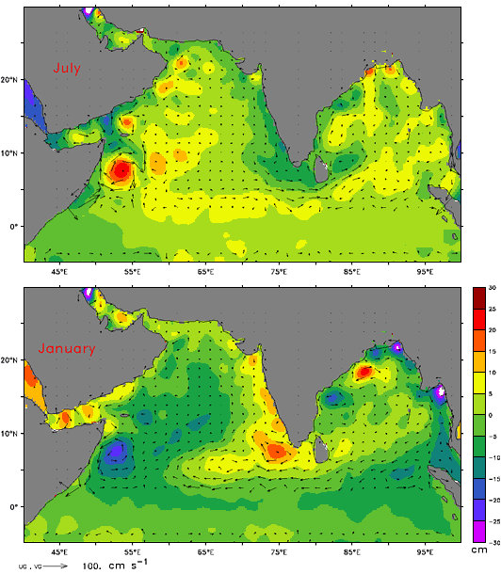
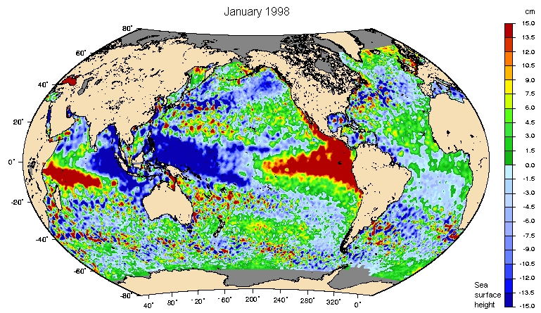
What can Sea Level Anomalies show?
Eddies (e.g. Kuroshio)
Monsoon-linked changes
El Niño

Slide 14
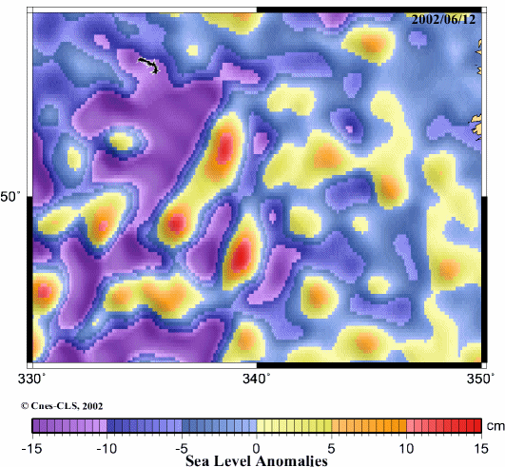
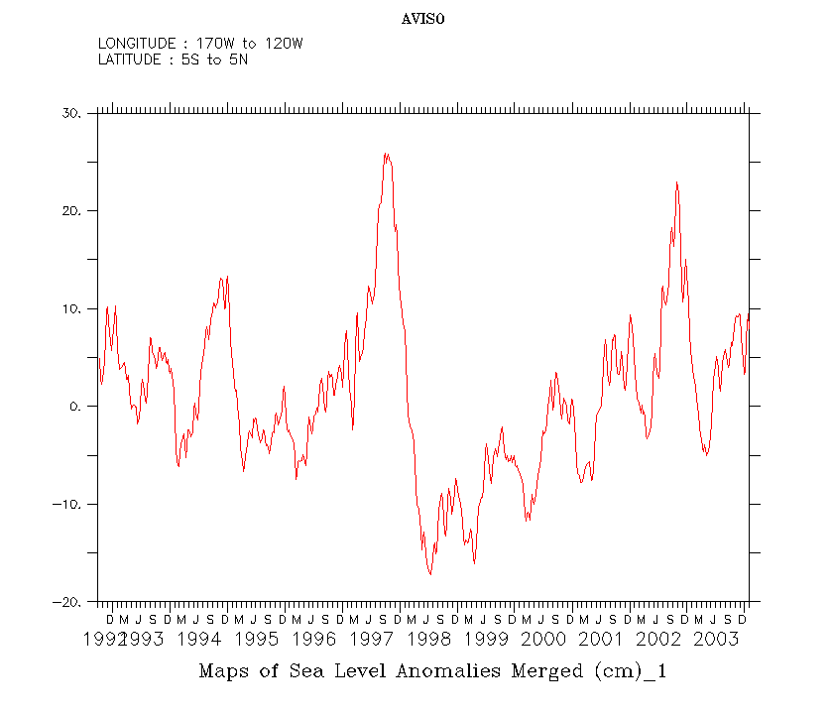
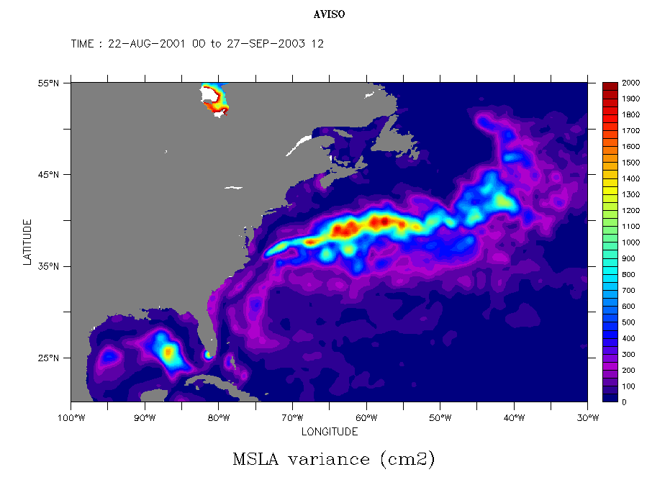
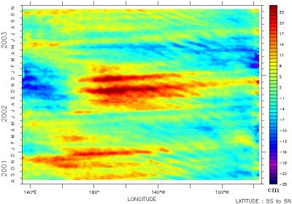
Eddies and buoys
El Niño year after year
Variance in the Gulf Stream
El Niño 2001-2003 : longitude – time diagram

Slide 15
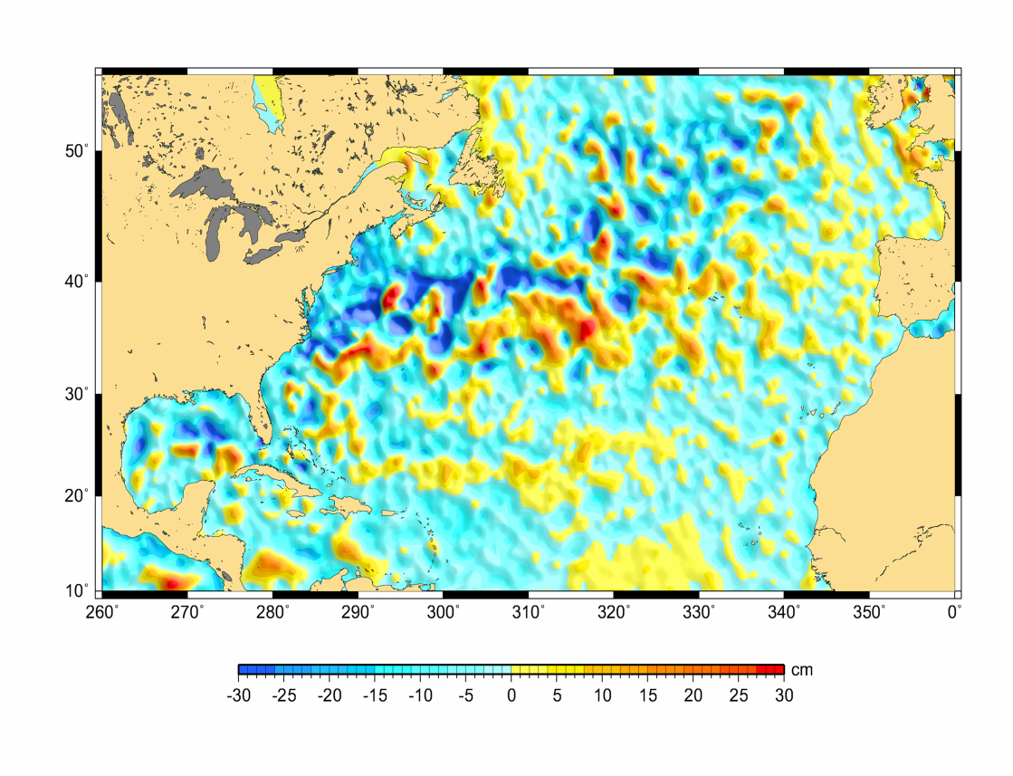
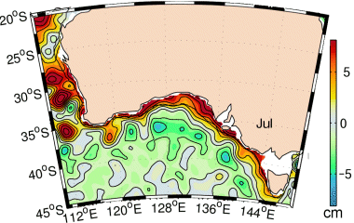
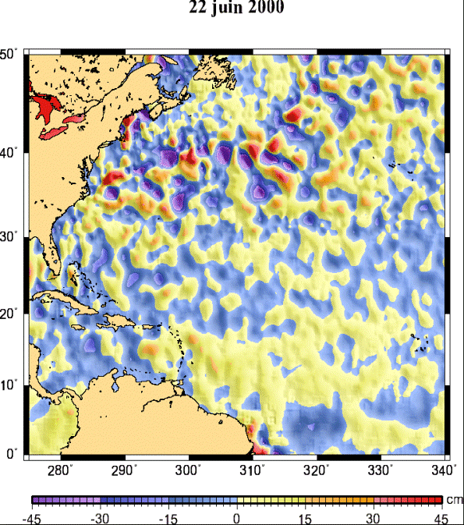
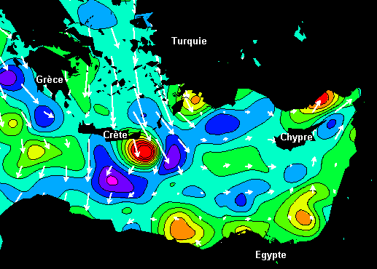
Eddies in the Gulf Stream
February 11, 2004
Eddies along the Australian coasts
(mean over July)
Ierapetra eddy(gyre)
A leatherback turtle
follows the
Gulf Streameddies

Slide 16
ENSO seen from altimetry

Slide 17
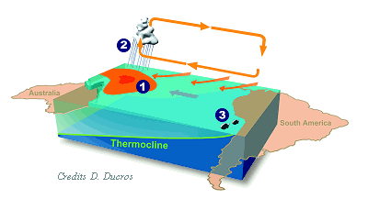
ENSO: El Niño Southern Oscillation
Under normal weather conditions, the trade winds, which blow from east to west, push the surface waters of the Pacific towards Australia and the Philippines.
This situation creates a reservoir of warm water in the western Pacific (the red area in the image) where the temperature and sea level are higher than in the eastern part of the basin.

Slide 18
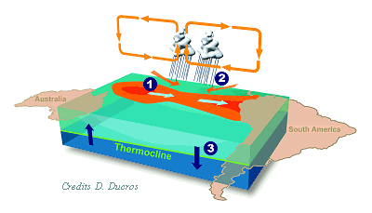
How El Niño works
When El Niño awakes, the reservoir of warm water flows back towards the east.
At the same time, triggered by this reservoir, the region of atmospheric convection also shifts.
This phenomenon causes the trade winds to weaken.

Slide 19
How does this translate in sea level anomalies??

Slide 20
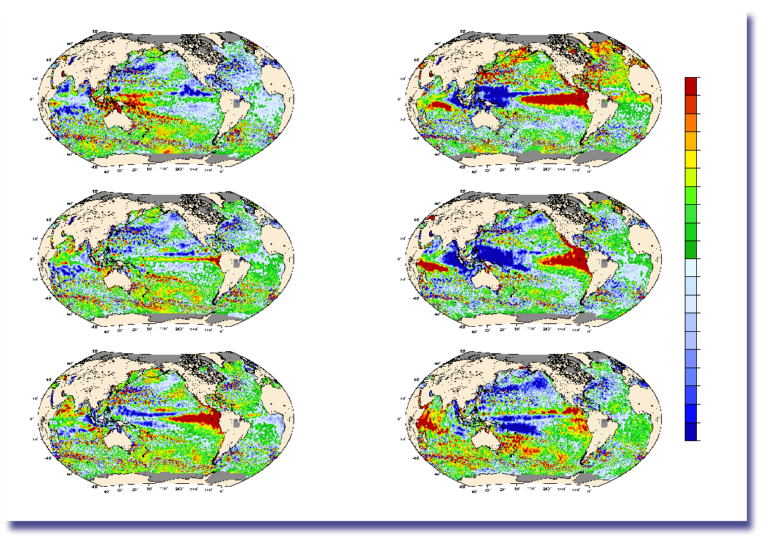
El Niño 1997-1998 seen by altimetry
Feb., Apr. 1997:
Topex/Poseidon revealed a considerable swelling in the waters of the central Pacific
by Nov. 1997, more than 30 cm elevation with respect to mean sea surface over a surface ~North America
Feb.18,1997
15.0
13.5
12.0
10.5
9.0
7.5
6.0
4.5
3.0
1.5
0.0
-1.5
-3.0
-4.5
-6.0
-7.5
-9.0
-10.5
-12.0
-13.5
-15.0
Oct.16,1997
Apr.29,1997
Jan. 14,1998
Jul. 08,1997
cm
Apr. 08, 1998

Slide 21
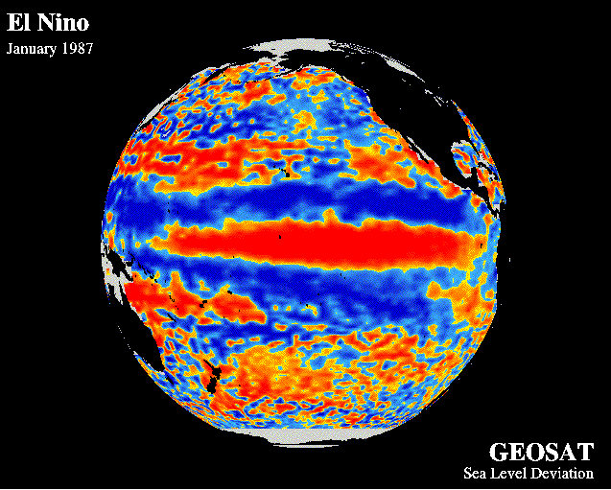
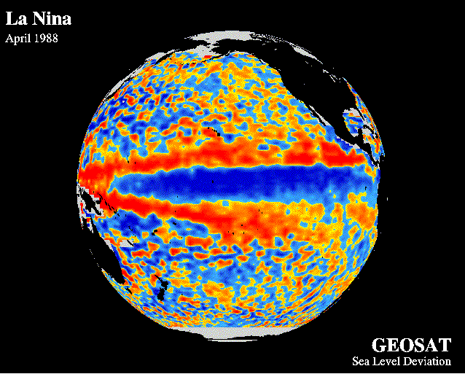
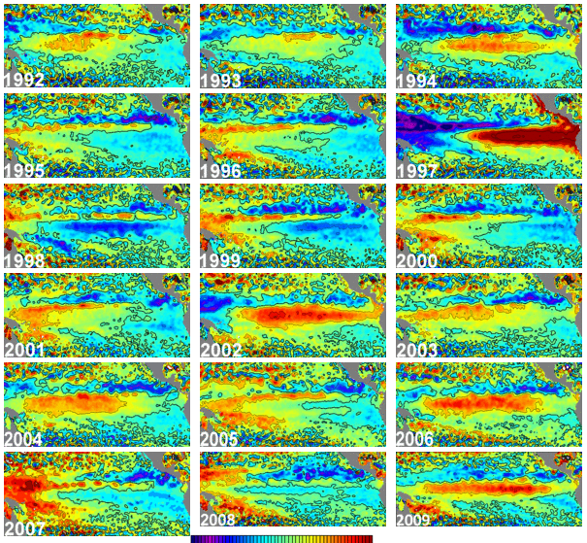
Chronology
Geosat first saw an El Niño/La Niña event sequence (1987-88)
First seen by Topex/Poseidon in 1993-94
1997-98 first real monitoring of the phenomena from its first stages (Feb-April) and on
Several episodes monitored since, including atypical ones (a.k.a. “El Niño Modokis”)

Slide 22
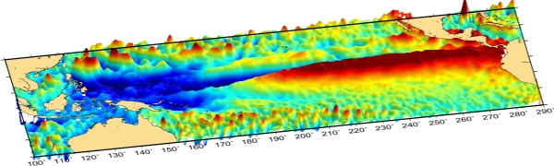
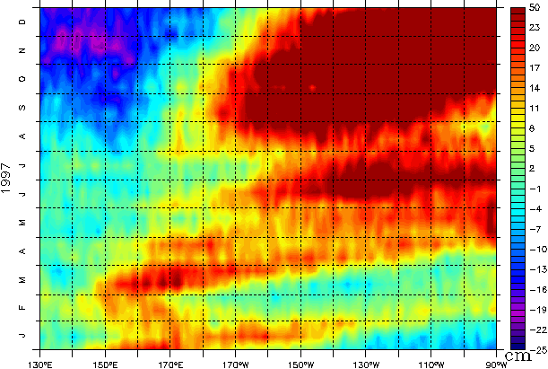
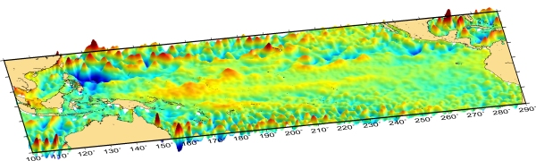
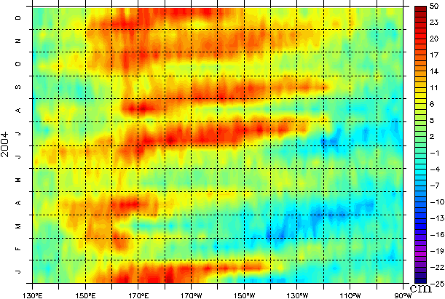
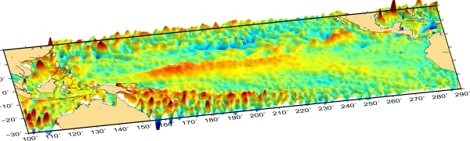
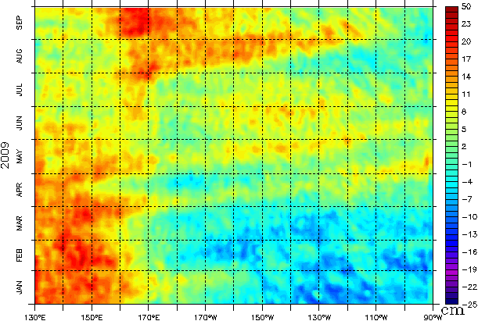
Past events and planetary waves
1997
Oct. 1997
2004
Oct. 2004
2009
Oct. 2009

Slide 23
Past events and planetary waves
Longitude-time (or Hovmoller) diagram put in evidence the train of planetary waves crossing the Pacific
Such waves play a major role in ENSO

Slide 24
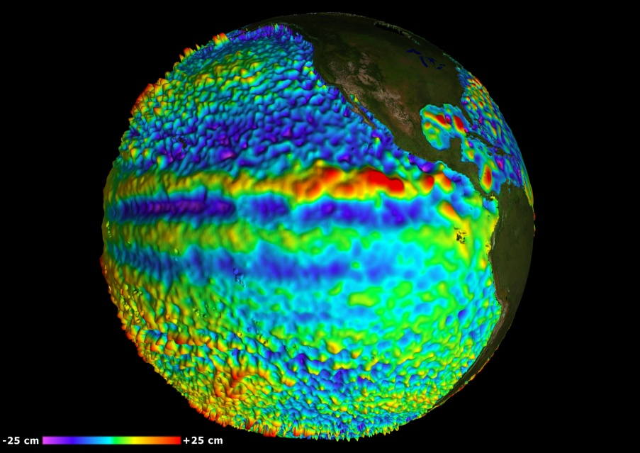
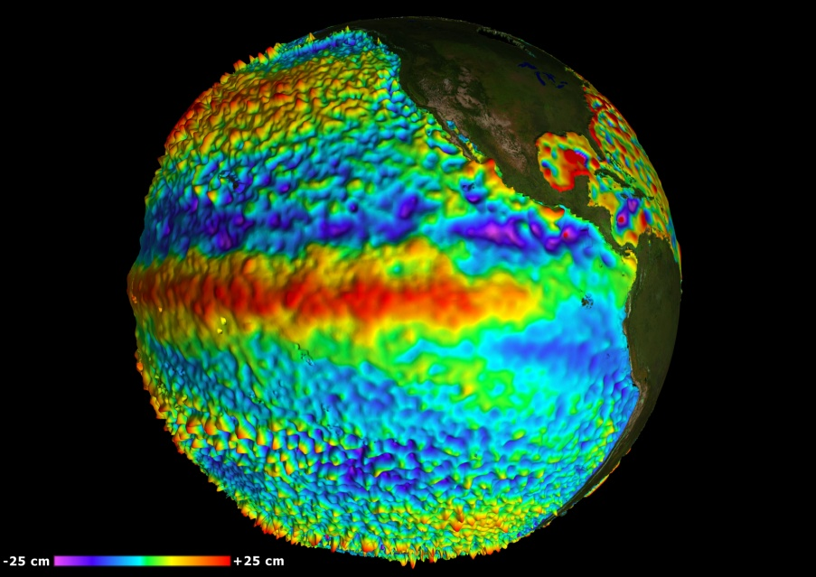
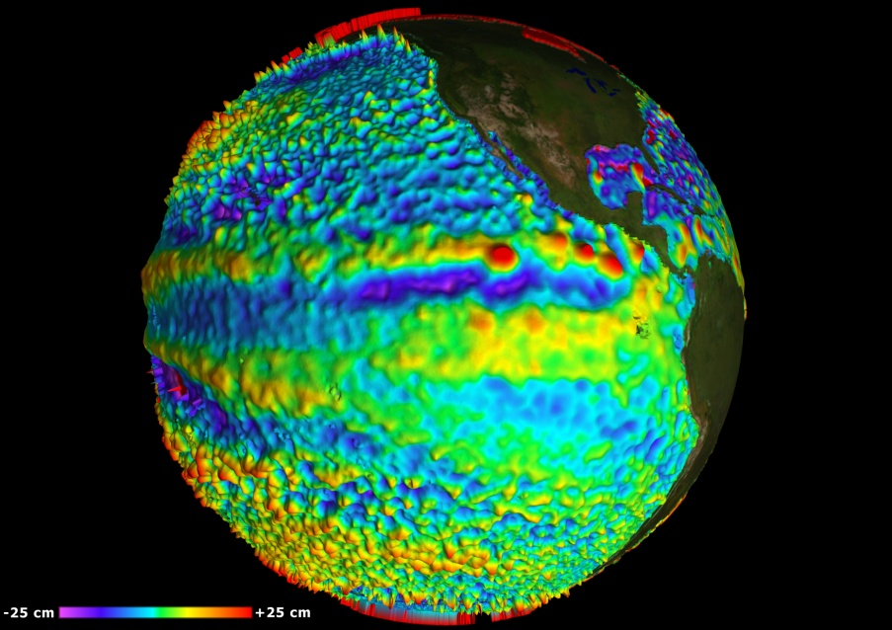
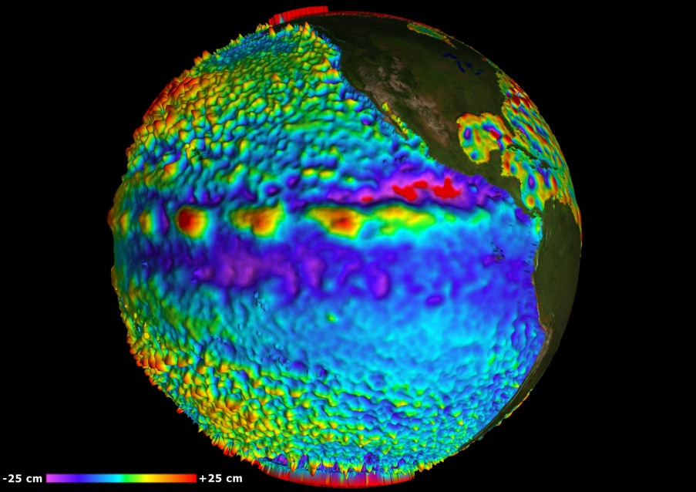
Last ENSO episode (2009-2010)
May 2009
November 2009
March 2010
September 2010

Slide 25
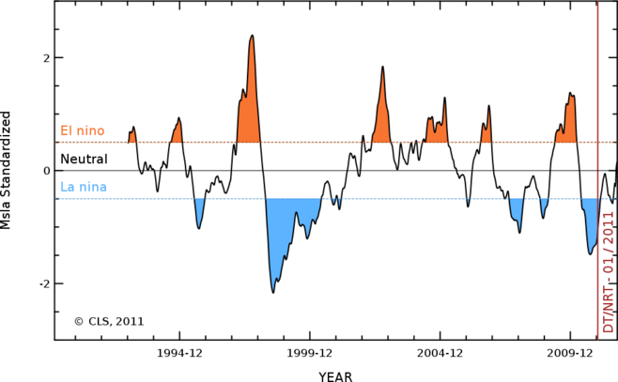
An ENSO index computed from altimetry
Index computed from merged Sea Level Anomalies and normalized.
(Nino3.4 region)
It matches well the classical index for ENSO

Slide 26
Global Mean Sea Level

Slide 27
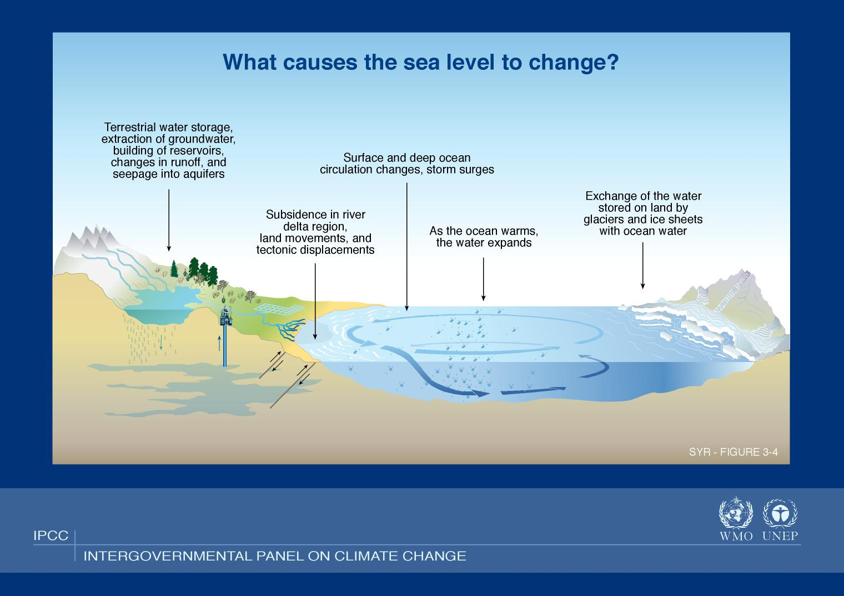
Global sea level: an indicator of climate change
What factors trigger changes in average sea level?
© WMO/UNEP

Slide 28
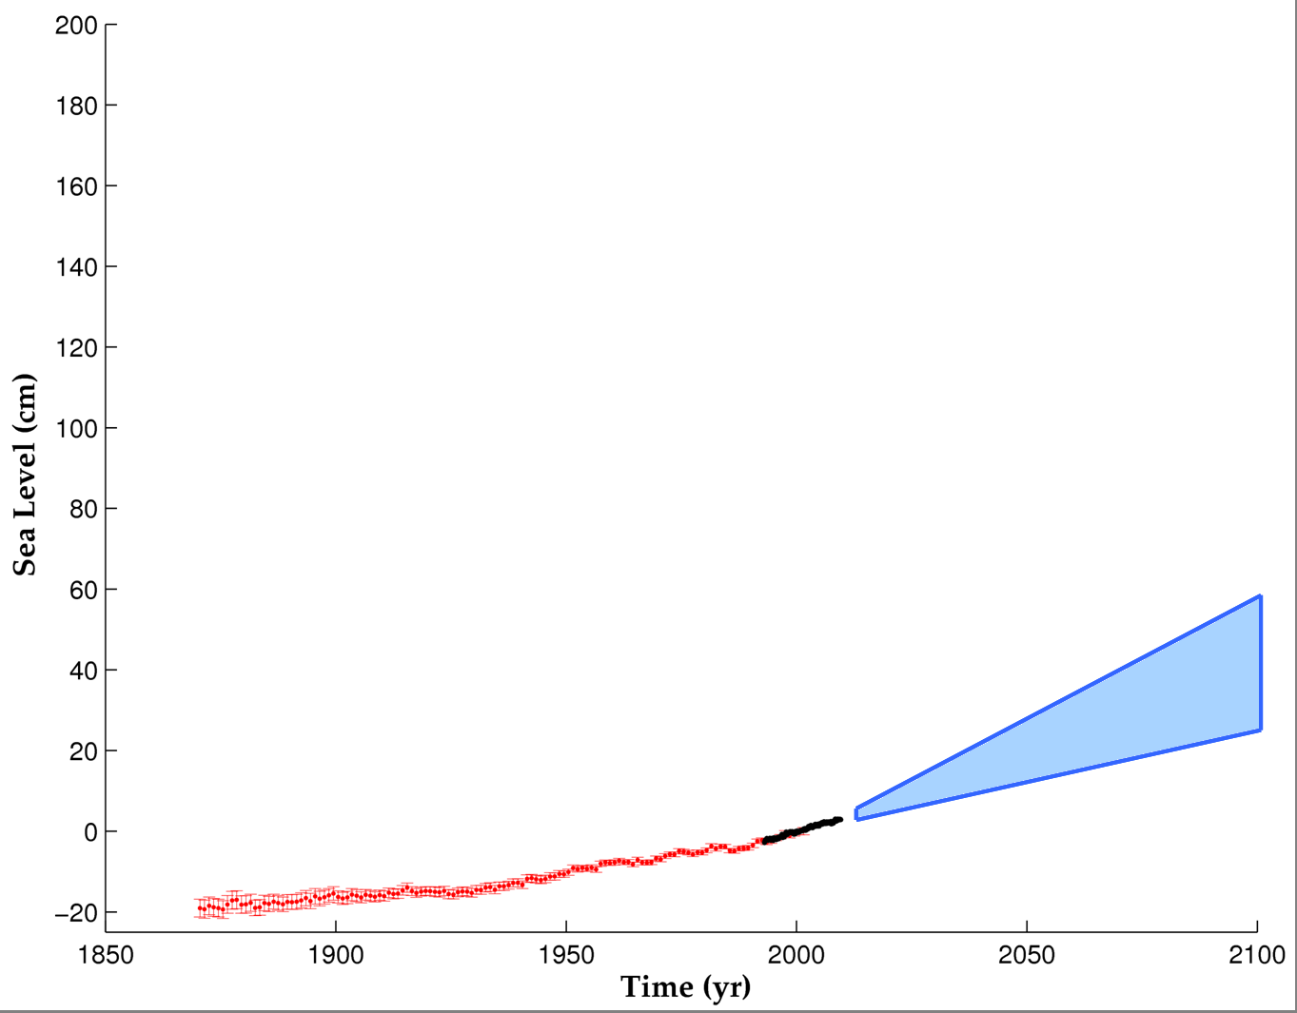
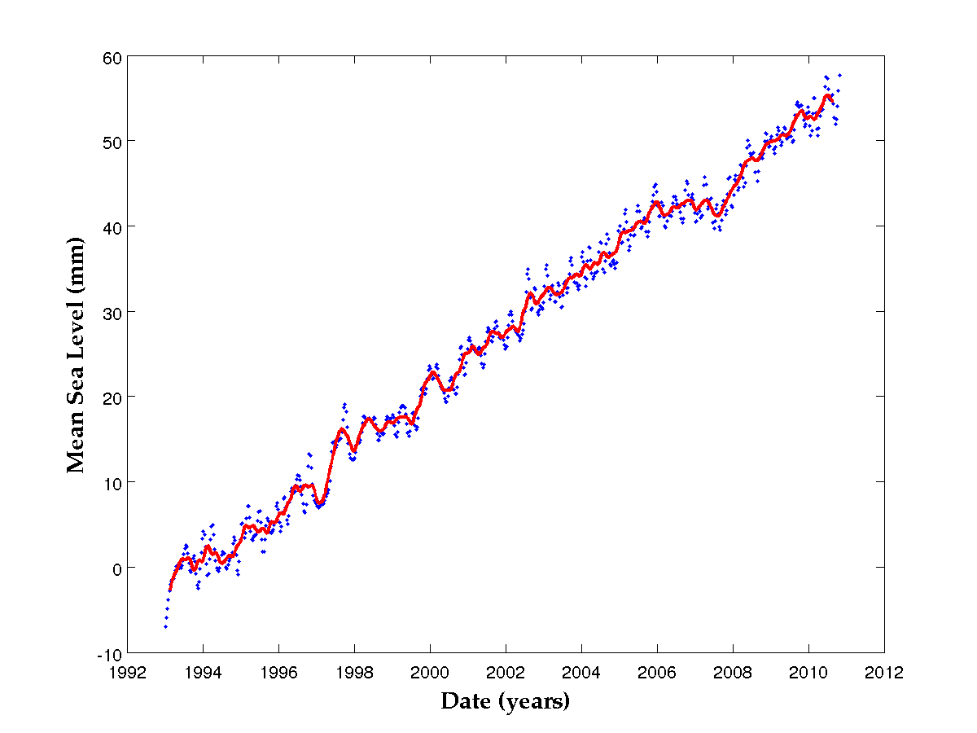
Mean sea level measured
by satellite altimetry since 1993
increase: 3.2 +/- 0.6 mm/yr
Projections (semi-empirical
methods)
IPCC 2007
Projections
Mean sea level measured by tide gauges
(Church & White, 2006)
Nicholls & Cazenave, Science, 2010

Slide 29
Sea Level: a sensitive index for climate change
In situ and satellite observations indicate that sea level is currently rising,
Models predict sea level will continue to rise in the future decades,
But how much ? We don’t know
Coastal impacts of sea level rise are among the most threatening consequences of global warming,
Continuous and accurate monitoring of sea level change (globally and regionally) is a high priority objective
satellite altimetry enable this!

Slide 30
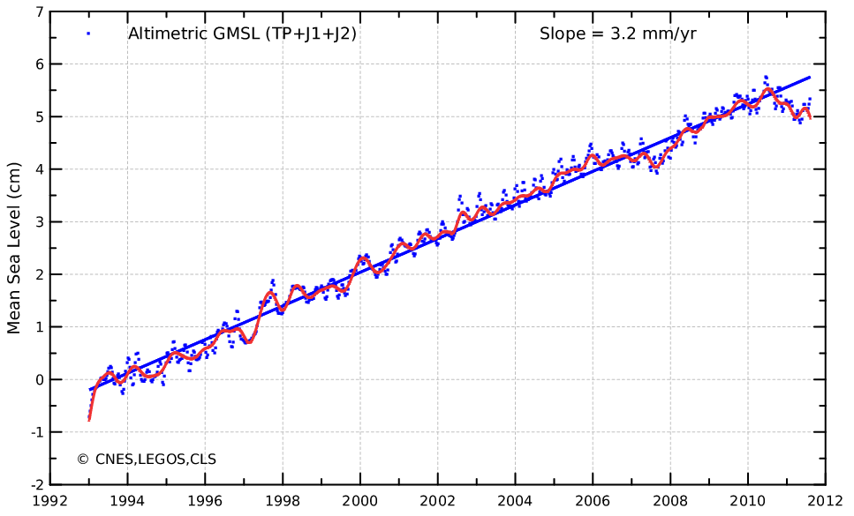
Mean Sea Level since 1992 as seen by altimeters
Altimetry ➔ global, synthetic, homogeneous measurements
Removing annual and semi-annual signals, Glacial Isostatic Ajustment
Correcting the data as best as possible
➔ +3.2 +/- 0.6 mm/yr since late 1992
Notes:
Update : http://www.aviso.oceanobs.com/msl/

Slide 31
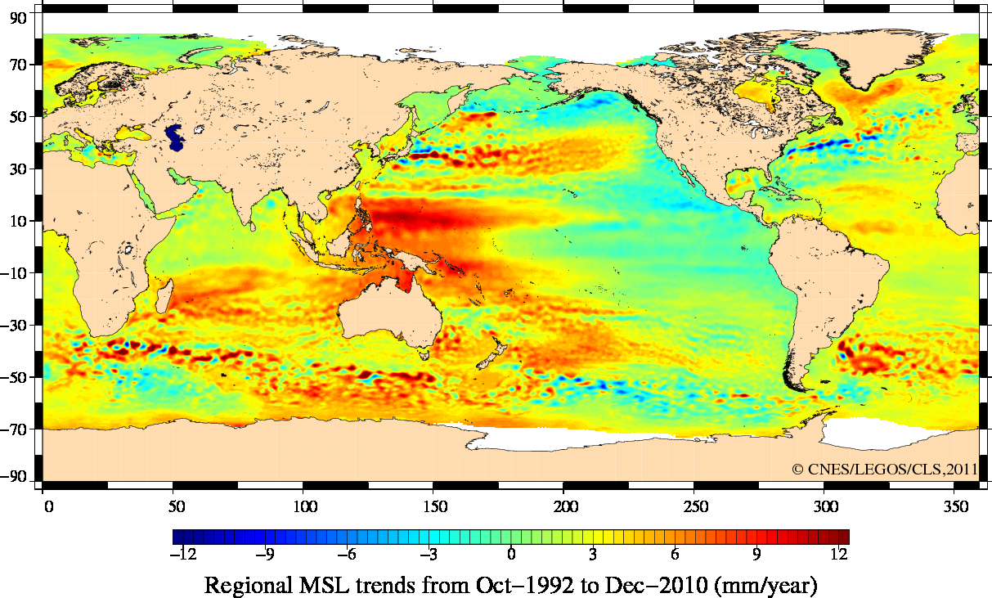
Mean Sea Level: geographical trends
Mapping the mean variation in sea level over a long period reveals the complexity of the phenomena involved.
Most of the variations seen on the map are for now from interannual variability rather than from climate change
Even longer time series,
more regional to local studies
are needed!
Notes:
Update : http://www.aviso.oceanobs.com/msl/

Slide 32
Mean Sea Level: geographical trends
NOTICE:
local conditions can’t be inferred from this map
  Subsidence
  Sediment transport
  Regional variation of glacial isostatic adjustment
  Etc.
  Must be taken into account. Studies to evaluate risk at local scale must be local!
Such global data give boundary conditions and general trend.

Slide 33
More information www.aviso.oceanobs.com

