Slide 1
Overshooting tops – satellite-based detection methods and correlation with severe weather conditions
Petra Mikuš
DHMZ, Croatia, EUMeTrain project
petra.mikus@cirus.dhz.hr

Slide 2
Outline
Introduction
Methods of OT detection using satellite imagery
Relationship between OT and severe weather
Data and methods
Examples
Conclusion and future work

Slide 3
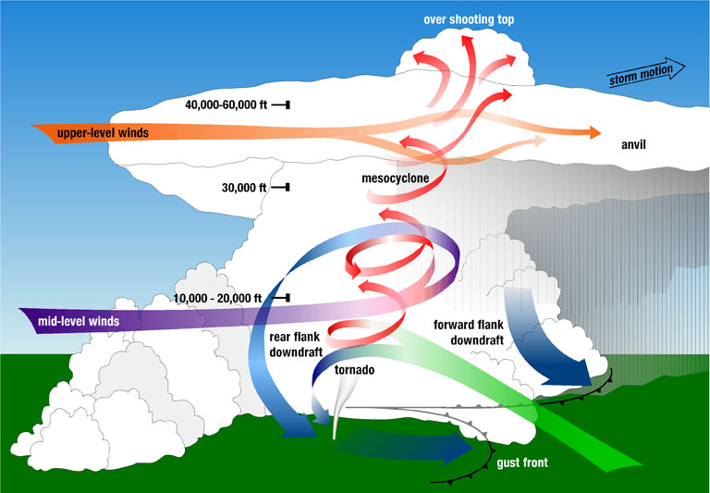
Introduction: Overshooting top (OT)
a domelike protrusion above a cumulonimbus anvil
forms when a thunderstorm's updraft protrudes its equilibrium level
exists for less than 30 minutes and has a maximum diametar of ~ 15 km
penetrating convective storms affect on the transport of various chemical species (especially water vapor) from the troposphere into the stratosphere
generates gravity waves which can produce significant turbulence
Figure: Diagram of a supercell thunderstorm, which shows the overshooting top rising above the anvil cloud

Slide 4
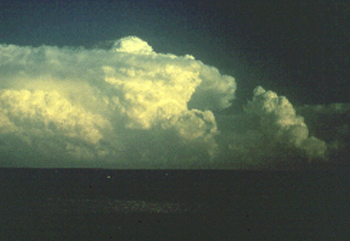
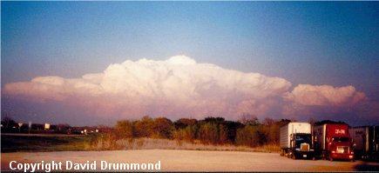
Examples: Overshooting tops
Photo: Looking east from about 60 miles away, we see a line of towering cumulus clouds and a large supercell storm. Note the great amount of anvil overhang and the large overshooting dome at the summit of the updraft. This particular storm was producing a tornado that stuck downtown Ft. Worth, TX on March 28, 2000.
Photo by Bluestein
Photo: Supercell thunderstorm with overshooting cloud top and anvil overhang, looking southeast from about 40 miles away. This storm produced baseball hail, but no known tornadoes, along a track in southeast Oklahoma and southwest Arkansas

Slide 5
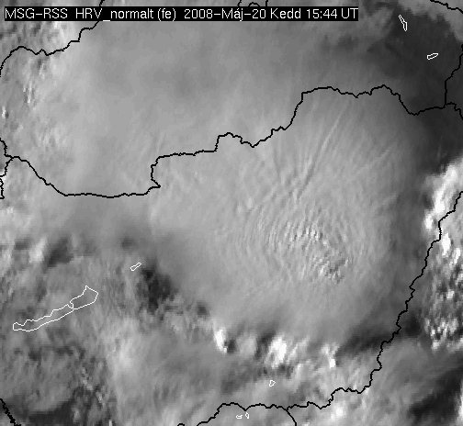
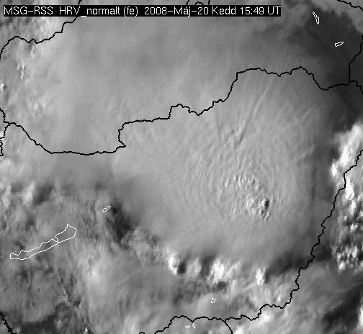
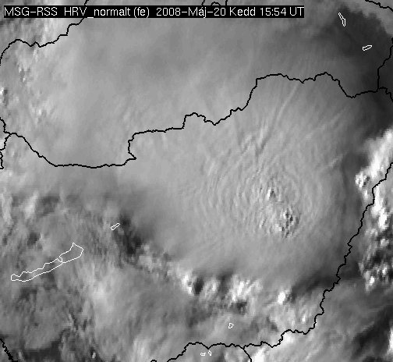
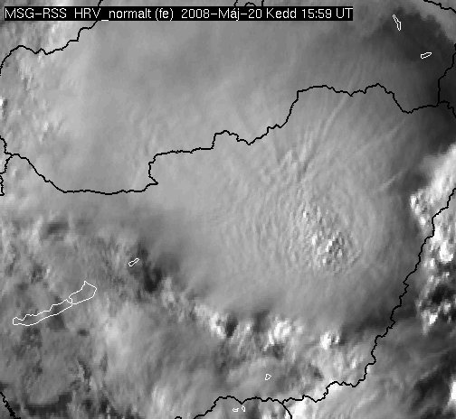
OTs on 5-minute (rapid scan) HRV data

Slide 6
Introduction: Detection of OT using satellite imagery
visible channel imagery – OT as the lumpy textured appearance
can be observed only during the day

Slide 7
objective satellite – based detection of OT:
WV-IR BTD (Schmetz,1997; Setvak, 2010)
greater than zero degrees are related to convective cloud with high vertical extension
often identifies OT regions with a spatial extent that is significantly larger than that of commonly observed OTs
often produce a significant number of false OT detection
“IRW – texture” (Bedka, 2010)
combination of 11µm IR channel, a numerical weather prediction model tropopause temperature forecast, OT size and BT criteria (defined through analysis of 450 thunderstorm events)
IR brightness temperature minima < 215K
OT ≤ 15 km diameter

Slide 8
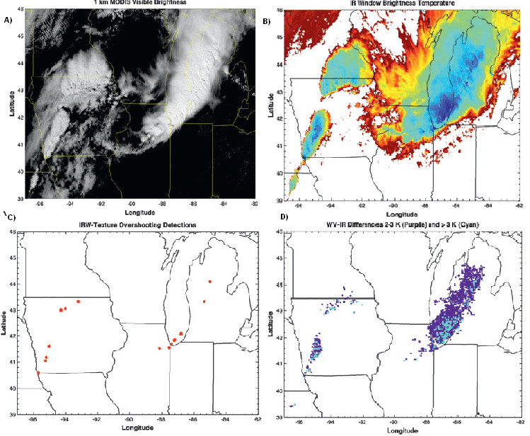
Figure :
A) Contrast – enhanced Aqua MODIS 0.65 μm visible channel imagery,
B) Color- enhanced Aqua MODIS IRW imagery,
C) IRW – texture overshooting top detections,
D) WV – IRW brightness temperature differences between 2 and 3 K (purple) and > 3 K (blue) (Bedka et al., 2010)

Slide 9
Introduction: Relationship between overshooting cloud top and severe weather
frequently produce hazardous weather (Bedka et. Al, 2010)
often associated with cloud to ground lightning (Machado et al., 2009)
often associated with significant turbulence (Lane et al., 2003)
Table : The number of events where overshooting tops were found to occur near to the location of tornado, severe wind and large hail events recorded within ESWD (SEVIRI European Domain) and SPCD (GEOS – 12 U.S. Domain) (Bedka, 2010).
SEVIRI European Domain |  | GOES-12 U.S. Domain
Severe Weather Type | Match Percentage | Severe Weather Type | Match Percentage
Tornado | 18% | Tornado | 56%
Severe Wind | 59% | Severe Wind | 58%
Large Hail | 61% | Large Hail | 51%
All Severe Types | 49% | All Severe Types | 54%

Slide 10
Motivation
Deep convective storms with OTs often produce hazardous weather conditions, such as heavy rainfall, damaging winds, large hail, cloud-to-ground lightning and tornadoes
OTs also generate gravity waves which can produce significant turbulence
These events can cause considerable property damages, influence everyday activities and even endanger the human lives

Slide 11
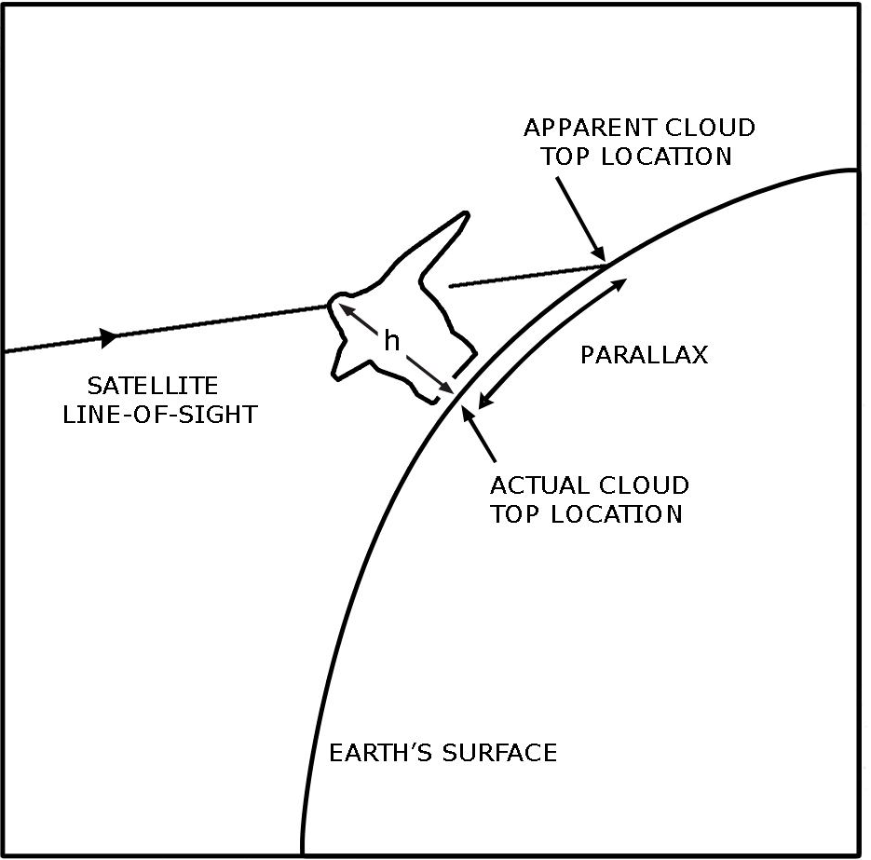
Data and methods
The OTs are detected from MSG data using BTD methods
Compared locations and times of appearance of the OTs with data measured by the automatic stations
Compared OT detections according the “IRW-texture” with data from automatic stations
Parallax correction
apperent displacement of cloud location in satellite imagery
depends on the height of the cloud top (important especially for high Cb clouds), its geographic location and position of the satellite
Method: each automatic station is shifted by the computed values of parallax shift for certain cloud top height

Slide 12
Parallax correction
Parallax correction for automatic stations
(cloud height is constant – based on soundings data)
MSG satellite position: 0°
Parallax correction tables for 80 different cloud heights for NE image section for the 0° position (http://www.convectionwg.org/parallax.php)
Parallax shift (°)
cloud top height (km) | 12 | 12 | 13 | 13 | 12 | 12
 | Croatia | Slovenia | Austria | Slovakia | Hungary | Bosnia and Herzegovina
N | 0,14 | 0,14 | 0,15 | 0,16 | 0,15 | 0,14
E | 0,08 | 0,07 | 0,08 | 0,12 | 0,11 | 0,08

Slide 13
Satellite-based overshooting top detection methods
Brightness temperature difference (BTD) methods:
IR=10.8 µm
WV = 6.2 µm
O3 = 9.7 µm
CO2 = 13.4 µm
Criteria
WV-IR
IR brightness temperature < 215K
>4K
O3-IR
>13K
CO2-IR
>3.5K
COMB (WV-IR & O3-IR)
>4K & >13K
some studies showed that this BTD methods are usefull for determining cloud top heights of convective clouds (Kwon et al.)

Slide 14
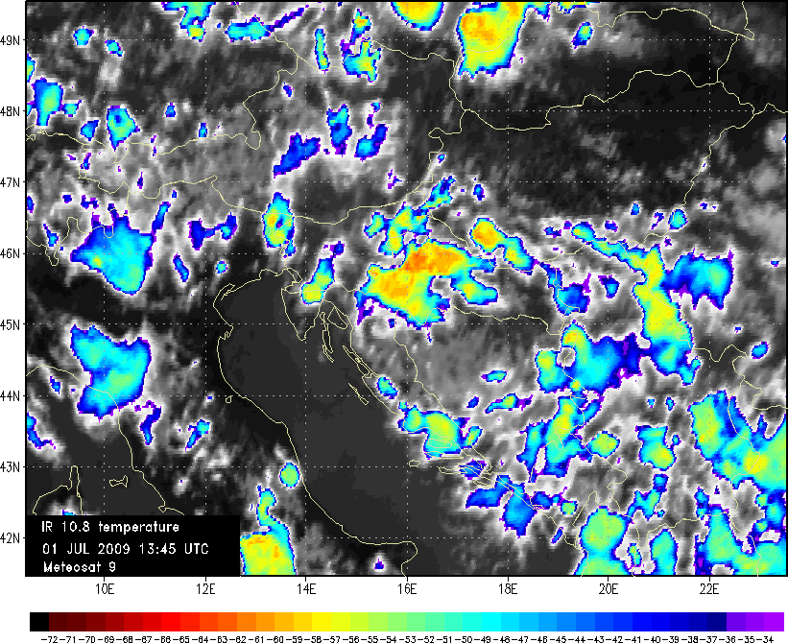
OT and their relationship with severe weather conditions
Zagreb

Slide 15
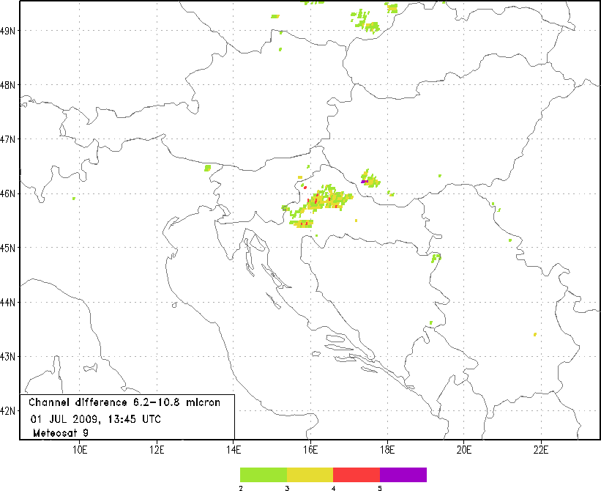

Slide 16
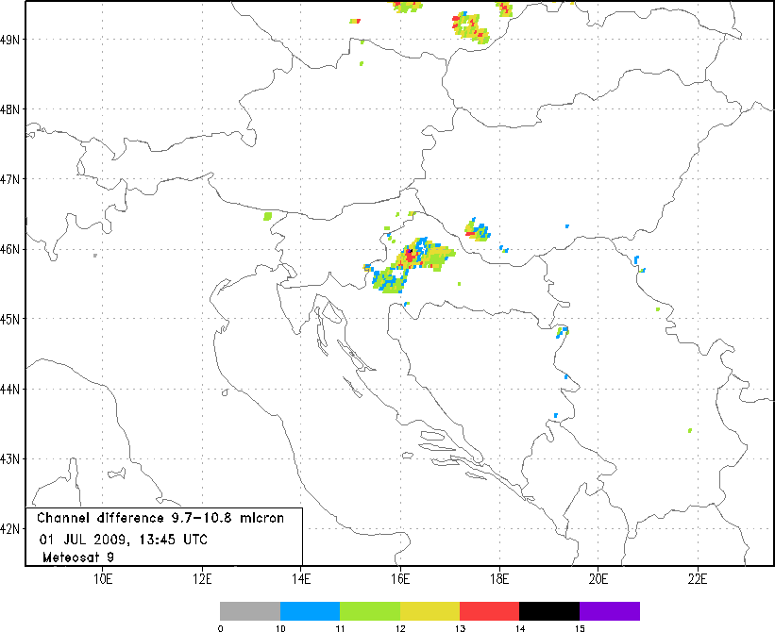

Slide 17
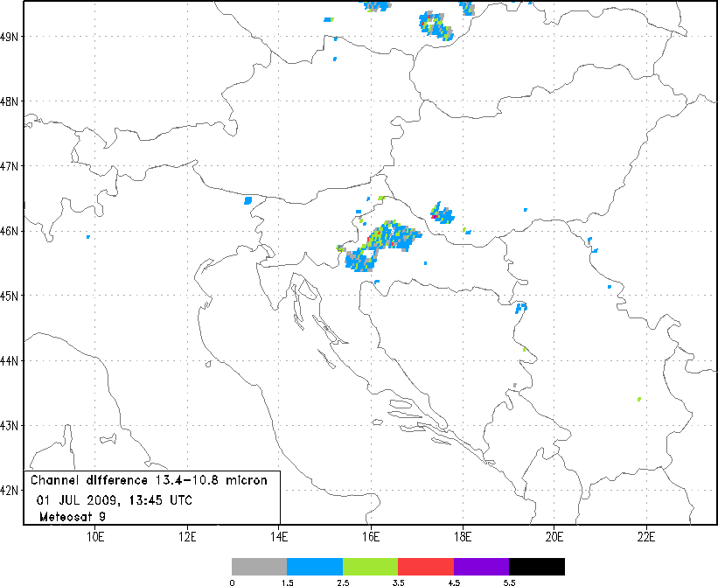

Slide 18
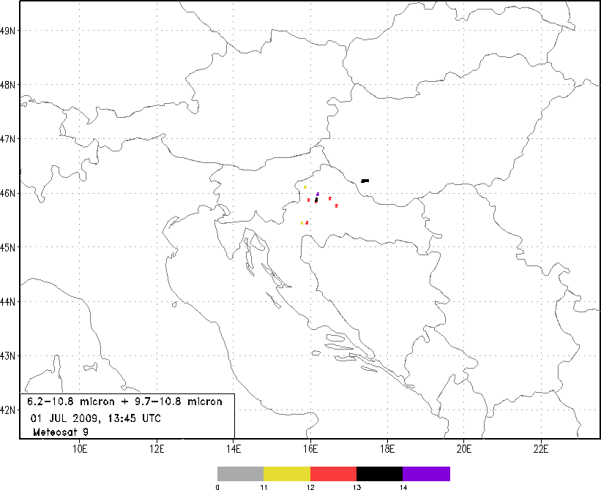

Slide 19
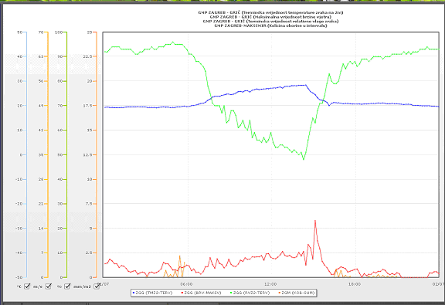
Example: OT vs. severe weather
Zagreb, 01.07.2009.
OT -13:45 UTC (Bedka, 2010)
Blue: temperature:
23.8°C(13 UTC) – 21.4°C(15 UTC)
Green: relative humidity
Orange: precipitation:
1.8 mm during 30min
Red: maximum wind speed:
16.2m/s; 14:06 UTC

Slide 20
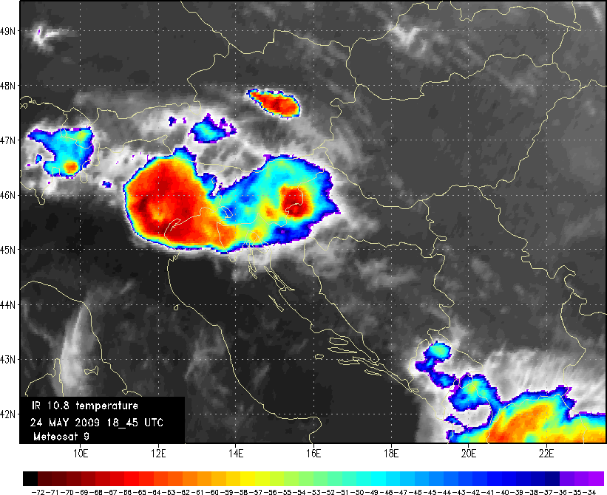
Example: 24.05.2009 – 18:45 UTC
Karlovac
Karlovac

Slide 21
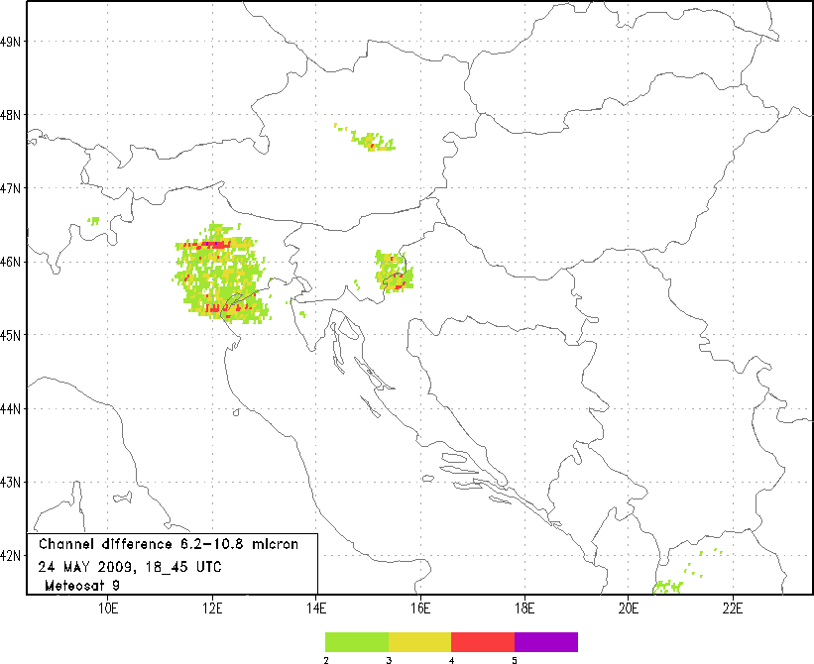

Slide 22
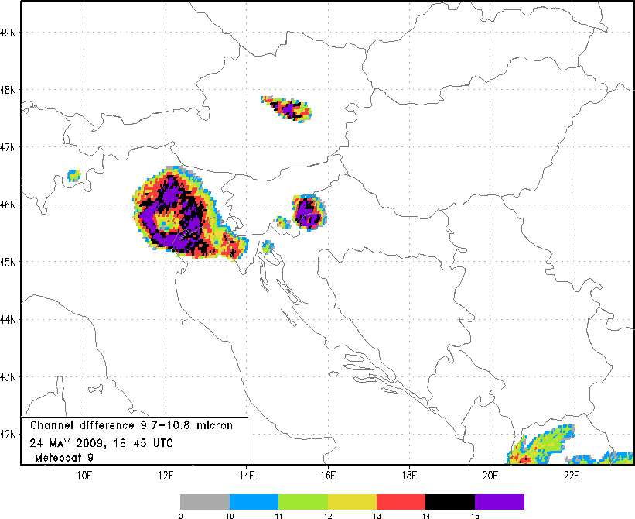

Slide 23
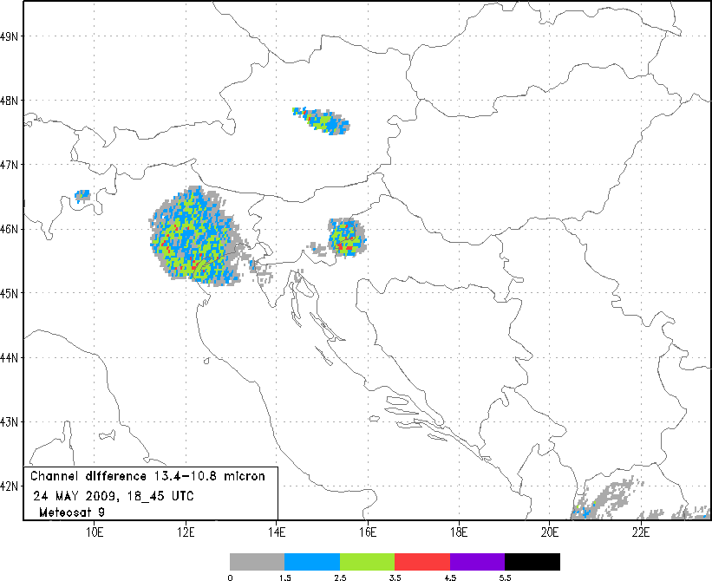

Slide 24
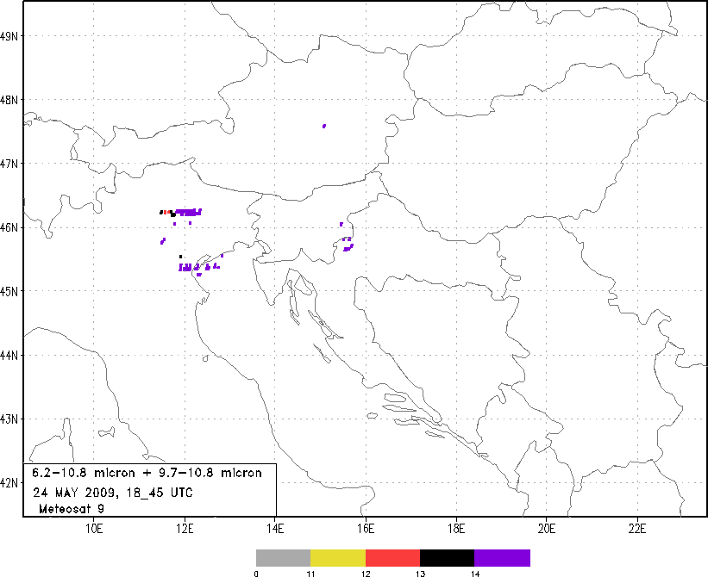

Slide 25
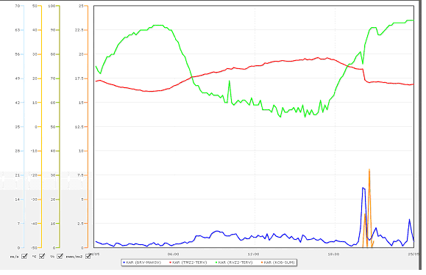
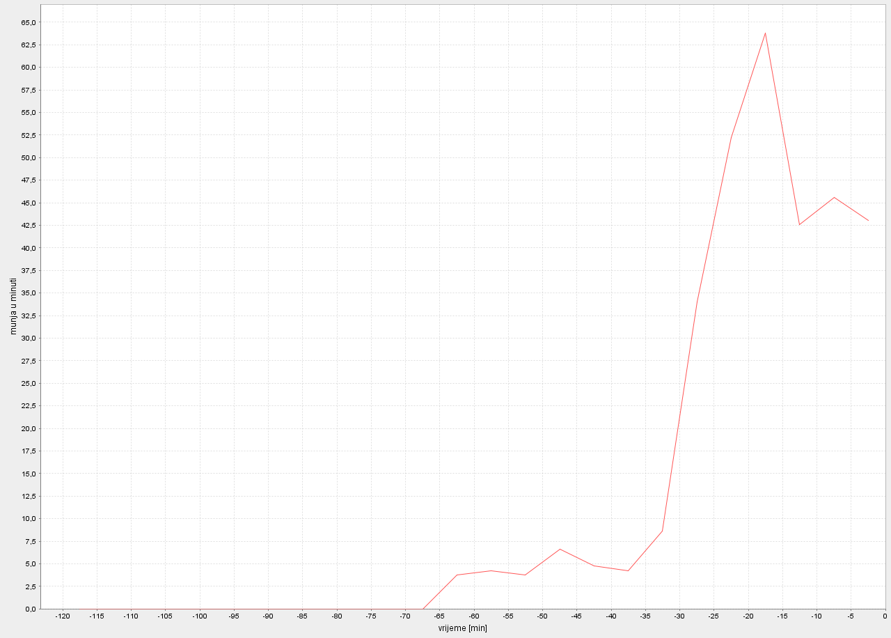
Example: OT vs. Severe weather
Karlovac, 24.05.2009.
OT -18:45 UTC (Bedka, 2010)
Red: temperature:
23.8°C(19 UTC) – 18.6°C(20 UTC)
Green: relative humidity
Orange: precipitation:
12.3 mm during 25 min
Blue: maximum wind speed:
17.4m/s; 19:09 UTC
24.05.2009, 18:00 – 20:00 UTC: Temporal distribution of lightning discharge –
maximum around 19:45 UTC

Slide 26
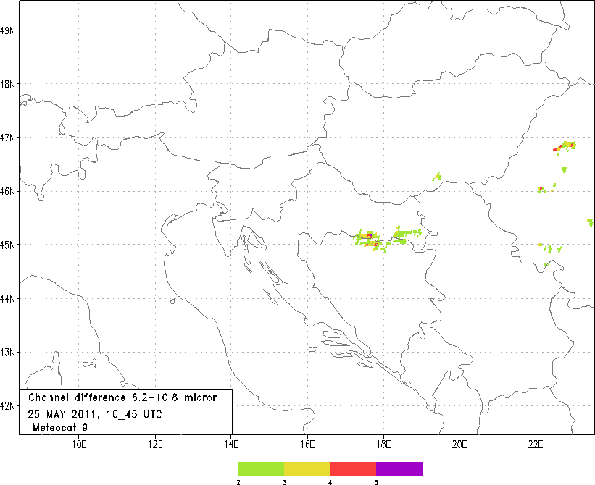
BTD methods vs. HRV satellite and radar data

Slide 27
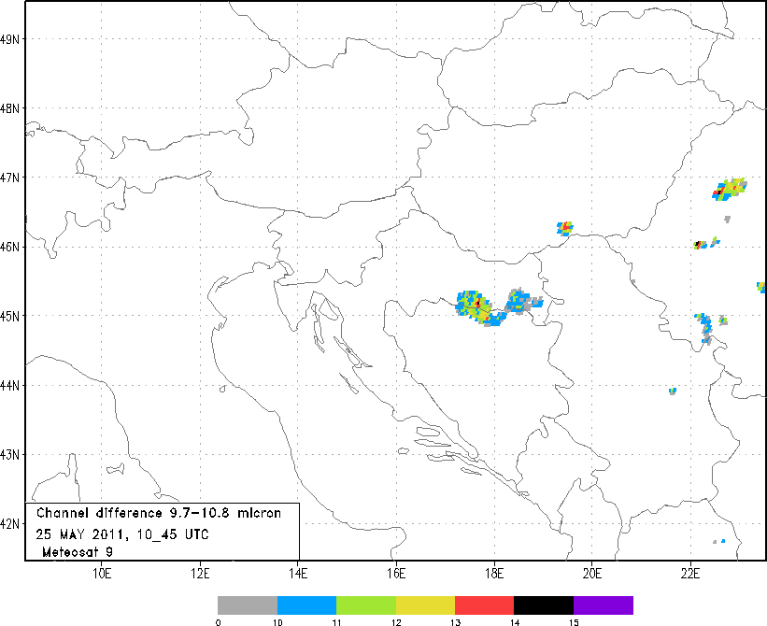

Slide 28
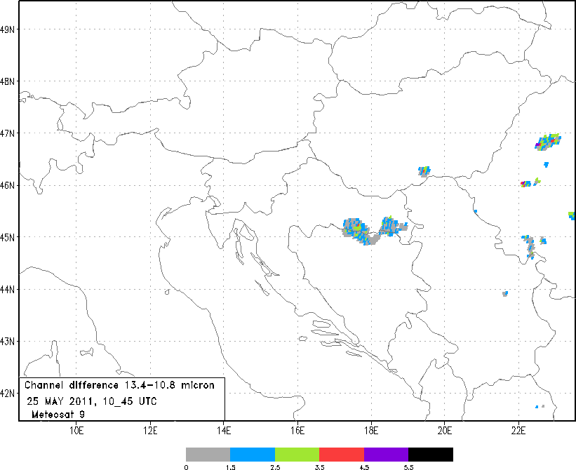

Slide 29
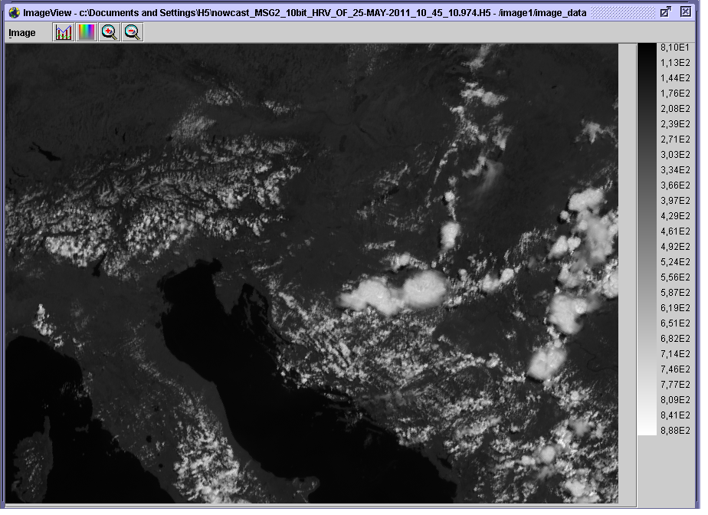

Slide 30
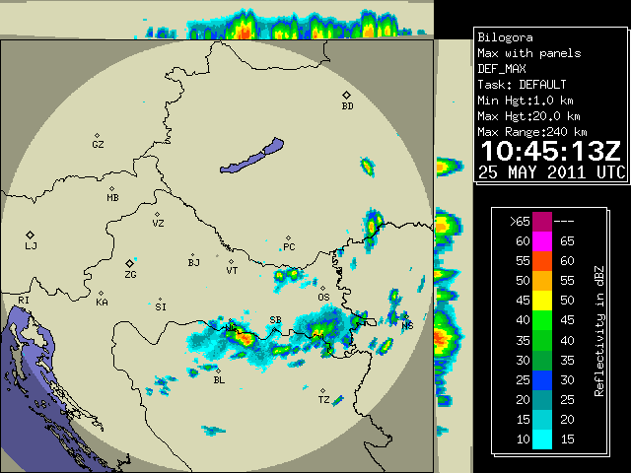
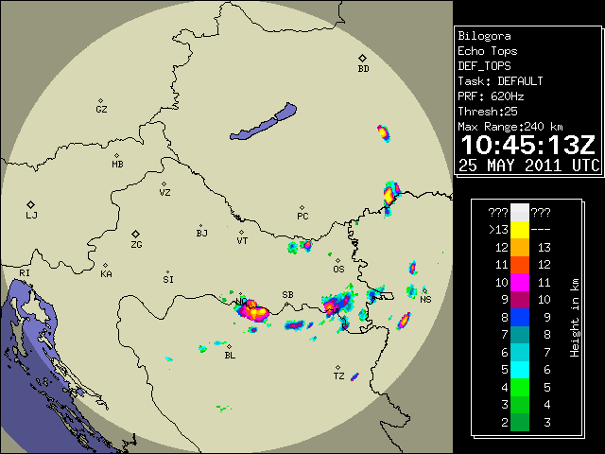
Reflectivity in dBZ
Height in km

Slide 31
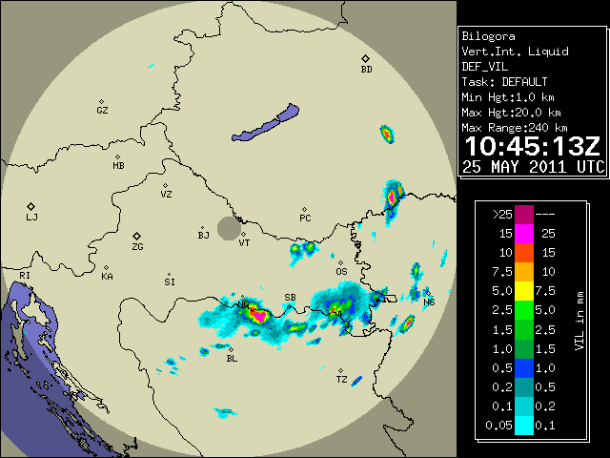
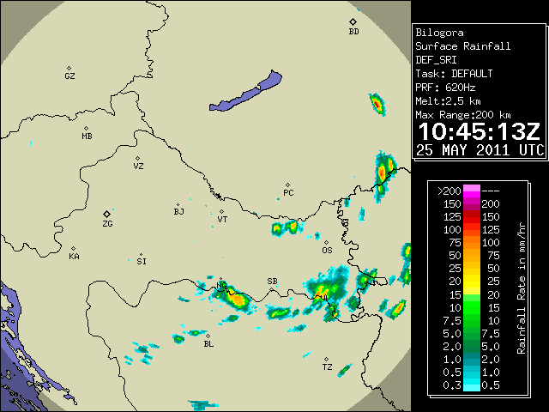
Vert. Int. Liquid in mm
Rainfall Rate in mm/hr
It has been concluded that all investigated methods indicate deep convection (but not necessarily OTs) !

Slide 32
Future work
Comparison of OT detections by all 4 (5) methods and automatic station data will be made – 2009 and 2010 detections already available!
OT validation database with OT signatures found in the HRV channel

Slide 33
Thank you for your attention!

